Slide 1
Quick look at the existing Fast Simulation Framework
Tao Lin
23 Dec 2019
CEPC

Slide 2
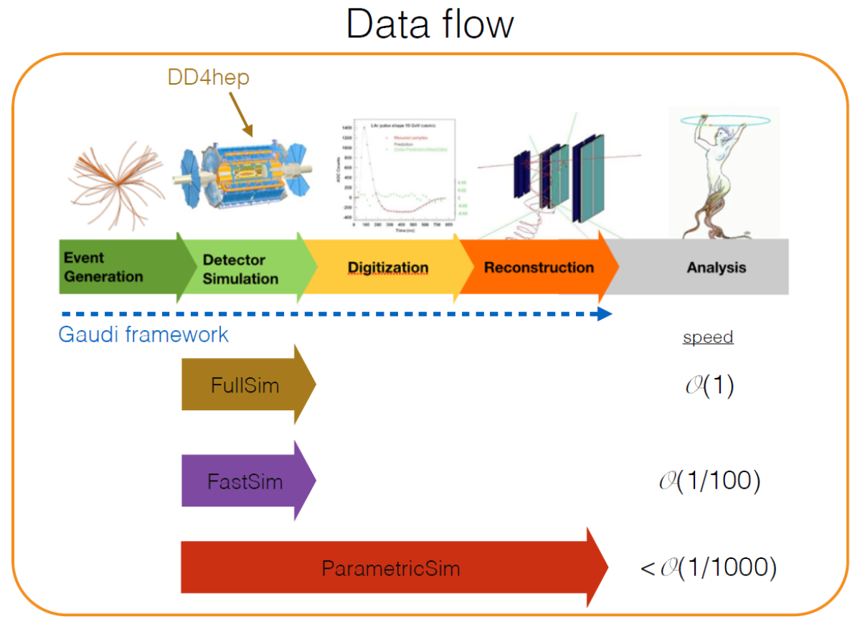
Motivation: support Full/Fast Sim
Prototyping a coherent framework for full, fast and parameteric detector simulation for the FCC project
J. Hrdinka et al. PoS EPS-HEP2015 (2015) 248

Slide 3
Fast simulation in FCCSW
Geant4 region-based
Several interfaces are implemented as Tools, which are then invoked by Geant4 Fast simulation model.
ISimG4RegionTool: Associate regions and fast simulation models.
SimG4FastSimCalorimeterRegion (GFlashShowerModel)
SimG4FastSimTrackerRegion (sim::FastSimModelTracker)
Delphes-based
Algorithm “DelphesSimulation”
https://cp3.irmp.ucl.ac.be/projects/delphes

Slide 4
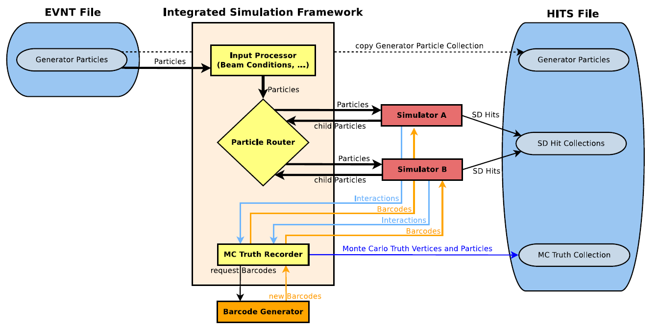
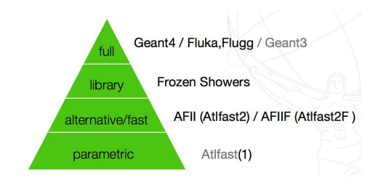
Fast simulation in ATLAS
ATLAS ISF (Integrated Simulation Framework)
Allow mixing of full and fast simulation within each physics event.
http://physik.uibk.ac.at/hephy/theses/diss_er.pdf

Slide 5
Summaries & Plans
FCC and ATLAS have their own fast simulation framework.
FCC adopts two different methods: Geant4-based and Delphes-based.
ATLAS develops ISF to integrate different simulators.
I will continue to evaluate the fast simulation framework in following parts:
Easy to use
Lightweight & compact
Extensible (different simulators, GAN)

