Slide 1
Data Object Relations in Event Data Model
Jiaheng Zou
2019.12.23

Slide 2
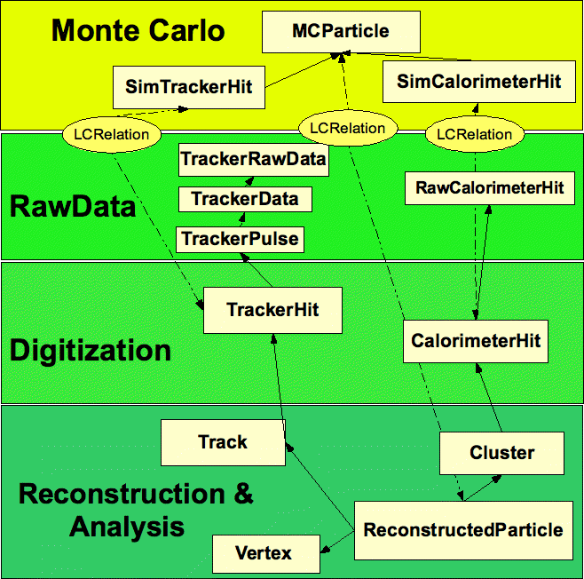
LCRelation
Aggregation

Slide 3
LCRelation
The relation outside of data objects
LCRelationCollection can be stored in both LCIO and PLCIO
LCIO
LCObject* getFrom();
LCObject* getTo();
PLCIO
Examples in CEPCSW/Reconstruction/Digitisers/PlanarDigiAlg
ObjectID& getFrom();
ObjectID& getTo();

Slide 4
Aggregation in LCIO
ReconstructedParticle
std::vector<Cluster*> getClusters();
std::vector<CalorimeterHit*> Cluster::getCalorimeterHits();
LCObject* CalorimeterHit::getRawHit();
std::vector<Track*> getTracks();
std::vector<TrackerHit*> Track::getTrackerHits();
std::vector<LCObject*> TrackerHits::getRawHits(); // not used in Marlin?
Vertex* getStartVertex();
Vertex* getEndVertex();

Slide 5
Aggregation in PLCIO
ReconstructedParticle
ConstCluster getClusters(unsigned int);
ConstCalorimeterHit Cluster::getHits(unsigned int);
ObjectID& CalorimeterHit::getRawHit();
Other similar interfaces…
Collections inherited from podio::CollectionBase
std::vector<std::vector<ObjectID>*> m_refCollections;
Store aggregation relations with ObjectIDs
Restored by PODIO when reading
Need more tests

Slide 6
Summary
Convert ObjectIDs to Data Objects
LCRelation
A few interfaces such as CalorimeterHit::getRawHit()
Validation
fcc-edm
Same aggregation pattern with PLCIO
Specified association classes instead of the general LCRelation
ParticleMCParticleAssociation, DigiTrackHitAssociation, etc.
Similar to the aggregation pattern

