Slide 1

Baryon Structure in
Basis Light-Front Quantization
Siqi Xu
With
Xingbo Zhao, Tiancai Peng,
Xiang Liu, Chandan Mondal,
Jiangshan Lan, Yang Li,
Henry Lamm, James Vary
Institute of Modern Physics , Chinese Academy of Sciences
Lanzhou, China
强子谱和强子结构研讨会
2021年1月23-25日，广州，中山大学

Slide 2
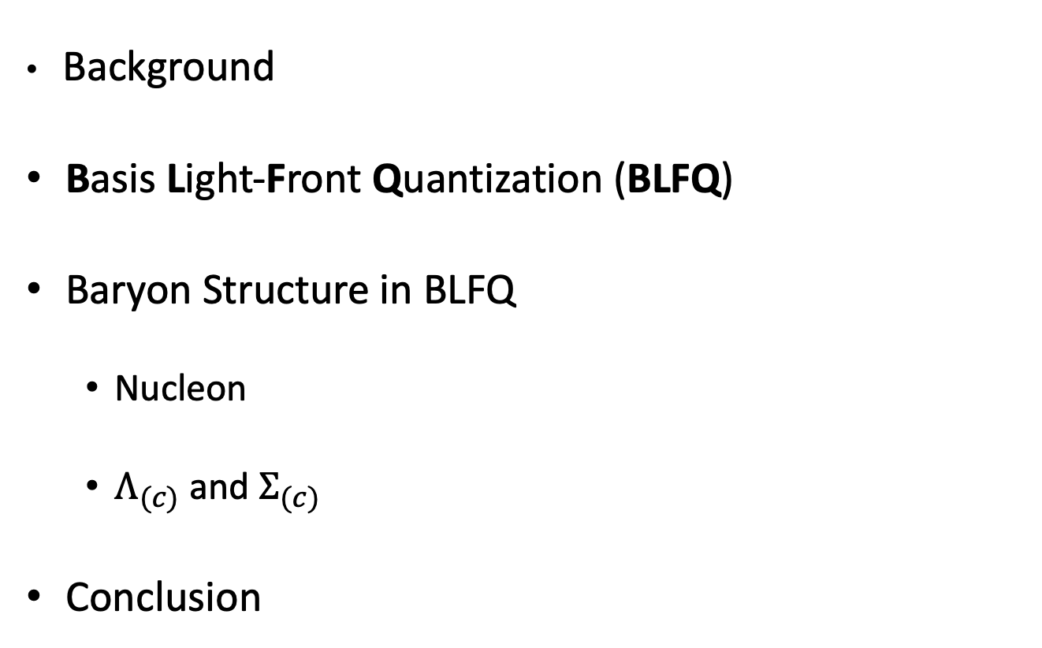
Outline
Background
Basis Light-Front Quantization (BLFQ)
Baryon Structure in BLFQ
  Nucleon
  $Λ_{(c)}$ and $Σ_{(c)}$
Conclusion

Slide 3
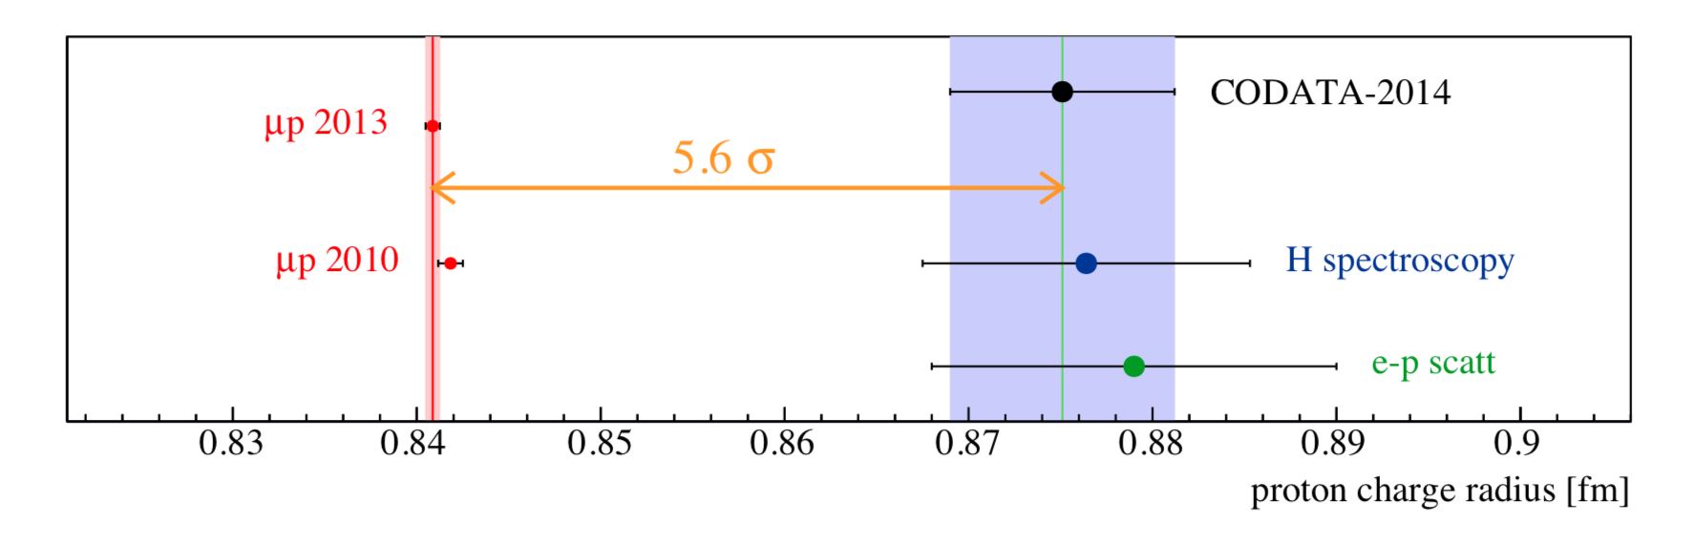
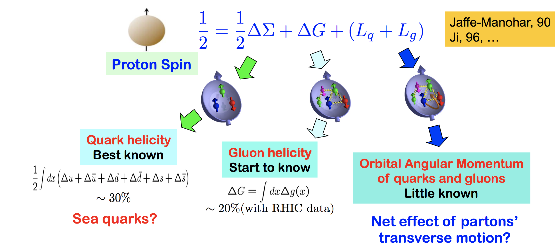
Background
Proton radius puzzle
Elastic electron scattering established the extended nature of the proton, [ R. Hofstadter, Nobel Prize 1961 ]
Different experiments give the different radius.
Spin crisis
In 1988s, EMC(European Muon Collaboration) found the contribution of spin of quark is smaller than expected.
3/16

Slide 4
Basis Light-Front Quantization
Solve the time-independent Schrödinger Equation:
[Vary, et.al, Phys.Rev.C ’10]
$$P^{−}\left|\left.β\right\rangle =P_{β}^{−}\right|\left.β\right\rangle$$
$P^{−}$: Light-Front Hamiltonian;
$|\left.β\right\rangle$: Eigenstates;
$P_{β}^{−}$: Eigenvalues for eigenstates.
Quantum numbers of basis states in BLFQ:
Longitudinal direction
  — discrete longitudinal momentum (labeled by k):
Transverse direction
  — 2-dimensional harmonic oscillator (labeled by n , m)
$$P^{+}=\frac{2π}{L}k$$
Truncation : $\left\{\begin{aligned}Nmax \\ Kmax\end{aligned}\right.$
$$Φ_{n,m}^{b}\left(p_{⊥}\right)=\frac{1}{b\sqrt{π}}\sqrt{\frac{n!}{\left(n+\left|m\right|\right)!}}e^{−\frac{p^{2}}{2b^{2}}}e^{−imφ}{\left(\frac{p}{b}\right)}^{\left|m\right|}L_{n}^{\left|m\right|}(\frac{p^{2}}{b^{2}})$$
Prof. Xingbo Zhao’s Talk
In the afternoon, Session 6
4/16

Slide 5
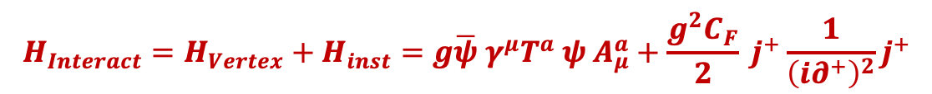

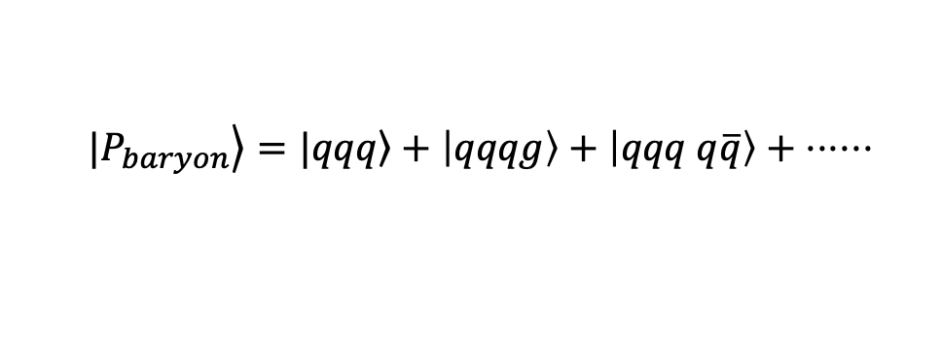
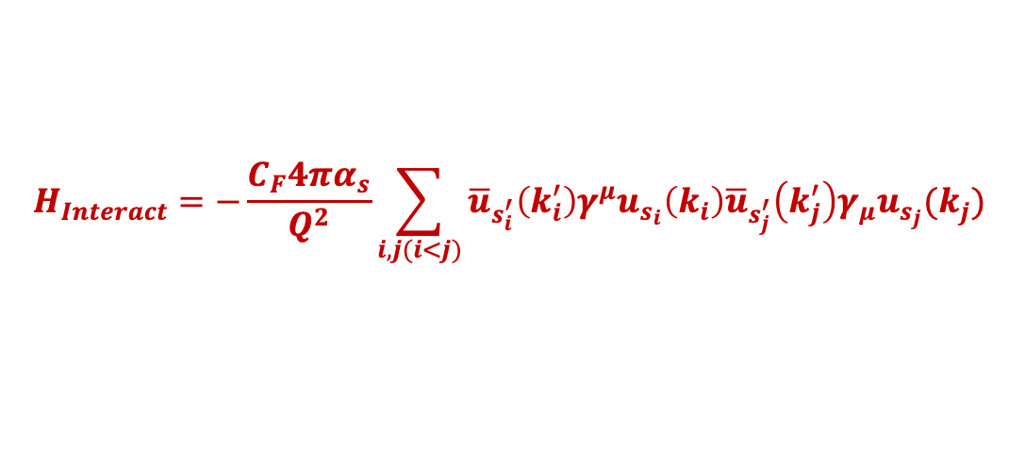
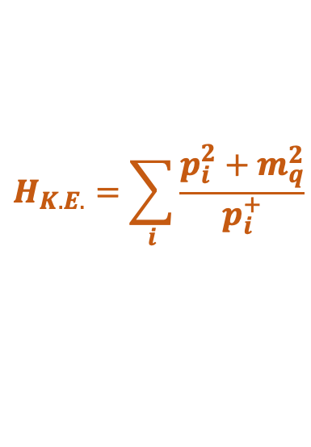
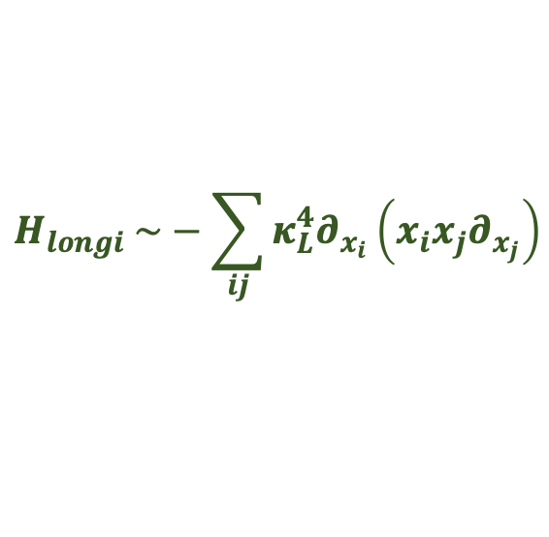
Light-Front Hamiltonian
$$P^{−}=H_{K.E.}+H_{trans}+H_{longi}+H_{Interact}$$
$$H_{K.E.}=\sum_{i}{\frac{p_{i}^{2}+m_{q}^{2}}{p_{i}^{+}}}$$
$H_{trans} \sim κ_{T}^{4}r^{2}$
-- Brodsky, Teramond arXiv: 1203.4025
$$H_{longi} \sim −\sum_{ij}{κ_{L}^{4}∂_{x_{i}}\left(x_{i}x_{j}∂_{x_{j}}\right)}$$
---Y Li, X Zhao , P Maris , J Vary, PLB 758(2016)
  $$|\left.P_{baryon}\right\rangle =|\left.qqq\right\rangle +\left|qqqg\right\rangle +\left|qqq q\overline{q}\right\rangle + ⋅⋅⋅⋅⋅⋅$$
Only include first Fock sector
$$H_{Interact}=−\frac{C_{F}4πα_{s}}{Q^{2}}\sum_{i,j(i<j)}{{\overline{u}}_{s_{i}^{′}}\left(k_{i}^{′}\right)γ^{μ}u_{s_{i}}\left(k_{i}\right){\overline{u}}_{s_{j}^{′}}\left(k_{j}^{′}\right)γ_{μ}u_{s_{j}}(k_{j}) }$$
Include the first and second Fock sector
$$H_{Interact}=H_{Vertex}+H_{inst}=g\overline{ψ} γ^{μ}T^{a} ψ A_{μ}^{a}+\frac{g^{2}C_{F}}{2} j^{+}\frac{1}{{\left(i∂^{+}\right)}^{2}}j^{+}$$

Slide 6
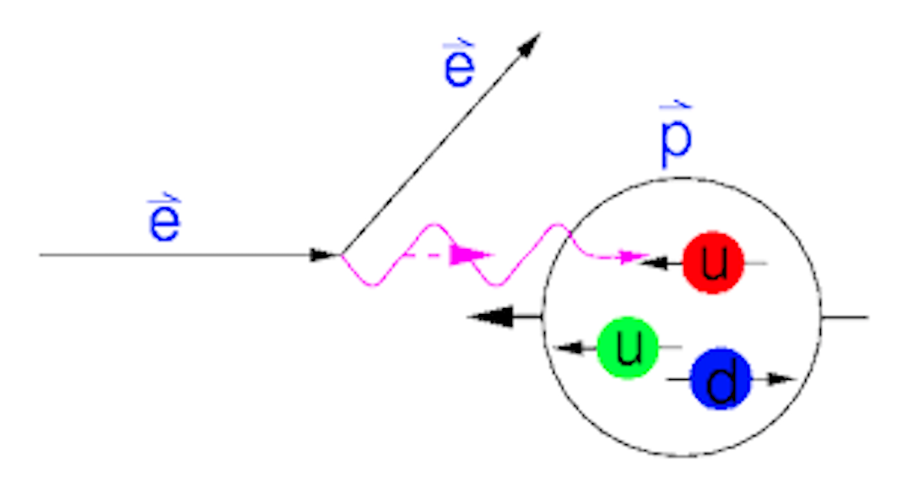
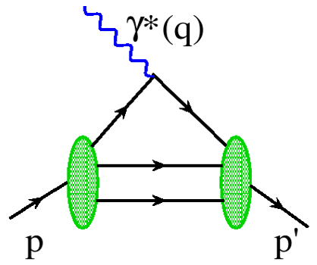
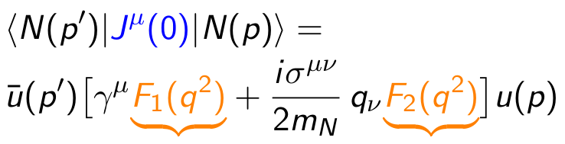

Electromagnetic Form Factor
Elastic scattering of proton
[ R. Hofstadter, Nobel Prize 1961 ]
$$e\left(p\right)+h\left(P\right)→e\left(p^{′}\right)+h(P^{′})$$
Elastic electron scattering established the extended nature of the proton (proton radius).
The Fourier transformation of these form factors provide spatial distributions (charge and magnetization distributions).
Dirac Form Factor
Pauli Form Factor

Slide 7
Nucleon Form Factor
[PhysRevD. 102. 016008, C. Mondal, Siqi Xu, et al. ]
proton
neutron
neutron
proton
With increasing the basis size, the nucleon form factors approximately agree the data

Slide 8
Nucleon Form Factor
[In preparetion, Siqi Xu, C. Mondal et.al ]
The ratio of nucleon Form Factor has a good agreement with experimental data.

Slide 9
Density for proton and neutron
[In preparation, Siqi Xu, C. Mondal et al. ]
For charge and magnetic density, BLFQ qualitatively agrees with fits.

Slide 10
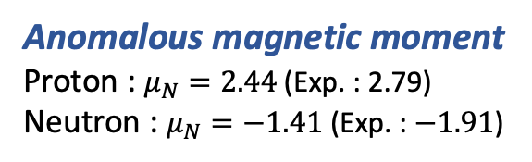
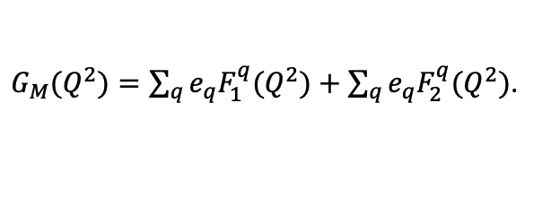
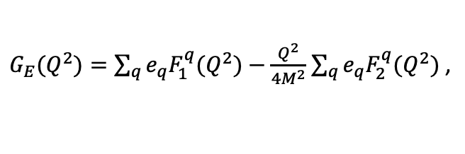
Nucleon Form Factor
[PhysRevD. 102. 016008, C. Mondal, Siqi Xu, et al. ]
$G_{E}(Q^{2})=\sum_{q}{e_{q}F_{1}^{q}(Q^{2})}−\frac{Q^{2}}{4M^{2}}$ $\sum_{q}{e_{q}F_{2}^{q}(Q^{2})}$ ,
$G_{M}(Q^{2})=\sum_{q}{e_{q}F_{1}^{q}(Q^{2})}+$ $\sum_{q}{e_{q}F_{2}^{q}(Q^{2})}$.
neutron
proton
Anomalous magnetic moment
Proton : $μ_{N}=2.44$ (Exp. : 2.79)
Neutron : $μ_{N}=−1.41$ (Exp. : $−1.91$)
proton
neutron

Slide 11

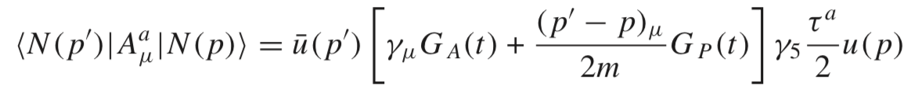


Axial Form Factor of The Proton
Axial form factor of the proton can be measured by ordinary muon capture (OMC)
$$μ^{−}\left(l\right)+p\left(r\right)→ν_{μ}\left(l^{′}\right)+n(r^{′})$$
Provide information on spin-isospin distributions
$$G_{A}\left(Q^{2}\right)=G_{u}\left(Q^{2}\right)−G_{d}(Q^{2})$$
we consider only the valence quark in our calculation, and neglect the sea quark and gluon contributions.
[PhysRevD. 102. 016008, C. Mondal, Siqi Xu, et.al ]
[Chandan Mondal, EPJC 2017]

Slide 12
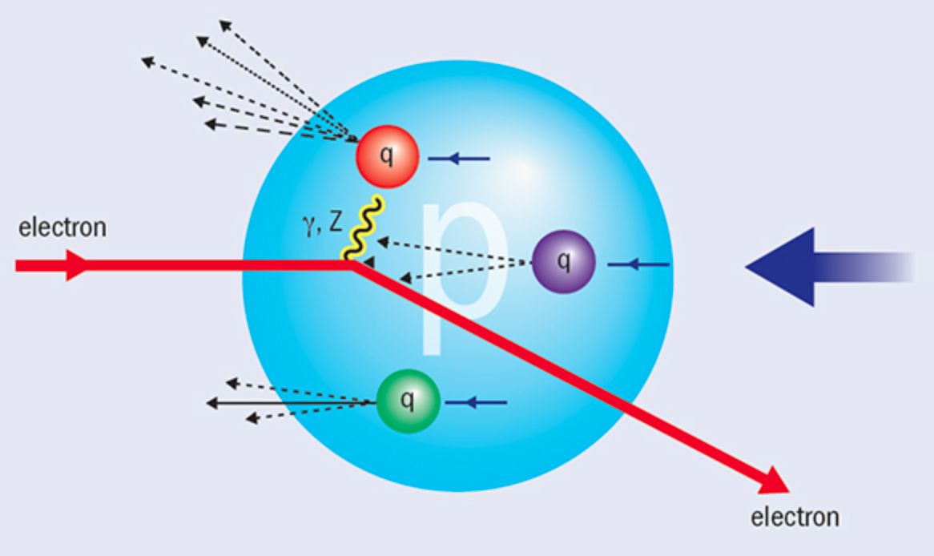
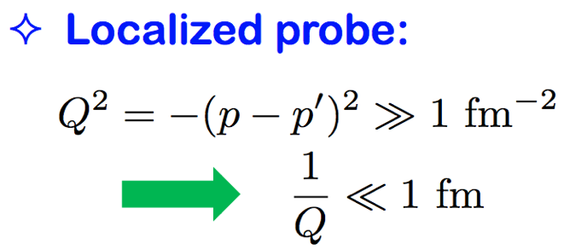

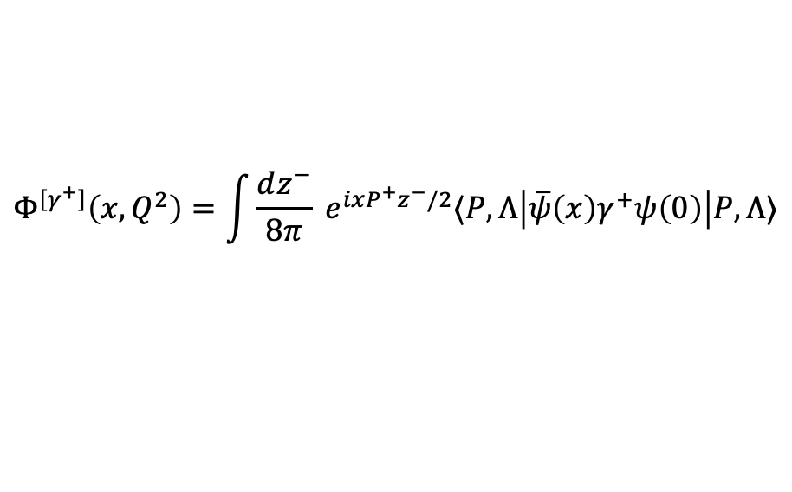


Parton Distribution Functions (PDF)
Deep Inelastic Scattering (SLAC 1968)
$$X$$
$$e\left(p\right)+h\left(P\right)=e^{′}\left(p^{′}\right)+X(P^{′})$$
$$X$$
Discovery of spin ½ quarks and partonic structure
Parton distribution functions (PDFs) are extracted from DIS processes.
$$Φ^{\left[γ^{+}\right]}\left(x,Q^{2}\right)=\int{\frac{dz^{−}}{8π}} e^{ixP^{+}z^{−}/2}⟨P,Λ\left|\overline{ψ}\left(x\right)γ^{+}ψ\left(0\right)\right|P,Λ⟩$$
PDFs encode the distribution of longitudinal momentum and polarization carried by the constituents

Slide 13
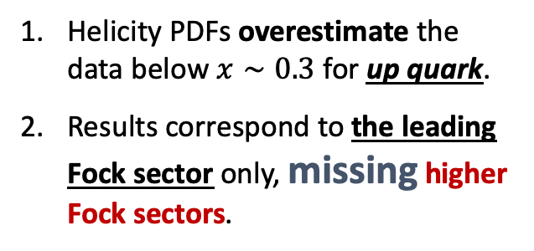


Unpolarized PDFs and Helicity PDFs
[PhysRevD. 102. 016008, C. Mondal, Siqi Xu, et al. ]
Unpolarized PDFs:
$$μ^{2}=10 GeV^{2}$$
Helicity PDFs:
$$μ^{2}=3 GeV^{2}$$
Helicity PDFs overestimate the data below $x∼0.3$ for up quark.
Results correspond to the leading Fock sector only, missing higher Fock sectors.

Slide 14


Helicity PDFs with Valence and Sea Quark
[PhysRevD. 102. 016008, C. Mondal, Siqi Xu, et.al ]
$$q^{+}(x)=q(x)+\overline{q}(x)$$
The differential contribution between up and down quark more or less agree with NNPDF data.
The helicity asymmetry is an observable for investigating the spin structure of the proton in experiments.
up quark
Considering the valence and sea quark contribution, our results have overestimate at small x region.
$$g_{1}^{q^{+}}(x)/f_{1}^{q^{+}}(x)$$
At least, The gluon contribution at initial scale is needed for BLFQ.
down quark

Slide 15
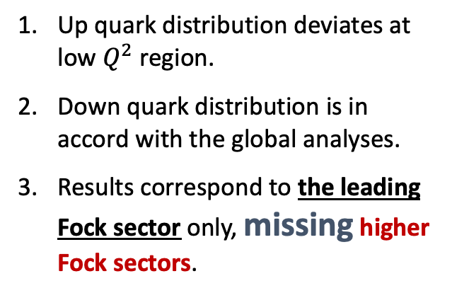
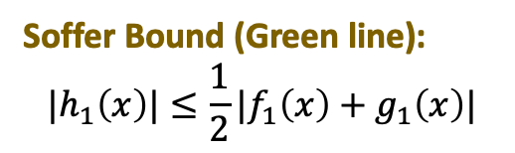
Transversity PDFs
[PhysRevD. 102. 016008, C. Mondal, Siqi Xu, et al. ]
Transversity PDFs：
Up quark distribution deviates at low $Q^{2}$ region.
Down quark distribution is in accord with the global analyses.
Results correspond to the leading Fock sector only, missing higher Fock sectors.
Soffer Bound (Green line):
$$|h_{1}\left(x\right)|≤\frac{1}{2}|f_{1}\left(x\right)+g_{1}\left(x\right)|$$

Slide 16
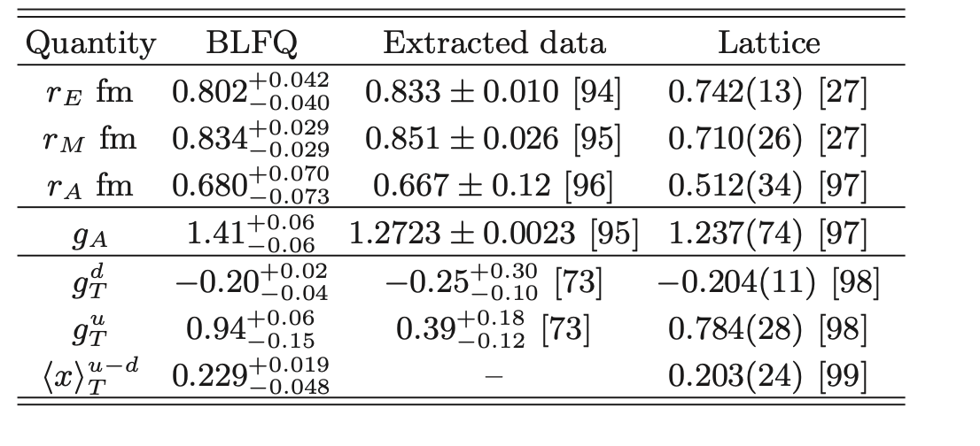
Proton radii, axial and tensor charges
The BLFQ results more or less agree with experimental data.
[PhysRevD. 102. 016008, C. Mondal, Siqi Xu, et al. ]

Slide 17
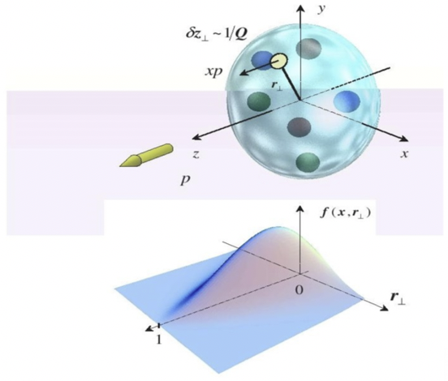
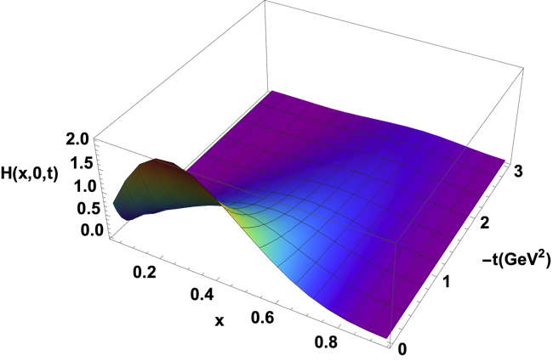
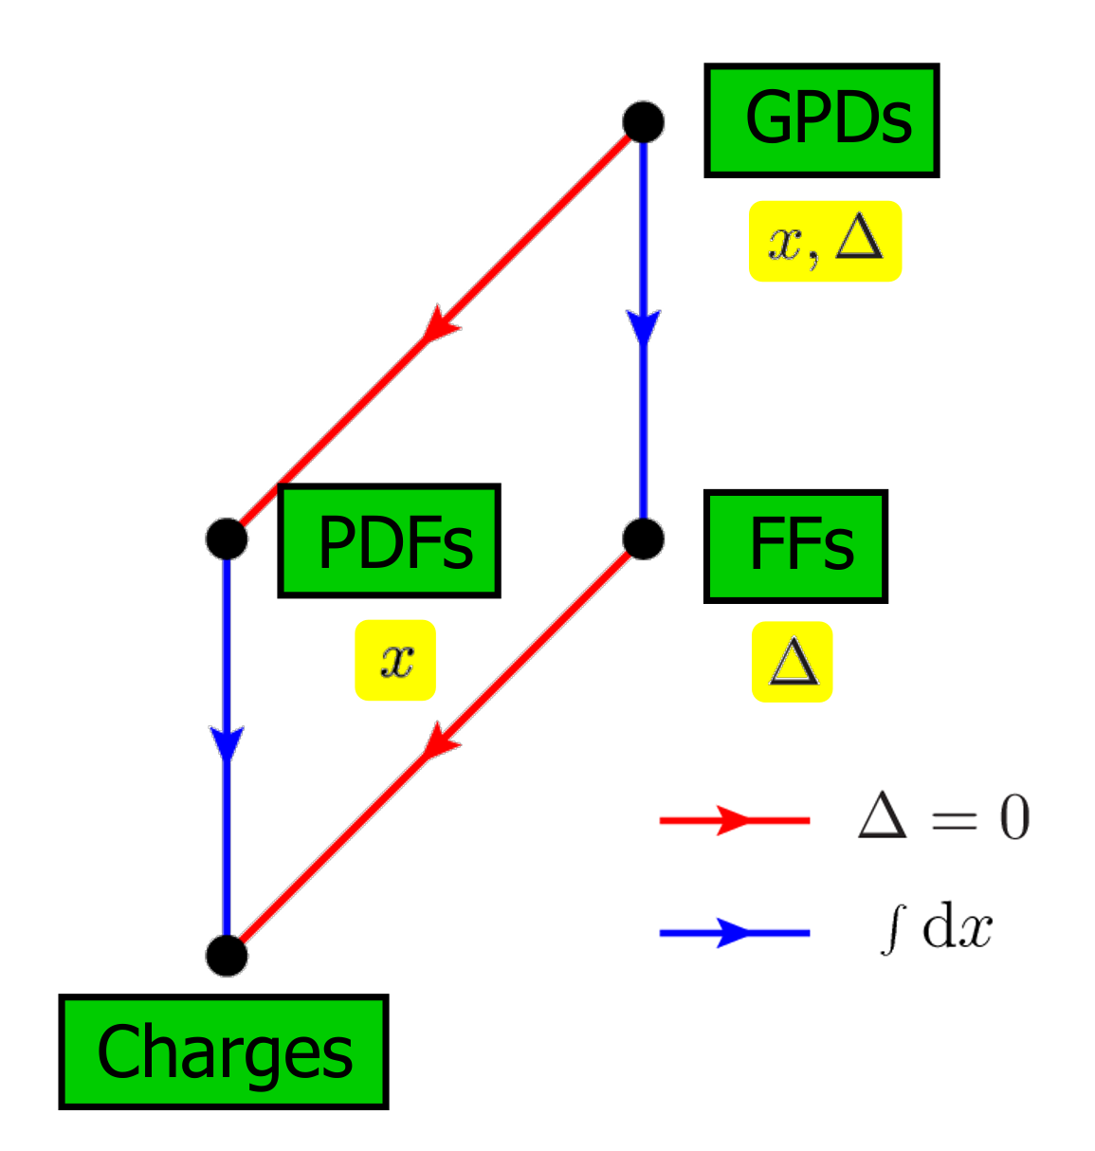

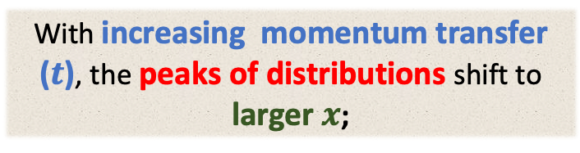
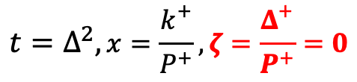
Generalized Parton Distribution Functions (GPD)
[Work in progress, C. Mondal, Siqi Xu, et al. ]
Encode the information about
three dimensional spatial structure
the spin and orbital angular momentum
With increasing momentum transfer ($t$), the peaks of distributions shift to larger $x$;
$$t=Δ^{2},x=\frac{k^{+}}{P^{+}}, ζ=\frac{Δ^{+}}{P^{+}}=0$$

Slide 18
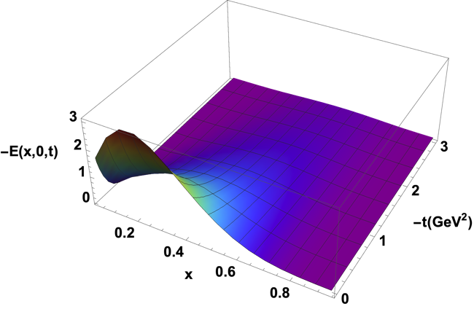
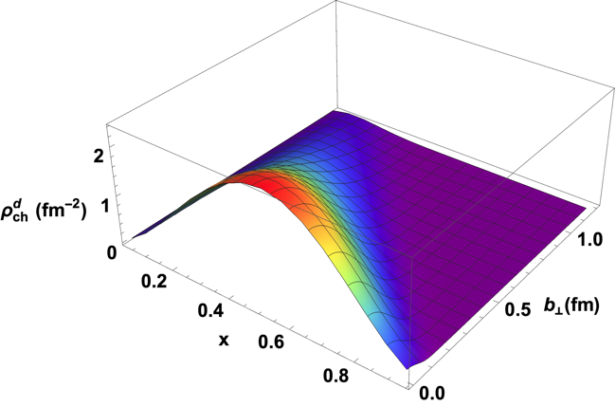
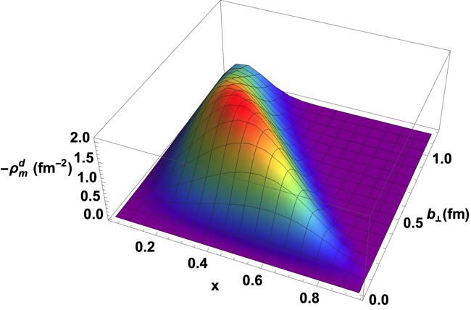


Generalized Parton Distribution Functions (GPD)
$$t=Δ^{2},x=\frac{k^{+}}{P^{+}}, ζ=\frac{Δ^{+}}{P^{+}}=0$$
$$Δ \underset{→}{Fourier Transform}b$$
[Work in progress, C. Mondal, Siqi Xu, et.al ]

Slide 19
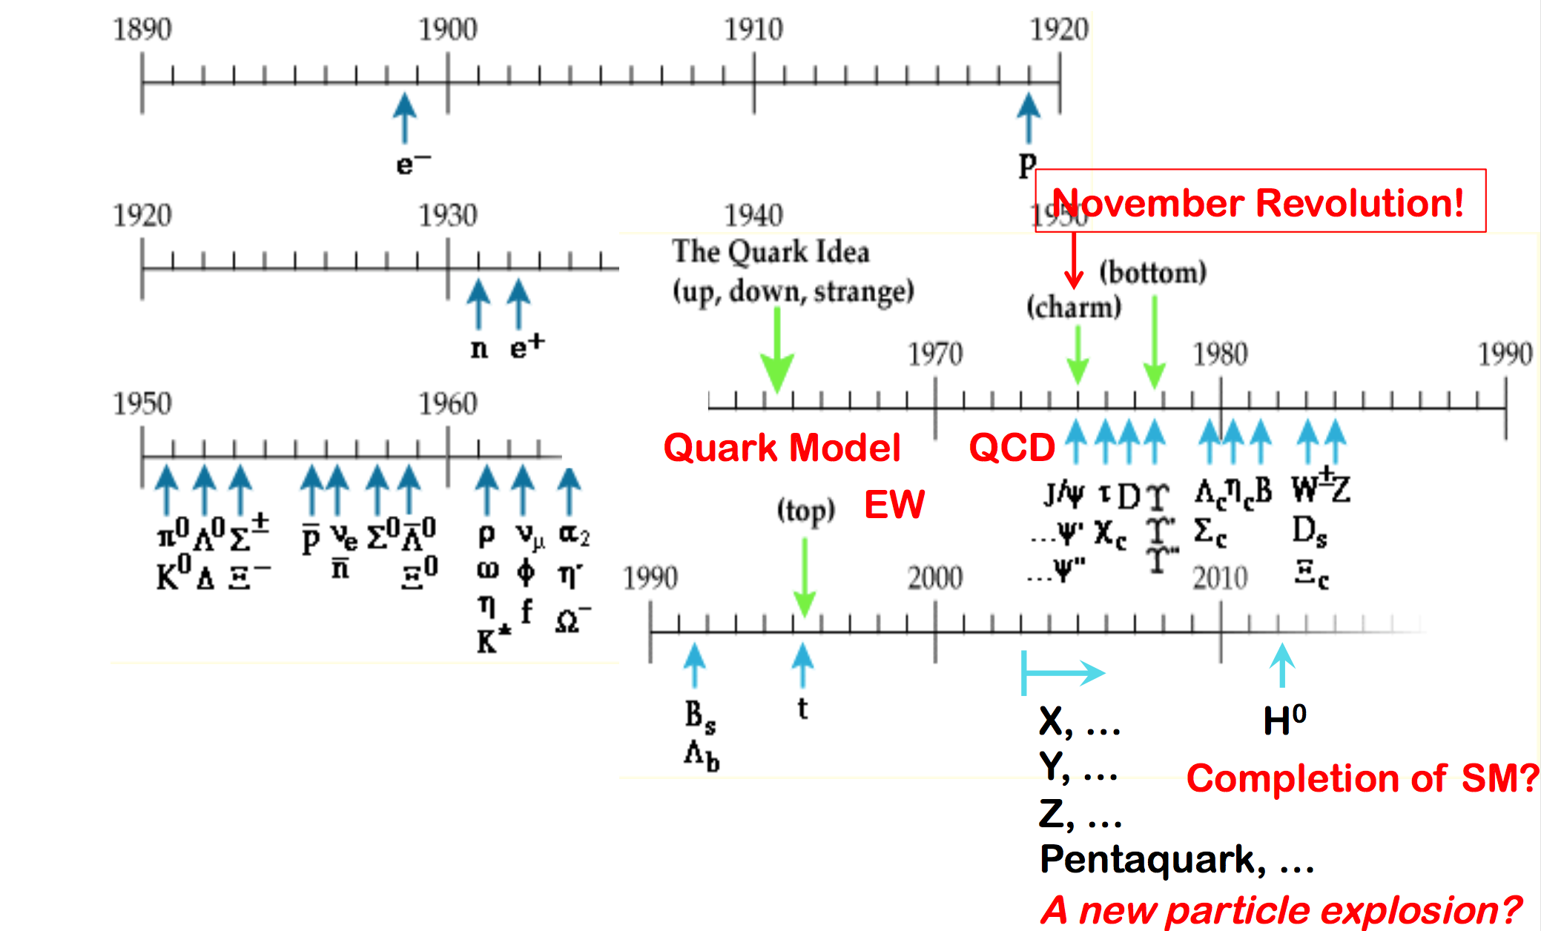
Extend to other hardon

Slide 20
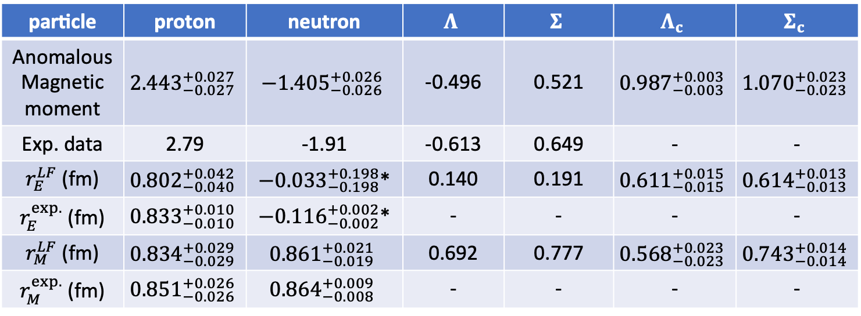

Observables of $Λ_{(c)}$ and $Σ_{(c)}$
particle | proton | neutron | $$Λ$$ | $$Σ$$ | $$Λ_{c}$$ | $$Σ_{c}$$
Anomalous Magnetic moment | $${2.443}_{−0.027}^{+0.027}$$ | $$−{1.405}_{−0.026}^{+0.026}$$ | -0.496 | 0.521 | $${0.987}_{−0.003}^{+0.003}$$ | $${1.070}_{−0.023}^{+0.023}$$
Exp. data | 2.79 | -1.91 | -0.613 | 0.649 | - | -
$r_{E}^{LF}$ (fm) | $${0.802}_{−0.040}^{+0.042}$$ | $−{0.033}_{−0.198}^{+0.198}$* | 0.140 | 0.191 | $${0.611}_{−0.015}^{+0.015}$$ | $${0.614}_{−0.013}^{+0.013}$$
$r_{E}^{exp.}$ (fm) | $${0.833}_{−0.010}^{+0.010}$$ | $−{0.116}_{−0.002}^{+0.002}$* | - | - | - | -
$r_{M}^{LF}$ (fm) | $${0.834}_{−0.029}^{+0.029}$$ | $${0.861}_{−0.019}^{+0.021}$$ | 0.692 | 0.777 | $${0.568}_{−0.023}^{+0.023}$$ | $${0.743}_{−0.014}^{+0.014}$$
$r_{M}^{exp.}$ (fm) | $${0.851}_{−0.026}^{+0.026}$$ | $${0.864}_{−0.008}^{+0.009}$$ | - | - | - | -
*: For the neutron, charge radius is replaced by ($r_{E}^{2} \left\langle fm^{2}\right\rangle$)
the BLFQ calculations approximately agree the experimental data.
We are using the same parameters with the proton case, and calculating other baryon.

Slide 21
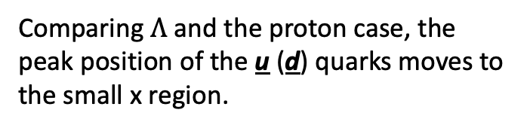

Parton Distribution Functions of $Λ$ and $Σ$
[Work in progress, T. Peng, Z. Zhu, Siqi Xu, C. Mondal, et al. ]
The u and d quarks have the same distributions at the longitudinal direction.
Comparing $Λ$ and the proton case, the peak position of the u (d) quarks moves to the small x region.

Slide 22

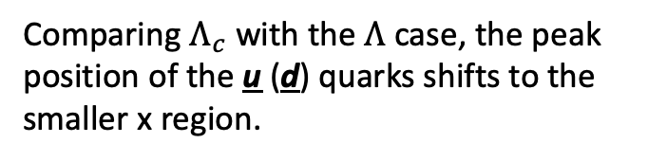
Parton Distribution Functions of $Λ_{c}$ and $Σ_{c}$
[Work in progress, T. Peng, Z. Zhu, Siqi Xu, C. Mondal, et al. ]
The u and d quarks have the same distribution at the longitudinal direction.
Comparing $Λ_{c}$ with the $Λ$ case, the peak position of the u (d) quarks shifts to the smaller x region.

Slide 23

Form Factor of $Λ$ and $Σ$
[Work in progress, T. Peng, Z. Zhu, Siqi Xu, C. Mondal, et al. ]
As the neutral particle, the baryon $Λ$ and $Σ$ have the similar behavior with the neutron.

Slide 24

Form Factor of $Λ_{c}$
[Work in progress, T. Peng, Z. Zhu, Siqi Xu, C. Mondal, et al. ]
$Λ_{c}$ has the similar Dirac FFs with the proton case, but has the very different Pauli FFs

Slide 25
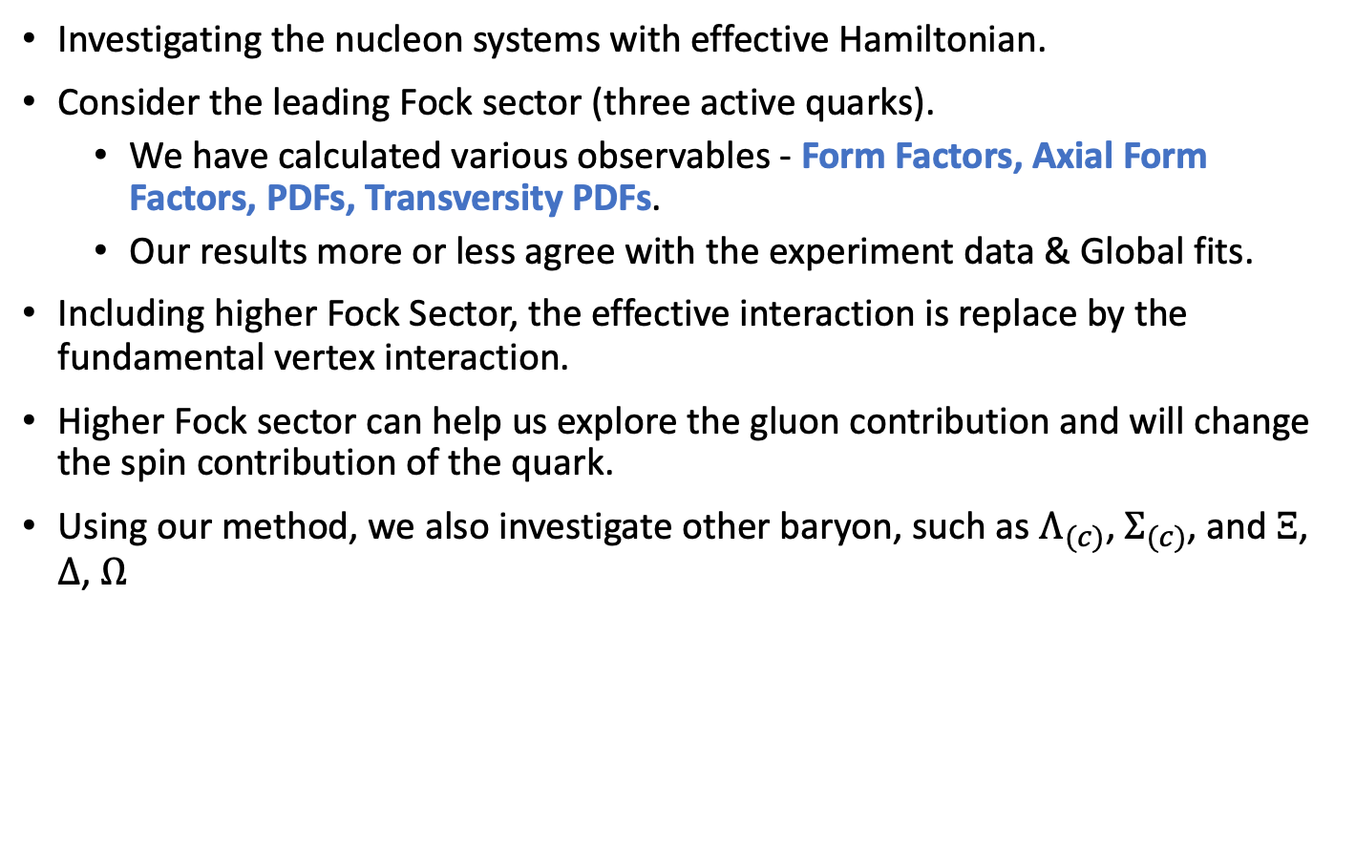
Conclusion
Investigating the nucleon systems with effective Hamiltonian.
Consider the leading Fock sector (three active quarks).
  We have calculated various observables - Form Factors, Axial Form Factors, PDFs, Transversity PDFs.
  Our results more or less agree with the experiment data & Global fits.
Including higher Fock Sector, the effective interaction is replace by the fundamental vertex interaction.
Higher Fock sector can help us explore the gluon contribution and will change the spin contribution of the quark.
Using our method, we also investigate other baryon, such as $Λ_{(c)}$, $Σ_{(c)}$, and $Ξ$, $Δ$, $Ω$

Slide 26
backup

Slide 27
backup

Slide 28

Parton Distribution Functions of $Σ$
[Work in progress,T. Peng, Z. Zhu, Siqi Xu, C. Mondal, et.al ]
We are using the same parameters with the proton case, and calculating other baryon.
The u and d quarks, as the light quarks, have the same distribution at the longitudinal direction.
Comparing with the s quark, the peak position of the u (d) move to the small x region.

Slide 29

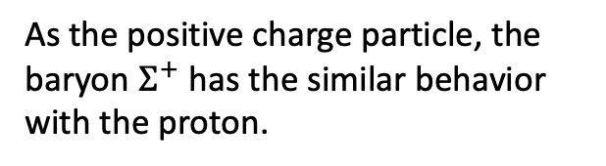
Form Factor of $Σ^{+}$
[Work in progress,T. Peng, Z. Zhu, Siqi Xu, C. Mondal, et.al ]
We are using the same parameters with the proton case, and calculating other baryon.
As the positive charge particle, the baryon $Σ^{+}$ has the similar behavior with the proton.

Slide 30
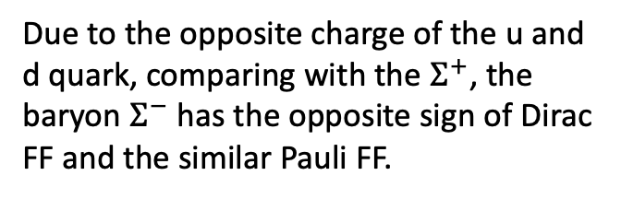

Form Factor of $Σ^{−}$
[Work in progress,T. Peng, Z. Zhu, Siqi Xu, C. Mondal, et.al ]
We are using the same parameters with the proton case, and calculating other baryon.
Due to the opposite charge of the u and d quark, comparing with the $Σ^{+}$, the baryon $Σ^{−}$ has the opposite sign of Dirac FF and the similar Pauli FF.

Slide 31

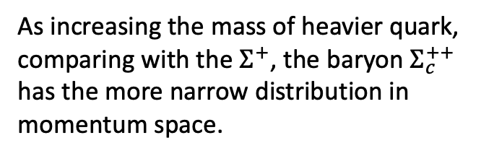
Form Factor of $Σ_{c}^{++}$
[Work in progress,T. Peng, Z. Zhu, Siqi Xu, C. Mondal, et.al ]
We are using the same parameters with the proton case, and calculating other baryon.
As increasing the mass of heavier quark, comparing with the $Σ^{+}$, the baryon $Σ_{c}^{++}$ has the more narrow distribution in momentum space.

Slide 32

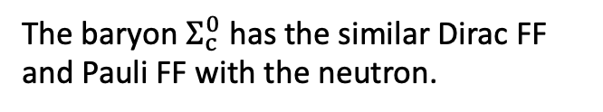
Form Factor of $Σ_{c}^{0}$
[Work in progress,T. Peng, Z. Zhu, Siqi Xu, C. Mondal, et.al ]
We are using the same parameters with the proton case, and calculating other baryon.
The baryon $Σ_{c}^{0}$ has the similar Dirac FF and Pauli FF with the neutron.

Slide 33
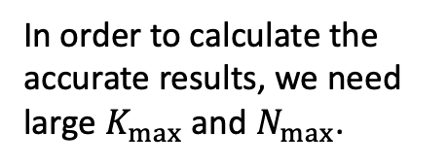

Unpolarized parton distribution functions
Preliminary results
$$\frac{xf_{g}\left(x\right)}{10}$$
In order to calculate the accurate results, we need large $K_{max}$ and $N_{max}$.
Unpolarized PDFs : longitudinal momentum distribution of unpolarized parton in unpolarized proton.
Without second Fock sector $\left|qqqg\right\rangle$, the gluon contributions all come from the DGLAP evolution。
Including the second Fock sector, there is an effect on the gluon contributions and less effect on the valence quark contributions.
[Work in progress, C. Mondal, Siqi Xu, et.al ]
[PhysRevD. 102. 016008, C. Mondal, Siqi Xu, et.al ]

