Slide 1
Insights into the Emergence of Mass from Studies of Pion and Kaon Structure
Lei Chang(常雷)
leichang@nankai.edu.cn
Nankai University
第五届“强子谱和强子结构研讨会”
2021/01/23, 线上

Slide 2

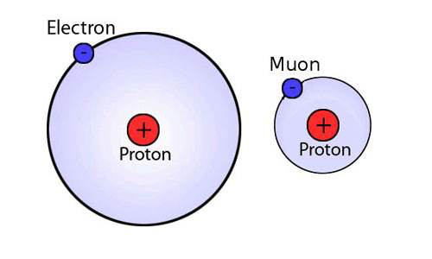
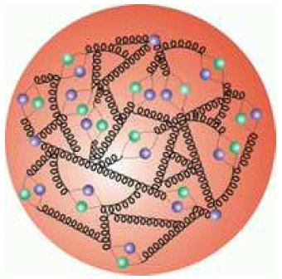
Bound state and quantum field theory
Trace anomaly
All renormalisable four-dimensional theories possess a trace anomaly;
The size of the trace anomaly in QED must be great deal smaller than that in QCD.
QED
QCD
Field theory Successful:
Nonrelativistic quantum mechanics to handle bound state;
Perturbation theory to handle relativistic effects
Field theory not Successful yet:
Growth of the running coupling constant in the infrared region;
Confinement;
Dynamical Chiral Symmetry Breaking;
Possible nontrivial vacuum structure in hadron

Slide 3
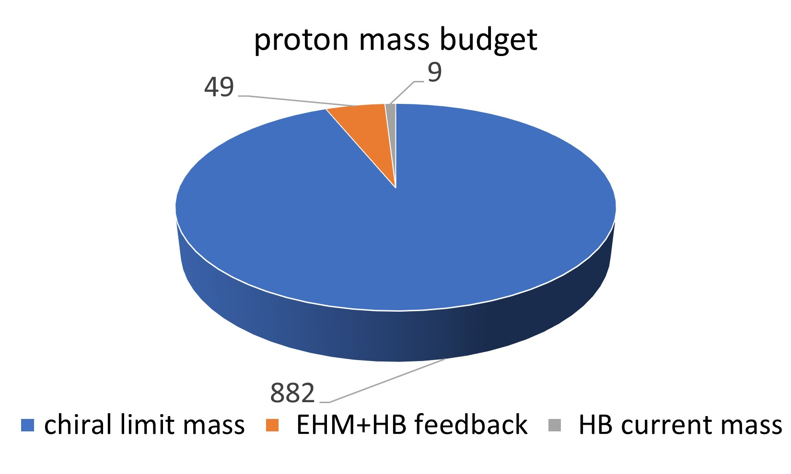
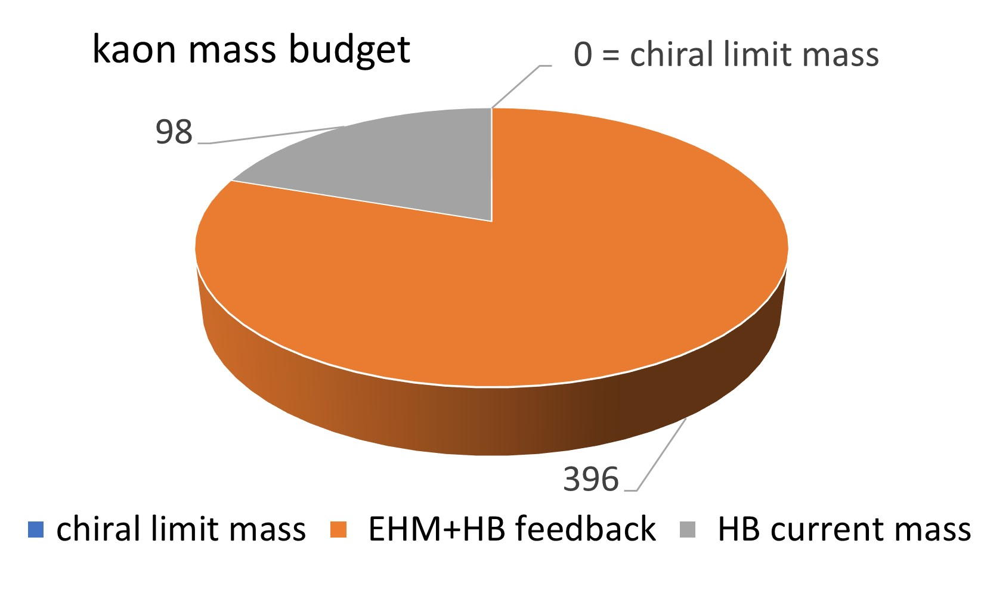
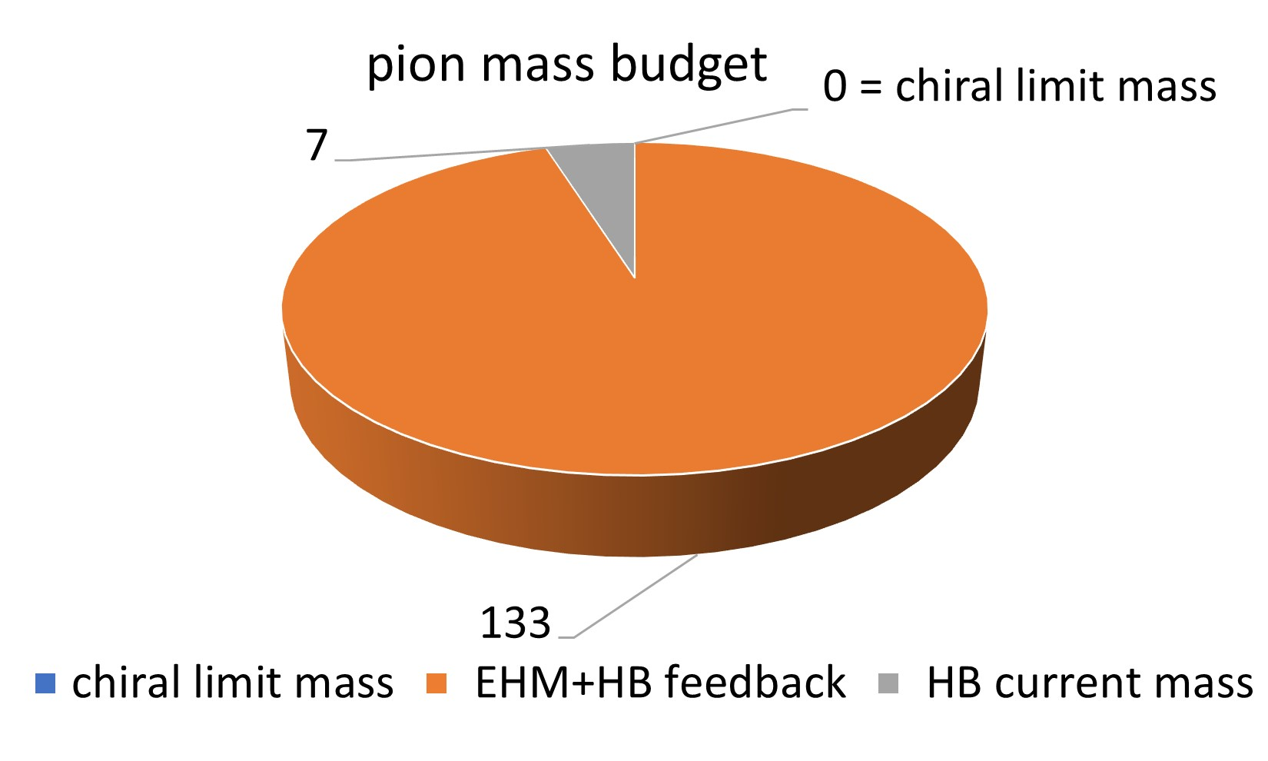
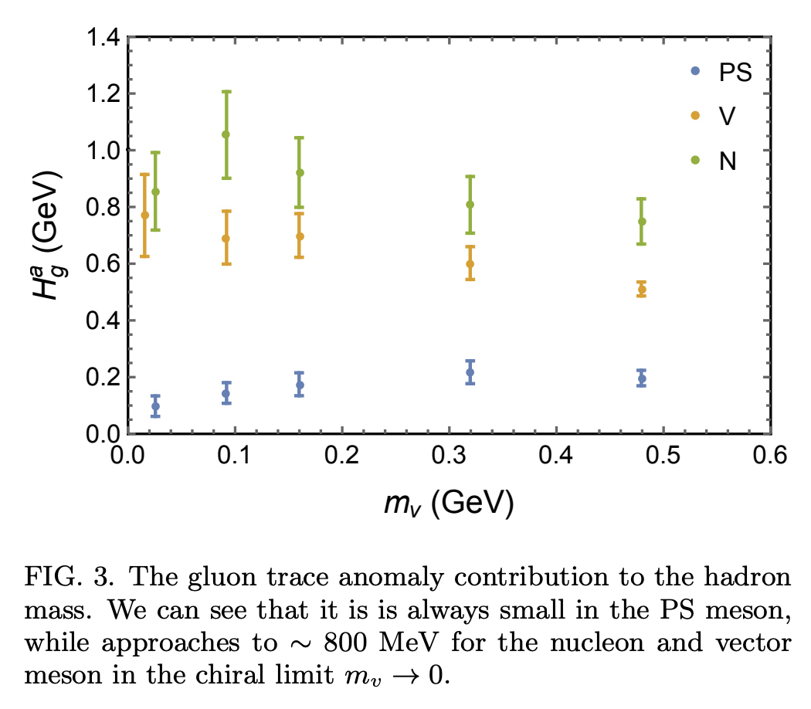
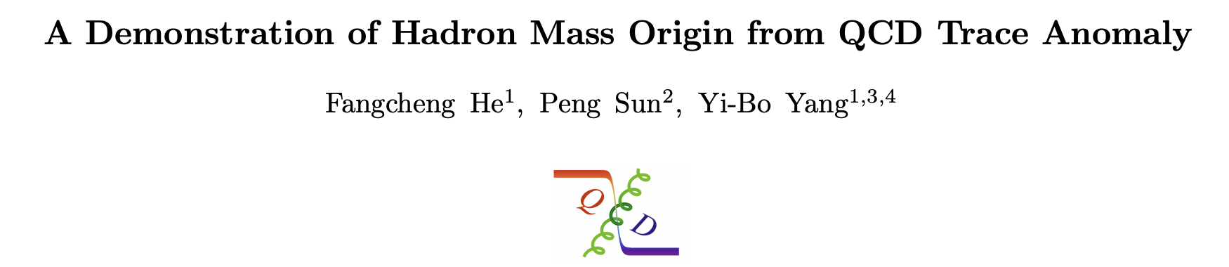
Mass budget
chiral limit mass: absence of Higgs coupling
HB current mass: Higgs-boson effects
EHM+HB feed back: interference between emergent hadronic mass and HB current mass
Absence of Higgs(in the chiral limit)
A very large fraction of the measured proton mass emerges as a consequence of the trace anomaly…by glue and the interactions between them;
Pion and Kaon masses are ZERO(NG mode associated with DCSB)
Restoring Higgs boson couplings
Sum of hadron’s valence-quark current masses……..0.01 m_{p}
Interference………………quark condensates☺
5% for proton 80% for kaon 95% for pion

Slide 4
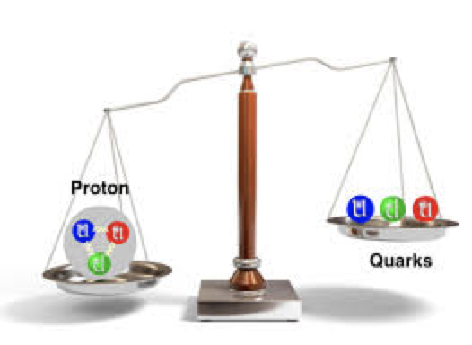
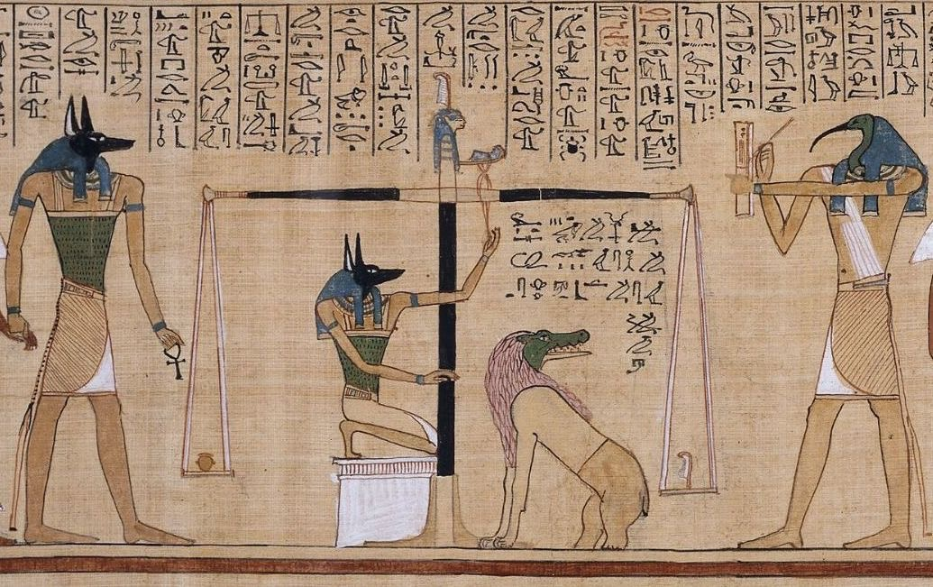
Mass puzzle
“How does the mass of the proton arise?” will only explain one part of a great puzzle
…simultaneously clarify Pion and Kaon
Fact(Confinement): no gluon or quark has been seen to propagate over a length scale which exceeds the proton radius…influence of emergent mass

Slide 5
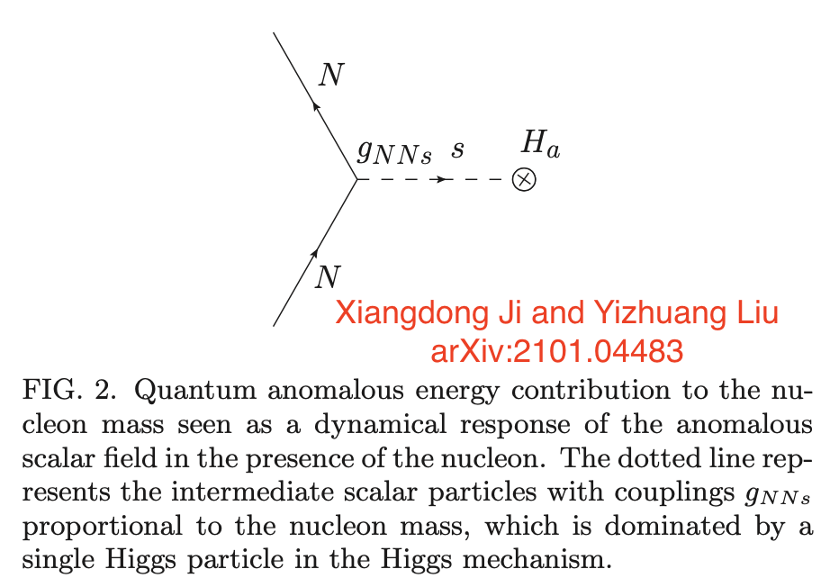
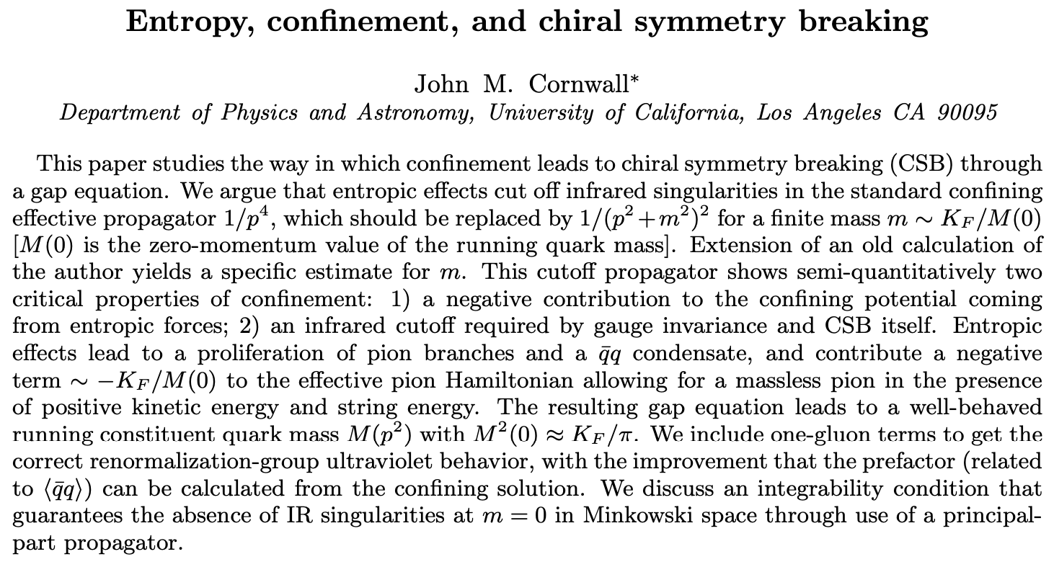
Mass puzzle
“How does the mass of the proton arise?” will only explain one part of a great puzzle
…simultaneously clarify Pion and Kaon
Confinement: no gluon or quark has been seen to propagate over a length scale which exceeds the proton radius…influence of emergent mass

Slide 6
Mass puzzle
“How does the mass of the proton arise?” will only explain one part of a great puzzle
…simultaneously clarify Pion and Kaon
Confinement: no gluon or quark has been seen to propagate over a length scale which exceeds the proton radius…influence of emergent mass
In tackling these questions, opportunities are provided by studies of the properties of the SM’s (pseudo-) Nambu-Goldstone modes, viz. Pions and Kaons.
Pion and Kaon distribution amplitudes
electromagentic form factors
structure functions
On the same footing

Slide 7

Continuum Schwinger function Method
Dyson, F. J. (1949), “The S Matrix In Quantum Electrodynamics,” Phys. Rev. 75, 1736.
Schwinger, J. S. (1951), “On The Green’s Functions Of Quantized Fields: 1 and 2,” Proc. Nat. Acad. Sci. 37 (1951) 452; ibid 455.
Dyson-Schwinger Equations
Bethe-Salpeter Equations(Nambu)
Faddeev Equation
Ward-Takahashi identity
Scattering Problem
……
They provide a systematic, symmetry-preserving approach to solving the bound-state problem in QCD;
Predictions from CSM analyses are practically identical to those obtained via the lattice-regularized theory.
DSEs group
Cui, et al, EPJA 57 (2021) 5, EPJC80 (2020) 1064
Ding, et al, CPC44 (2020) 031002, PRD101(2020)054014
Binosi, et al, PLB790(2019)257
Chen, et al, PRD98(2018) 091505
Gao, et al, PRD96 (2017) 034024
Chang, et al, PLB737(2014), PRL110(2013)132001,PRL111(2013)1418002

Slide 8
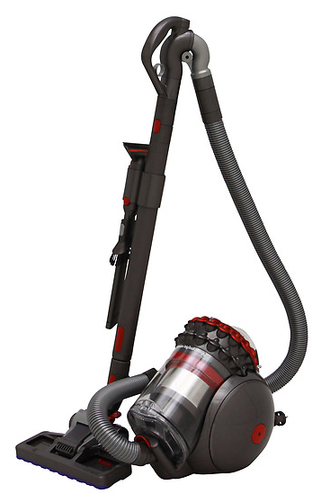

DSEs
$$F\left[G^{n}\right]=F[G^{n},G^{n+1}]$$

Slide 9
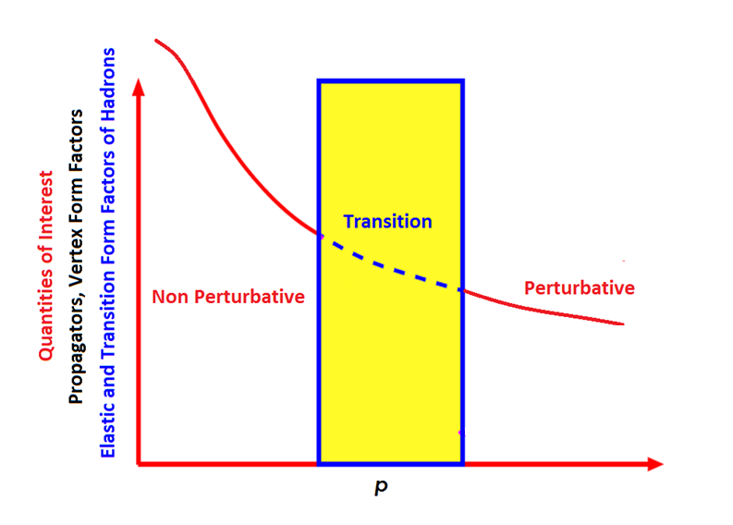
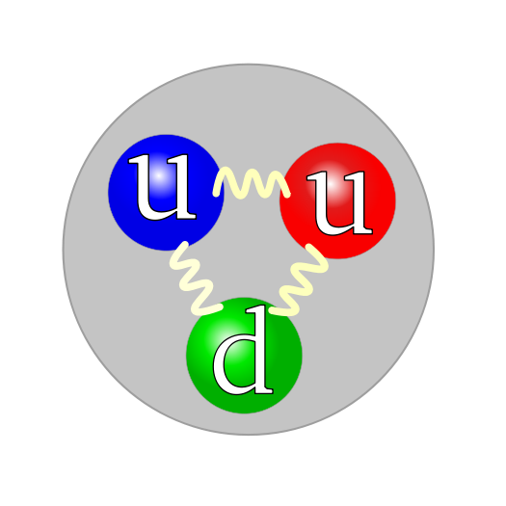

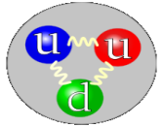
Dyson-Schwinger Equation scope
Study bound state problem within an continuum field theory
QCD
Exact representation
Lattice
DSEs
Modeling…HadronPhysics
SCL
Truncation
Faddeev Equation
Bethe Salpeter
Equation
Masses, Decays
Form Factors
MC
??
Quark Propagator
Theory Vs.
Experiment
QCD
DSEs

Slide 10
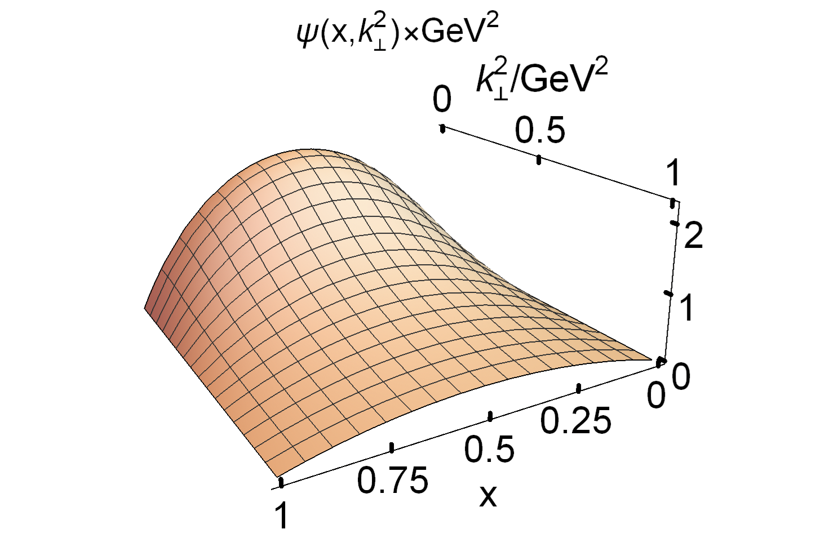
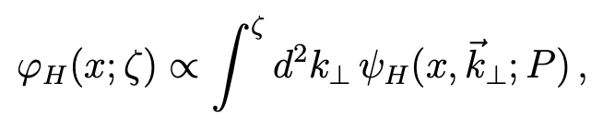
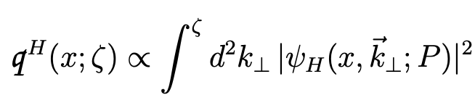
Light Front Wave Function
DA:
DF:
An eigenfunction of a QCD Hamiltonian defined at fixed light-front time
DSE approach: Compute the hadron’s Poincare-covariant Bethe-Salpeter wave function, and then Project this object onto the light front
Story begin from LC, I.Cloet, J.C-Martinez, C.D.Roberts, S.M.Schmidt, P.C.Tandy, etal, PRL110(2013)132001

Slide 11
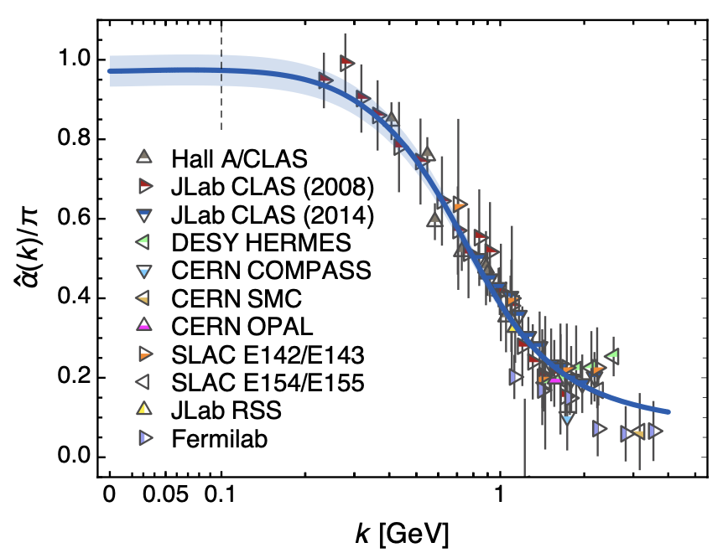
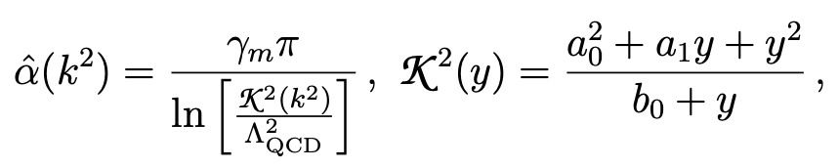
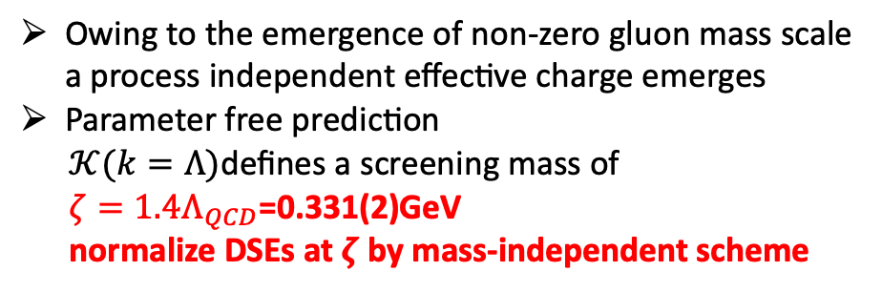
Light Front Wave Function
DA:
DF:
Owing to the emergence of non-zero gluon mass scale a process independent effective charge emerges
Parameter free prediction
$𝒦(k=Λ)$defines a screening mass of
$ζ=1.4Λ_{QCD}$=0.331(2)GeV
normalize DSEs at $ζ$ by mass-independent scheme

Slide 12
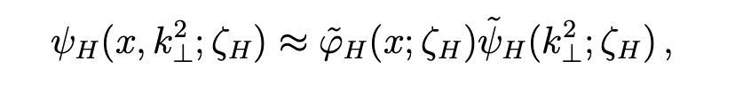
Light Front Wave Function
DA:
DF:
Factorized Approximation
at hadronic scale, not valid on larger scale
Integrated quantities, not detail of LFWF

Slide 13
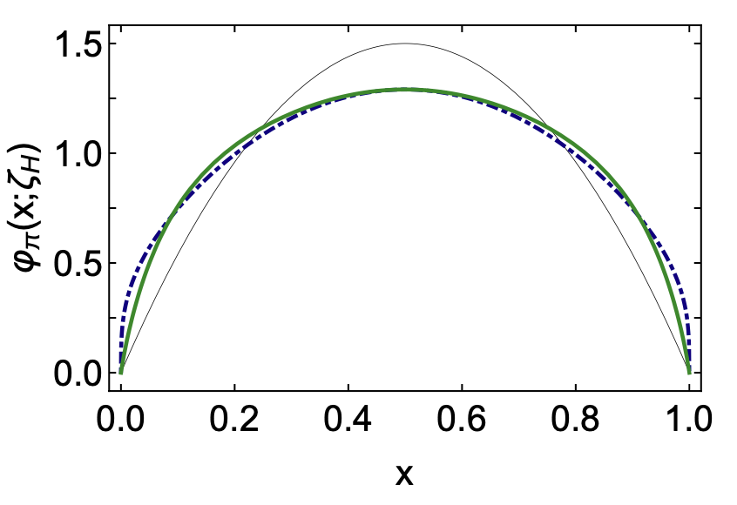
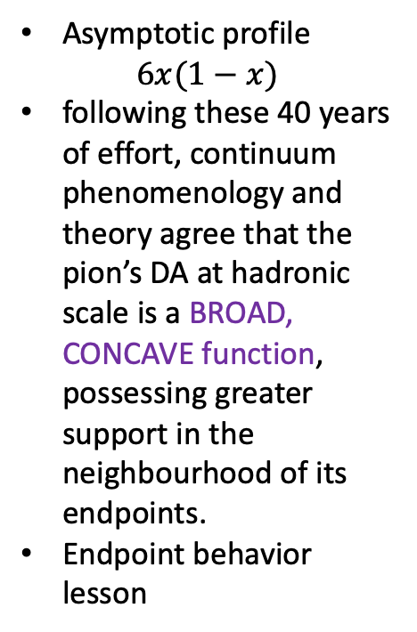
NG’s DA(absence of Higgs)
Higgs Boson
Asymptotic profile
$$6x(1−x)$$
following these 40 years of effort, continuum phenomenology and theory agree that the pion’s DA at hadronic scale is a BROAD, CONCAVE function, possessing greater support in the neighbourhood of its endpoints.
Endpoint behavior lesson
EHM-induced broadening
Y2013->Y2020

Slide 14
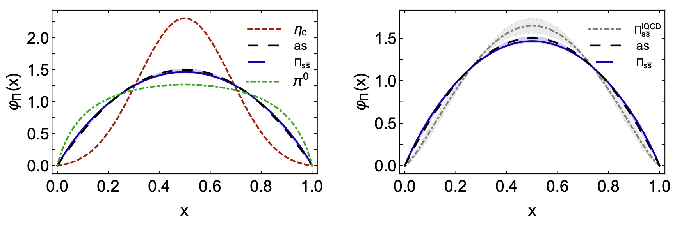
NG’s DA (presence of Higgs)
Higgs Boson
Question: when does the Higgs mechanism begin to influence mass generation (pion…eta_c)
A critical current quark mass lies in the neighbourhood of the s-quark
lQCD calculation(R. Zhang, et al, PRD102(2020)094519) and continuum analyses in QCD agree upon the existence of such critical current mass(ps boundsate mass 0.69GeV both)
For a DA very similar to Asymptotic one, EHM and Higgs-boson couplings are playing a roughly equal role in forming the wave function

Slide 15
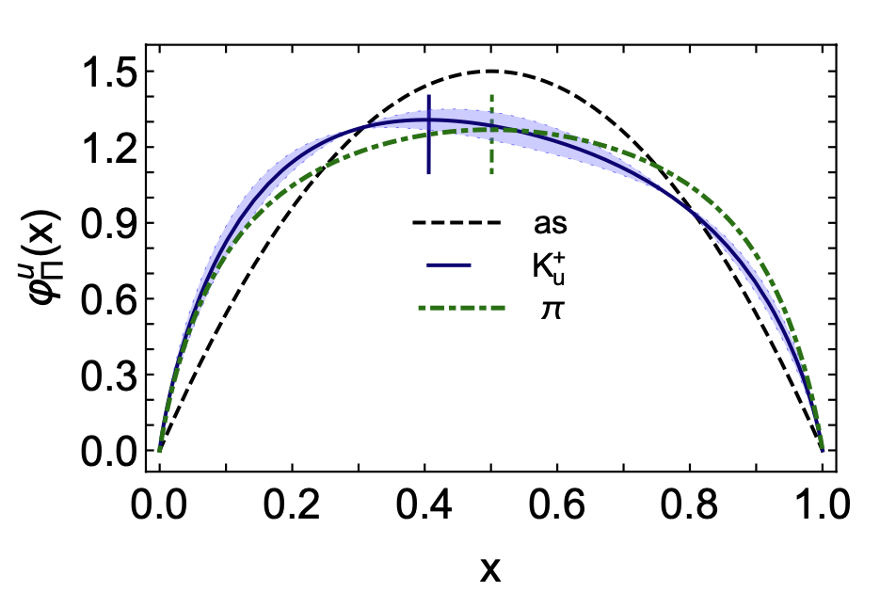


Kaon’s DA
$$K^{+} (u\overline{s})$$
Flavor asymmetry
Peak shifted to x=0.4
20% to the left
Higgs-boson modulation of EHM
With increasing current mass
of the heavier quark the
distortion of this DA becomes more pronounced and its peak location moves toward x=0.

Slide 16
Measurement of the π⁺ Form Factor
At low Q², Fπ can be measured directly via high energy elastic π⁺ scattering from the atomic electrons
CERN SPS used 300 GeV pions to measure form factor up to Q²=0.25GeV²
(Amedolia et al, NPB277, 168 (1986))
These data used to constrain the pion charge radius: rπ=0.657±0.012 fm
At larger Q², Fπ must be measured indirectly using the “pion cloud” of the proton in exclusive pion electroproduction: p(e, e’ π⁺)n
at small –t, the pion pole process dominates the longitudinal cross section, σ_{L}
(L. Favart, et al, Eur. Phys. J. A 52 (2016) 158)
In the Born term model, Fπ appears as
Sullivan process, in which a nucleon’s pion cloud is used to provide access to the pion’s elastic form factor
Experimental studies over the last decade have given confidence in the electroproduction method yielding the physical pion form factor----Tanja Horn

Slide 17
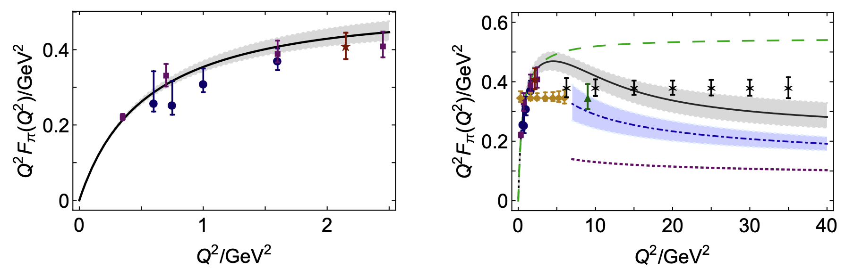
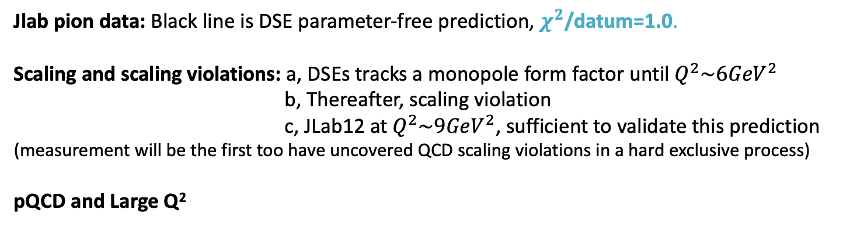
Elastic Electromagnetic Form Factors of Pion(EHM)
Jlab pion data: Black line is DSE parameter-free prediction, $χ^{2}$/datum=1.0.
Scaling and scaling violations: a, DSEs tracks a monopole form factor until $Q^{2}\sim 6{GeV}^{2}$
b, Thereafter, scaling violation
c, JLab12 at $Q^{2}\sim 9{GeV}^{2}$, sufficient to validate this prediction
(measurement will be the first too have uncovered QCD scaling violations in a hard exclusive process)
pQCD and Large Q²

Slide 18
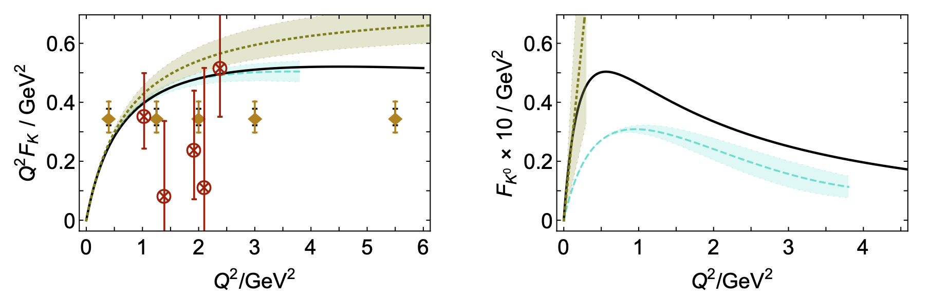
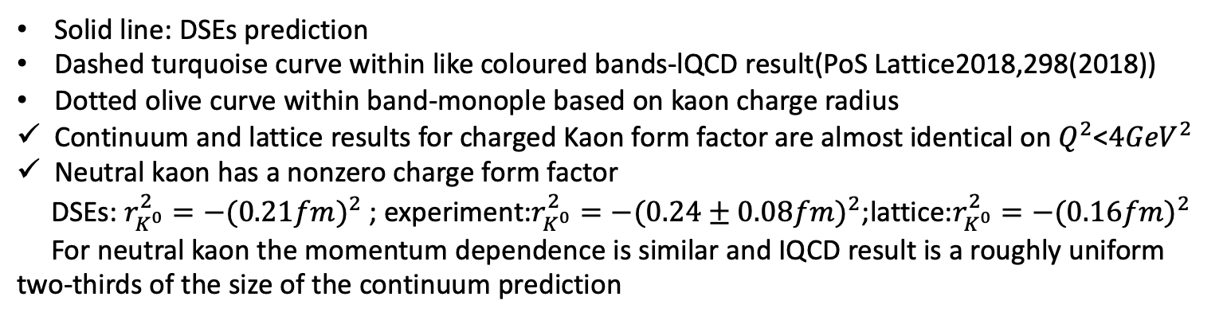
Elastic Electromagnetic Form Factors of Kaon
Solid line: DSEs prediction
Dashed turquoise curve within like coloured bands-lQCD result(PoS Lattice2018,298(2018))
Dotted olive curve within band-monople based on kaon charge radius
Continuum and lattice results for charged Kaon form factor are almost identical on $Q^{2}$<$4{GeV}^{2}$
Neutral kaon has a nonzero charge form factor
DSEs: $r_{K^{0}}^{2}=−{(0.21fm)}^{2}$ ; experiment:$r_{K^{0}}^{2}=−{(0.24±0.08fm)}^{2}$;lattice:$r_{K^{0}}^{2}=−{(0.16fm)}^{2}$
For neutral kaon the momentum dependence is similar and IQCD result is a roughly uniform two-thirds of the size of the continuum prediction

Slide 19
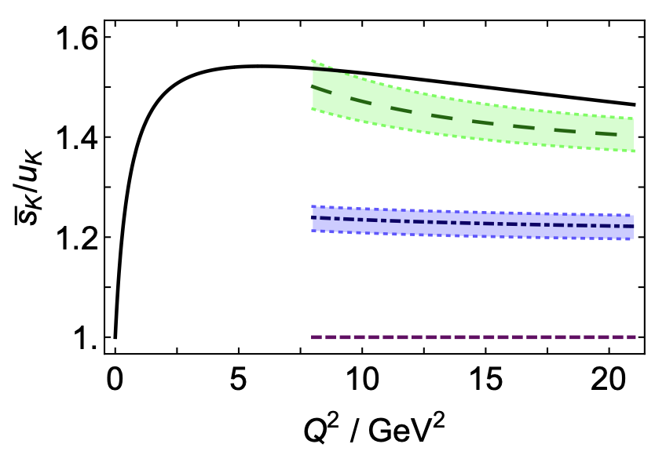
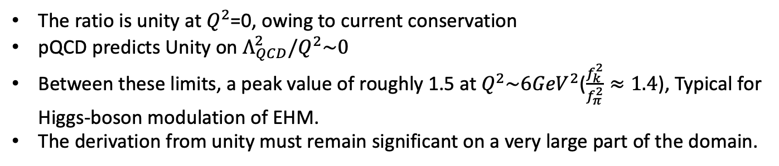
Elastic Electromagnetic Form Factors of Kaon
Falvor separation
Factored out the electric charges
The ratio is unity at $Q^{2}$=0, owing to current conservation
pQCD predicts Unity on $Λ_{QCD}^{2}/Q^{2}\sim 0$
Between these limits, a peak value of roughly 1.5 at $Q^{2}\sim 6{GeV}^{2}$($\frac{f_{k}^{2}}{f_{π}^{2}}≈1.4$), Typical for Higgs-boson modulation of EHM.
The derivation from unity must remain significant on a very large part of the domain.

Slide 20
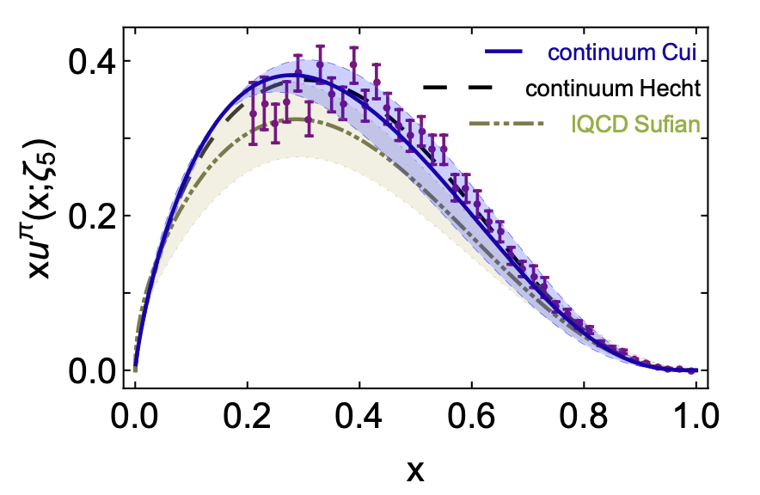
Pion’s DF
1989…Conway et al. Phys. Rev.D 39 (1989) 92
Leading-order analysis of Drell-Yan data
2000…Hecht et al. Phys. Rev.C 63 (2001)025213
QCD connected model calculation
2010...Aicher et al. Phys. Rev. Lett.105 (2010) 252003
Consistent next-to-leading order anaylsis
2019/04...Ding, et al.
Continuum QCD prediction
2019/01...Sufian, et al.
1st exploratory lattice-QCD calculation
Using lattice-calculated matrix element obtained through spatially separated current-current correlations in coordinate space
Update analyses: Chang, et al, CPC44(2020)114105

Slide 21
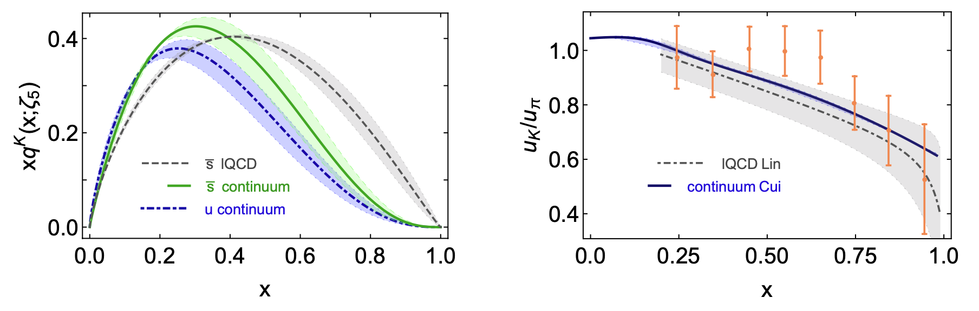
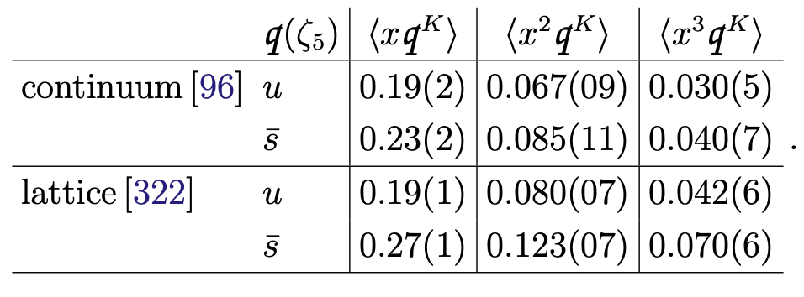
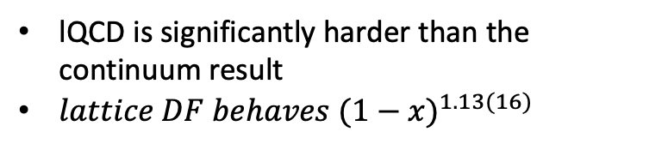
Kaon’s valence DF
lQCD is significantly harder than the continuum result
${lattice DF behaves (1−x)}^{1.13(16)}$
Higgs-modulation of EHM
DSE: $\frac{{\left\langle x\overline{s}\right\rangle }^{K}}{{\left\langle x\overline{u}\right\rangle }^{K}}=1.18\left(1\right)$ vs. lQCD: $\frac{{\left\langle x\overline{s}\right\rangle }^{K}}{{\left\langle x\overline{u}\right\rangle }^{K}}=1.38\left(7\right)$
It may reasonably to anticipated that future refinements of lQCD setups, algorithms and analyses will move lattice and continuum DFs closer together
IQCD: H-W Lin, etal, arXiv:2003.14128

Slide 22
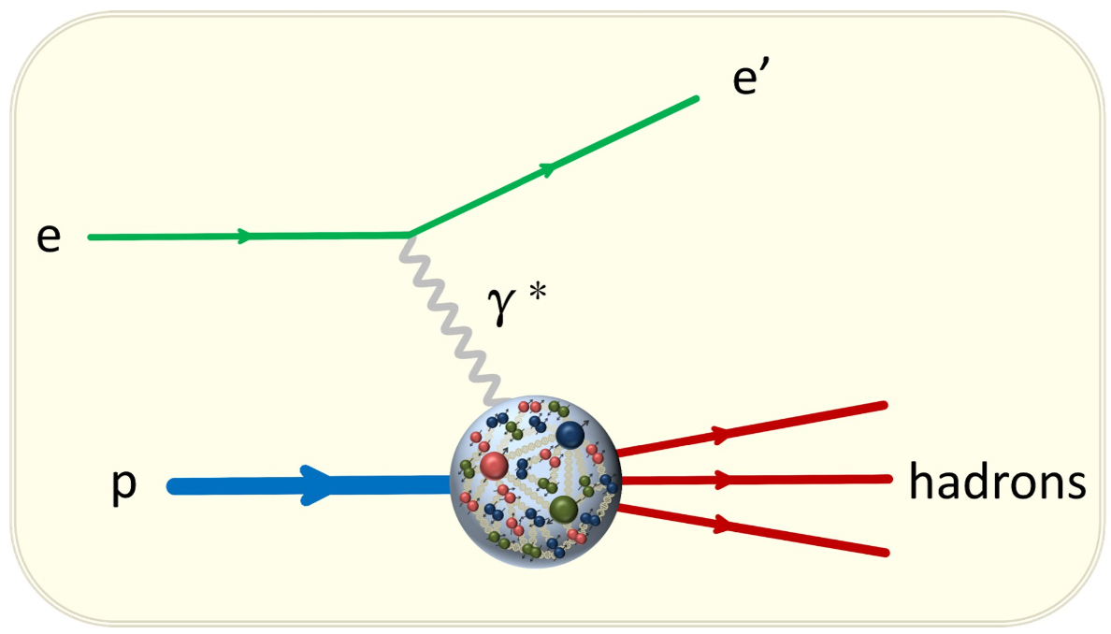
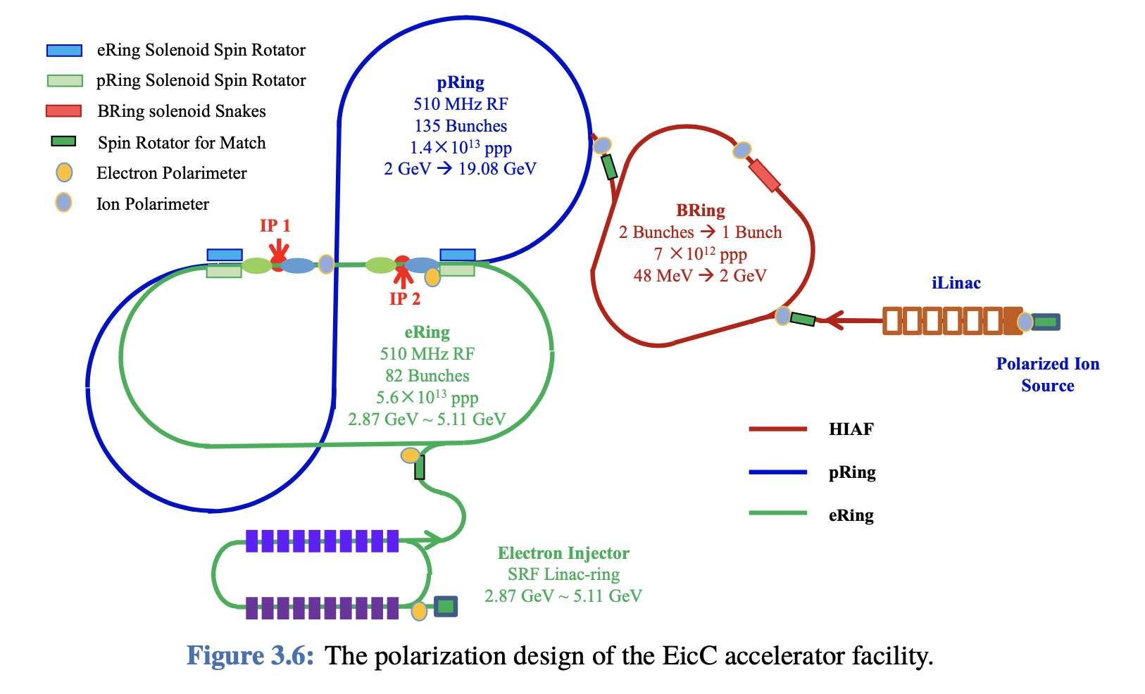
Thanks for your attention
lQCD
DSEs

