Slide 1

Double-heavy tetraquark states with heavy diquark-antiquark symmetry
学无止境， 气有浩然
程剑波
山东大学
2021.1.24

Slide 2
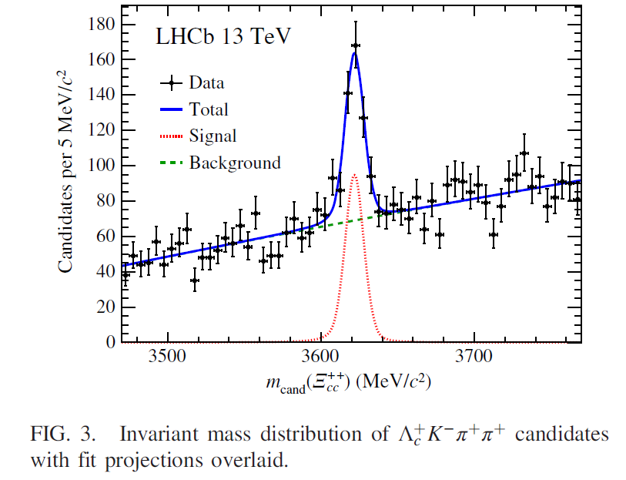
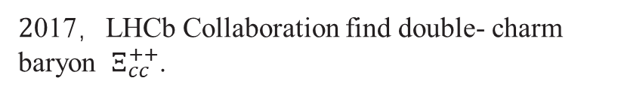

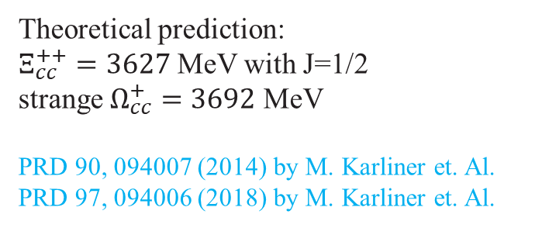
Background
Experiment
Phys.Rev.Lett. 119, 112001 (2017)
$2$017，LHCb Collaboration find double- charm baryon $Ξ_{cc}^{++}$.
Theory
Theoretical prediction:
$Ξ_{cc}^{++}=3627$ MeV with J=1/2
strange $Ω_{cc}^{+}=3692$ MeV
PRD 90, 094007 (2014) by M. Karliner et. Al.
PRD 97, 094006 (2018) by M. Karliner et. Al.
Any other double- charm hadron exist?
$cc\overline{q}\overline{q}$?
2

Slide 3
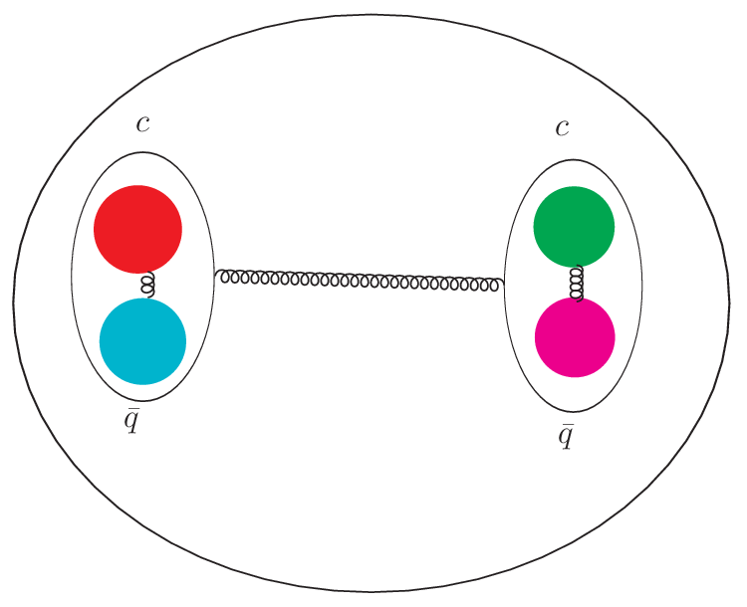
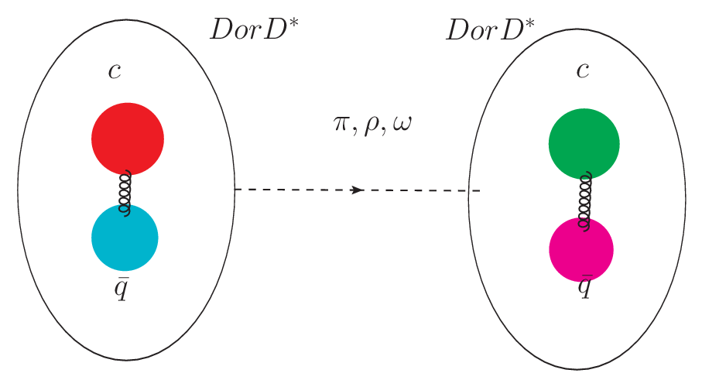
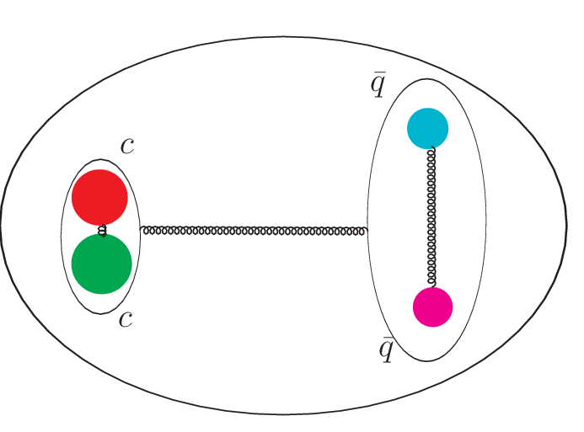

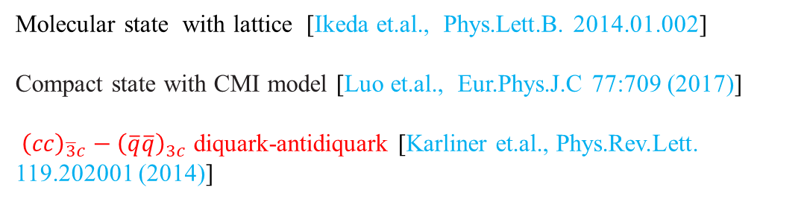
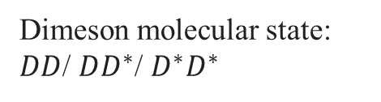
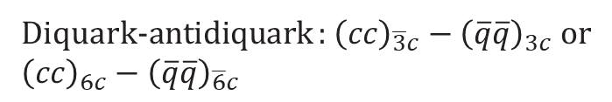
Physical image of $cc\overline{q}\overline{q}$
Structure
Colored “dimeson”: ${\left(c\overline{q}\right)}_{8c}−{\left(c\overline{q}\right)}_{8c}$
Compact tetraquark state
Dimeson molecular state: $DD$/ $DD^{∗}$/ $D^{∗}D^{∗}$
Molecular state with lattice [Ikeda et.al., Phys.Lett.B. 2014.01.002]
Compact state with CMI model [Luo et.al., Eur.Phys.J.C 77:709 (2017)]
${\left(cc\right)}_{\overline{3}c}−{\left(\overline{q}\overline{q}\right)}_{3c}$ diquark-antidiquark [Karliner et.al., Phys.Rev.Lett. 119.202001 (2014)]
Diquark-antidiquark : ${\left(cc\right)}_{\overline{3}c}−{\left(\overline{q}\overline{q}\right)}_{3c}$ or ${\left(cc\right)}_{6c}−{\left(\overline{q}\overline{q}\right)}_{\overline{6}c}$
3

Slide 4
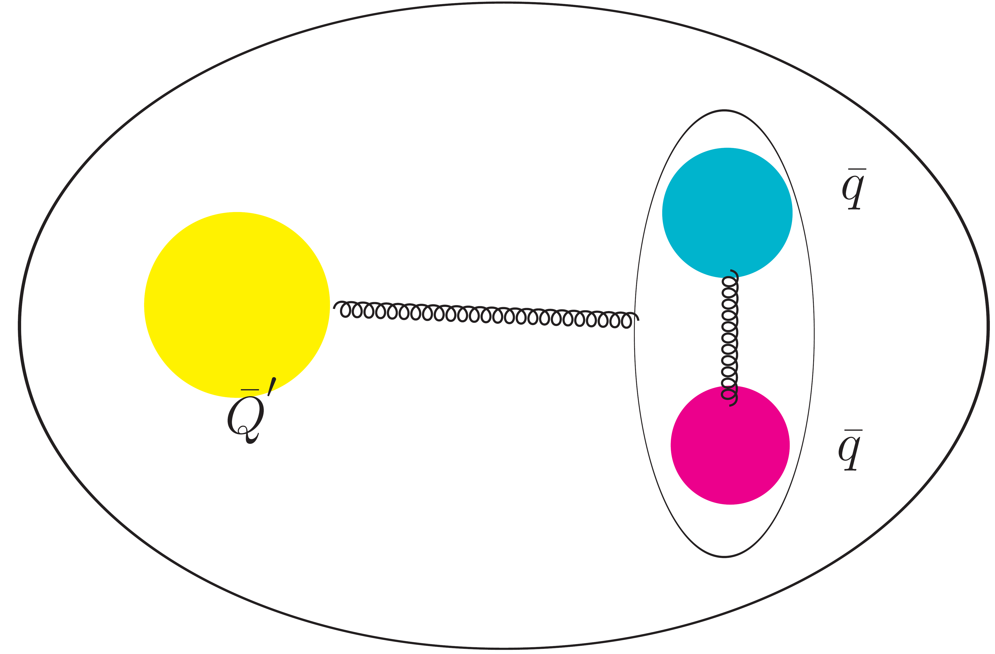


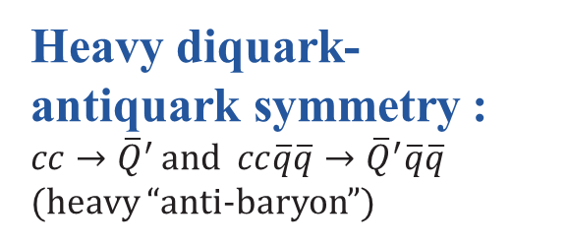
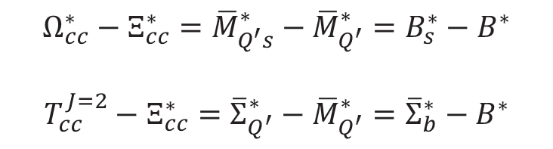
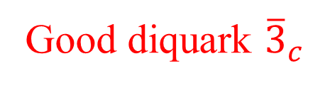


Heavy diquark-antiquark symmetry (HDAS)
Small distance
Small distance
Good diquark ${\overline{3}}_{c}$
Heavy diquark-antiquark symmetry : $cc→{\overline{Q}}^{′}$ and $cc\overline{q}\overline{q}→{\overline{Q}}^{′}\overline{q}\overline{q}$ (heavy “anti-baryon”)
The highest spin state mass
$$Ω_{cc}^{∗}−Ξ_{cc}^{∗}={\overline{M}}_{Q^{′}s}^{∗}−{\overline{M}}_{Q^{′}}^{∗}=B_{s}^{∗}−B^{∗}$$
$$T_{cc}^{J=2}−Ξ_{cc}^{∗}={\overline{Σ}}_{Q^{′}}^{∗}−{\overline{M}}_{Q^{′}}^{∗}={\overline{Σ}}_{b}^{∗}−B^{∗}$$
Heavy quark flavor symmetry (HQFS)
$T_{cc}^{J=2}=4194$ MeV>${2D}^{∗}$
$Ξ_{cc}$ as input
M. Anselmino et.al., Rev.Mod.Phys. 65 (1993) 1199-1234 c
4
Lichtenberg et.al., Phys. Rev. D 53.6678 (1996)

Slide 5
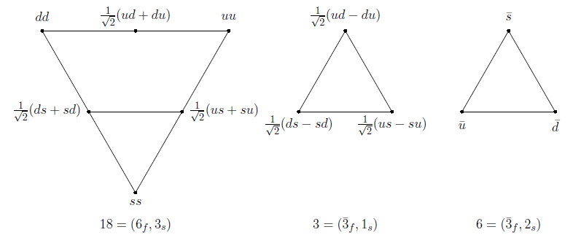

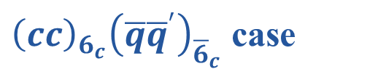
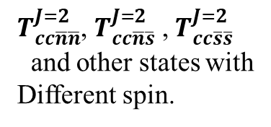



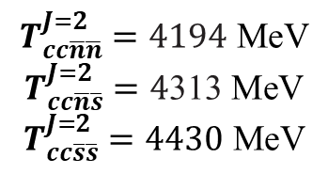



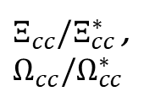
Heavy diquark-antiquark symmetry
Other states: $T_{cc\overline{n}\overline{s}}$, $T_{cc\overline{s}\overline{s}}$
$${\overline{Ξ}}_{Q^{′}}^{∗}\left(cc\overline{n}\overline{s}\right)−{\overline{M}}_{Q}^{∗}\left(ccn\right)={\overline{Ξ}}_{b}^{∗}−B^{∗}$$
$${\overline{Ω}}_{Q^{′}}^{∗}\left(cc\overline{s}\overline{s}\right)−{\overline{M}}_{Q}^{∗}\left(ccs\right)={\overline{Ω}}_{b}^{∗}−B_{s}^{∗}$$
${\left(cc\right)}_{6_{c}}{\left(\overline{q}{\overline{q}}^{′}\right)}_{{\overline{6}}_{c}}$ case
$T_{cc\overline{n}\overline{n}}^{J=2}$, $T_{cc\overline{n}\overline{s}}^{J=2}$ , $T_{cc\overline{s}\overline{s}}^{J=2}$
and other states with
Different spin.
$T_{cc\overline{n}\overline{n}}^{J=1}$, $T_{cc\overline{n}\overline{s}}^{J=1}$, $T_{cc\overline{s}\overline{s}}^{J=1}$
$Ξ_{cc}/Ξ_{cc}^{∗}$ , $Ω_{cc}/Ω_{cc}^{∗}$
$\overline{3}3$ and $6\overline{6}$ mixing
$$T_{cc\overline{n}\overline{n}}^{J=2}=4194 \text{MeV}$$
$$T_{cc\overline{n}\overline{s}}^{J=2}=4\text{313} \text{MeV}$$
$$T_{cc\overline{s}\overline{s}}^{J=2}=4430 \text{MeV}$$
$$?$$
How to get the masses?
$Mass$:
5

Slide 6
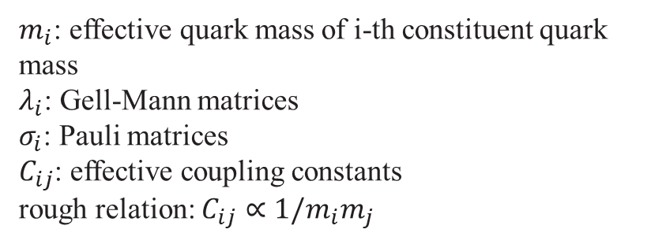
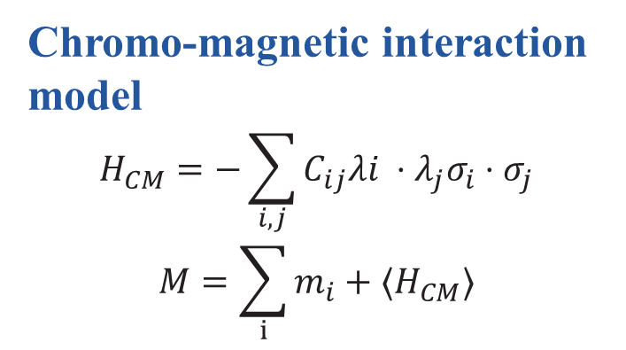
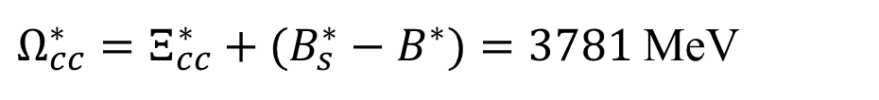
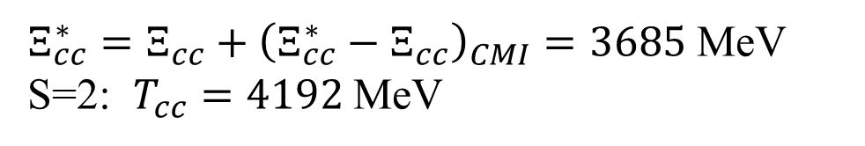
Chromo-magnetic interaction (CMI) model
Chromo-magnetic interaction model
$$H_{CM}=−\sum_{i,j}{C_{ij}λi ⋅λ_{j}σ_{i}⋅σ_{j}}$$
$$M=\sum_{i}{m_{i}+⟨H_{CM}⟩}$$
$m_{i}$: effective quark mass of i-th constituent quark mass
$λ_{i}$: Gell-Mann matrices
$σ_{i}$: Pauli matrices
$C_{ij}$: effective coupling constants
rough relation: $C_{ij}∝1/m_{i}m_{j}$
$Ξ_{cc}^{∗}=Ξ_{cc}+{\left(Ξ_{cc}^{∗}−Ξ_{cc}\right)}_{CMI}=3685$ MeV
S=2: $T_{cc}=4192$ MeV
$Ω_{cc}^{∗}=Ξ_{cc}^{∗}+(B_{s}^{∗}−B^{∗})=3781$ MeV
6

Slide 7
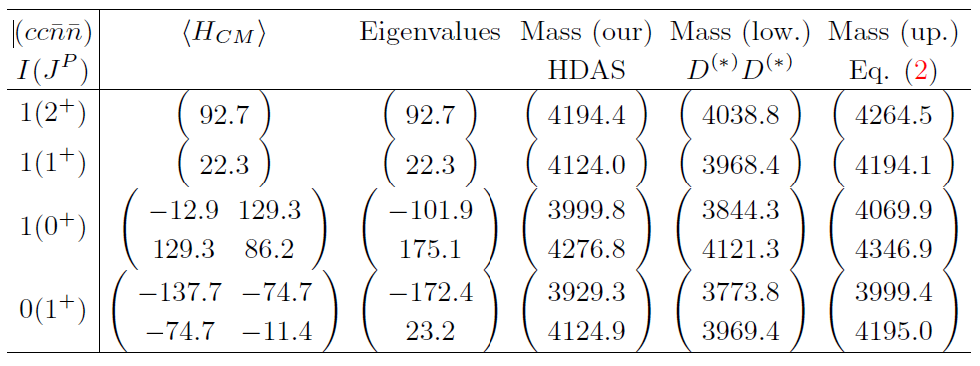

Bases and Spectra
Wave bases
CMI matrices and mass spectra
Result of $T_{cc\overline{n}\overline{n}}$
The superscript stand for spin, and subscript for color.
7

Slide 8
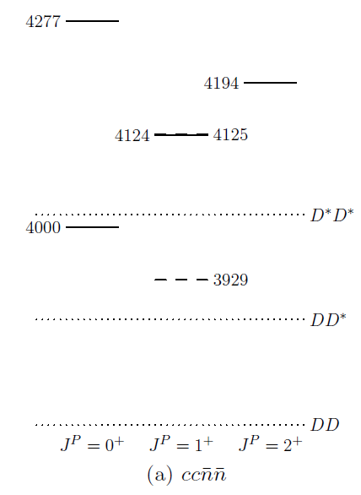
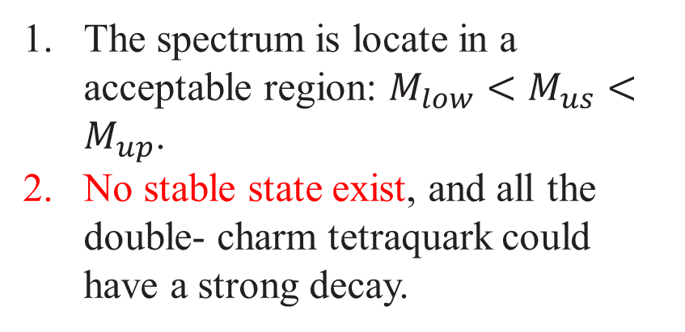
Spectra
Result
The spectrum is locate in a acceptable region: $M_{low}<M_{us}<M_{up}$.
No stable state exist, and all the double- charm tetraquark could have a strong decay.
Solid/dashed for isovector/isoscalar
8

Slide 9
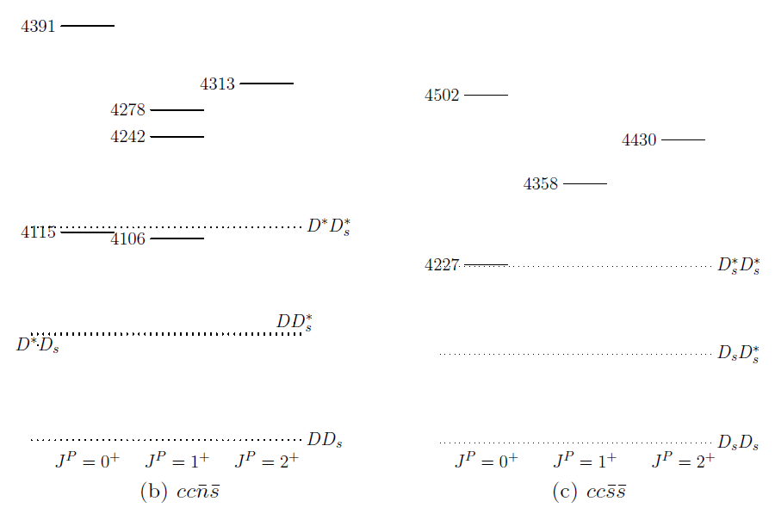
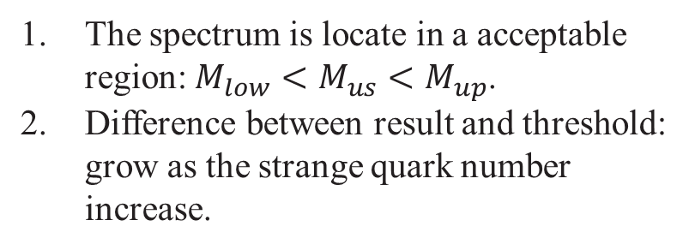
Strange- double- charm tetraquark
Numerical value
The spectrum is locate in a acceptable region: $M_{low}<M_{us}<M_{up}$.
Difference between result and threshold: grow as the strange quark number increase.
No stable state in strange- double- charm tetraquark!
9

Slide 10
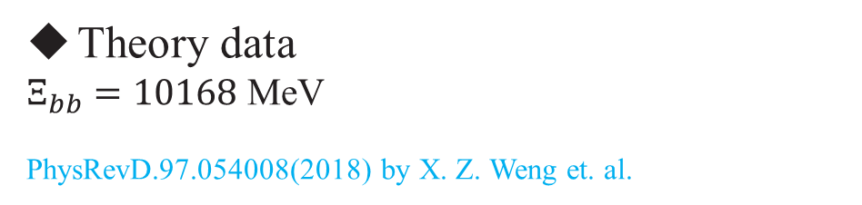
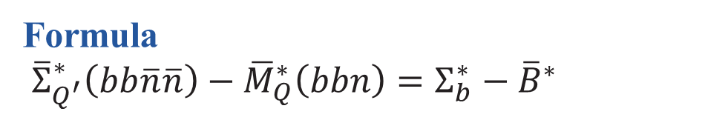
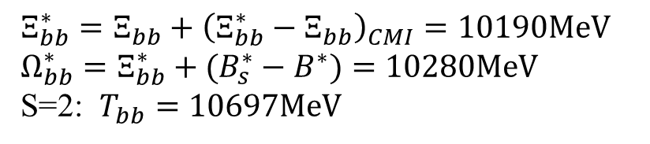

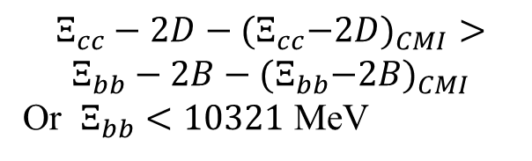
Double- bottom tetraquark
Formula
${\overline{Σ}}_{Q^{′}}^{∗}\left(bb\overline{n}\overline{n}\right)−{\overline{M}}_{Q}^{∗}\left(bbn\right)=Σ_{b}^{∗}−{\overline{B}}^{∗}$
Theory data
$Ξ_{bb}=10168$ MeV
PhysRevD.97.054008(2018) by X. Z. Weng et. al.
Feagure
Advantage: heavy enough
Disadvantage: no data in experiment.
$$⇒$$
$Ξ_{bb}^{∗}=Ξ_{bb}+{\left(Ξ_{bb}^{∗}−Ξ_{bb}\right)}_{CMI}=10190MeV$
$Ω_{bb}^{∗}=Ξ_{bb}^{∗}+(B_{s}^{∗}−B^{∗})=10280MeV$
S=2: $T_{bb}=10697MeV$
Theoretical limit
$$Ξ_{cc}−2D−{(Ξ}_{cc}−2D)_{CMI}>$$
$$Ξ_{bb}−2B−{(Ξ}_{bb}−2B)_{CMI}$$
Or $Ξ_{bb}<10321$ MeV
From Coulomb potential
10

Slide 11
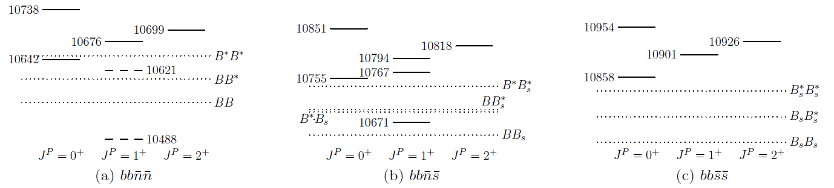
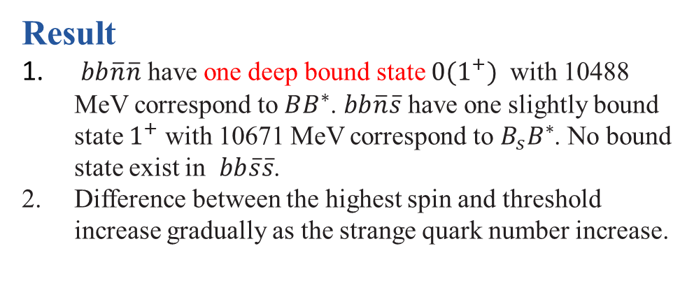
Double- bottom spectra
Shallowly bound
No bound
Result
$bb\overline{n}\overline{n}$ have one deep bound state $0(1^{+})$ with 10488 MeV correspond to $BB^{∗}$. $bb\overline{n}\overline{s}$ have one slightly bound state $1^{+}$ with 10671 MeV correspond to $B_{s}B^{∗}$. No bound state exist in $bb\overline{s}\overline{s}$.
Difference between the highest spin and threshold increase gradually as the strange quark number increase.
Isoscalar: Deeply bound
11

Slide 12
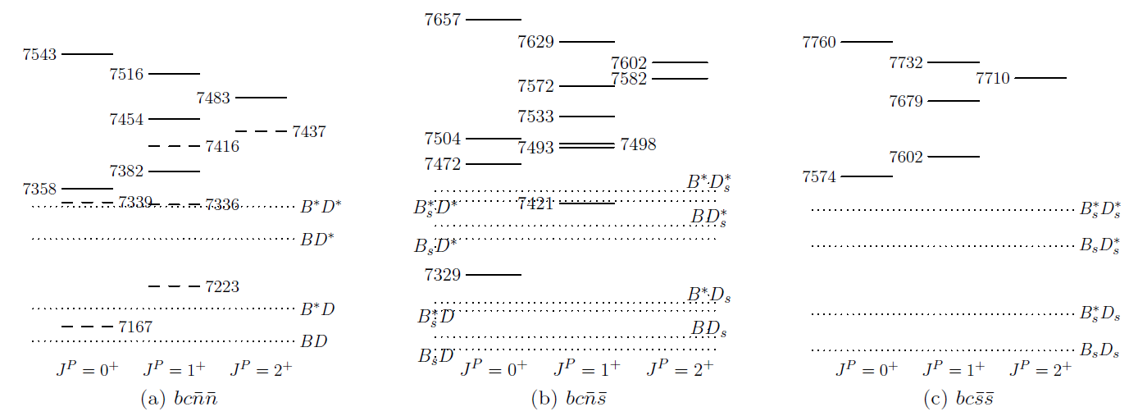
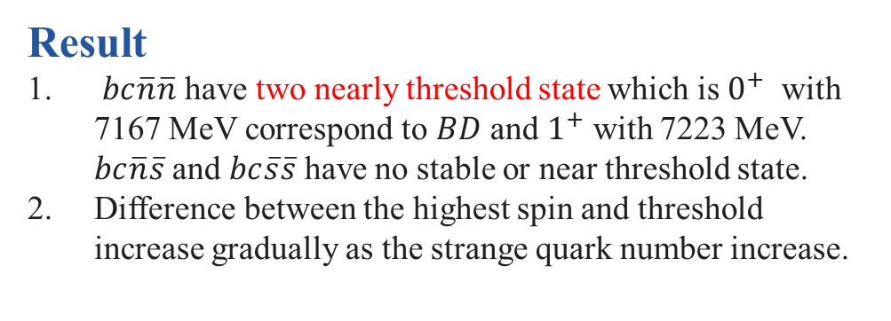
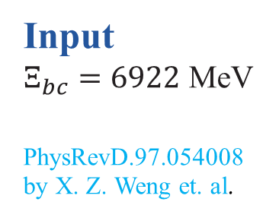
Bottom-Charm tetraquark
Input
$Ξ_{bc}=6922$ MeV
PhysRevD.97.054008 by X. Z. Weng et. al.
No bound state
Result
$bc\overline{n}\overline{n}$ have two nearly threshold state which is $0^{+}$ with 7167 MeV correspond to $BD$ and $1^{+}$ with 7223 MeV. $bc\overline{n}\overline{s}$ and $bc\overline{s}\overline{s}$ have no stable or near threshold state.
Difference between the highest spin and threshold increase gradually as the strange quark number increase.
Two near threshold state
12

Slide 13
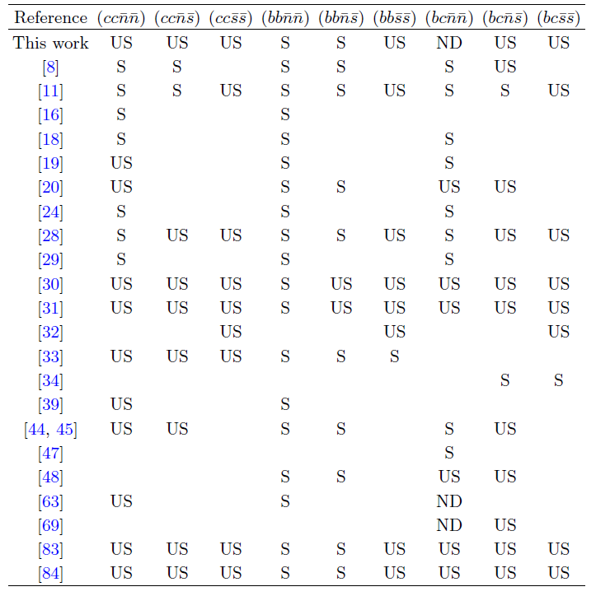
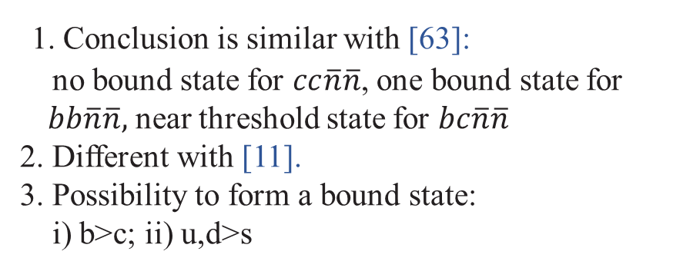
Discussion
Comparison
S, US, ND stand for stable, unstable, not determined
1. Conclusion is similar with [63]:
no bound state for $cc\overline{n}\overline{n}$, one bound state for $bb\overline{n}\overline{n},$ near threshold state for $bc\overline{n}\overline{n}$
2. Different with [11].
3. Possibility to form a bound state:
i) b>c; ii) u,d>s
[11]: Luo et.al., Eur. Phys. J. C 77, 709 (2017)
[19]: Karliner et.al., Phys. Rev. Lett. 119, 202001 (2017)
[63]: Carlson et.al., Phys. Rev. D. 37, 744 (1988)
13

Slide 14
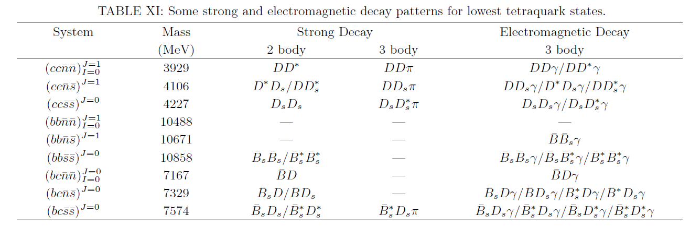
Discussion
Some decay mode for lowest state
Stable
14

Slide 15
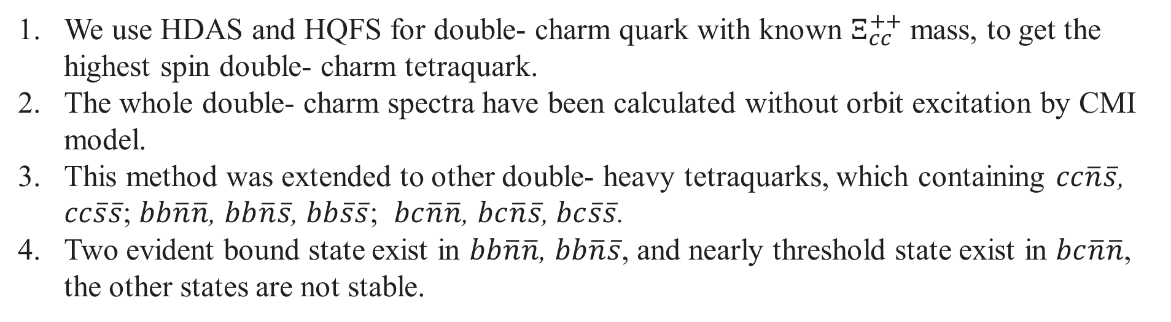
Summary
We use HDAS and HQFS for double- charm quark with known $Ξ_{cc}^{++}$ mass, to get the highest spin double- charm tetraquark.
The whole double- charm spectra have been calculated without orbit excitation by CMI model.
This method was extended to other double- heavy tetraquarks, which containing $cc\overline{n}\overline{s}$, $cc\overline{s}\overline{s}$; $bb\overline{n}\overline{n}$, $bb\overline{n}\overline{s}$, $bb\overline{s}\overline{s}$; $bc\overline{n}\overline{n}$, $bc\overline{n}\overline{s}$, $bc\overline{s}\overline{s}$.
Two evident bound state exist in $bb\overline{n}\overline{n}$, $bb\overline{n}\overline{s}$, and nearly threshold state exist in $bc\overline{n}\overline{n}$, the other states are not stable.
15

Slide 16
Thanks!

