Slide 1







Heavy Meson Structure on the Light-front
$$†$$
$$†$$
$$†$$
$$†$$
Xingbo Zhao , Jiatong Wu, Hengfei Zhao, Kaiyu Fu
Jiangshan Lan, Chandan Mondal, Siqi Xu,
Yang Li, Pieter Maris, James P. Vary
Institute of Modern Physics, CAS, Lanzhou, China
‡University of Chinese Academy of Sciences, China
Iowa State University, Ames, US
$$†$$
$$†$$
$$†$$
‡
*
*
$$†$$
*
第五届强子物理会议 2021年1月21日

Slide 2
Outline
Basis Light-front Quantization approach
Application to heavy mesons
  Gluon content
Summary

Slide 3
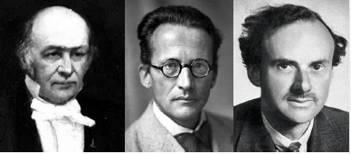



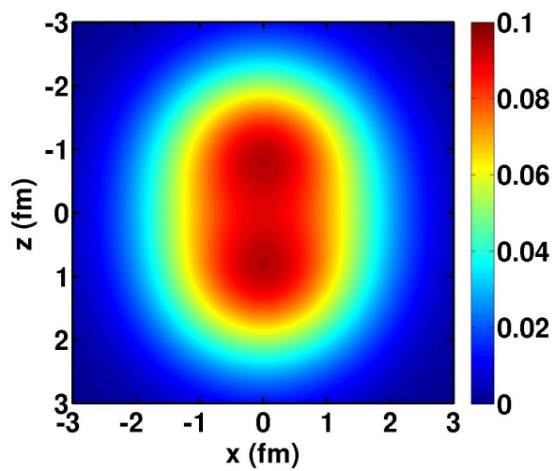
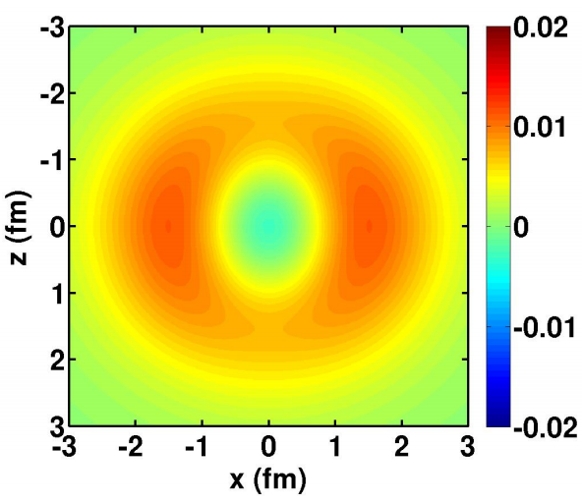

Hamiltonian Formalism
Schrödinger equation universally describes different physics：
$$H|ψ〉=E|ψ〉$$
atom
nucleus
hadron
Nonrelativistic, few-body
Nonrelativistic, many-body
Relativistic, many-body
Wave functions encode full information of the system
Proton density
Neutron – proton density
3

Slide 4
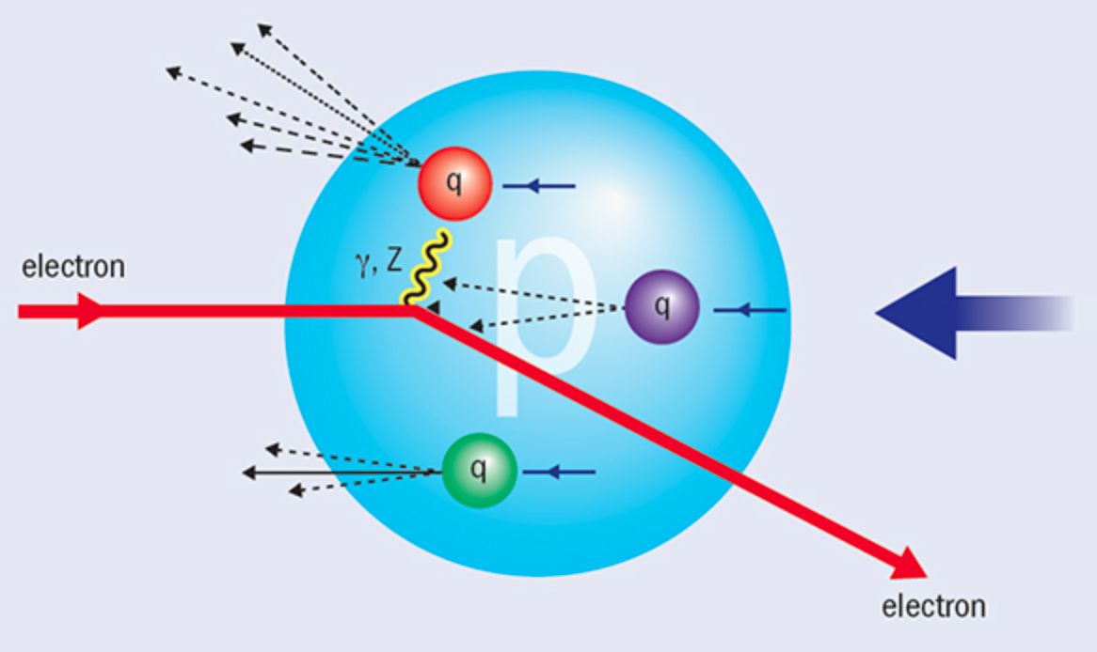

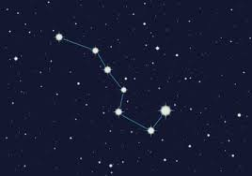

Light-front Time
Hadron structure is measured by (virtual) photon
We "see” the world at fixed light-front time ($t=x^{0}$ + $x^{3}$)

Slide 5



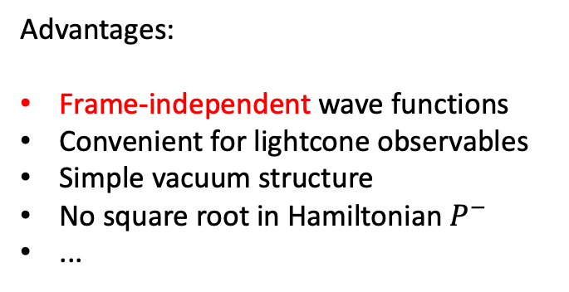

Light-front Quantization
[Dirac, 1949]
Equal time quantization
Light-front quantization
Not just a coordinate transformation
Different quantization surface
Profound consequences?
$$x^{1},x^{2},x^{3}$$
$${x^{−}=x}^{0}−x^{3},$$
$$x^{⊥}=x^{1,2}$$
Advantages:
Frame-independent wave functions
Convenient for lightcone observables
Simple vacuum structure
No square root in Hamiltonian $P^{−}$
...
$$P^{0},\overset{⃑}{P}$$
$${P^{−}=P}^{0}−P^{3},$$
${P^{+}=P}^{0}+P^{3}$,$P^{⊥}=P^{1,2}$
Notes:
Light front was first proposed by Dirac, at 1949.
1. First, what is light-front. Different from equal time theory. We define light-front time as a linear combination of the regular time and one of the spatial coordinate, usually we choose z direction.
So our field quantized at this equal light-front time plane. Where in equal time quantization, they quantized at this equal time plane.
X minus is longitudinal coordinate. P minus is light front Hamiltonian. P plus is longitudinal momentum.
This is light front version of schordinger equation.
Please note that it is not just a coodernate transformation, it is a new theory in a different quantization.
Why go to light front? For we can get Frame Independent wavefunction. Which encods all the information of the bound state structure. It has simple vacuum structure. The theory is boost invariant. And there is no square root in Hamiltonian p minus.

Slide 6
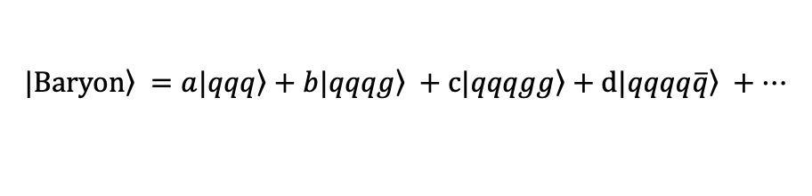
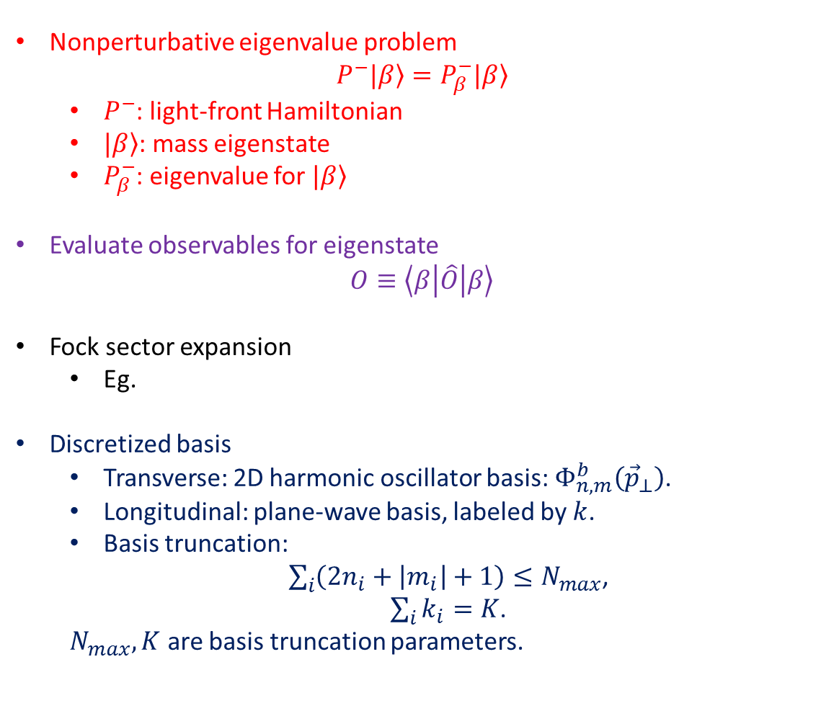
Basis Light-front Quantization
[Vary et al, 2008]
Nonperturbative eigenvalue problem
$$P^{−}|\left.β\right\rangle =P_{β}^{−}|\left.β\right\rangle$$
  $P^{−}$: light-front Hamiltonian
  $|\left.β\right\rangle$: mass eigenstate
  $P_{β}^{−}$: eigenvalue for $|\left.β\right\rangle$
Evaluate observables for eigenstate
$$O≡\left\langle β | \hat{O} | β\right\rangle$$
Fock sector expansion
  Eg.
Discretized basis
  Transverse: 2D harmonic oscillator basis:${ Φ}_{n,m}^{b}\left({\vec{p}}_{⊥}\right)$.
  Longitudinal: plane-wave basis, labeled by $k$.
  Basis truncation:
  $\sum_{i}{\left(2n_{i}+\left|m_{i}\right|+1\right)}≤N_{max}$,
  $\sum_{i}{k_{i}}=K$.
  $N_{max}, K$ are basis truncation parameters.
$$\left.|Baryon\right\rangle =a\left.|qqq\right\rangle +b\left.|qqqg\right\rangle +c\left.|qqqgg\right\rangle +d\left.|qqqq\overline{q}\right\rangle +…$$
  $$\left|Meson\right\rangle =a\left|q\overline{q}\right\rangle +b\left|q\overline{q}g\right\rangle +c\left|q\overline{q}q\overline{q}\right\rangle +…$$
Large $N_{max}$ and $K$ : High UV cutoff & low IR cutoff
Notes:
1.

Slide 7
Talks on Light-front Approach
Monday, 25 January | Chair 赵行波 Zoom ID: 65131192396 password：187136
08:50-09:10 | Relativistic description of heavy hadrons in QCD using renormalization group procedure for effective particles and basis light-front Quantization | Kamil Serafin
09:10-09:25 | Transverse structure of electron and proton in momentum space from basis light-front quantization | Chandan Mondal
09:25-09:40 | Mechanical properties of proton within light-front quark-diquark model in AdS/QCD | Sreeraj Nair
 | Chair 何军 Zoom ID: 64134095791 password：371694
11:05-11:20 | The structure of the baryon in basis light-front quantization | 徐思琦
 | Chair 刘伯超 Zoom ID: 65131192396 password：187136
11:20-11:35 | Light meson structure from basis Light-front quantization | 蓝江山

Slide 8


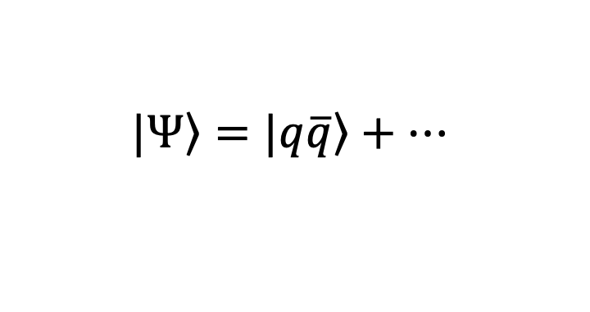
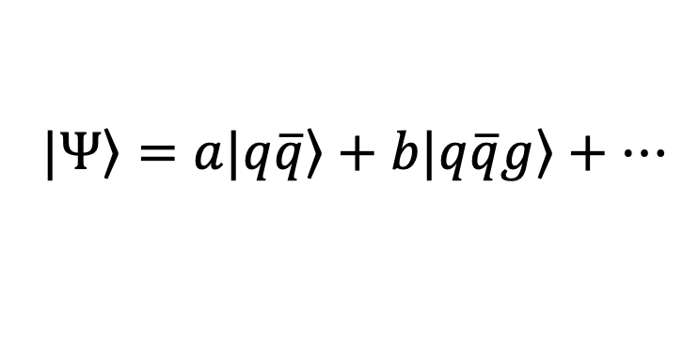
Progress in Heavy Meson: Including One Dynamical Gluon
$$\left.|Ψ\right\rangle =\left.|q\overline{q}\right\rangle +…$$
[Yang Li, et al, 2017]
$$\left.|Ψ\right\rangle =a\left.|q\overline{q}\right\rangle +b\left.|q\overline{q}g\right\rangle +…$$
[Hengfei, et al, in preparation]

Slide 9
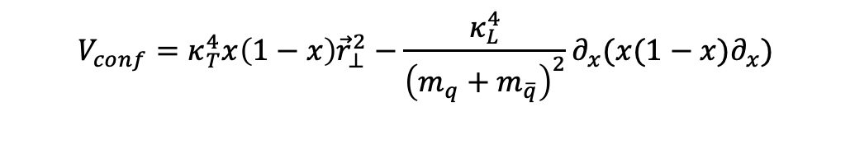

Heavy Quarkonium
Heavy meson in progress
Light-front QCD Hamiltonian + effective confining potential:
$$P_{eff}^{−}=P_{LFQCD}^{−}+V_{conf}$$
Confining potential:
Long-distance
$$V_{conf}=κ_{T}^{4}x\left(1−x\right){\vec{r}}_{⊥}^{2}−\frac{κ_{L}^{4}}{{\left(m_{q}+m_{\overline{q}}\right)}^{2}}∂_{x}(x(1−x)∂_{x})$$
Inspired by light-front holographic QCD
Longitudinal confinement
[Brodsky, et al, 2015]
[Yang Li, et al, 2017]

Slide 10
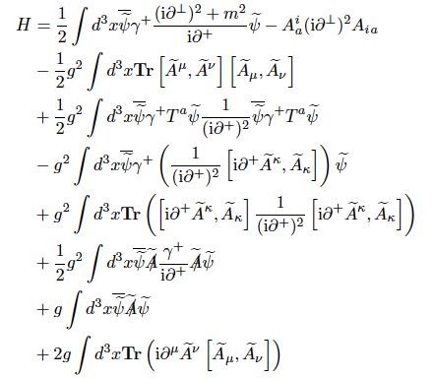

Light-front QCD Hamiltonian
$$P_{LFQCD}^{−}$$

Slide 11
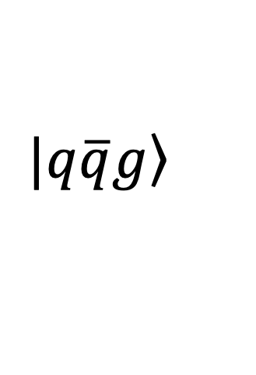
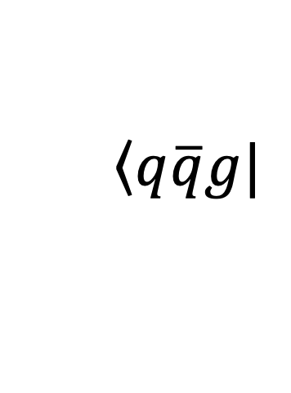
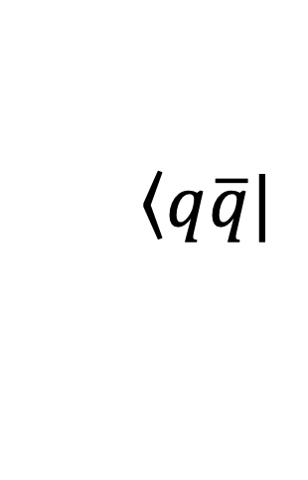

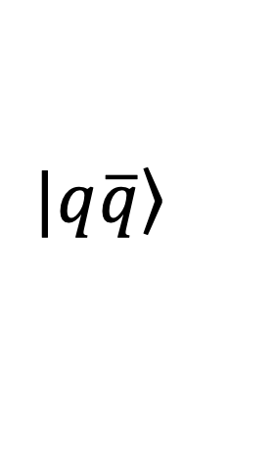
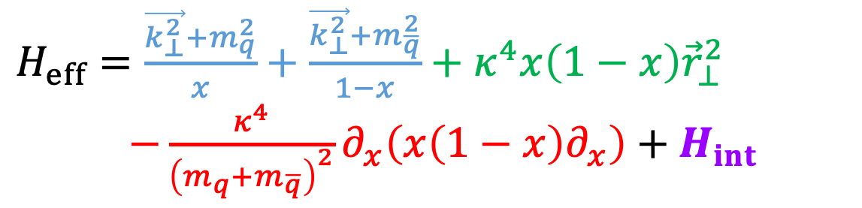
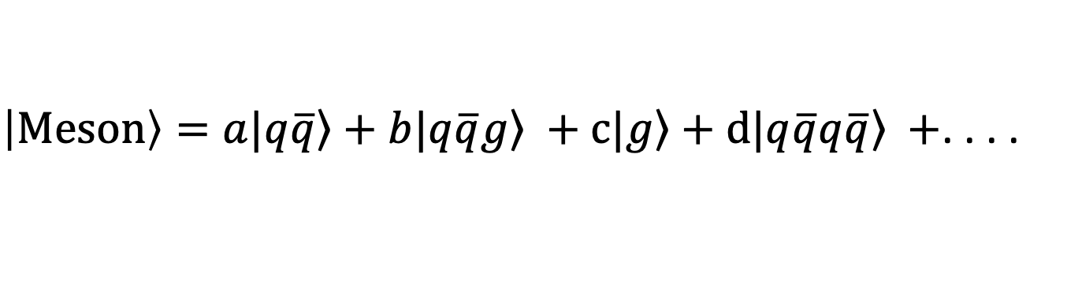
Heavy meson in progress
Interaction Part of Hamiltonian
$\left|Meson\right\rangle =a\left.|q\overline{q}\right\rangle +b\left.|q\overline{q}g\right\rangle +c\left.|g\right\rangle +d\left.|q\overline{q}q\overline{q}\right\rangle +$. . . .
$H_{eff}=\frac{\vec{k_{⊥}^{2}}+m_{q}^{2}}{x}+\frac{\vec{k_{⊥}^{2}}+m_{\overline{q}}^{2}}{1−x}+κ^{4}x\left(1−x\right){\vec{r}}_{⊥}^{2}$
$−\frac{κ^{4}}{{\left(m_{q}+m_{\overline{q}}\right)}^{2}}∂_{x}\left(x\left(1−x\right)∂_{x}\right)+H_{int}$
dynamic gluon
 |  | 0
$$H_{int}$$
$$\left.|q\overline{q}\right\rangle$$
$$\left.|q\overline{q}g\right\rangle$$
$$\left\langle q\overline{q}|\right.$$
$$\left\langle q\overline{q}g|\right.$$

Slide 12
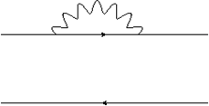
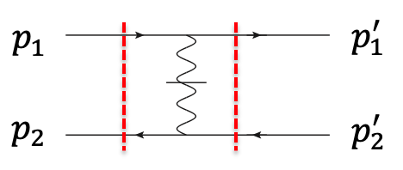
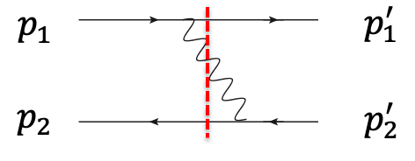
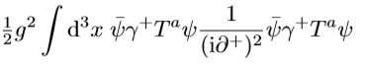
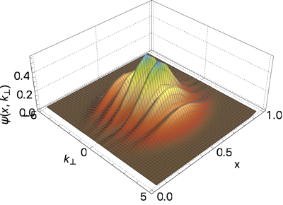









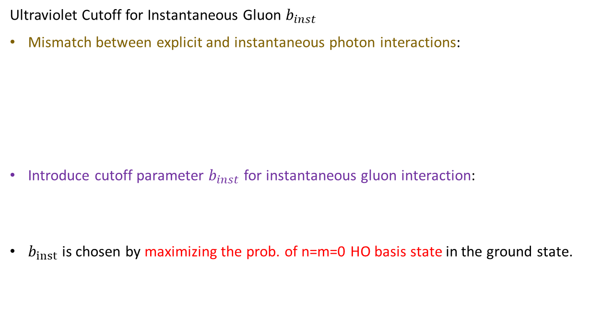
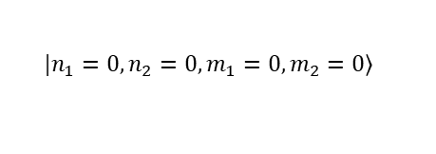
Heavy meson in progress
Renormalization
Mass Renormalization
Mass renormalization is performed on the level single physical quark
Mass counterterm is determined by fitting single quark mass
Plug the physical quark and anti-quark into the quarkonium.
$$p_{1}{(p}_{2})$$
$$p_{1}^{′}(p_{2}^{′})$$
$$p_{2}{(p}_{1})$$
$$p_{2}^{′}(p_{1}^{′})$$
Ultraviolet Cutoff for Instantaneous Gluon $b_{inst}$
Mismatch between explicit and instantaneous photon interactions:
Introduce cutoff parameter $b_{inst}$ for instantaneous gluon interaction:
$b_{inst}$ is chosen by maximizing the prob. of n=m=0 HO basis state in the ground state.
for instantaneous gluon:
$p_{rel}=p_{1}−p_{2}$ not limited
for explicit gluon:
$p_{rel}=p_{1}−p_{2}$subject to $N_{max}$ truncation
$$V_{inst}≡$$
$$V_{inst}×exp\left(−\frac{p_{⊥}^{2}}{b_{inst}^{2}}\right)$$
Since without $b_{inst}$
$$\left.|n_{1}=0, n_{2}=0, m_{1}=0,m_{2}=0\right\rangle$$
[Kaiyu Fu et al, in preparation]

Slide 13
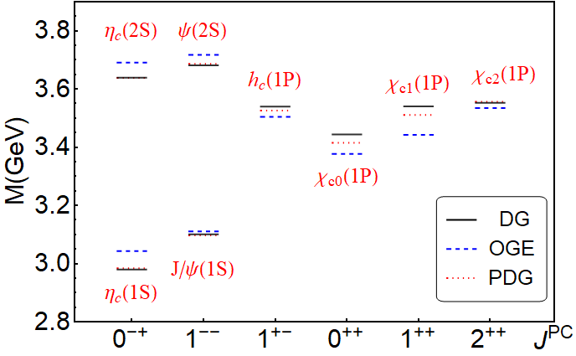
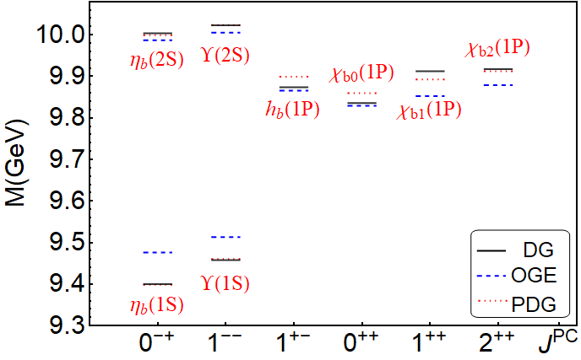
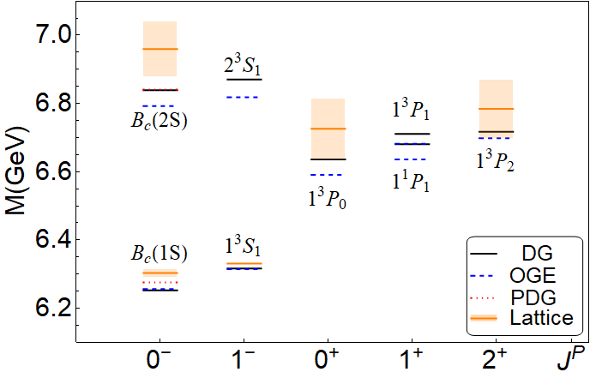



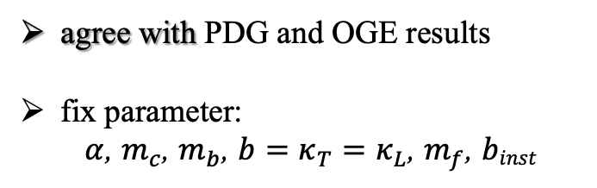

Heavy meson in progress
Mass spectrum
Charmonium
Bottomonium
$B_{c}$meson
agree with PDG and OGE results
fix parameter:
$α$, $m_{c}$, $m_{b}$, $b=κ_{T}=κ_{L}$, $m_{f}$, $binst$
OGE($c\overline{c} and b\overline{b}$) : [Yang Li, et al, 2017]
OGE($b\overline{c}$) : [Shuo Tang, et al, 2018]
[Hengfei Zhao et al, in preparation]
This Work: $N_{max}=10,K_{max}=11,M_{J}=0$

Slide 14
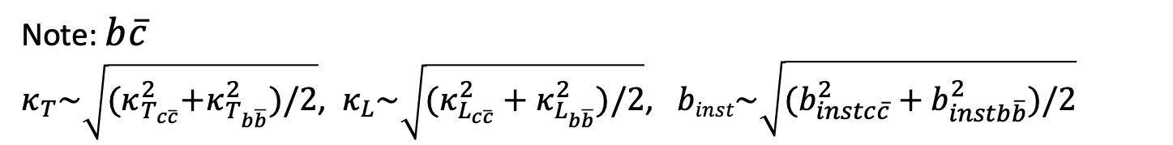
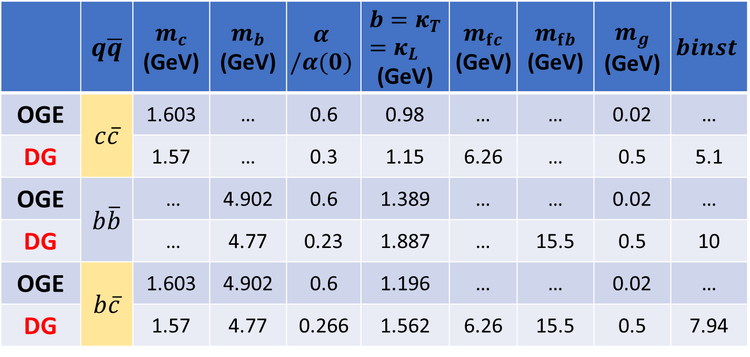

Heavy meson in progress
Parameters
 | $$q\overline{q}$$ | $$m_{c}$$ (GeV) | $$m_{b}$$ (GeV) | $$α$$ $$/α(0)$$ | $${b=κ}_{T}=κ_{L}$$ (GeV) | $$m_{fc}$$ (GeV) | $$m_{fb}$$ (GeV) | $$m_{g}$$ (GeV) | $$binst$$
OGE | $$c\overline{c}$$ | 1.603 | … | 0.6 | 0.98 | … | … | 0.02 | …
DG |  | 1.57 | … | 0.3 | 1.15 | 6.26 | … | 0.5 | 5.1
OGE | $$b\overline{b}$$ | … | 4.902 | 0.6 | 1.389 | … | … | 0.02 | …
DG |  | … | 4.77 | 0.23 | 1.887 | … | 15.5 | 0.5 | 10
OGE | $$b\overline{c}$$ | 1.603 | 4.902 | 0.6 | 1.196 | … | … | 0.02 | …
DG |  | 1.57 | 4.77 | 0.266 | 1.562 | 6.26 | 15.5 | 0.5 | 7.94
Note: $b\overline{c}$
$κ_{T}\sim \sqrt{{(κ}_{T_{c\overline{c}}}^{2}+κ_{T_{b\overline{b}}}^{2})/2}$, $κ_{L}\sim \sqrt{(κ_{L_{c\overline{c}}}^{2}+κ_{L_{b\overline{b}}}^{2})/2}$, $binst\sim \sqrt{(b_{instc\overline{c}}^{2}+b_{instb\overline{b}}^{2})/2}$
This Work: $N_{max}=10,K_{max}=11,M_{J}=0$
[Hengfei Zhao et al, in preparation]

Slide 15
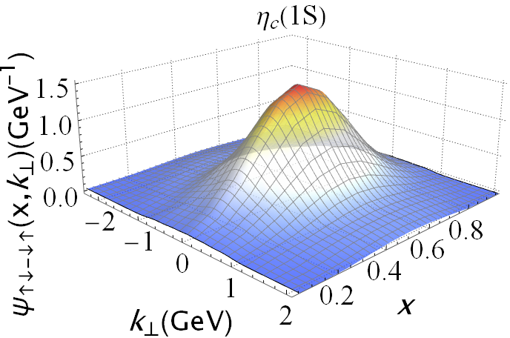
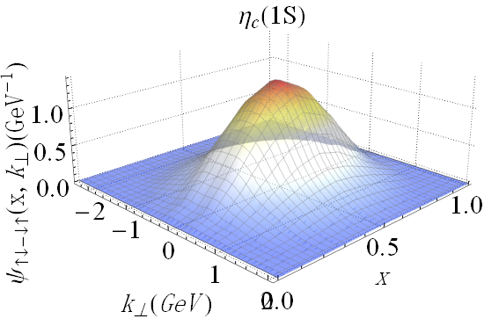

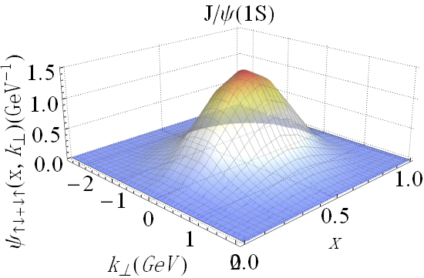

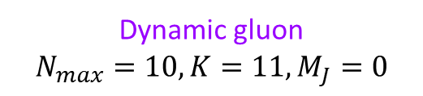


Heavy meson in progress
Wave function
Dynamic gluon
$$N_{max}=10, K=11, M_{J}=0$$
The effective one-gluon-exchange
$$N_{max}=8, L=8, M_{J}=0$$
${norm}_{q\overline{q}}$=0.717
${norm}_{q\overline{q}}$=0.724
Charmonium
[Hengfei Zhao et al, in preparation]
[Yang Li, et al, 2017]

Slide 16
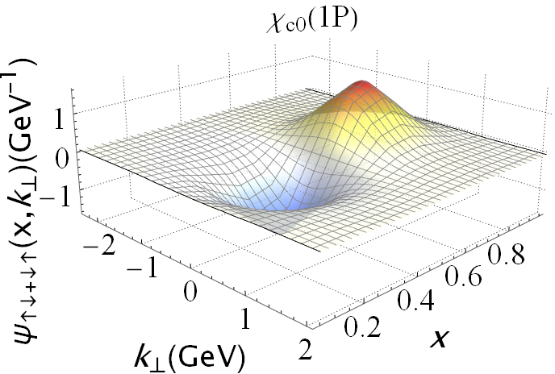
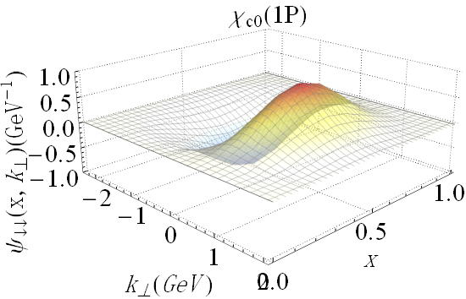
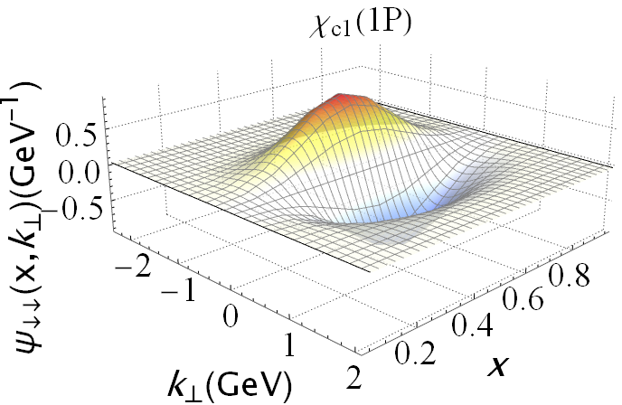
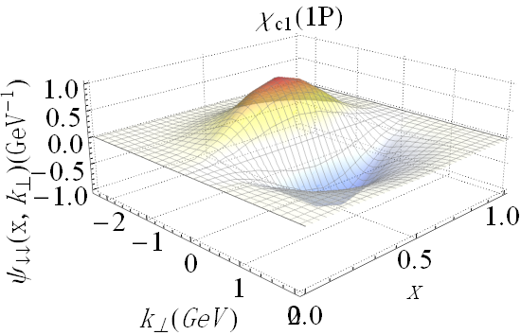


Heavy meson in progress
Wave function
Dynamic gluon
$$N_{max}=10, K=11, M_{J}=0$$
The effective one-gluon-exchange
$$N_{max}=8, L=8, M_{J}=0$$
${norm}_{q\overline{q}}$=0.613
${norm}_{q\overline{q}}$=0.599
Charmonium
[Hengfei Zhao et al, in preparation]
[Yang Li, et al, 2017]

Slide 17
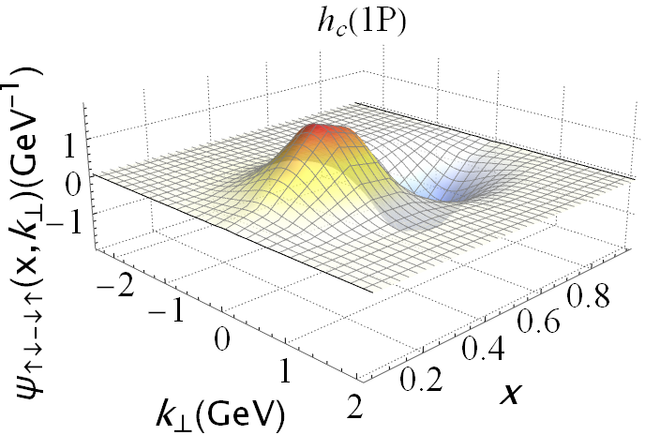
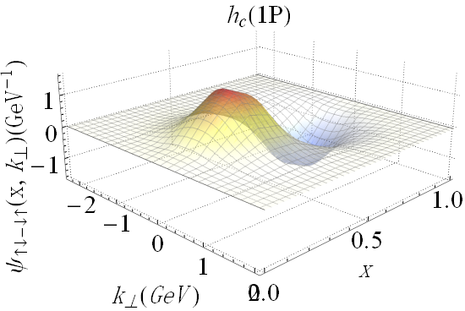

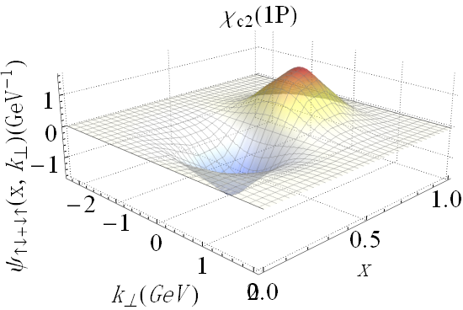

Heavy meson in progress
Wave function
Dynamic gluon
$$N_{max}=10, K=11, M_{J}=0$$
The effective one-gluon-exchange
$$N_{max}=8, L=8, M_{J}=0$$
${norm}_{q\overline{q}}$=0.617
${norm}_{q\overline{q}}$=0.599
Charmonium
[Hengfei Zhao et al, in preparation]
[Yang Li, et al, 2017]

Slide 18
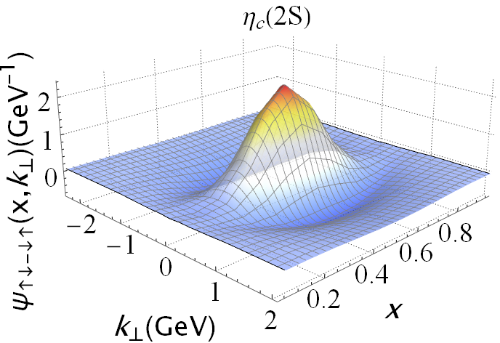
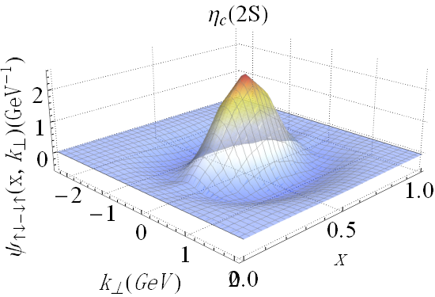
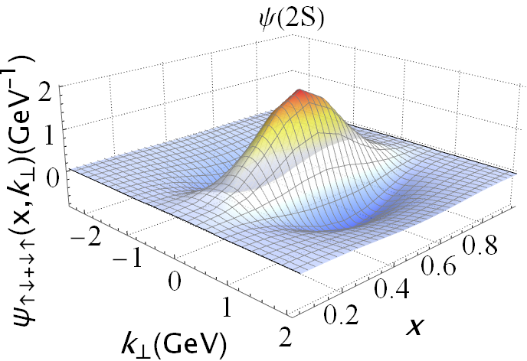



Heavy meson in progress
Wave function
Dynamic gluon
$$N_{max}=10, K=11, M_{J}=0$$
The effective one-gluon-exchange
$$N_{max}=8, L=8, M_{J}=0$$
${norm}_{q\overline{q}}$=0.574
${norm}_{q\overline{q}}$=0.610
Charmonium
[Hengfei Zhao et al, in preparation]
[Yang Li, et al, 2017]

Slide 19
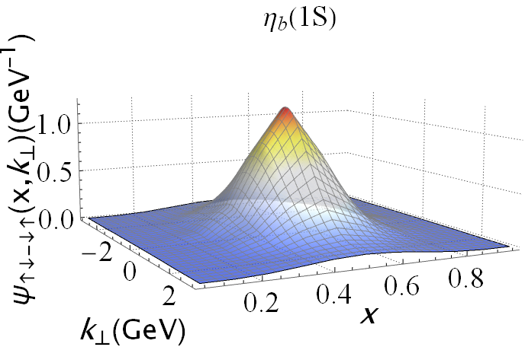
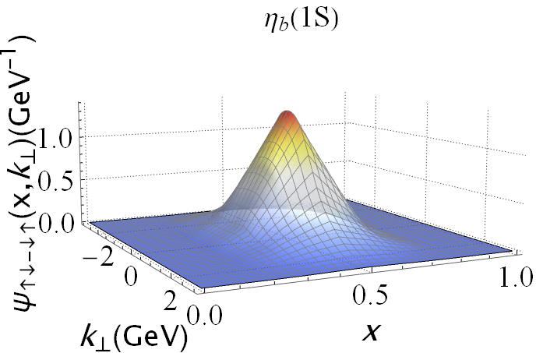
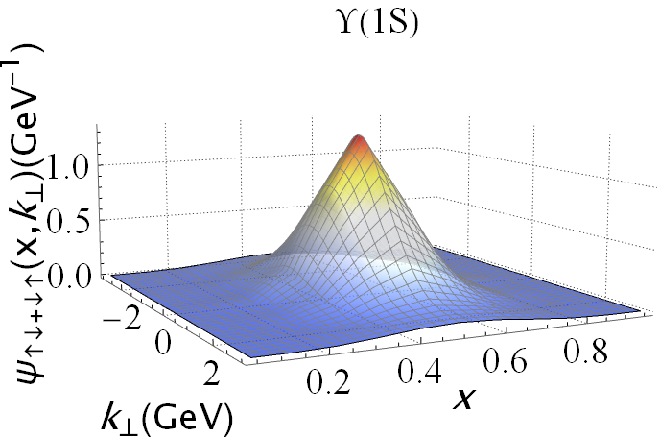



Heavy meson in progress
Wave function
Dynamic gluon
$$N_{max}=10, K=11, M_{J}=0$$
The effective one-gluon-exchange
$$N_{max}=8, L=8, M_{J}=0$$
${norm}_{q\overline{q}}$=0.846
${norm}_{q\overline{q}}$=0.855
Bottomonium
[Hengfei Zhao et al, in preparation]
[Yang Li, et al, 2017]

Slide 20
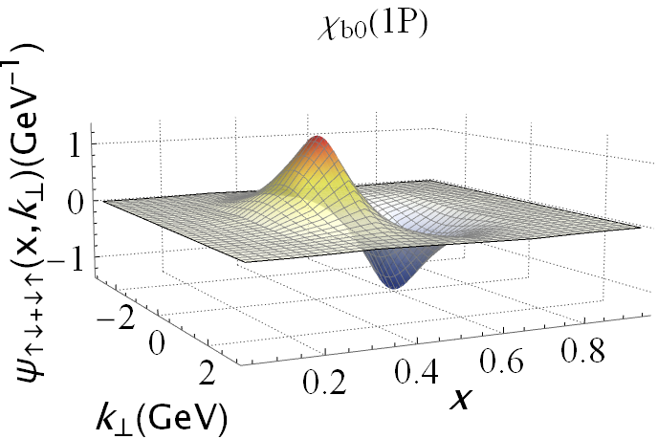





Heavy meson in progress
Wave function
Dynamic gluon
$$N_{max}=10, K=11, M_{J}=0$$
The effective one-gluon-exchange
$$N_{max}=8, L=8, M_{J}=0$$
${norm}_{q\overline{q}}$=0.775
${norm}_{q\overline{q}}$=0.783
Bottomonium
[Hengfei Zhao et al, in preparation]
[Yang Li, et al, 2017]

Slide 21






Heavy meson in progress
Wave function
Dynamic gluon
$$N_{max}=10, K=11, M_{J}=0$$
The effective one-gluon-exchange
$$N_{max}=8, L=8, M_{J}=0$$
${norm}_{q\overline{q}}$=0.780
${norm}_{q\overline{q}}$=0.785
Bottomonium
[Hengfei Zhao et al, in preparation]
[Yang Li, et al, 2017]

Slide 22






Heavy meson in progress
Wave function
Dynamic gluon
$$N_{max}=10, K=11, M_{J}=0$$
The effective one-gluon-exchange
$$N_{max}=8, L=8, M_{J}=0$$
${norm}_{q\overline{q}}$=0.733
${norm}_{q\overline{q}}$=0.713
Bottomonium
[Hengfei Zhao et al, in preparation]
[Yang Li, et al, 2017]

Slide 23













Heavy meson in progress
Wave function
${norm}_{q\overline{q}}$=0.767
${norm}_{q\overline{q}}$=0.772
${norm}_{q\overline{q}}$=0.690
${norm}_{q\overline{q}}$=0.689
${norm}_{q\overline{q}}$=0.689
${norm}_{q\overline{q}}$=0.661
Preliminary
$B_{c}$meson
Nodal structure in radial direction
[Hengfei Zhao et al, in preparation]

Slide 24







Heavy meson in progress
Decay constants
$$\frac{f_{P,V}}{2\sqrt{2N_{c}}}=\lim_{Λ_{UV}→∞}{Z_{2}(μ,Λ_{UV})\int_{0}^{1}{\frac{dx}{\sqrt{x(1−x)}}\int^{≤μ^{2}}{\frac{d^{2}k_{⊥}}{2{(2π)}^{3}}Ψ_{↑↓∓↓↑}^{λ=0}(x,{\vec{k}}_{⊥})}}}$$
Charmonium
Bottomonium
$B_{c}$meson
agree with PDG and OGE for Charmonium
$N_{max}$, $K_{max}$need increase for $b\overline{b}$, $b\overline{c}$
OGE : [Yang Li, et al, 2017 and Shuo Tang, et al, 2018]
Lattice : [C. McNeile et al, 2012]
Dyson-Schwinger equations : [M. Blank, et al, 2011]
This Work: $N_{max}=10,K_{max}=11,M_{J}=0$
[Hengfei Zhao et al, in preparation]

Slide 25






Heavy meson in progress
Distribution amplitudes
$$\frac{f_{P,V}}{2\sqrt{2N_{c}}}φ_{P,V}(x;μ)=\frac{1}{\sqrt{x(1−x)}}\int^{≤μ^{2}}{\frac{d^{2}k_{⊥}}{2{(2π)}^{3}}Ψ_{↑↓∓↓↑}^{λ=0}(x,{\vec{k}}_{⊥})={\frac{1}{4π}Ψ}_{↑↓∓↓↑}^{λ=0}(x,{\vec{r}=0}_{⊥})}$$
[Lepage ’80]
Bottomonium S-wave
Charmonium S-wave
agree with OGE results
$B_{c}$meson
S-wave
OGE : [Yang Li, et al, 2017 and Shuo Tang, et al, 2018]
This Work: $N_{max}=10,K_{max}=11,M_{J}=0$
[Hengfei Zhao et al, in preparation]

Slide 26






Heavy meson in progress
Heavy meson in progress
PDF
$$Φ^{\left[γ^{+}\right]}\left(x,Q^{2}\right)=\int{\frac{dz^{−}}{8π}} e^{ixP^{+}z^{−}/2}⟨P,Λ\left|\overline{ψ}\left(x\right)γ^{+}ψ\left(0\right)\right|P,Λ⟩$$
PDF in the first fock sector
PDF in the all fock sector
Charmonium
Preliminary
[Hengfei Zhao et al, in preparation]
[Hengfei Zhao et al, in preparation]

Slide 27





Heavy meson in progress
PDF
PDF in the first fock sector
PDF in the all fock sector
Bottomonium
Preliminary
[Hengfei Zhao et al, in preparation]

Slide 28




Heavy meson in progress
GPD
[ physical review D 89]
$$H\left(x_{i},ξ=0,t=−{{\vec{Δ}}^{2}}_{⊥}\right)∼∫dk_{⊥}ψ_{n}^{↑∗}\left(x_{i},k_{⊥_{i}}^{′},λ_{i}\right)ψ_{n}^{↑}(x_{i},k_{⊥_{i}},λ_{i})$$
Bottomonium
Charmonium
[Hengfei Zhao et al, in preparation]

Slide 29






Heavy meson in progress
Form Factor and Radii
Lattice : [Dudeck ‘06]
[Yang Li, FBS ‘17]
[ Brodsky ’06]
Dyson-Schwinger equations : [Mari ‘07]
$$F\left(Q^{2}\right)=\sum_{i}{∫dx_{i}H(x_{i},0,Q^{2}) }$$
$$<r_{c}^{2}> =−6\frac{∂}{∂Q^{2}}F_{ch} (Q^{2})$$
Charmonium FF
Charmonium
Bottomonium FF
Bottomonium
[Hengfei Zhao et al, in preparation]

Slide 30
Conclusions
Hamiltonian approach to relativistic bound states
Many-body wave functions available (momentum, spin, color...)
Straightforward to calculate lightcone observables
Consistency between mass spectrum and hadron structure
Systematically expandable by including higher Fock sectors
Thank you!
Postdoc positions:
https://inspirehep.net/jobs/1839309

