Slide 1
Plan for CEPC Software Development in 2020
Weidong Li and Shengsen Sun
representing CEPC Software Group December 25th, 2019

Slide 2
Software Environment
Requirements from ACTS:
gcc (>= 6.2), cmake (>=3.7), boost (>=1.62), ROOT (>=6.10)
Requirements from TensorFlow and multi-threaded Gaudi
TensorFlow: gcc >= 8
Gaudi v32.0: gcc >=7
Plan to move from LCG_94 to LCG_96b
 | Current | Update
LCG | LCG_94 | LCG_96b (latest)
gcc | 6.2.0 | 8.3.0
binutils | 2.28 | 2.30
cmake | 3.8.1 | 3.8.1
Boost | 1.66.0 | 1.77.0
ROOT | 6.14.04 | 6.18.04
Gaudi | v29r2 | 32.0

Slide 3
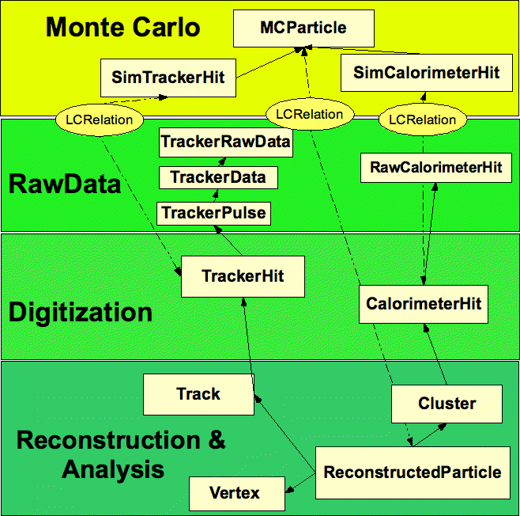
Association Relationships in EDM
Association
TrackerHit
SimTrackerHit
CalorimeterHit
SimCalorimeterHit
ReconstructedParticle
MCParticle
Aggregation
A subtype of association relationship
In our case, upstream objects can access their own downstream objects: ReconstructedParticle → Track → TrackerHit → TrackerPulse

Slide 4
Plan for Event Navigation
Requirements to Event Navigation
Needed by digitization algorithms and tracking algorithms for performance evaluation particularly in the development stage
Problems with PLCIO
Object IDs are used in Association and Aggregation
Not straightforward to retrieve an object with its Object ID
Plan
Develop helper classes or Gaudi services to facilitate event navigation between
TrackerHit and SimTrackerHit
CalorimeterHit and SimCalorimeterHit
ReconstructedParticle and MCParticle

Slide 5
Porting tracking algorithm
Tracking process (Marlin)
SiliconTracking process
SiliconTracking_MarlinTrk is chosen as the first migrated reconstruction, since it has less dependency and the tracking for silicon detector is more simple than TPC.
SiliconTracking for vertex detector (pixel VXD) only (without strip SIT) is most simple option.

Slide 6
Plans for tracking algorithms
Migration algorithms from Marlin to CEPCSW and Validation
Tracker
Full Silicon Fu Chengdong
TPC Zhang Yao / Zhao Mingrui
PFA
Arbor Ruan Manqi, ...
Pandora Guo Fangyi, Li Gang, …
Jet / Flavor Li Gang, …
Validation: Time consumption, manpower, computing resource…
ACTS: A Common Tracking Software
Benefit from software upgrade projects for international experiments
Long term using ACTS as CECP tracking (track finding)
FATRAS: an option of tracker fast simulation tool for CEPC

Slide 7
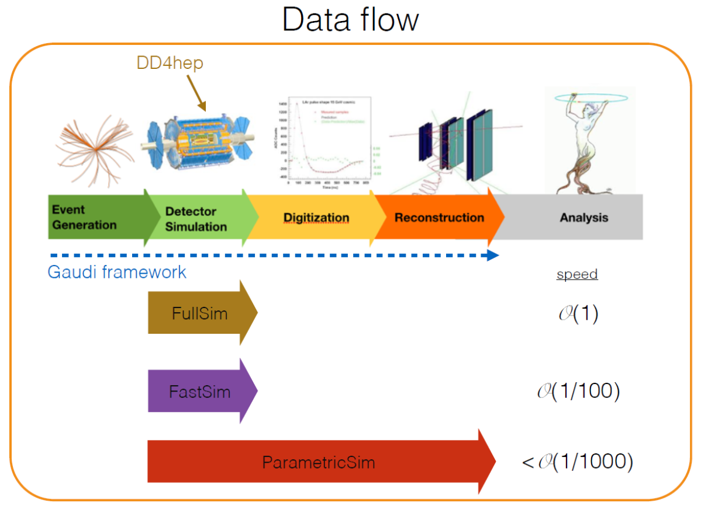
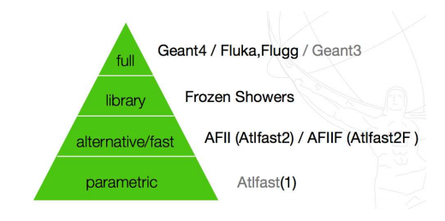
Fast Simulation
Three types of simulation
Full simulation (Geant4) O(1)
Fast simulation O(1/100)
Parametric simulation O(1/1000)
Plan to develop a coherent simulation framework
Allow mixing of full and fast simulations
when a particle enters a certain detector region, user-defined simulation tool will be used.
Fast simulation tool development plan
Tracker: hit level fast simulation
Calorimeter: frozen showers, GAN
ATLAS ISF (Integrated Simulation Framework)

Slide 8
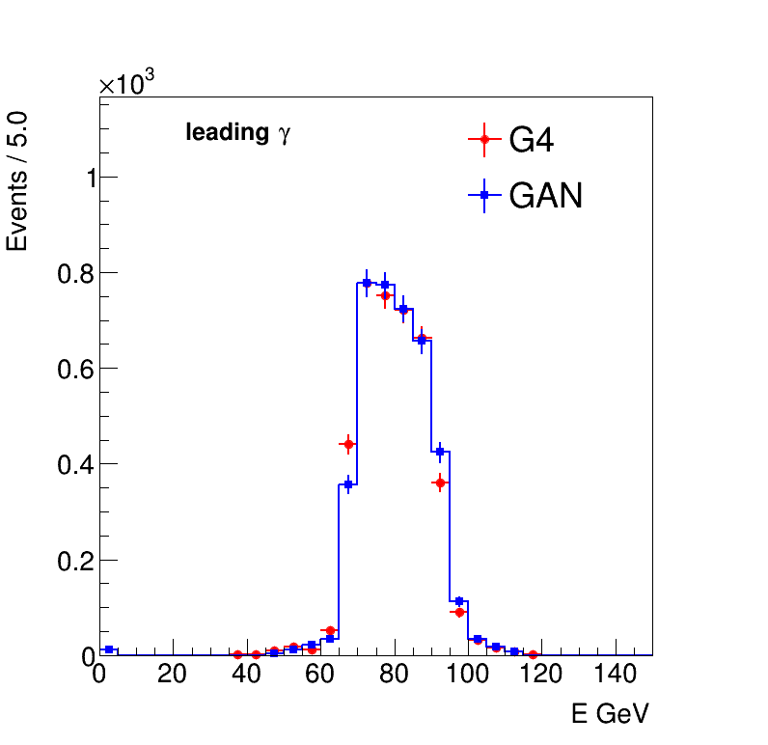
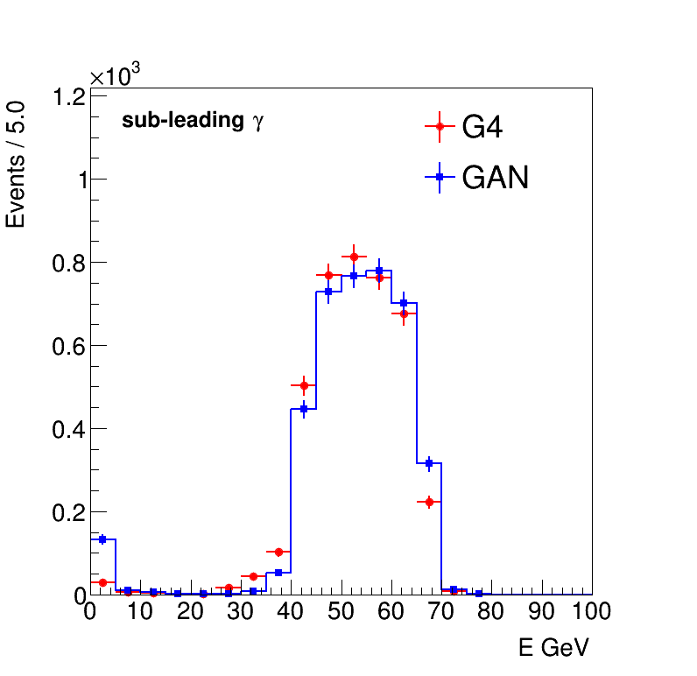
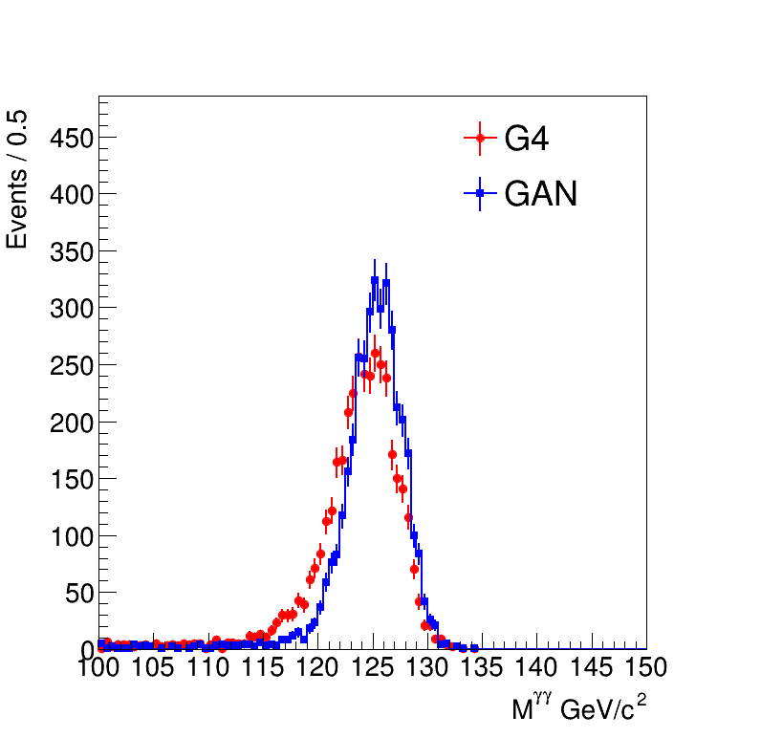
Calorimeter Simulation with GAN (1)
Full simulation with Geant4 :
The most accurate approach, but also the most computationally intensive.
Computing time scales roughly linearly with both the incident particle energy and the number of incident particles.
Calorimeter simulation is one of bottlenecks.
Simulation with Generative Adversarial Networks (GAN) is one of fast simulation methods
Current status:
Trained GAN for electron and photon using particle gun samples.
Checked its performance using $e^{+}e^{−}→Z(νν)H(γγ)$ mc samples.
Compared some properties of reconstructed gamma from Geant4 and GAN.
E of Leading $Υ_{rec}$
E of Sub-Leading $Υ_{rec}$
$$M_{γγ}$$
Looks fine, has room for improvement.

Slide 9
Calorimeter Simulation with GAN (2)
In general, the results from GAN looks good and shows its potential for fast calorimeter simulation.
There is still lots of work need to be done and our plan is as follows:
Optimization of GAN architecture, initial parameters including hyper parameters to improve its performance
More performance studies like energy scale, resolution, identification and isolation variables.
Combine ECAL and HCAL in GAN simulation.
Training with other data samples like $π$, k and so on.

Slide 10
Plan for Multi-threading Testing
Framework Testing
Update Gaudi to the latest version of V32.0
Detector simulation chosen to be Multi-threaded application
Testing of Event Store
To check whether it is thread-safe or not
Event Data IO Testing
Data synchronization and performance measurements
Performance optimization

Slide 11
Thank You !
谢谢

