Slide 1
Straight Line Fit
Hongpeng Wang, LiangLiang Wang
2019-12-19

Slide 2
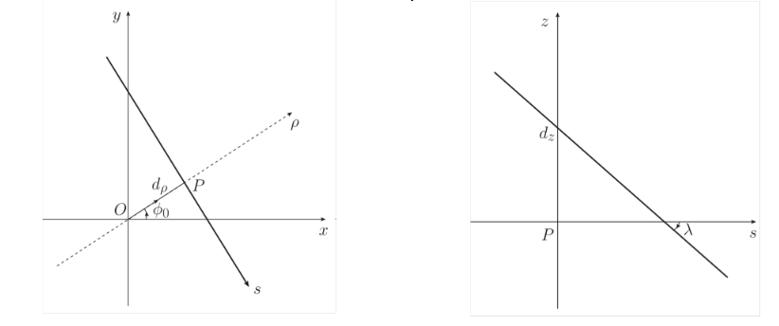
Introuduciton
Straight line model
$l(dρ,φ_{0},d_{Z},tgλ)$
Minimization method
$i$:number of clusters
$σ^{X/V}$: resolution of X/V

Slide 3
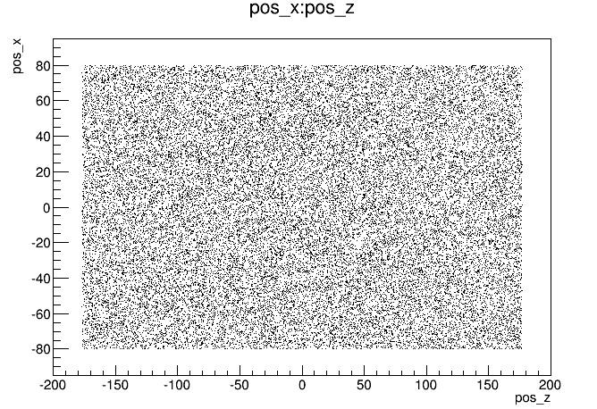
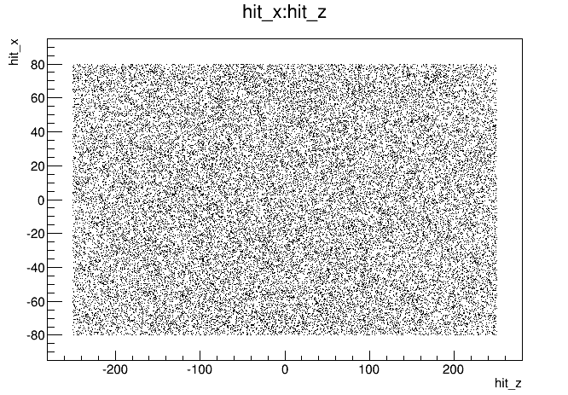
MC simulation
500,000 events generated. 36856 reserved.
Clusters : Smeared MC truths with$resolution σ=130 μm.$
Scintillator position
W * L： 160mm*500mm .
Distance：600 mm.
Particle gun position on upper plane
&hit position on bottom plane.
Particle gun:
$\left|cosθ\right|>0.6$
$φ∈(−2.5,−0.5)$
Upper
plane
Bottom
plane
Limited by G4,
Just reach 180 mm.

Slide 4
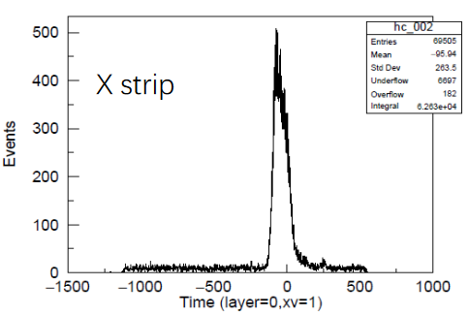
Selection criteria
Requirements of strips :
time: (-180,100 )
charge: Q>0
X-V clusters:
 | run1 | run2 | run3 | run4 | run5
At least one | 30350 | 31604 | 28327 | 44072 | 18018
Only one in Layer 1 | 2903 | 4110 | 3700 | 2904 | 954
Only two in Layer 2 | 13140 | 10468 | 8526 | 15293 | 9
Three sheets | 6713 | 12289 | 12225 | 22377 | 2

Slide 5
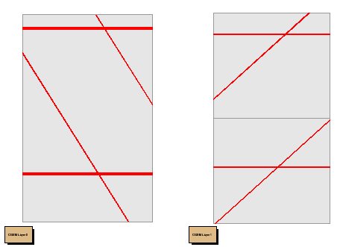
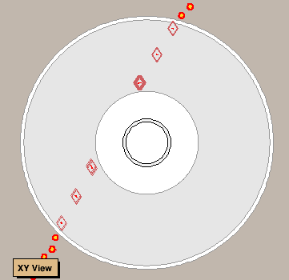
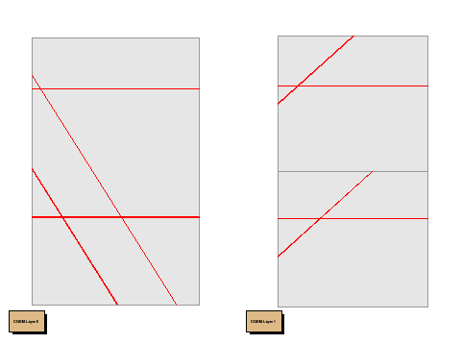
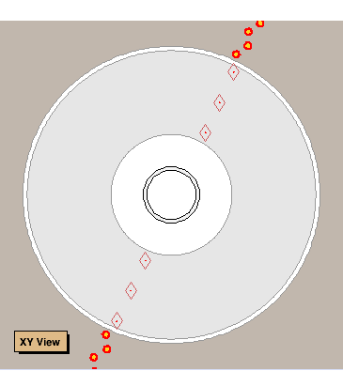
Strategy
Data: choose the cluster with largest Q.
MC: ~50% events has two xv-cluster in inner layer($φ>0$).
Discard one by the line linked between clusters in middle layer.
Just use 3 clusters in fit.
One cluster
Two cluster
Inner layer middle layer x-y plane

Slide 6
Straight Line Fit by CC clusters
.
Data _cc
Run1-4
MC

Slide 7
Data _cc
Run1
Run2
Run3
Run4

Slide 8
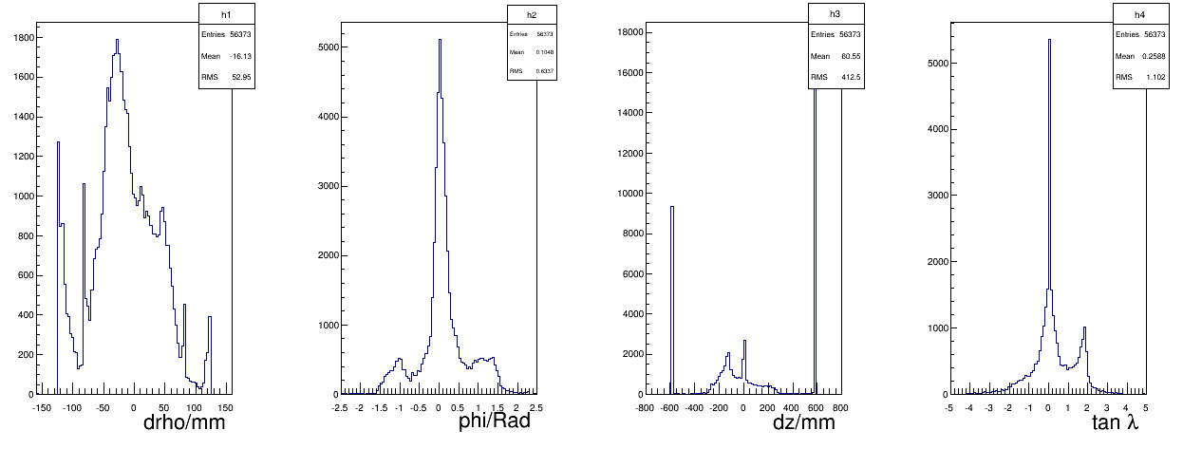
Straight Line Fit by mTPC clusters
.
Data _cc
Run1-4
MC

Slide 9
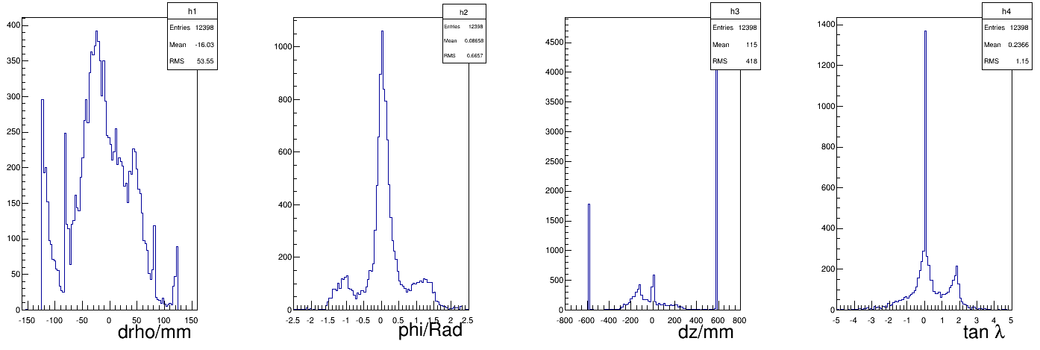
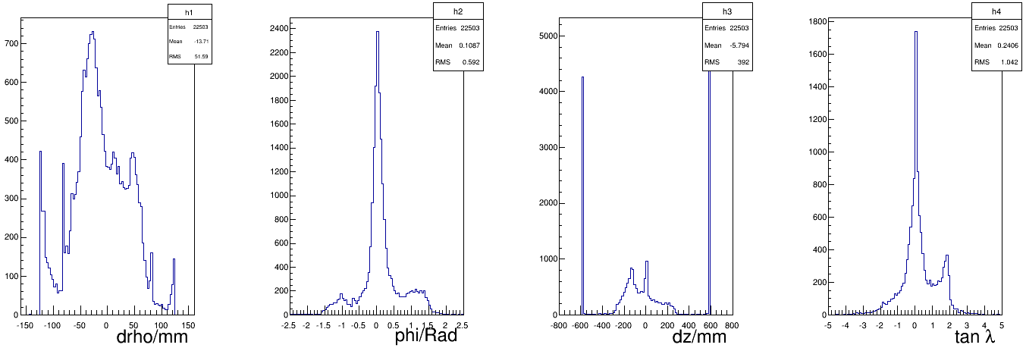
Data_mTPC
Run1
Run2
Run3
Run4

Slide 10
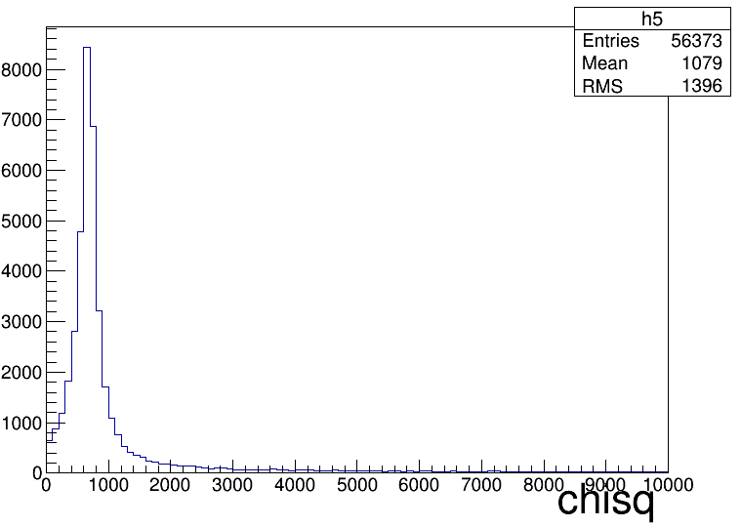
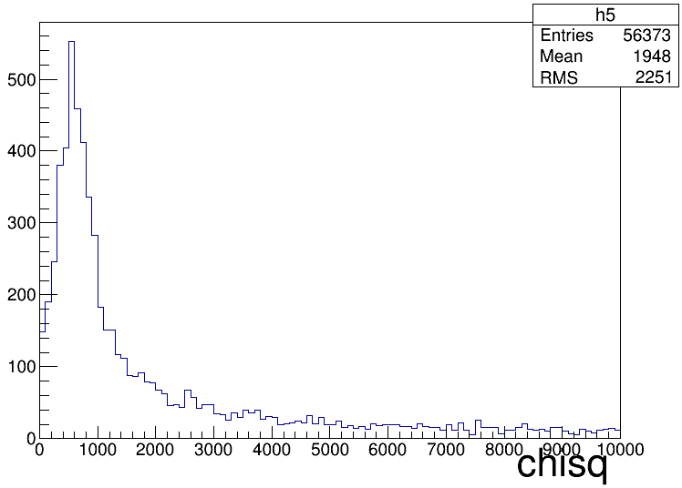
$$χ^{2}$$
MC CC mTPC

Slide 11
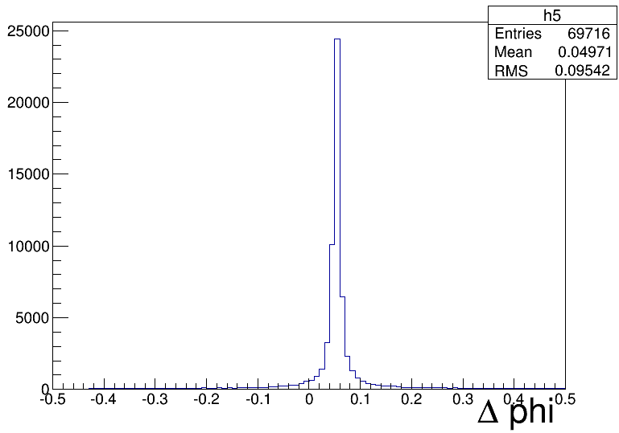
Offset effect
Link line between clusters in middle layer , and calculate the cluster in inner layer.
$Δphi={phi}_{real}−{phi}_{cal}$
CC

Slide 12
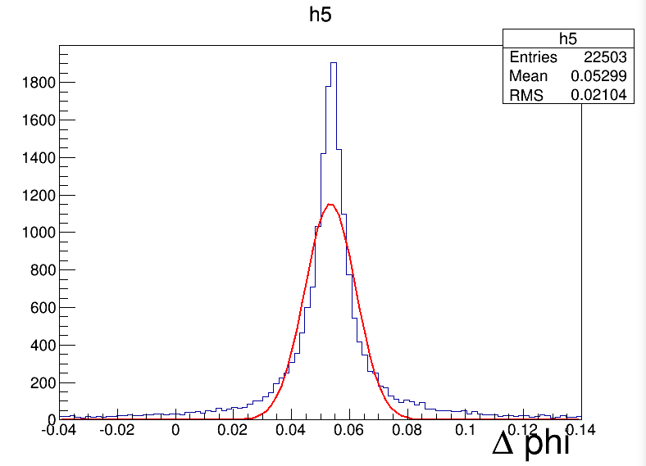

Slide 13
Strategy
Data: choose the cluster with largest Q.
MC: ~50% events has two xv-cluster in inner layer($φ>0$).
Discard one by the line linked between clusters in middle layer.
Just use 3 clusters in fit.
One cluster
Two cluster
Inner layer middle layer x-y plane

Slide 15
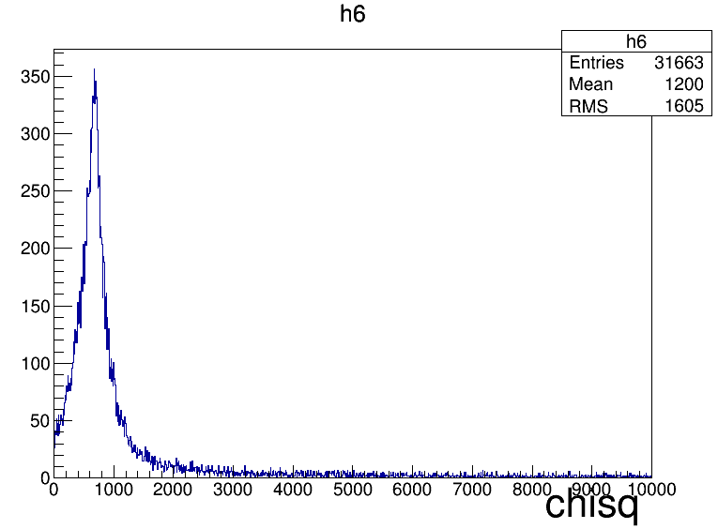
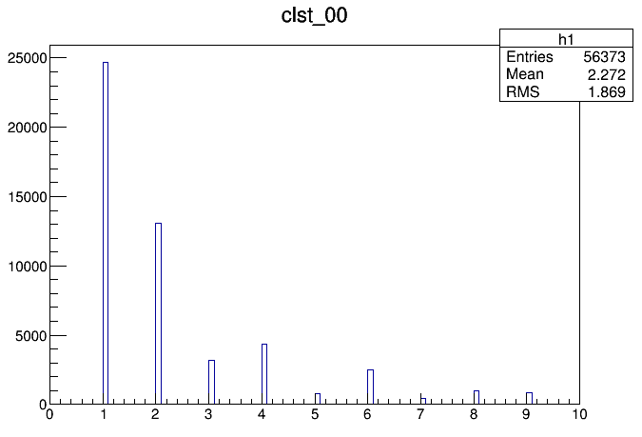
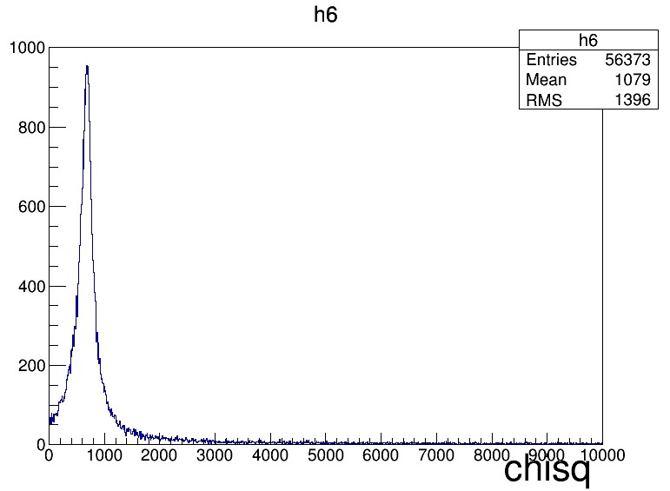
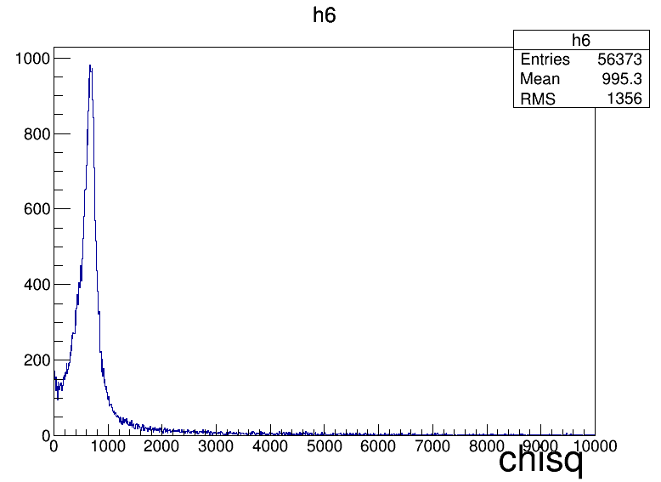
Max charge vs Pos. Closest

Slide 16
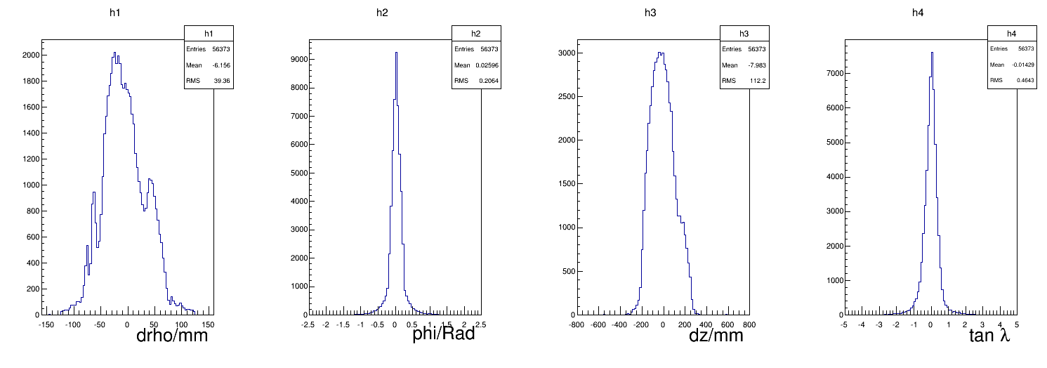
Max charge vs Pos.Closest

Slide 17
Cluster_mTPC Loss
 | X-Cluster | V-Cluster
Layer1 sheet0 | 12433 | 14039
Layer2 sheet0 | 2305 | 5261
Layer2 sheet1 | 2432 | 3471
All |  | 39941

Slide 18
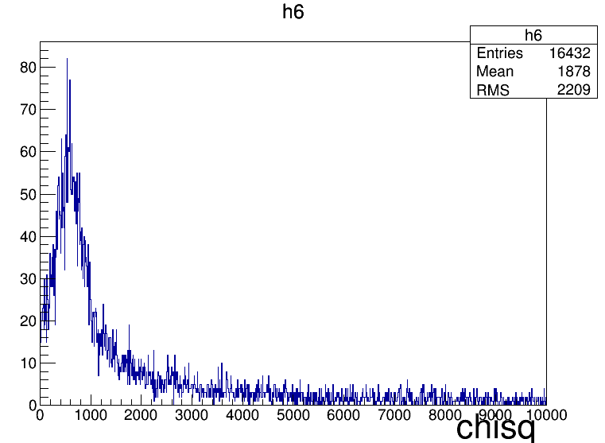
Fit Status

Slide 19
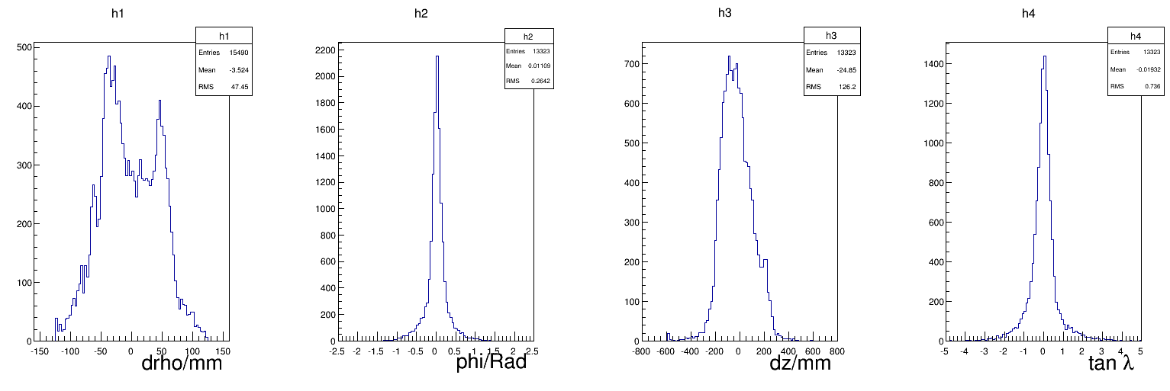
mTPC vs CC

Slide 20
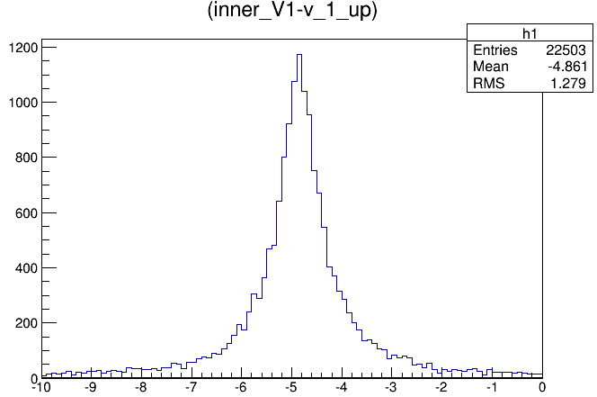
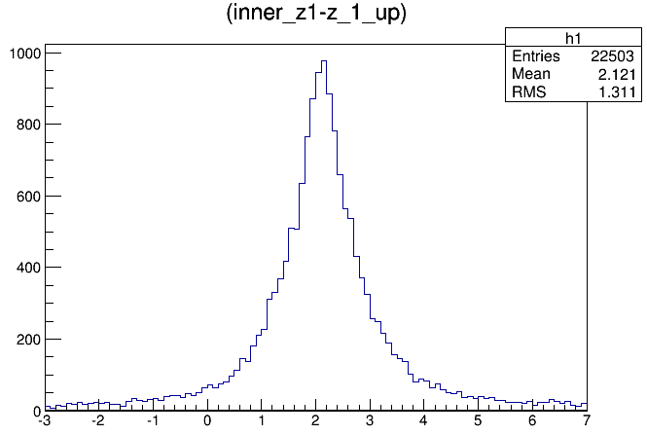
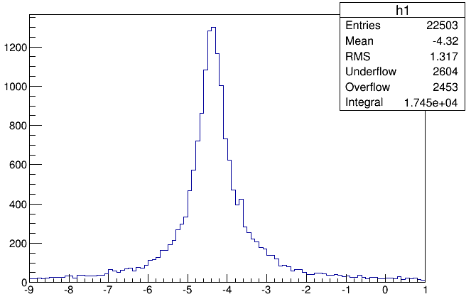

Slide 21
