Slide 1
CGEM Cosmic Line Fit
Hongpeng Wang
4-2

Slide 2
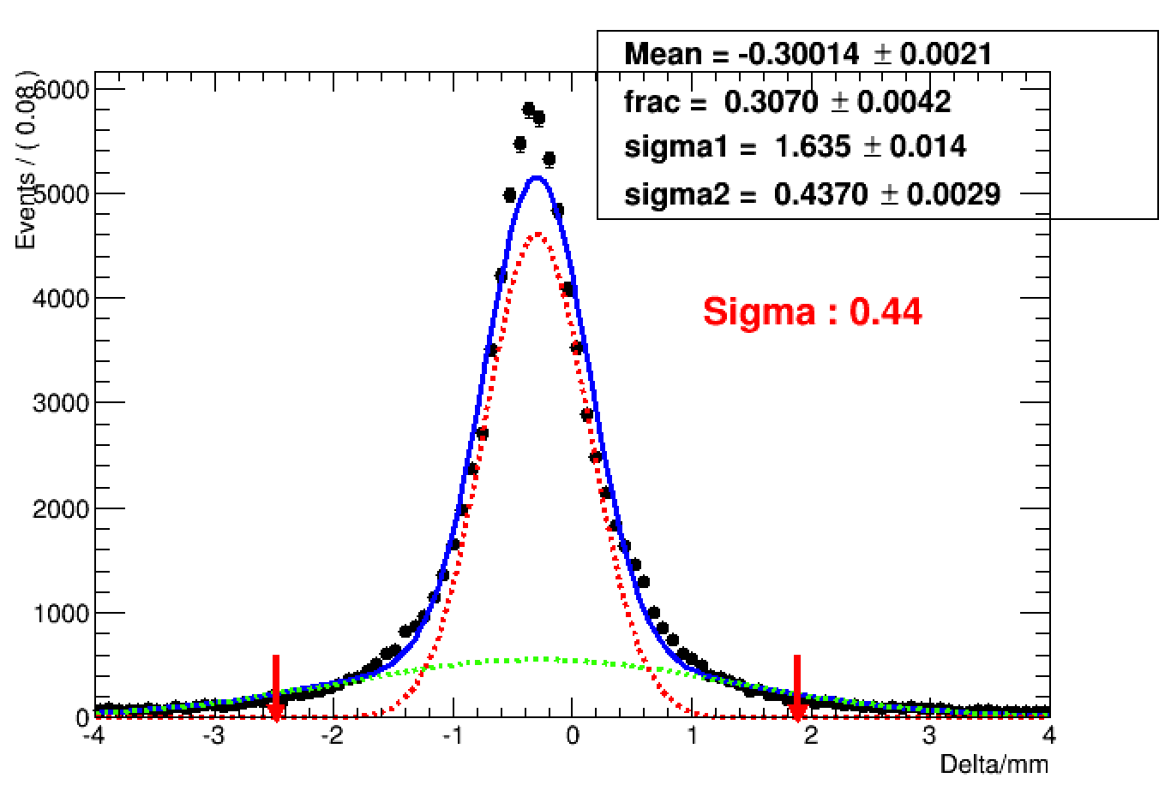
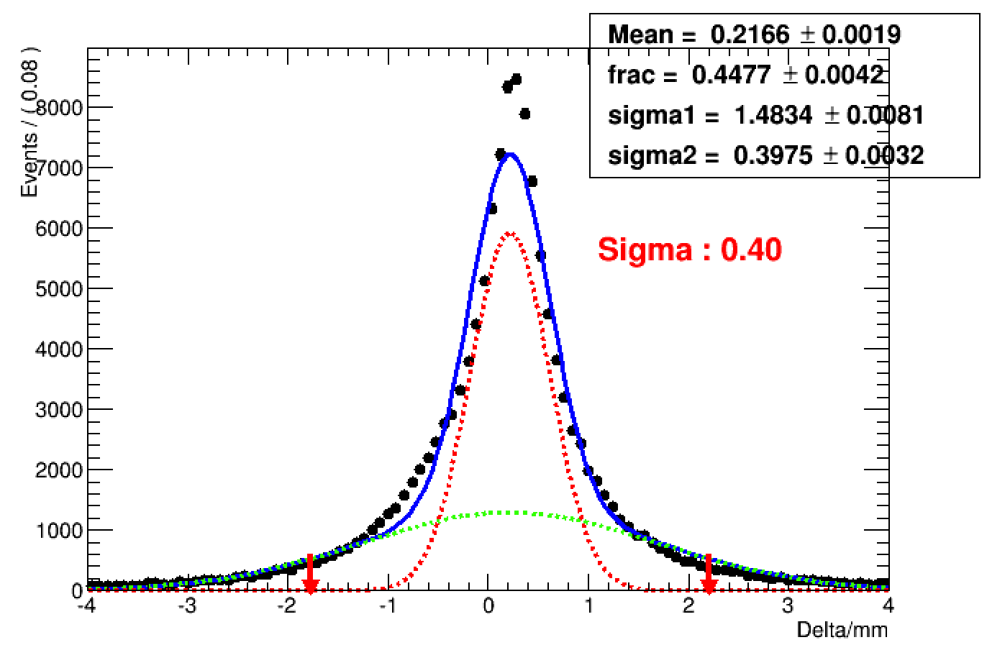
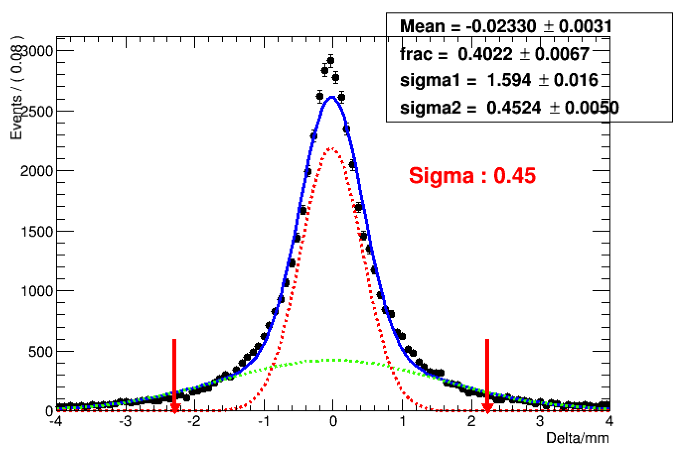
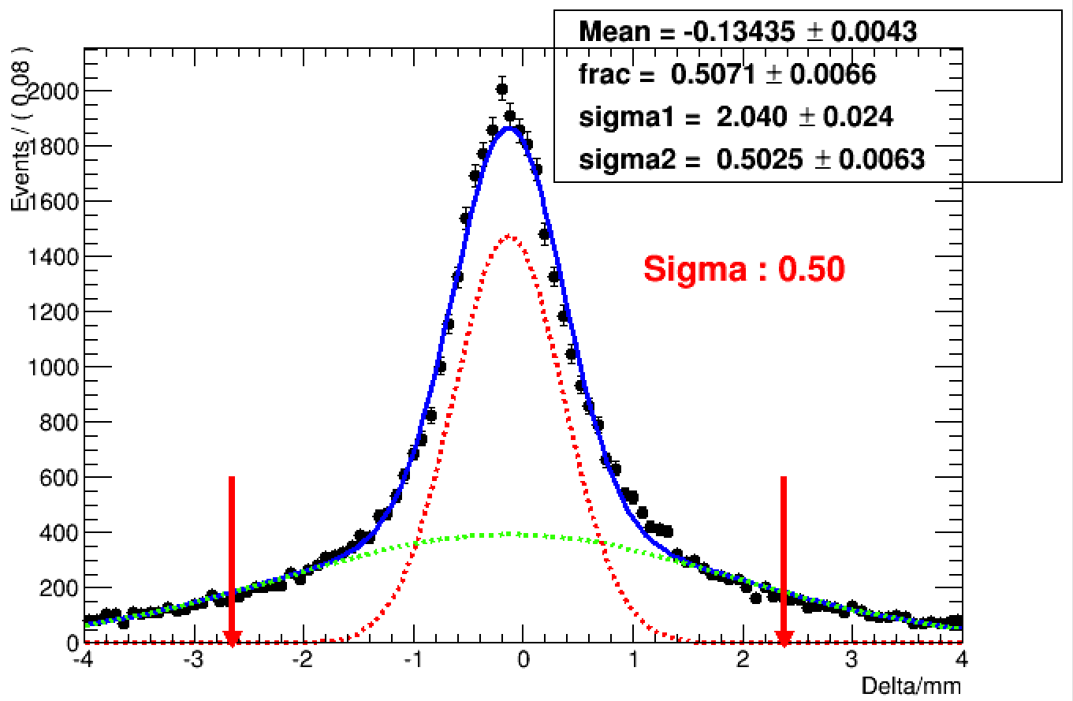
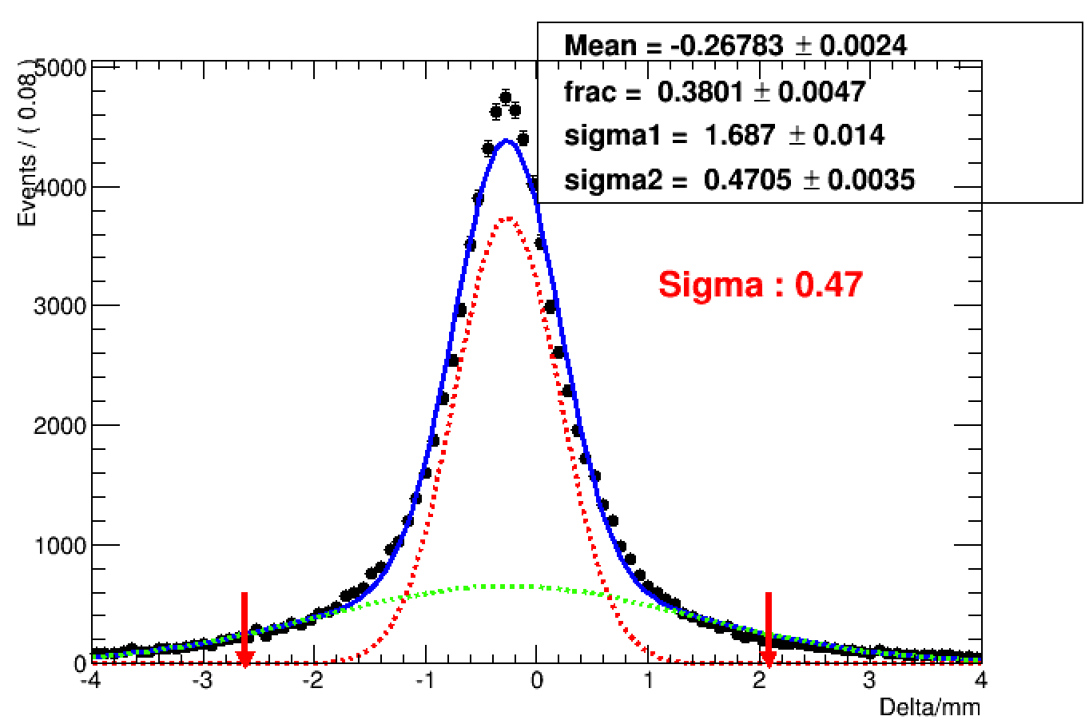
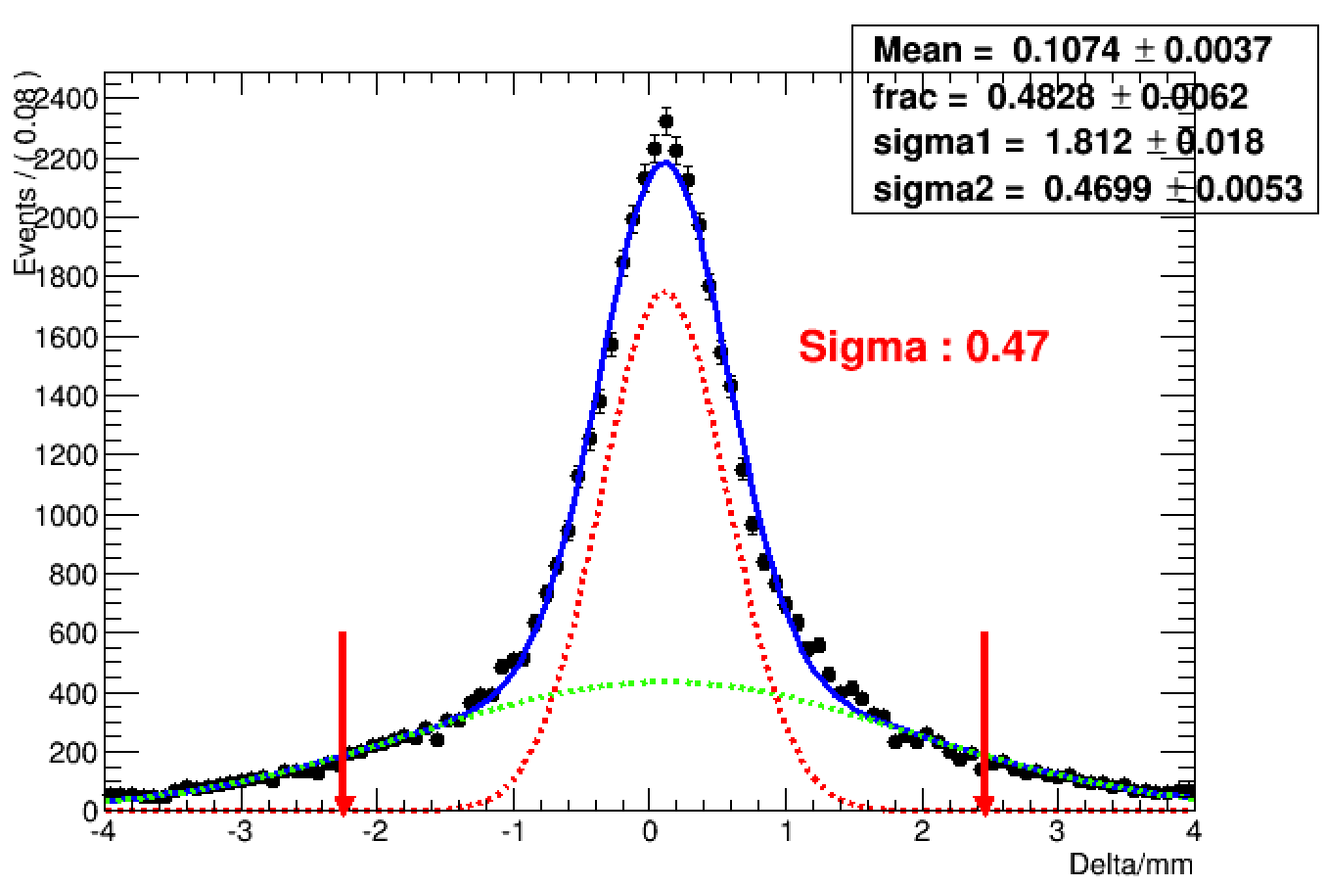
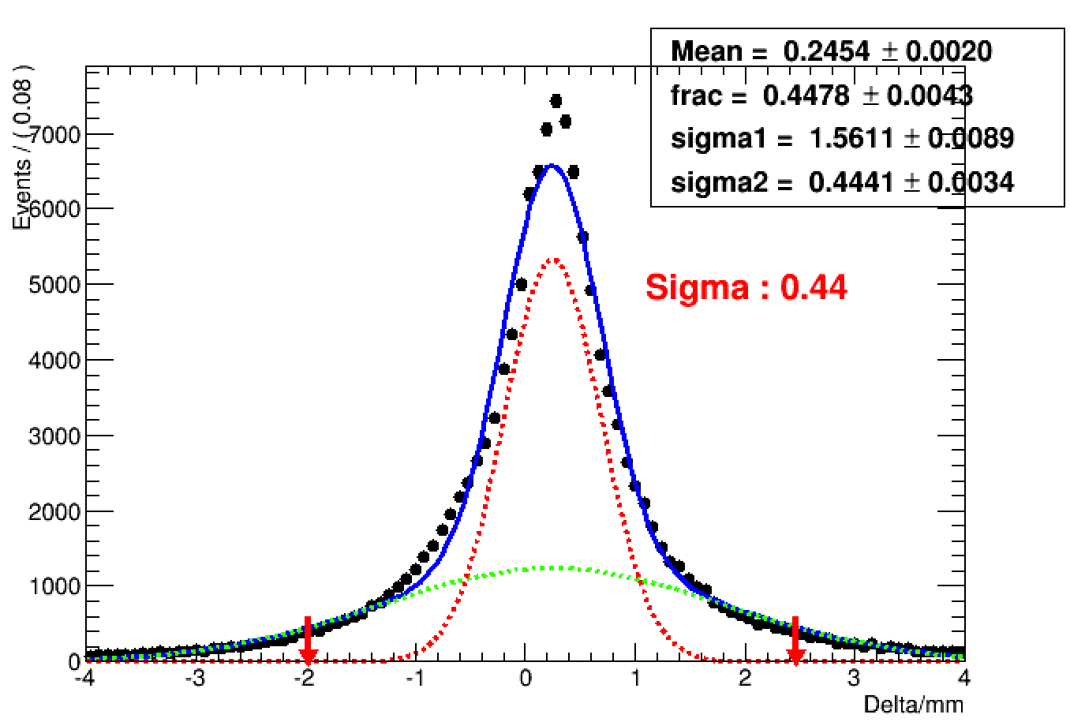
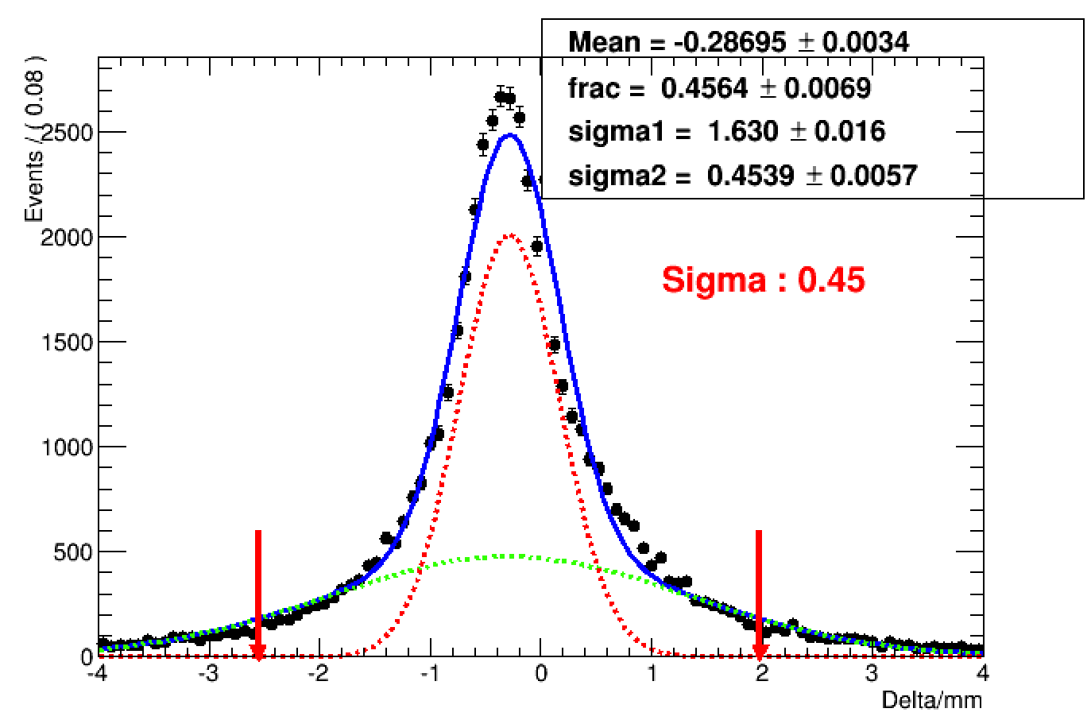
Residual distribution
up, middle bottom, middle up, inner bottom, inner
$σ$X :mm
$σ$V:
mm
Eff.=0.752
Eff.=0.841
Eff.=0.845
Eff.=0.843
Eff.=0.817
Eff.=0.801
Eff.=0.854
Eff.=0.847

Slide 3
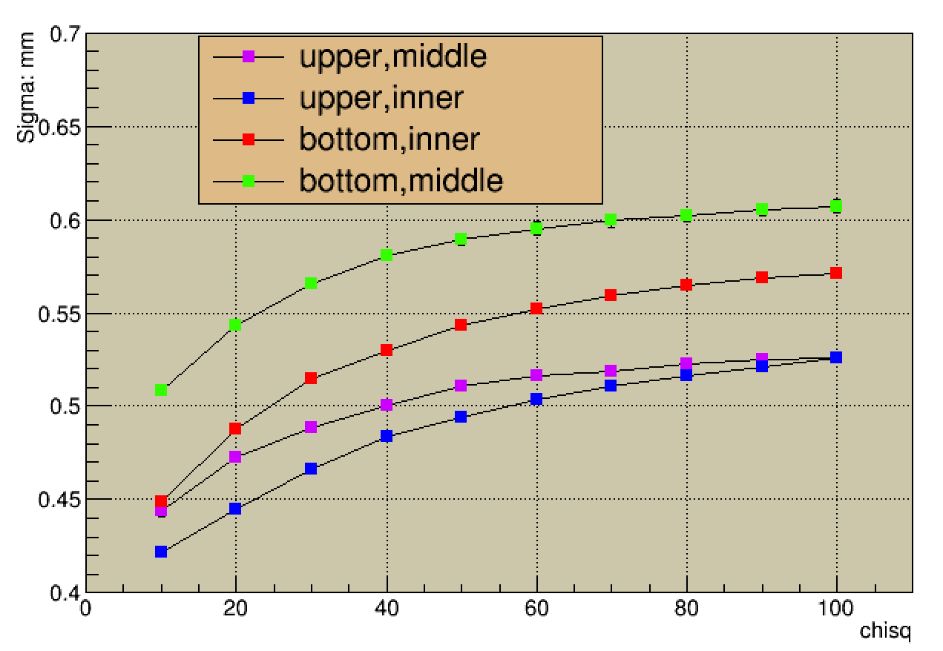
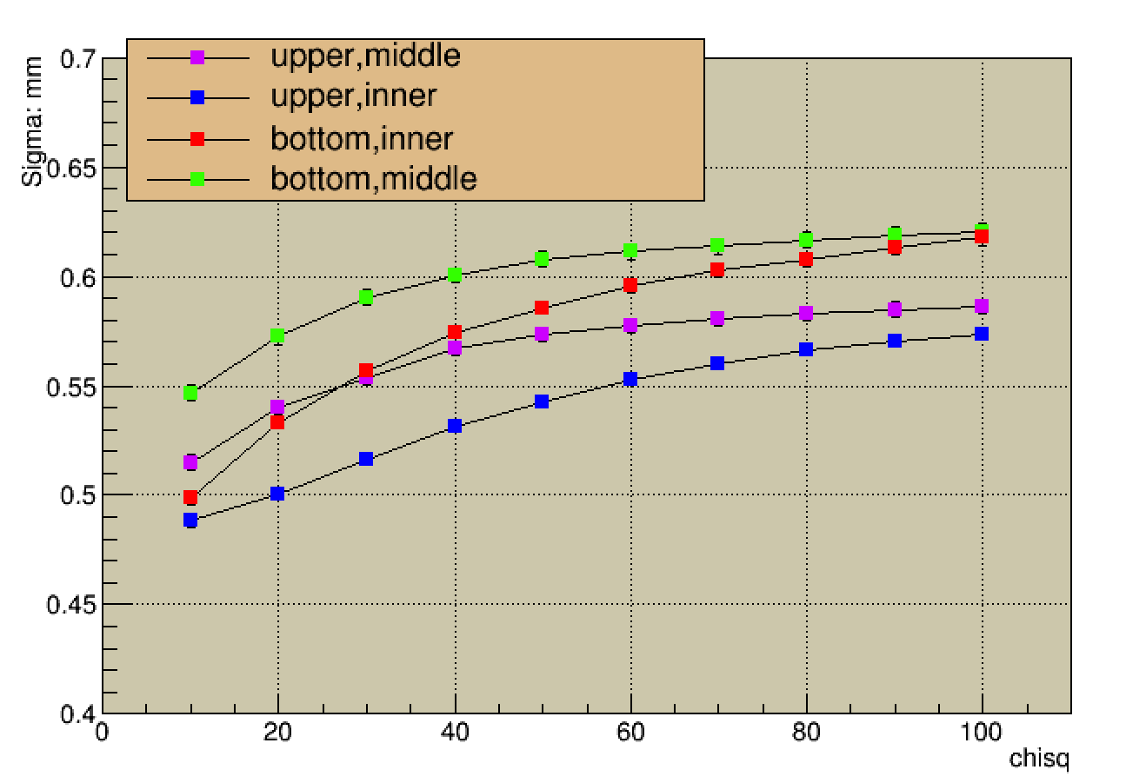
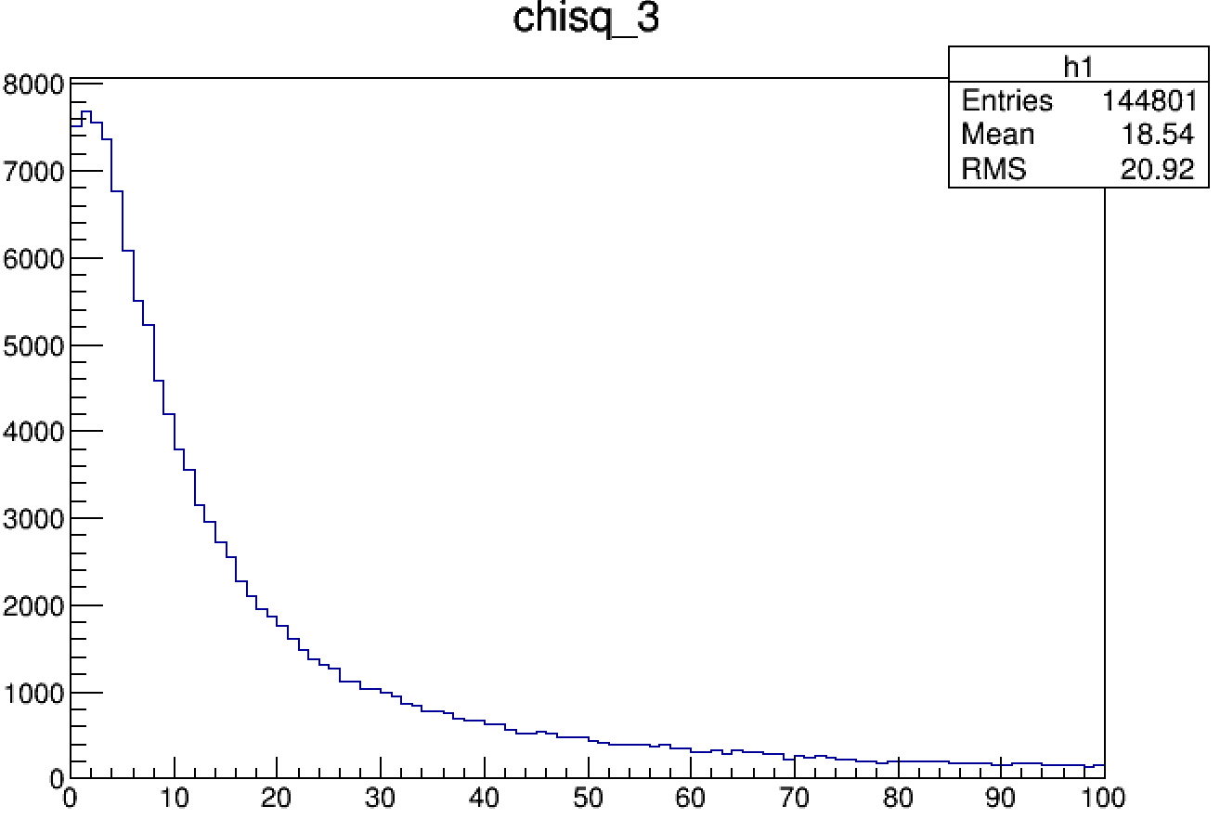
$χ^{2}$ cut scan
$σx$：mm
$σV$:mm
$$χ^{2}$$

Slide 4
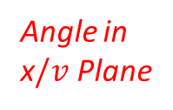
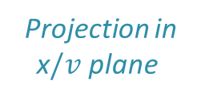
Incident angle in x/v plane
Project the cosmic line to the x/v plane, which is perpendicular to drift plane and parallel to the $\vec{x} /\vec{v}$ direction.
Study relation between the resolution and the incident angle in x/v plane.
x$/v$ Plane
Angle in x$/v$ Plane
$$\vec{x} /\vec{v}$$
Drift Plane
Projection in x$/v$ plane

Slide 5
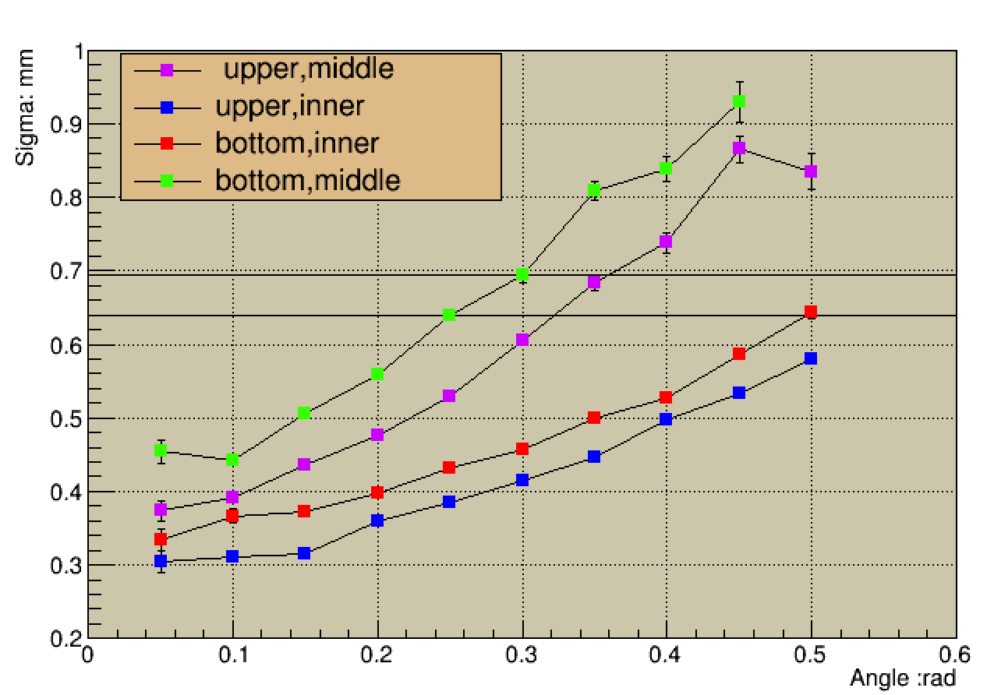
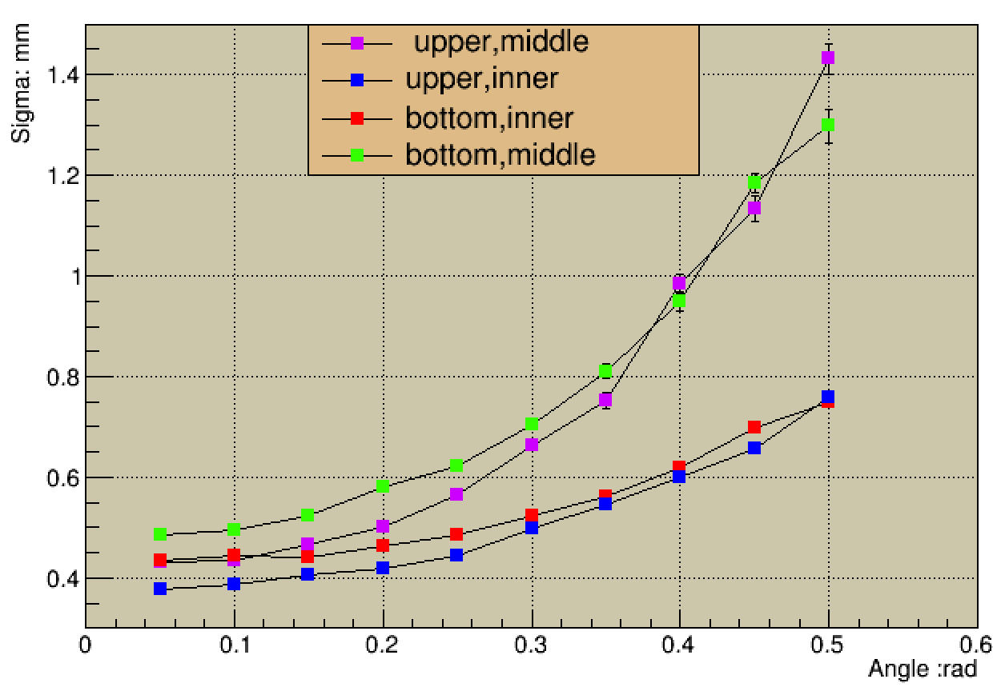
Residual distribution vs x/v Angle (charge centered)
$σ$X vs x angle $σ$V vs v angle
$χ_{xv}^{2}={\left(\frac{φ−φ^{′}}{\frac{σ}{R_{n}}}\right)}^{2}$ + ${\left(\frac{V−V′}{σ}\right)}^{2},$ $σ=130um$

Slide 6
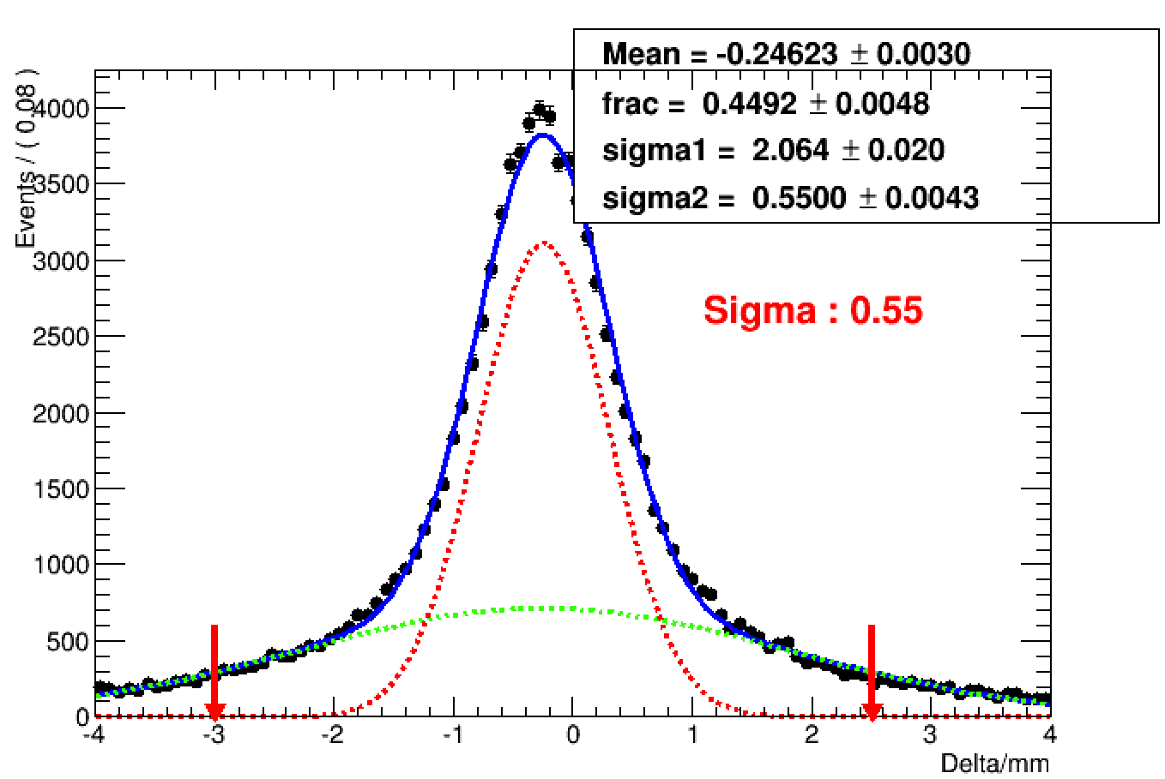
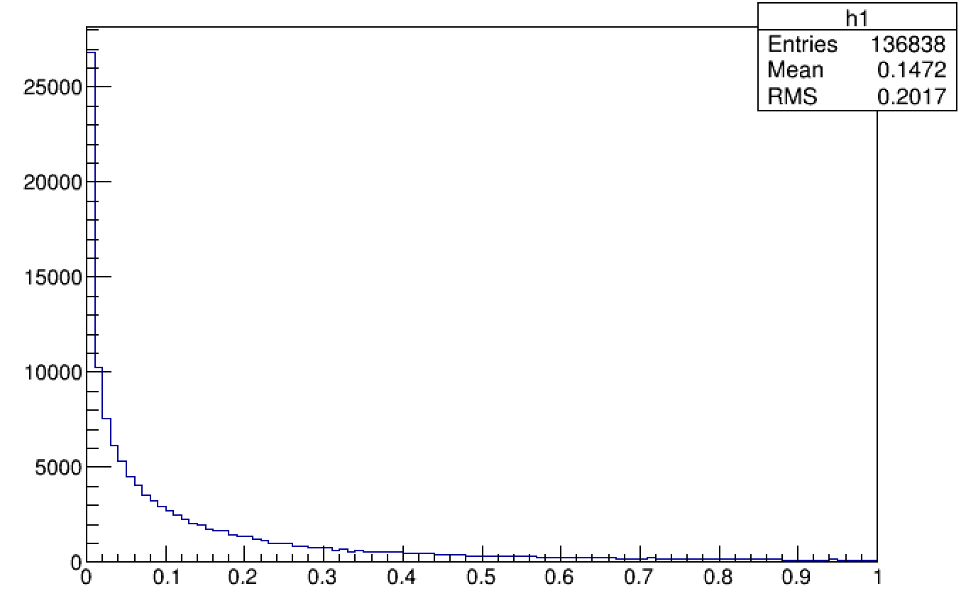
$σ=$130um vs $σ$(angle)
$σx$：mm
$σV$:mm
$$χ^{2}$$

