Slide 1
Tuning check
2020/1/6

Slide 2
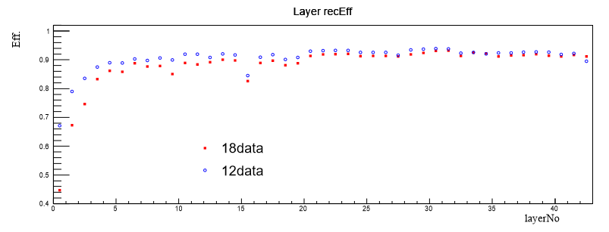
For reconstruction

Slide 3
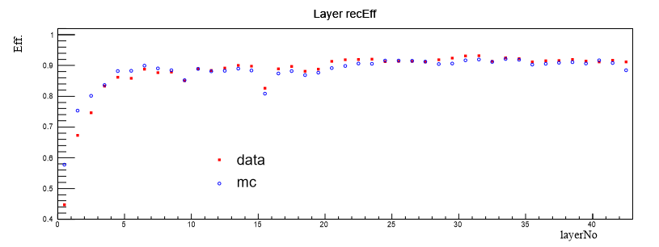
18 data & 18 mc
Old tuning parameter

Slide 4
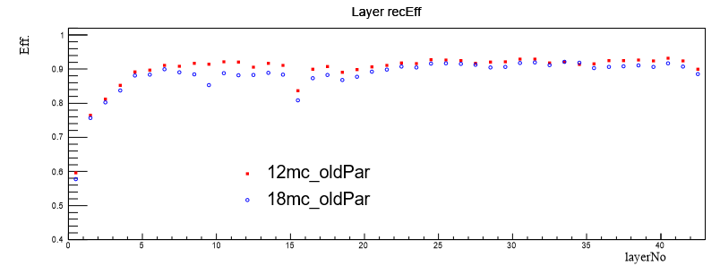
18 mc & 12 mc
Old tuning parameter

