Slide 1
weekly report Introduction to R-CNN
Hosein Karimi
2020/01/16

Slide 2
Motivation
There are already very sophisticated image analysis techniques developed using neural networks which can be used for particle recognition.

Slide 3
Example
They are using deep learning to analyze CMS events.

Slide 4
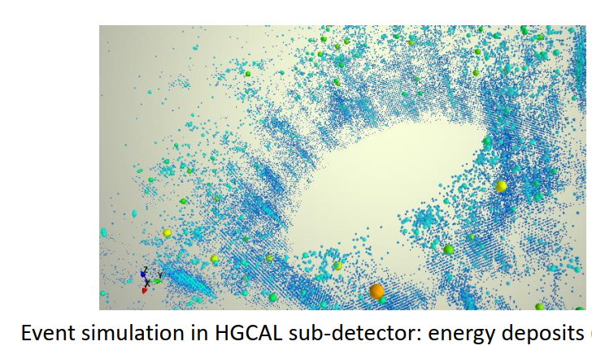
Example
They try to localize thousands of showers and clusters in such events by looking at them as “objects” in images and using deep learning techniques.

Slide 5
Example
They use “Mask R-CNN” and do it for 2D projections to test their ideas

Slide 6
CNN = Convolutional Neural Network
A neural network which has some ‘convolutional’ hidden layers. These are layers which use ‘filters’ in order to find patterns of an image.
filters are matrices which simplify pictures and single out a particular pattern in them.

Slide 7
CNN = Convolutional Neural Network

Slide 8
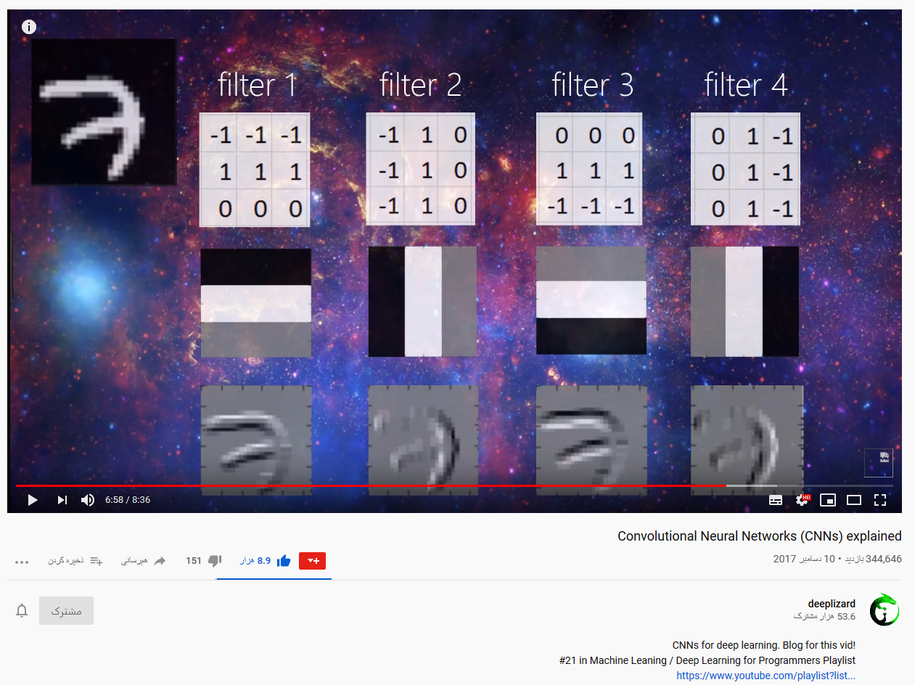
CNN = Convolutional Neural Network

Slide 9
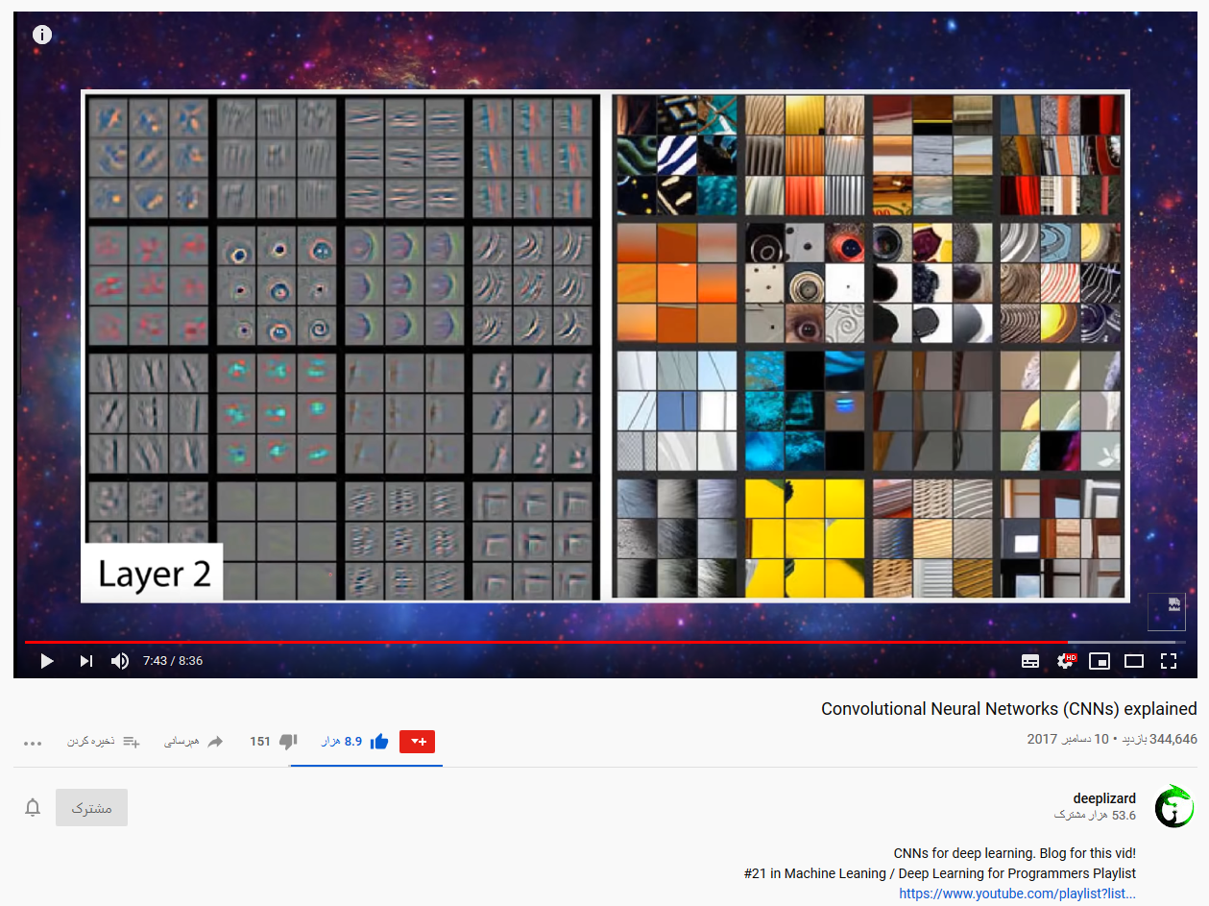
CNN = Convolutional Neural Network
This feature of CNNs makes them very powerful tools for image classification. Another example:

Slide 10
CNN = Convolutional Neural Network
filters also can reduce or increase resolution (down sampling and up sampling)

Slide 11
CNN = Convolutional Neural Network
another example of a convolutional layer

Slide 12
CNN = Convolutional Neural Network
Filters also get trained

Slide 13
CNN = Convolutional Neural Network
In addition of image classification, more advanced CNNs can be used for other purposes:

Slide 14
Semantic Segmentation
The approach is to reduce the resolution and establish layers associated to favorite
features of the image. When layers are detected, each pixel gets assigned to one of them.

Slide 15
An example: U-net
It is designed for the
segmentation of biomedical images

Slide 16
Localization
The network ha to decide about the class of the image and the position and size of the box around the feature object.

Slide 17
R-CNN: Region based Convolutional Neural network
localization can be looked at as a regression problem.

Slide 18
Object Detection
There is a need to a separate algorithm to suggests boxes. (region Proposals, region of interest)
Since the number of objects are arbitrary, the above approach is not efficient.

Slide 19
Fast R-CNN

Slide 20
another illustration

Slide 21
Faster R-CNN
Faster R-CNN is when it goes through the region proposal algorithm after the first bunch of CNN.

Slide 22
Mask R-CNN
Mask R-CNN combines the above techniques to do “instant segmentation”

Slide 23
Mask R-CNN
Mask R-CNN adds a FCN unit to do pixel segmentation.

Slide 24
A totally different approach!
In this approach the neural network is designed to grasp the underneath physical laws, or equivalently, estimate correct composite solutions for differential equations. It is then different with using image recognition tools.
Examples:
arXiv:1707.02568v3
arXiv:1807.10300v2
arXiv:1910.07291v1
arXiv:2001.02515v2

Slide 25
Solving classical three bodies problem with ANN

Slide 26
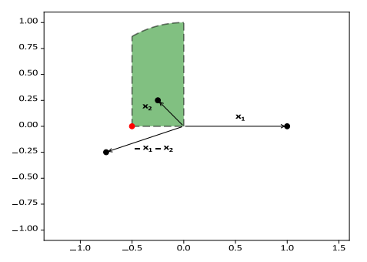
Solving classical three bodies problem with ANN

Slide 27
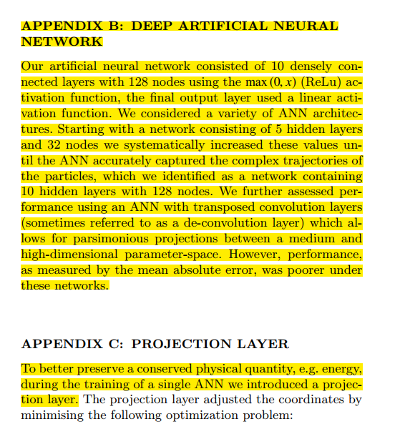
Solving classical three bodies problem with ANN

