Slide 1
Introduction
2020.4.30
Chen Zhengyuan
Tracking software meeting

Slide 2
content
Motivation
Traditional Method
TMVA Method
Progress

Slide 3
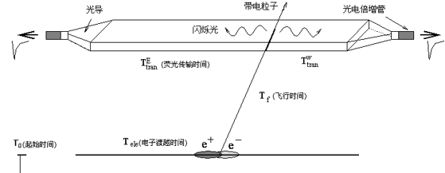
Motivation
Use new method for TOF calibration to improve time resolution
$$t_{raw}$$
$$t_{measure}$$
$$t_{0}$$
TOF:
MDC:
$t_{measure}=t_{raw}−t_{0}−t_{cor}$
$t_{predict}$
$$∆t=t_{measure}−t_{predict}$$
$$( t_{cor}=t_{tran}+t_{PMT}+t_{ele} )$$

Slide 4
Traditional Method
TOF:
$t_{measure}=t_{raw}−t_{0}−t_{cor}$
$$t_{cor}=t_{tran}+t_{PMT}+t_{ele}$$
Calibration function:
$t_{cor} =t_{raw}−t_{0}−$ $t_{measure}$
$$t_{predict}$$
Get calibration constant: $P_{0}, P_{1}, P_{2}, P_{3}, P_{4}, P_{5}, P_{6}$

Slide 5
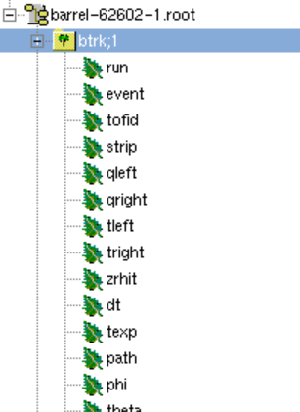
TMVA Method
TOF:
$$t_{measure}=t_{raw}−t_{0}−t_{cor}(q,z)$$
$$t_{predict}$$

Slide 6
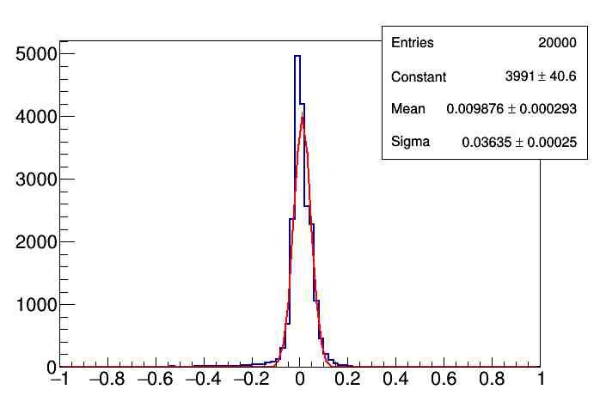
Progress
Time Resolution:
electron: 18ps
Add pion: 36ps
Expectation: about 130ps
Researching…

