Slide 1
Status of ACTS integration to CEPC tracking

Slide 2
ACTS: A Common Tracking Software
Aims to provide a tracking toolkit for the future tracking community (currently mainly based on ATLAS experience)
ATLAS
ACTS
Well tested code
High tracking performance
Not thread safe – (improving to be AthenaMT)
Grown structure, not long-time maintainable
…
Encapsulate existed code from ATLAS (or other experiments)
Thread safe/long vectorization
Modern C++ 17, minimal requirements …
Experiments independent
Open-source

Slide 3
Motivations and Overview
Good level of participation in future-oriented tracking software development / gain LHC experience in past 20 years
Facilitate to implement the CEPC detector and change geometry with common tracking software
learn the detector details and performance, optimize layout – hope to benefit from the common tools
Some tools should be adapt for specific detector (from common to specific)

Slide 4
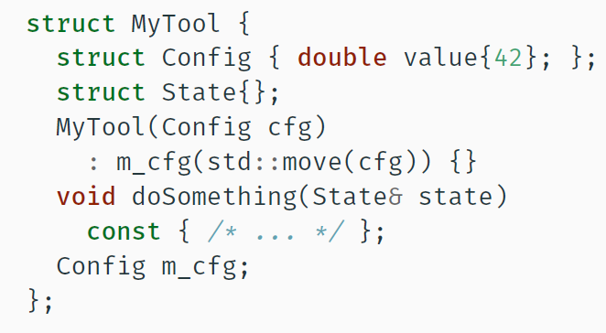
ACTS modules layout and Basic Design
Plugins: DD4HEP, TGEO, Geant4…
Thread-safe code and configurations
Core
Geometry
Surface
EDM
Material
MagneticField
Utilities
Propagator
RKN Stepper
StraightLine Stepper
Navigator
Fitter
Kalman Fitter
Gaussian Sum Fitter
Seeding
Vertexing
Track Finding
CKF
Calibration – no need
Alignment – no need
Const-correctness and visitor pattern
The caller create the cache which stays local to the thread
Constant configuration as config struct at construction
A light-weight Gaudi framework for integration and concurrency test
FATRAS: ATLAS fast simulation

Slide 5
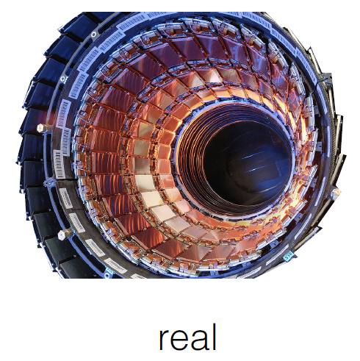
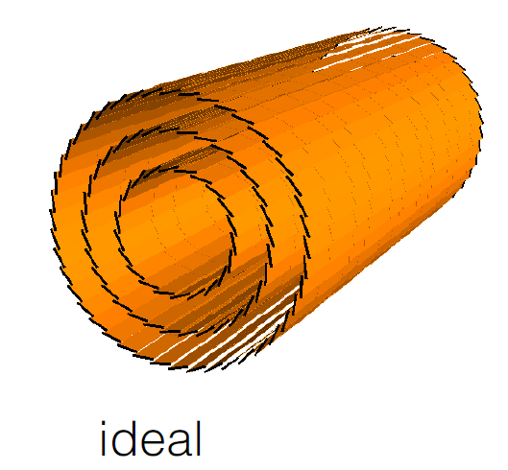
Tracking Geometry
Tracking Geometry =
Simplified geometry + approximated material
full detailed detection module
Simplified material description
ACTS : DD4HEP and TGeo
G4, fast simulation and reconstruction
Silicon tracker + Calorimeter
Other type of detector (wire chamber/TPC are taking consideration)

Slide 6
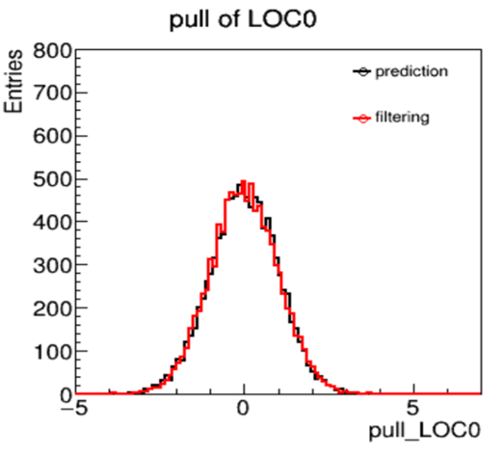
Propagation and Kalman Filter
Propagation
In the magnetic field
integrated to tracking geometry geometry
material effect,
measurement update
Aborters
Stepper
Reliable accuracy
On surface
Navigation
Actors
Kalman Filter in ACTS
Implemented as an Actor
Update direction, uncertainties after filtering step
Aims to minimize heap allocation
Study of numerical performance (From Xiaocong Ai)
These tools serve for the track reconstruction chain/support (convenient mechanism of validation for geometry building)

Slide 7
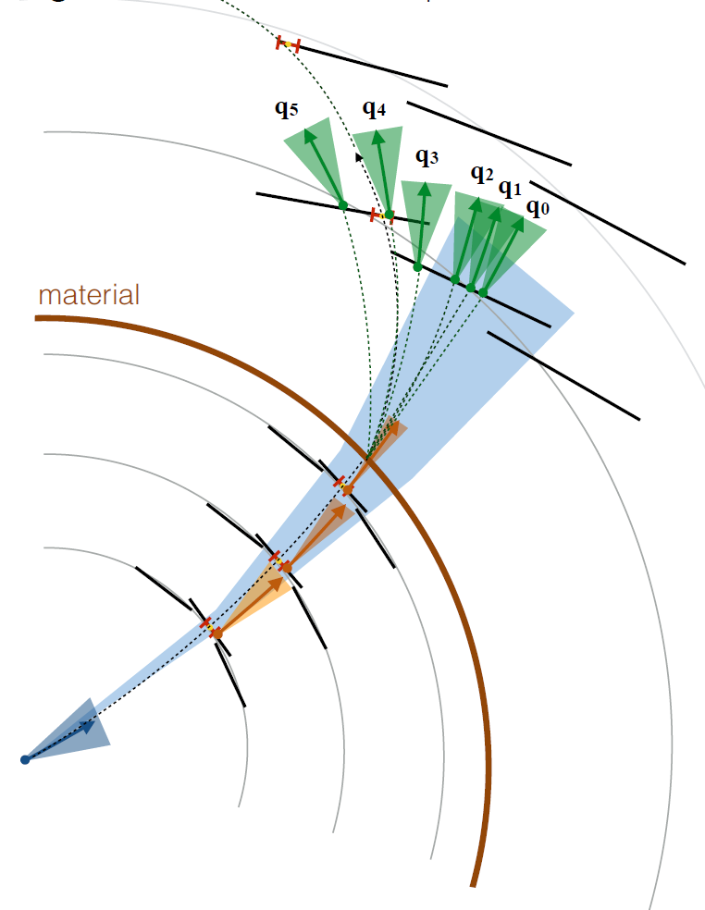
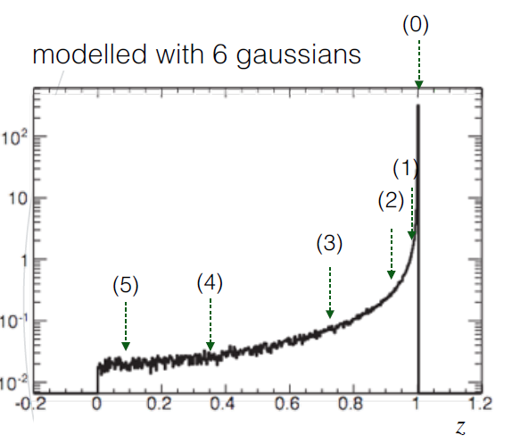
Gaussian Sum Filter
Electron reconstruction are well handled with Gaussian Sum Filter, which is a parallel sets of Kalman Filter
The bremsstrahlung energy loss distribution can be approximated as a weighted sum of gaussian components
Each component behaves like a Kalman component, propagate individually
Components should be merged to avoid the exponentially increasing
One component splits into 6 components
The (mean/cov/weight) of each component taken from ATLAS at the first step

Slide 8
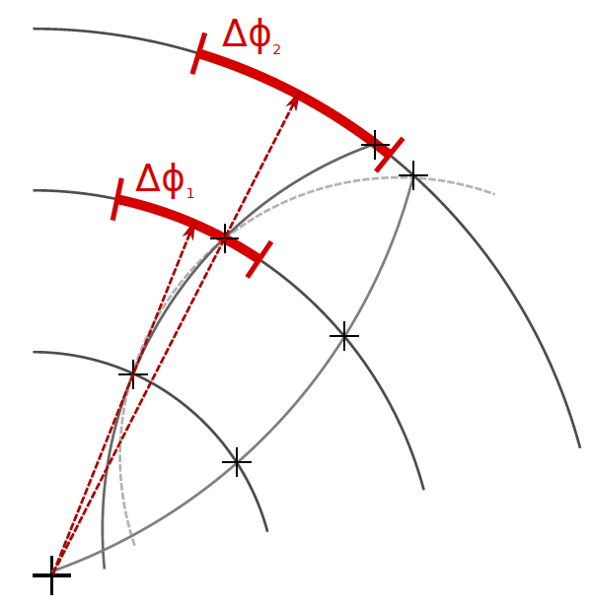
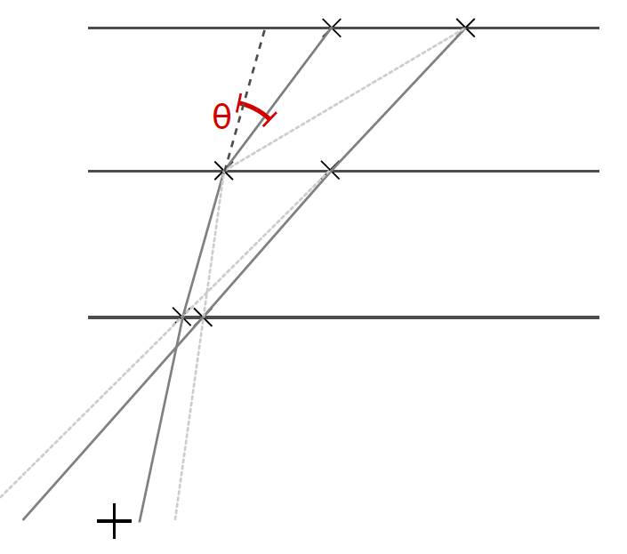
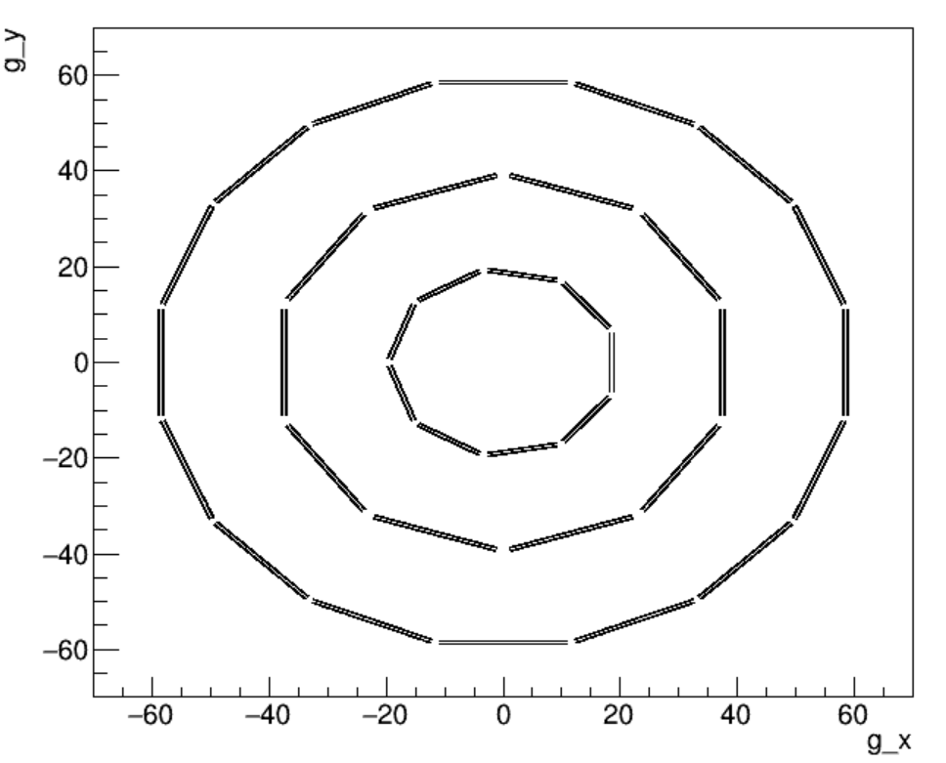
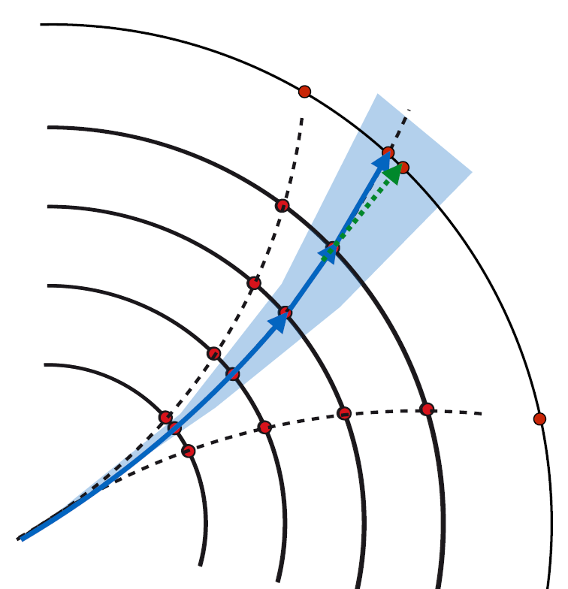
Seeding and Track Finding
A combinatorial seed finder – select 3-hit seeds
Multi thread seed finder in different regions intra event is allowed
x-y plane
r-z plane
Blue thread
Red thread
CKF as the basic track finding method is under developing
Combinatorial Kalman Filter

Slide 9
CEPC-ACTS Integration Status
V0 of CEPC baseline detector(without TPC) is implemented
CEPC tracking detector: V0
高能物理计算资源的挑战,
CEPC tracking detector: V1
TPC
Geometry
Fatras
geometry
Material recording
propagation
FATRAS
Kalman filter
Full silicon
Kalman filter
Material mapping
V1 of CEPC detector are ready with the geometry
Silicon detectors implemented with typical ACTS tools
TPC implemented with 220 cylinder layers currently
Material mapping is in being validated
Temporarily using acts-framework
planning to migrate ACTS into Gaudi for CEPC
ACTS Core
ACTS-framework
CEPC framework
ACTS Core

Slide 10
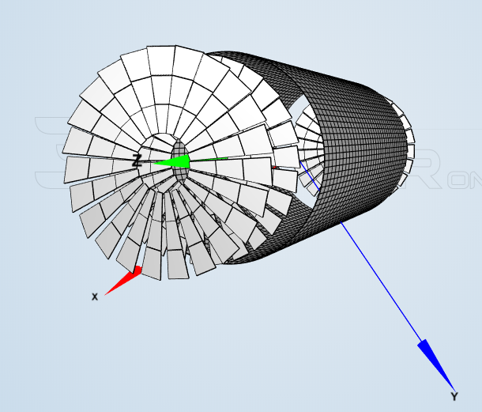
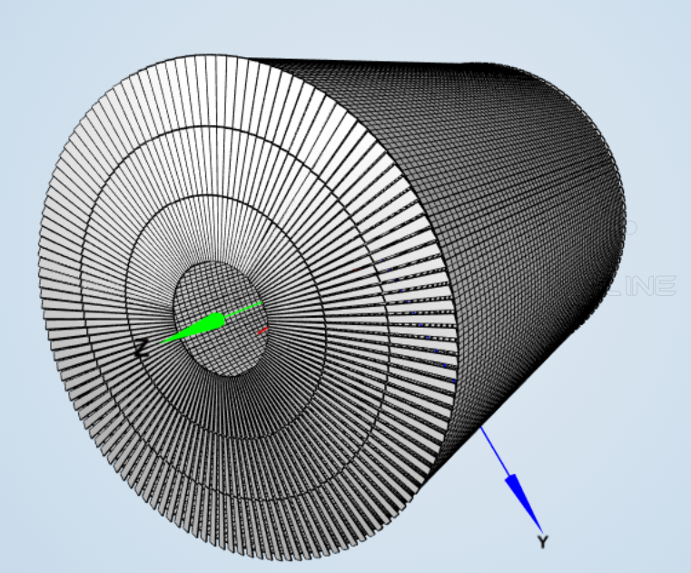
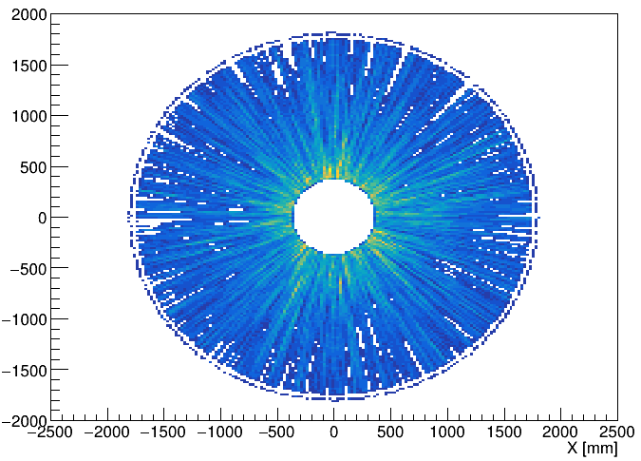
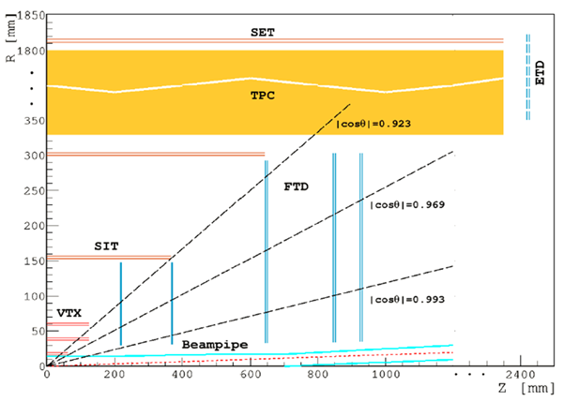
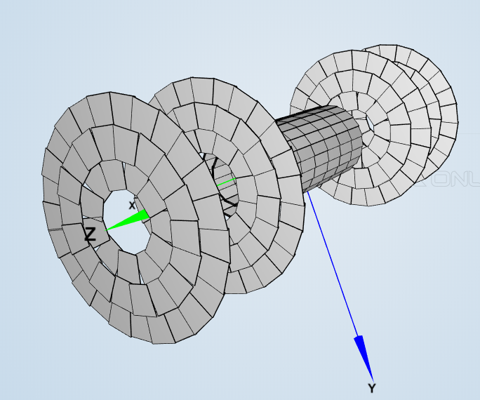
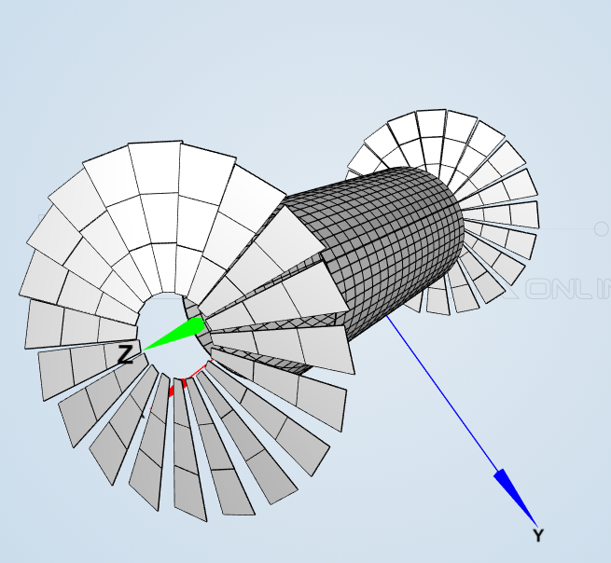
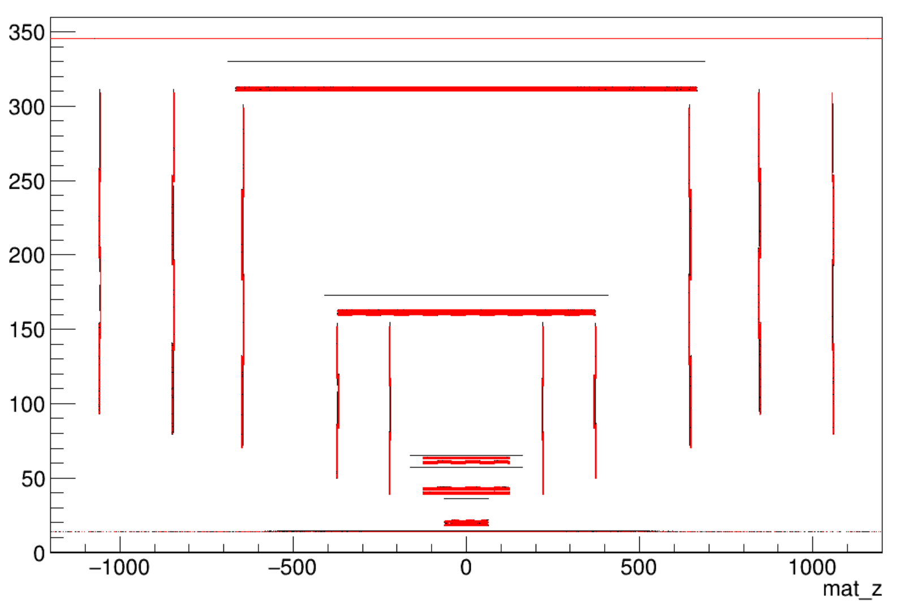
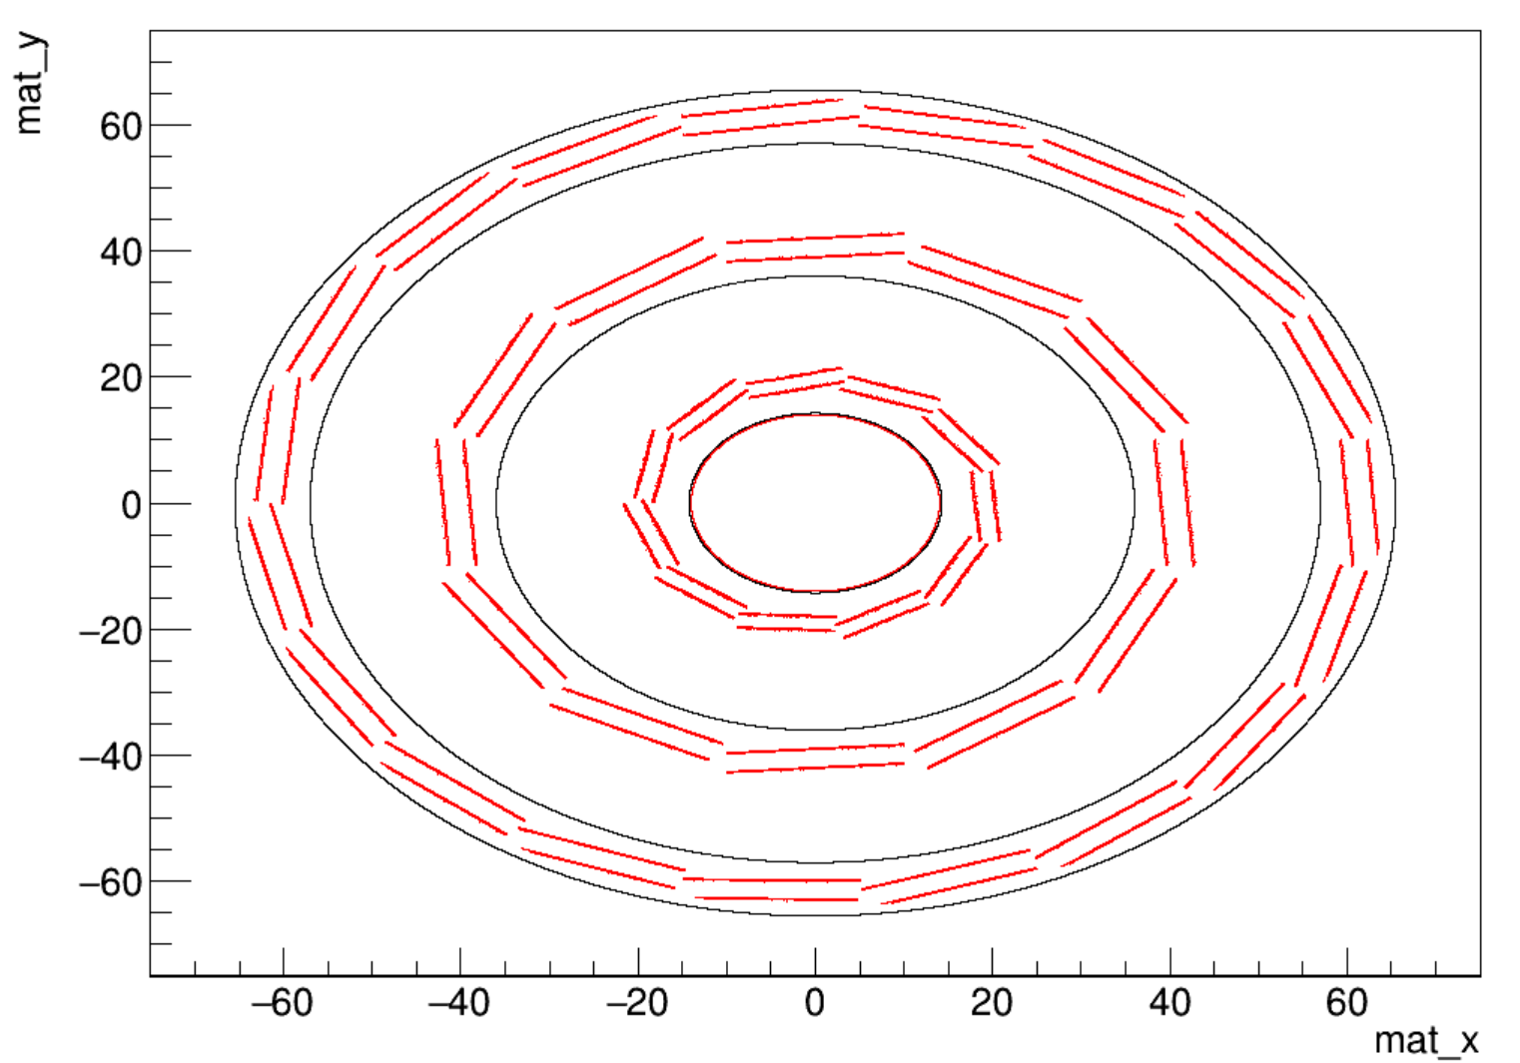
Geometry and Material mapping
Silicon trackers are built with ACTS typical building method
TPC Surface-based concept of surface : 220 cylindrical surface
Fast simulation of TPC hit
Material recording(geant4 plugin) and material mapping have been validated:
Plugin for Geant4: Recording the detailed full material
Mapping the material recorded onto the chosen binned surface
G4 mapping to surface

Slide 11
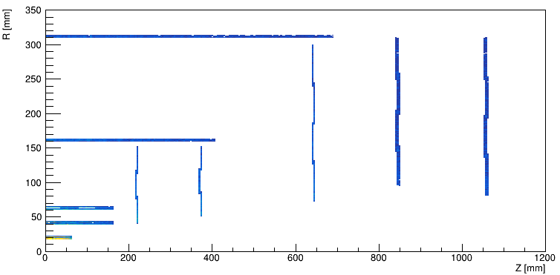
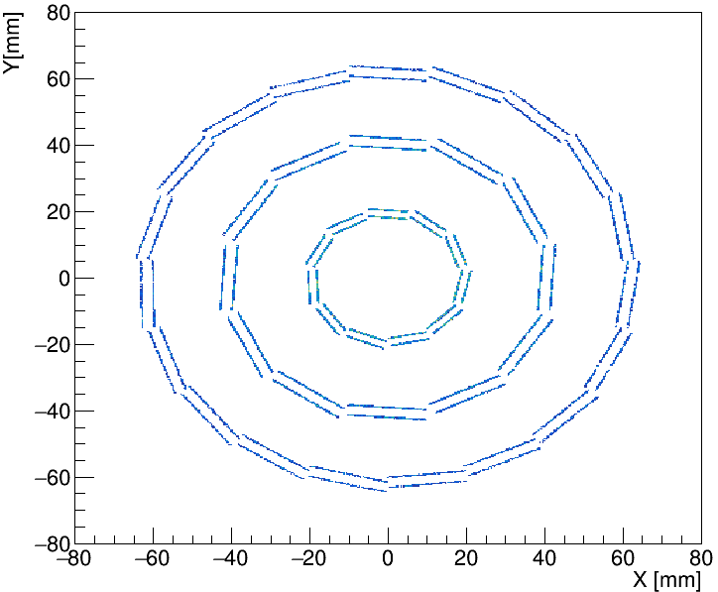
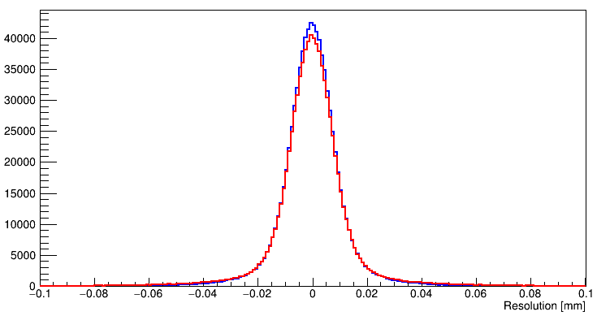
FATRAS and Kalman Filtering
Tracking Geometry debugged with the propagation tool
Validation of Kalman filter in progress
Propagation (sensitive) output
Filter
Predictor

Slide 12
Next
Recent plan
Geometry
Including geometry details of CEPC baseline design
Material mapping
TPC material strategy (volume based/surface based)
Validations between Geantino recording and material mapping
Validations of FATRAS and Kalman filter
Long perspective
Integration to the CEPC framework
Detector layout and material study

Slide 13
Backup

Slide 14
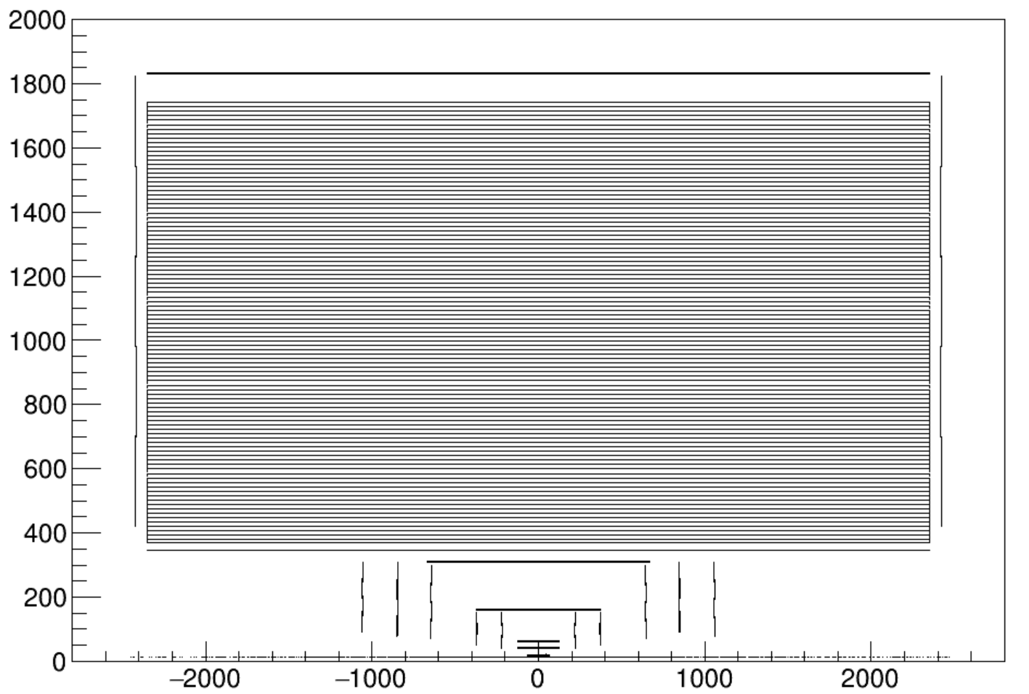
Geometry – TPC first version
Surface-based concept
Geometry: 220 cylindrical surface
Propagation/Kalman filter: with the typical ACTS tool
Digitization: a Cylinder Digitization model is needed

Slide 15
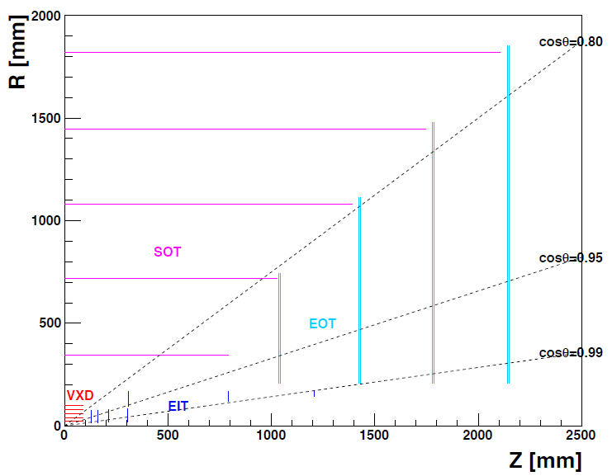
CEPC Tracker
1.CEPC Baseline tracker
Beampipe
Vertex Detector
Silicon Inner Tracker && Silicon External Tracker
Forward Tracking Detector && Endcap Tracking Detector
Time Projection Chamber
2.FST-2
Beampipe
Vertex Detector && Silicon Outer Tracker
Endcap Inner Tracker && EndCap Outer Tracker

Slide 16
BACKUP

Slide 17
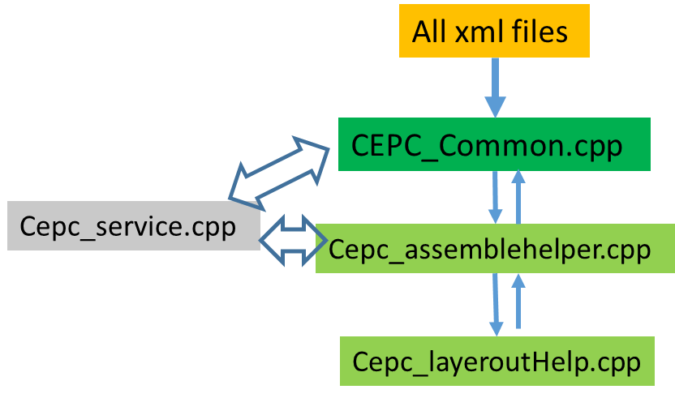
Implementation into ACTS-FW
ACTS provides TGeo and DD4hep plugins for Geometry description
DD4HEP: generic detector description for simulation and reconstruction
CEPC baseline tracker:
Source files
Xml files
Material service (further validatation)

Slide 18
Geometry
Baseline tracker
Validated silicon tracker construction process (e.g. ATLAS)
Built with ACTS typical building method

Slide 19
Tracking geometry
Each ACTS Geometry object is based on Surface or extended from Surface
Surface keeps the full details of the sensitive detector element
Supporting geometry implementation
Silicon tracker + Calorimeter + Muon
Other type of detector (wire chamber/TPC are taking consideration)

Slide 20
DD4HEP Geometry Setup
ACTS DDG4 Plugin
ACTS Plugin
G4 full simulation
Tracking Geometry
Tracking Geometry
Magnetic field
Alignment data
Long term
FATRAS
FATRAS
Digitization
Propagation
Track Fitting
….
Basic plan
Track finding
Fitting
Basic plan
Learn material budget effect
Detector layout optimization
Provide track information to Carlo and others in fast way
Long perspective
Research on if ACTS can be the future CEPC tracking sw
Performance study and comparison from current CEPC tracking sw
Some tools should be adapted for our detector (from common to specific)

Slide 21
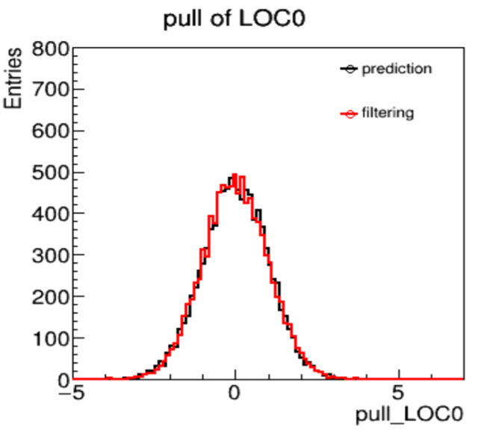
Kalman filtering
Kalman filter implemented as an Actor
Called automatically during propagation
Can update direction, uncertainties after filtering step
Aim to minimize heap allocation
Study of numerical performance (see here and here by Xiancong Ai)

Slide 22
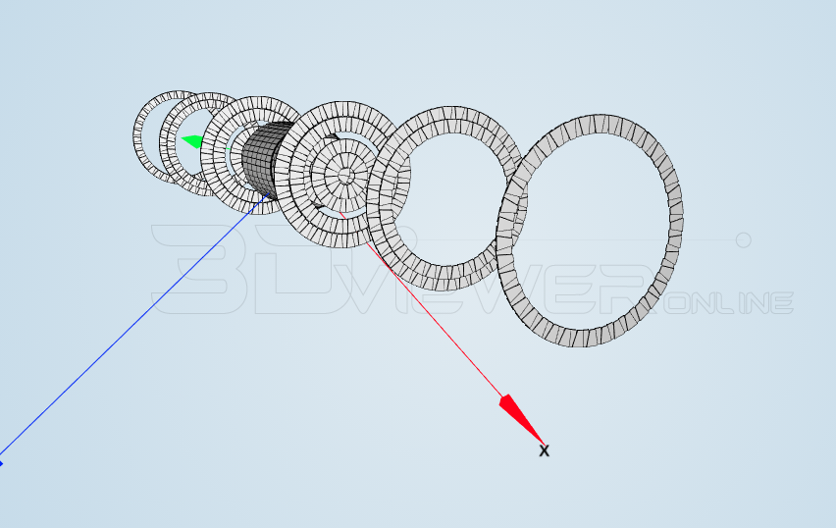
Full silicon detector option
The other part to be validated …

Slide 23
CEPC Integration
Valid a tool for
The tracking geometry should put in a right way (with propagation tool)
The material should put correct (material validation)
Tuning FATRAS to Geant4 (e.g. record the energy loss)
Kalman filter validations

