Slide 1
Design Status of CEPC Control System
Presented by Gang Li
Feb. 14th, 2020

Slide 2
Outline
Characteristics and Challenge of CEPC Control System
Feedback from 2019 CEPC IAC
Investigation and Research on key technology of control system
Summary

Slide 3
Characteristics and Challenge of CEPC Control System
Super scale--CEPC VS BEPCII, CSNS or HEPS
Linac: 1.2/1.4Km
Ring: 100Km
A large number of Controlled Equipments
Discrete distributed in the Linac and Ring
Quantity of controlled devices’ PV
Hundreds of thousands

Slide 4
Feedback from 2019 CEPC IAC
Data rate, traffic in the network
Interface between the detectors and accelerator

Slide 5
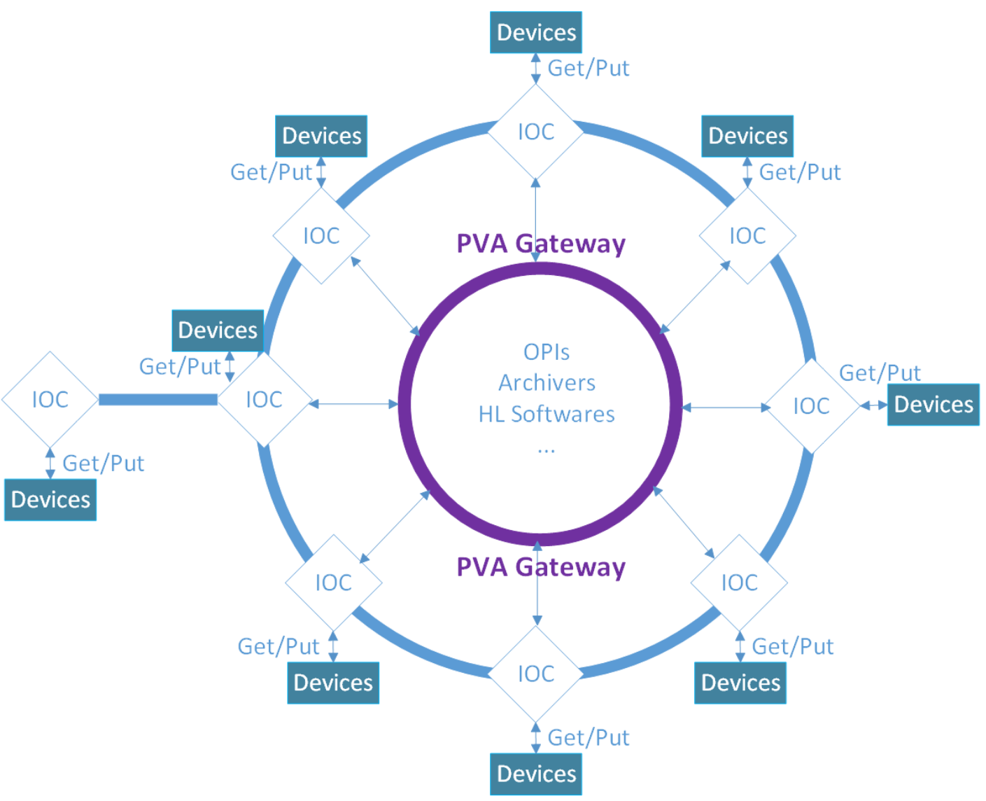
Investigation and Research on key technology of control system
Distributed control system
Based on Ethernet
Data processing
Hardware: Control Network(VLANs)
Software: PVA Gateway

Slide 6
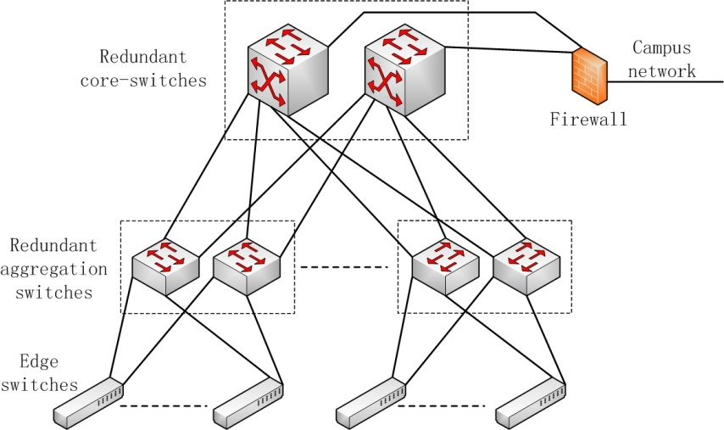
Investigation and Research on key technology of control system
Control Network
Commercial products(Huawei,Ruijie, etc)
Distance：40Km
Transmission rate：100Gbit/s，30Gbit/s
The rate of signal in optical fiber: ~0.7*c
Delay time: 200µm*2
Notes:
周长100Km，直径31.85Km，光速3*10e8，在光纤中速度约2*10e8

Slide 7
Investigation and Research on key technology of control system
Software
VLAN(Virtual Local Area Network)
Archivers
CA/PVA Gateway
…
Notes:
周长100Km，直径31.85Km，光速3*10e8，在光纤中速度约2*10e8

Slide 8
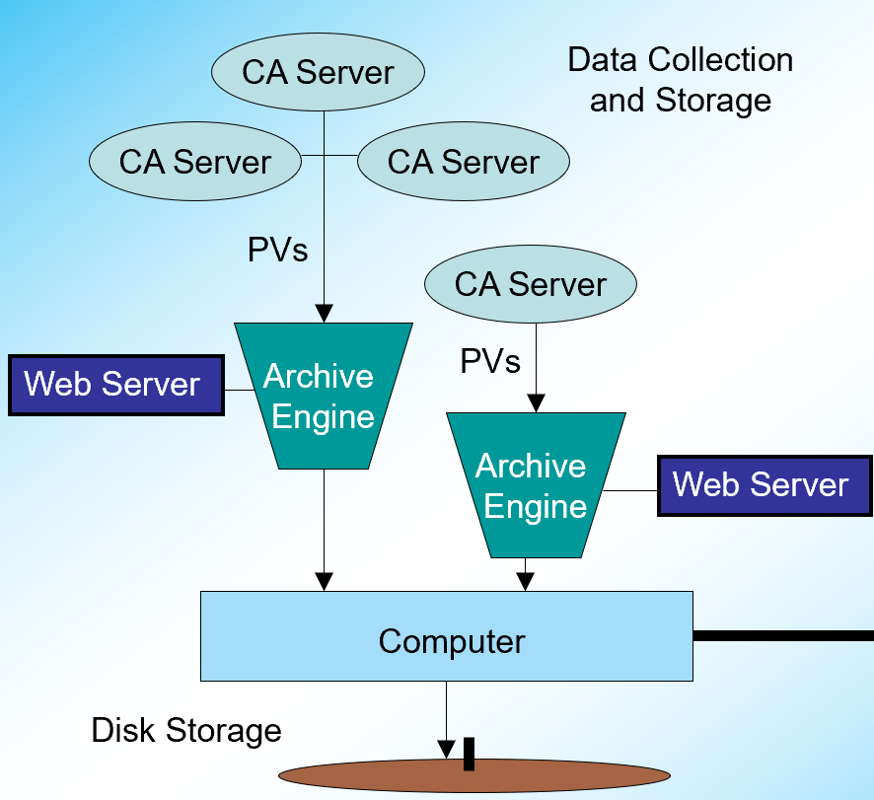
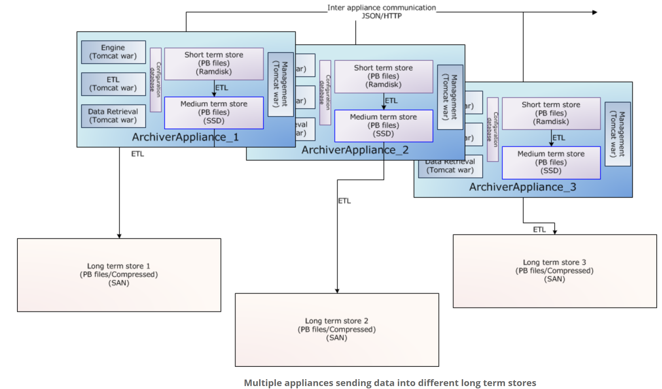
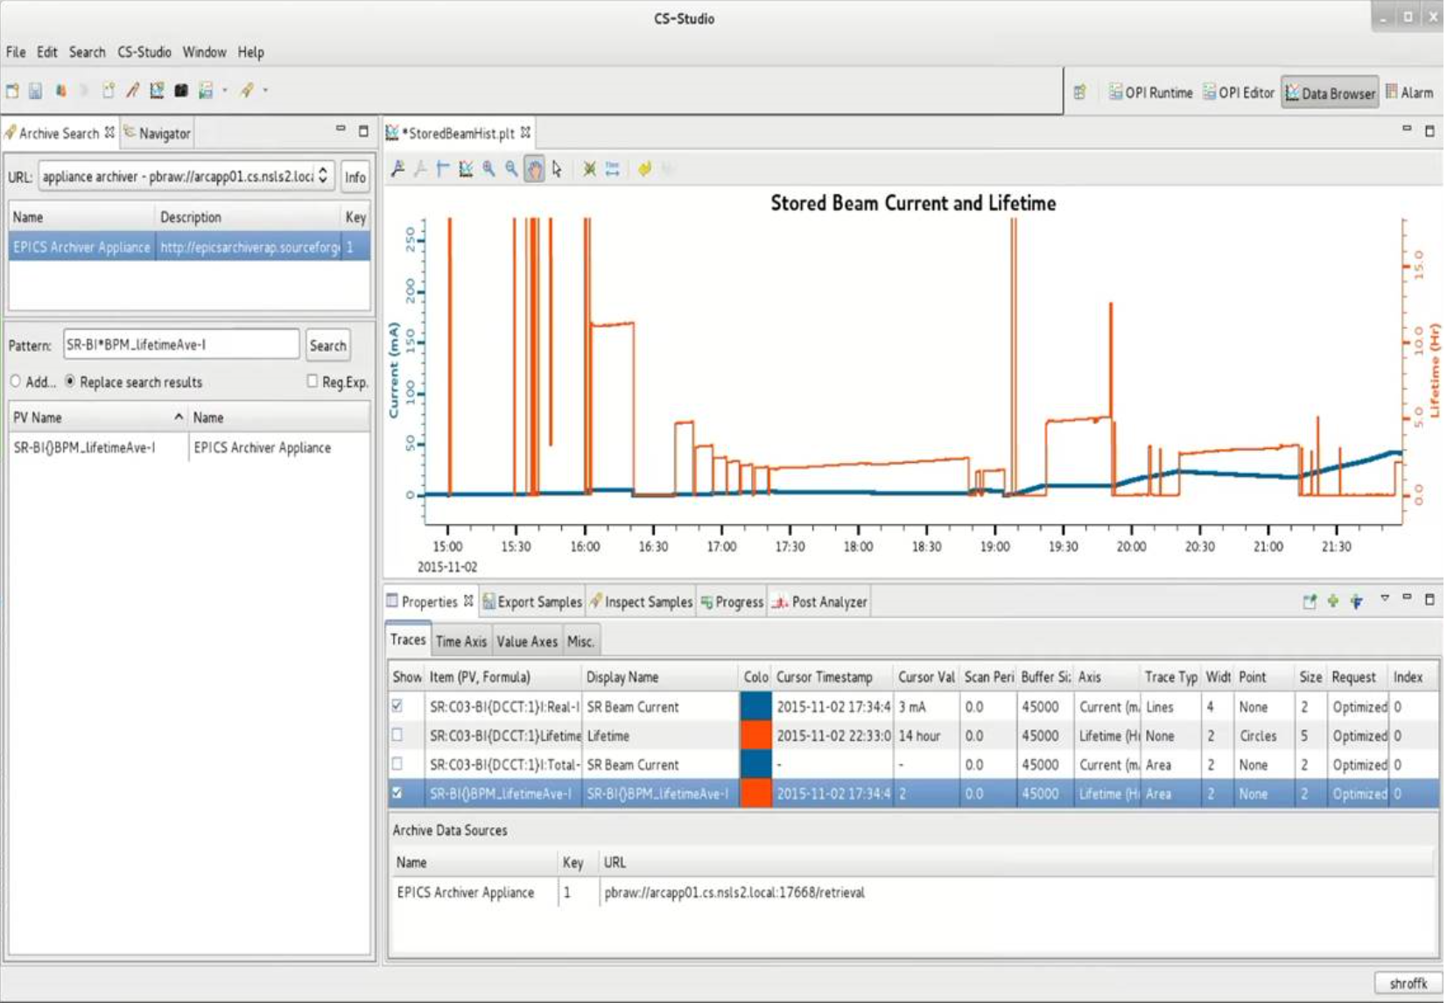
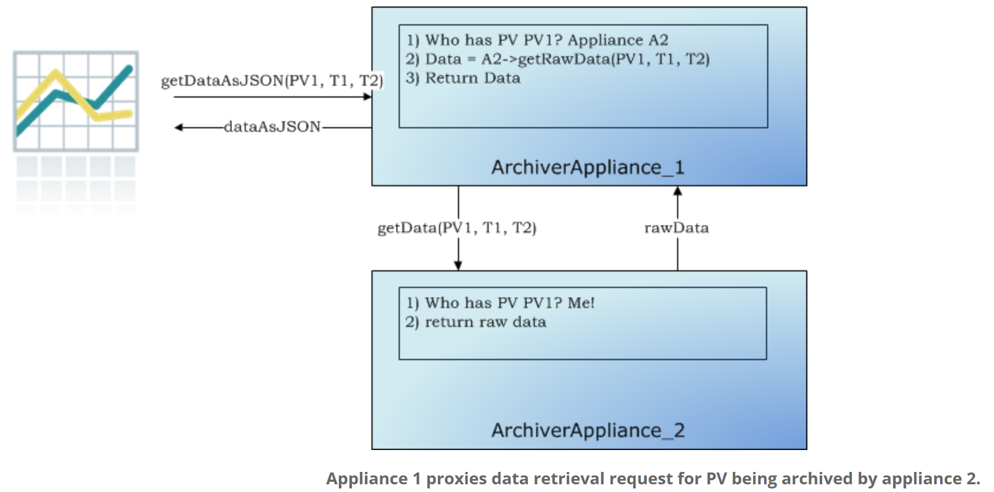
Investigation and Research on key technology of control system
Software
Data Archiver
Channel Archiver(CA)
Archiver Appliance(CA/PVA)
Archive millions of PVs
Notes:
周长100Km，直径31.85Km，光速3*10e8，在光纤中速度约2*10e8

Slide 9
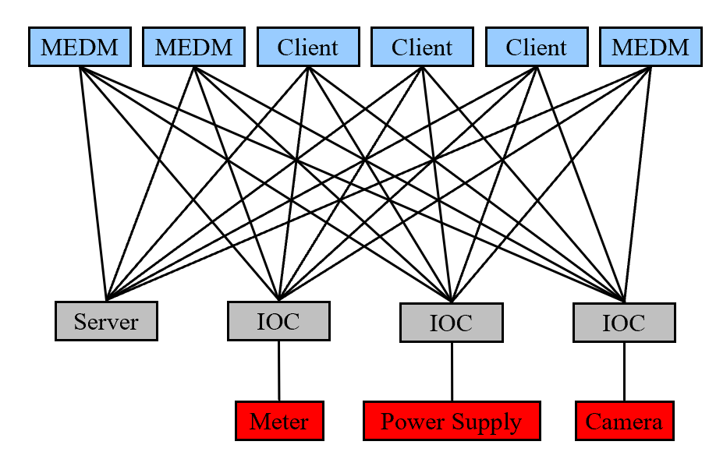
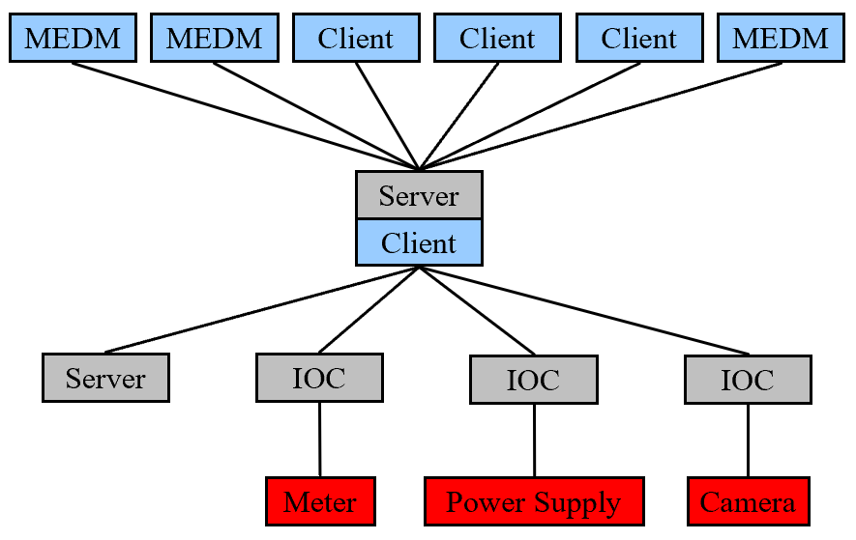
Investigation and Research on key technology of control system
Software
CA/PVA Gateway
Reduce the resource load on IOCs
M*N->M+N
CA/PVA Gateway
Notes:
周长100Km，直径31.85Km，光速3*10e8，在光纤中速度约2*10e8

Slide 10
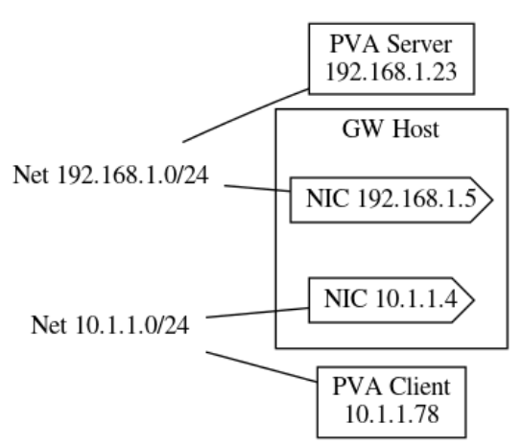
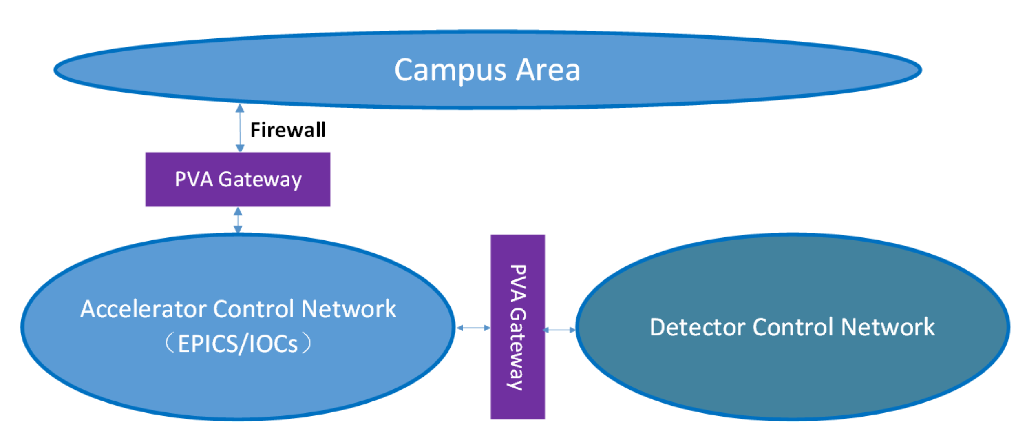
Investigation and Research on key technology of control system
Software
CA/PVA Gateway
Access control restrictions to requests from the clients
Accelerator
Detectors
Notes:
周长100Km，直径31.85Km，光速3*10e8，在光纤中速度约2*10e8

Slide 11
Investigation and Research on key technology of control system
Localization controller
PLC controller
SUPCON(浙江中控)
HollySys(和利时)
Notes:
周长100Km，直径31.85Km，光速3*10e8，在光纤中速度约2*10e8

Slide 12
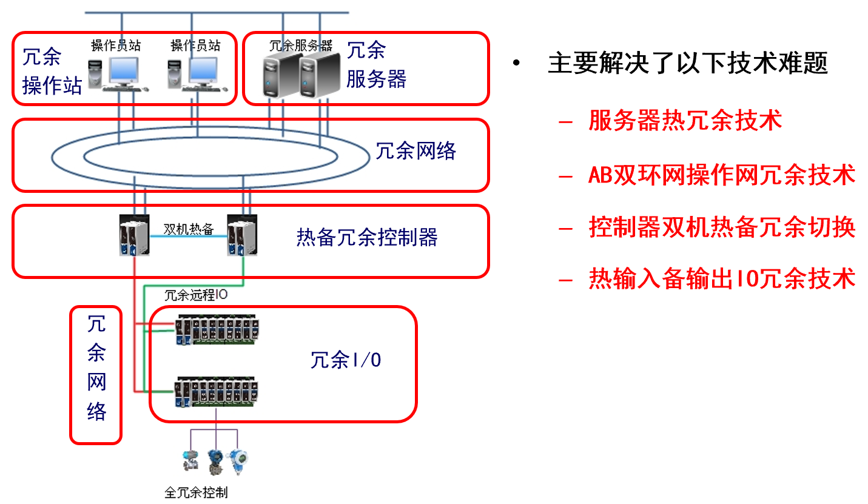
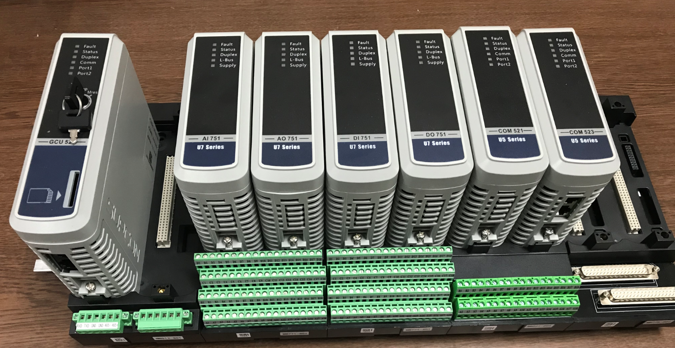
Investigation and Research on key technology of control system
Localization controller(SUPCON PLC)
2019.7/2019.12, technology exchange
Reliability
Availability
The prototype PLC at Lab
Notes:
周长100Km，直径31.85Km，光速3*10e8，在光纤中速度约2*10e8

Slide 13
Investigation and Research on key technology of control system
Interact with Detectors
Software signal
Hardware signal
Notes:
周长100Km，直径31.85Km，光速3*10e8，在光纤中速度约2*10e8

Slide 14
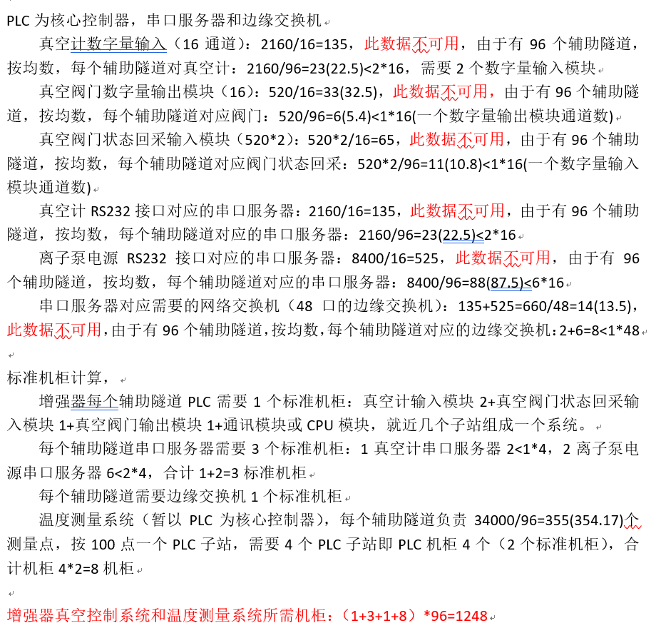
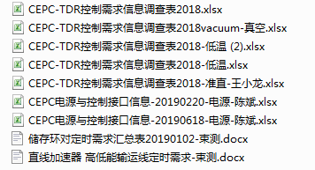
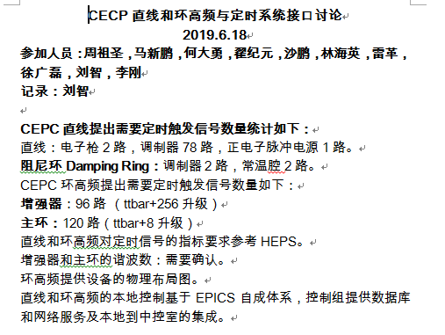
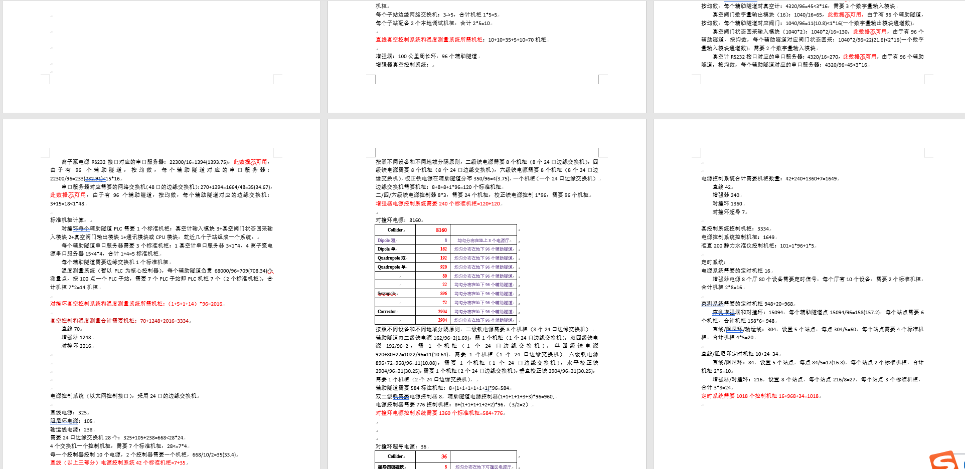
Investigation and Research on key technology of control system
Requirement information of controlled devices
Notes:
周长100Km，直径31.85Km，光速3*10e8，在光纤中速度约2*10e8

Slide 15
Summary
More detailed requirements should be further clarified, with the progress of CEPC TDR
EPICS：Cooperate closely with EPICS community
AI/machine learning in control system
Thanks a lot!

