Slide 1
CEPC Radiation protection and Dump system design status
Zhongjian MA, Guangyi TANG, Xiaohao CUI
14/02/2020

Slide 2
Dump and dump transfer line design
Recall from last report:
Based on Z-2T model, a set of kicker magnets has been used to dilute the beam horizontally and vertically
Bunch distribution on the dump surface is assumed to be 25cm x 25cm; The highest temperature rise on the dump core is reasonable from thermal conduction formula calculation
The length of transfer tunnel is about 100m; the diameter is about 2m, considering the vacuum equipment, pipe installation
The size for dump cavern is about 5m in transverse and 7m in longitudinal
Operation Model | Energy GeV | number of particles per bunch 10^10 | bunch number | beam current mA | Lifetime h | Beam loss electrons/s | beam loss power W/m | Time/s Dump in one cycle | beam current cal mA | energy stored in the tunnel/ MJ | Prompt Power on the target / MW
tt | 175 | 24.15 | 34 | 3.95 | 0.7 | 3.26E+09 | 9.12E-04 | 3.33E-04 | 3.94 | 0.23 | 6.90E+02
Higgs | 120 | 17 | 218 | 17.8 | 0.22 | 4.68E+10 | 8.98E-03 | 3.33E-04 | 17.79 | 0.71 | 2.13E+03
W | 80 | 12 | 1568 | 90.4 | 1.2 | 4.36E+10 | 5.58E-03 | 3.33E-04 | 90.32 | 2.41 | 7.23E+03
Z-2T | 45.5 | 8 | 12000 | 461 | 2 | 1.33E+11 | 9.71E-03 | 3.33E-04 | 460.80 | 6.99 | 2.10E+04
Z-3T | 45.5 | 15 | 15000 | 1081.4 | 1.8 | 3.47E+11 | 2.53E-02 | 3.33E-04 | 1080.00 | 16.38 | 4.91E+04

Slide 3
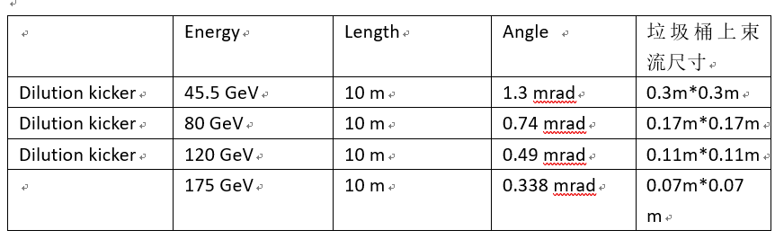
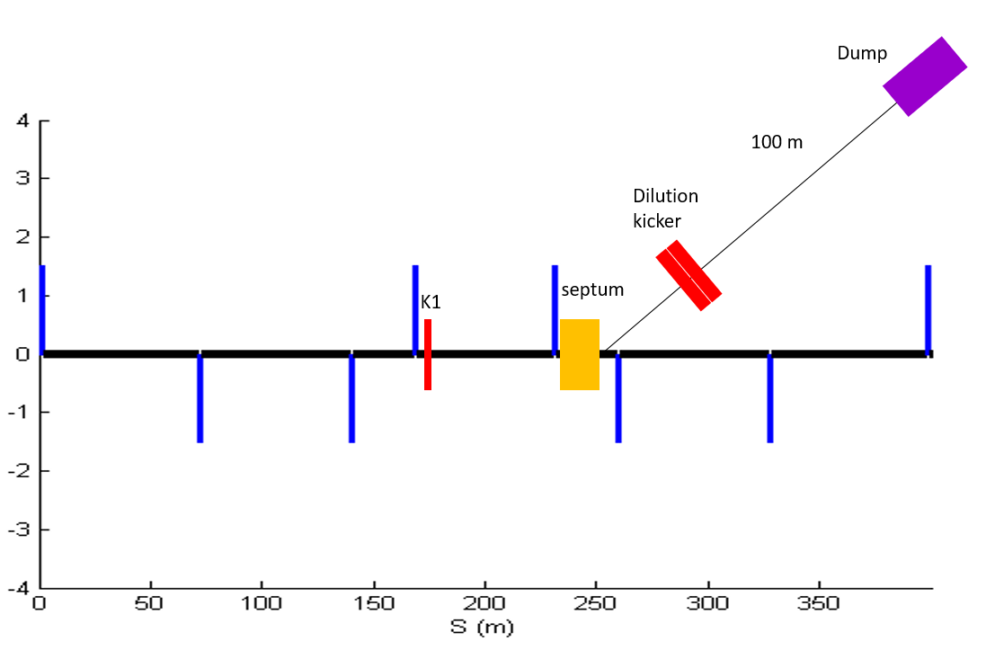
Dump Lattice design
Keep the drift distance is 100m, two sets of dilution kicker requirement was designed by Cuixh
Set 1: keep the magnet strength is the same
Set 2: maximum the bunch distribution on the dump surface, about 30cm*30cm
Need to be further discuss:
The transfer line inside the tunnel lasts long that may effect the components layout near the CEPC beam line; also have to consider the bypass method for the future SPPC beam line;

Slide 4
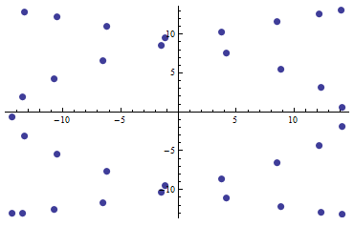
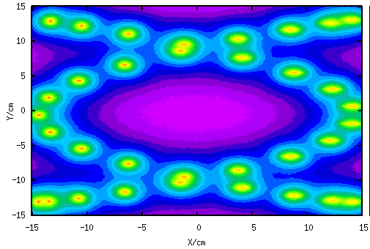
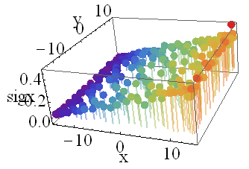
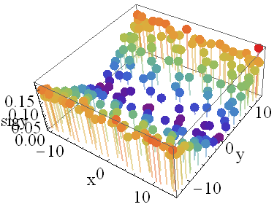
Bunch distribution and analysis
The distributions of bunches for 5 operation models on the dump surface is simulated by Dr. Cui Xiaohao.
Focus on 4 sub regions because the bunches in these regions are smaller than any others.
Revised Fluka to enlarge the limit on number of bins;
Bin size is about mm@z direction and ten um@xy direction
Find the bin which contain maxium energy deposition
Import to ANASYS to analyze the material stability.
Bunch distribution-tt model
Energy deposition on the dump core
Sig_x & Sig_y analysis for bunch distribution

Slide 5
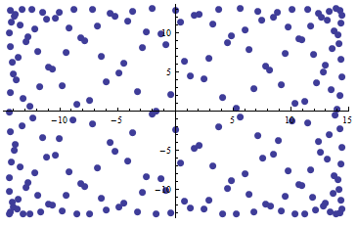
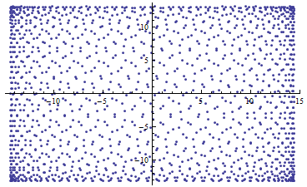
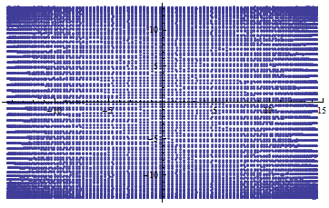
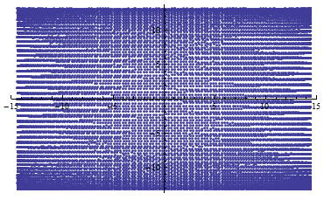
Bunch distribution and analysis-con
Higgs mode
Z 3T
W threshold
Z 2T high-lumi
Z-3T
Z-2T

Slide 6
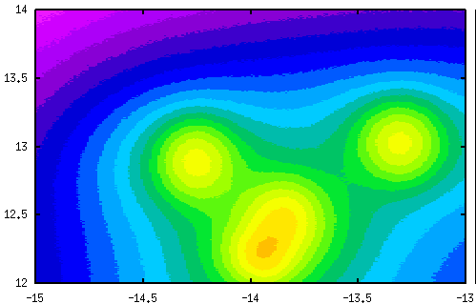
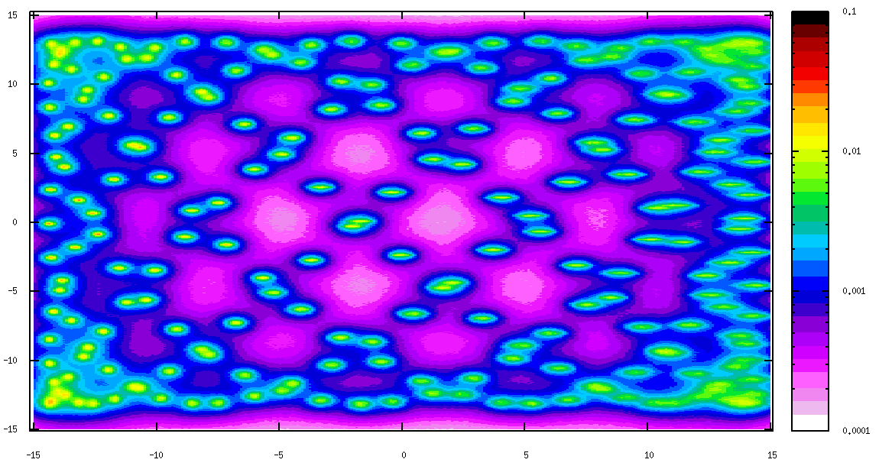
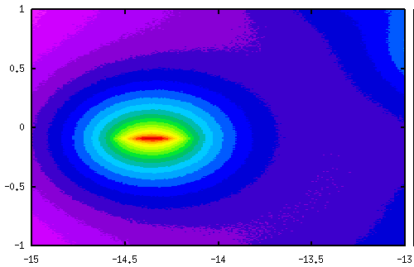
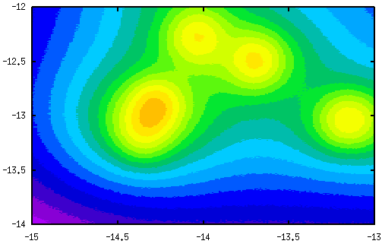
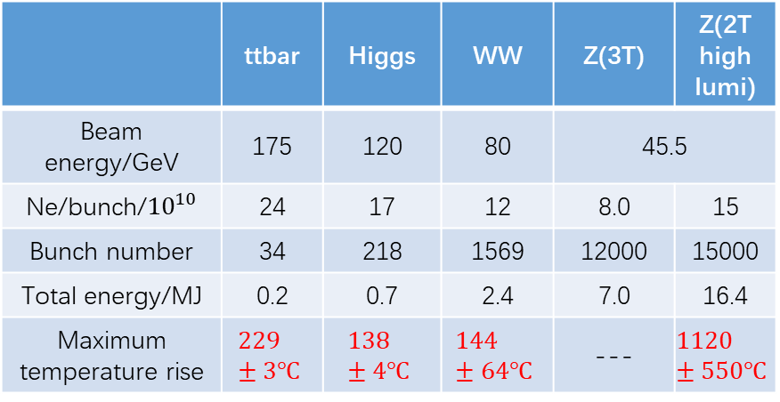
Energy deposition and temperature rise-pre
 | ttbar | Higgs | WW | Z(3T) | Z(2T high lumi)
Beam energy/GeV | 175 | 120 | 80 | 45.5
Ne/bunch/${10}^{10}$ | 24 | 17 | 12 | 8.0 | 15
Bunch number | 34 | 218 | 1569 | 12000 | 15000
Total energy/MJ | 0.2 | 0.7 | 2.4 | 7.0 | 16.4
Maximum temperature rise | $$229±3℃$$ | $$138±4℃$$ | $$144±64℃$$ | --- | $$1120±550℃$$
Table: The highest temperature rise in the setting bins was found
Figure: Energy deposition map for Higgs model, from Fluka simulation

Slide 7
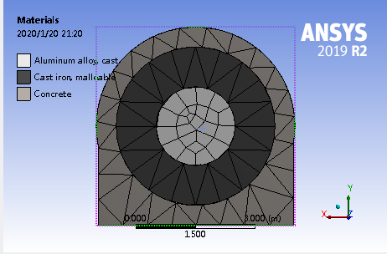
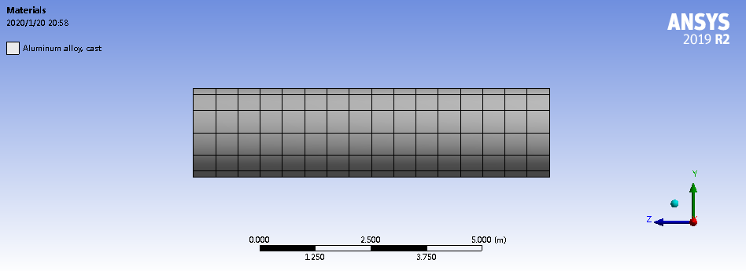
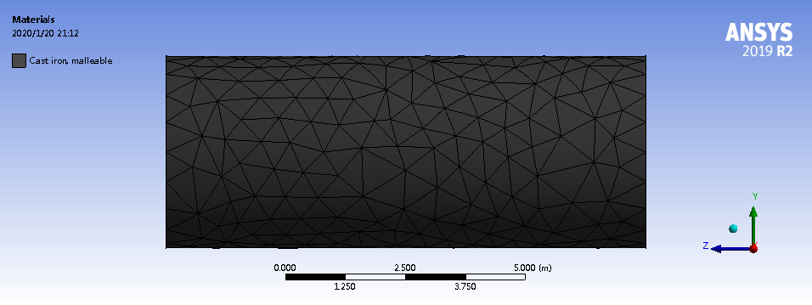
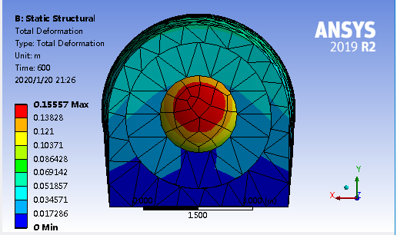
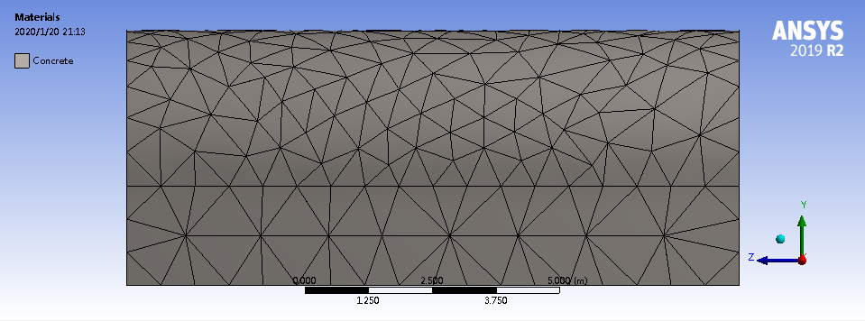
ANSYS: mechanical simulation
Geometry: cylinder, Al absorber surrounded by Cast iron and concrete
Thermal-static structural model:
A uniform heat generation in the core is used to test the model. Deformation is shown in the lower figure.
Next step:
Import the energy distribution from Fluka simulation.
Besides deformation, study more properties

Slide 8
Many thanks!
Materials are offered by Guangyi TANG, Xiaohao CUI; useful discuss with Jianli WANG; ANSYS software supported by Haijing WANG;

