Slide 1
Progress of Mechanics system
Haijing Wang
CEPC DAY, 2020/2/14

Slide 2
Overview
Progress since 2019/06/28 (Last report on CEPC day):
Supports
Movable collimators
MDI mechanics
Installation scenarios
Remote vacuum connection
Cryostat support system

Slide 3
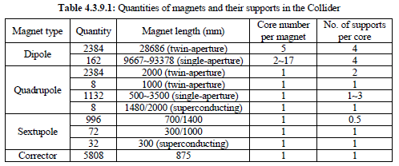
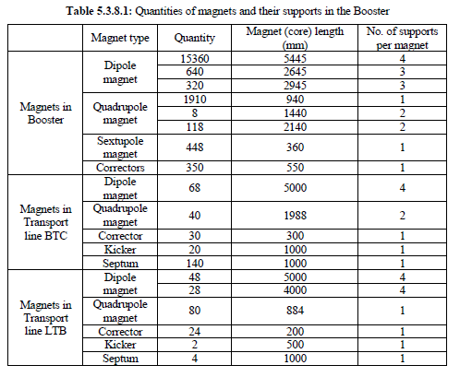
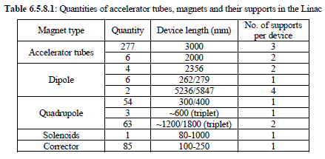
Supports
Over 80% of the length is covered by magnets of about 138 types, each magnet needs to be supported.
Accelerating tubes, vacuum tubes, instruments…, all need supports.
We has began the cooperation on design with members of CIPC

Slide 4
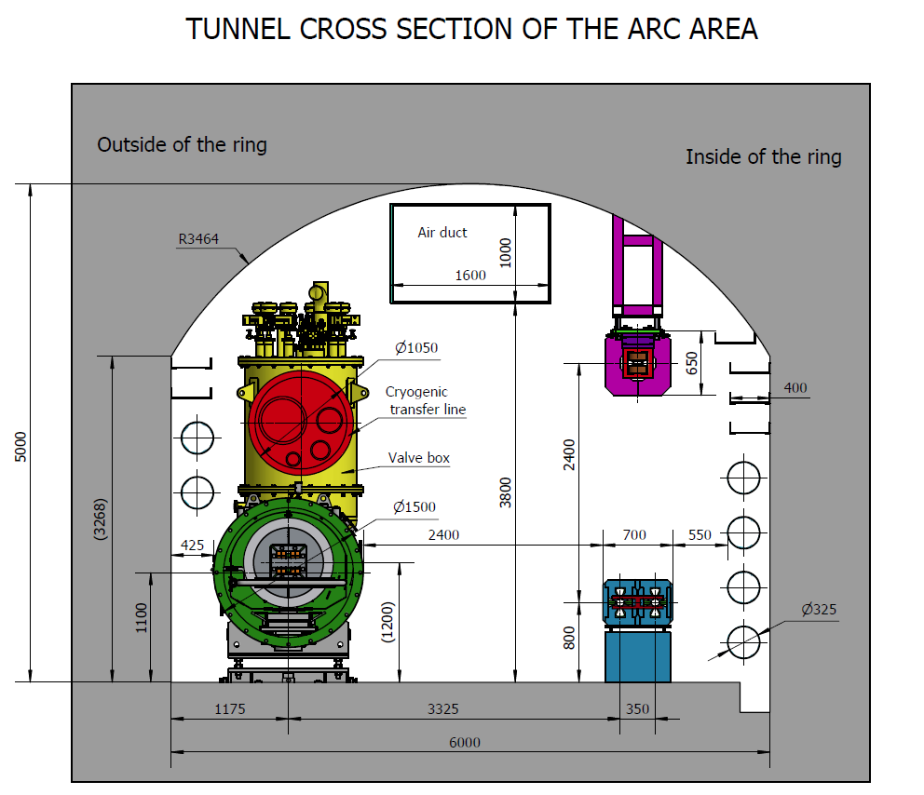
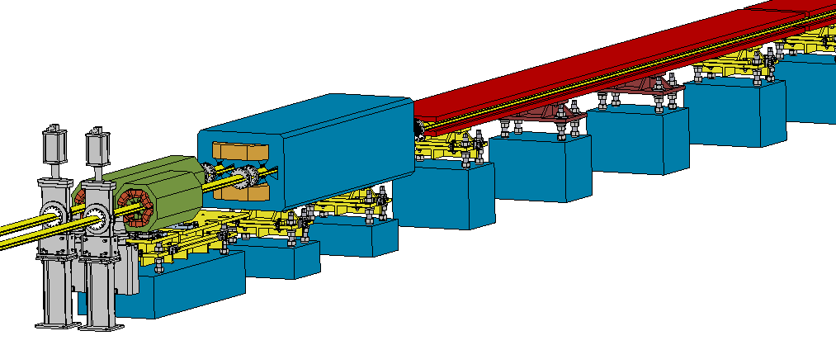
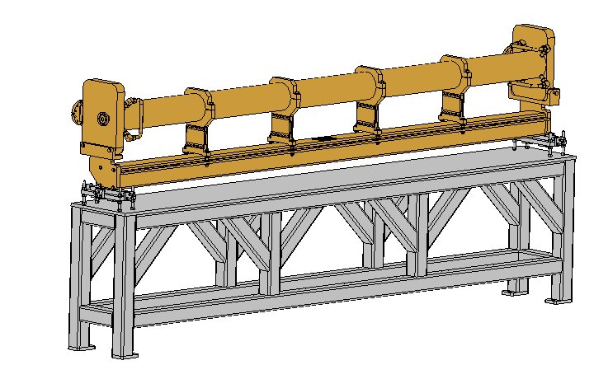
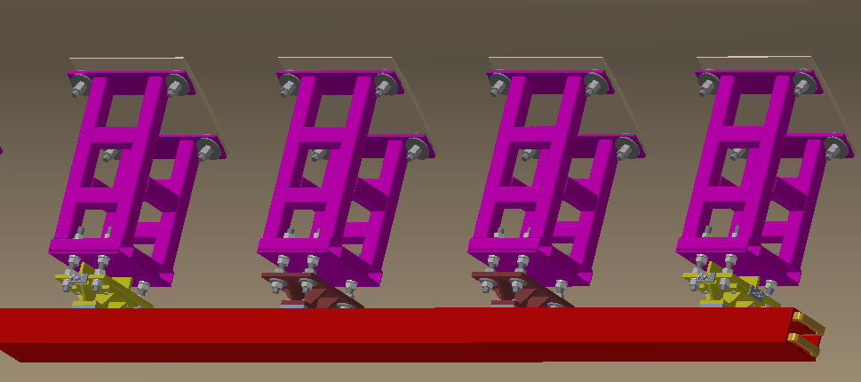
Supports
Booster
Collider
Common girders for quadrupoles and sextupoles are also in consideration
Pre-aligned units can save workload in tunnel and reduce the relative misalignment
Long and thin, hard to design in stiffness
No change for the supports in Booster and Linac

Slide 5
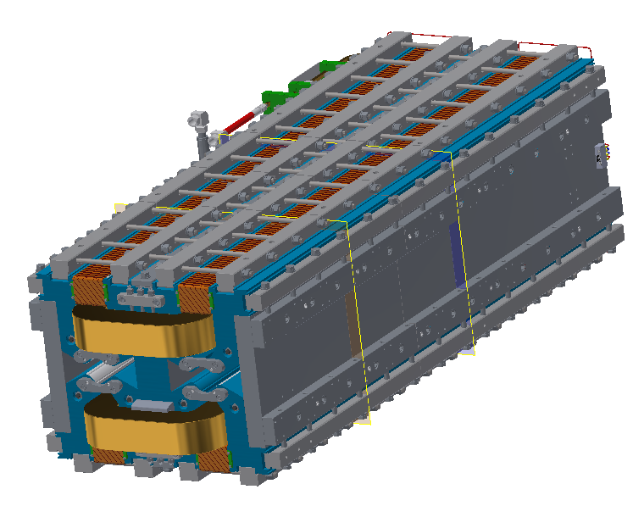
Tunnel mockup
A tunnel mockup is designed for the interface checking of the equipment locations, installation, alignment and transportation. It includes part of arc section and part of RF section.
Total length: 40 m
The relative locations between magnets in each ring is the same as the lattice design.

Slide 6
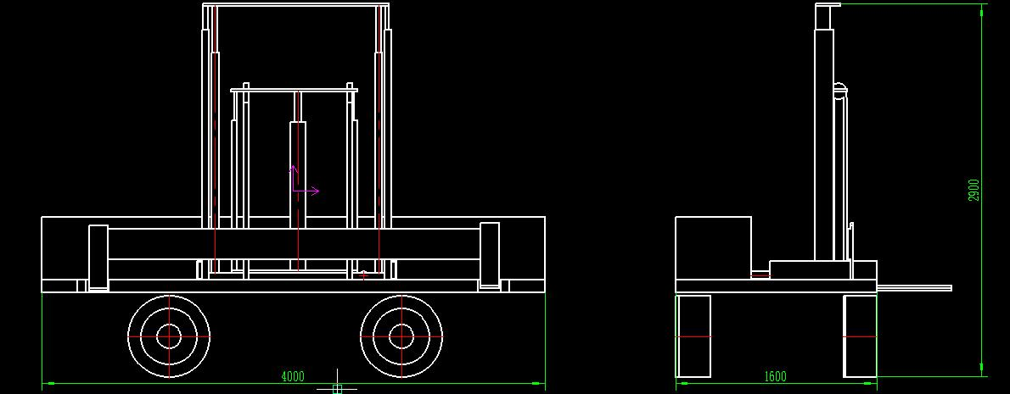
Transport vehicles
Over 80% of the tunnel length is covered by magnets. Efficiency of transportation and installation must be considered.
Transport vehicles are designed for the magnets transportation and coarse positioning.
Accuracy of coarse positioning: better than 0.5 mm.
Vertical driven unit
Load support
Balance weight
Chassis
Horizontal driven unit
* Cooperate with Beijing North Vehicle Group Corporation.

Slide 7
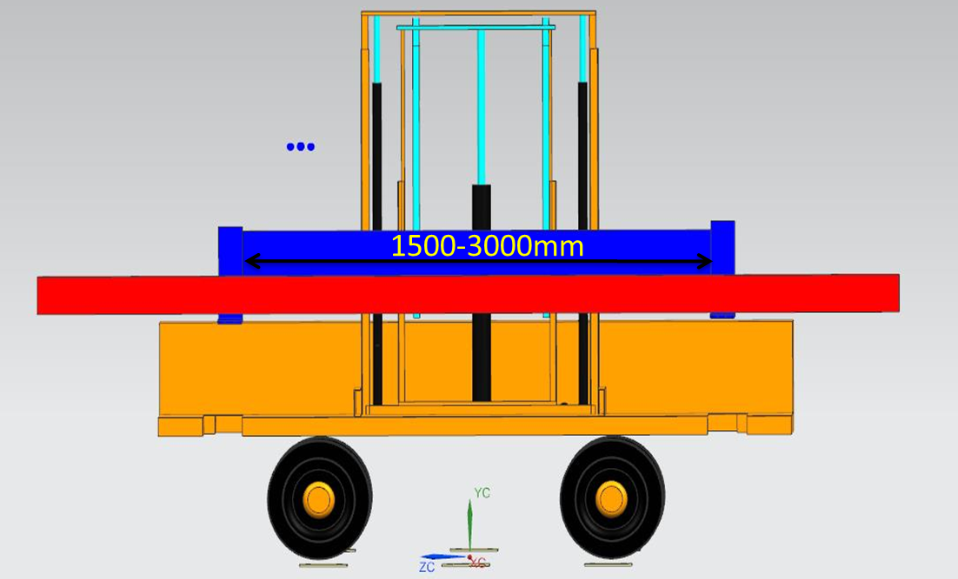
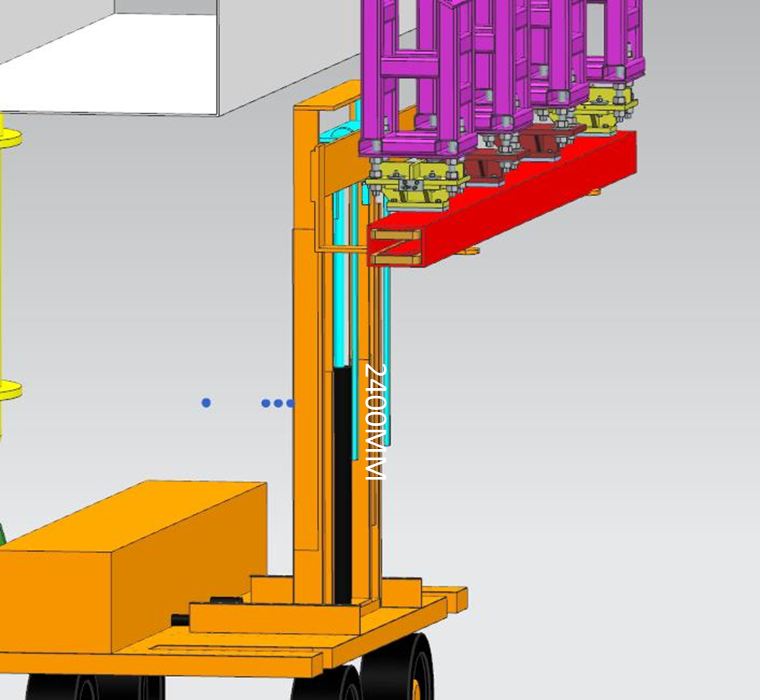
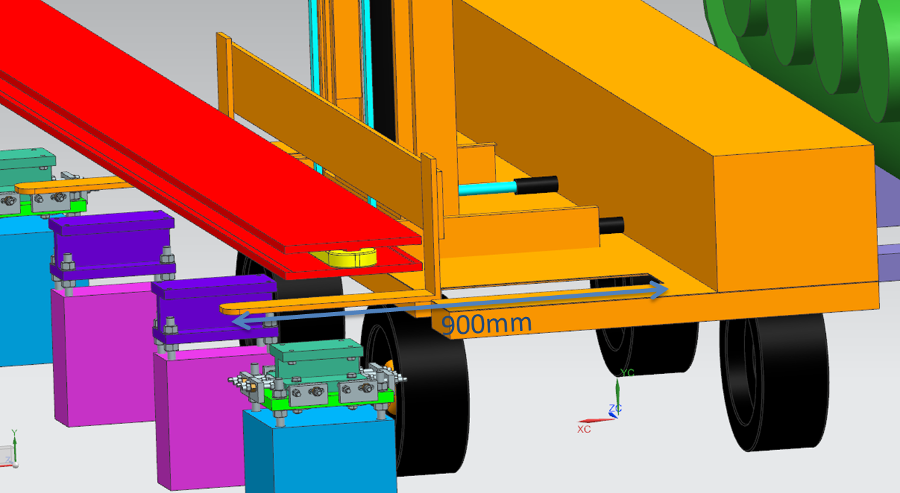
Transport vehicles
Flexible load support for “long” devices and “short” devices
Transportation and coarse location of magnets in Booster
Transportation and coarse location of magnets in Collider
* Cooperate with Beijing North Vehicle Group Corporation.

Slide 8
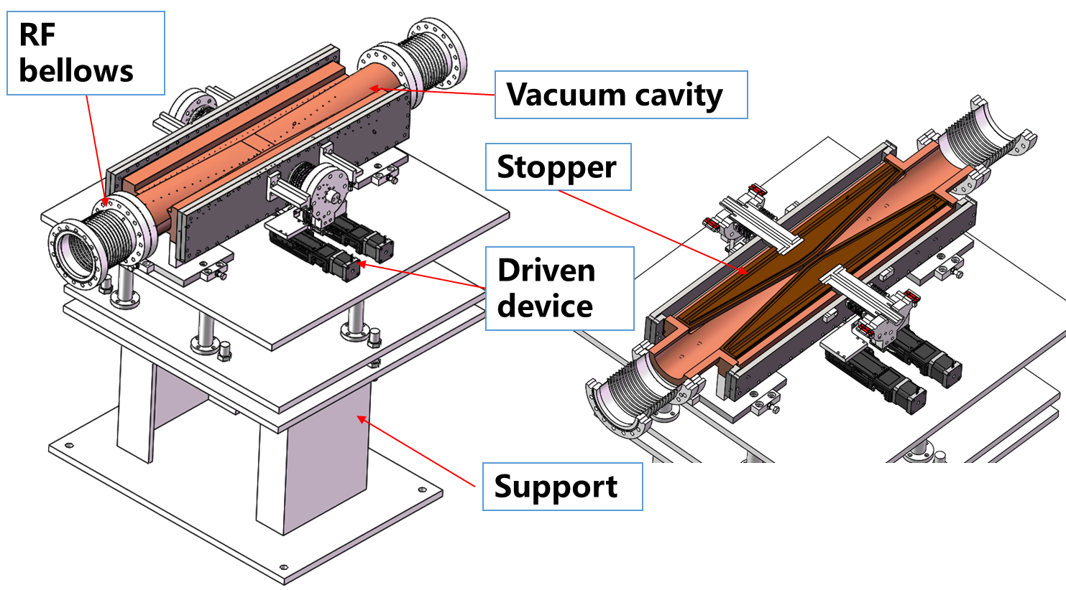
Movable collimators
Located in straight section between two dipoles, the length is 800 mm.
Five horizontal collimators in each ring are designed in the TDR stage.

Slide 9
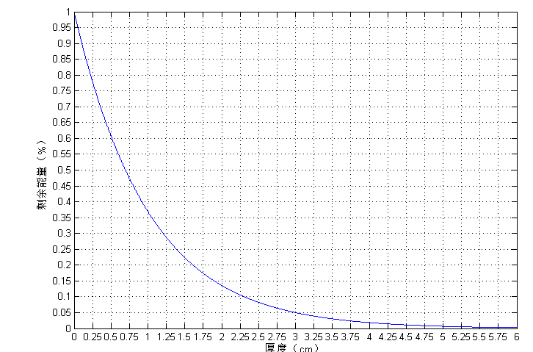
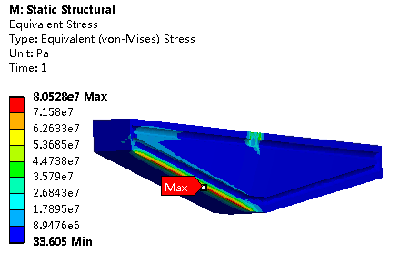
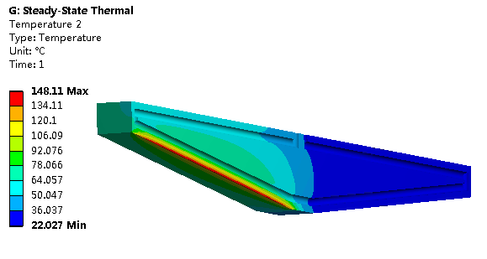
Movable collimators
Synchrotron radiation: 7700W @120GeV, 30MW.
Preliminary thermal-static analyses by synchrotron radiation have been done. Material: Glidcop-Al15.
Photon energy damping in
Copper @ 300 KeV
Highest Von Mises Stress by synchrotron radiation: 81 MPa
Highest temperature by synchrotron radiation: 148 ℃
Cooling method | Loads | Highest temperature（℃）
Copper & water | Surface load | 286
Copper & water | Volume load (Damping of X ray) | 148
Laminated material & water | Surface load | 146

Slide 10
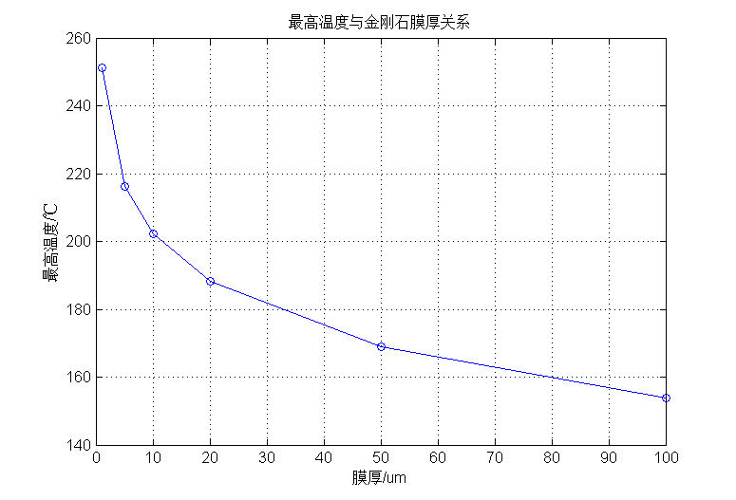
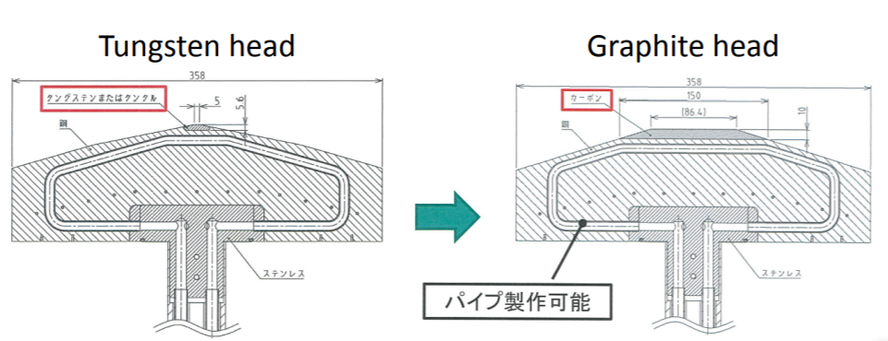
Movable collimators
Laminated materials with metal and high-thermal-conductivity membrane is considered for severe heat load.
Y: Highest temperature;
X: Thickness of membrane of high thermal conductivity
Laminated material with copper and graphene film
* From Carsten Niebuhr, IAS MDI Workshop, Hongkong, 16.-17.01.20

Slide 11
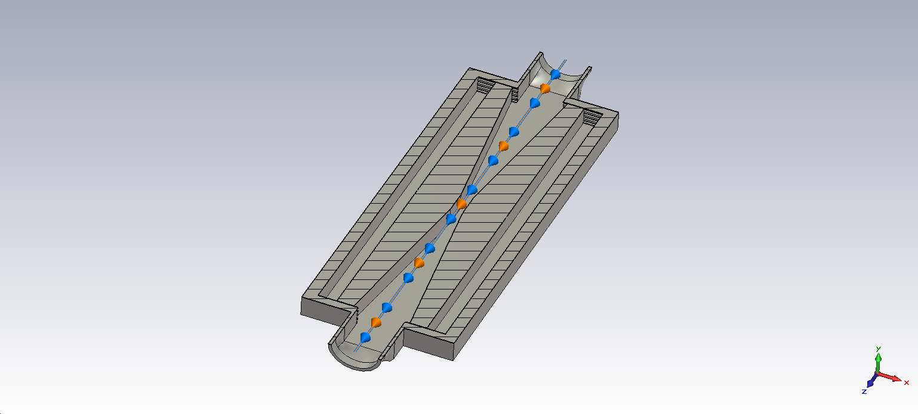
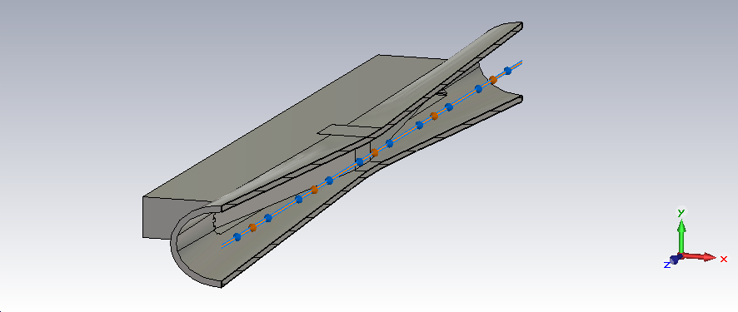
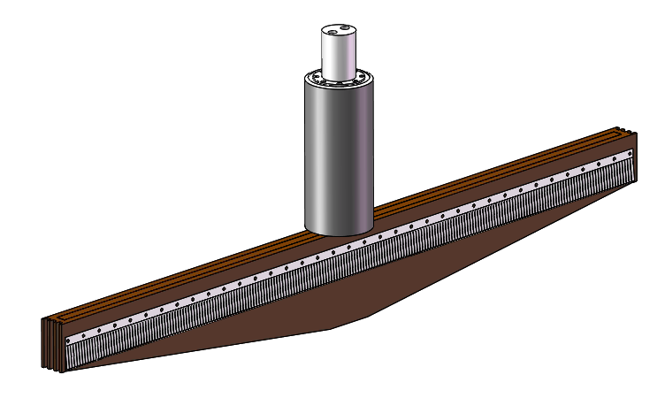
Movable collimators
Two inner profiles are designed, gradual rectangle and gradual ellipse with movable stoppers in them.
RF fingers are at the edges of the stoppers to decrease impedance.
Gradual rectangle profile
Gradual ellipse profile
 |  | Energy loss (no RF fingers) (W)
 |  | Higgs | W | Z
Gradual rectangle profile | Stopper open | 66 | 267 | 933
 | Stopper closed | 39 | 160 | 560
Gradual ellipse profile | Stopper open | 8 | 32 | 112
 | Stopper closed | 19 | 76 | 266
* From Y Liu et al., Impedance and Collective Instabilities for Collider, Booster and damping ring in CEPC, this workshop

Slide 12
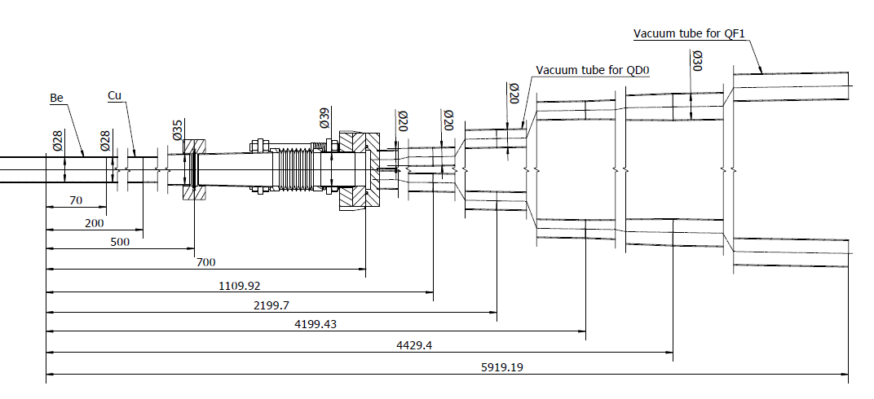
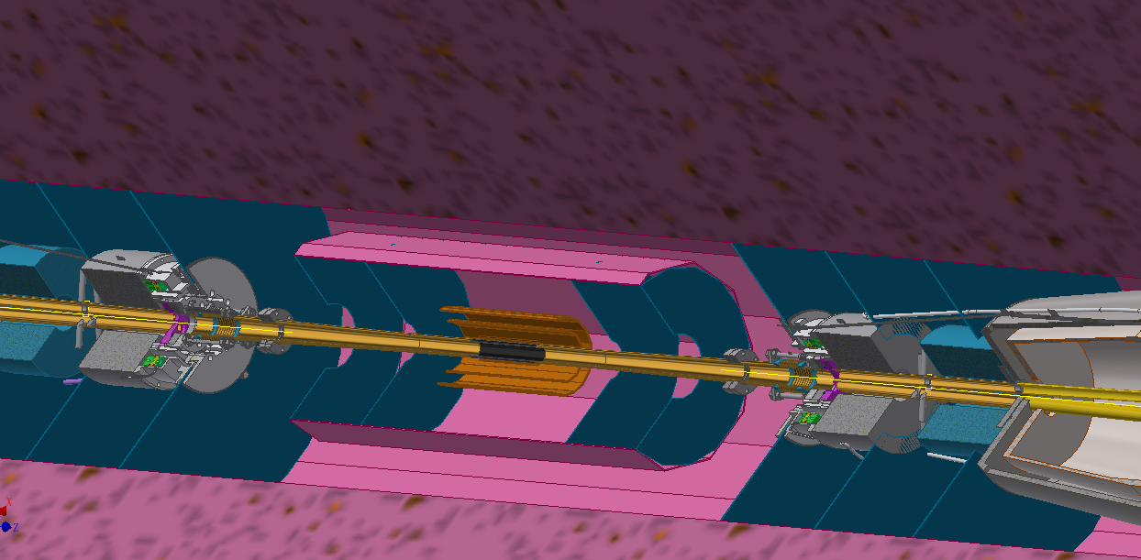
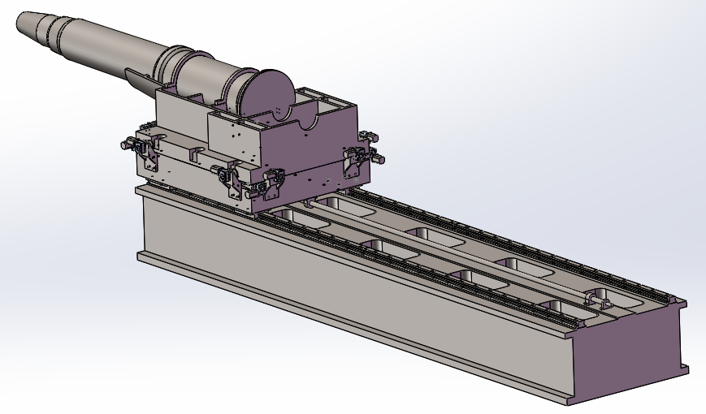
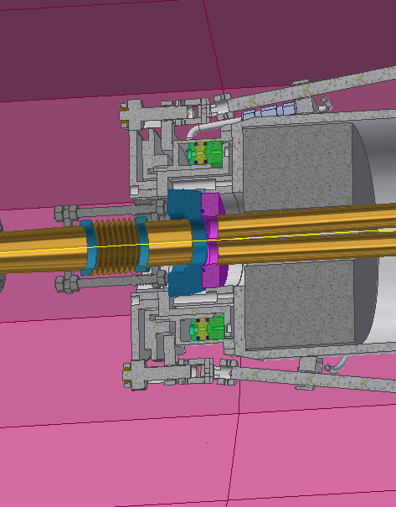
MDI mechanics
IP chamber & pixel support by Q. Ji
First vacuum pump @±6.5m
Connection interface of detector and accelerator
SC magnets, cryostat and their support

Slide 13
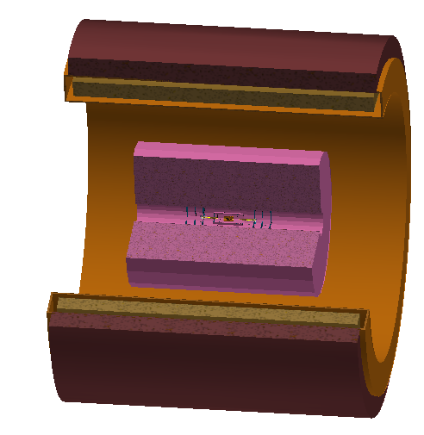
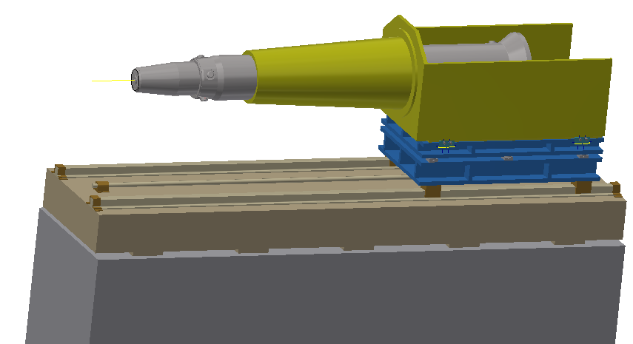
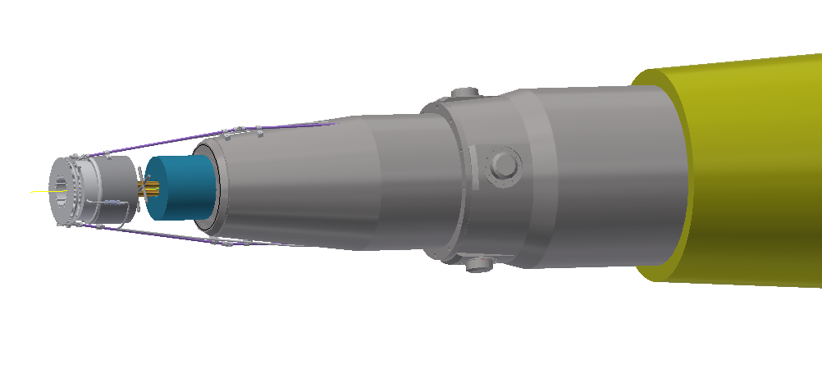
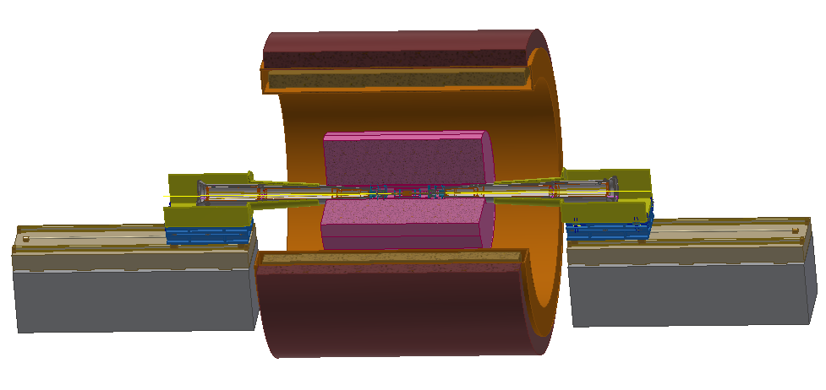
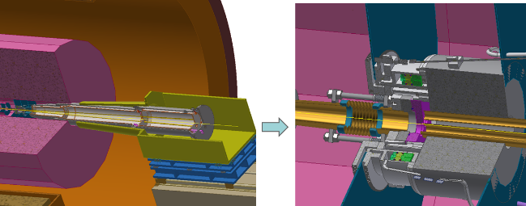
MDI mechanics
Installation scenario of MDI
Assume the IP chamber and the detectors, the yoke have been installed.
The remoted vacuum connection methods will be used.
The support system of cryostat is under studying.
The idea of Lumical being moved to the detector part has been discussed.
Pre-alignment of SC magnets and installation of accelerator components
The similar procedure at the other side
The connection and alignment of one side

Slide 14
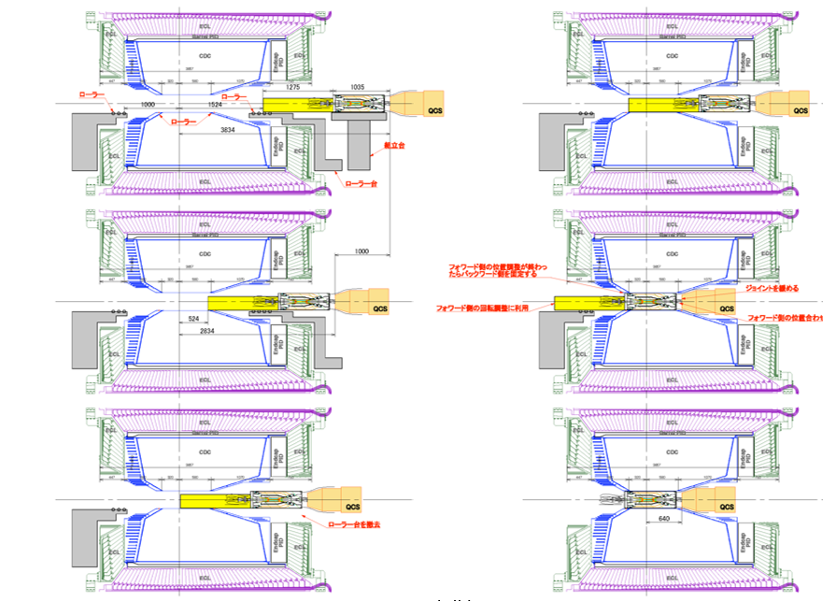
MDI mechanics
An alternative scenario
The baseline of SuperKEKB before the validation of RVC.
This scenario is connecting one end of IP chamber with cryostat outside the detector .
But unlike the asymmetry of SuperKEKB MDI, this scenario can't cut out the remote vacuum connection at the other end of IP chamber.
Not advisable
From K. Kanazawa of KEKB, the 18th KEKB Accelerator Review Committee, 2013

Slide 15
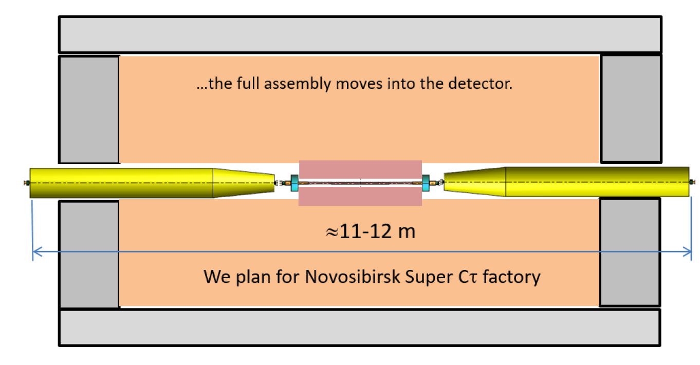
MDI mechanics
Another alternative scenario
The method like DAFNE. Being considered by FCC and BINP.
This scenario is connecting both ends of IP chamber outside the detector like
DAFNE.
The two cryostats can be well pre-aligned but it is impossible to move the whole assembly into the detector without changing the size of detector hole.
Not advisable
A. Bogomyagkov, et al., Mechanical design of the FCC-ee interaction region, FCC week (24 –28 June 2019) Brussel
A.Bogomyagkov, MDI issues of BINP Super TauCharmfactory, Report on IAS 2020.(Hongkong, 2020).

Slide 16
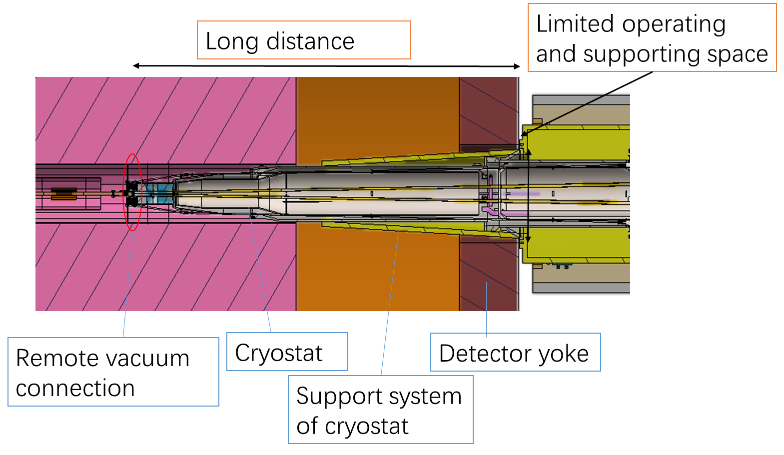
MDI mechanics
Lists to be done:
Vacuum connection method. Leak rate requirement: ≤2.7e-11Pa.m3/s
Support system. Alignment error requirement: ≤30 μm, at least ≤50 μm.
3D layout of all the components, find and solve the space problems.
The vacuum tubes and cooling methods.
Integration of accelerator and detector, and the installation and replacement scenarios.

Slide 17
 | Distance from yoke boundary to connection location (m) | Alignment requirements of SC/ deformation of cryostat (μm)
BEPCII | ~2.3 (has manual operation space) | Tested deformation: 960
SuperKEKB | ~3.5 (the longer side) [1] | Analyzed deformation: 900 [2]
FCC-ee | ~4.37 [3] | Alignment error: ≤50 [4]
CEPC | ~3.8-6.1 * | Alignment error: ≤50
[1] Hiromi linuma, SuperKEKB status. Report, Nov, 2013。
[2] Hiroshi Yamaoka, et al, The mechanical and vibration studies of the final focus magnet-cryostat for SuperKEKB. Proceedings of IPAC 2014, Dresden, Germany.
[3] M. Koratzinos, Overview of MDI at FCC-ee, Report on IAS 2020.(Hongkong, 2020).
[4] Future Circular Collider Study. Volume 2: The Lepton Collider (FCC-ee). Conceptual Design Report. V0.20, 8 Nov, 2018
*: The distance needs to be discussed further. The current design is based on the shortest version.

Slide 18
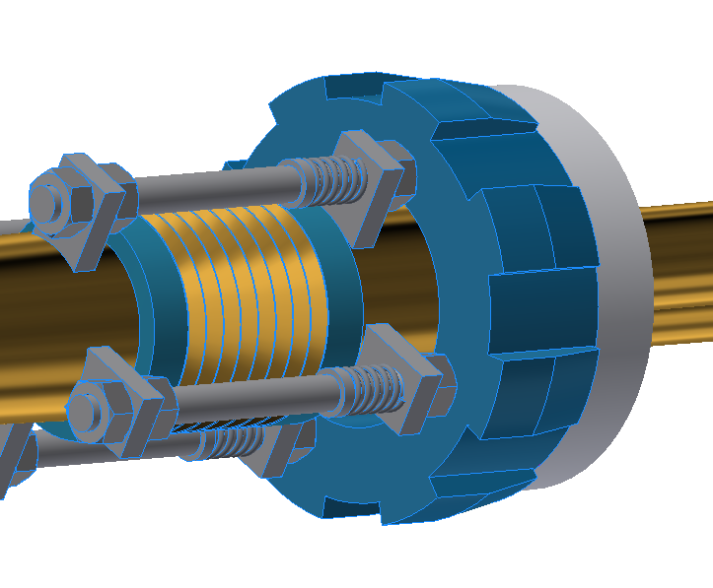
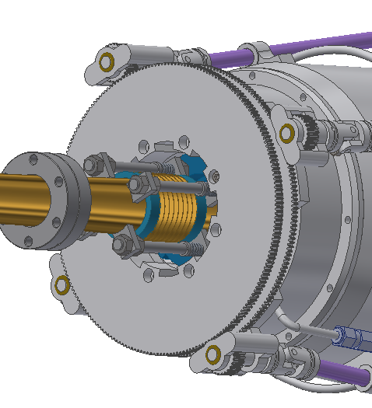
MDI mechanics-Remote vacuum connection
RVC Design
Spline flange
Spline gear
Flange
Pneumatic annular
Limit pin
Support
Screw thread
Spline gear
Bellows
Spline flange
Locking gear
Long tools
Dimensions:
Transversal: Max. ϕ264mm
Longitudinal: ~223mm
flange
* Cooperate with Shenyang Huiyu vacuum technics co., Ltd.

Slide 19
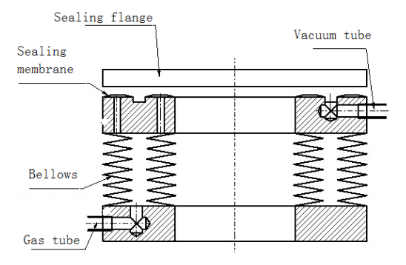
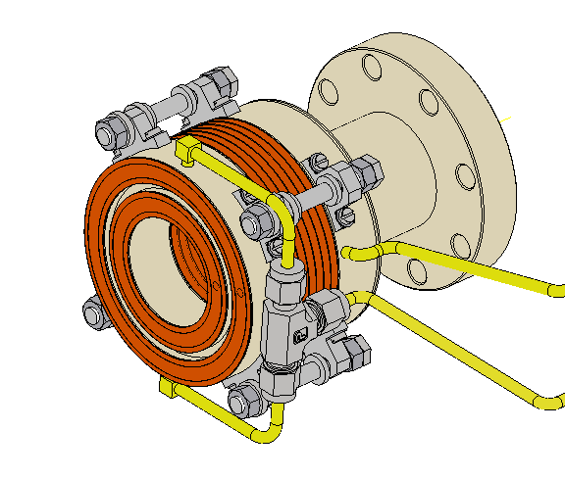
MDI mechanics-Remote vacuum connection
Inflatable seal design
Experience from CSNS: leak rate requirement: ~10-7 Pa.m3/s level, four levels higher then CEPC requirement.
Best obtained: ~10-9 Pa.m3/s level
Improved methods
Precision machining of sealing membrane and flange.
Different materials of sealing membrane and flange.
Using edge sealing instead of membrane sealing.
…
bellows
Flange
Flange
Flange
Sealing membrane
Tubes
Dimensions:
Transversal: Max. ϕ112mm
Longitudinal: ~120mm
Guiderods and limits

Slide 20
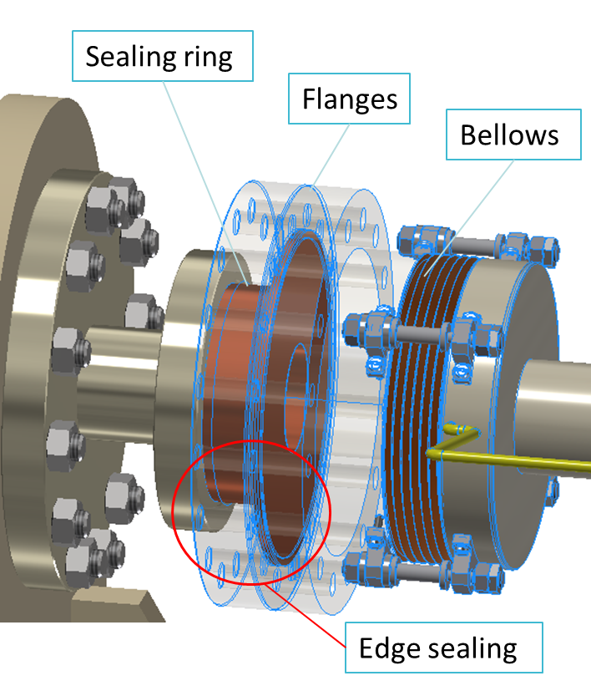
MDI mechanics-Remote vacuum connection
 | RVC design | Inflatable seal design
Sealing methods | Pneumatic clamping with auxiliary locking | Pneumatic clamping
Advantages | Successful experience from SuperKEKB; Having auxiliary locking Independent on operating distance to some extend (rotating long tools ). | Small and simple; Bellows at accelerator side; Independent on operating distance totally.
Disadvantages | Big and complex; Bellows at IP chamber side; | Difficult on leak rate requirement; Without auxiliary locking
An improved design of inflatable seal
Three MDI installation scenarios→ Remote vacuum connection is inevitable.
Remote vacuum connection design is relatively independent on other devices.
We will concentrate the leak rate problem of inflatable seal design by the improvement methods, and also take the RVC design as the baseline since it has successful experience from SuperKEKB.

Slide 21
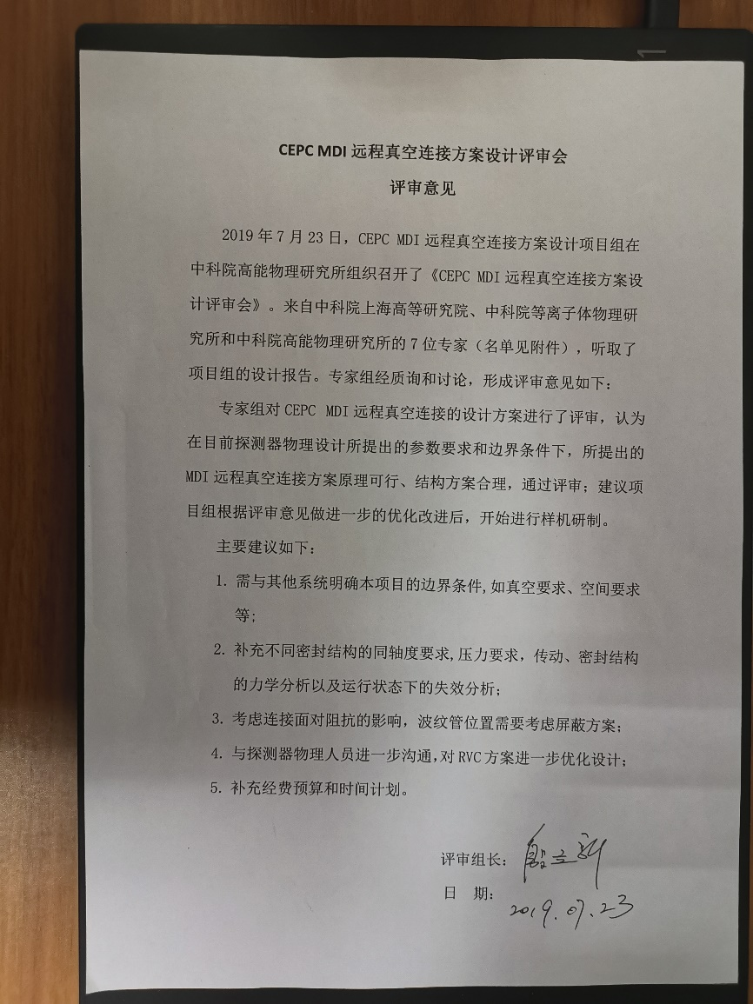
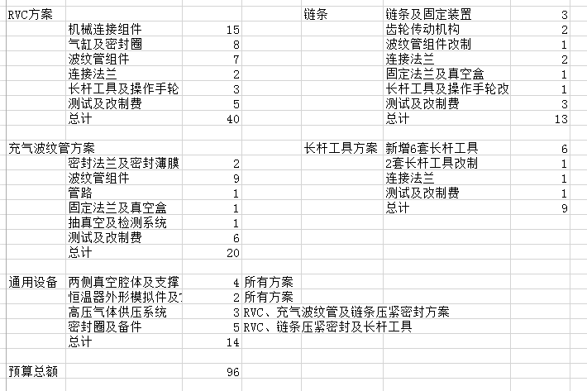
MDI mechanics-Remote vacuum connection
The design review was hold on July 23,2019
…,所提出的MDI远程真空连接方案原理可行、结构方案合理，通过评审。
Total valuation: 960,000 RMB

Slide 22
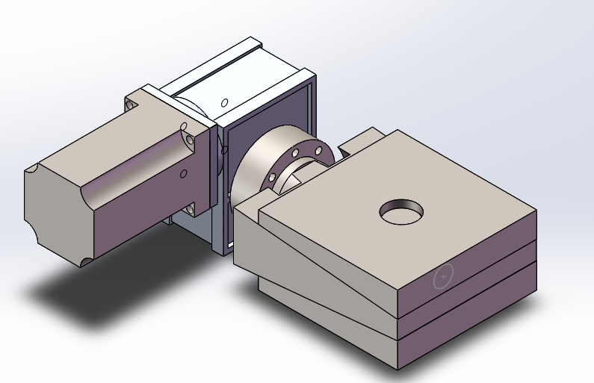
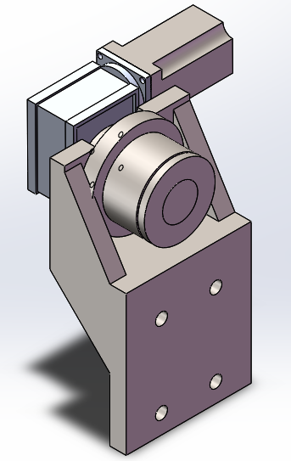
MDI mechanics-Support system
Support system of SC magnets
The alignment accuracy of SC magnets: ≤30 μm, at least ≤50 μm.
Movement mechanism: high precision track & rack.
Adjusting mechanism: motor driven wedges jacks for vertical direction, motor driven screw jacks
Cryostat
Adjusting mechanism
Support bed
Movement mechanism
* Cooperate with Beijing Institute of Space Mechatronics

Slide 23
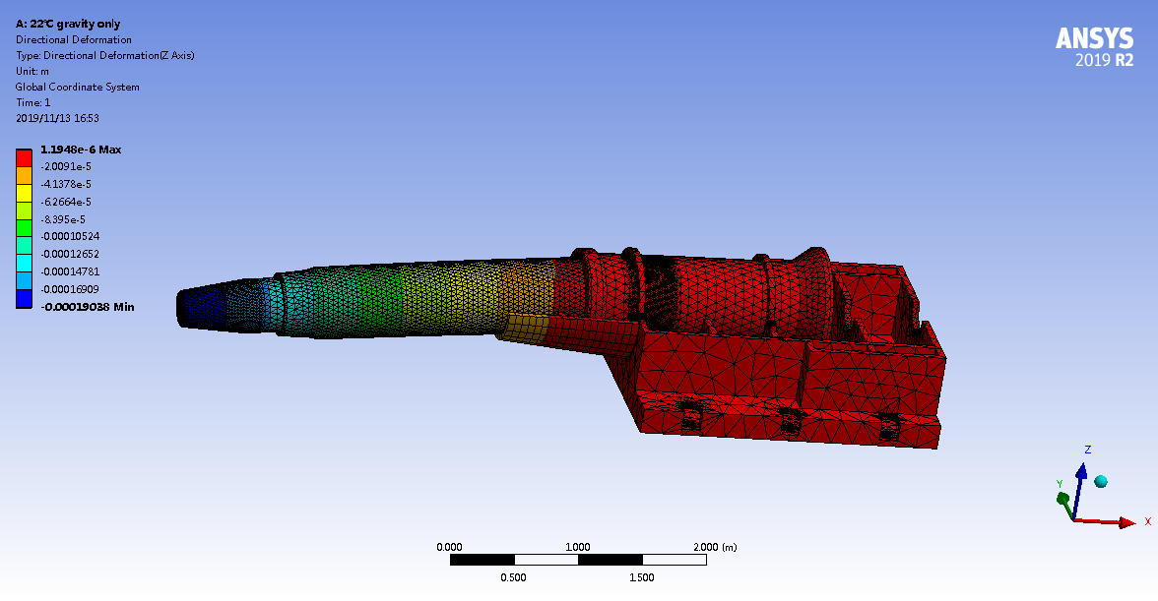
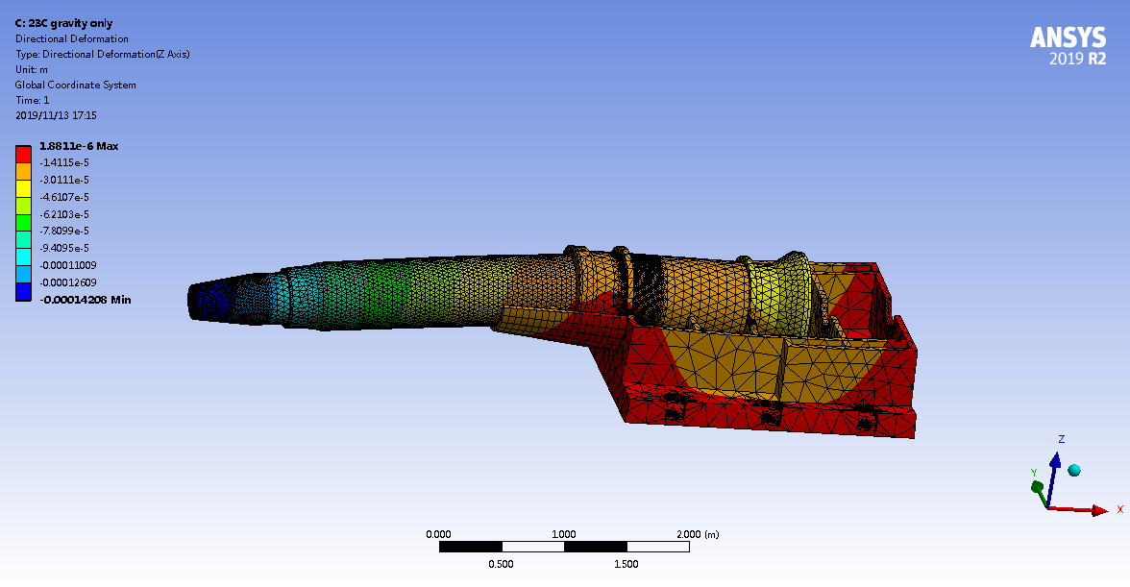
MDI mechanics-Support system
Max deformation owing to gravity: 190 um
Under 1 ℃ environment temperature variation, Max deformation varies 48 um
Detailed analyses of the cryostat & support assembly should be done, including the deformation and vibration, considering gravity, temperature, magnetic field force.
The current design of cryostat is 5 meters long with18 mm thick stainless walls. The weight of the cryostat is about 2 tons.
Only the cryostat itself is considered in the calculation above.
If the yoke length gets larger, the deformation will be even larger, which is proportional to the 4th power of length.
If the weight of components inside the cryostat and the magnetic field forces are considered, the deformation will be much larger.

Slide 24
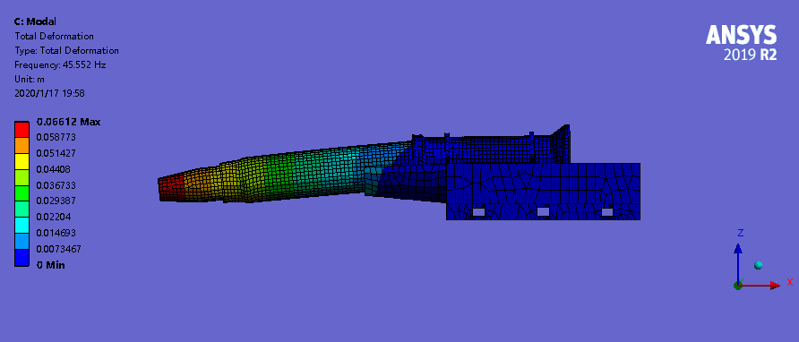
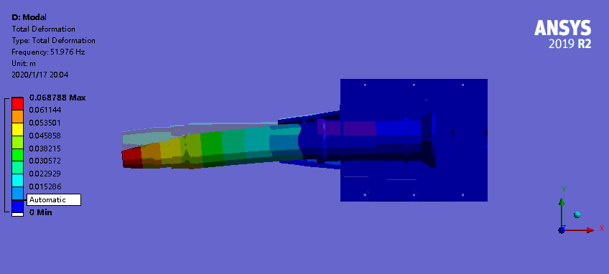
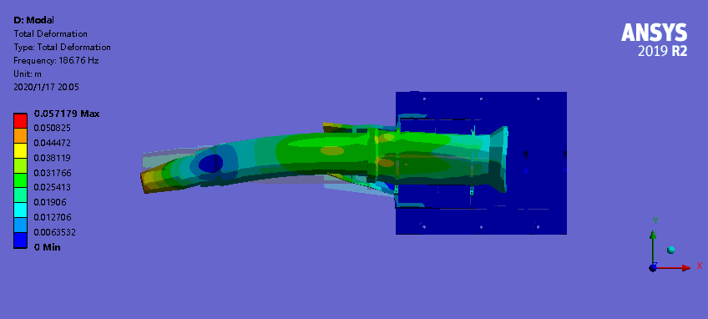
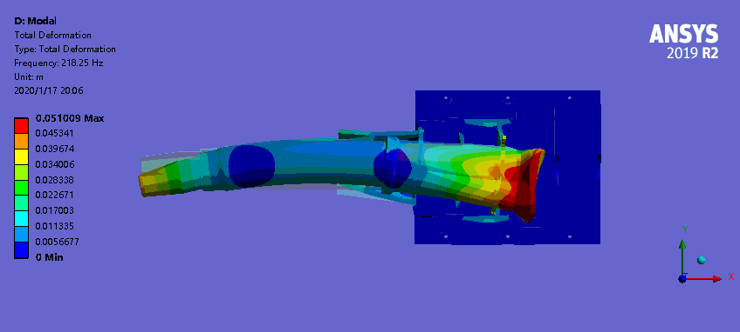
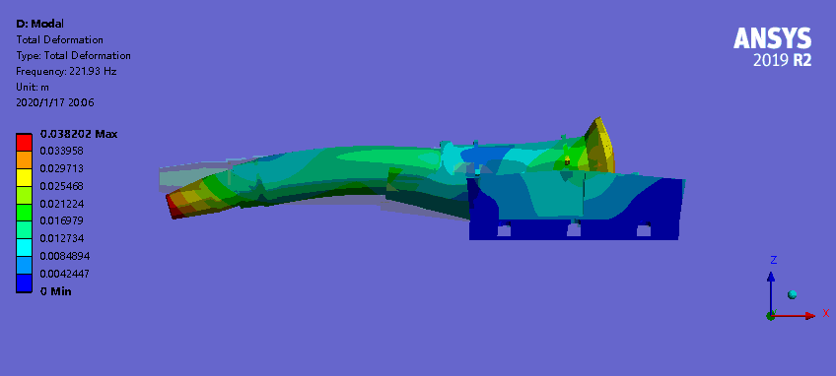
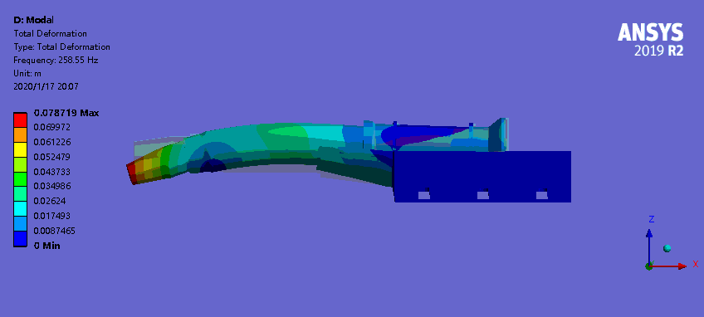
MDI mechanics-Support system
1st: Vertical wiggling
2nd: Horizontal wiggling
3rd: Horizontal bending
4th : Horizontal bending
5th : Vertical bending
6th : Vertical bending
Modal analyses: order 1- order 6

Slide 25
MDI mechanics-Support system
7th
8th
9th : Rotating
10th
FCC said the just considered the rotating modal order.
We think we can only ignore the 7th, 7th, and 10th modal orders. At least the first Eigen frequency must not be ignored.
We have the same ideal as SuperKEKB.
Needs discussion further.

Slide 26
MDI mechanics-Support system
No clear alignment solution right now!
We are considering to pre-align the SC magnets to “certain location” to compensate the effect of loads. It needs complex stiffness design and has risk, especially for the stability and repeatability.
The magnetic field forces in Z, H, and W operations are different. The pre-alignment should fulfill all the cases.
The design will be adjusted with detector design, dynamic design and alignment design.
We will learn the successful experience from other facilities.
SSW measurement of SuperKEKB
Max. center misalignment is 0.69 mm
“Every alignment errors are able to corrected by the corrector magnets.
N. Ohuchi, IPAC2018

Slide 27
Summary
The common girder design is being considered as a alternative support method for quadrupoles and sextupoles in Collider.
A 40 meters mockup of arc-section has been designed for interface checking, installation, alignment and transportation.
Transport vehicles for the magnets transportation and coarse positioning has been designed.
Preliminary structure design, FEA and impedance calculation has been done for the movable collimators.
For the MDI region, the design of the remote vacuum connection methods have been done, and the support system of SC magnets is under design.

Slide 28
Thanks

