Slide 1
CEPC Plasma Injector R & D
2020-02-14
CEPC DAY
W. Lu & D.Z. Li

Slide 2
OUTLINES
Timetable and Current Status
Plasma acceleration (Sim. & Exp.)
e- gun, Linac and e+ damping ring

Slide 3
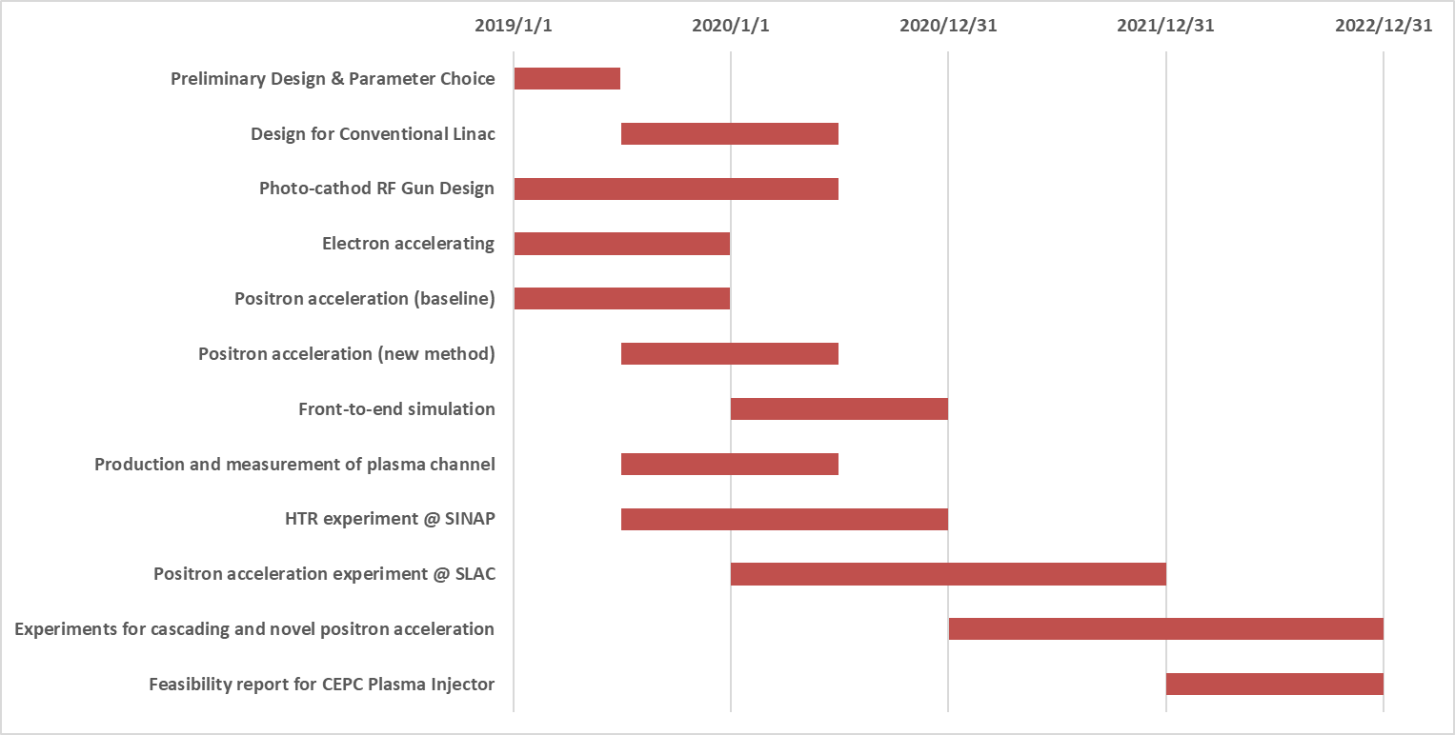
Timetable of CEPC plasma injector study

Slide 4
Key Physics and Technology:
Electron Acceleration
High transformer Ratio, High efficiency, Stability
Positron Acceleration
Stable acceleration (different schemes), energy spread control, efficiency enhancement……
Conventional Accelerator design and optimization
Photon-guns, Linac, Positron generation and damping ring ……
Beam manipulations:
Dechirper, external injection, staging and cascading ……

Slide 5
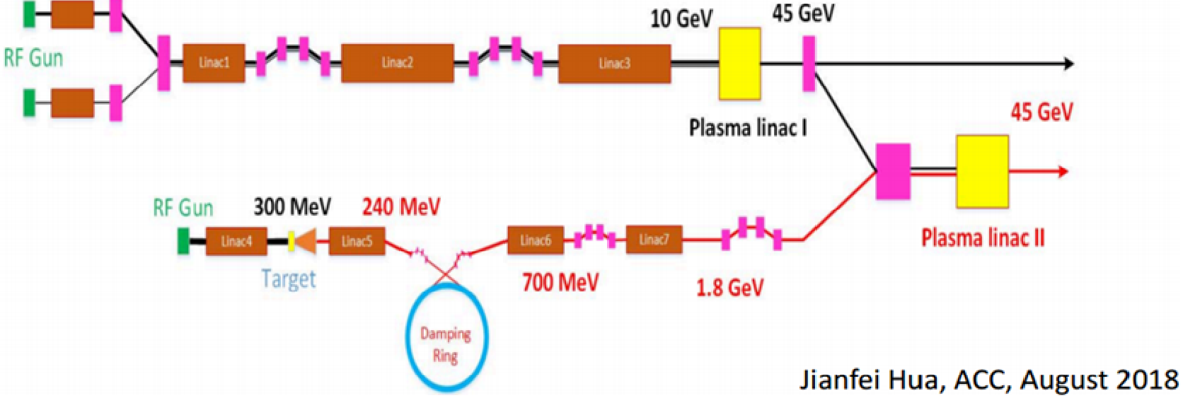
Current Status: V1.0→V2.0
CEPC Plasma Injector V1.0
2nC
Jianfei Hua, AAC, August 2018
CEPC Plasma Injector V2.0
4nC
Dazhang Li, CPS, September 2019

Slide 6
Current Status: V1.0→V2.0
CEPC Plasma Injector V2.0
Dazhang Li, CPS, September 2019

Slide 7
More people joined the team
Plasma Acceleration Simulation
Prof. Wei Lu, Shiyu Zhou (THU), Prof. Weiming An (BNU), Xiaoning Wang (IHEP)
Plasma Acceleration Experiment
Prof. Jianfei Hua, Shuang Liu, Bo Peng (THU), Dazhang Li……
Conventional Accelerator design and optimization
Prof. Jingru Zhang, Dr. Cai Meng (Linac), Guan Shu (e- gun)
Dr. Dou Wang, Xiaohao Cui, Xiaoning Wang (Positron damping ring, final focus and bunch compression)
Dr. Yiwei Wang (e- Final Focus),

Slide 8
OUTLINES
Timetable and Current Status
Plasma acceleration (Sim. & Exp.)
e- gun, Linac and e+ damping ring

Slide 9
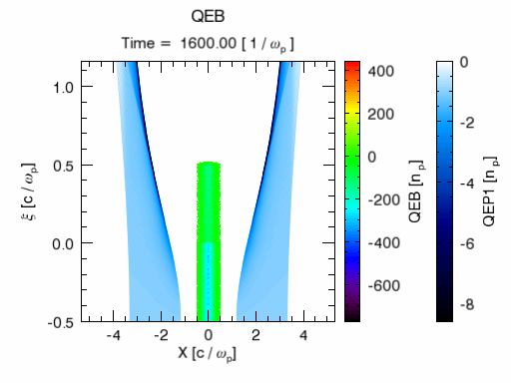
Positron Acceleration—CDR Baseline
e-, shaped
2nC, 45GeV
Hollow Plasma Channel
e+
1nC, 45GeV
e+, Gaussian
1.2nC, 2/4GeV
High efficiency 60%
Low energy spread ~0.5%
Small emittance growth
Tight tolerance on injection parameters to control transverse instability （beam tilt or offset ~ 0.1μm）

Slide 10
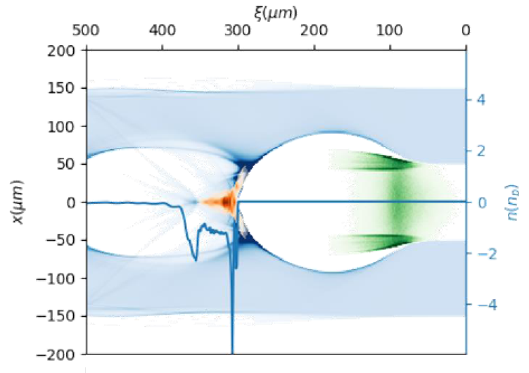
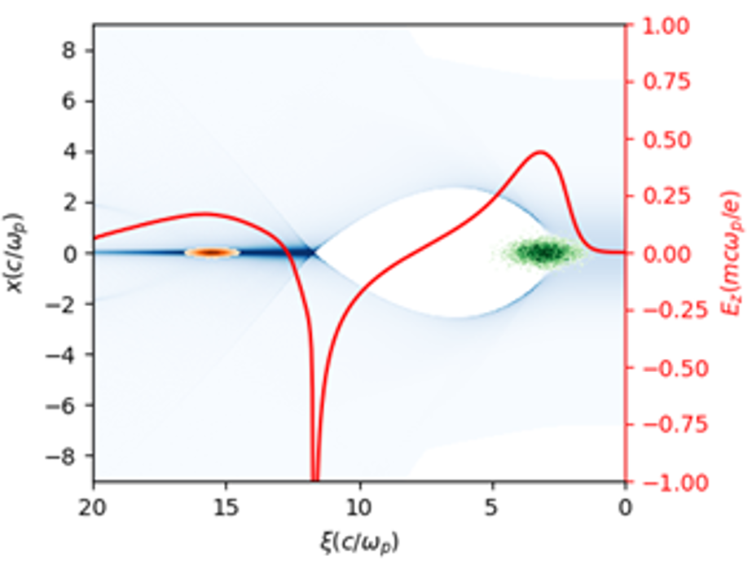
Positron Acceleration—New Methods
Efficiency Error tolerance Emittance Energy Spread
Efficiency Error tolerance Emittance Energy Spread
Efficiency Error tolerance? Emittance Energy Spread

Slide 11
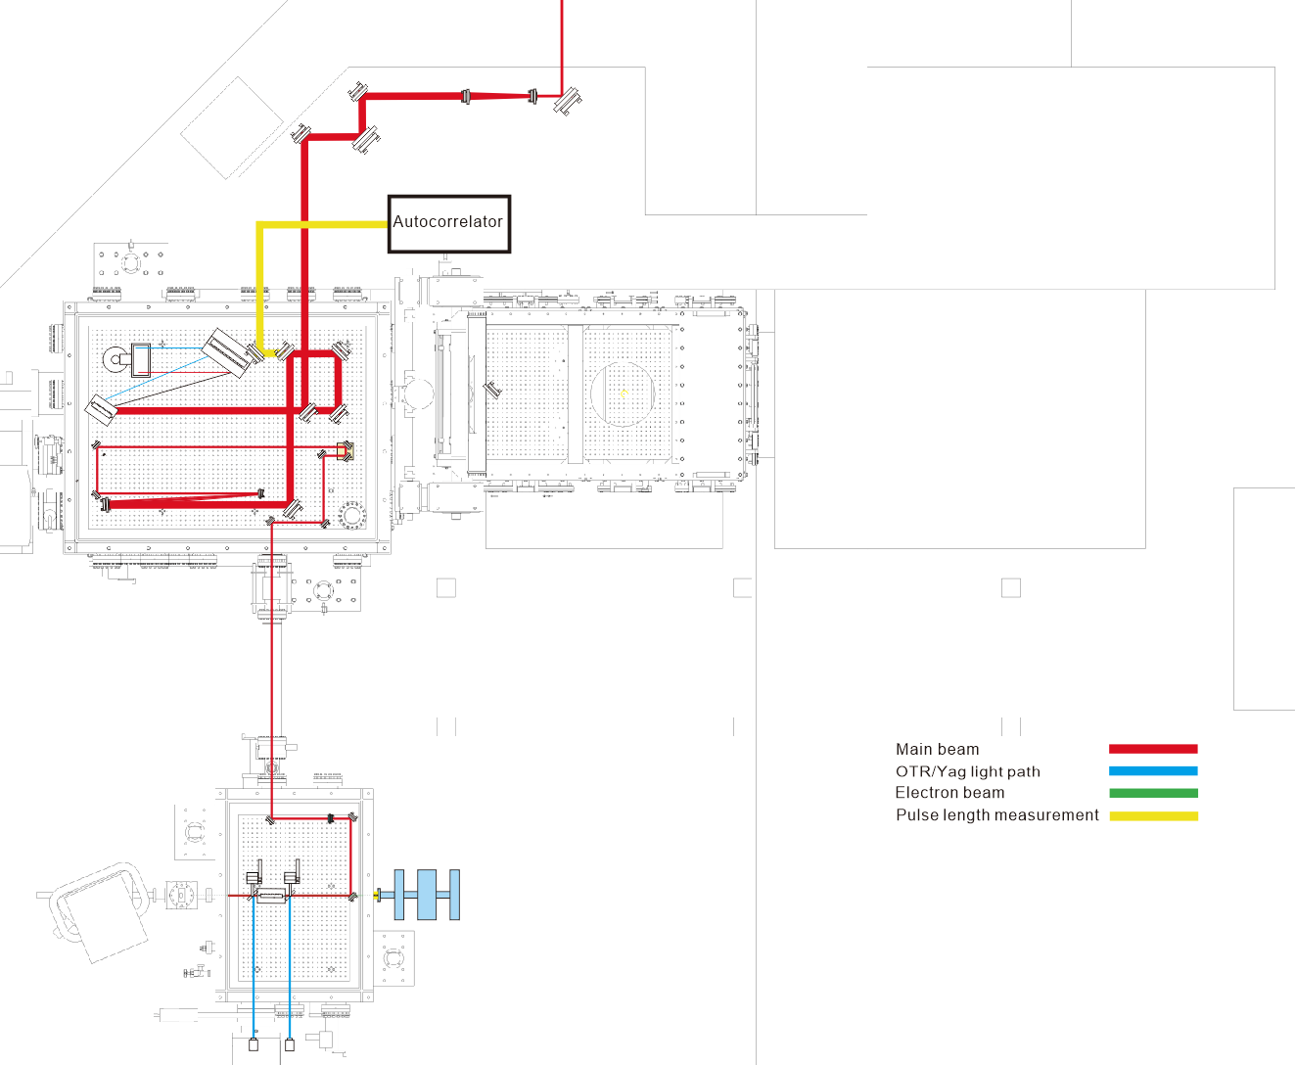
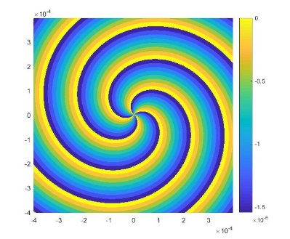
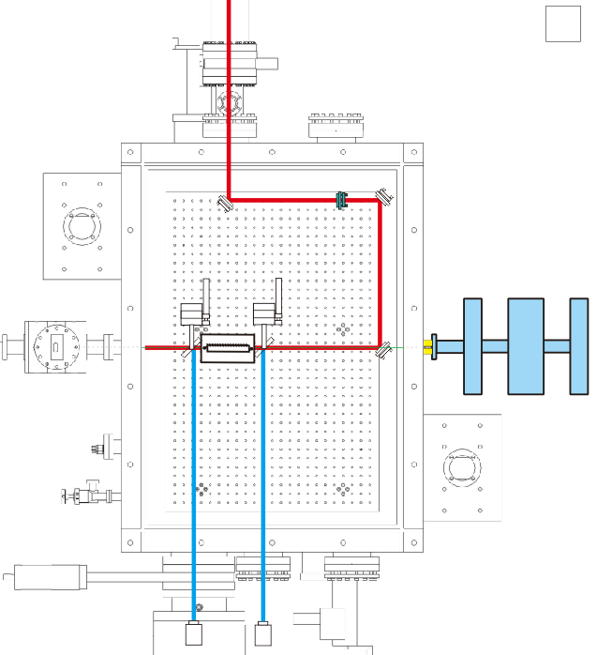
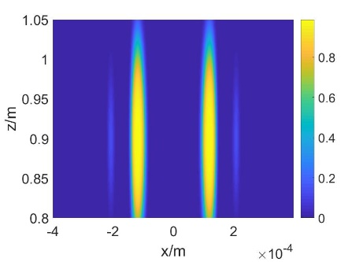
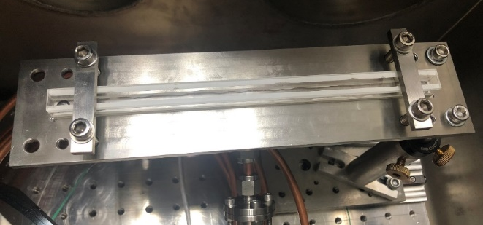
Plasma Dechirper Experiment @ THU
Kinoform plate
Laser beam
Beam Diagnostics
Electron beam
Bessel Beam
Gascell

Slide 12
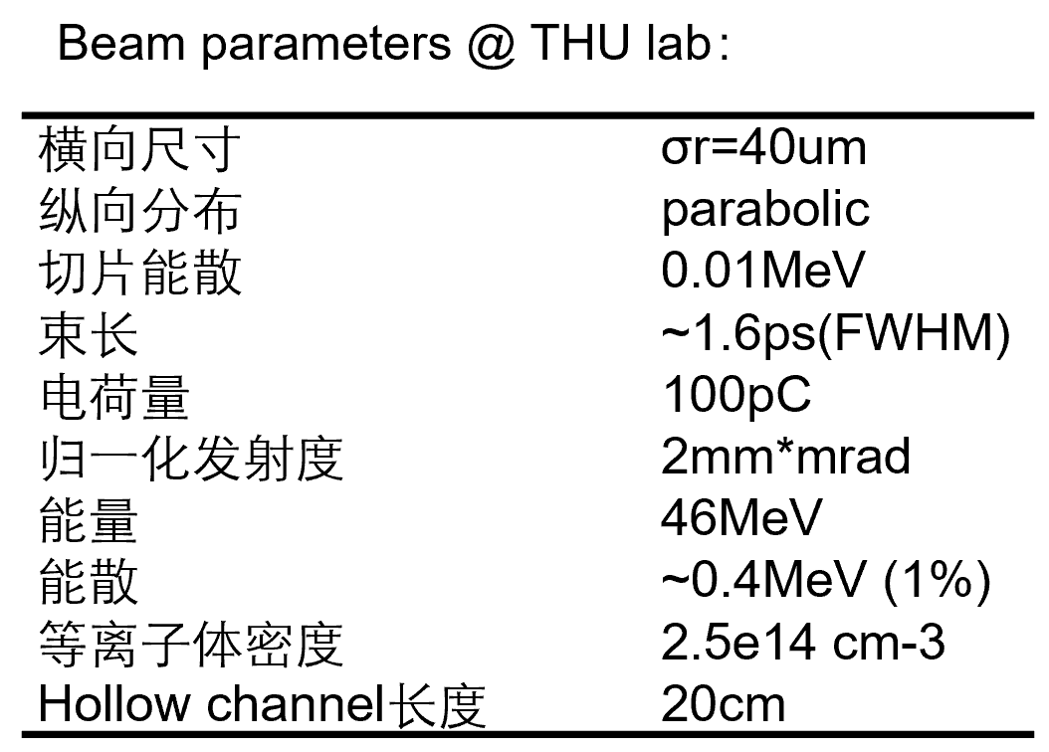
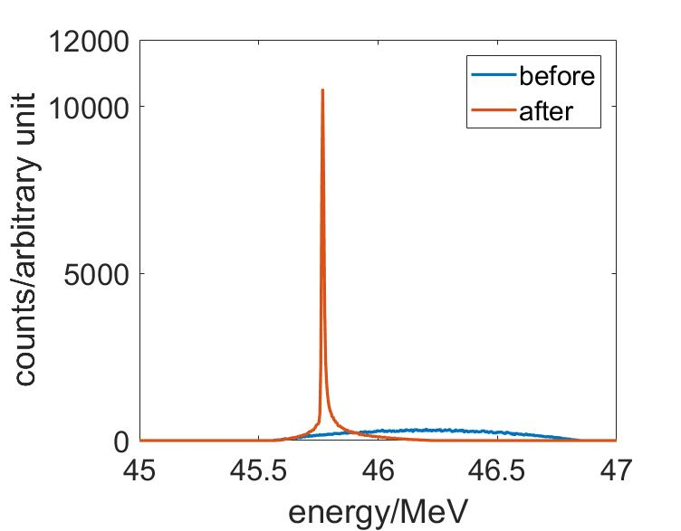
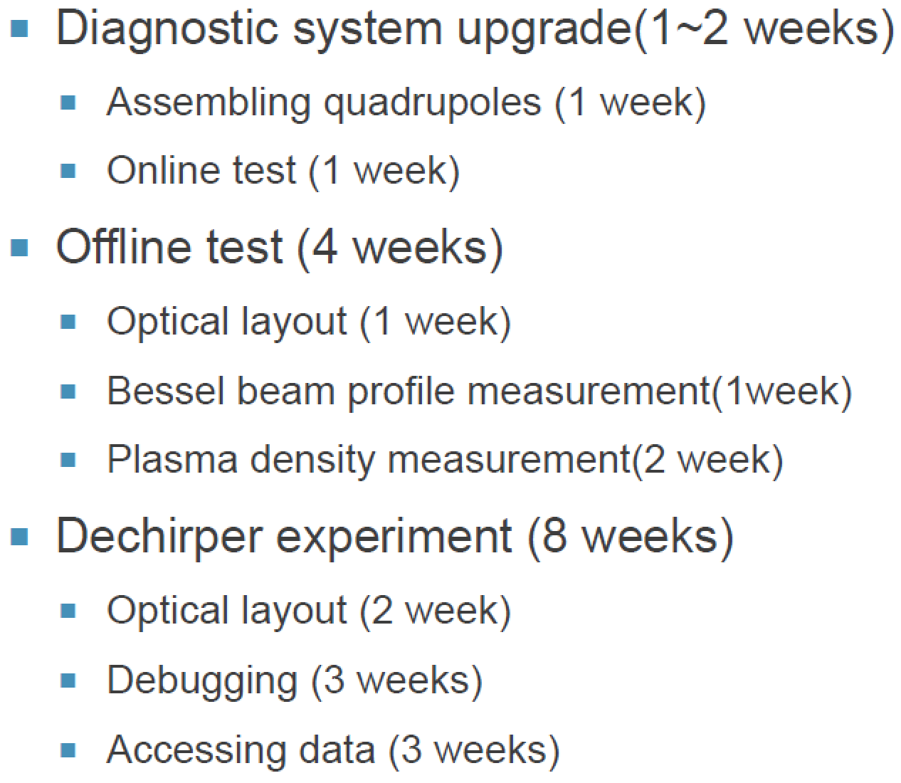
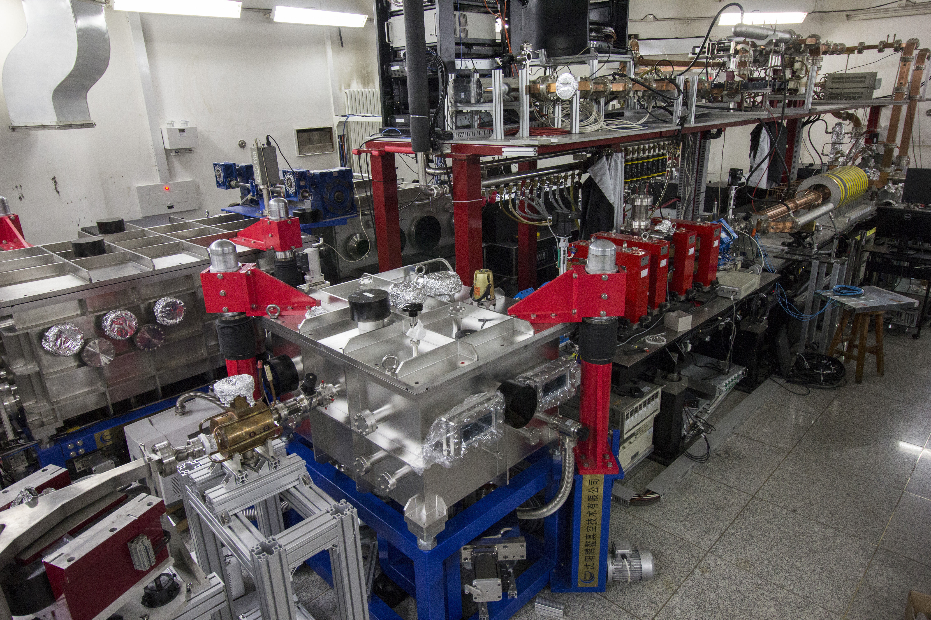
Plasma Dechirper Experiment @ THU
PIC Simulation
2019.11-2020.02
RF gun
Experiment Goal：
1.Decrease the energy spread to 0.1%
2.Hollow channel impact on beam quality
Chicane
S-band
linac
Compressor
beam
Interaction
chamber
Deflecting
cavity
Dipole

Slide 13
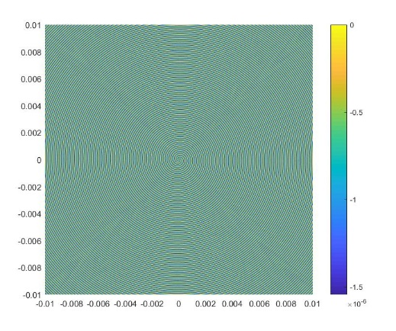
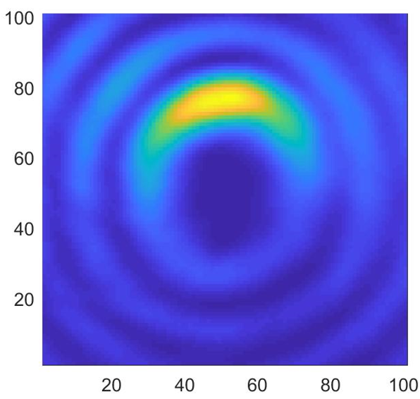
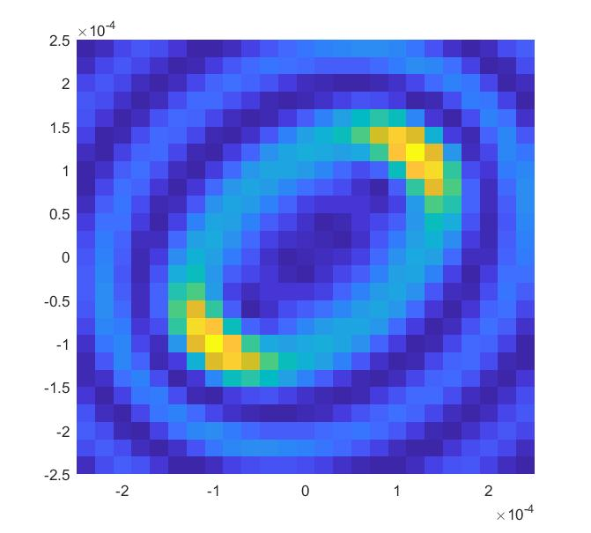
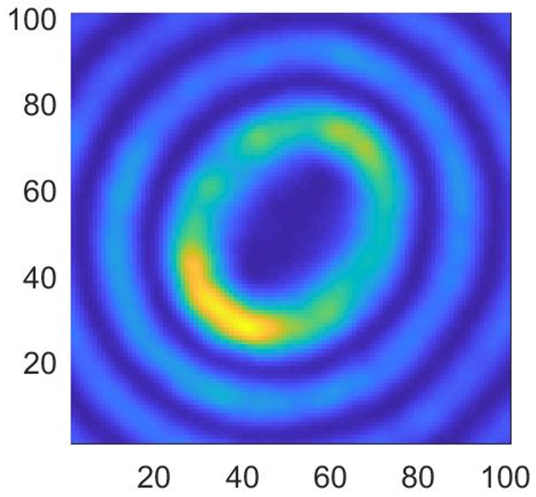
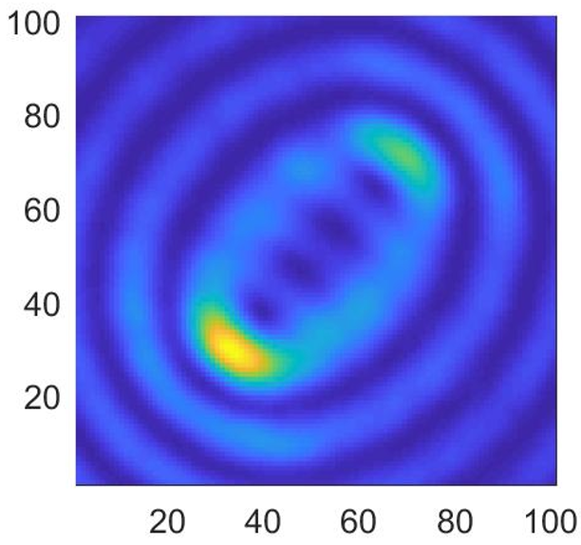
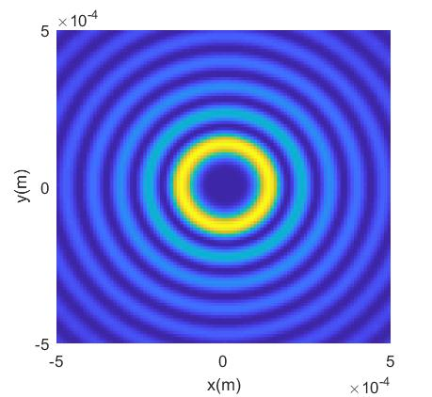
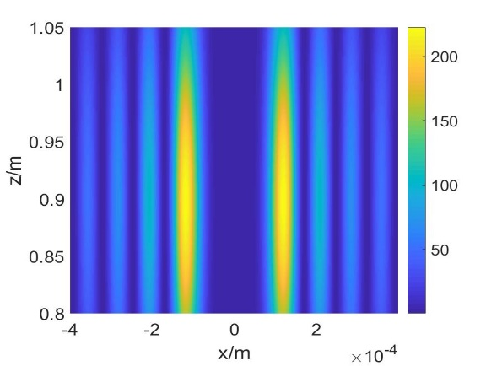
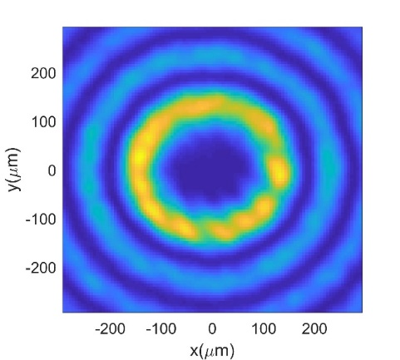
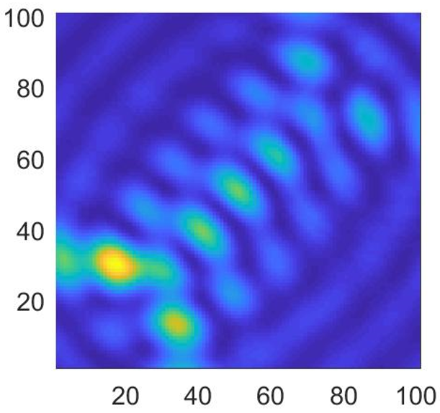
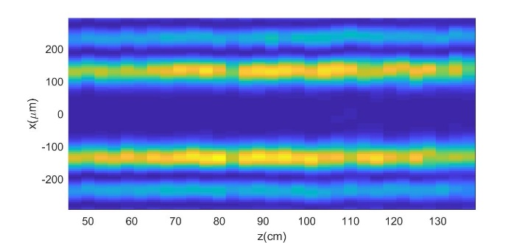
Bessel beam generation and optimization
Kinoform Plate
Simulation
Simulation
Experiment
Experiment

Slide 14
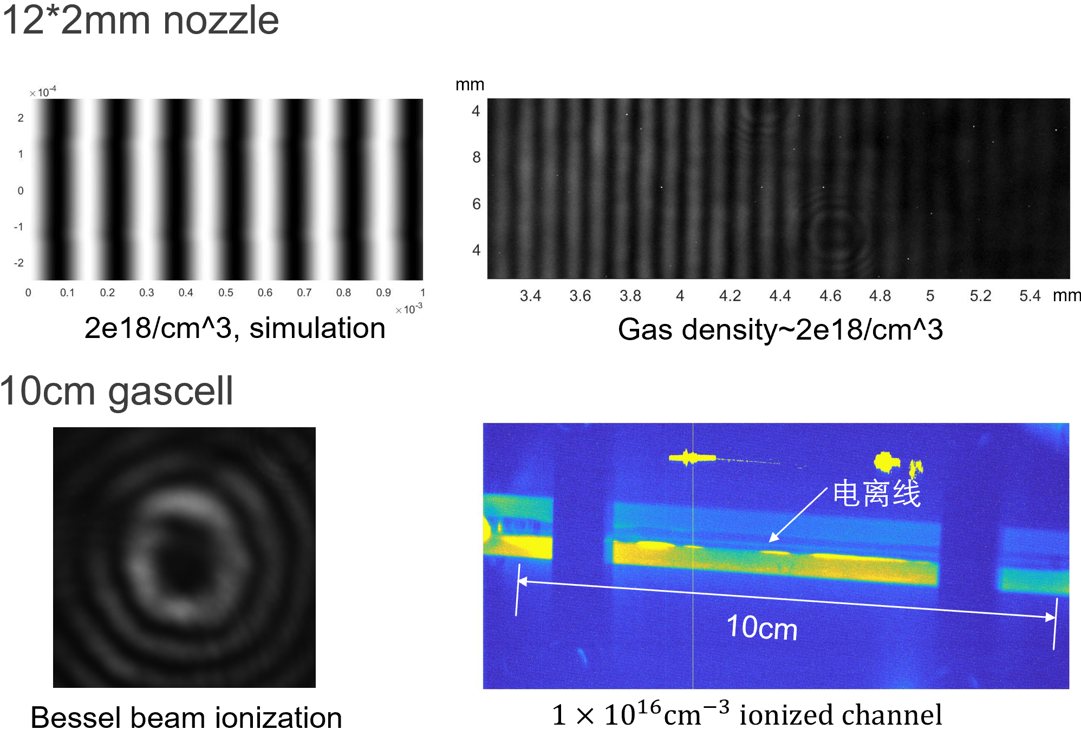
Hollow Channel and density measurement

Slide 15
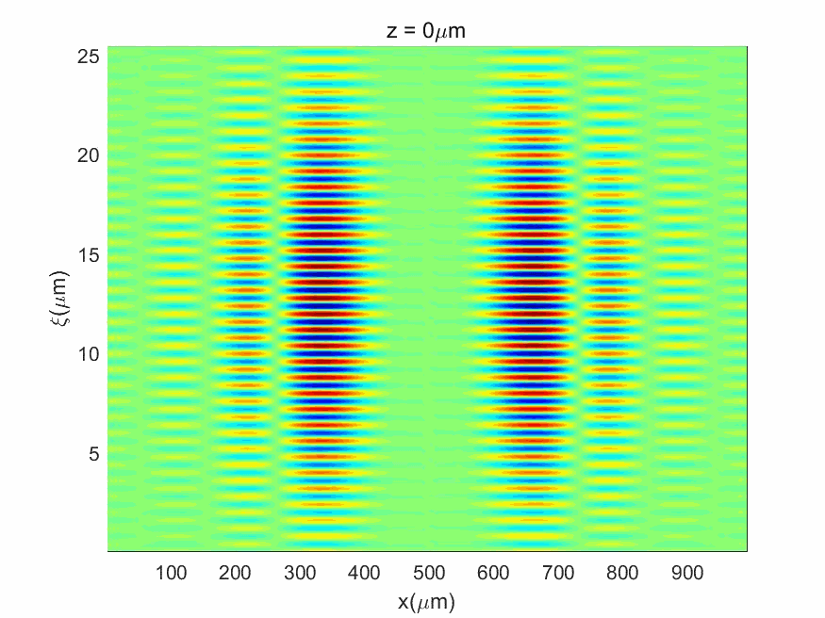
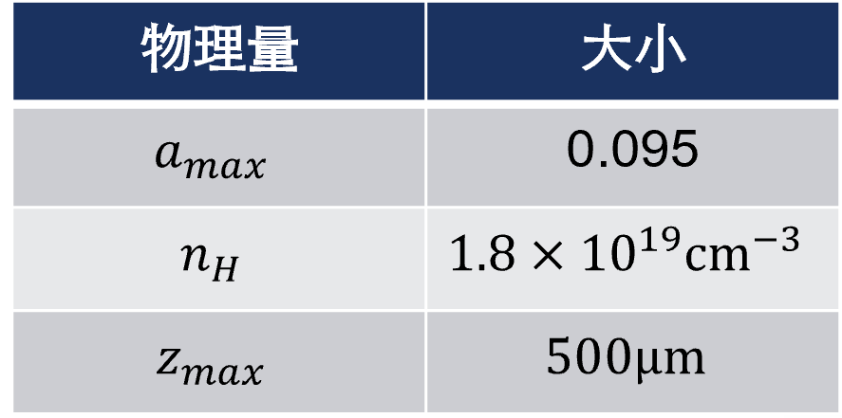
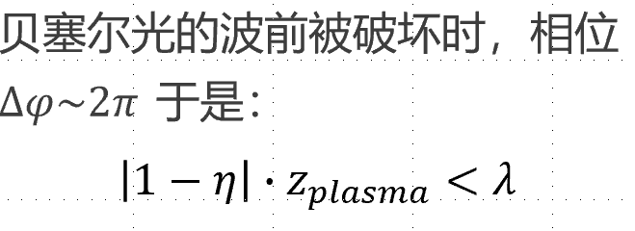
Simulation Analysis
Good news:
NOT too severe for low density plasmas (< 1×10¹⁷ cm⁻³)!!

Slide 16
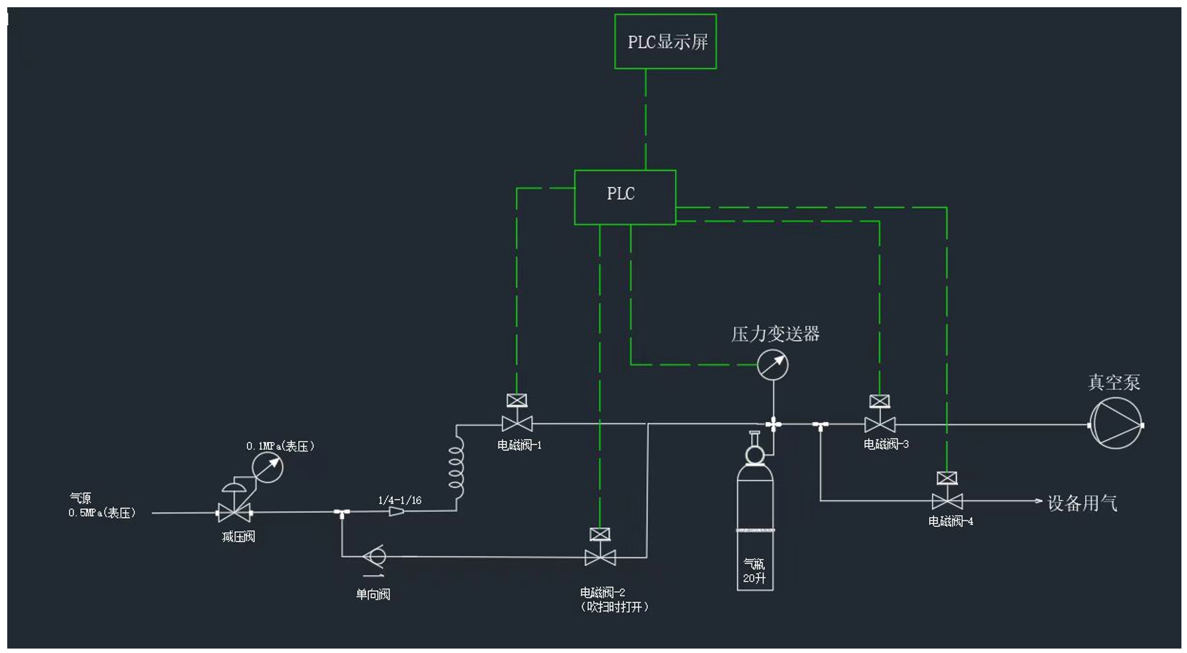
Low pressure gas system (100-3000pa)
Finish installation and under Debugging

Slide 17
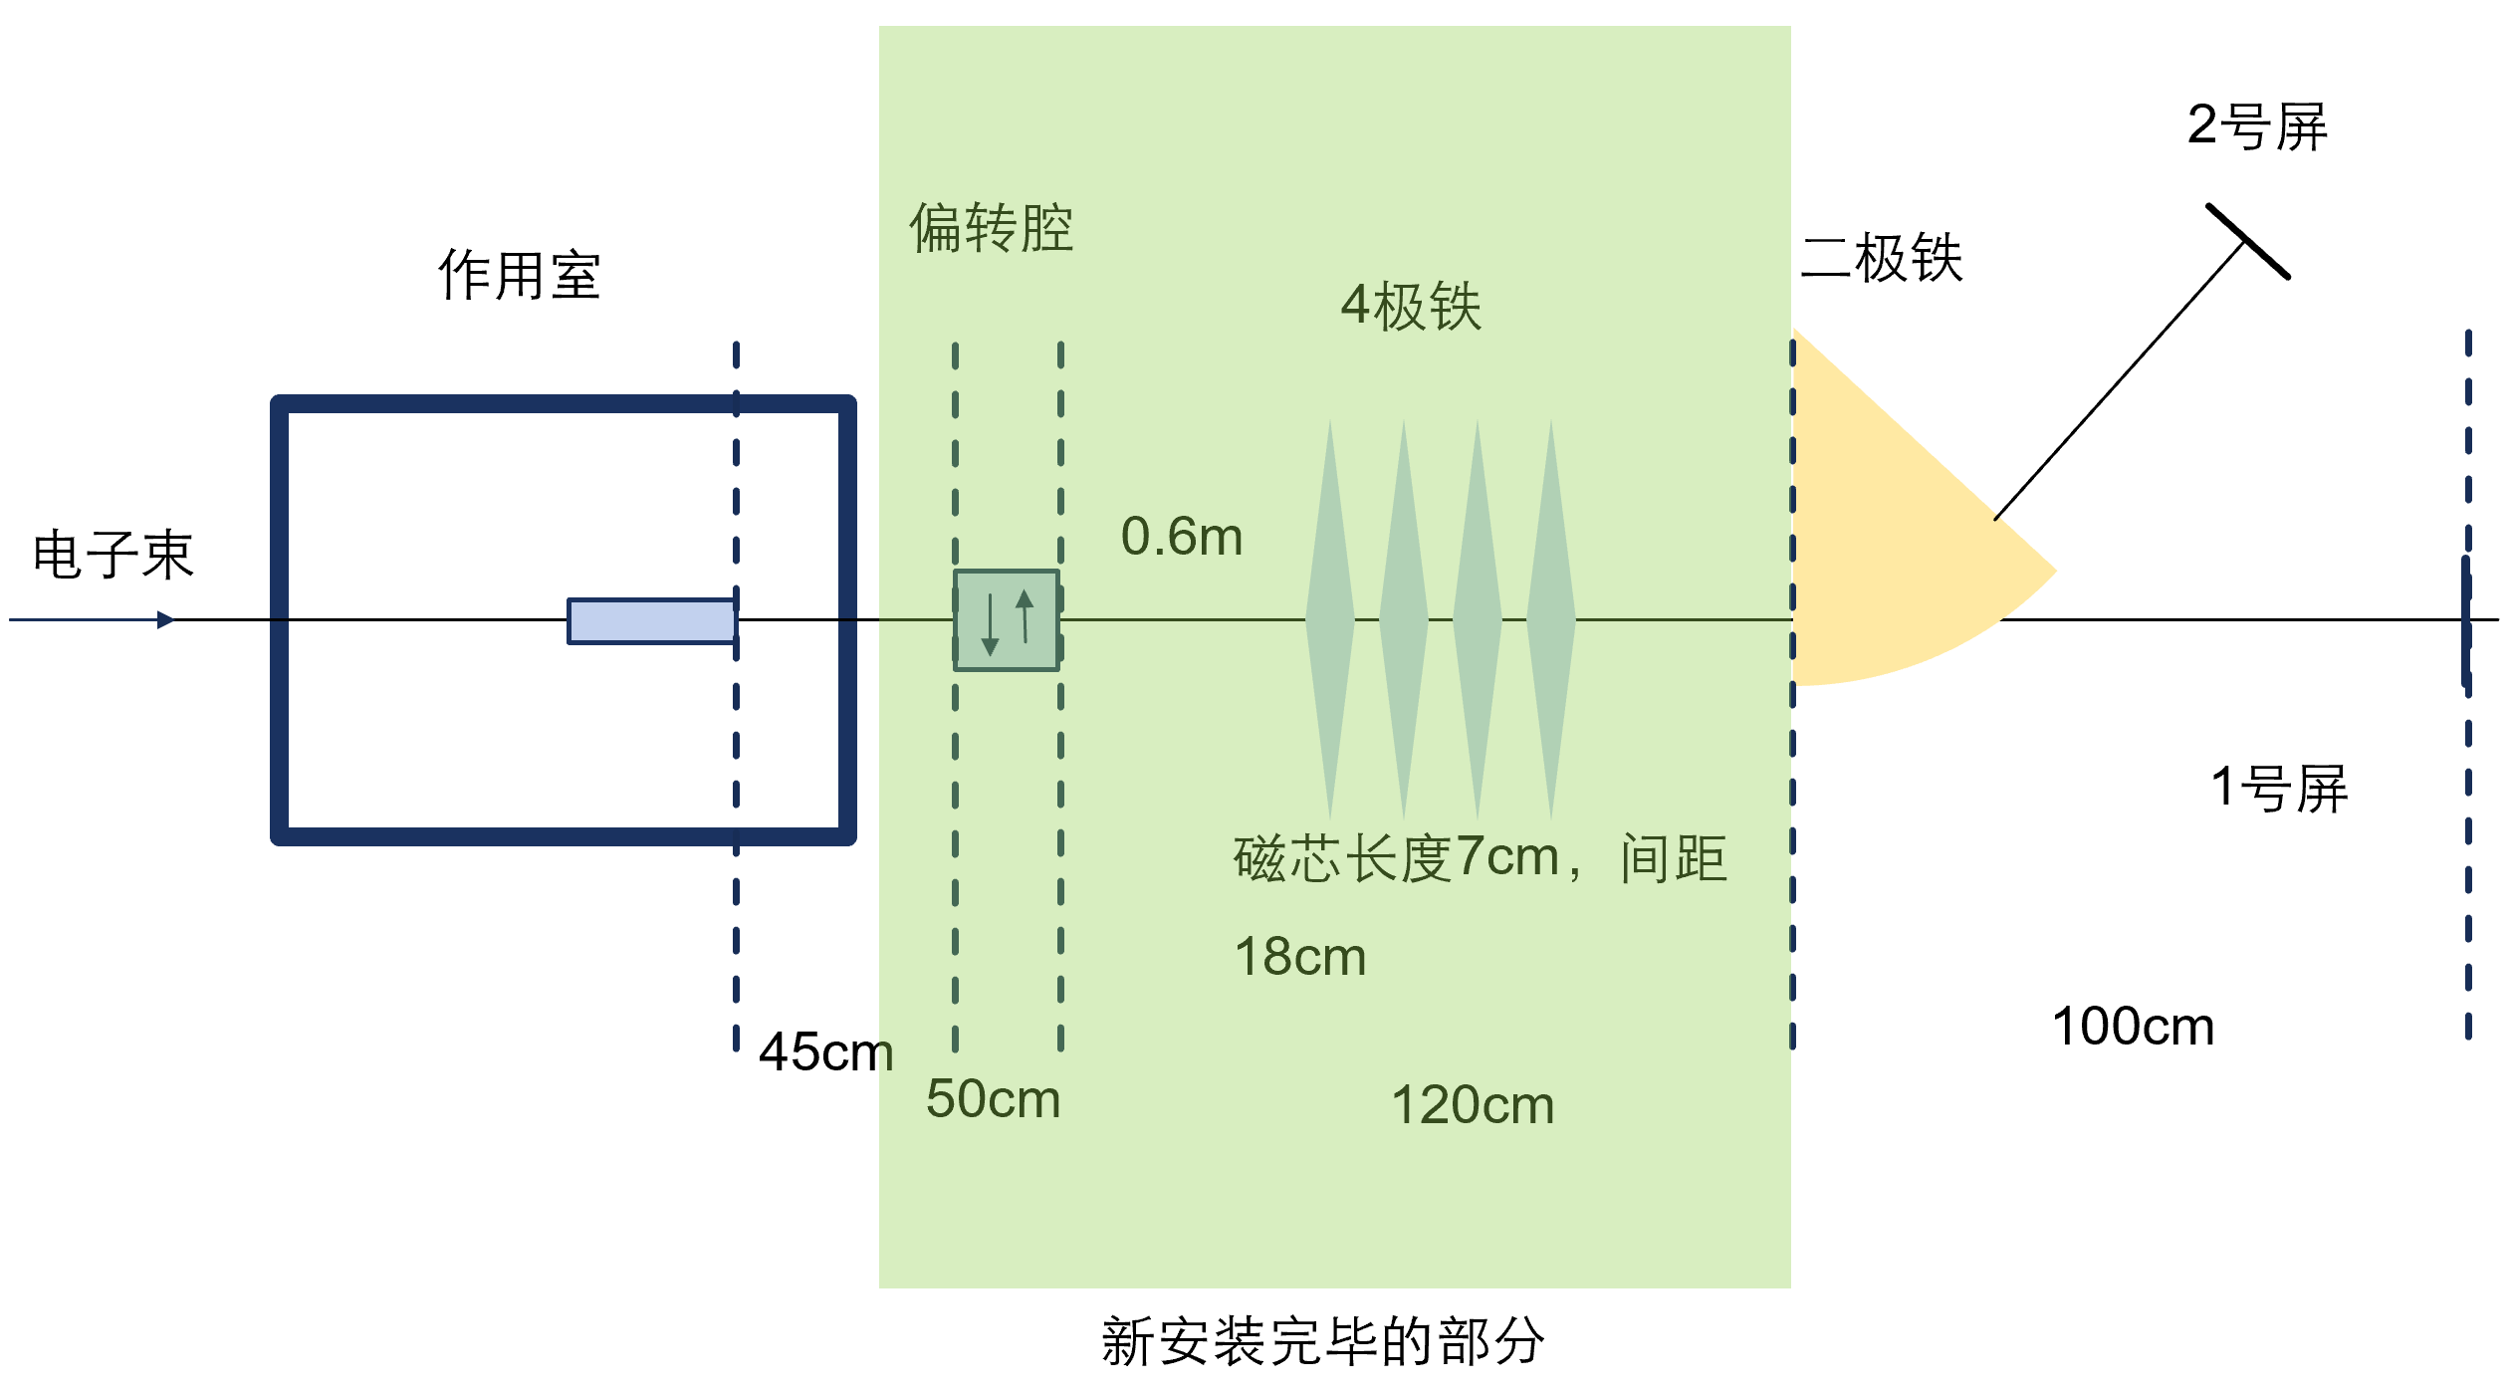
Electron Beam Diagnostic system
Finish installation and under Debugging

Slide 18
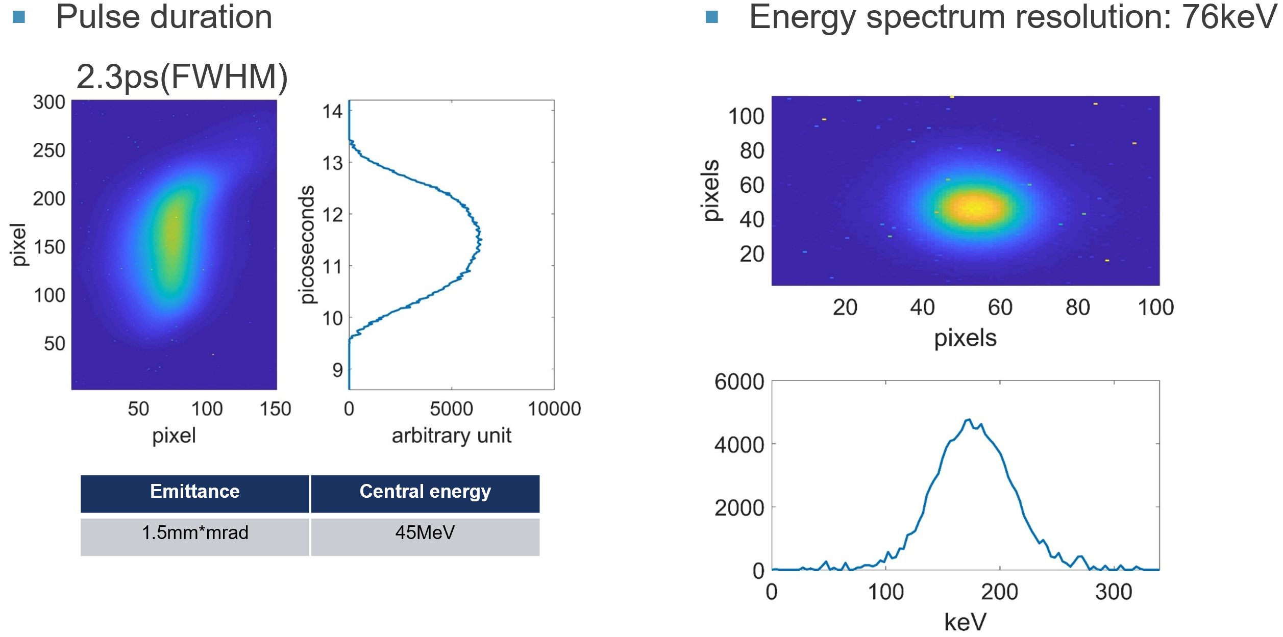
Electron Beam Parameter Measurement

Slide 19
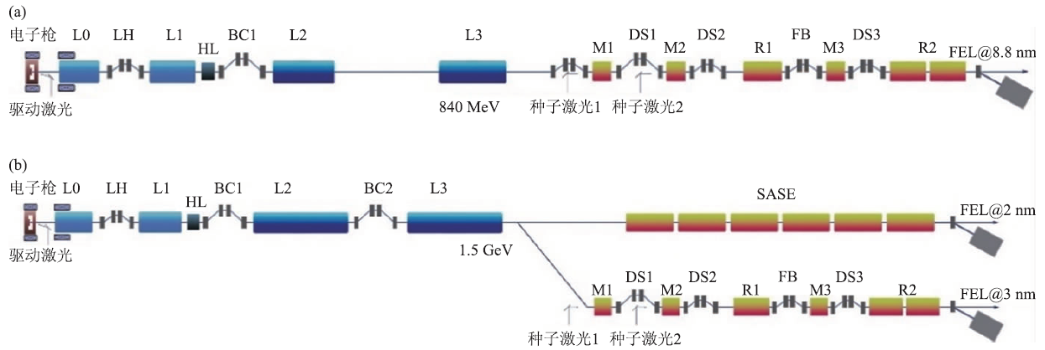
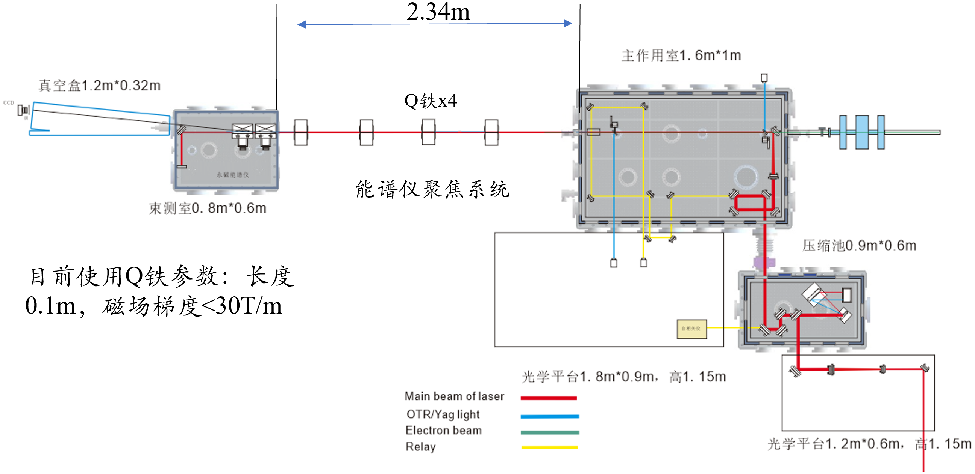
Dechirper & HTR Experiment @ SXFEL
Parameter | Value
Energy | 0.8GeV
Charge | 50pC
Emittance | 0.8μm
Beam size | 10μm
Peak current | 2.4kA
Energy Chirp | ~8MeV
Plasma Section
Dechirper experiment schedule
First step: Obtaining a stable positively-chirped beam with few percent energy spread
Second step: Post-processing the beam using a passive dechirper
Plan to start experiment station installation before April (according to the discussion on Jan. 18)

Slide 20
OUTLINES
Timetable and Current Status
Plasma acceleration (Sim. & Exp.)
e- gun, Linac and e+ damping ring

Slide 21
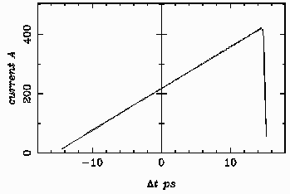
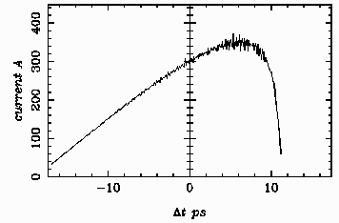
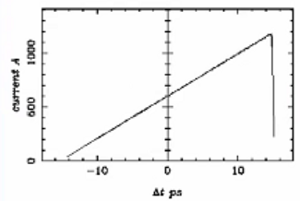
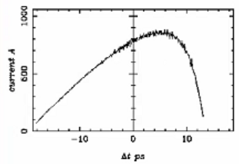
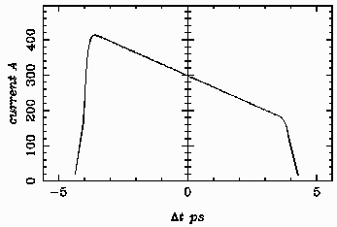
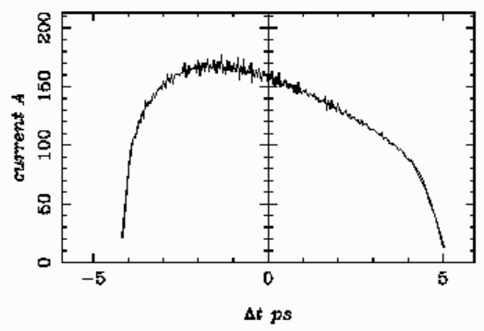
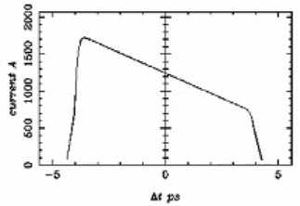
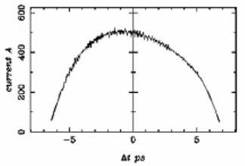
ASTRA Simulations for Electron Gun 1-4
e1- driving beam, 6.5nC
e2 driving beam, 18nC
e3- witness beam, 1.2nC
e4 witness beam, 5nC
Laser profile
RF gun exit beam
Laser profile
RF gun exit beam
Conclusion and outlook
Preliminary beam dynamics simulations have achieved the expected longitudinal beam shapes. Further optimizations are needed.
Laser shaping technique and beam line optics tuning (further bunch length compression in main linac) have to be investigated.
Experiments to benchmark the beam dynamics study is required to verify the simulation reliability on large bunch charge case.

Slide 22
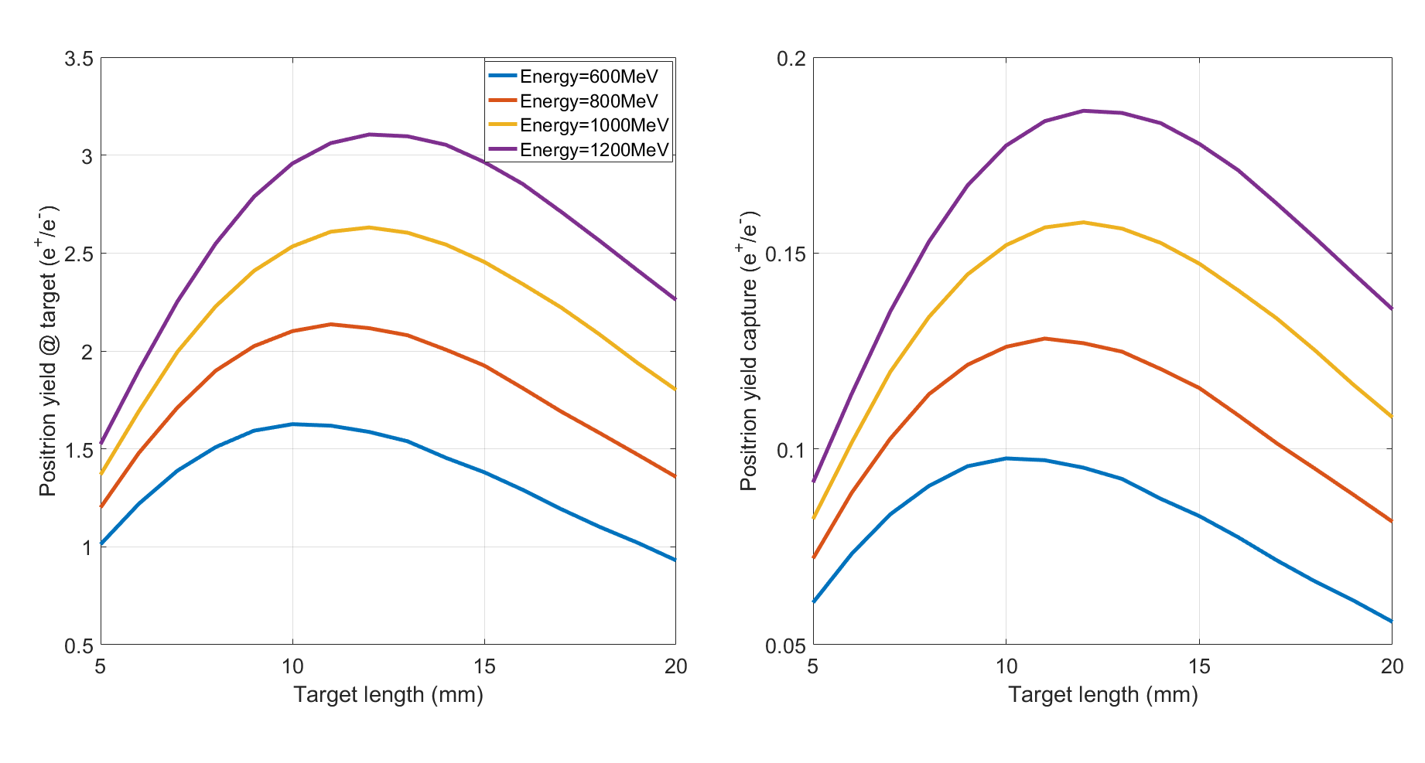
Positron Source—Parameter Choice
Total yield at target
Effective yield
$$C_{0} ≈k \text{×} n_{0}×E_{0}$$
Positron beam (C₀): 1.2~1.5 nC
Electron bunch charge: 10nC; Electron linac energy: 1GeV
Target length scan: 12mm

Slide 23
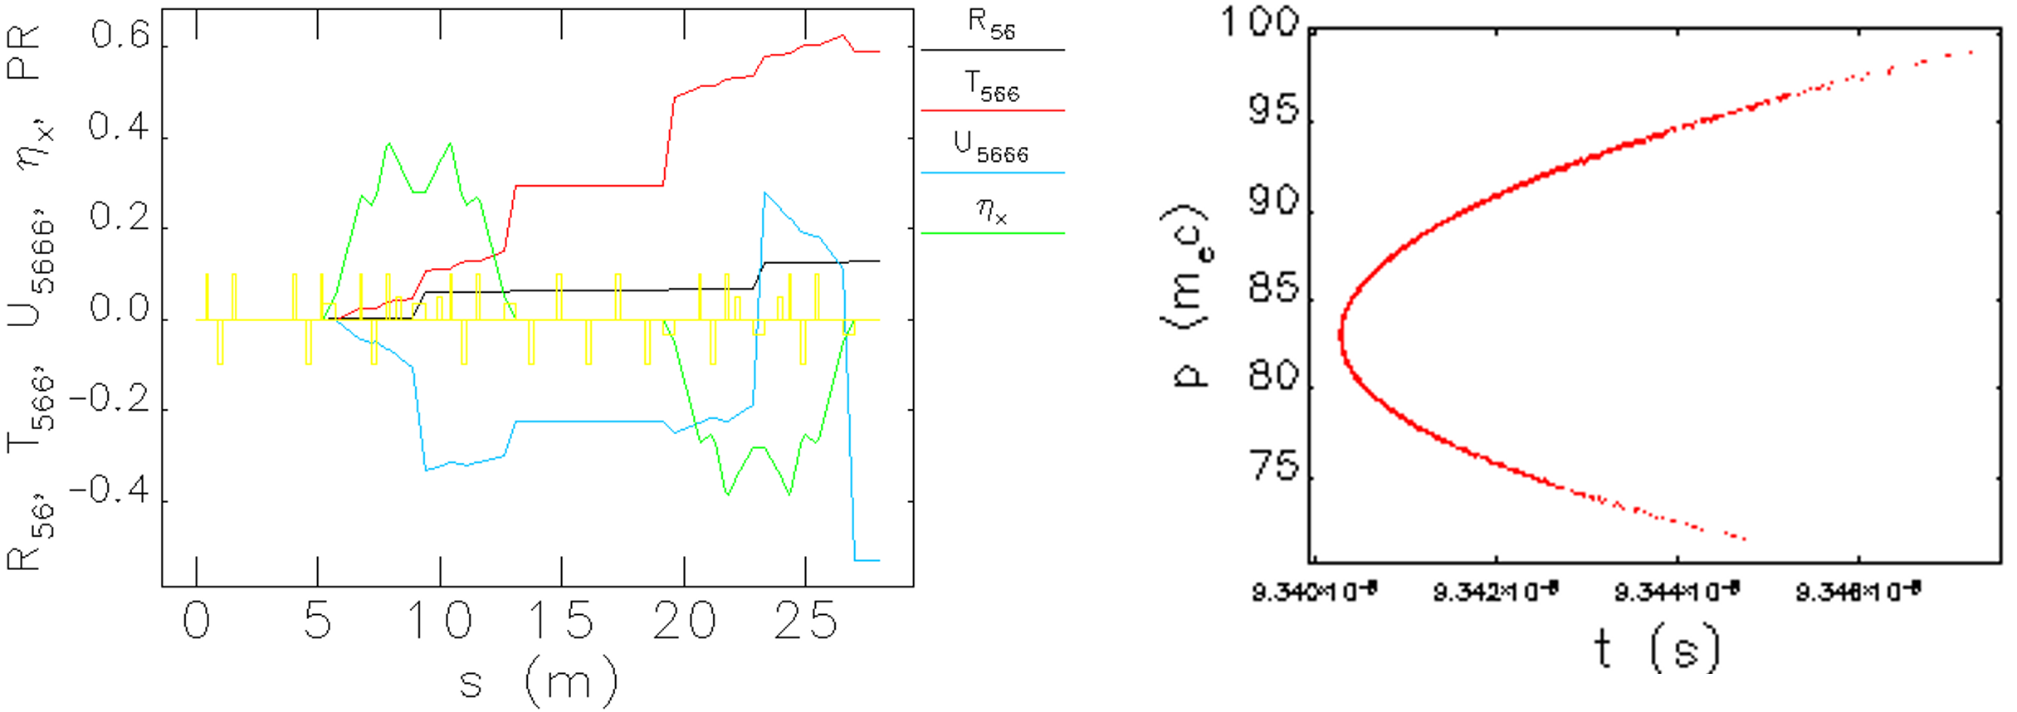
e- Bunch Compression: 2 Methods
Method 1：Conventional Chicane Structure (Simple but not good enough)
Method 2：2 TBA Structure (Under optimization)

Slide 24
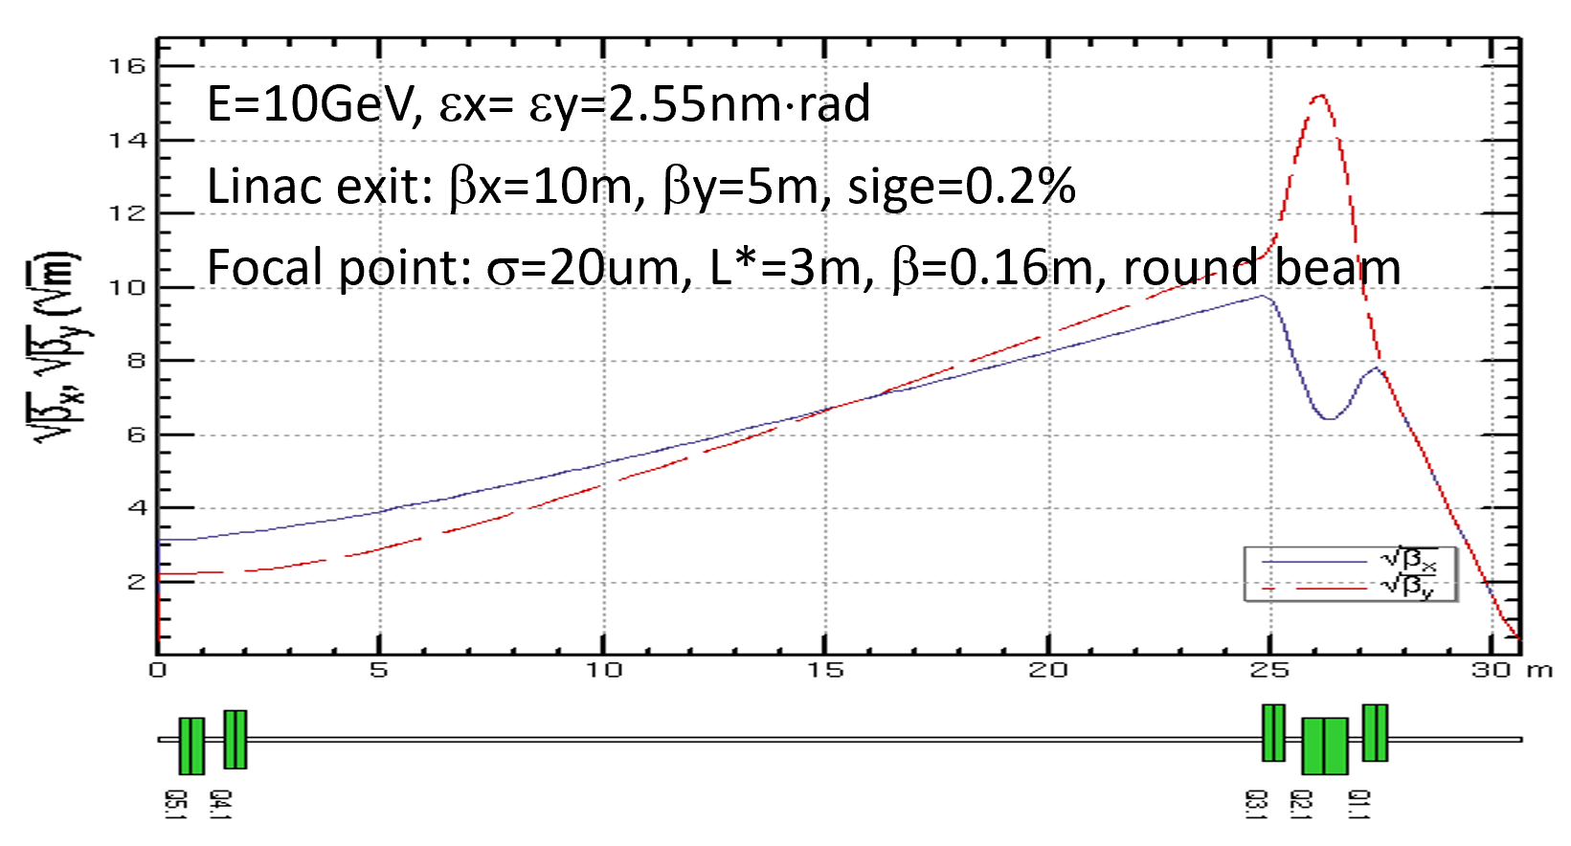
e- Bunch Final Focus Lattice Design
Requirement
E=10GeV, εx= εy=2.55nm⋅rad (εxn= εyn=50mm⋅mrad)
Linac exit: β~10m, α=0, sige=0.2%
Focal point: σ=20um to 100 um, L*>3m, β=0.16m to 3.92m, round beam
Beam size can be changed with quadrupoles at the entrance.
Only for 20um for the preliminary design

Slide 25
Positron Damping Ring Parameters
 | DR V2.1
Energy (MeV) | 400
Circumference （m） | 20.5
Bunch number | 2 (3*)
B0 (T) | 0.97
U0 (keV/turn) | 5.0
Damping time x/y/z (ms) | 10.9/10.9/5.4
δ0 (%) | 0.054
ε0 (mm.mrad) | 11
Nature σz (mm) | 4.3
Extract σz (mm) | 4.4
εinj (mm.mrad) | 2400
εext x/y (mm.mrad) | 68/57 (14/9*)
δinj /δext (%) | 0.6 /0.054
Storage time (ms) | 20 (30*)
Wiggler parameters
Dipole strength (T) | 4.61
Magnetic period (m) | 0.176
Total length (m) | 1.42
average βx (m) | 1.3
RF parameters
RF frequency (MHz) | 500
RF voltage (MV) | 1.5
Cavity number (single cell) | 2
Energy acceptance by RF(%) | 2.3
harmonic | 34
Cavity length (m) | 0.5
* 120GeV upgrade are taken into account

Slide 26
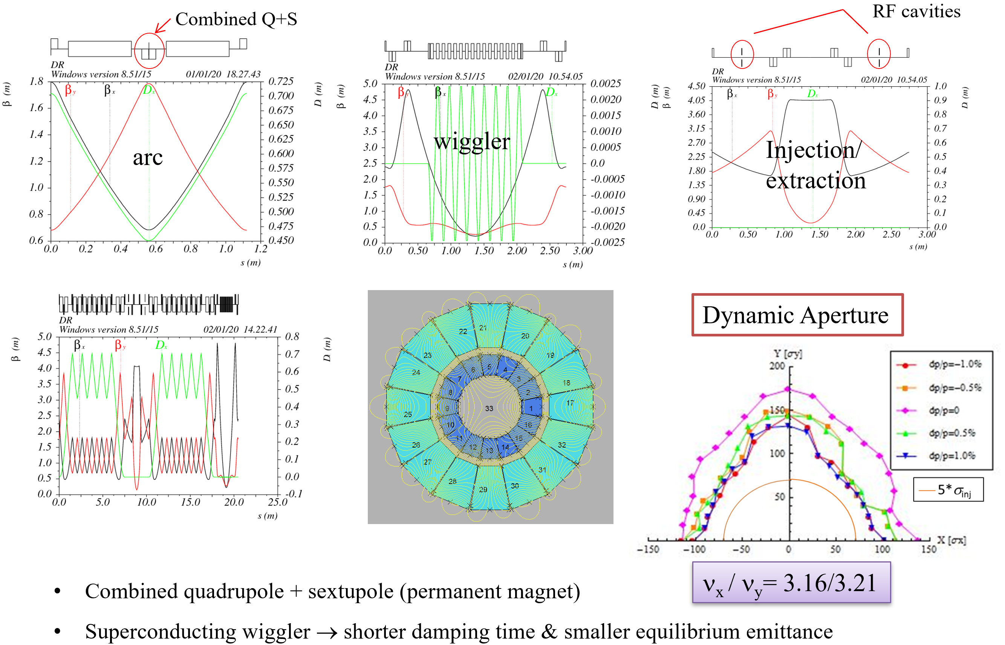
Damping Ring Optics Design V3.0

Slide 27
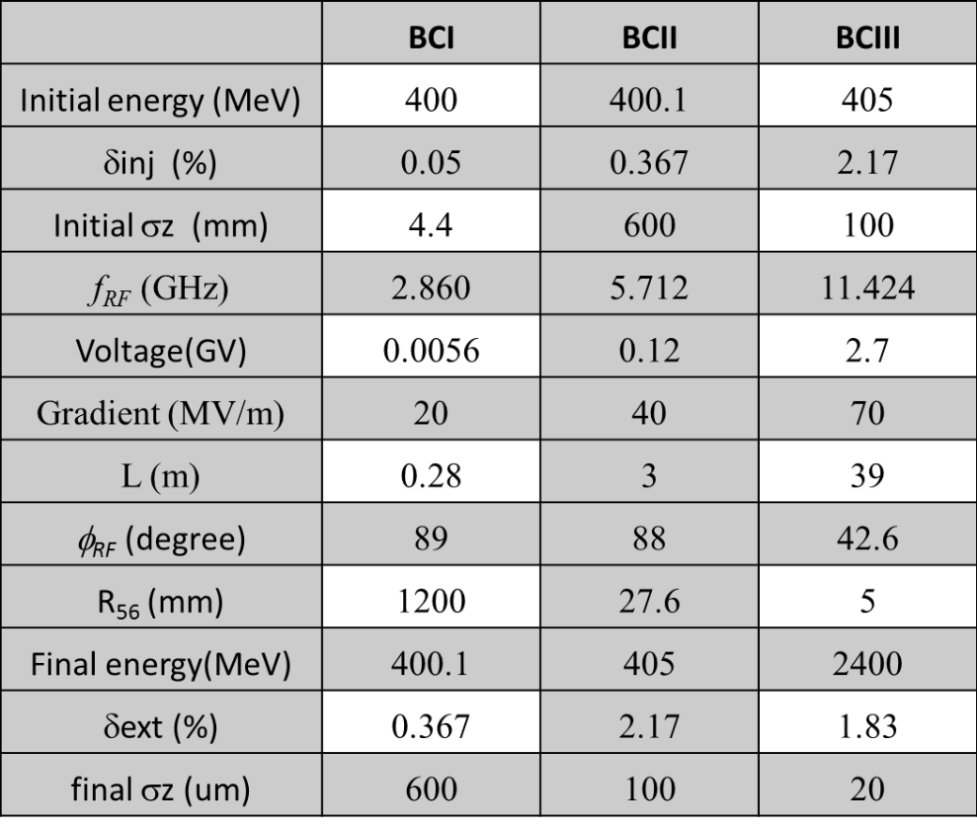
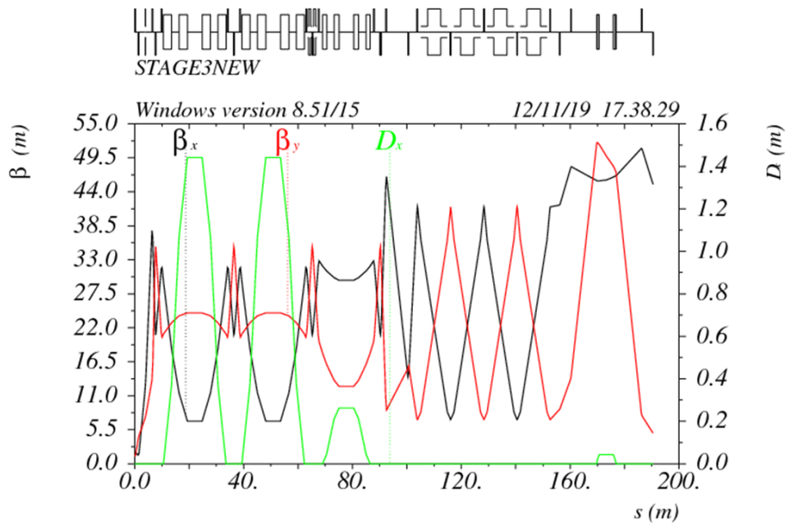
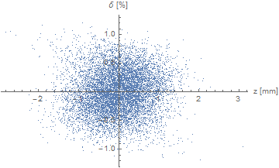
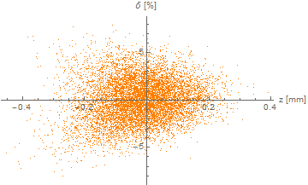
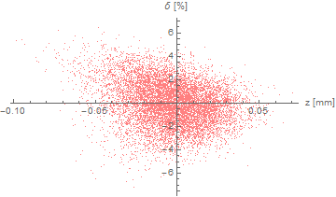
3-Stage Bunch Compressor
Energy: 400MeV → 2.4 GeV
Bunch length: 4.4mm → 20um
Energy spread: 0.054% → 1.8%
BC2
BC3
BC1
BC1
BC2
BC3

Slide 28
Positron Final Focus Lattice Design
L*=3.5m
βx*=0.75m
βy*=0.83m
FFS
Goal: 20um beam size for horizontal/vertical
100um beam size has been realized.
Strong chromatic effect due to large energy spread (1.8%) @2.4GeV
Update with local chromaticity correction is on the way.

Slide 29
Thank you !

Slide 30
Current Status
2019年1月-2019年6月：
确定等离子体注入器的初步参数，完成第一版等离子体注入器的设计→进行中，传统加速器设计有问题需解决
完成 PWFA方面的电子加速模拟部分（含误差）
完成 SINAP高变压比电子加速实验所需设备的采买工作→调研选型完成，绝大部分设备8周内可以到货
2019年7月-2019年12月：
完成SINAP高变压比电子加速实验的准备工作（含激光器能量升级）→真空腔室正在安装，预计十月进场准备
完成电子加速和正电子加速基础方案的数值模拟研究，确定最终版的CEPC等离子体注入器的参数需求
2020年1月-2020年6月：
完成在清华大学进行的米级等离子体通道的产生和测量研究→米级等离子体通道加工中，年底开始实验
完成正电子加速新方案的探索模拟研究，并判断其可行性→已提出两种改进方案，还需进一步优化
根据等离子体注入器的最终需求，完成传统加速器部分的设计
2020年7月-2020年12月：
完成 SINAP 进行的高变压比实验验证，并给出低能、小电荷下的定标率
完成 front-to-end 的整体数值模拟研究，以及级联加速的数值模拟研究。
确定可以在FACET-II上进行的实验内容，完成（见证）高变压比实验结果，提出正电子加速的实验方案

Slide 31
Positron Acceleration—New Methods
e-, shaped & evolved
3-4nC, 45GeV
Uniform Plasma Channel
e+
1nC, 45GeV
e+ flat-top
2nC, 2/4GeV
能量转换效率不超过40%
Slice能散>1%（有待优化）
发射度保持和注入时同一数量级
对误差容忍度提高1个数量级以上
可以通过debuncher + dechirper将slice能散降低至至0.2%水平
31

Slide 32
正电子等离子体加速方案（3）
e-, shaped
10nC, 45GeV
Transverse non-uniform
Hollow Plasma Channel
e+
1nC, 45GeV
e+
1.2nC, 2/4GeV
能量转换效率~10%
Slice能散~0.2%
发射度保持和注入时同一数量级
对误差容忍度提高1个数量级以上
32

