Slide 1
R&D of CEPC Cryogenic System
Ruixiong Han , Shaopeng Li
On behalf of CEPC cryogenic team
CEPC Day, Beijing, Feb.14,2020

Slide 2
Outline
Introduction of CEPC cryogenic system
Cooling diagram for SC RF cavities
Design of CEPC 650MHz cavity Cryomodules
Layout of cryogenic sation for RF system
Summary

Slide 3
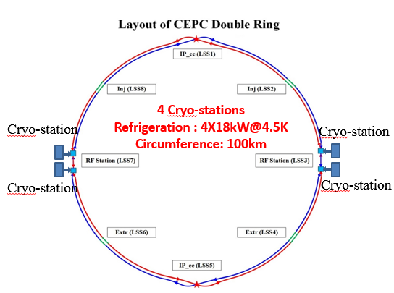
Introduction of CEPC Crygenic Station
Booster ring:
1.3 GHz 9-cell cavities, 96 cavities
12 cryomodules
3 cryomodules/each station
Temperature: 2K
Collider ring:
650MHz 2-cell cavities, 240 cavities
40 cryomodules
10 cryomodules/each station
Temperature: 2K
IR magnets:
4 IR magnets, 32 Sextupole magnets, 36 cryomodules
18 cryomodules/each cryo-station
Temperature: 4.5K
Cryo for IR
Cryo for IR

Slide 4
Cooling diagram for SC RF cavities
One Cryo-station will supply the cooling for 10 collider cryomodules and 3 booster cryomodules.
The cryomodules have two thermal shields, a 40K~80K shield and a 5K~8K shield.
A 2.2K@1.2bar subcooled helium will be supplied for the cryomodules and the 2K helium gas return to the cold box by the cold compressors .

Slide 5
Design of 650MHz cavity Cryomodule
Six 2-cell Cavities Cryomodule
Overall length(flange to flange, m) | 8.0
Diameter of Vacuum vessel ,m | 1.3
Beamline height from floor, m | 1.5
Cryo-system working temperature, K | 2
Number of cavities | 6
Number of coupler | 6
HOM absorber | 2
Number of 200-POST | 6
Cryomodule performance |  | Specification
RF gradient [MV/m] |  | 13.8(H), 9.4(W), 9.6(Z)
Dynamic heat loads at 2K (Q_{o}=1E10) |  | 19.0(H), 8.7(W), 9.2(Z)
Static heat loads at 2K (Max. Operation) |  | <5W
Number of leakage | He →insulation | <1E-9 Pa.m³/s
 | He →beam pipe | <1E-9 Pa.m³/s
 | Insulation →coupler | <1E-9 Pa.m³/s
 | Insulation →beam pipe | <1E-9 Pa.m³/s
 | Coupler →beam pipe | <1E-9 Pa.m³/s
Alignment x/y inside (Cavities) |  | within±0.5mm
Alignment z inside |  | within ±2 mm
Coupler antenna design z |  | within ±2 mm

Slide 6
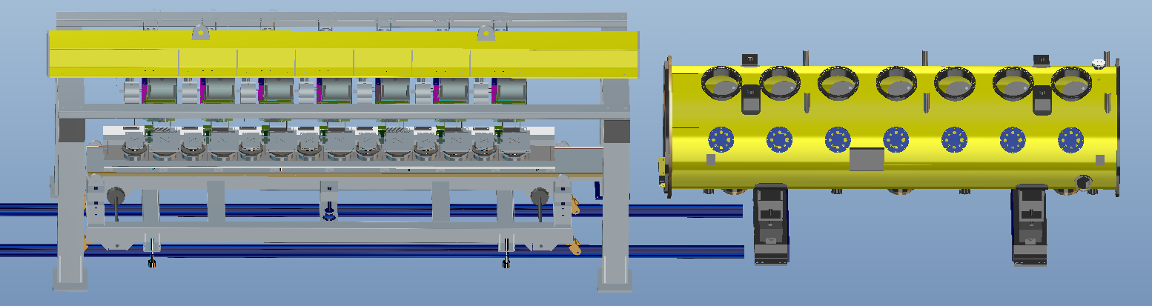
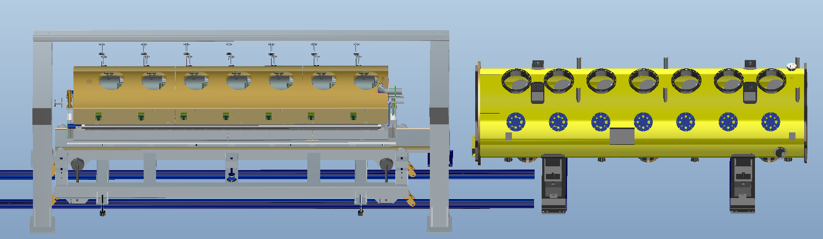
CEPC cryomodule Assembly equipment

Slide 7
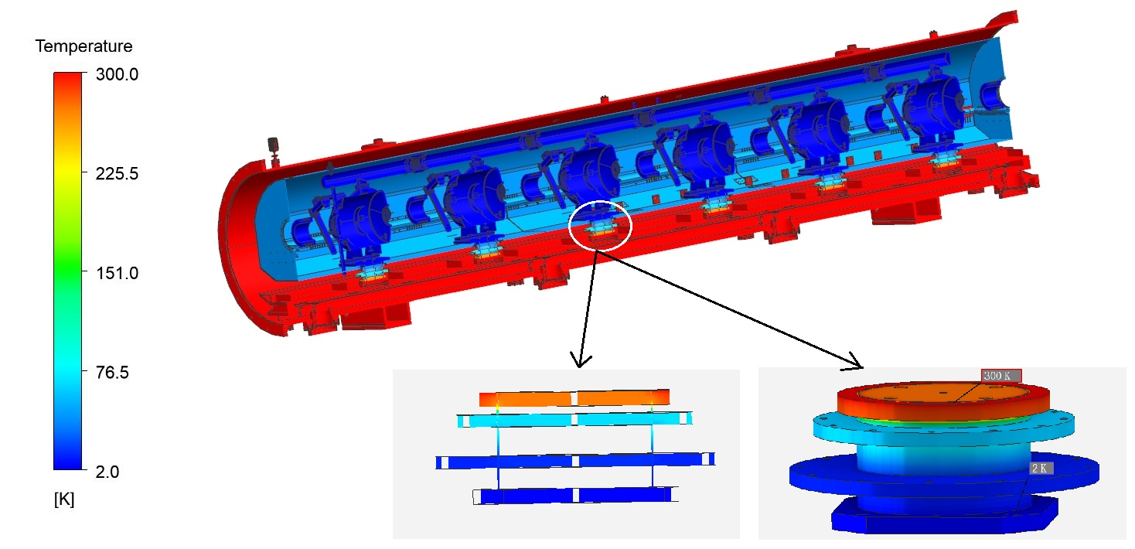
Heat Load of 650MHz cryomodule
Heat source | N | Static/W |  |  | Dynamic/W
 |  | 80K | 5K | 2K | 80K | 5K | 2K
Cavities | 6 | / | / | / | / | / | 120
Input Couplers | 6 | 36.00 | 18.00 | 2.10 | 60.00 | 36.00 | 6.00
HOM couplers | 12 | / | / | / | / | / | 6.00
200-POSTs | 6 | 44.37 | 6.81 | 2.10 | / | / | /
Instrumentation Cables | / | / | / | 0.54 | / | / | /
Radiation | / | 32.50 | 1.28 | / | / | / | /
Beam pipes | / | 1.00 | 0.30 | 0.20
Summary |  | 113.87 | 26.49 | 4.94 | 60 | 36 | 132

Slide 8
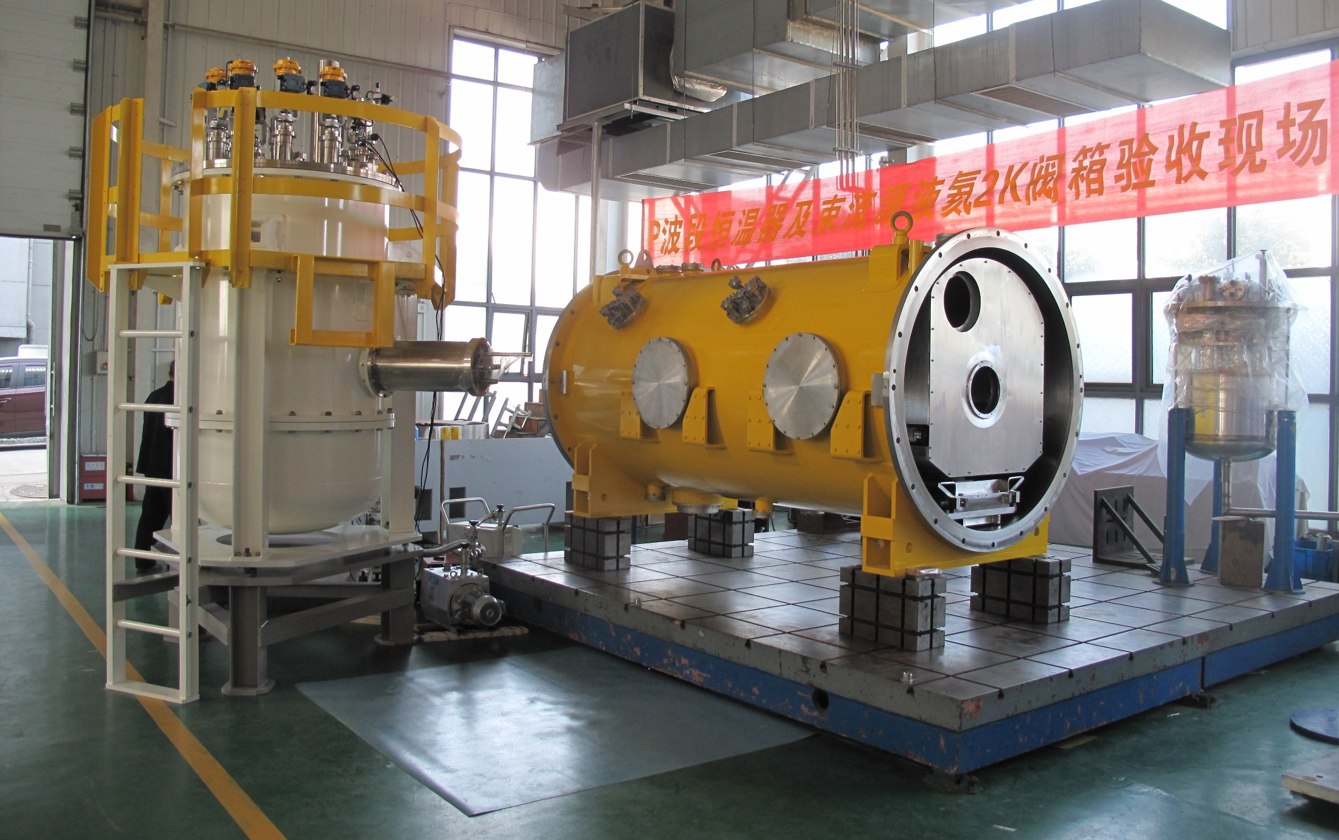
Fabrication of test cryostat and VB

Slide 9
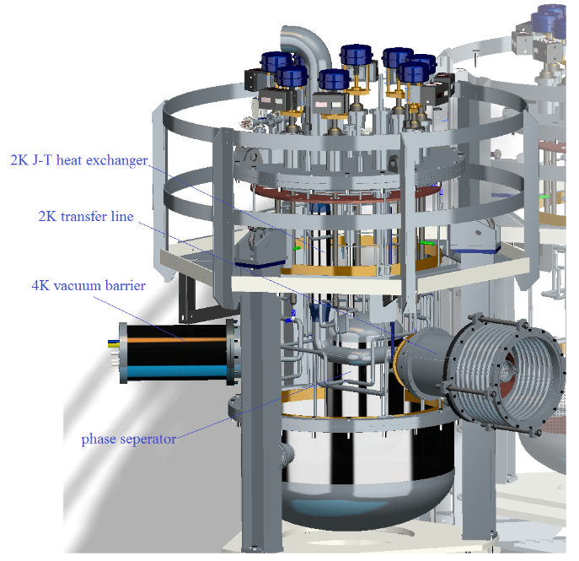
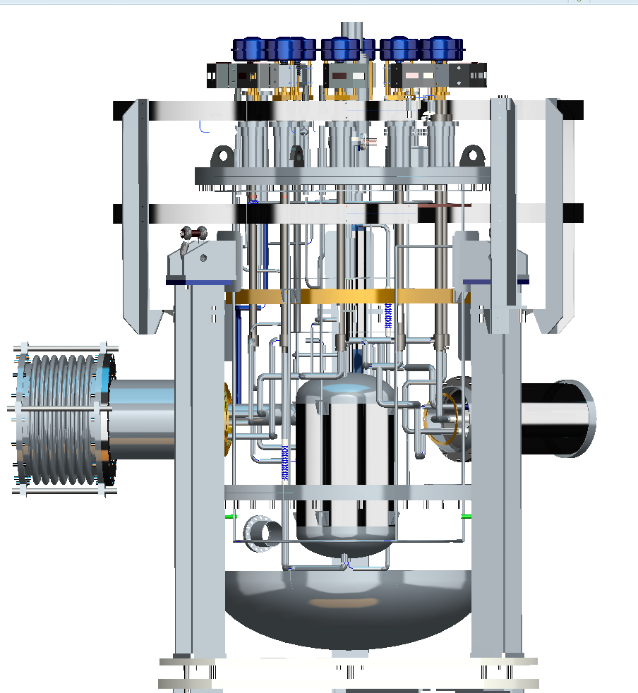
2K Distribution Valve Box
φ1200

Slide 10
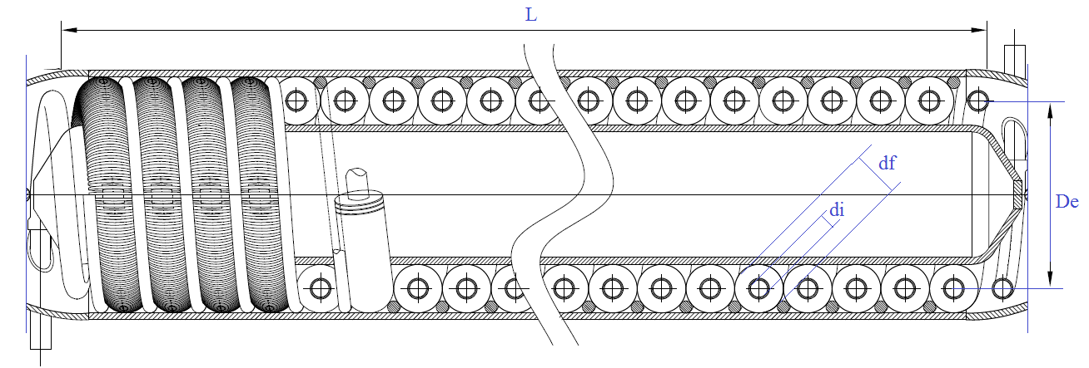
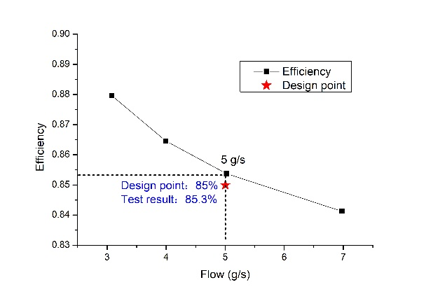
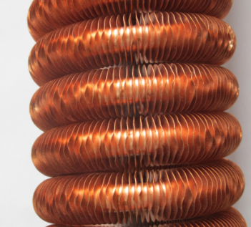
2K J-T Heat Exchanger
gas helium
Liquid helium
Fluid | Liquid helium | Gas helium
Inlet temperature（K） | 4.45 | 2
Inlet pressure（Pa） | 1.25E+05 | 3100
Outlet temperature（K） | 2.2 | 3.36
Liquid
helium
gas helium
Fig.1 J-T heat exchanger

Slide 11
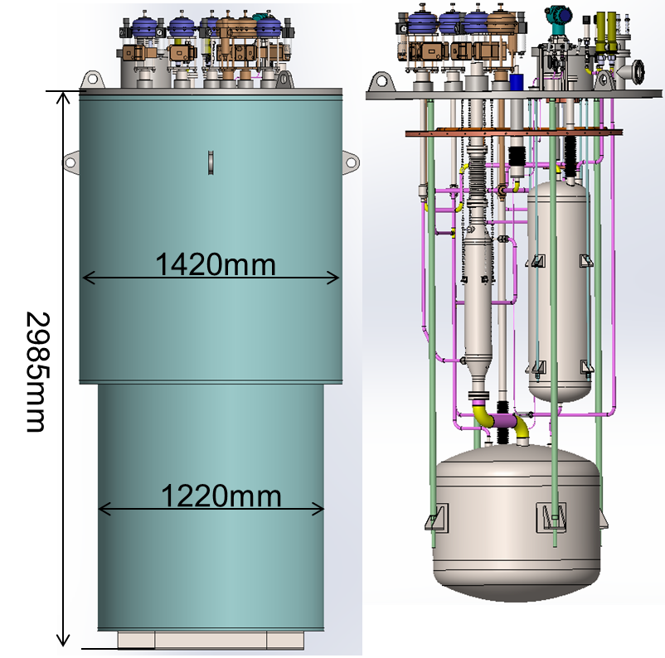
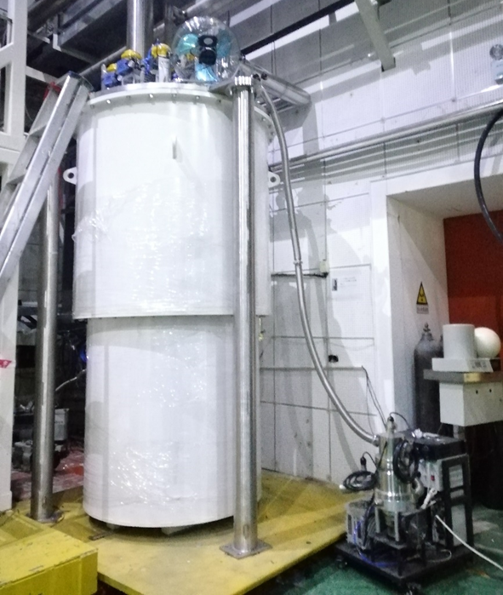
Test Dewar for 2K J-T heat exchanger
Test Cryostat
T | 2K | 80K
Heat load（W） | 1.53 | 19.55

Slide 12
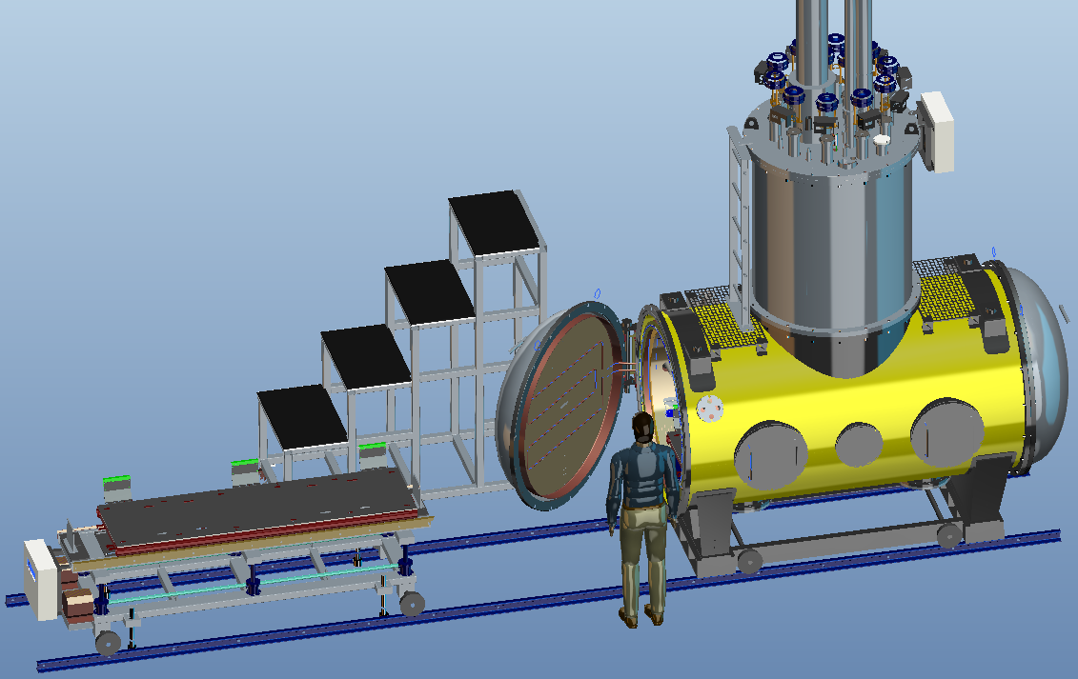
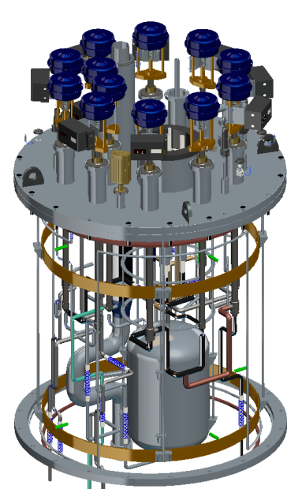
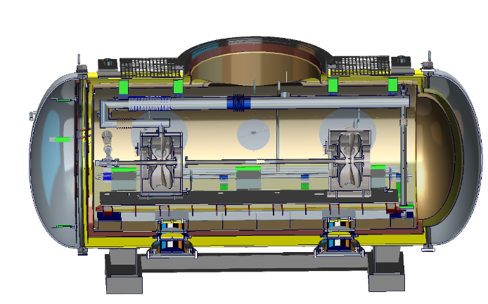
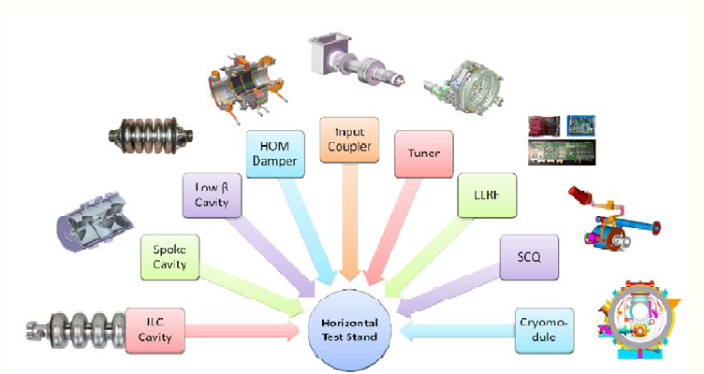
Design of Horizontal test cryostat
L=2700 mm
D=1500 mm
•Check tuner and cavity tuning stability
•Test fundamental power coupler
•Test HOM couplers
• Measure Q0 Cavity quality measurements
• The attainable fields under different conditions
•An excellent system to study cryogenic engineering issues. & Many other Tests

Slide 13
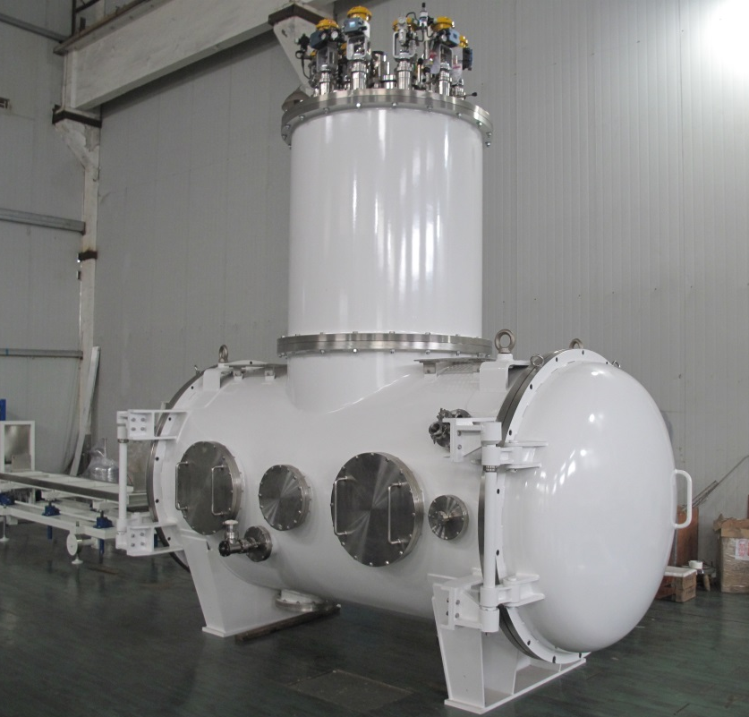
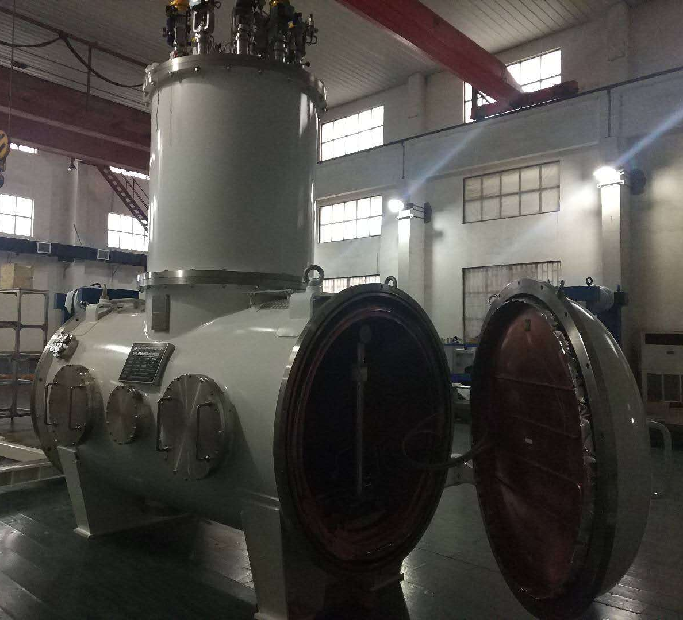
Fabrication of Horizontal test cryostat

Slide 14
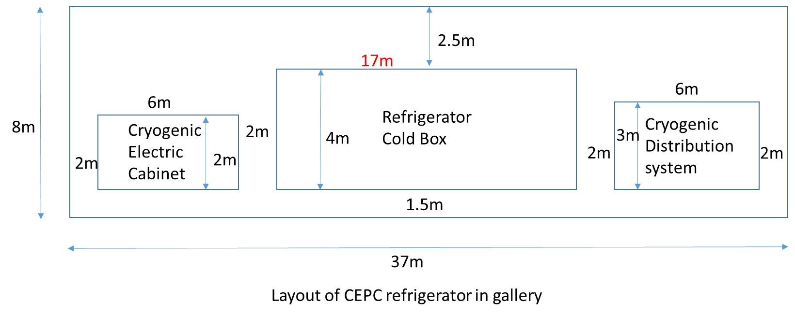
Infrastructure of SC RF Cryo-system
Each cryo-station has an underground plant in the gallery, the size is 37m * 8m.

Slide 15
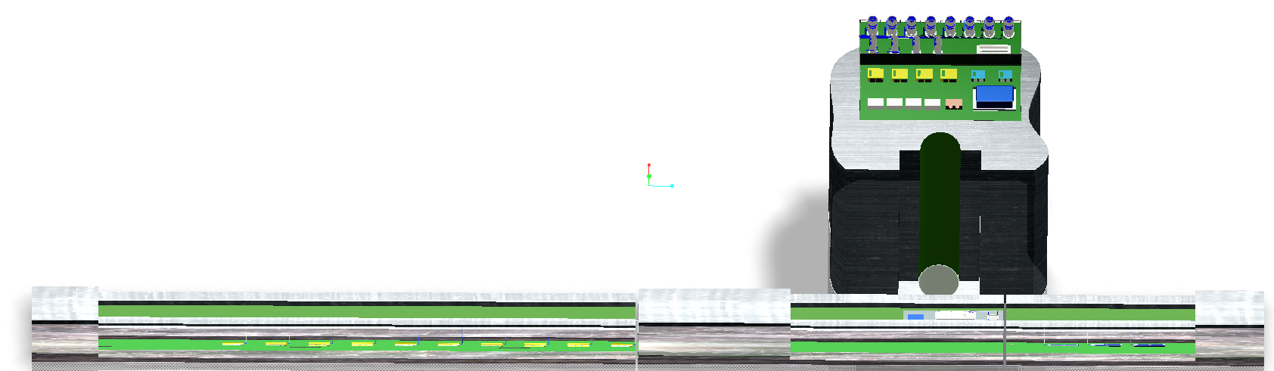
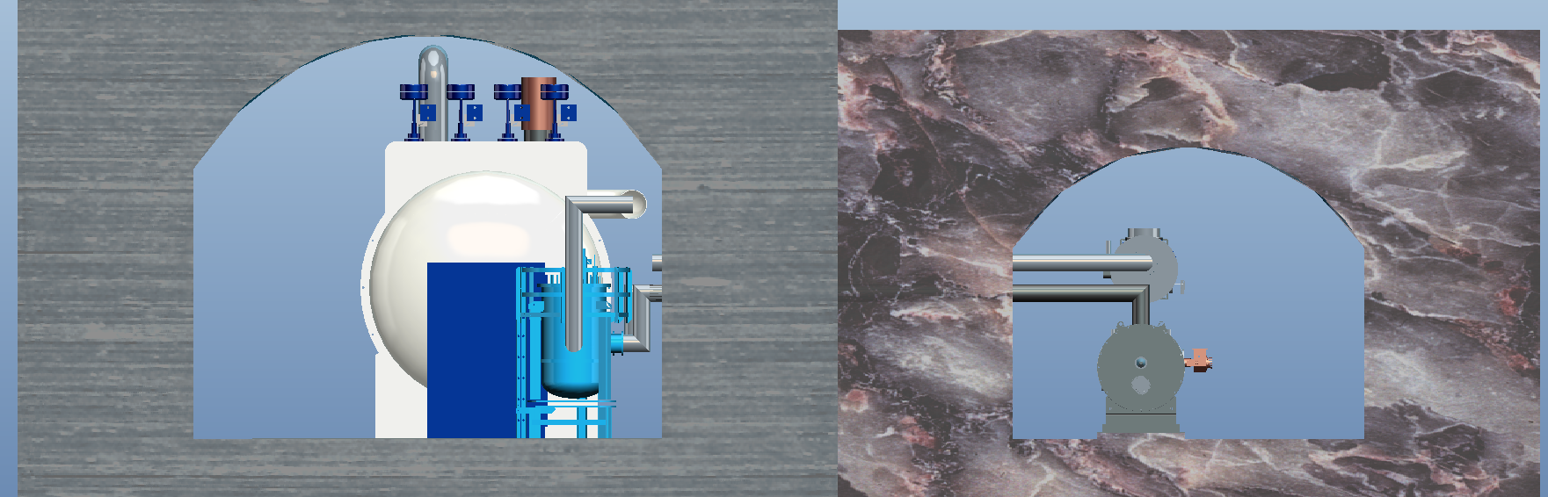
Layout of SC RF cryo-system
Pressure Vessels area
Room equipments hall
Ground
Collider part
Booster part
Refrigerator
Gallery
RF Tunnel
Transfer line
Refrigerator
1.3GHz cryomodule
2K valve box
650MHz cryomodule

Slide 16
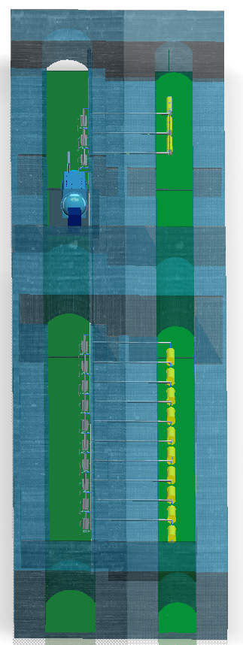
Layout of SC RF cavities cryo-system
1.3GHz cavity
cryomodule
2K
Valve box
Booster part
Refrigerator
main valve box
18kW@4.5K
2K
Valve box
Collider part
650MHz cavity cryomodule

Slide 17
Conceptual Design of Refrigerator

Slide 18
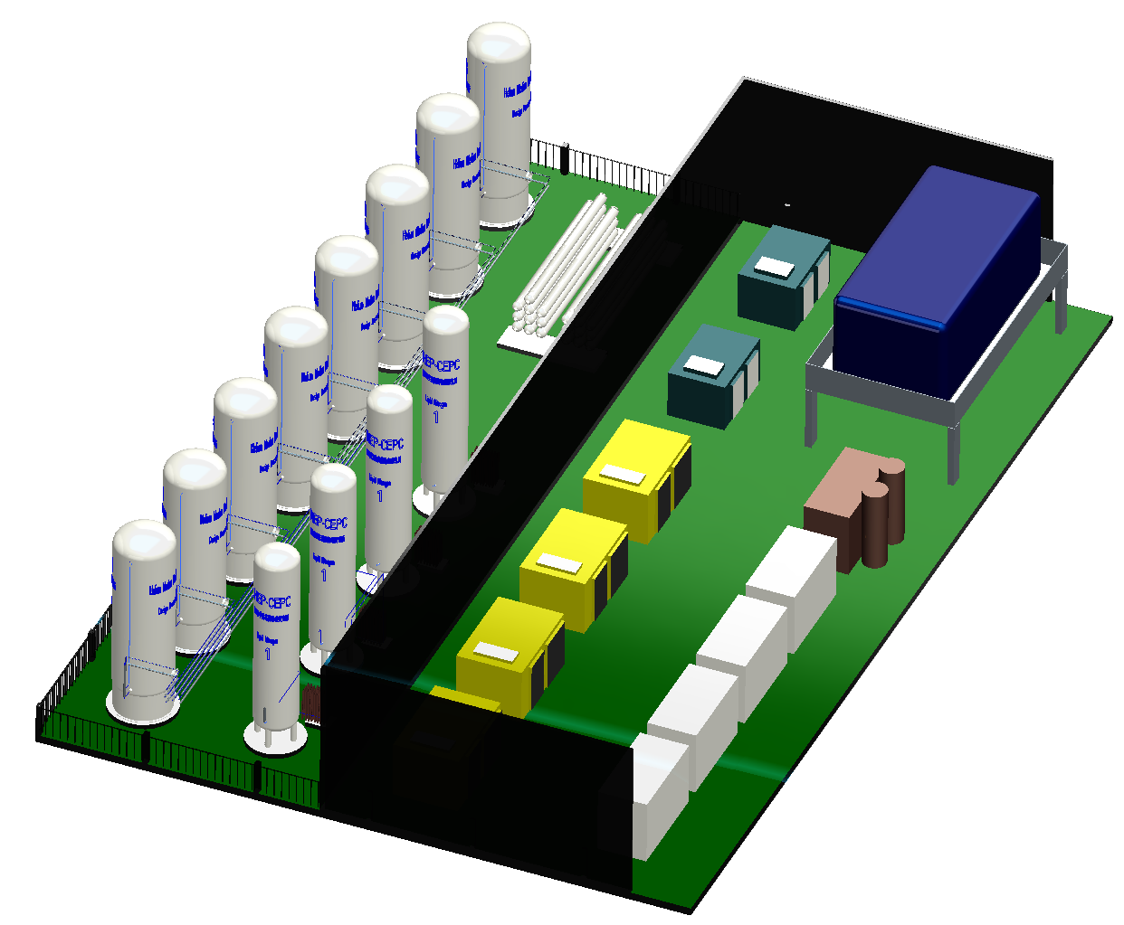
Layout of RF Cry-system warm hall
High pressure helium cylinders
Piston compressors
Recovery and purification system
10*100m³ helium gas
Pressure vessels
Design pressure
1.6MPa
Helium gas bag
Helium purifier
Electrical control system
4*50m³ LN₂ Storage Tanks
Recycle screw compressors

Slide 19
Summary
Preliminary Layout design of cryogenic system for RF SC cavities was completed.
Preliminary design of 650MHz cavity cryomodule was completed.
R&D and test platform is under design, which will support the performance test and mass production of the CEPC SC cavities.
Detailed design of the CEPC cryogenic system is under way.

Slide 20
Thanks for your attention

