Slide 1
Propagator generation with Chroma+QUDA for various fermion actions
2021.11.02
Zhang Kuan
Collaborate with Yang Yibo …

Slide 2
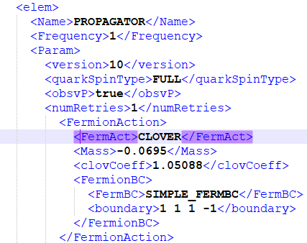
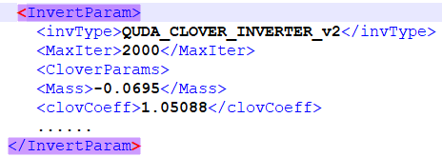
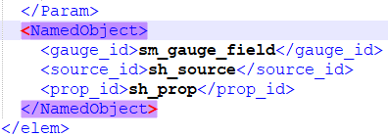
Chroma+QUDA
Chroma from Jefferson Lab efficient, flexible, user friendly
accelerate D-slash on GPU
QUDA is a library for performing calculations in lattice QCD on GPUs

Slide 3
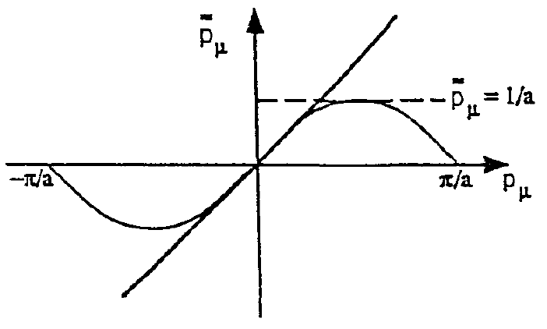
Fermion action on lattice
$$S=\sum_{x}{\overline{ψ_{x}}\left[\frac{1}{2}\left(∂_{μ}+∂_{μ}^{∗}\right)γ^{μ}+m_{0}\right]ψ_{x}}$$
naïve fermion fermion doubling!
Wilson fermion √
Wilson-type fermion clover fermion √ twist mass fermion
overlap fermion
HISQ(highly improved staggered quark) fermion
domain wall fermion
$$S=\sum_{x}{\overline{ψ_{x}}\left[\frac{1}{2}\left(∂_{μ}+∂_{μ}^{∗}\right)γ^{μ}−\frac{1}{2}\left(∂μ∂_{μ}^{∗}\right)+m_{0}\right]ψ_{x}}$$

Slide 4
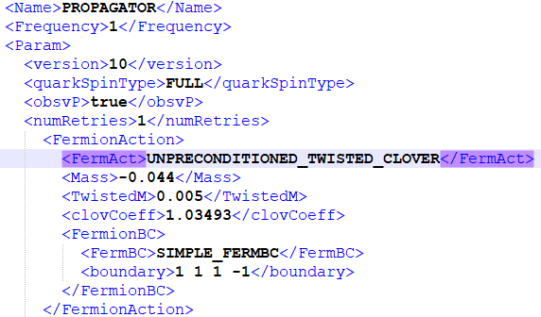
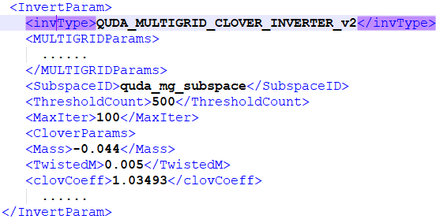
Twist mass fermion
avoid the exceptional condition due to the unstablity of the critical point
Automatic O(a) improvement if $ω=\frac{π}{2} α→ω$

Slide 5
acceleration
m_{π} ~ 300MeV
residual = 2e-6
 | ensembles | mass | processes | time(subspace)
CPU | MILC06 | -0.0398 | 36 | 6992s
GPU | MILC06 | -0.0398 | 36 | 652s
GPU with multi-grid | MILC06 | -0.0398 | 36 | 99s(515s)
GPU with multi-grid | MILC06 | -0.044+0.005i | 36 | 78s(154s)

Slide 6
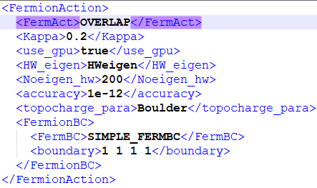
Overlap fermion action
Ginsparg-Wilson relation
Overlap
Sign function ~ polynomial of Hwilson D-slash polynomial
$$D=V Λ V^{−1} D^{n}={V Λ}^{n} V^{−1} f\left(D\right)=V f\left(Λ\right) V^{−1}$$
$D\left(ψ_{1},ψ_{2},⋯{,ψ}_{k}\right)=\left({c_{1}ψ}_{1},c_{2}ψ_{2},⋯{,c_{k}ψ}_{k}\right)=$ $\left(ψ_{1},ψ_{2},⋯{,ψ}_{k}\right)$ $\left(\begin{matrix}\begin{matrix}c_{1} & \\ & c_{2}\end{matrix} & \begin{matrix} & \\ & \end{matrix} \\ \begin{matrix} & \\ & \end{matrix} & \begin{matrix}⋱ & \\ & c_{k}\end{matrix}\end{matrix}\right)$ $⇒ DV=VΛ ⇒$ $D=V Λ V^{−1}$

Slide 7
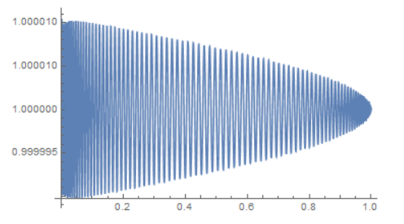
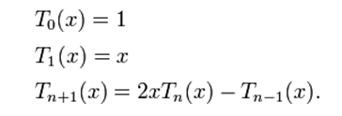
Chebyshev polynomial
Definition converge faster
Chebyshev coefficients
$ε$:chebyshev cut
Hwilson low mode

Slide 8
Chebyshev coefficients
Estimate the ranks of polynomial: n according to $ε$, δ
Solve the equations
Use extreme points as the new y(z)
Clenshaw recursion less round-off error
initial value
meet the tolerance δ

Slide 9
Hwilson Eigen solver
Chebyshev acceleration reduce high mode
Arnoldi factorization: Krylov array Schmidt orthogonalization Diagonalize Hessenberg matrix
$$f\left(D\right)=V f\left(Λ\right) V^{−1}$$
$AQ=QTΛ T^{−1}$ $A=QTΛ{(QT)}^{−1}$

Slide 10
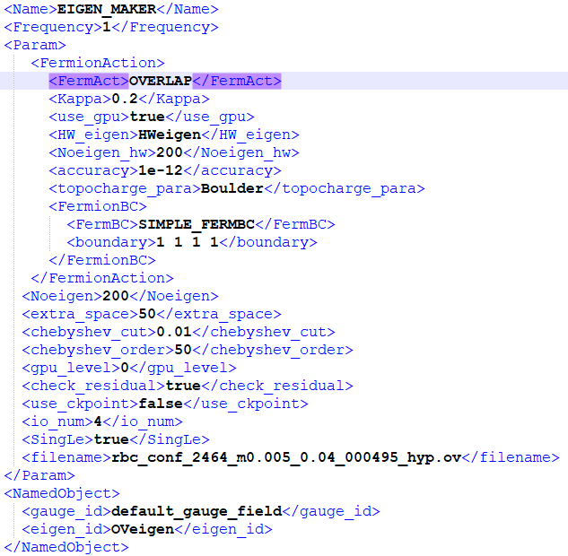
Overlap Eigen solver
deflation overlap low node
complex eigenvalue╳ arnoldi needs real !
half of spinor $Dψ=λψ Dγ^{5}ψ=λ^{∗}γ^{5}ψ$ $\left(1±γ^{5}\right) D\left(1±γ^{5}\right)ψ= \left(λ+λ^{∗}\right)\left(1±γ^{5}\right)ψ$
reconstruct
$D=V Λ V^{−1}{ D}^{−1}=VΛ^{−1}$ $V^{−1}$

Slide 11
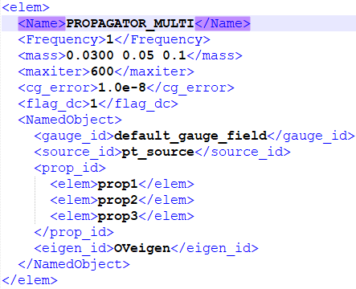
Overlap propagator
deflation: accelerate inversion
multi-mass: calculate propagators with different mass simultaneously

Slide 12
GPU acceleration
m_{π} ~ 300MeV
Hwilson eigen system
Overlap eigen system
residual = 1e-15
 | ensembles | eigenvectors | processes | time(chroma)
CPU | RBC11 | 200 | 4 | 8070s
GPU | RBC11 | 200 | 4 | 491s
CPU | RBC08 | 200 | 16 | 4704s
GPU | RBC08 | 200 | 16 | 635s
residual = 1e-12
 | ensembles | eigenvectors | processes | time(chroma) | time(gwu-code)
CPU | RBC11 | 200 | 4 | >12h | -
GPU | RBC11 | 200 | 4 | 7600s | 16110s
CPU | RBC08 | 200 | 16 | >12h | -
GPU | RBC08 | 200 | 16 | 10236s | 14370s
Intel Xeon Gold 6142
NVIDIA Tesla V100 32GB

Slide 13
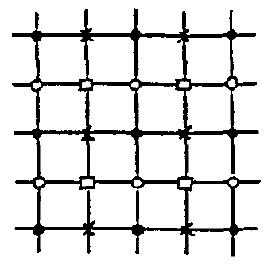
Staggered fermion
Fermion double: 2⁴=16
Staggered transformation: 4 $ψ^{,}\left(x\right)=γ_{0}^{x_{0}}γ_{1}^{x_{1}}γ_{2}^{x_{2}}γ_{3}^{x_{3}}ψ\left(x\right)$
Residual 4 freedom
HISQ(highly improved staggered quark) long link fat link
Phys.Rev.D75:054502,2007
Cheap!

Slide 14
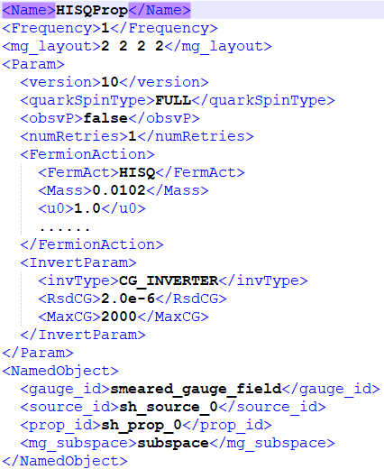
HISQ inverter
CPU version in Chroma √
GPU version in QUDA √
Interface between CHROMA and QUDA
set parameters for inverter calculate&load long&fat link
invertQuda(***);

Slide 15
GPU acceleration
m_{π} ~ 300MeV
residual = 2e-6
 | ensembles | Mass | processes | time(subspace)
CPU | MILC12 | 0.0102 | 4 | 523s
GPU | MILC12 | 0.0102 | 4 | 17s
GPU with multi-grid | MILC12 | 0.0102 | 4 | 26s(334s)
CPU | MILC09 | 0.0074 | 12 | 1086s
GPU | MILC09 | 0.0074 | 12 | 23s
GPU with multi-grid | MILC09 | 0.0074 | 12 | 42s(311s)
Intel Xeon Gold 6142
NVIDIA Tesla V100 32GB

Slide 16
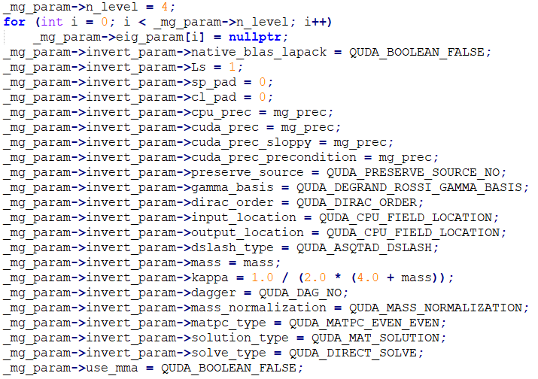
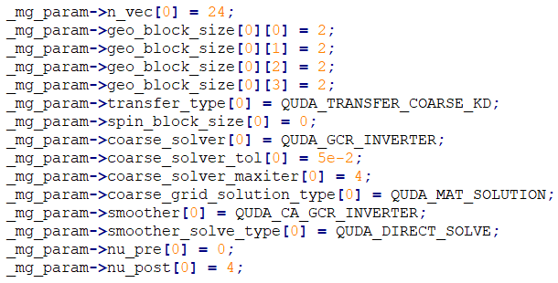
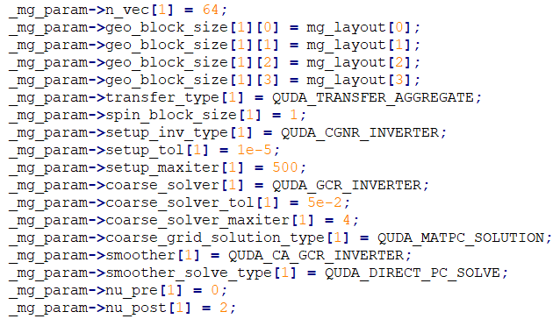
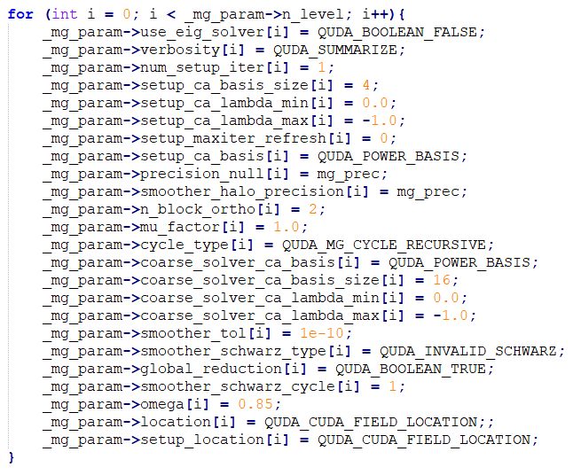
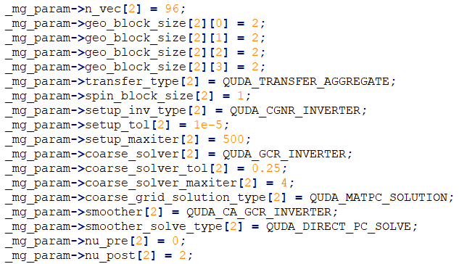
My parameters for HISQ multigrid
Copied from MILC interface

Slide 17
Summary
We wrote interfaces of twist-mass, overlap, and HISQ fermion actions between Chroma and QUDA.
The GPU acceleration effect is obvious.
We plan to write the interface of domain wall fermion in the future.

