Slide 1
Weekly Report
24/02/2020
Shuiting Xin

Slide 2
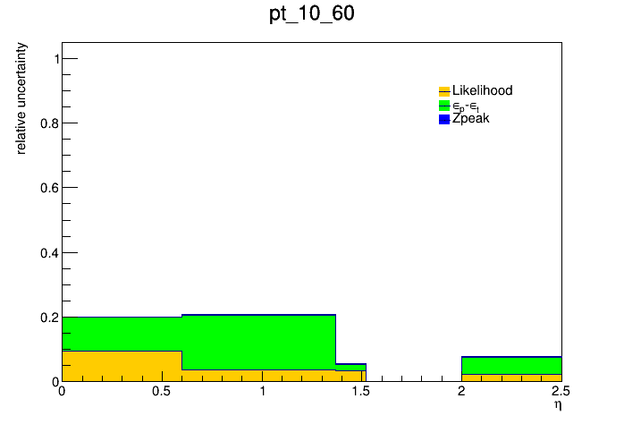
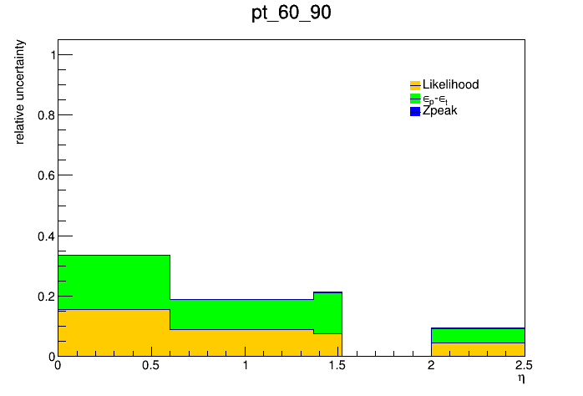
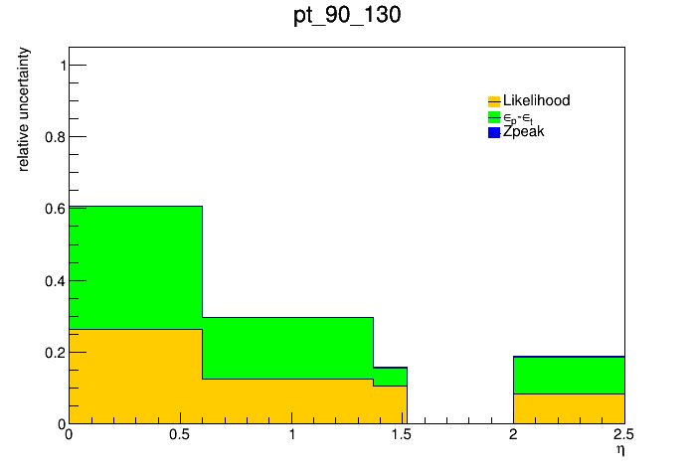
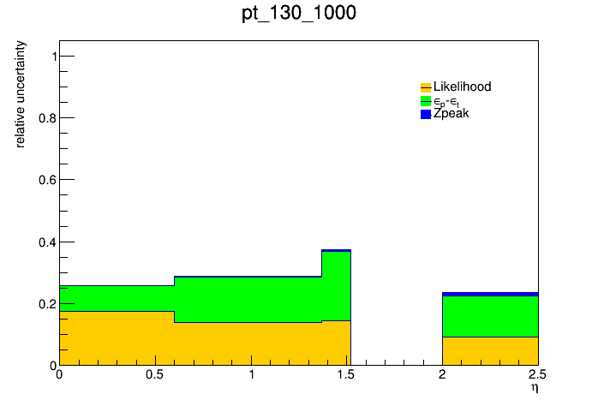
2LSS systematic uncertainties
Uncertainties from data-driven method
QmisID
Sources: statistics, difference between truth and likehood, Zpeak region
Very low bkgs even in sideband.
Uncertainties could be
negligible.
Since this term doesn’t matter, no need to fit it better.

Slide 3
Fake factor
Sources :
Statistics
propagated from QmisID rate suspect to be 15%
Extrapolation from low jet region to high jet region
processes dependence
MC cross-section propagated from prompt, Vgam MC simulations
Using ttbar(semi-lepton decay, only one tight lepton?) to estimate
Predict fakes by FF-method and compare with real fakes (require two tight lepton,or from lep_isfake* if this truth-info is correct)
Didn’t find the samples now, done with 450720(at least one lepton)
Dominated by ttbar and Wjets
Wjets are “soft” than ttbar, larger ratio from heavy flavor decay in ttbar than Wjets

Slide 4
1<=Njet<=2 | Sys uncert. on e | Sys uncert. on mu
Statistics | 0.049 | 0.097
QmisID | 0.15 | 0.15
Closure test (highly underestimated now) | 0.028 | 0.041
…
Since most of staffs are not fixed, plan to be familiar with the analysis procedure but not the result

