Slide 1
R & D progress of CEPC vacuum system
Haiyi Dong
2/20/2020

Slide 2
Contents
R&D of vacuum chambers
R&D of RF shielding bellows
NEG coating inside of vacuum chambers
Targets of the midterm and present status
Summary

Slide 3
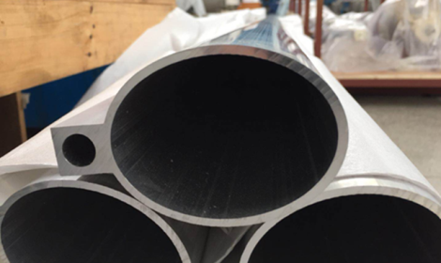
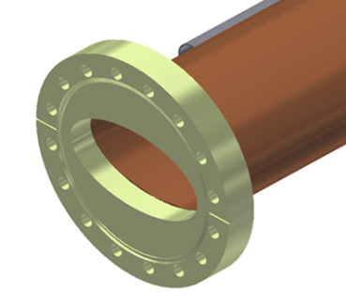
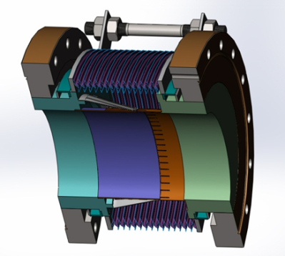
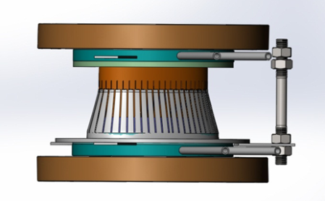
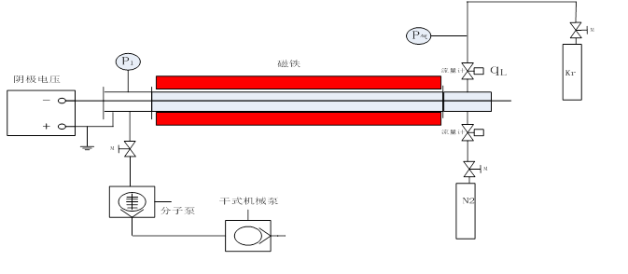
R & D process of vacuum system (MOST2)
Both types of dipole chambers have been fabricated. One is aluminum chamber for electron ring, another is copper chamber for positron ring. Some technical challenges such as extrusion, machining and welding have been solved, and the finite element analysis of the vacuum chambers are completed.
The design, machining and welding of the RF shielding bellows are being carried out, and the key technology specifications have been achieved.
NEG coating setups have been built for a long vacuum chamber, and coating methods and parameters are being studied. The structure, composition, SEY and pumping speed of NEG film samples are measured.

Slide 4
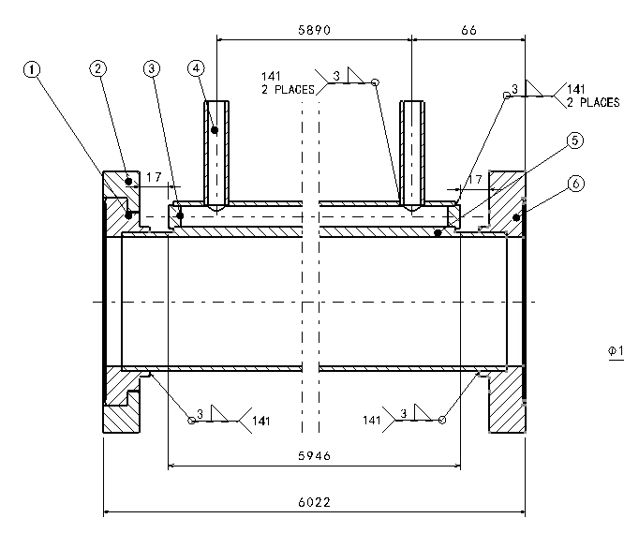
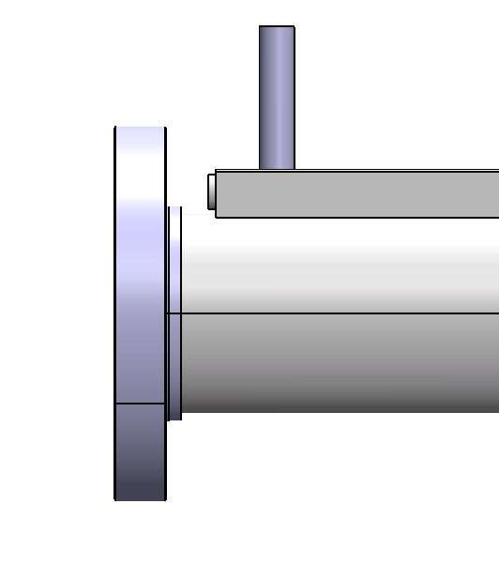
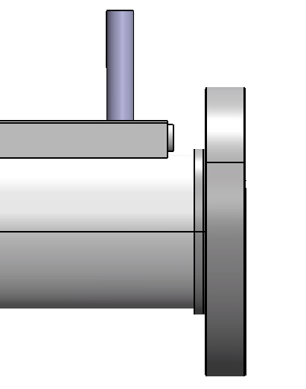
R&D of Al vacuum chamber
Structure of Al vacuum chamber
CF100 rotatable flange
CF100 no-rotatable flange
Al-6061 is chosen as the material of Al vacuum tube, and flanges are fabricated from explosion bonding S.S.-Al transition plate. Flange and tube are welded by manual AC TIG. The fittings for water cooling channels are also Al-6061 and are welded by TIG.

Slide 5
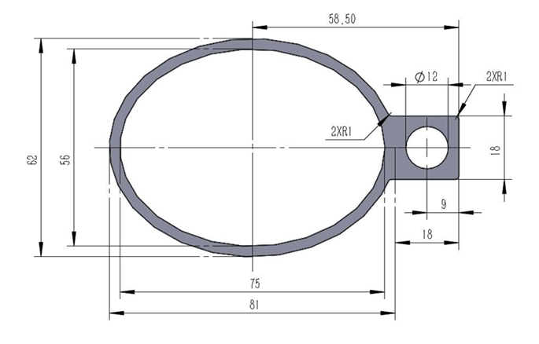
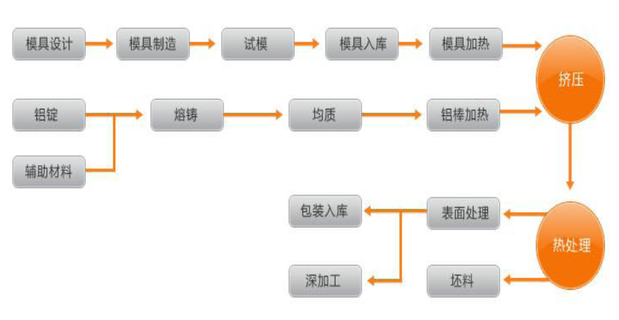
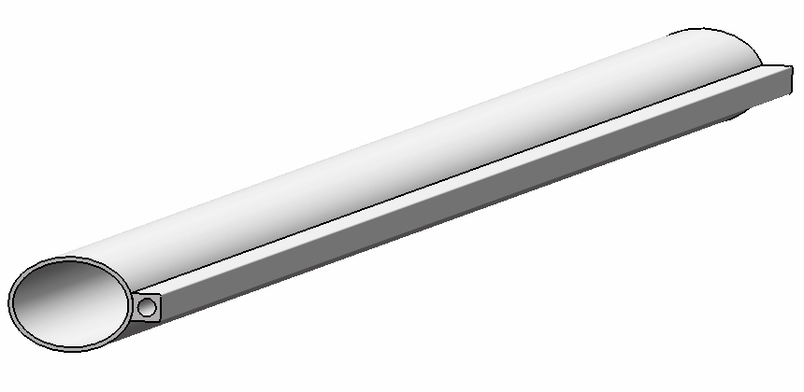
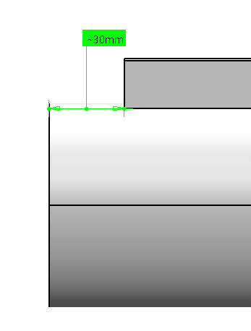
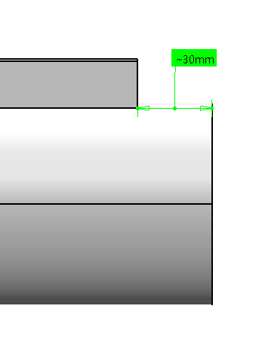
Fabrication process of Al vacuum tube
Aluminum vacuum tube is thermally extruded. Extrusion follows these steps as follows:
Aluminum vacuum chamber
(elliptic 75×56, thickness 3, length 6000)
The connection ports of cooling water channels are machined by numerical control machine tool.

Slide 6
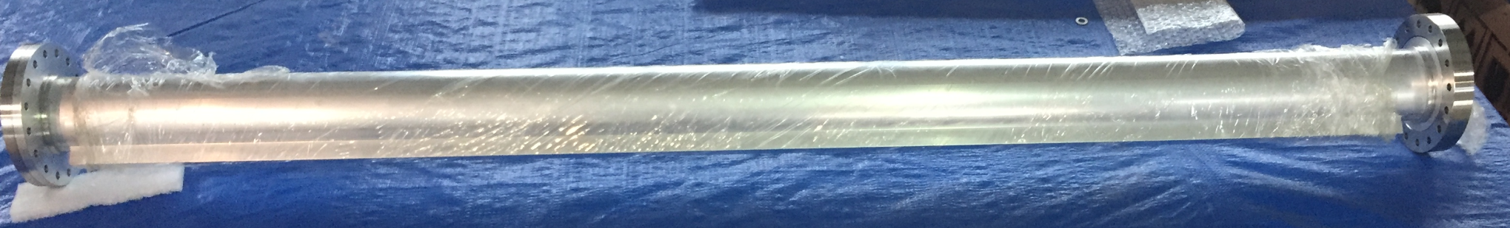
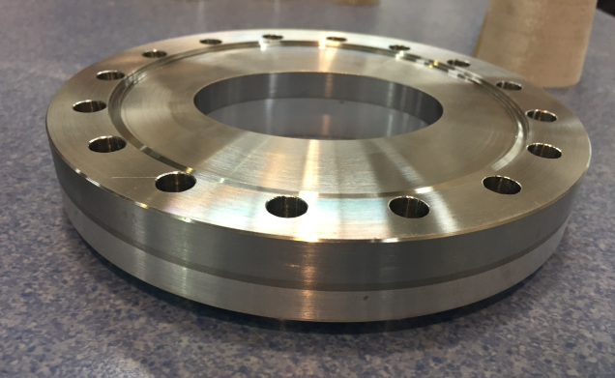
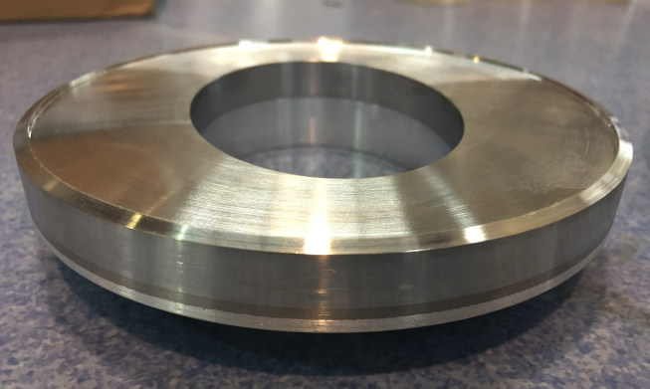
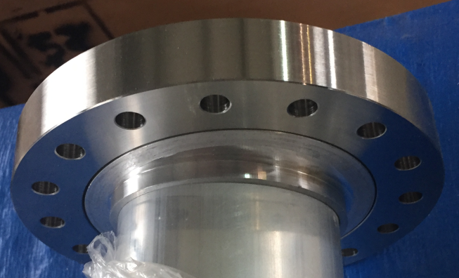
Conflat flanges of S.S.-Al transition material
S.S.-Al transition plate are fabricated through explosion bonding in a domestic company.
Ultrasonic flaw detection is used before the flange will be machined.
Leak detection is carried out after the flange has been machined.

Slide 7
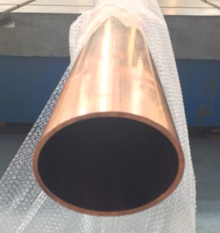
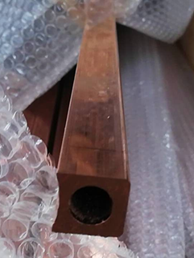
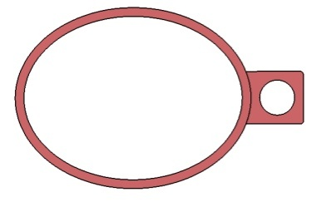
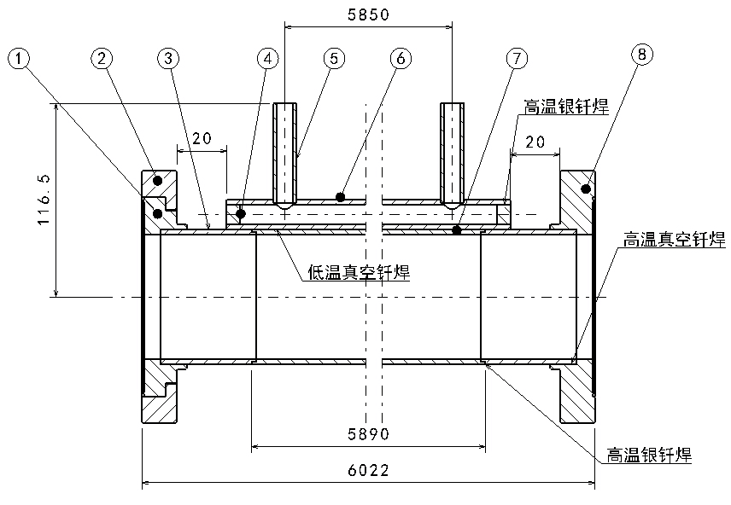
R&D of Cu vacuum chamber
Cu beam pipe and water cooling channel are extruded respectively, and brazed together.
Stainless steel material is used for flanges, and there is a rotatable flange at an end of vacuum chamber.
The flanges and beam pipe are welded by high temperature brazing solder, and low temperature brazing solder are used between the beam pipe and water cooling channel as a 6 m long high temperature vacuum furnace is difficult to be found.
Vacuum chamber
Beam pipe +
Cooling channel

Slide 8
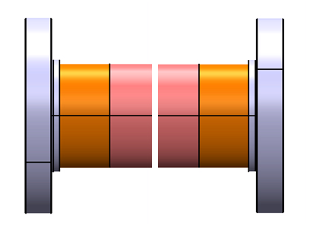
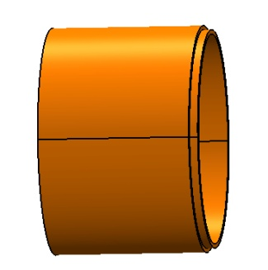
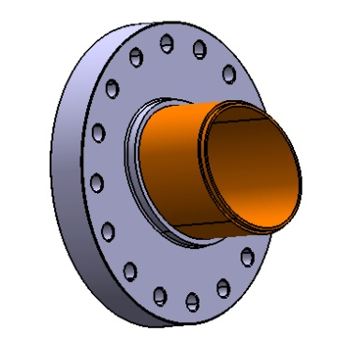
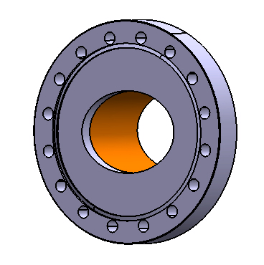
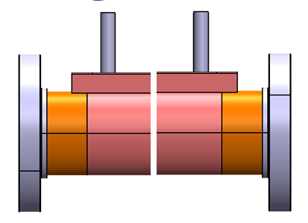
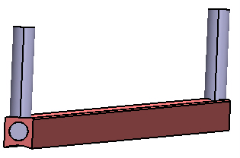
Technique process of Cu vacuum chamber
Leak detection
Transition tube machining
Brazing
Knife edge machining of flange
Silver brazing or EBW
Leak detection
Leak tests for hydraulic pressure and vacuum
Cleaning, leak detection, baking and pumping down
Welding between beam pipe and cooling channel with a low temperature brazing solder
Welding of fittings for cooling channel

Slide 9
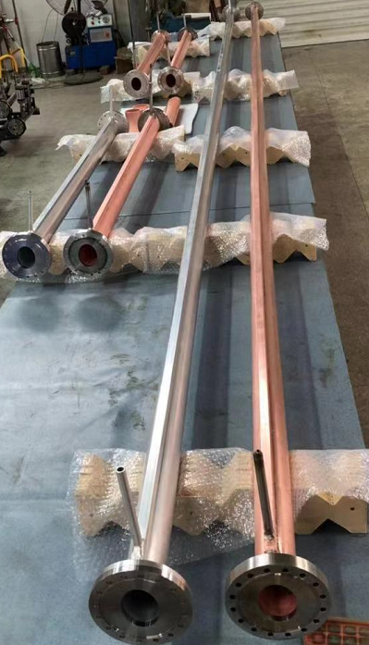
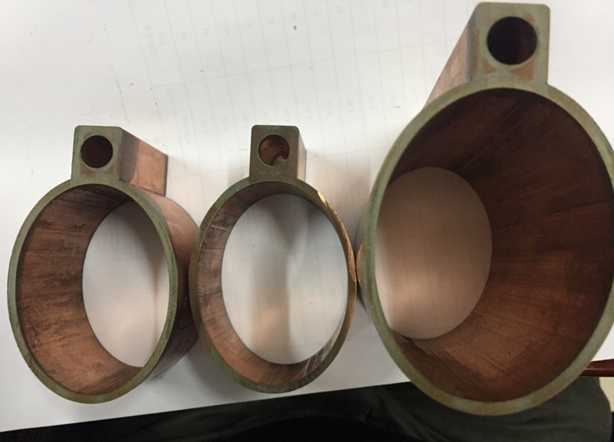
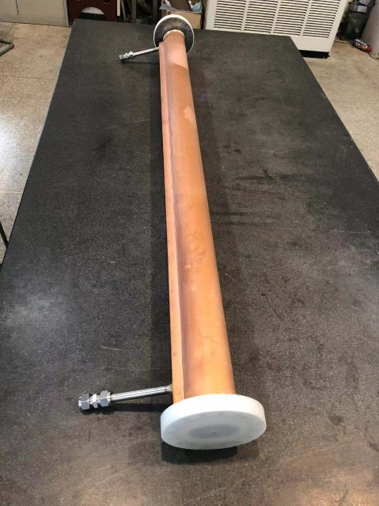
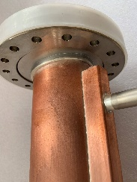
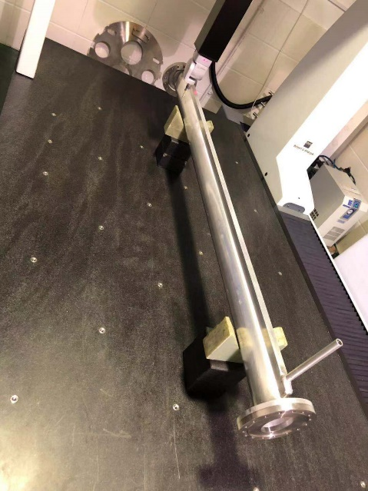
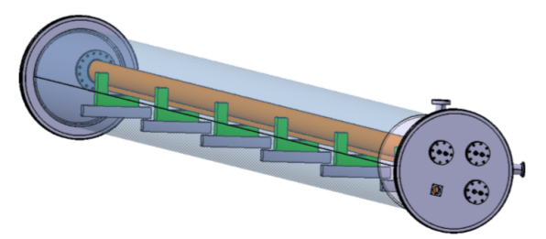
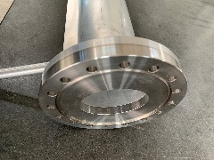
Cu and Al vacuum chamber prototypes
A 6 m long simple vacuum furnace is fabricated, which is used to weld the water cooling channels of Cu chambers through low temperature brazing solder.
The welding seams are checked by wire-electrode cutting. The welding joints are smooth and have good contacting.
The prototypes of copper & aluminum vacuum chambers with a length of 6 m have been fabricated and tested, which meet the engineering requirements.

Slide 10
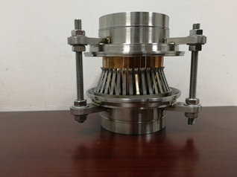
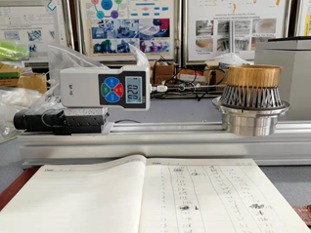
RF shielding bellows Structure
Bellows module
Spring fingers module
Total length: 140 mm
Inner and exterior diameter of bellows: 125mm/140mm
Expansion/contraction: 5mm/12mm
Offset: 2 mm
Bending: 50 mrad
Above technical specifications have been reached.
Contact fingers module

Slide 11
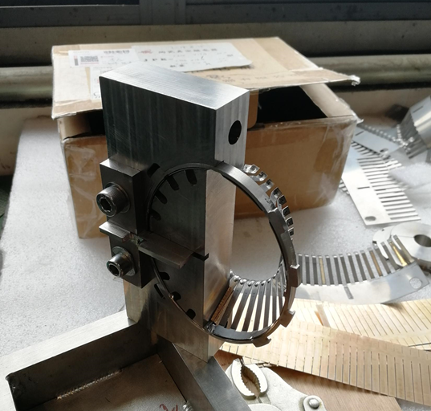
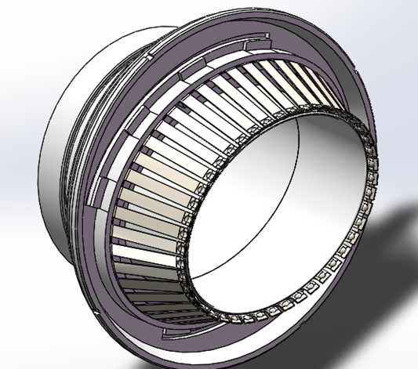
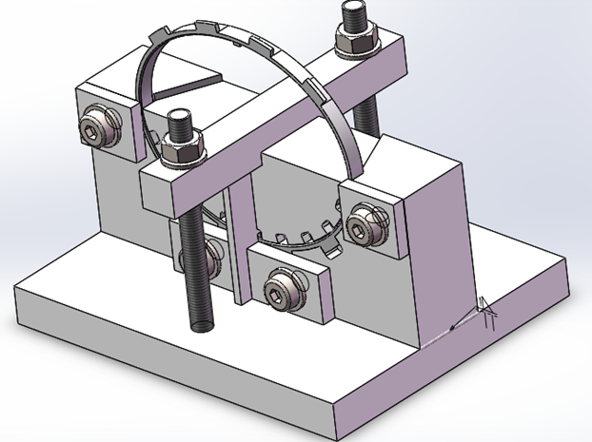
Tool-making of the spring fingers of RF shielding bellows

Slide 12
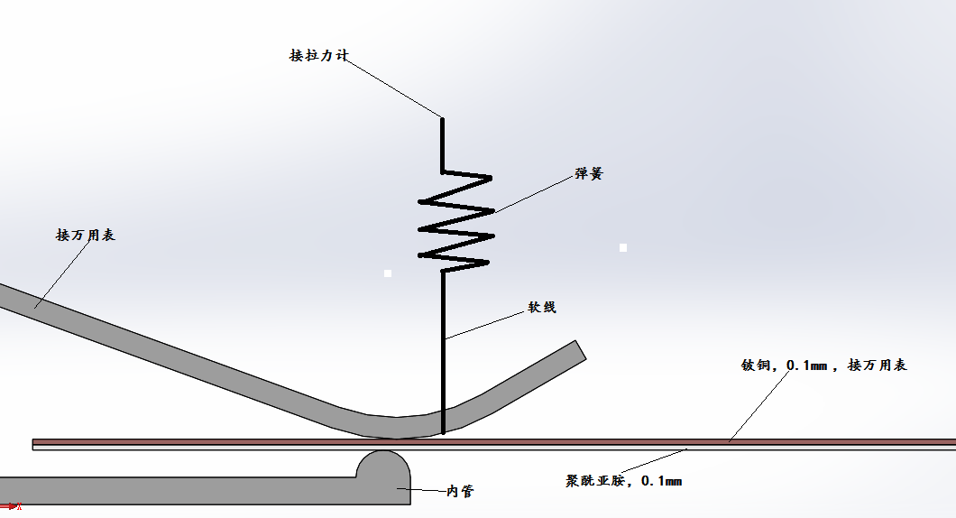
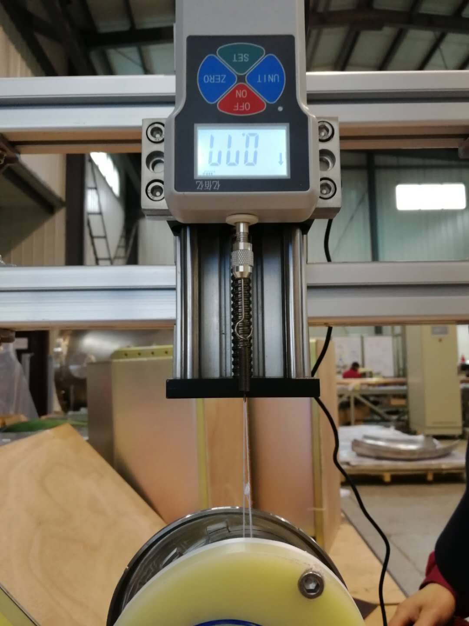
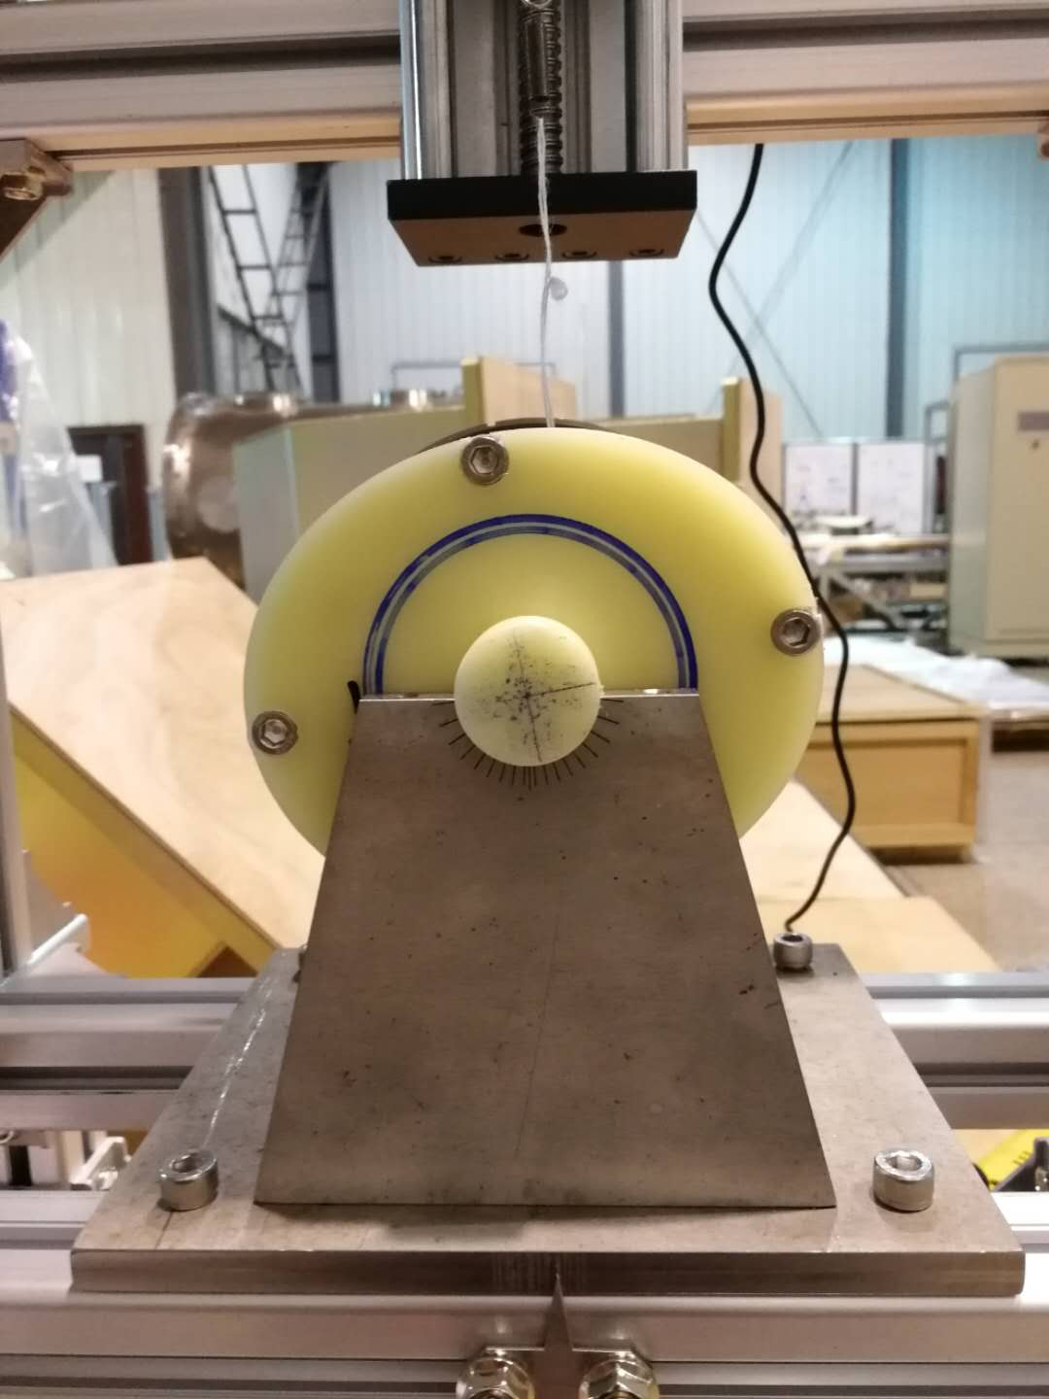
Measurement of the contact pressure of a spring finger

Slide 13
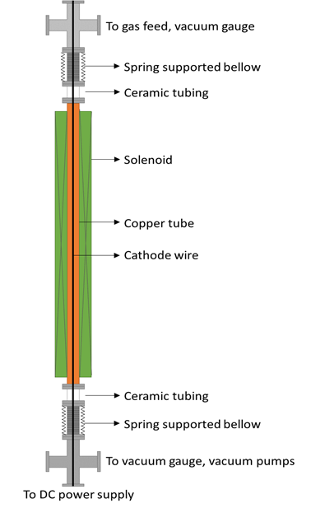
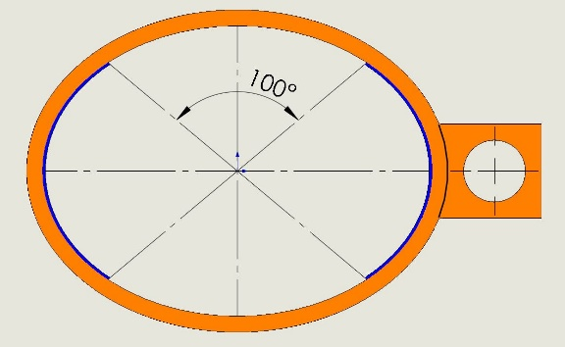
NEG coating of the inside chamber
NEG coating suppresses electron multipacting (SEY < 1.2) and beam-induced pressure rises, as well as provides extra linear pumping.
The NEG coating is a titanium, zirconium, vanadium alloy, deposited on the inner surface of the chamber through sputtering.
In order to decrease the resistive wall impedance, the top and bottom of the vacuum chambers will be uncoated NEG films, while the other part of inner surface will be coated with NEG films in thickness of 1 μm , which may supply enough pumping speeds and absorbed gas capacities, and acceptable impedance budgets.
1 μm TiZrV

Slide 14
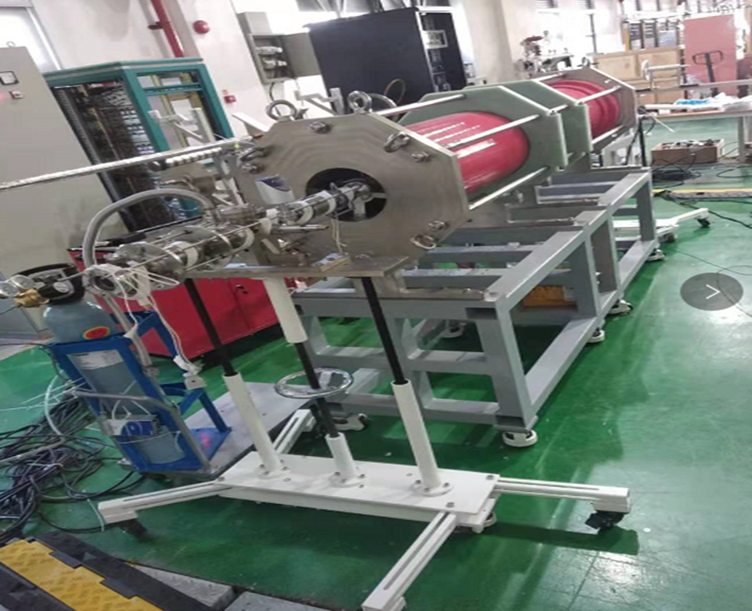
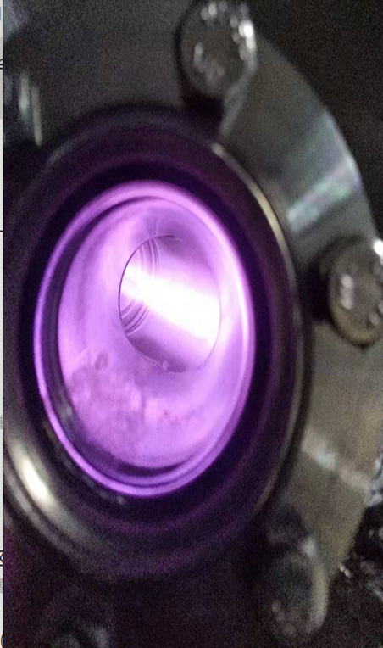
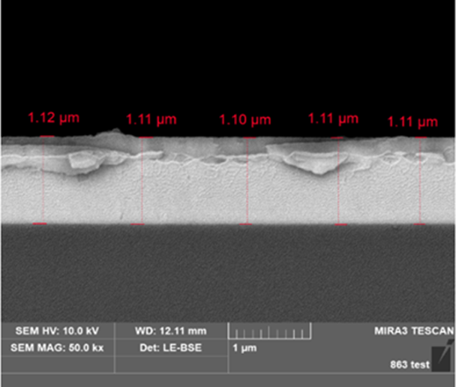
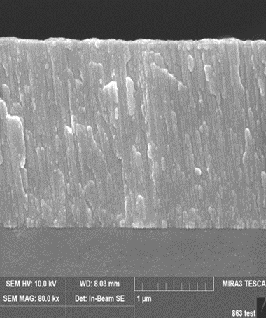
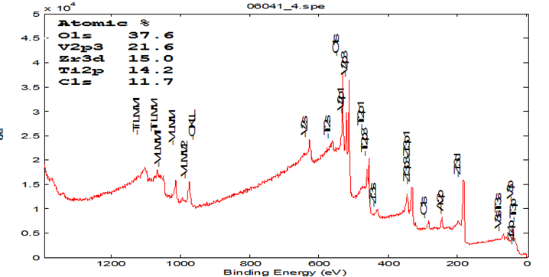
NEG coating setup
The setup of NEG coating has been built, and some experiments have been done.
Thickness of film: ∼1.1 μm; Proportion: Ti：Zr：V=0.28 : 0.3 : 0.42 ( after Ar⁺ surface etching of 10 nm) ; Columnar film for high pumping speed.
All related parameters (plasma gas pressure, substrate temperature, plasma current, and magnetic field value) are recorded and suitably adjusted to ensure the stability of the deposition process.
A horizontal coating equipment is easy to be installed, and long vacuum chambers can be coated by moving the magnet.

Slide 15
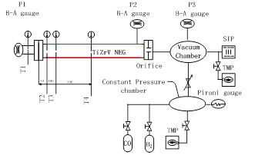

Pumping speed measurements for NEG films
A high pure hydrogen（99.999%）is introduced by the injection valve, the gas passes through the coated pipe and is absorbed by the NEG film. The P2/P1 ratio is measured by the pressure gauges, which is related to the average sticking probability and pumping speed of the pipe walls.

Slide 16

Measurement results of pumping speed for NEG film
NO | P2/P1 | Sticking probability | S [L/(s⋅cm²)] | Note
CEPC4-B2-180-24 for H2 | 8.5 | 0.0055 | 0.242 | Stainless steel pipe Length * diameter：750*35
CEPC4-B2-200-20 for H2 | 11.6 | 0.0068 | 0.2992
CEPC4-B2-225-20 for H2 | 17.5 | 0.0088 | 0.3872
CEPC4-B2-250-20 for H2 | 17 | 0.0087 | 0.3828
CEPC4-B2-275-20 for H2 | 8 | 0.0052 | 0.2288
CEPC4-B2-300-20 for H2 | 3.5 | 0.0025 | 0.11

Slide 17
Targets of the midterm and present status
The Leak rate of the vacuum chambers is less than 3×10⁻¹⁰ Torr⋅L/s; (achieved)
The ultimate pressure of the vacuum chambers is less than 3×10⁻¹⁰Torr；(will be achieved in the end of this year)
The contact pressure of spring fingers for RF shielding bellows is 125×30 g/finger; (achieved)
There are no obvious problems found.

Slide 18
Summary
The engineering drawings, FEA, technique designs and manufacture contracts of the vacuum chambers were completed, and 6 m long prototypes for Al and Cu chambers have been fabricated, respectively.
The investigation and engineering designs of RF shielding bellows have been finished, the key components experiments such as spring fingers and contact fingers have been carried out.
The technology route of NEG coating for 6m long vacuum chamber has been proposed, NEG coating tests have been being done, and preliminary results meet the engineering requirements.

Slide 19
Thank you！

