Slide 1
Progress of the high precision low field dipole magnet
Wen Kang
IHEP, Feb. 20-21, 2020

Slide 2
Contents
Midterm parameters of the CEPCB dipole magnets
Progress of the subscale prototype dipole magnets
Test of the subscale prototype dipole magnets
Summary

Slide 3
Main parameters of CEPCB dipole
 | BST-63B
Quantity | 16320
Minimum field (Gs) | 28
Maximum field (Gs) | 338
Gap (mm) | 63
Magnetic Length (mm) | 4700
Good field region (mm) | 55
Field uniformity | 0.1%
Field reproducibility | 0.05%
Midterm target:
Min. working field: 60Gs
Field uniformity in GFR: 5E-4

Slide 4
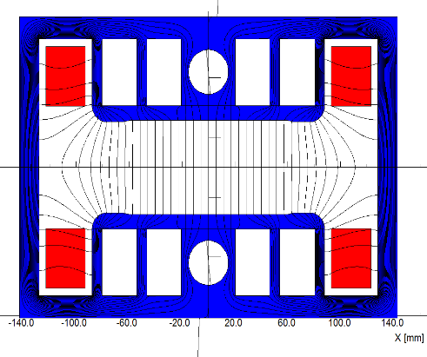
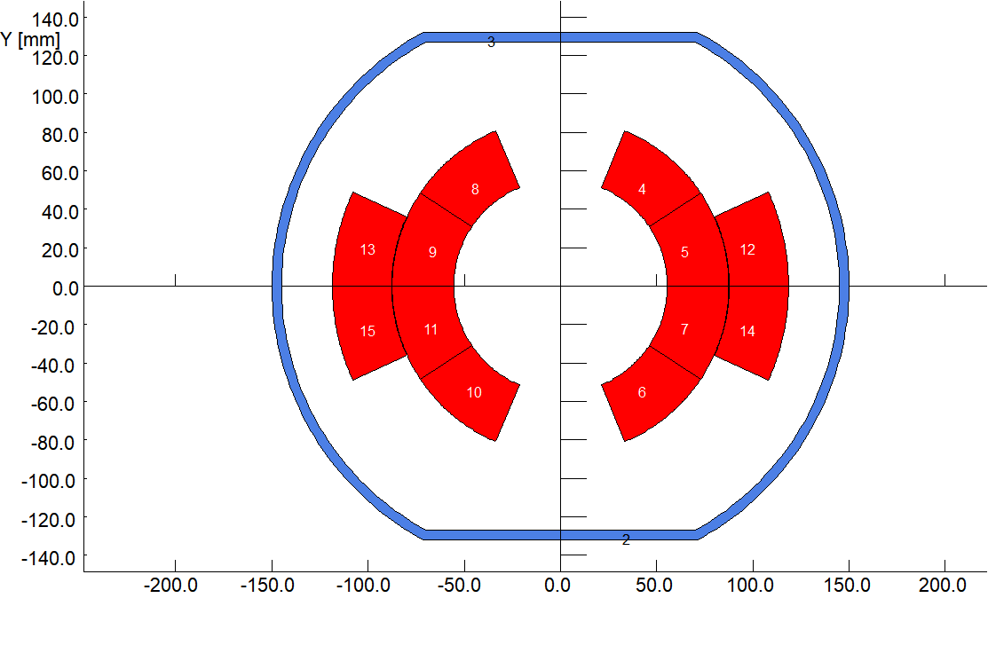
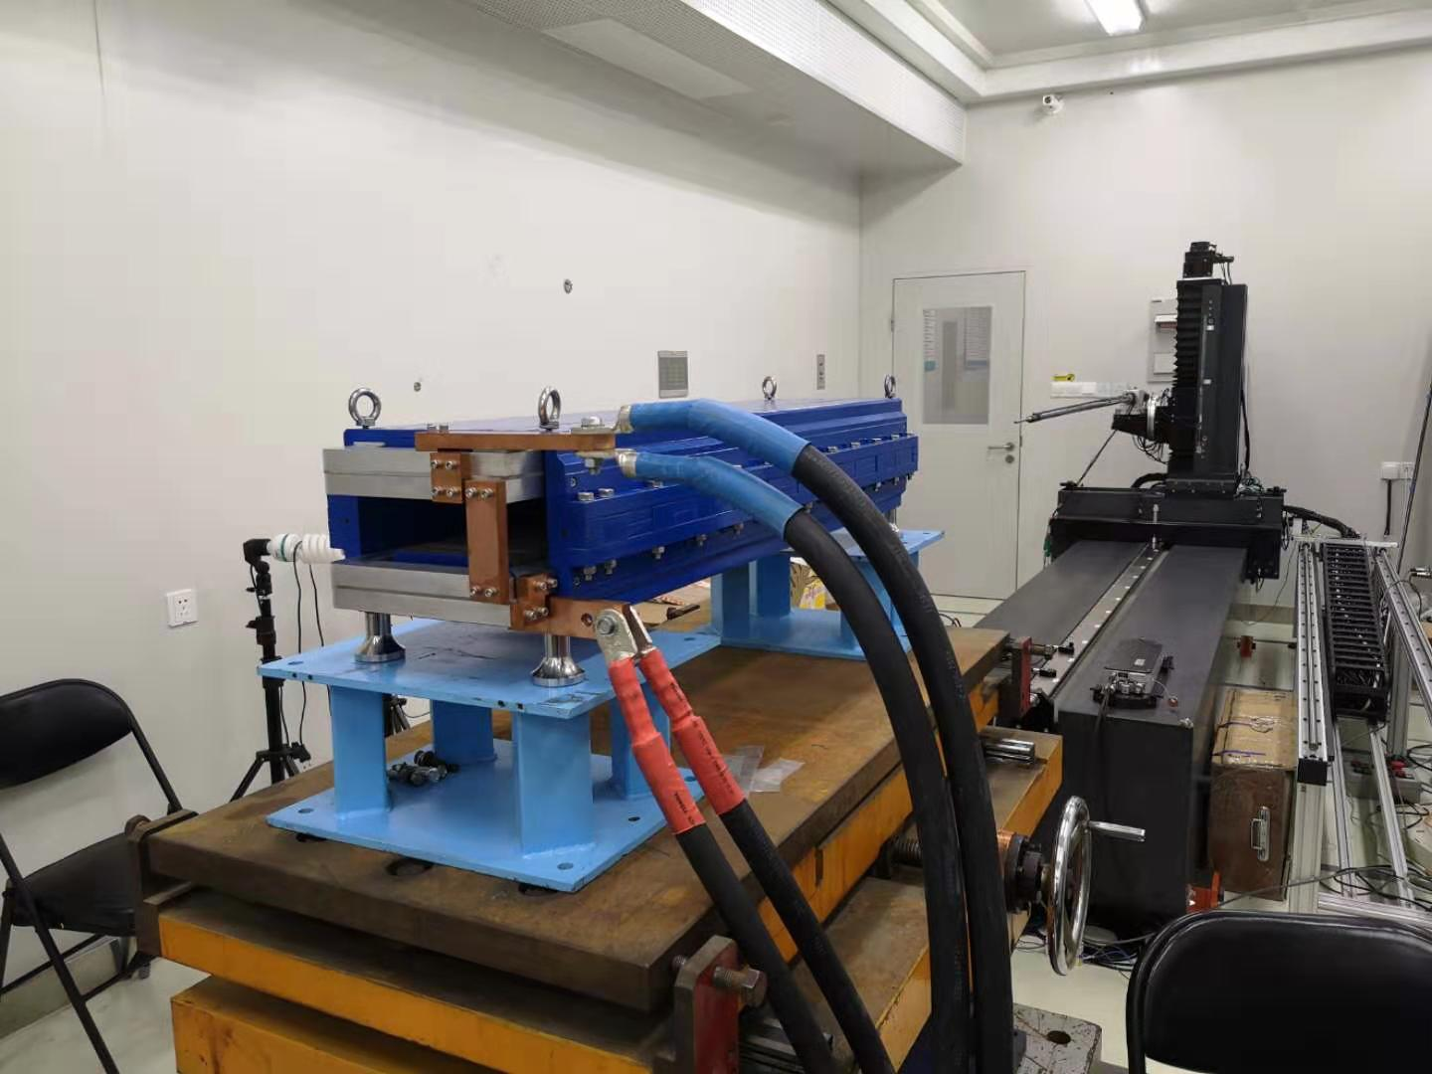
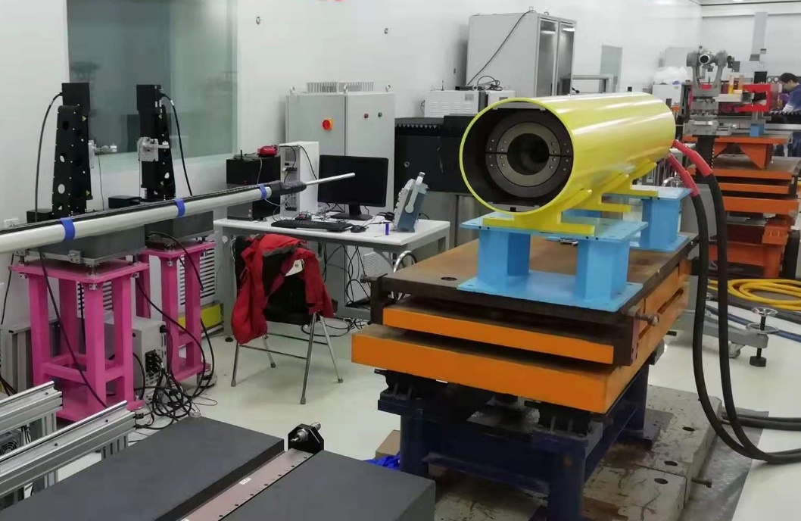
Progress of the CEPCB prototype dipole magnet
Two subscale prototype dipole magnets with and without iron cores were produced and tested.

Slide 5
Test results of the magnet with iron cores
The measurement results of the magnet with iron cores show,
The field uniformity in GFR is about 0.3% at low field level of 28Gs and 0.1% at high field level, which can not meet the requirements.
The field reproducibility at all level is better than the required value of 5E-4.

Slide 6
Test of the magnet with iron cores
The max. remnant field in the GFR is only 1.6Gs as expected, but it has a similar distribution curve to the low field (28Gs). The difference of the remnant field is 0.13Gs, which is 0.46% of 28Gs, nearly 5 time larger than the required value of 0.1%.
It is very difficult to reduce the 0.13Gs difference of the remnant field to improve the field precision at low field level.

Slide 7
Test results of the magnet without iron cores
The measurement results of the magnet without iron cores show,
The field precision at all level, especially at low field level of 28Gs, is better than the required value of 0.1%.
The magnet is excited for 3 times from 28Gs to 338Gs then back to 28Gs, the field reproducibility at all level is better than the required value of 5E-4.

Slide 8
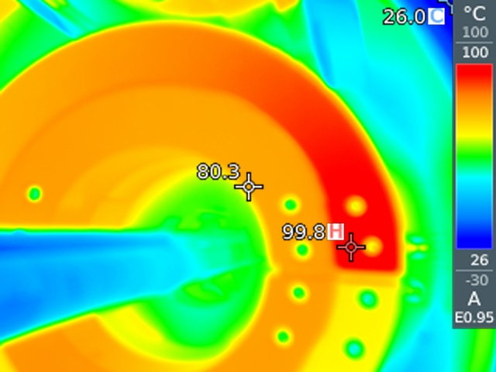
Problem of the CT coil dipole magnet
A serious problem is that the temperature of the coils increases to 80ºC-100ºC when the field increases to high level.
The reason is that the aluminum alloy not the pure aluminum was selected as the material of the conductors because of its good mechanical properties when the magnet was produced.
The resistivity of the aluminum alloy is 1.6 times larger than the pure aluminum, so the power loss of the coils increases by 1.6 times.
In addition, the touch resistance of the contacted surfaces of the conductors is larger than the expected one.

Slide 9
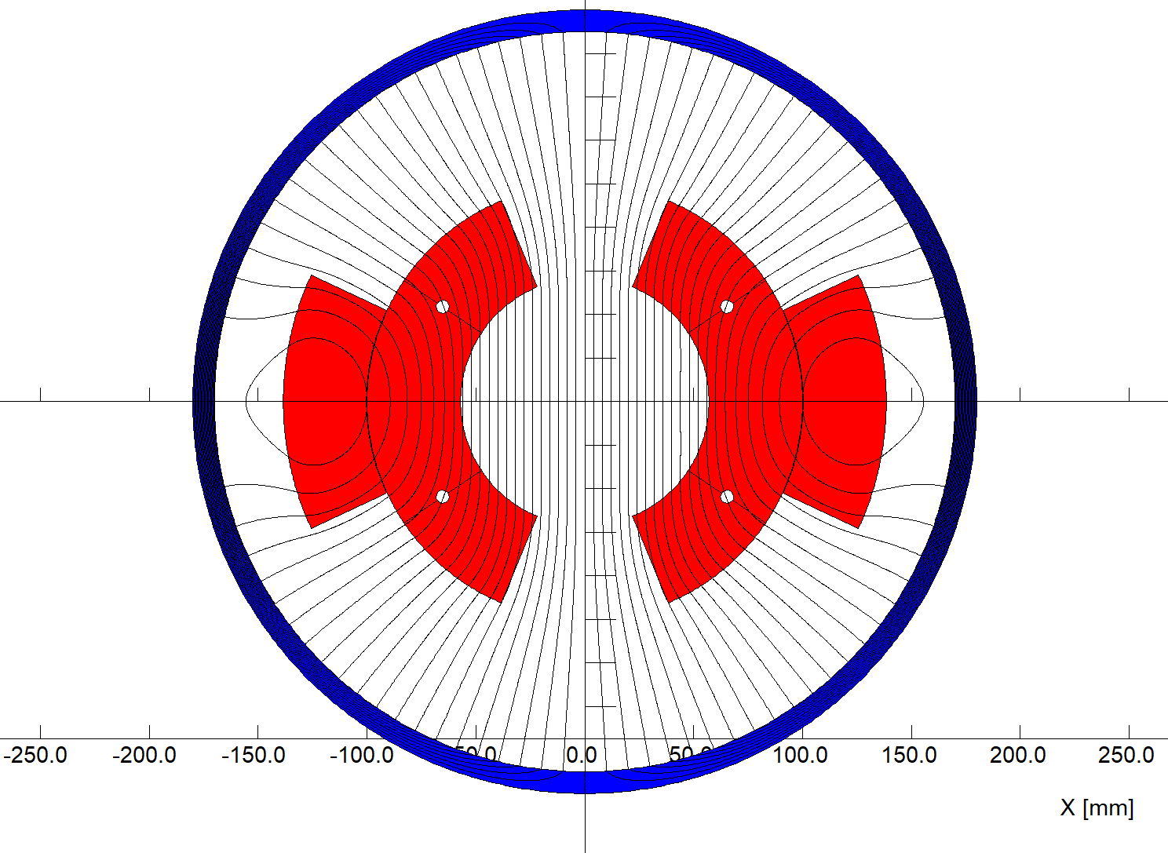
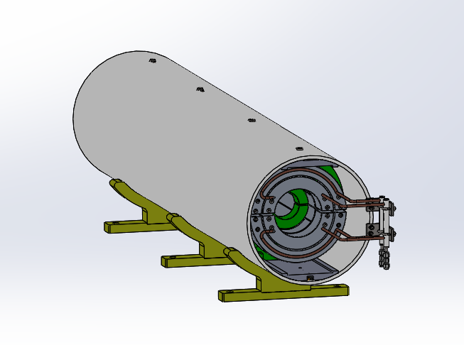
Problem of the CT coil dipole magnet
To decrease the temperature of the coils at high field level in future,
The pure aluminum not aluminum alloy will be selected as the material of the conductors.
Increasing the cross section areas of the conductors and inserting water cooling tube into the coils.
Coating the silver film on the touch surfaces of the connected conductors.

Slide 10
Summary
Two kinds of subscale prototype dipole magnets with and without iron cores were fabricated and tested.
Due to the unavoidable influence of the remnant field, it is very difficult to make the magnet with iron cores to meet the precision requirement at low level of 28 Gs.
The CT coil dipole magnet without iron core has high precision and good reproducibility field both at low and high field level, which is satisfied with the requirements.
The problem found in the test of the CT type dipole magnet can be solved in future.

Slide 11
