Slide 1
CEPC Beam Polarization
Zhe Duan
Institute of High Energy Physics, CAS
On behalf of CEPC Beam Polarization Working Group
Presented at MOST2018 CEPC Project 2020 Internal Meeting
Feb 21, 2020, IHEP

Slide 2
Outline
Mid-term tasks and indicators
Status
What still needs to be done

Slide 3
Mid-term tasks and indicators in the task book
年度 Year | 任务 task | 考核指标 Assessment indicator | 成果形式 outcome
2018.5 – 2019. 4 | 研究极化扭摆器的参数选择及精确能量测量的工作模式 The parameter selection of polarization wigglers and the working mode of accurate energy measurement are studied. | 完成束流能量精确测量的工作模式研究与设计 completes the research and design of the work mode of beam energy accurate measurement. | 课题年度技术进展报告 Annual report
2019.5 – 2020. 4 | 开发完善储存环平衡极化度模拟程序，及误差效应对平衡极化度的影响。 The simulation program for the equilibrium beam polarization of storage ring is developed, and the effect of error effect on the equilibrium polarization is also studied. | 完成储存环平衡极化度模拟程序的开发，结合储存环误差校正的结果评估束流平衡极化度及对束流能量测量精度的影响，达到中期考核指标。 the development of the simulation program for the balance polarization of the storage ring is completed, and the effect of the beam balance polarization and the measurement accuracy of beam energy is evaluated by the result of the correction of the storage ring error. Reaching the mid-term assessment index. | 课题中期技术进展报告 Mid-term report
Mid-term indicators:
明确极化插入件的基本参数选择和精确能量测量的工作模式；模拟研究束流极化度大于50%的实现条件。
The parameter selection of polarization insertion devices and the working mode of the precise energy measurement are defined. The realization conditions of beam polarization > 50% are simulated.

Slide 4
After Mid-term tasks in the task book
年度 Year | 任务 task | 考核指标 Assessment indicator | 成果形式 outcome
2020.5 – 2021. 4 | 研究比较自旋旋转器的各种设计方案及储存环磁聚焦结构的调整。 Study and compare the various design schemes of spin rotators and study the adjustment of the storage ring lattice. | 完成自旋旋转器参数选择及储存环磁聚焦结构设计优化 Complete parameter selection of spin rotators, optimization of the storage ring lattice. | 课题年度技术进展报告 Annual report
2021.4 – 2022. 4 | 研究极化束流运行对注入器设计的要求及设计方案。 Study the requirement and design scheme of the injector for polarized beam operation. | 完成兼容极化束流运行的注入器设计。 Complete the design of injector for compatible polarized beam operation. | 课题年度技术进展报告 Annual report
2022.4 – 2023.4 | 完善储存环磁聚焦结构设计， 撰写极化束流运行的物 理设计报告,开展同行评 议。 Improve the storage ring lattice design, draft the physical design report of polarized beam operations, and carry out the peer review. | 完善储存环磁聚焦结构设 计，撰写极化运行的物理设计报 告。束流极化度大于 50%，束流 寿命大于 60 分 钟。 Improve the storage ring lattice design, draft the physical design report of polarized beam operations. Beam polarization exceeds 50%, beam lifetime exceeds 60 min. | 课程最终科技报告，论文，新方法（束流极化物理设计） Final report Papers, new method ( beam polarization design)

Slide 5
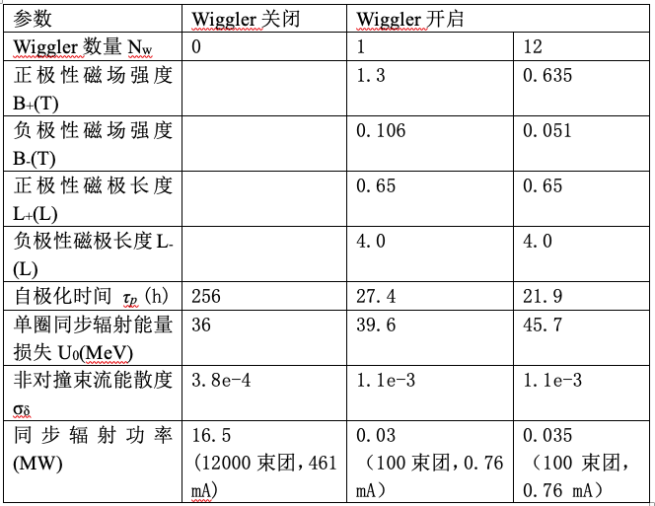
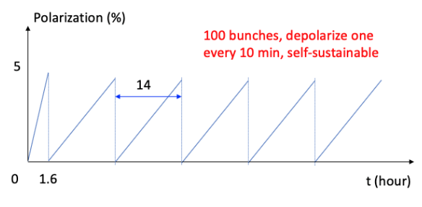
Status of assessment indicator 1
“parameter selection of polarization insertion devices and the working mode of the precise energy measurement.”
Following the example of FCC-ee, we studied the polarization wiggler parameters, and implemented into the CEPC ring lattice, and worked out how to do resonant depolarization measurements to continuously monitor the beam energies.

Slide 6
Status of assessment indicator 2
”The realization conditions of beam polarization > 50% are simulated.”
Previously we did some simulations of beam polarization for a toy machine of CEPC with a circumference of 50 km, with some typical errors but without error correction. The simulations were done with MAD-X and PTC.
To use the latest CEPC lattice in SAD, we need to check the convertor from SAD to PTC, especially in the presence of lattice errors. We also need some work on modification of the PTC code.

Slide 7
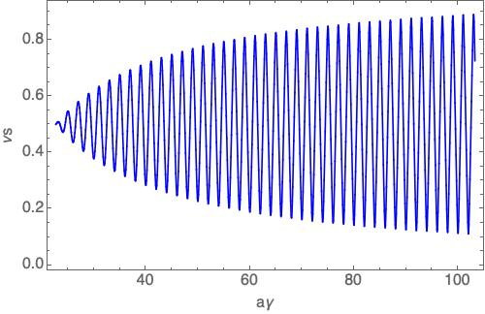
Status of work beyond assessment indicators
Did some preliminary studies into the generation, maintenance of beam polarization in the injector (planned to be delivered by 2022)
Idea of e+ polarizer ring
Siberian snakes in the booster ring are considered necessary
Next:
Siberian snakes implementation into the booster lattice
Detailed lattice design of e+ polarizing ring

Slide 8
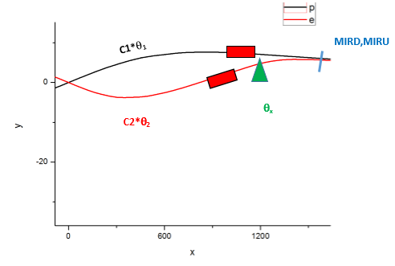
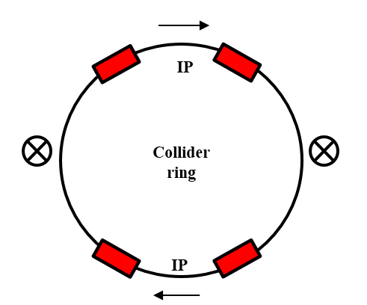
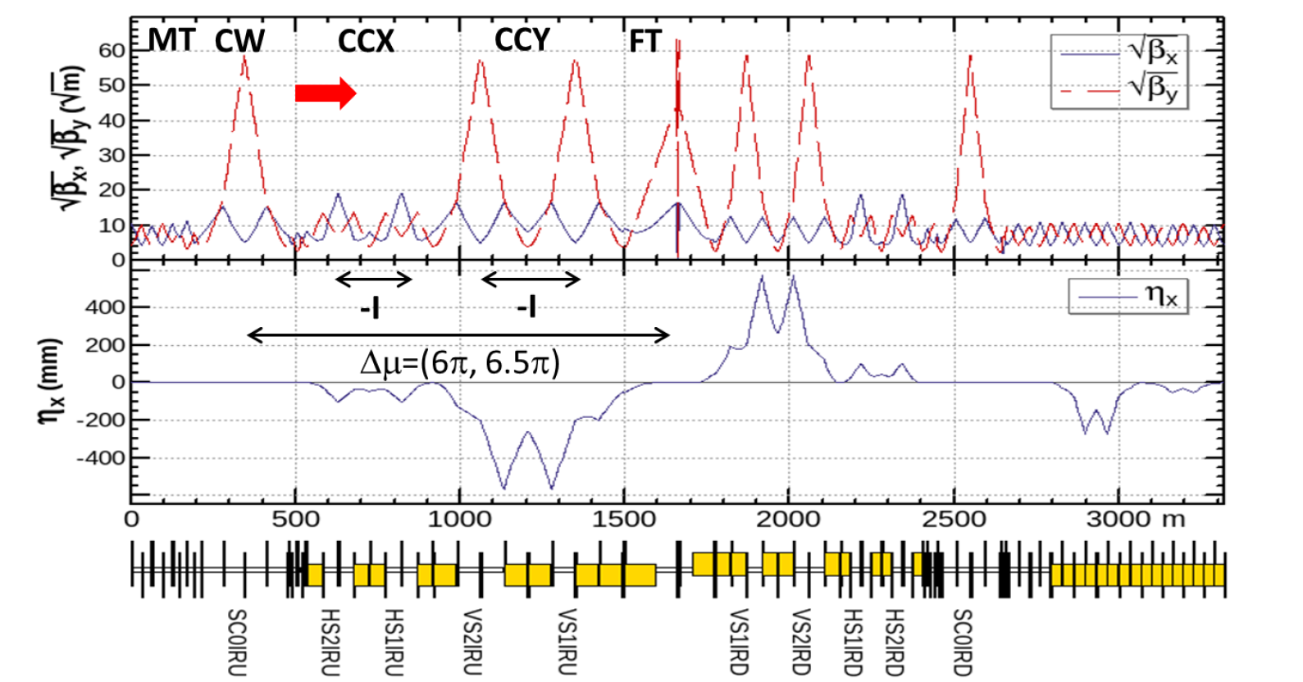
Status of work beyond assessment indicators
Spin rotator design and implementation into the storage ring lattice is also under way (planned to be delivered by 2021)
Solenoid-based spin rotators have been studied.
Some space has been located for implementation of spin rotators near the Ips
Influence on the equilibrium beam polarization is under study

Slide 9
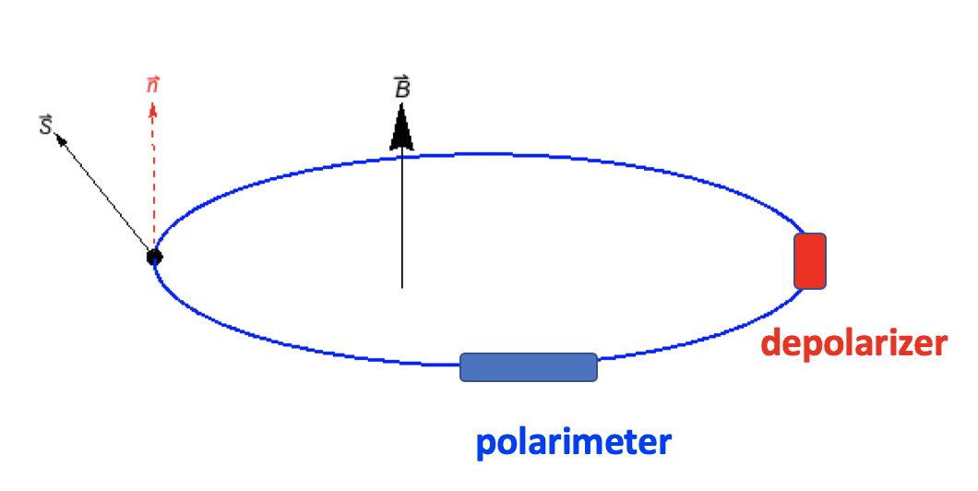
What still need to be done
Assessment indicator 1: “parameter selection of polarization insertion devices and the working mode of the precise energy measurement.”
Specification of the resonant depolarizer parameters

Slide 10
What still need to be done
Assessment indicator 2: ”The realization conditions of beam polarization > 50% are simulated.”
Crosscheck the SAD-PTC lattice convertor and modify the PTC code
Evaluate the beam polarization of latest CEPC lattice with practical lattice errors
This could takes about 2~3 months

Slide 11
What still need to be done
Beyond the mid-term assessment indicator
Spin rotator design and implementation into the storage ring lattice is also under way (planned to be delivered by 2021)
Evaluate the storage ring beam polarization w/ spin rotators, and study spin matching methods to mitigate the polarization loss
Improve spin rotator designs, reduce the technical challenges and costs
Iterate with the lattice design, to minimize the influence on orbital motion aspects

Slide 12
What still need to be done
Beyond the mid-term assessment indicator
The generation, maintenance of beam polarization in the injector (planned to be delivered by 2022)
Implementation of the Siberian snakes into the booster lattice
Realistic tracking to study how well the beam polarization could be maintained during the acceleration
Lattice design of the e+ polarizing ring

Slide 13
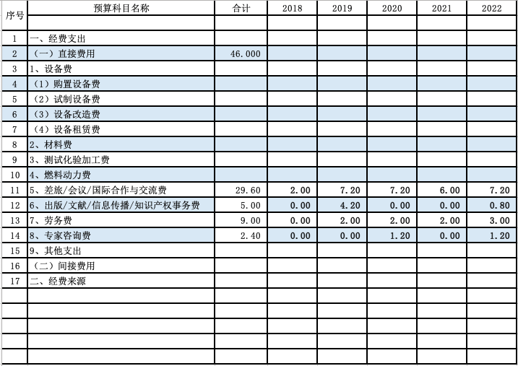
Financial status
Budget:
Spending:
So far, two international travel
were supported, the total cost was about 30000 CNY.
More collaboration with BINP could be expected if the virus epidemic cease soon.

