Slide 1
CEPC Electro-Magnetic Separator and Magnet Power supply R&D
Bin Chen ( IHEP, CAS )
2020.10.26 Shanghai
International Workshop on CEPC

Slide 2
Contents
  Design and progress for electro-magnetic separator
    Design of dipole magnet
    Design of electrostatic separator
    Installation error analysis of electrostatic separator
    Methods to reduce the parasitic mode losses
    Thermal analysis of the electrode
    Vacuum design
    Mechanical design
  Design and progress for power supply
    Design of Booster power supply
    Design of Corrector (Multi-unit combination structure)
  Summary

Slide 3
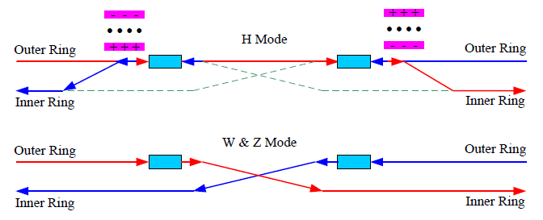
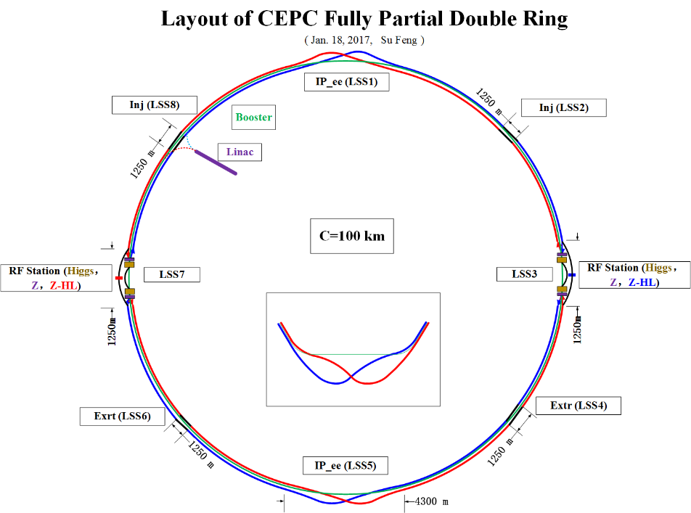
Design and progress for electro-magnetic separator
  In the RF region, A set of electrostatic separators combined with dipole magnet (Electro-Magnetic Separator ) are installed downstream of the RF cavities.
  They are used to avoid bending of incoming beam and deflect the outgoing beam in H mode. After the Separators , the positive and negative electron beams of the outer ring passing through the RF cavities are deflected to their respective inner rings.
Introduction
Layout of RF region
  Optics of the RF region for Higgs (left), W and Z (right) modes

Slide 4
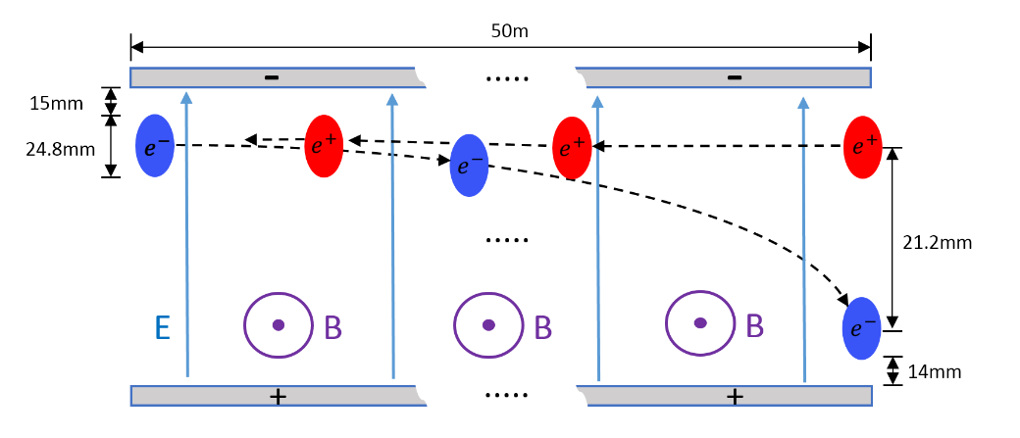
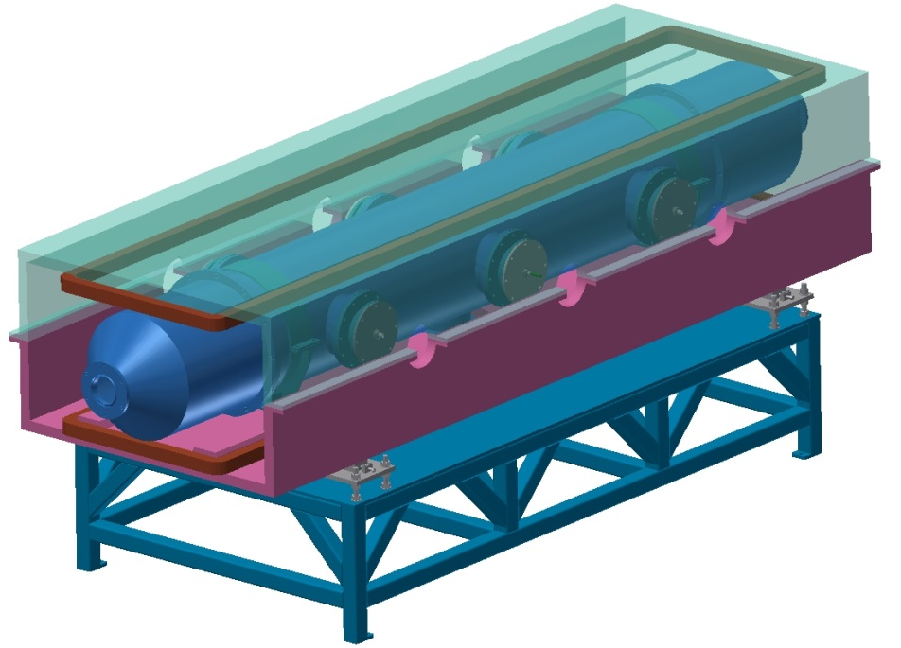
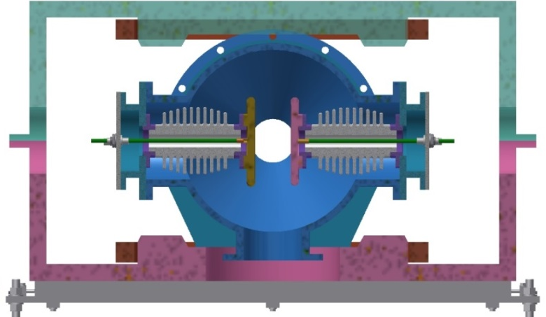
Design and progress for electro-magnetic separator
  The Electro-Magnetic Separator is a device consisting of perpendicular electric and magnetic fields.
  One set of Electro-Magnetic Separators including 8 units, total 32 units will be need for CEPC.
 | Filed | Effective Length | Good field region | Stability
Electrostatic separator | 2.0MV/m | 4m | 46mm ⅹ11mm | 5ⅹ10⁻⁴
Dipole | 66.7Gauss | 4m | 46mm ⅹ11mm | 5ⅹ10⁻⁴
Schematic of Electrostatic-Magnetic Deflector
metal-ceramic support
high voltage feedthrough
UHV tank
Magnet
Support
  structure drawing of Electro-Magnetic Separator
coil
electrode

Slide 5
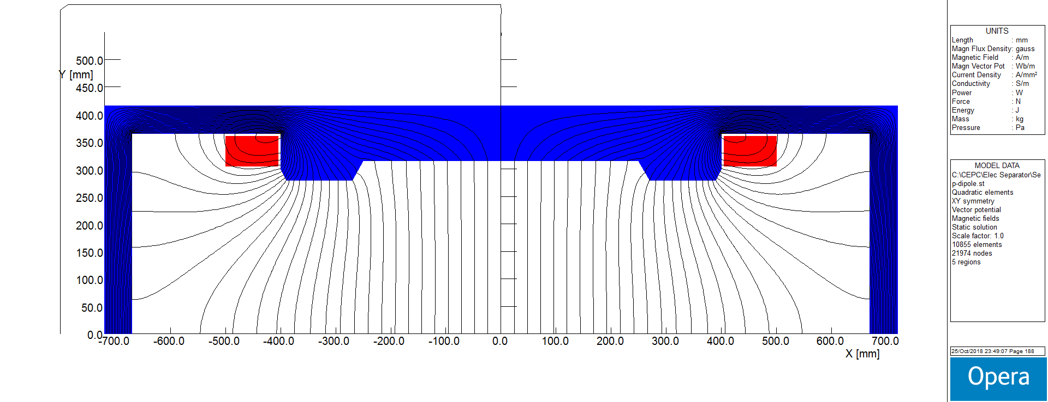
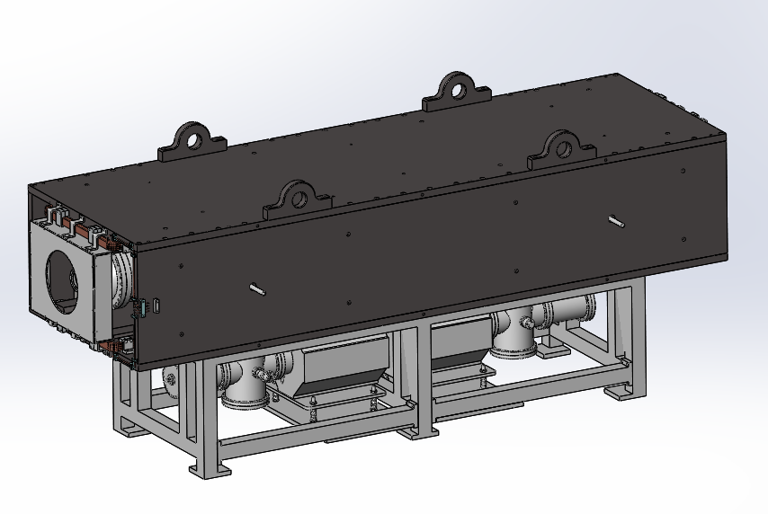
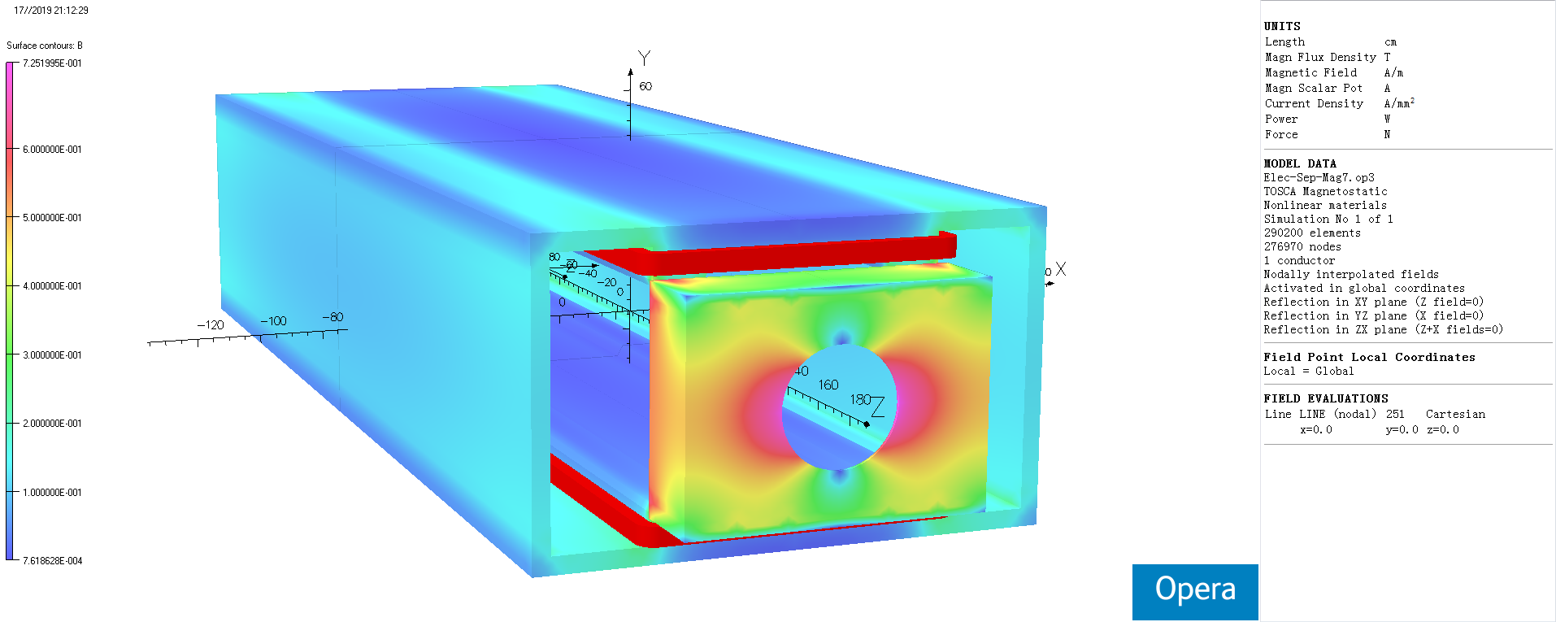
Design of dipole magnet
  The magnet adopts h-type yoke structure, because of the higher field integrals uniformity and installation consideration of the electro-static system.
  The magnetic field design and manufacturing technology are quite mature.
  The magnet development is supported by IHEP internal fund.
  The prototype is being fabricated.
Field Distribution
whole structural of magnet
Magnetic flux density distribution in 3D Model

Slide 6
  Design of Electrostatic Separator
  An electrostatic separator comprise a pair of electrodes, UHV tank, metal-ceramic supports, high voltage feedthrough, High voltage circuit and vacuum system, etc.
  Key technology :
  Field uniformity design
  Reduce the separator's impedance and loss factor
  Mechanical structure design
  Parameters of electrostatic separator
Separator length | 4.5m
Inner diameter of separator tank | 380mm
Electrode length | 4.0m
Electrode width | 180mm
Nominal gap | 75mm
Maximum operating field strength | 2MV/m
Maximum operating voltage | ±75kV
Maximum conditioning voltage | ±135kV
Good field region (0.5‰ limit) | 46mm ⅹ11mm
Nominal vacuum pressure | 2.7e-8 Pa

Slide 7
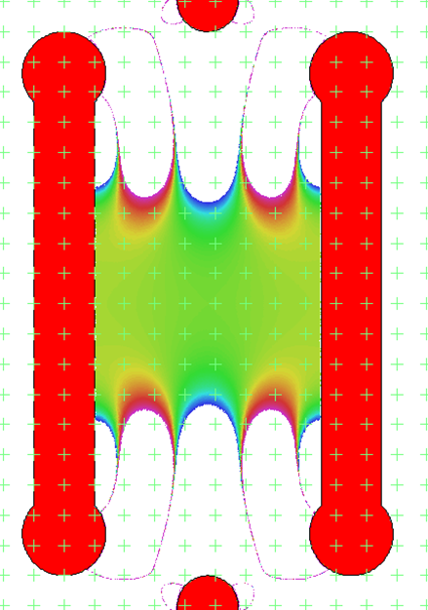
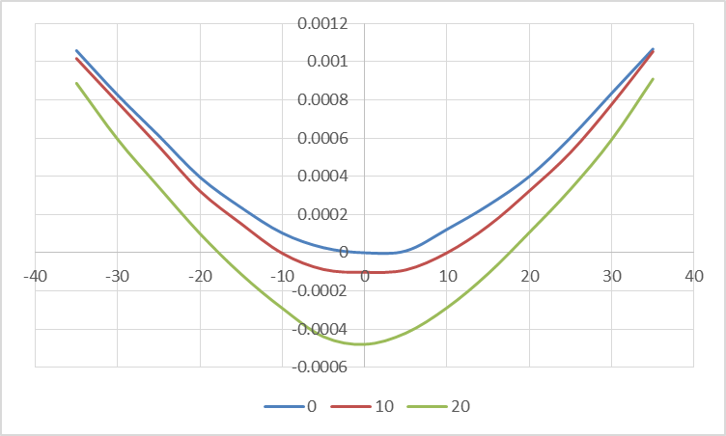


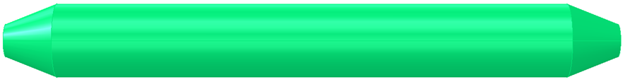
  Design of Electrostatic Separator
Electrode (a pair of metal flat plate)
Dimension : 4m long and 180mm wide
Material : Pure Titanium
  Field strength : 2MV/m
UHV tank
4.5m long and 38cm inner diameter
Material : stainless-steel 316L
Field homogeneity：7.5cm*5cm 0.5‰
Calculated electrical field integrals uniformity ：4.6cm*3cm 0.5‰
18cm
Length：400cm
With：18cm
Thickness：2cm
Radius：1.5cm
Density：4.54g/cm³
Weight：≈65kg
400cm
ID：9.5cm
ED：7.5cm
thickness：1cm
25cm
400cm

Slide 8
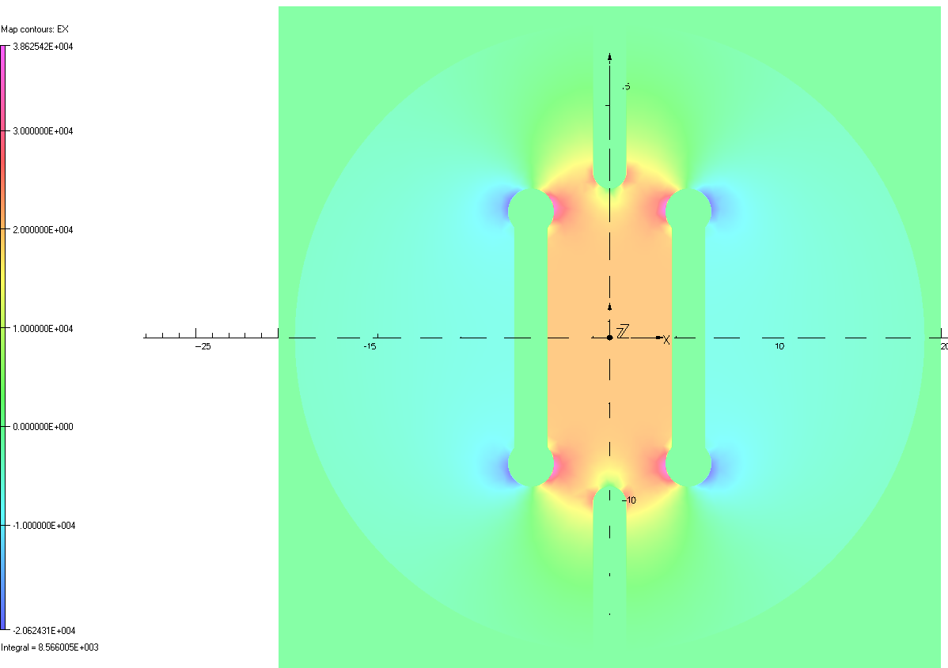
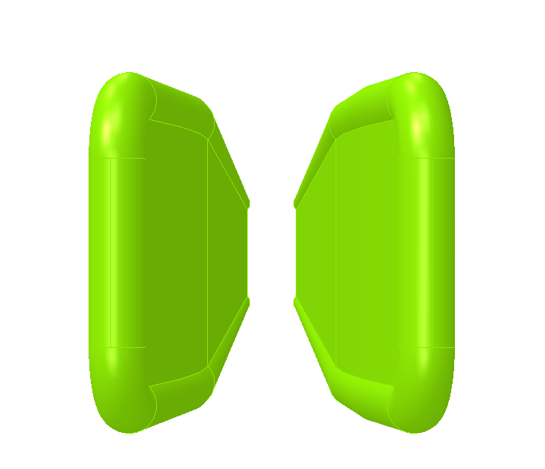
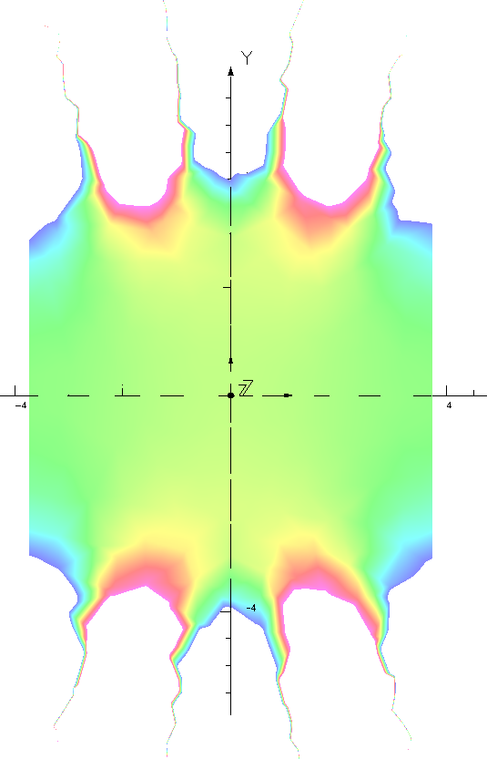
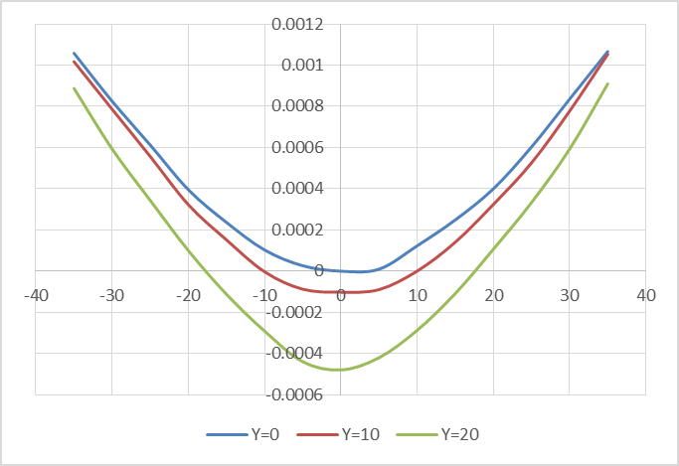
  Installation error analysis of electrostatic separator
no error in the mechanical position ：
电场分布
0.5‰好场区范围约75mm×60mm
纵向积分均匀性：0.5‰范围约为45mm×40mm

Slide 9
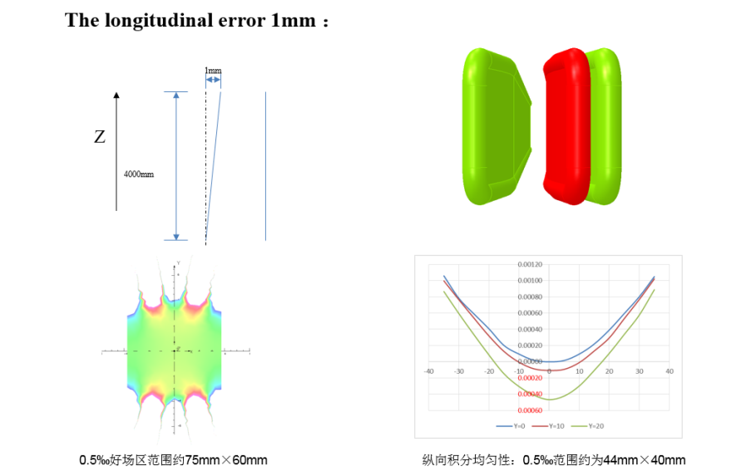
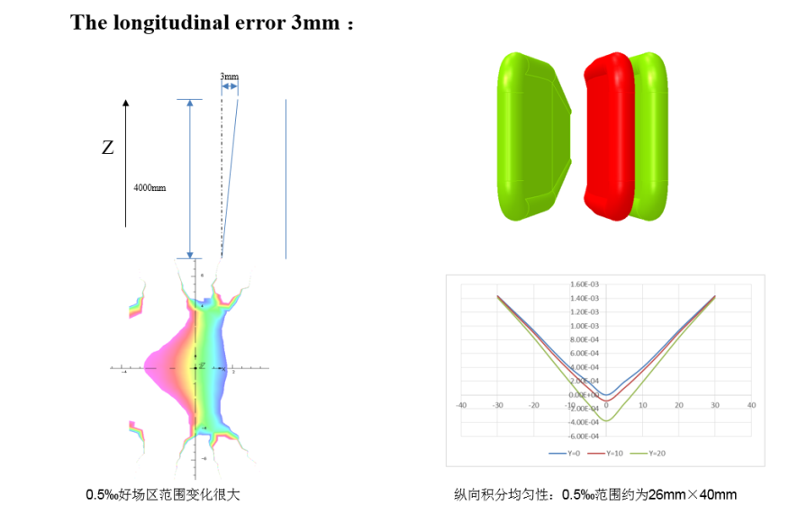
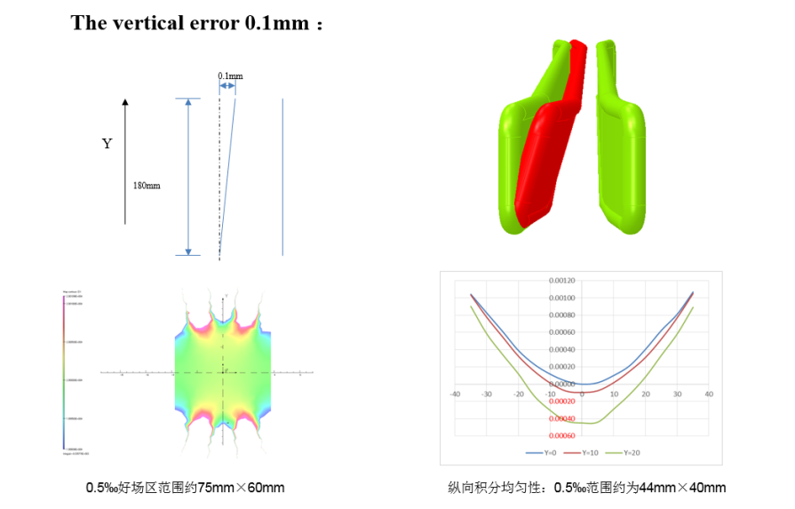
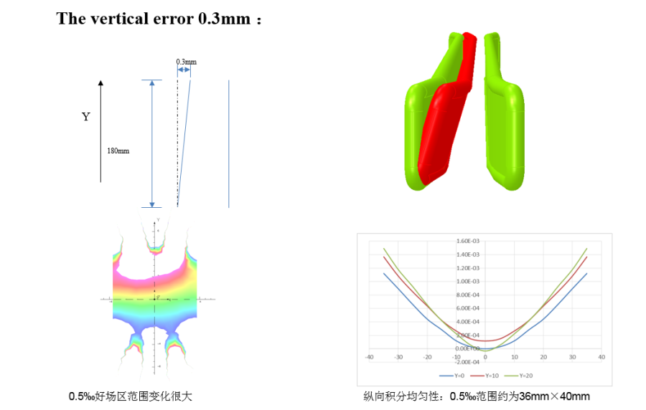
  Installation error analysis of electrostatic separator
According to the simulation result of installation error of electrostatic separator , the longitudinal error should be less than 1mm and the vertical error should be less than 0.1mm.

Slide 10

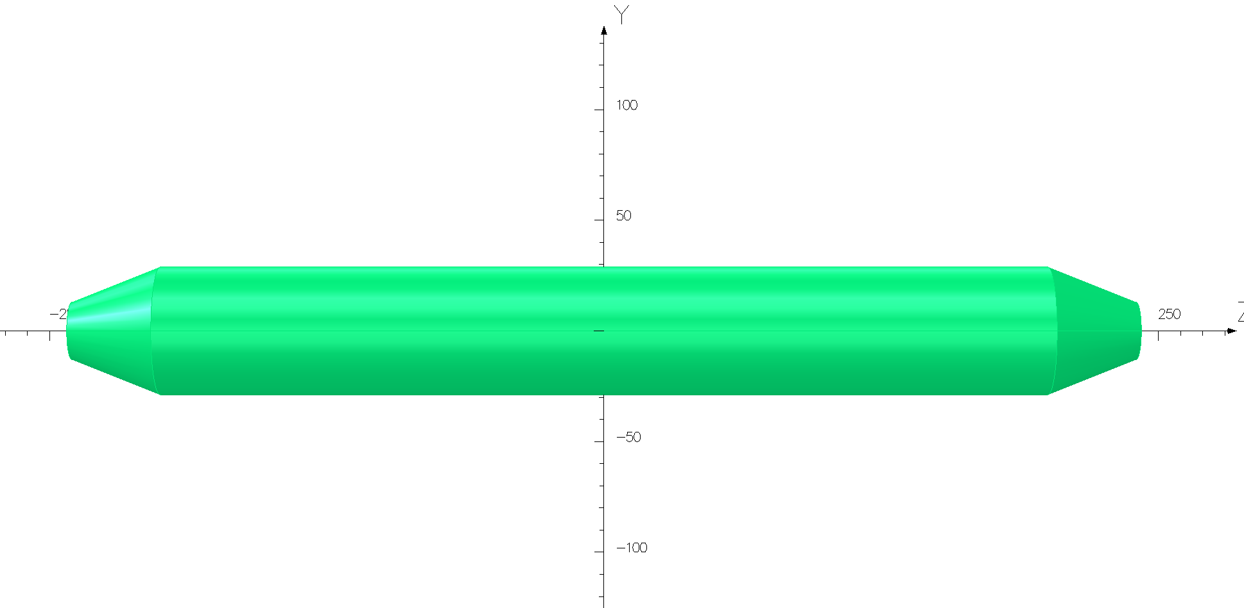
Methods to reduce the Parasitic mode losses
  The electrostatic separators are large contributors to the overall impedance. There are two methods implemented in the design of the separator which reduce the loss factor:
  ground electrodes
  tapered ends
  These two methods are merged in one unusual surface which smoothly guides the field energy from a normal vacuum chamber geometry to the multiple electrode geometry and then back to the normal vacuum chamber.
tapered ends
Ground electrodes

Slide 11
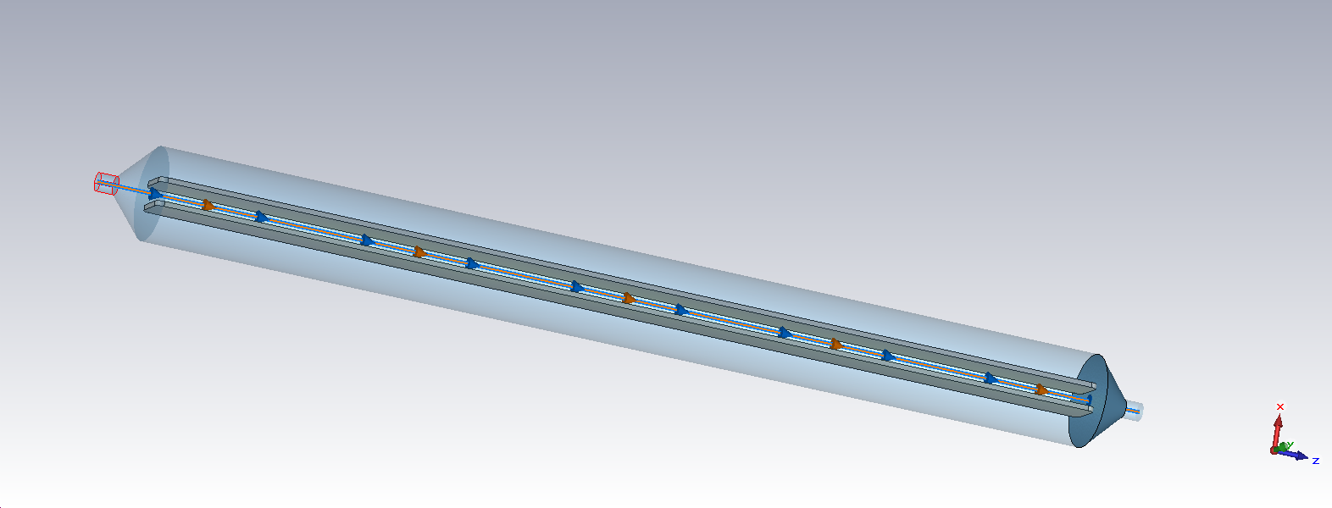
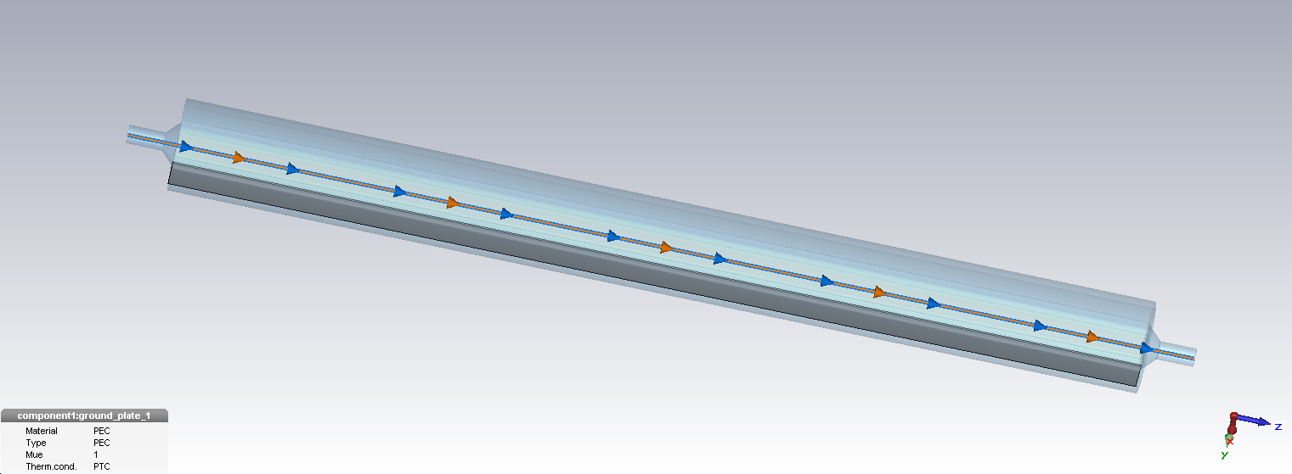
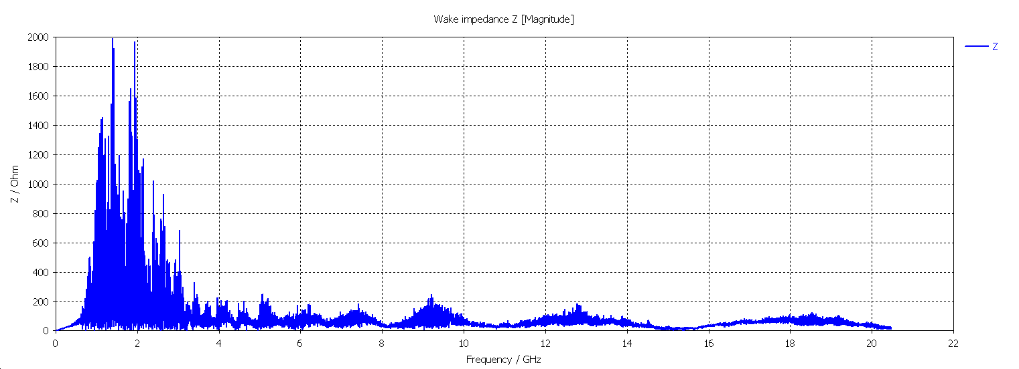
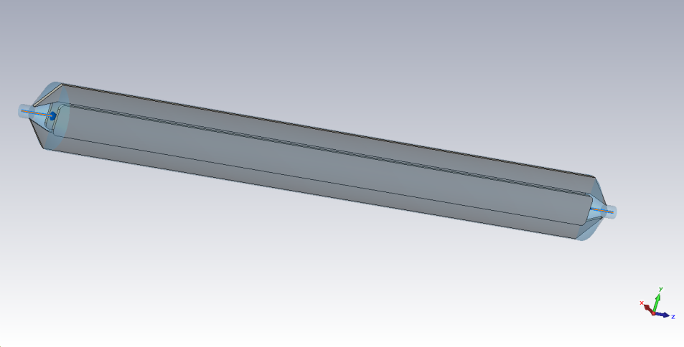
Methods to reduce the Parasitic mode losses
 | Partially tapering + g.e. | 3D tapering, no g.e. | 3D tapering + g.e.
Separator tank length | 4000mm | 4000mm | 4000mm
Inner diameter of separator tank | 380mm | 380mm | 380mm
Electrode height | 180mm | 180mm | 180mm
Electrode gap | 75mm | 75mm | 75mm
Electrode thickness | 20mm | 20mm | 20mm
Transition taper length | 52.5mm | 52.5mm | 150mm
Transition pipe diameter | 75mm | 75mm | 75mm
Ground plate length | × | 4000mm | 4300mm
Ground plate height | × | 100mm | 100mm
Ground plate thickness | × | 10mm | 10mm
P_{loss}: 495w(Higgs)/1.98kw(W)/6.91kw(Z)

Slide 12
Methods to reduce the Parasitic mode losses
  According to the simulation, there is a relatively strong narrowband impedance below 3GHz (caused by cavity structure).
  The structure of the cavity needs further optimization (increase the thickness of the ground electrode, and make it as close to the beam as possible)
  The absorber maybe necessary to absorb such high power in separator;
  Equipping the electrodes with a simple closed-loop Cooling system.
No. Description | K [V/pC]
(1) Partially tapering + g.e. | 1.393547
(2) 3D tapering, no g.e. | 1.256987
(3) 3D tapering + g.e. | 1.170499

Slide 13
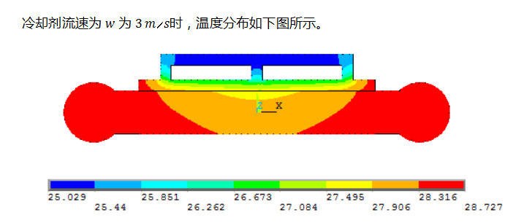
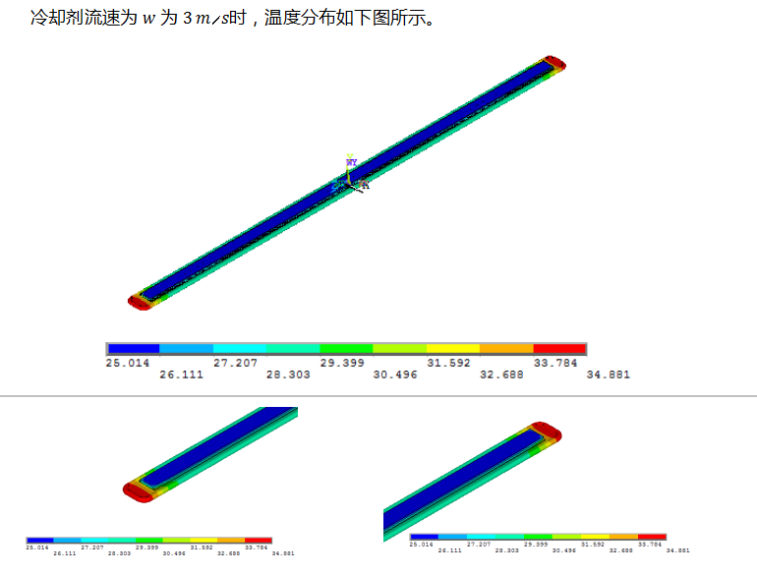
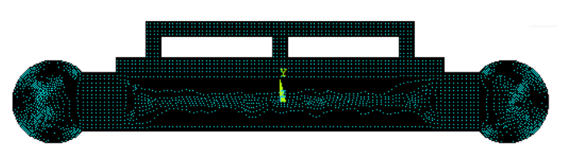
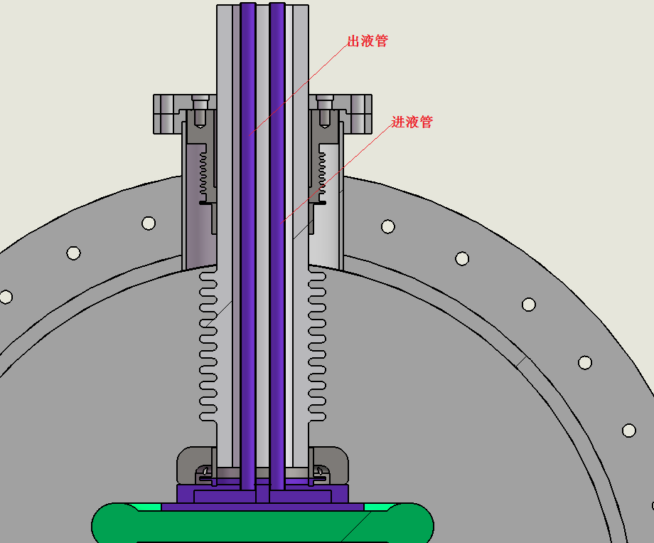
    Thermal analysis of the electrode
Closed-loop cooling system
The cooling plate is mounted on the outside of the electrode plate
The coolant : 3M “Fluorinert” FC-77
Simulation (2D &3D)
The thermal analysis of the electrode plate was carried out . When the flow rate was 1m/s, the temperature rise at the end of the electrode plate was about 15℃.

Slide 14
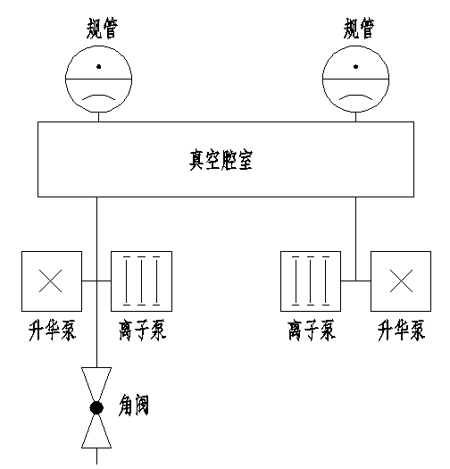
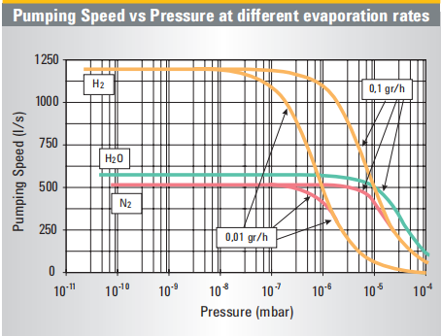
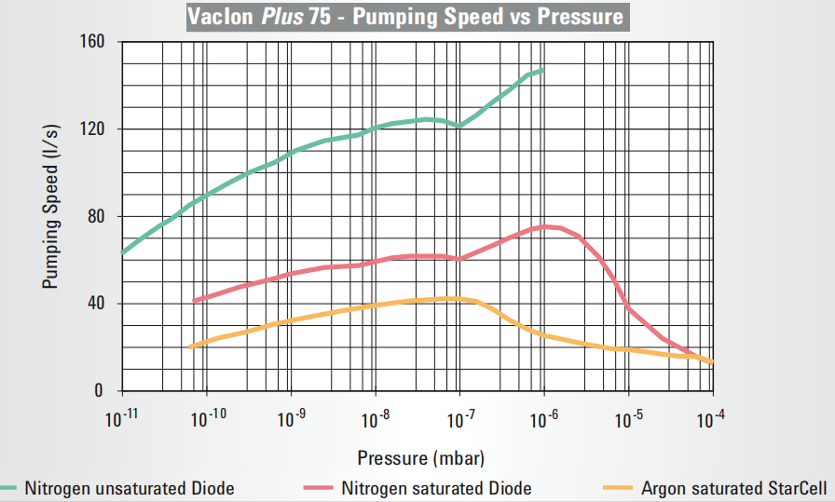
  Vacuum design
真空系统示意图
离子泵的抽速曲线
升华泵的抽速曲线
  To minimize the breakdown rate, the vacuum in all separators will be kept at the low pressure of about 2×10⁻¹⁰Torr. However, the size of the whole prototype is very large, so it is not easy to reach the test goal. So special care will be taken to the welding, sealing of the separator components in vacuum system design.
Including: two sputter ion pump ( pumping speed 1000l/s), and two sublimation pump ( pumping speed 1000l/s).
Considering add the NEG pump, which maintains a high pumping rate at ultra-high vacuum, especially for hydrogen.

Slide 15
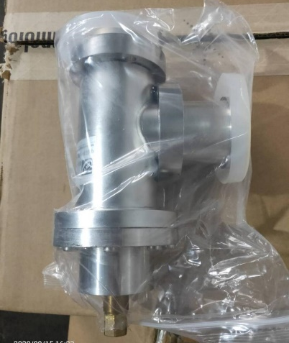
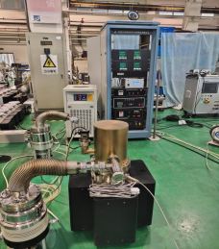
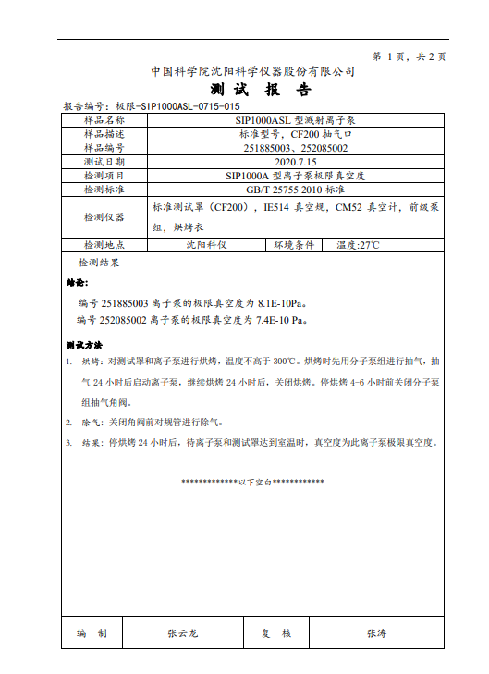
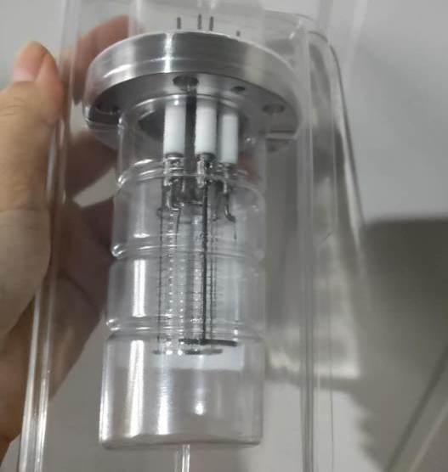
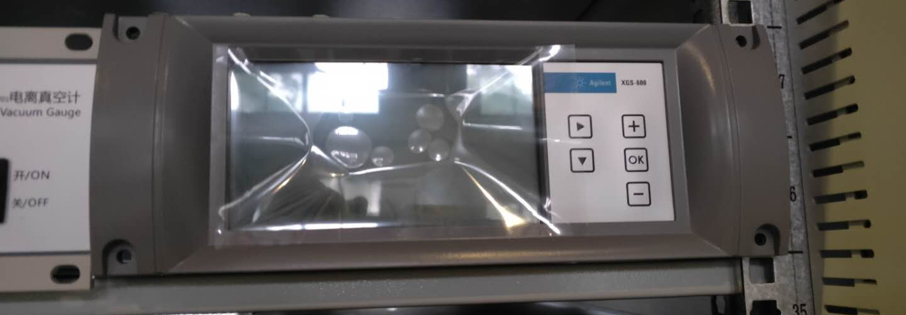
  Vacuum design
the ultimate vacuum test of ion pump
Angle valve, gauge and vacuum gauge

Slide 16
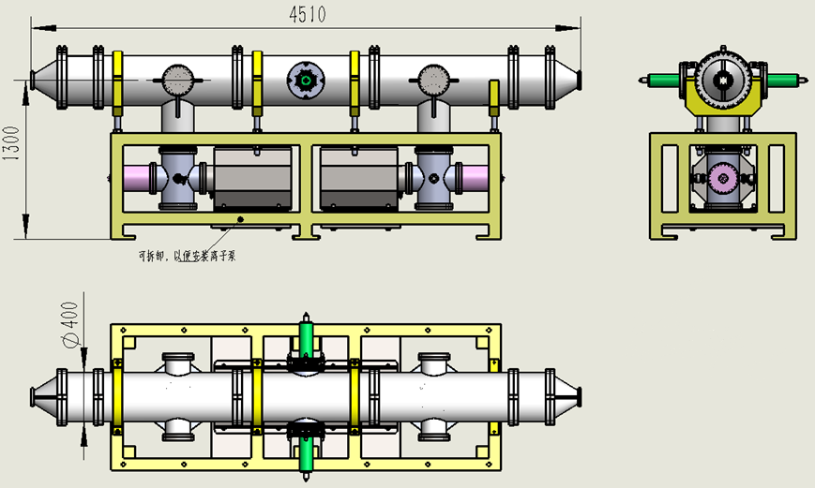
  Mechanical design
whole structural

Slide 17
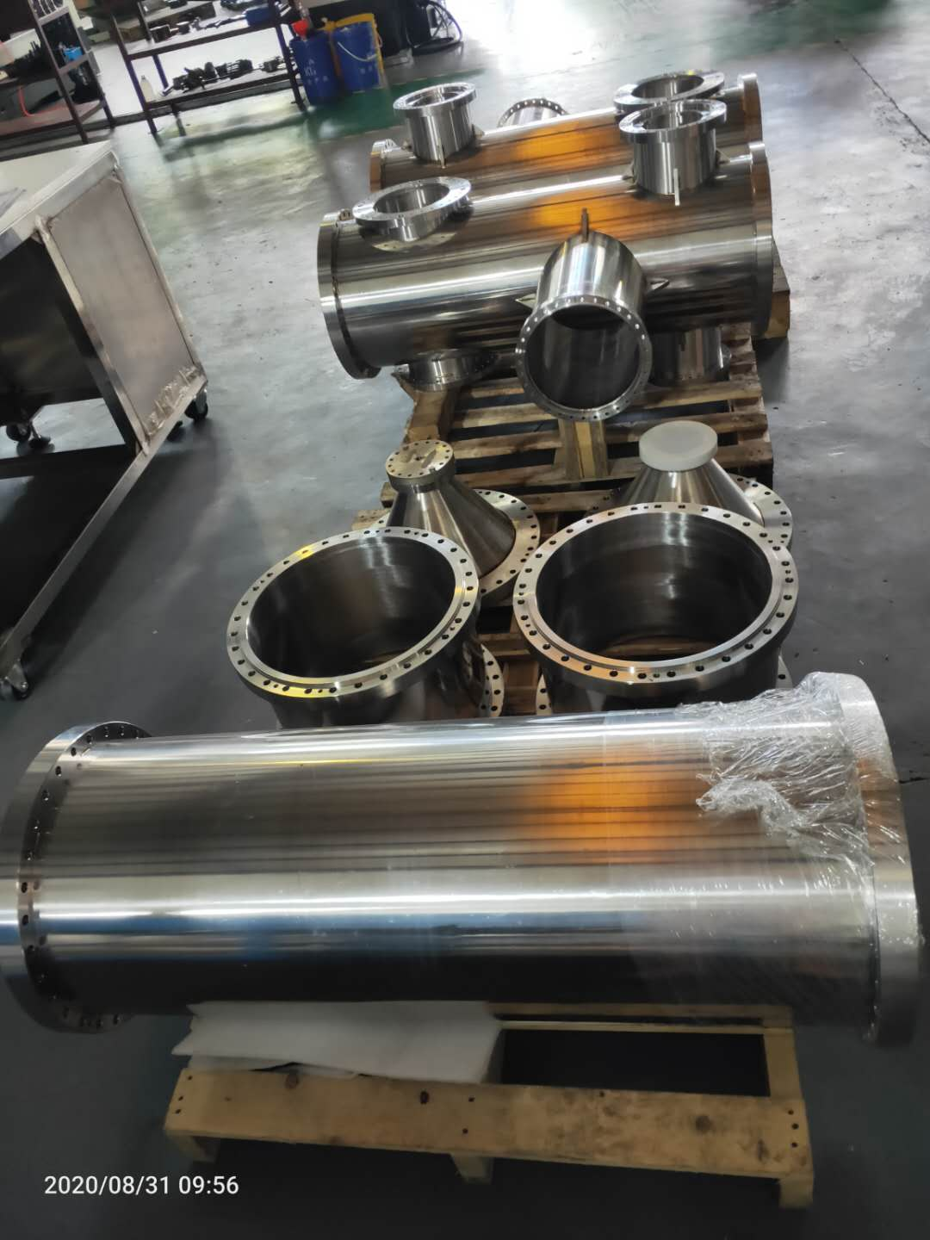
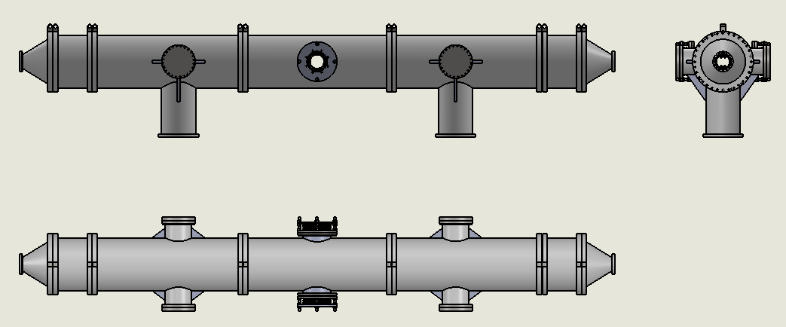
  Mechanical design
UHV tank
Material : stainless-steel 316L.
Split into 7sections, step positioned to ensure installation accuracy.
Electrochemical polishing treatment to make the HV sparking rate as low as possible.
High temperature vacuum degassing treatment to achieve ultra high vacuum.
Adopt metal seal to keep low leak rate of vacuum.

Slide 18
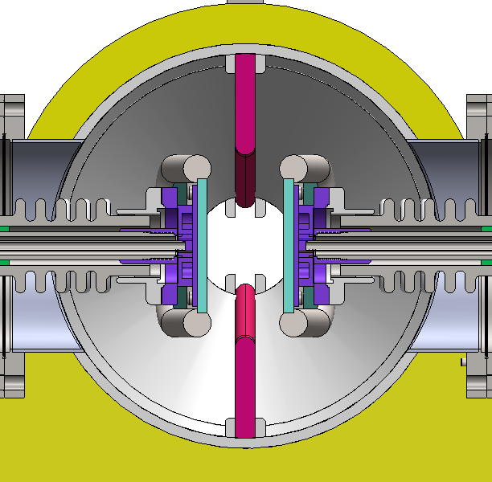
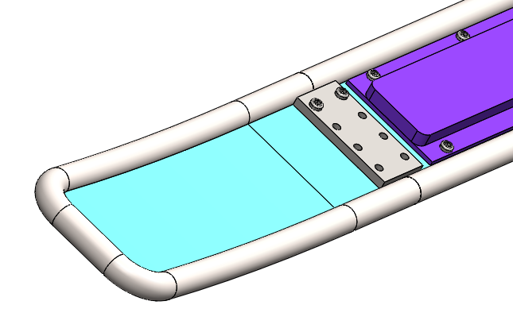
  Mechanical design
Electrode
Due to the large size, titanium welding deformation is large and difficult to correct, so as to minimize the range of welding.
Electrode plate and cooling plate are separated and bolted together.
The cold plate material is stainless-steel 316L.
The electrode plate is divided into three sections: the middle straight plate, the arc plate on both sides, and bolted connection. In this way, the dimensional accuracy of the middle part and the curved part on both sides is easy to be realized.

Slide 19
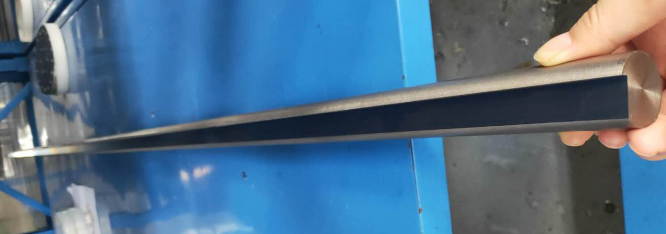
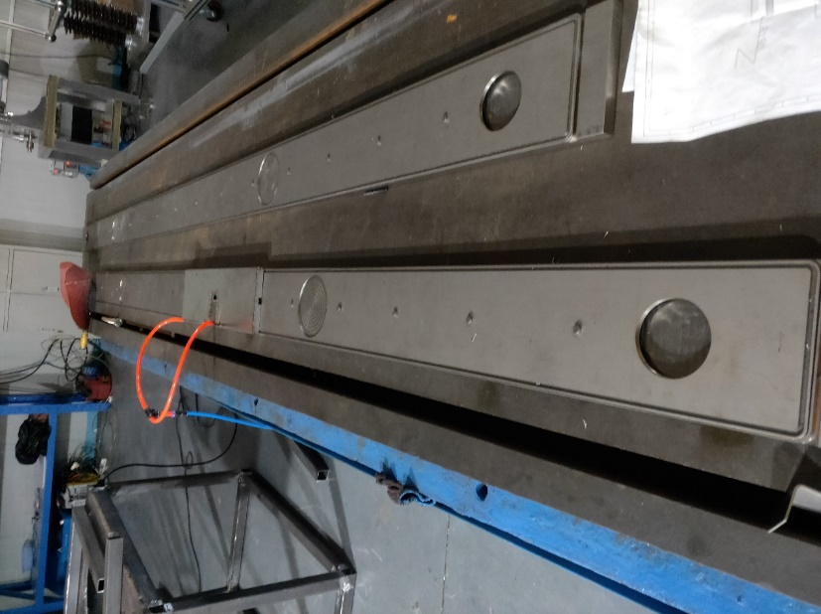
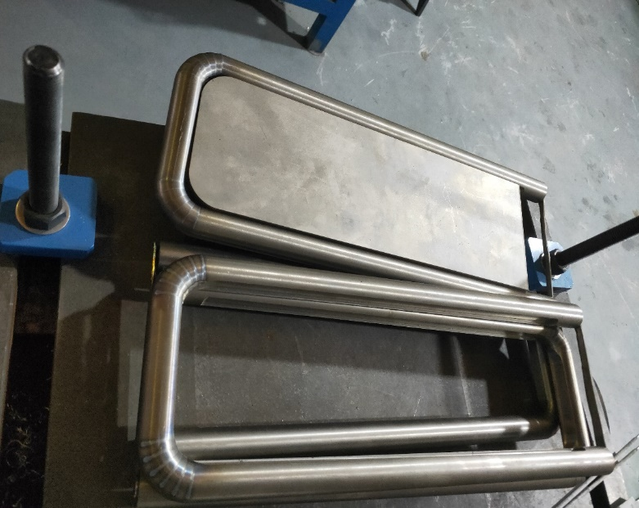
  Mechanical design
Electrode
Titanium rod processing completed
cooling plate processing completed
Titanium rod an plate at both ends

Slide 20
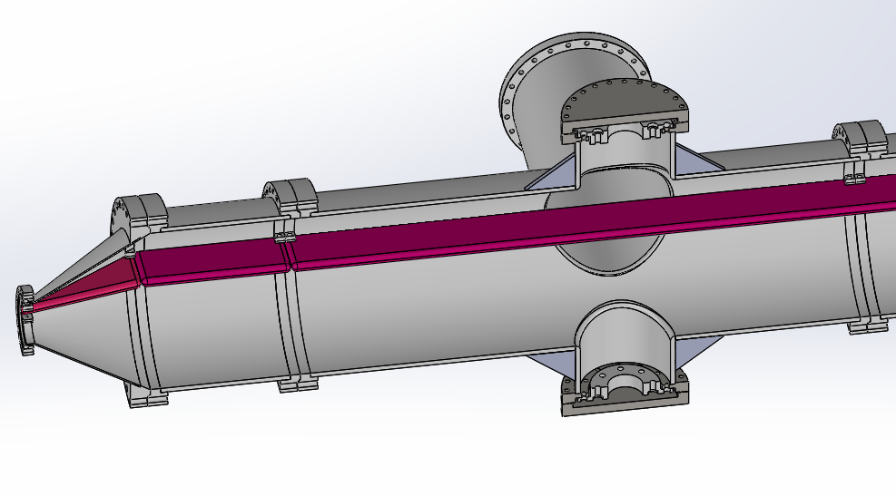
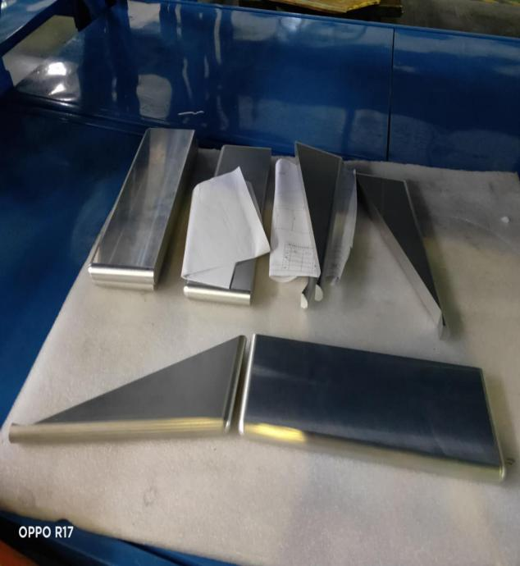
  Mechanical design
Ground Electrode
The ground electrode material is aluminum 6061 T6.
The ground electrode is divided into 5 sections: 2 sections of triangle, 2 sections of short rectangle and 1 section of long rectangle. The purpose of segmentation is to facilitate machining and installation
The ground electrode is fixed with a fixed clamp welded on the vacuum chamber.

Slide 21
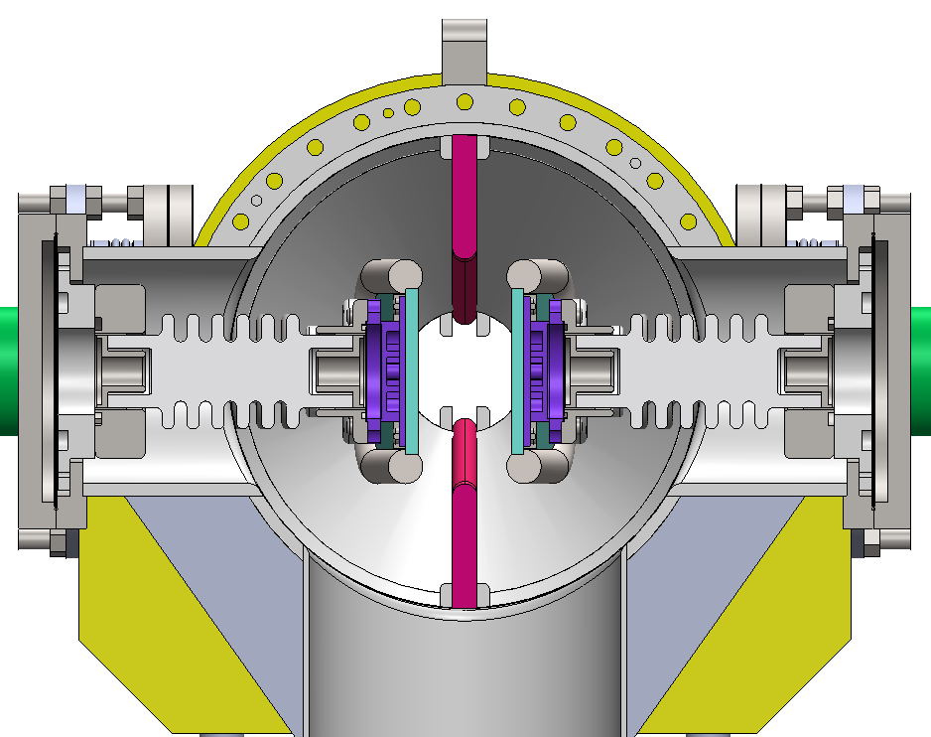
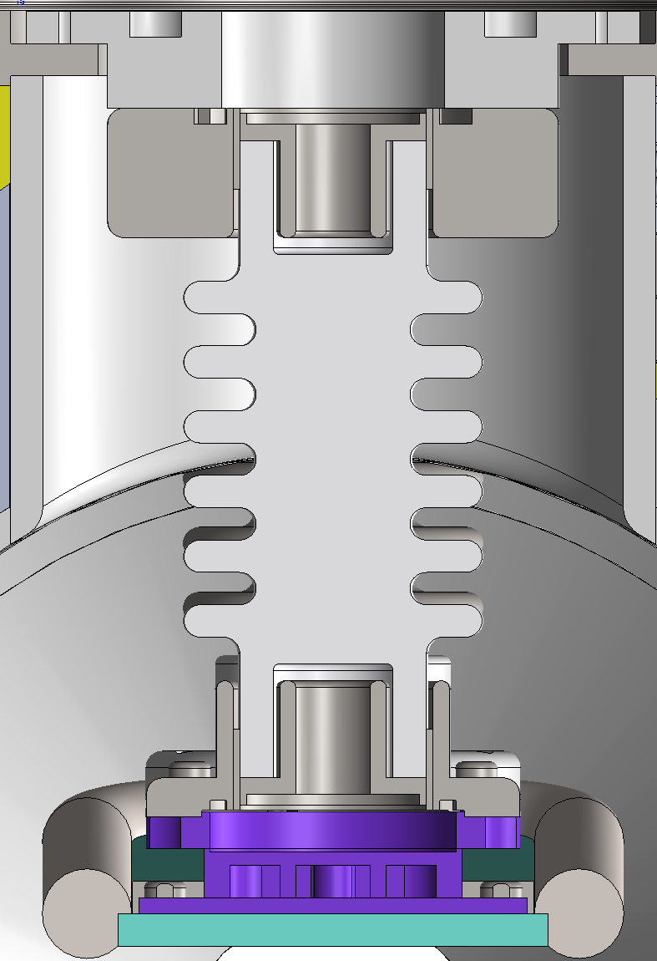
  Mechanical design
HV metal-ceramic support
The ceramic parts are made of 95% alumina ceramics.
The ceramic ends are metallized , and the metal flanges are welded for fixation, which has the advantage of high mechanical strength.
The electrode have two supports, one is fixed, the other can be fine-tuned, to ensure the installation accuracy requirement and avoid the deformation of electrode.

Slide 22
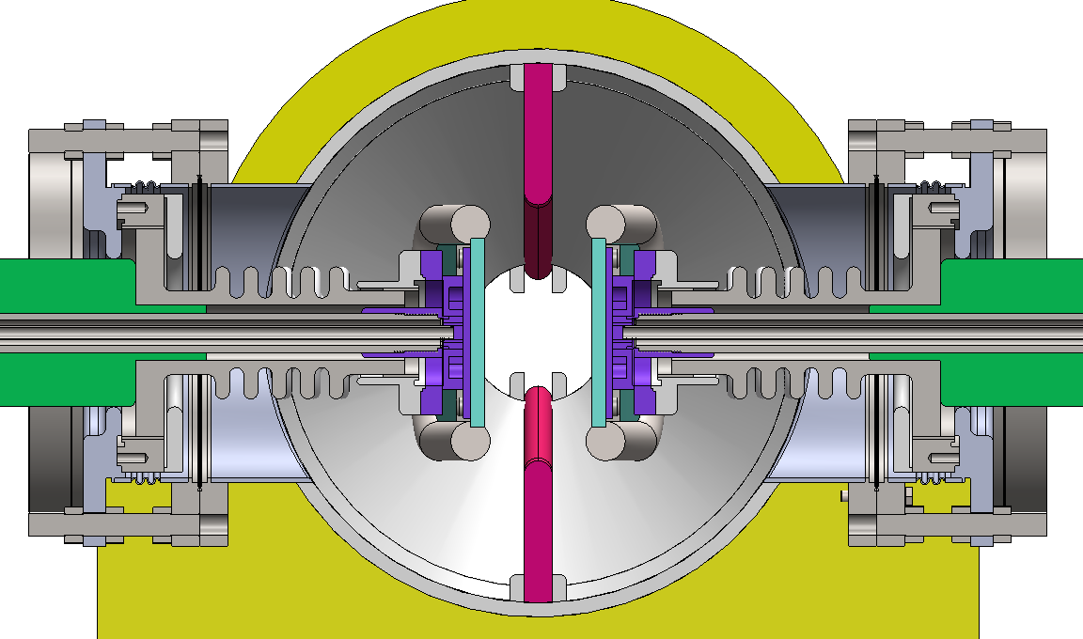
  Mechanical design
High voltage feedthrough
The feedthrough device of each electrode plate , both feed HV and cooling liquid.
The inside of the ceramic tube is atmosphere, with feedthrough cable and liquid pipe, and the outside is vacuum.
Bellows are soft connections for easy installation and position adjustment.

Slide 23
Design and progress for power supply
  Basic design principles for the power supplies
    Modular design for power supplies
    Switching mode as the main topology.
    digital design for all power supplies.
Focusing on key issues for PS system
    Booster Power Supply
    Corrector PS (Multi-unit combination structure)

Slide 24
Design and progress for power supply
  the digital control power supplies are split in three independent parts
    A power part acting as a voltage source or a current source, which is suitable for industrial design and production
    Current transducers （Commercial Product or Self-design)
    Self-designed digital electronics control module, which performs the current regulation, diagnostics, monitoring and local/remote service . It’s standardized for all types of power supply.

Slide 25
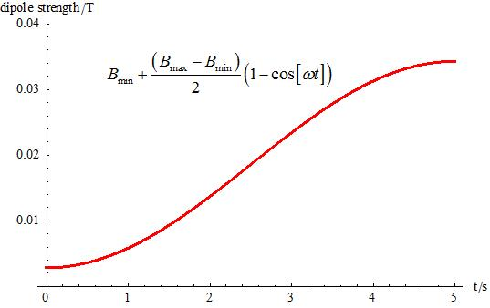

Booster power supply
  Design principles of the booster power supplies：
  Based on the current waveform requirement of the dipoles, quadrupoles and sextupoles (as shown below); the rating voltage considering the inductive value caused by the magnet inductance.
  Duration of ramp-up and ramp-down are 5s .
  Repetitive frequency 0.08Hz, trapezoidal .
  Power supply performance: tracking error less than 0.2% .
The magnetic field cycle waveform for CEPC booster

Slide 26
booster power supply
  Topology:
    Mature Multi – module series technology is adopted for high voltage output.
    AC-DC-AC structure
    Front stage rectifier circuit: diode rectifier + Booster.
    Output stage is the two-quadrant chopper,
    A power control circuit is used to reduce the fluctuation of input power

Slide 27



booster power supply
  Simulation:
red curve: output current ; blue curve: output voltage
output current and tracking error waveform

Slide 28




Prototype: test
the stability meets the requirements.
Prototype for HEPS magnet Measuring
The power supply has overshoot at zero

Slide 29


Corrector PS Design
  For large number of corrector PS:
  1) each one stand-along, but multi power supplies share one chassis;
  2) power supplies in one chassis share one digital controller
  pros:
  each power supply can be maintained independently;
  cost effective with respect of chassis and digital controller, and space savings.

Slide 30



Corrector PS Design
  Topology of single module:
    AC-DC source + Full Bridge (Zero Voltage Switch-Phase Shifting)
  Embedded self-designed DPSCM

Slide 31


Prototypes: test
  Stability: (Imax – I min)/IN during 6h, 61.5ppm , meets the requirements.
High frequency ripples caused by PWM switching frequency (24.1255kHz)
It is also found large ripples at 80Hz, 160Hz and 260Hz in Low frequency range.

Slide 32
Summary
  The Electro-magnetic separator including two part: Electrostatic Separator and Dipole Magnet
  The magnet yoke is H-type. The prototype is being fabricated.
  A separator unit consists of a pair of pure Titanium electrodes — each 4 m long and 180 mm wide —mounted in an UHV tank of about 380 mm inner diameter.
  There are two methods implemented in the design of the separator to reduce the loss parameter: ground electrodes & tapered ends, but the loss factor is still high.
  The cooling system of the electrodes is designed. The thermal analysis of the electrode plate was carried out .
  The Vacuum system include two sputter ion pump, and two sublimation pump.
  The mechanical design of the separator has been completed, and the prototype is being fabricated.
Prototypes for Booster power supply and Correctors with Multi-unit combination structure has been fabricated and finished the test.

Slide 33
Thank You!

