Slide 1
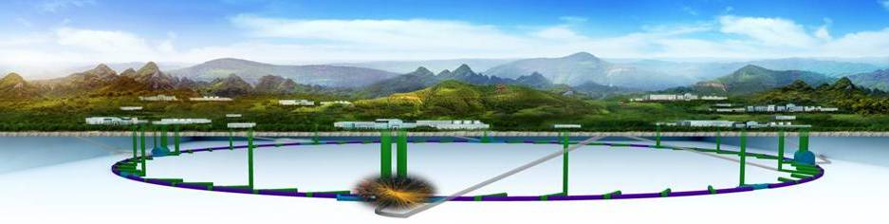
R&D Activities for CEPC Accelerator Key Technologies at HERT
ZHAO Jianbing
Institute of High Energy Physics, CAS, Beijing HE-Racing Technology Co., Ltd.
Oct. 26, CEPC-CIPC 2020, Shanghai
The 2020 International Workshop on the High Energy Circular Electron Positron Collider (Oct. 26-28, 2020), Shanghai, China

Slide 2


Outline
1
  Brief Introduction
2
Magnets R&D for CEPC
3
  SRF Cavities and FPCs R&D for CEPC
4
  Accelerating structure R&D for CEPC
5
  Summary

Slide 3
  1. Brief Introduction
History
Beijing HE-Racing Technology Co., Ltd. (HERT) reorganized from the Machine Shop of IHEP, which has same history with IHEP.
Work and Function
As an important support department of IHEP and its facilities, based on collaboration with Accelerator Center, HERT undertake the function of accelerator and accelerator components R&D and manufacture of IHEP, and the work of accelerator components collaboration between IHEP and other institutes or companies.

Slide 4
  1. Brief Introduction
Main Products:
  Magnets and Insertion Devices
  Accelerating structures, SLEDs
  Microwave devices
  RFQ and DTL
  Super-conducting Cavities, Couplers, Cryomodules, etc..

Slide 5
  1. Brief Introduction
Project and Experience:
BEPC/BEPCII, CSNS, SSRF, HEPS-TF, HLSII, THz, DCLS, SXFEL, ϒ-LS, ADS, TPS …
PLS/PLSII, PAL-FEL, PEFP, KEK-B, FIR/THz, RISP …
PEPII, SPEAR3, NSLSII, CLS, ILC-ATF2, LCLSII…
SPARK, LEG, E-XFEL, MAXIV, FERMI-Eletta, KIPT-ADS …

Slide 6
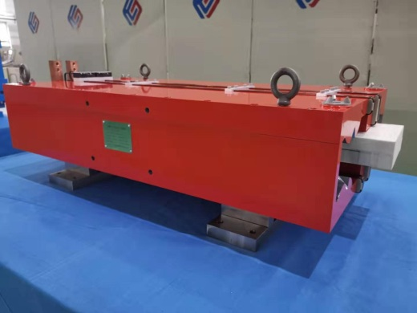
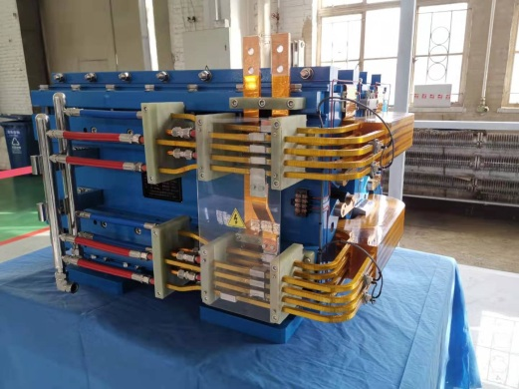
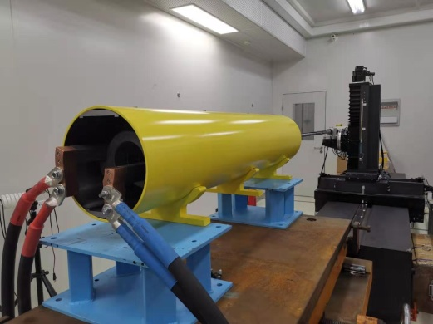
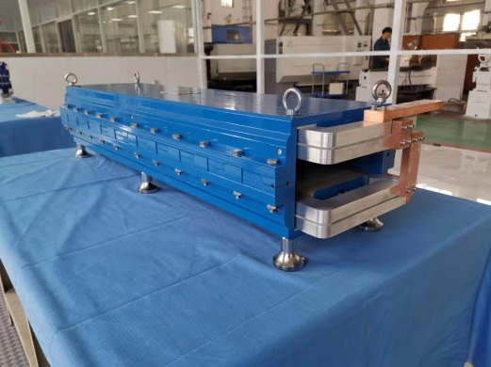
  2. Magnets R&D for CEPC (Subscale Prototype)
Dual Aperture Dipole of Collider Ring
Dual Aperture Quadruple of Collider Ring
Dipole of Booster
(without iron cores)
Dipole of Booster
(with iron cores)

Slide 7
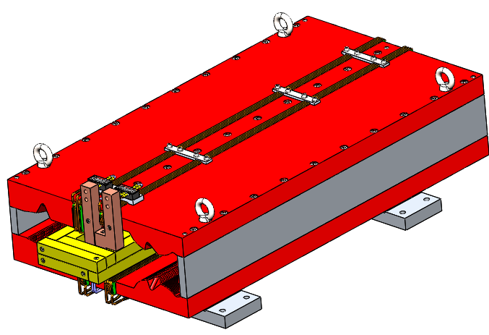
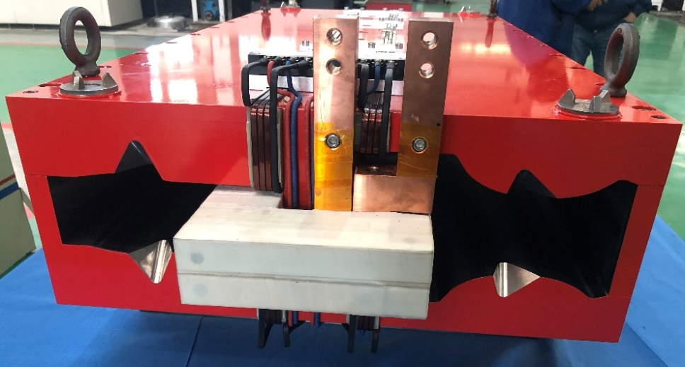
  DAD ( Dual Aperture Dipole ) of Collider Ring
Mechanical design
Liron=1m, solid yoke , three parts;
Main coils: aluminum bus bars, 4 turns, air cooled, interconnect by screw;
Trim coils: copper wire, 4 turns per pole, air cooled;
Two stainless steel supporters to increase rigidity of the overall structure.
Magnetic strength [T] |  | 0.0373
Aperture [mm] |  | 70
Main coil | Turns | 4
 | Material | Aluminum
 | Current [A] | 563
 | Current density [A/mm2] | 0.7
 | Power consumption [kW] | 0.12
Trim coil | Turns | 1×4
 | Material | Copper
 | Current [A] | 16.7
 | Current density [A/mm2] | 0.093
 | Power consumption [kW] | 0.0005
Tot cross section(mm) |  | 535*200
Iron length (mm) |  | 1000
Iron weight(kg) |  | 510
Al weight(kg) |  | 22
Cu weight(kg) |  | 0.3
CAD model of dual aperture dipole
Dual aperture dipole prototype

Slide 8
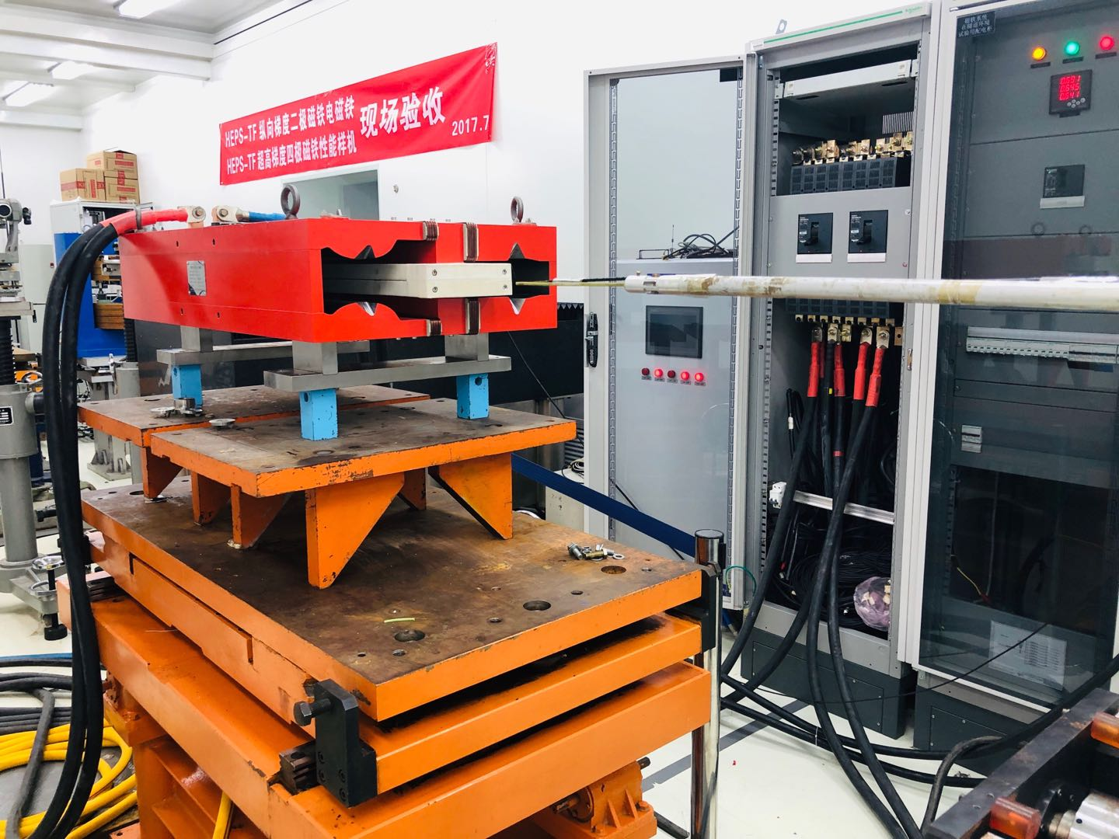
  DAD ( Dual Aperture Dipole ) of Collider Ring
Magnetic measurements: dipole transfer function
The transfer function at two apertures:
  Center field difference <0.3% in two apertures(residual field effect and different gaps at the two apertures).
Ap2
Ap1
Dipole measured by a hall probe system
B/I Transfer function
By along z at different energy

Slide 9
  DAD ( Dual Aperture Dipole ) of Collider Ring
Magnetic measurements: field difference and harmonics
Integral field differences
  Difference is less than 0.15%@45GeV.
Harmonics@Rref=13.5mm
E(GeV) | Ap1 ByL(T.mm) | Ap2 ByL(T.mm) | Differ
45 | 15.3972 | 15.3765 | -0.13%
80 | 27.3358 | 27.3199 | -0.06%
120 | 41.2001 | 41.1810 | -0.05%
Harmonics at two apertures
n | Ap1@45GeV | Ap2@45GeV
2 | 5.38 | -1.40
3 | 113.24 | -157.23
4 | 4.49 | -2.00
5 | 0.015 | 2.14
6 | -5.29 | 2.60
Measured integral field in the vertical midplane (y=0)

Slide 10
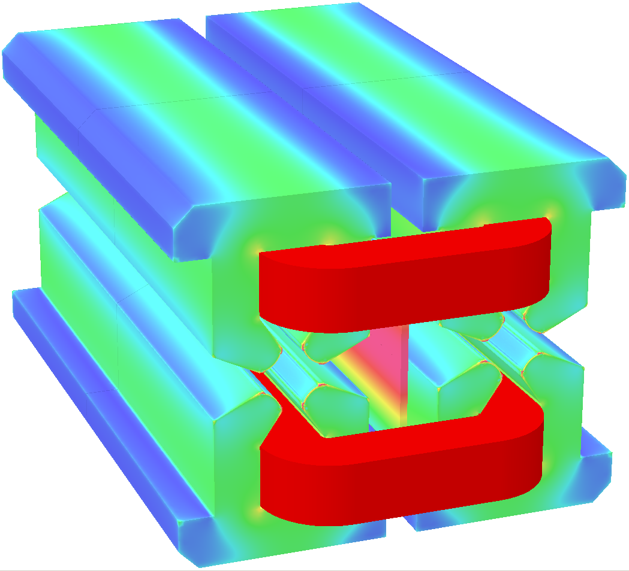
Physical design of DAQ prototype
  DAQ ( Dual Aperture Quadruple ) of Collider Ring
Gradient [T/m] |  | 8.42
Aperture [mm] |  | 76
Main coil | Turns | 64×2
 | Material | Aluminum
 | Current [A] | 154
 | Current density [A/mm²] | 1.89
 | Power consumption [kW] | 5.3
Trim coil | Turns | 20×4
 | Material | Copper
 | Current [A] | 7.2
 | Current density [A/mm²] | 0.9
 | Power consumption [kW] | 0.04
Cooling water | Velocity [m/s] | 1.3
 | Flux [l/s] | 0.201
 | Temperature rise [°C] | 6.3

Slide 11
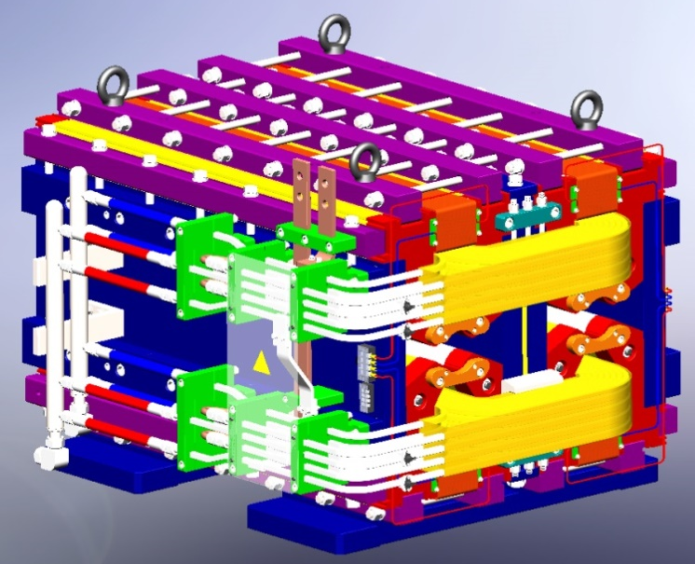
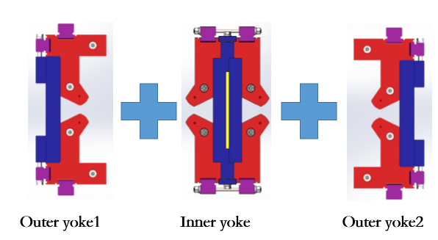
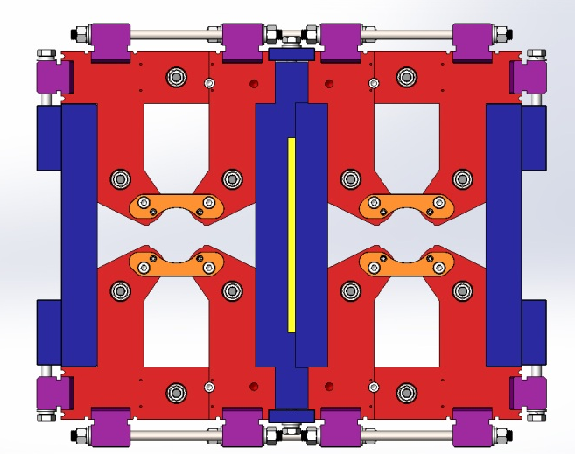
  DAQ ( Dual Aperture Quadruple ) of Collider Ring
Mechanical design
Short model (1m in length),laminated yoke
Trim coils :±1.5% adjustability, enameled copper wire
Main coils: hollow aluminum coils, water cooled, 64 turns/pole
Large size of wire and low current density
Stainless steel as a supporter and separate two yokes.

Slide 12
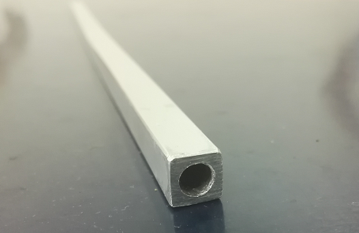
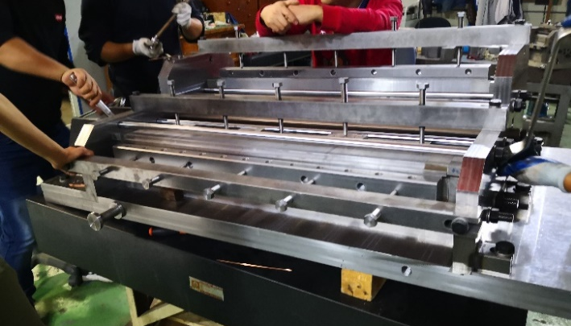
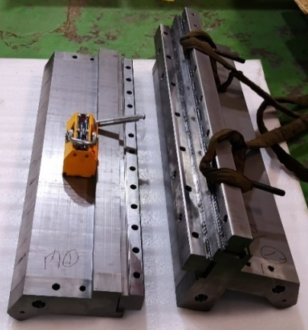
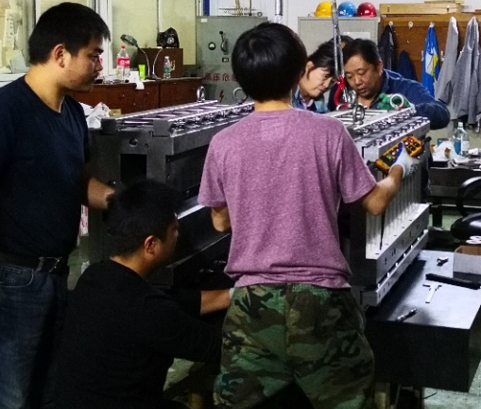
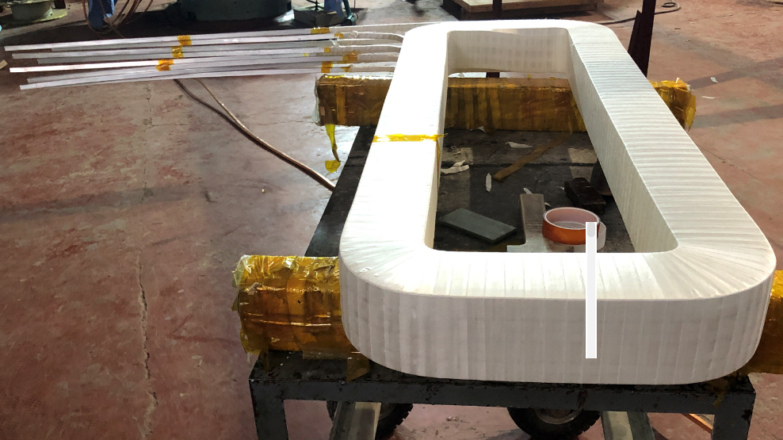
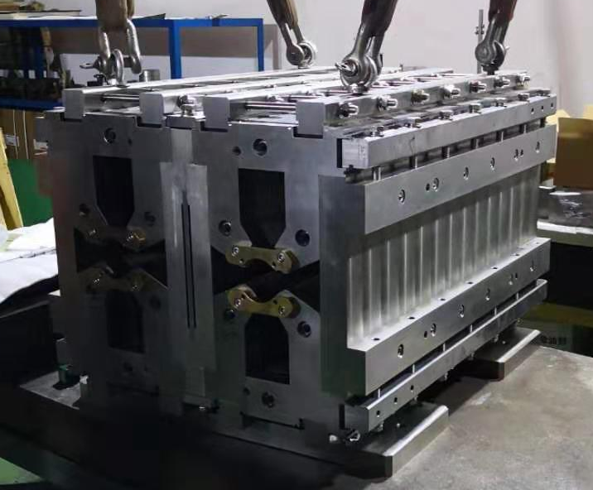
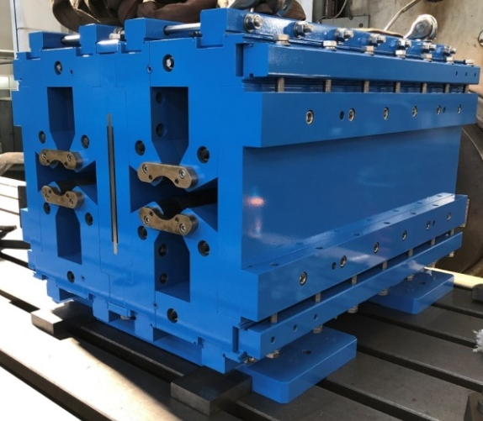
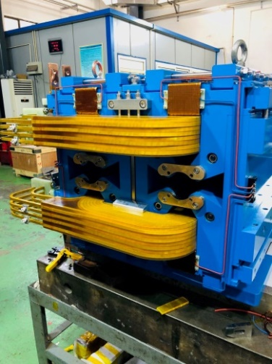
  DAQ ( Dual Aperture Quadruple ) of Collider Ring
Hollow aluminum wire and main coil
Iron of dual aperture quadrupole

Slide 13
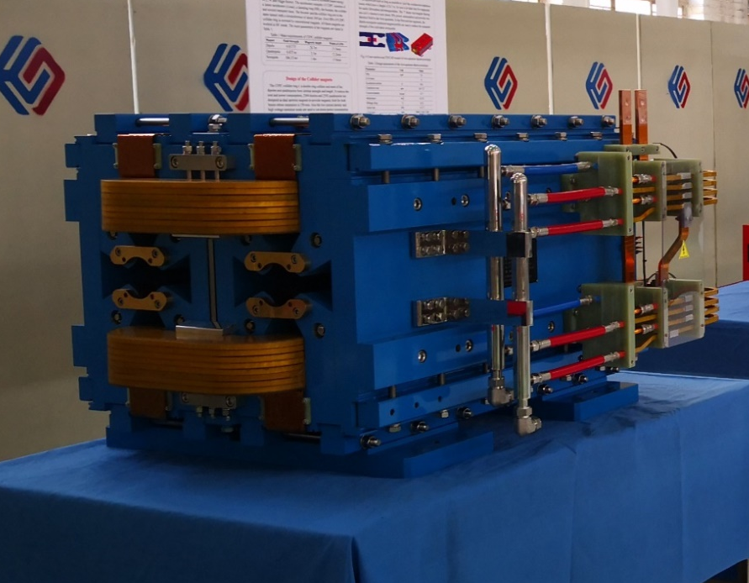
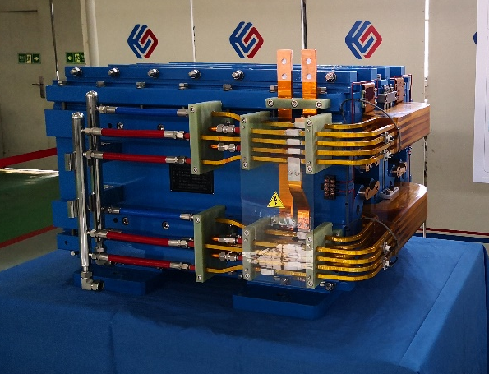
  DAQ ( Dual Aperture Quadruple ) of Collider Ring
Dual aperture quadruple prototype, measurement soon

Slide 14
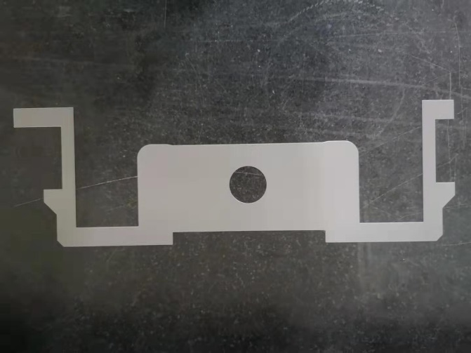
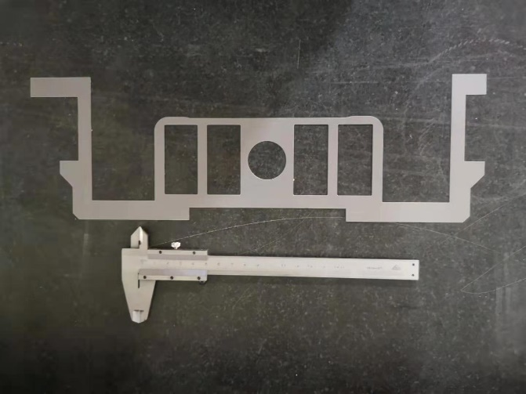
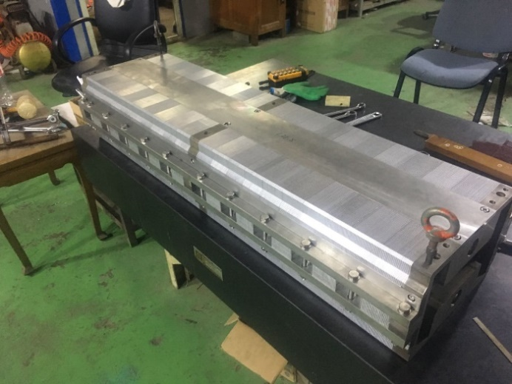
  Dipole of Booster (with iron cores)
The magnet has the upper and lower cores, which are stacked by the grain-oriented silicon steel and aluminum laminations with the thickness ratio of 1:1.
To investigate the influence of the holes in the pole areas, two kinds of laminations with and without holes are produced. So each half of the cores is stacked by the laminations with the holes and half without holes.

Slide 15
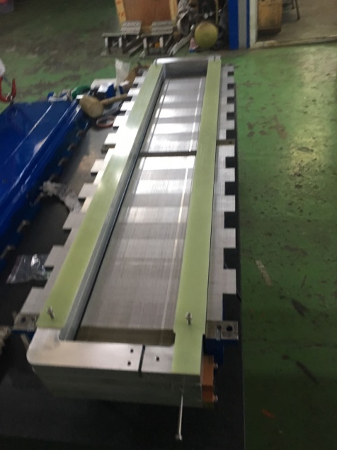
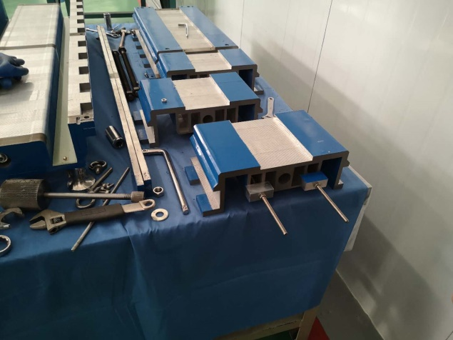
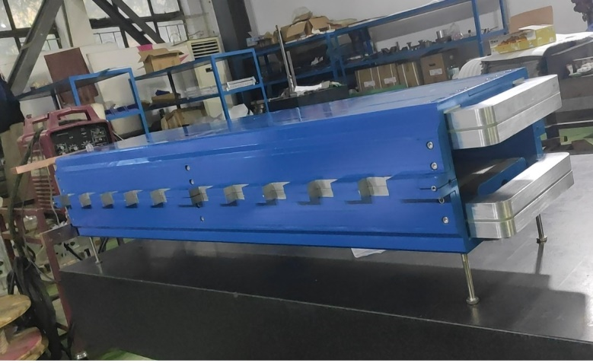
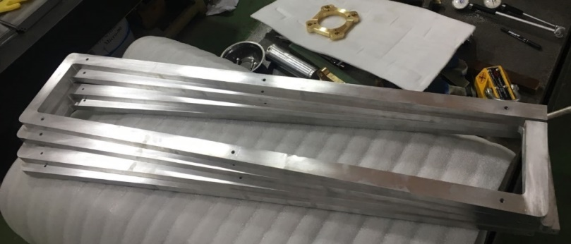
  Dipole of Booster (with iron cores)
The magnet has two coils and each coil has two turns. The conductors of each turn are directly fabricated from the aluminum plates
Because the working voltage is not high, the G10 plates with thickness of 4mm are used for the insulation either from turn to turn or between the coils and cores. The test results show that it can stand 500V.

Slide 16
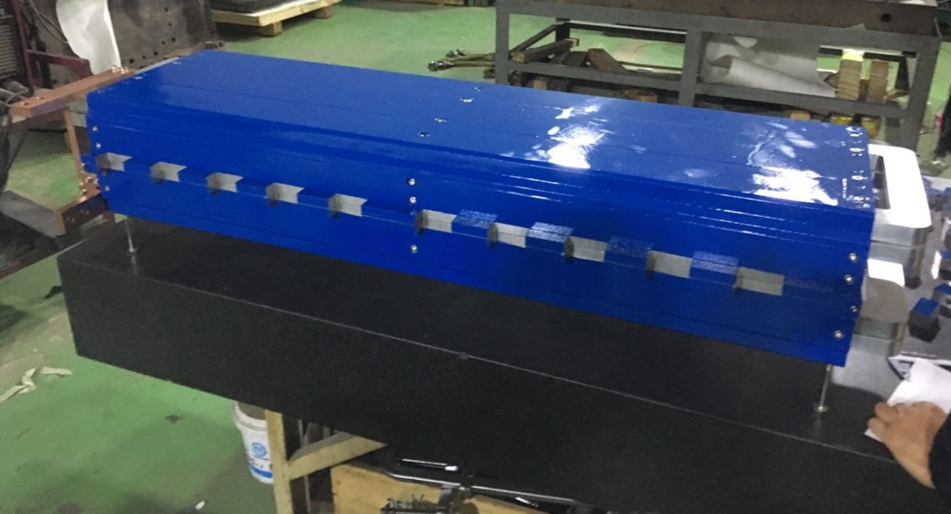
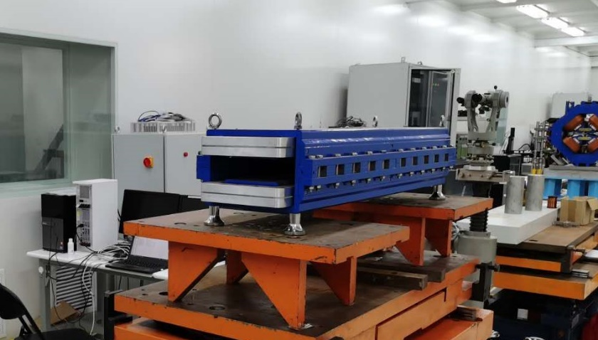
  Dipole of Booster (with iron cores)

Slide 17
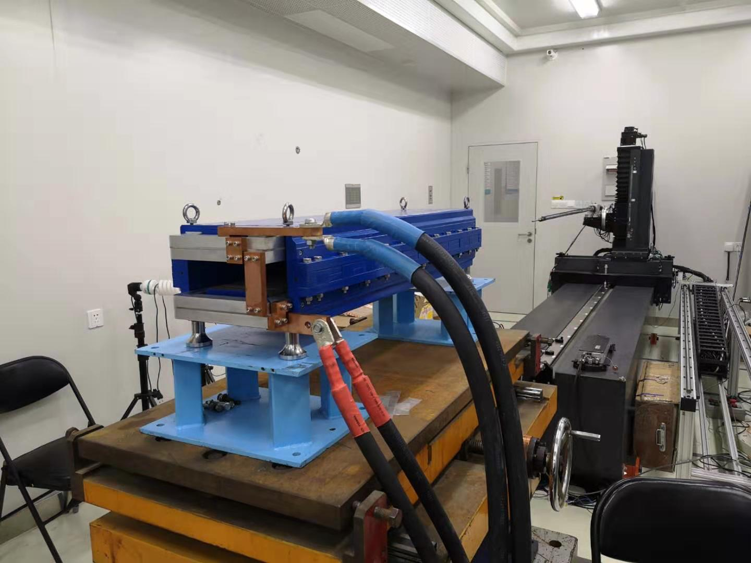
  Dipole of Booster (with iron cores)
The dipole magnet with iron core was tested in the lab.

Slide 18
  Dipole of Booster (with iron cores)
The measurement results
The field uniformity in GFR is about 0.3% at low field level of 28Gs and 0.1% at high field level, which can not meet the requirements.
The magnet is excited for 4 times from 28Gs to 338Gs then back to 28Gs, the field reproducibility at all level is better than the required value of 5E-4.

Slide 19
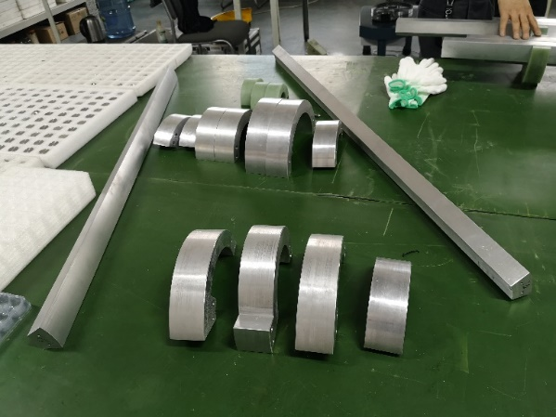
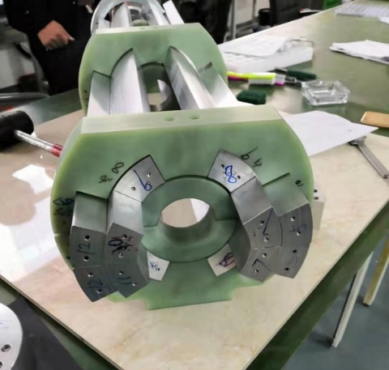
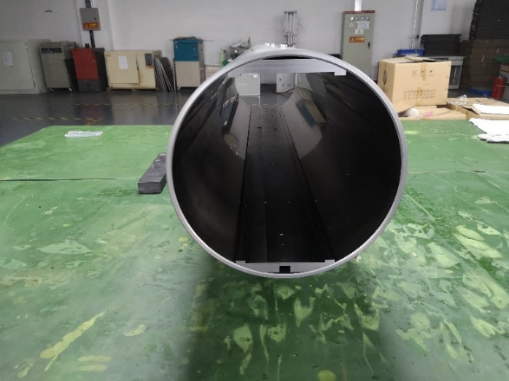
  Dipole of Booster (without iron cores)
The inner and outer conductors of the CT coils are directly fabricated from two aluminum tubes with the right diameters.
The shielding cylinder was made from a long iron tube with inner diameter of 300mm.
All the surfaces of the aluminum conductors were anodized for the insulation from turn to turn, the thickness of the anodized film is about 50 microns.

Slide 20
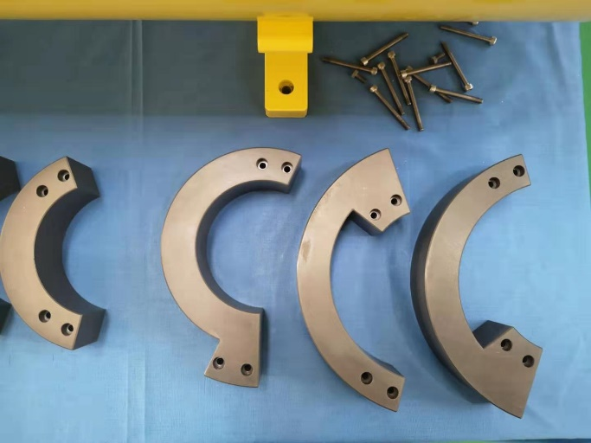
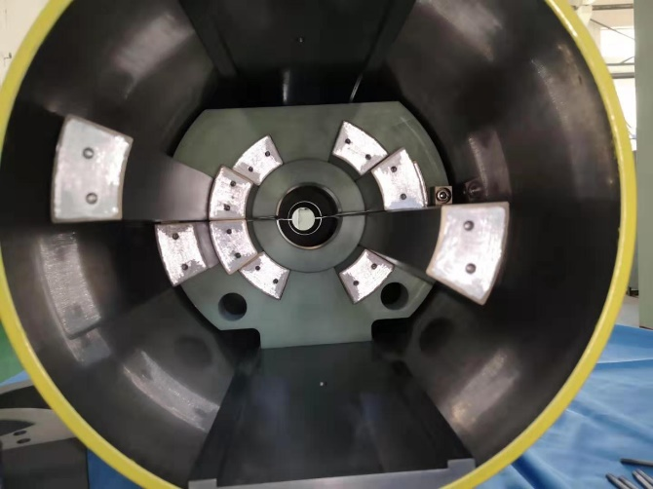
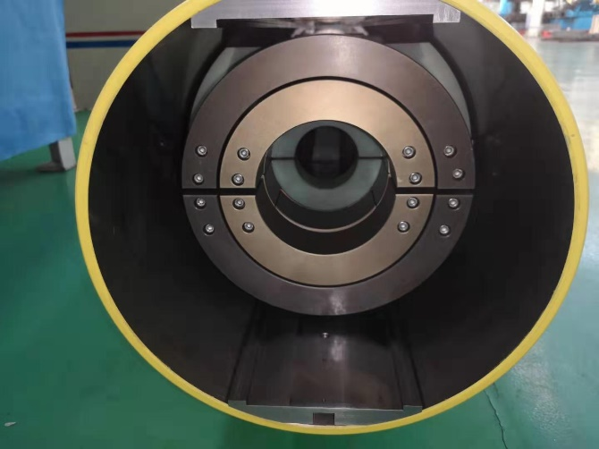
  Dipole of Booster (without iron cores)
The inner and outer conductors of the coils were connected by the by-pass circular conductors, the anodized film of the connected touch surfaces was gotten rid of before the conductors were connected.
The final assembling errors of the CT coil dipole magnet were checked to be less than 50 microns.

Slide 21
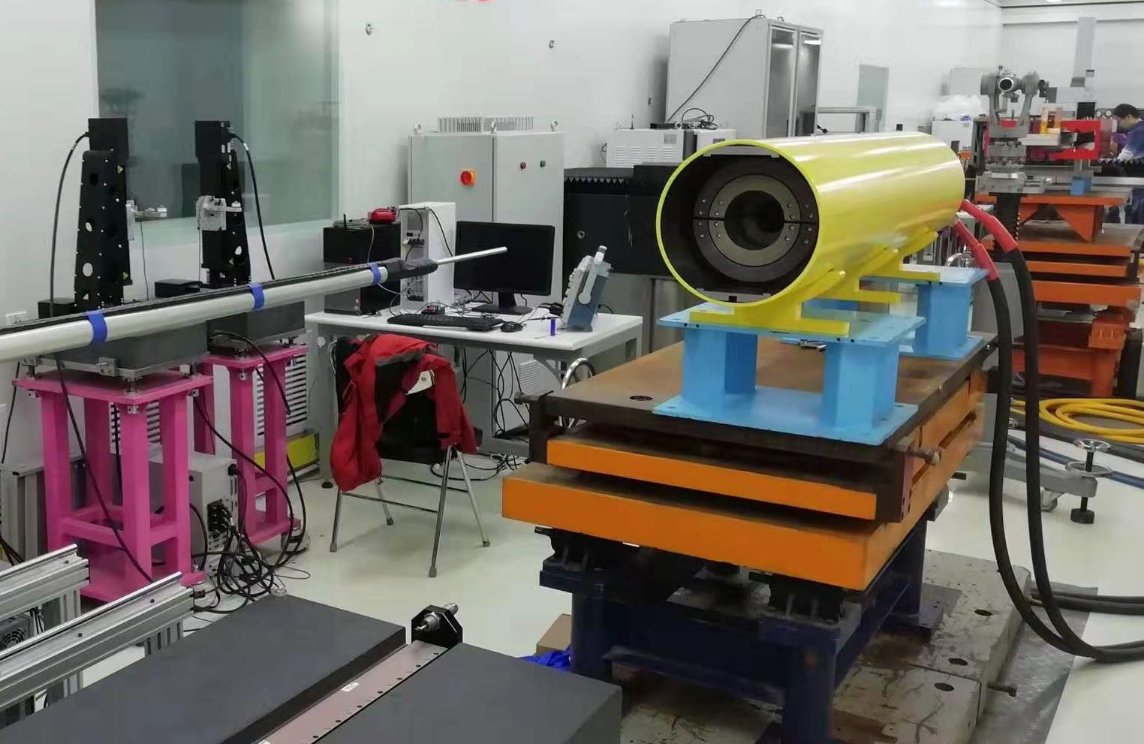
  Dipole of Booster (without iron cores)
The CT coil dipole magnet was tested in the lab.

Slide 22
  Dipole of Booster (without iron cores)
The measurement results
The field precision at all level, especially at low field level of 28Gs, is better than the required value of 0.1.
The magnet is excited for 3 times from 28Gs to 338Gs then back to 28Gs, the field reproducibility at all level is better than the required value of 5E-4.

Slide 23
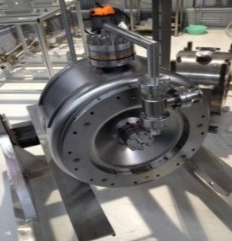
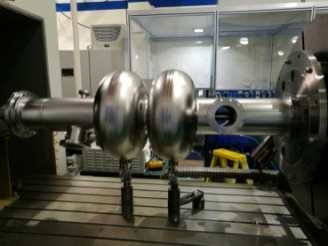
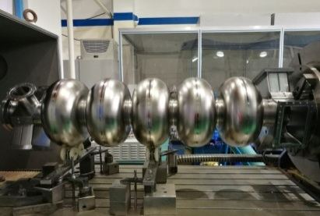
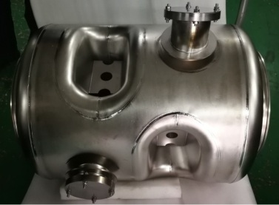
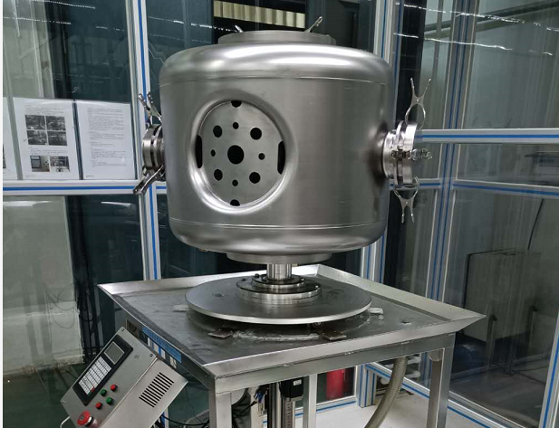
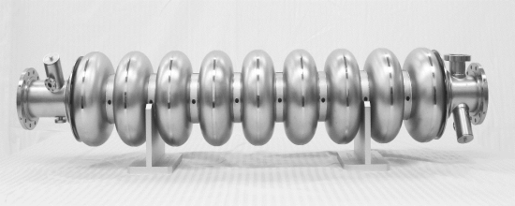
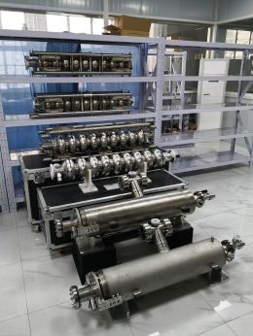
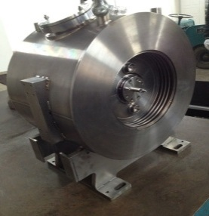
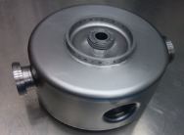
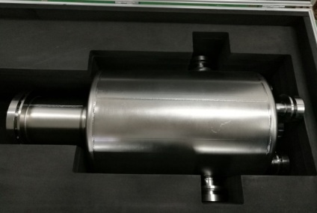
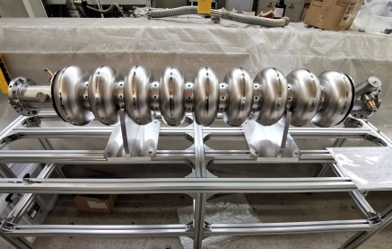

  3. SRF Cavities and FPCs R&D for CEPC
Spoke 024
第一支超导腔
（325MHz）
9 Cell 超导腔
第一支椭球腔
（1.3GHz）
2 Cell 超导腔
5 Cell 超导腔
（650MHz）
双Spoke腔
（325MHz）
Spoke 051
SSR2超导腔
（325MHz）
2014
2015
2016
2017
2018
2019
2020
Spoke 012
ADS 注入器超导腔
小批量生产
Spoke 021
ADS 主加速器超导腔
小批量生产
HEPS-TF超导腔
第一支QWR超导腔
（166.6MHz）
高Q值1.3GHz 9 Cell
高Q值1.3GHz 单 Cell
SRF Cavities

Slide 24















  3. SRF Cavities and FPCs R&D for CEPC
ADS RFQ耦合器
1.3GHz 9 Cell腔耦合器
162.5MHz HWR腔耦合器
500MHz 超导腔耦合器
CSNS聚束腔耦合器
1.3GHz 9 Cell
双窗可调耦合器
166.6MHz QWR腔耦合器(HEPS-TF)
325MHz Spoke 腔耦合器
325MHz Spoke 腔耦合器
CSNS RFQ耦合器
— — FPCs for RF Cavities— —
—— —— —— PFCs for SRF Cavities—— —— ——
PFCs for Cavitiy

Slide 25






  1.3GHz 1-cell Cavity
About 30 cavities have been manufactured for High Gradient and High Q R&D work.

Slide 26



  High Gradient 1.3GHz 1-cell Cavity (EP)
All 12 single-cell cavities > 40 MV/m
Max 46 MV/m

Slide 27

  High Q 1.3GHz 1-cell Cavity (Mid-T Annealing)
High-T annealing + (light EP) + (baseline VT) + expose to air + HPR + 250-400 C Mid-T annealing (3 hours, time not optimized yet) + HPR
All 13 single-cell cavities > 2.7E10 @ 16 MV/m. 300 C has the highest Q: 4.9E10@16 MV/m. S6: 3.5E10@30MV/m. Most of the quench gradient > 30 MV/m.
Will solve the high-field Q-slope problem and reach high gradient with high Q.
Outside BCP sometimes helps to increase Q. Lower magnetic sensitivity than N-doped cavities.

Slide 28











  1.3GHz 9-Cell Cavity
12 cavities have been manufactured for High Gradient and High Q R&D work.

Slide 29



  High Gradient 1.3GHz 9-cell Cavity (EP)
High gradient is the basis for high Q because of large gradient degradation
With new EP tool, only 5 months to achieve 36 MV/m on 9-cell cavity
All of the five 9-cell cavities > 30 MV/m, cell gradient near or above 40 MV/m
Two main FE sources: EP sulfur contamination, HPR contamination
Further push the gradient to 35~40 MV/m with 90% yield

Slide 30



  High Q 1.3GHz 9-cell Cavity (Mid-T Annealing)
World’s first mid-T high Q 9-cell cavity. 4E10@16 MV/m. 3.9E10@22.7 MV/m quench.
Exceed LCLS-II and SHINE spec. Close to LCLS-II-HE (2.7E10@23 MV/m) and CEPC (3E10@24 MV/m) spec.
Further push the gradient and yield by light cold EP between 900 C and 300 C.

Slide 31











  FPC for 1.3GHz 9-Cell Cavity
Strength Test (>100 MPa)
Bellow fatigue testing
Adjustment mechanism
waveguide
Copper plated parts
Ceramic Window EBW
Ceramic

Slide 32







  FPC for 1.3GHz 9-Cell Cavity
Copper Plating
TiN Sputtering device and SEM section
检测结果：
1、内导体光管部位镀铜层厚度平均厚度140μm，满足150μm±20%，
波纹管部位镀铜层厚度179μm，满足150μm±30%要求
2、外导体内表面镀铜层厚度满足30μm±20%，
波纹管部位镀铜层满足30μm±30%要求
(冷端外导体光管镀铜厚度平均27μm，波纹管平均厚度24μm；
热端外导体光管镀铜厚度平均35μm，波纹管平均厚度32μm。)
成份（Ti:N=1:1）：测试值10.75:10.97
厚度（ 7-15nm ）：测试值10.3

Slide 33







  FPC for 1.3GHz 9-Cell Cavity
洁净间清洗
洁净间组装
冷端极限真空
热端极限真空

Slide 34

  FPC for 1.3GHz 9-Cell Cavity
Two 1.3 GHz TTFIII-type variable input couplers. Modified for 7 kW CW power.
High power conditioning at Shanghai (14 kW TW, 7 kW SW).
  完成以下测试老炼项目：
    脉冲行波28千瓦，占空比分别为5%、10%、15%和20%；
    连续波行波14千瓦，在此功率下老炼持续时间为6小时，真空、温度等各项监测信号均正常，无打火；
    连续波驻波7千瓦，在此功率下老炼持续时间为12小时，真空、温度等各项监测信号均正常，无打火。
  老炼结束后，检测真空部件内貌，全部符合要求

Slide 35







  650MHz Cavity (2 Cell)

Slide 36





  650MHz Cavity (2 Cell)
BCP
BCP 650 MHz 2-cell cavities: 2.8E10@22 MV/m (CEPC VT spec: 4E10@22 MV/m)
Performance no change after install HOM coupler
EP and N-doping/N-infusion/mid-T are planned

Slide 37







  650MHz Cavity (5 Cell)

Slide 38








  FPC for 650MHz Cavity
  Fabrication Pictures

Slide 39



  FPC for 650MHz Cavity
  Assembly and Baking

Slide 40







  FPC for 650MHz Cavity
650 MHz variable couplers tested to CW TW 150 kW (SSA power limit), SW 100 kW (corresponding to 400 kW TW power at the window, exceeds CEPC spec 300 kW). One of the highest variable couplers in the world.
High power test with CEPC 800 kW klystron soon (need high power circulator)
Bellow on inner conductor. Inner conductor water cooling. Outer conductor He gas cooling.
TW high power test to 150 kW
Window SW field and power
Window SW field and temperature rise

Slide 41

  4. Accelerating structure R&D for CEPC
The main parameters of the whole structure
  The filling time is 784 nS
  The total attenuation is 0.46 Np
Parameters | Values | Unit
No. of Cells | 84+2*0.5 | -
Phase advance | 2π/3 | rad
Total length | 3.1 | m
Length of cell (d) | 34.988 | mm
Disk thickness (t) | 5.5 | mm
Shunt impedance (Rs) | 60.3~67.8 | MΩ/m
Quality factor | 15465~15373 | -
Group velocity: Vg/c (%) | 2% ~ 0.94% | -
Filling time (t_{f} ) | 784 | ns
Attenuation factor (τ) | 0.46 | Np

Slide 42


  4. Accelerating structure R&D for CEPC
Mechanical design
  Inner water-cooling has been adopted. 8 pipes are around the cavity.
  Compact coupler arrangements. The splitter is milling together with the coupling cavity.
  Two tuners are outside the cavity.
Splitter integrated with input/output cavity.

Slide 43




  4. Accelerating structure R&D for CEPC
Cold test
  The phase shift and the cumulative phase shift are less than 1 deg
  The VSWR is 1.02 at working frequency

Slide 44




  4. Accelerating structure R&D for CEPC
High power test
2020.6.8，在高功率测试中，采用能量倍增系统进行了加速梯度的测量，测得调制器高压为37kV，输入至加速管的峰值功率为155.4MW,对应的加速梯度达到了33MV/m。
高梯度加速结构运行情况
高功率测试台上的加速管
脉冲高压、速调管激励及速调管输出波形
输入加速管的峰值功率

Slide 45
  5. Summary
HERT full with the experience for accelerator key technology and components R&D and manufacture.
HERT has Successfully developed the several prototype for CPEC, such as subscale magnet, accelerating structure, SRF cavities and PFCs.
HERT is willing to undertake more R@D work for CEPC Accelerator key technologies with domestic and international companies and institutes

Slide 46
Thanks for your attention！

