Slide 1
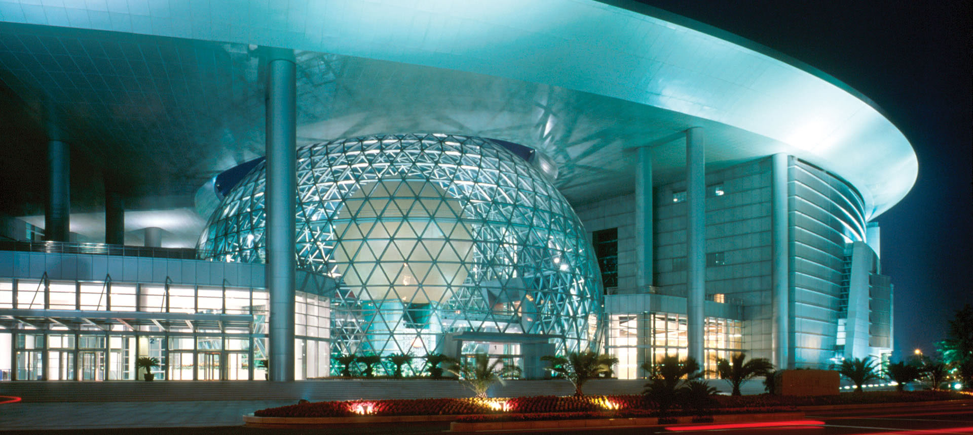
Analysis Tools and Infrastructure
G. Watts (UW/Seattle)

Slide 2
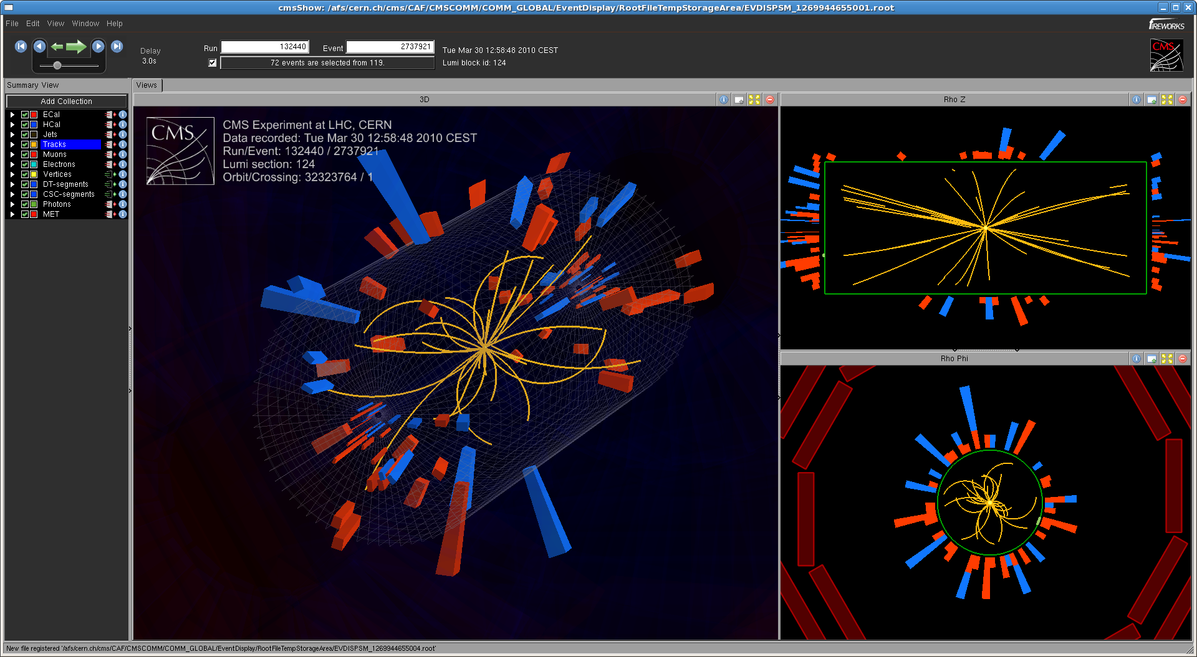
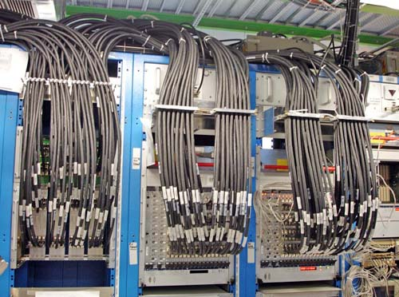
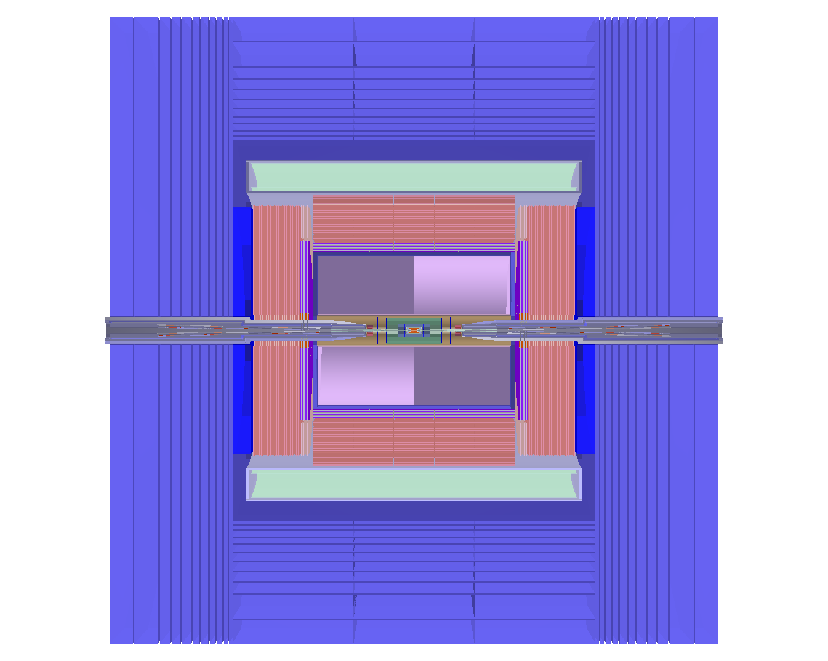
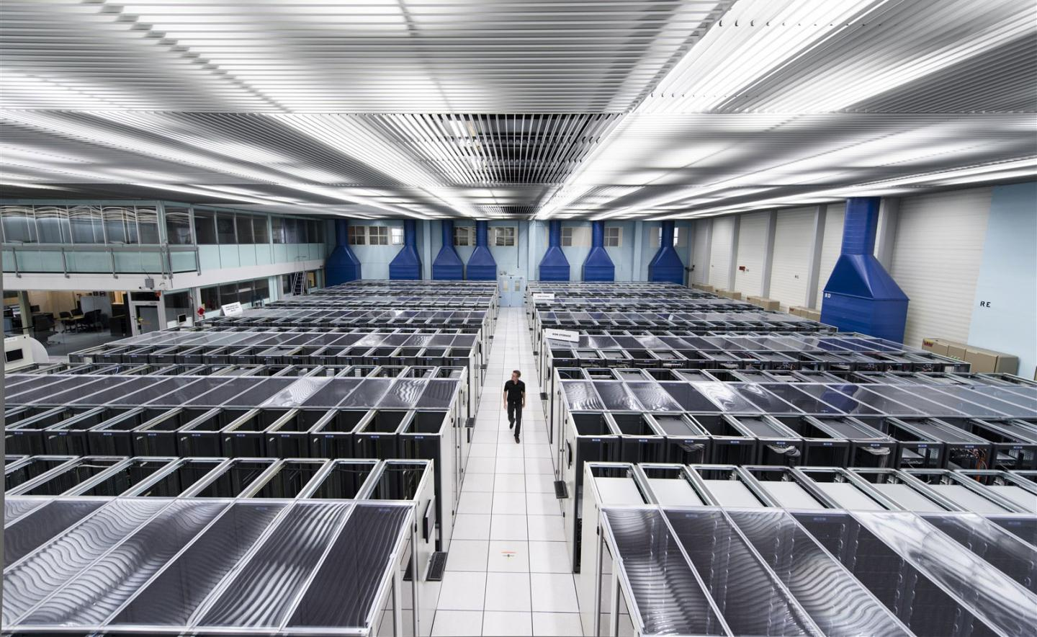
Analysis Software
Production System Analysis Files
Detector
Trigger
Reconstruction
DataLake storage

Slide 3
Analysis Software
Production System Analysis Files
File-Based
ROOT format
Meta Data (calibrations, lumi, in-file, etc.)
For many reasons the current answer is rucio
What should this be?
This will be the first point of contact for analyzers.
Users, analysis groups, etc.
Reduction/etc. runs by analysis groups.
Data Lake
Data-Lake storage

Slide 4
Analysis Software
Production System Analysis Files
File-Based
ROOT format
Meta Data (calibrations, lumi, in-file, etc.)
Data Lake
(how to do them “right”?)
Data-Lake storage

Slide 5
Analysis Software From 30K
Capture & Reuse
Production System Analysis Files
Scan data, explore with histograms, making final plots (w/sys)
Fitting, modeling, manipulation, limit extrapolation, sys
Archiving, publication,
Reinterpretation,
etc.
Analysis Systems, analysis & declarative languages
(underlying framework)

Slide 6
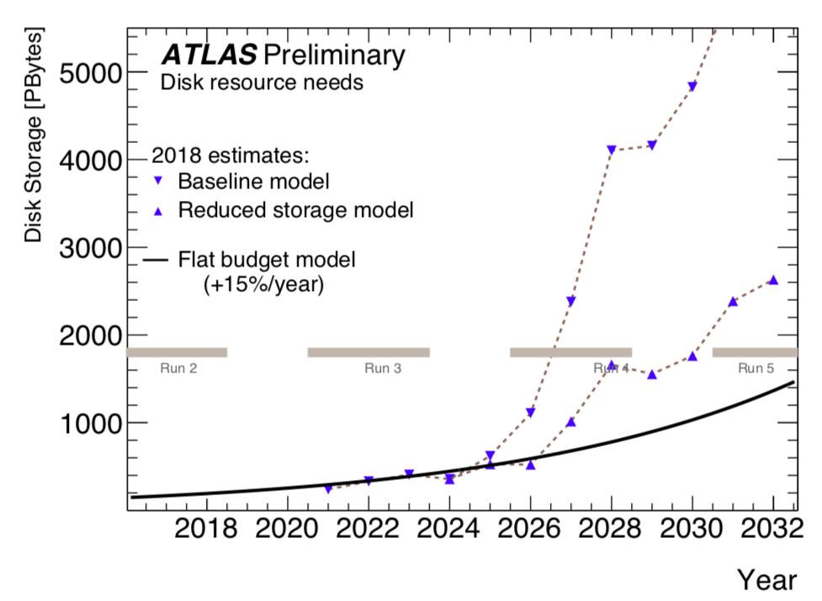
Production Decisions do Affect Analysis!
This will change the way we do analysis in ATLAS

Slide 7
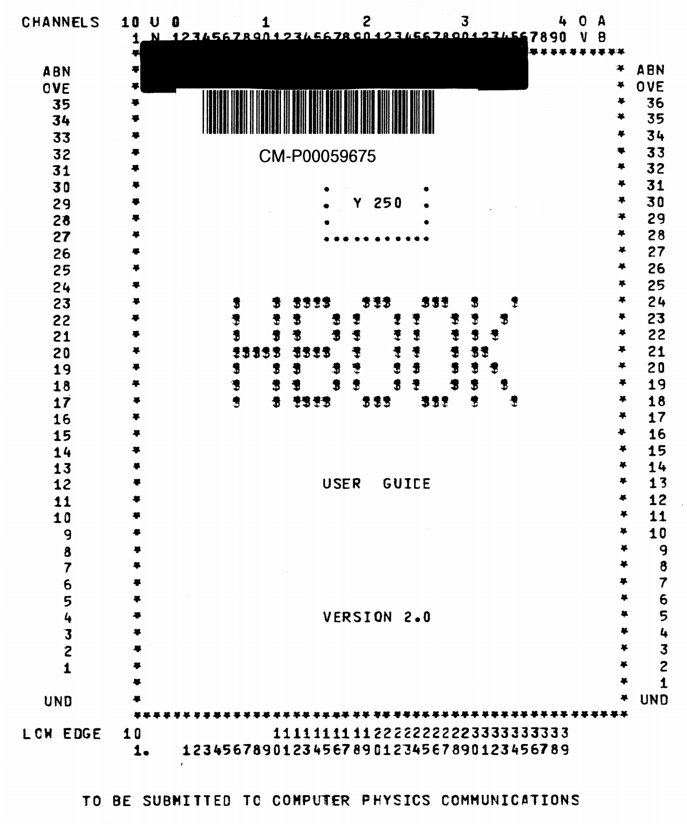
How it started… How it is going…

Slide 8
There is a lot new…
OpenData
Also plays a roll here
High Level
Reproducibility
Differentiable Analysis
Python Eco-system, C++ Eco-system
Software professionals vs physicists as software developers
Analysis Facilities
Continuous Integration*
Declarative Analysis, Procedural Analysis
Distributed Analysis, Large Analysis Datasets
Columnar Analysis, Event Analysis
I didn’t put ML on here.
Low Level
GPU’s, CPU’s, TPU’s, FPGA’s

Slide 9
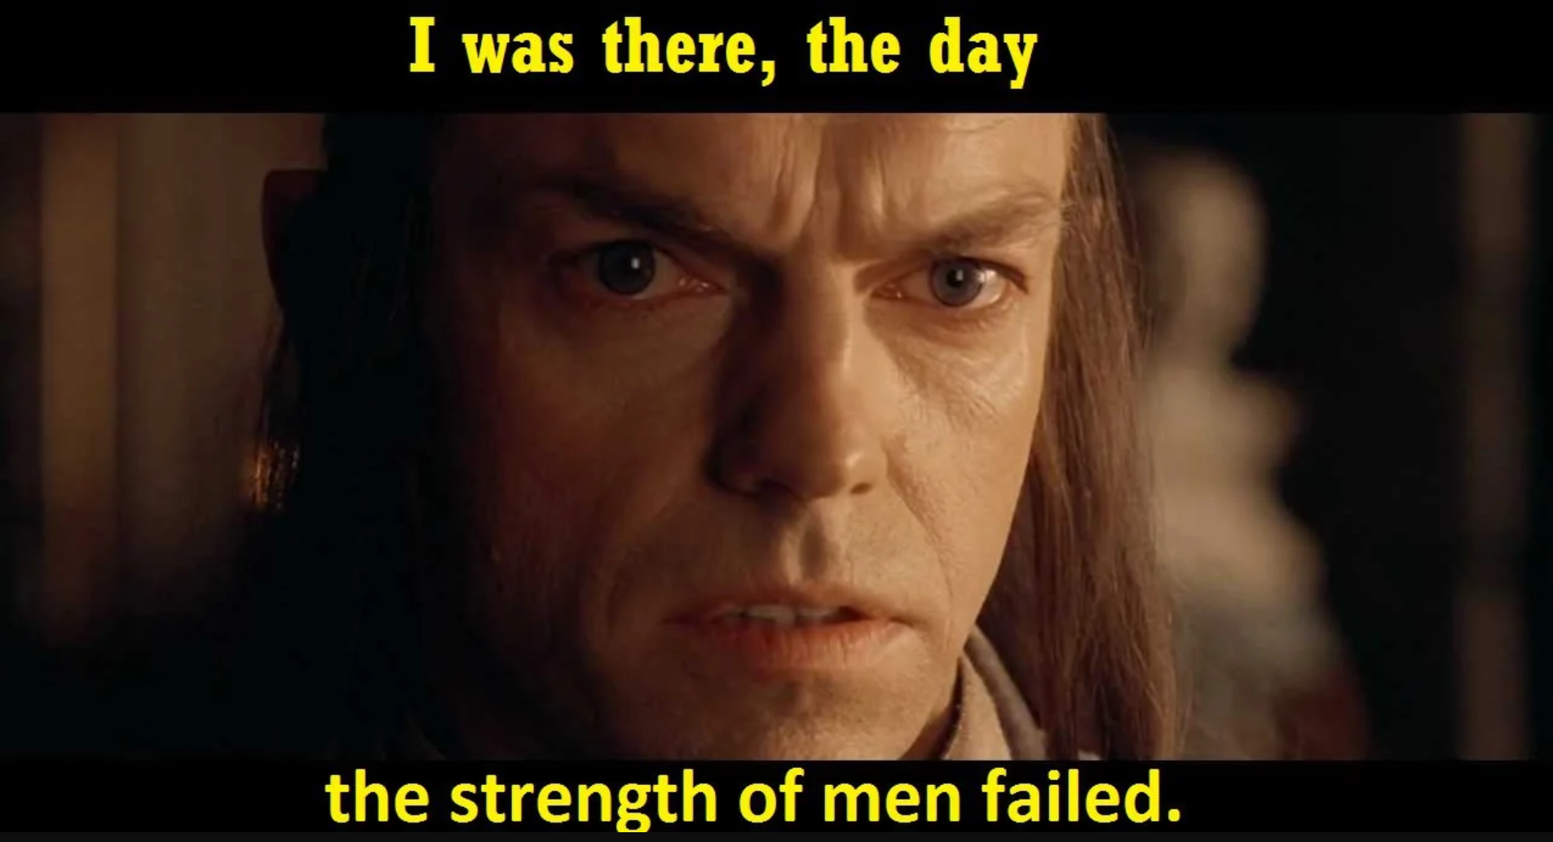
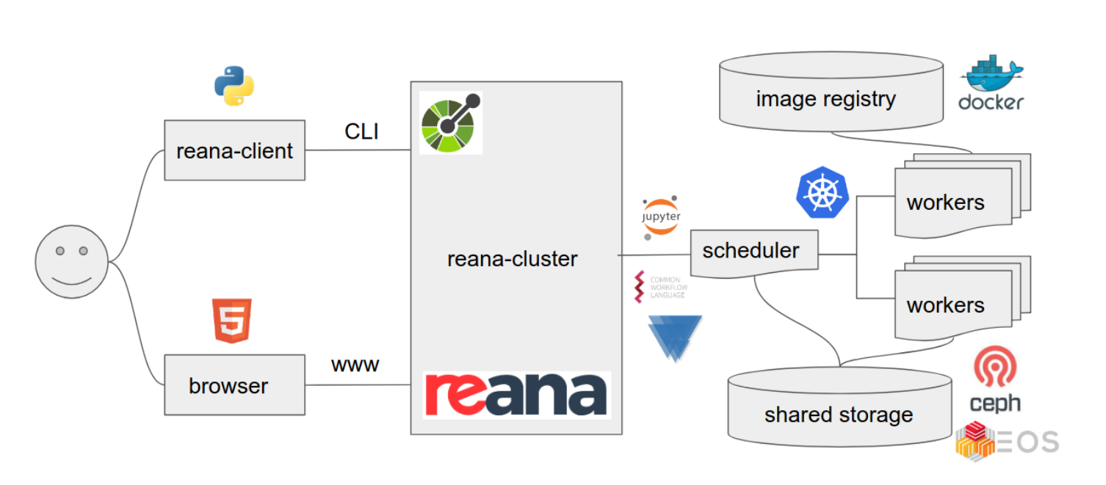
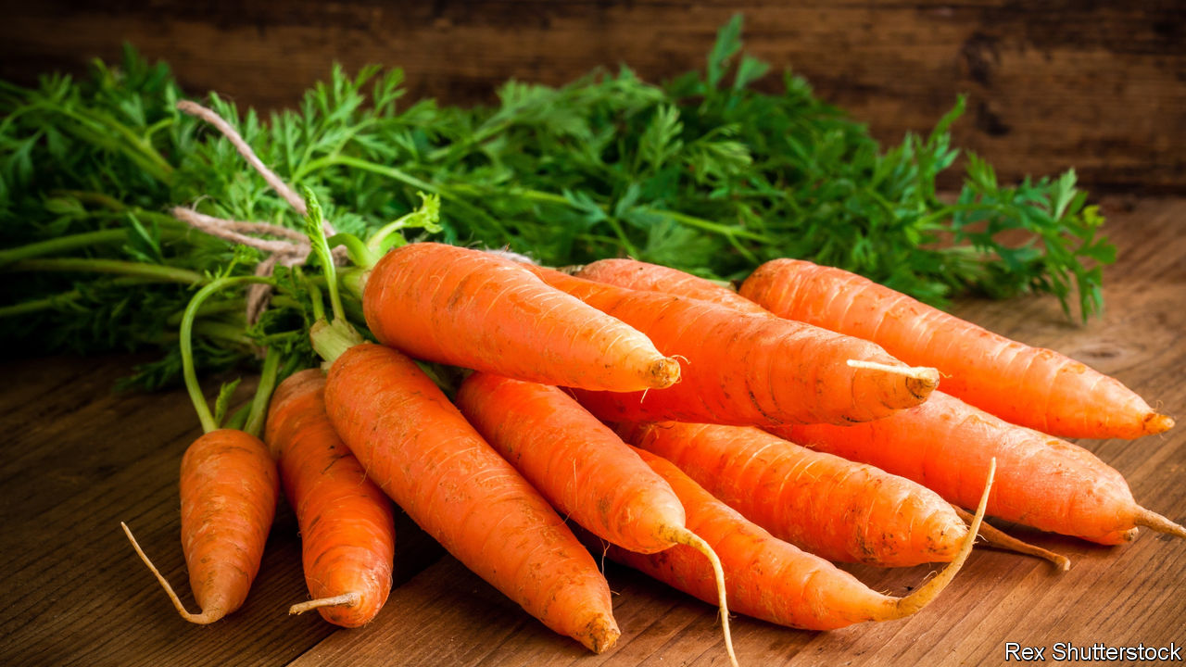
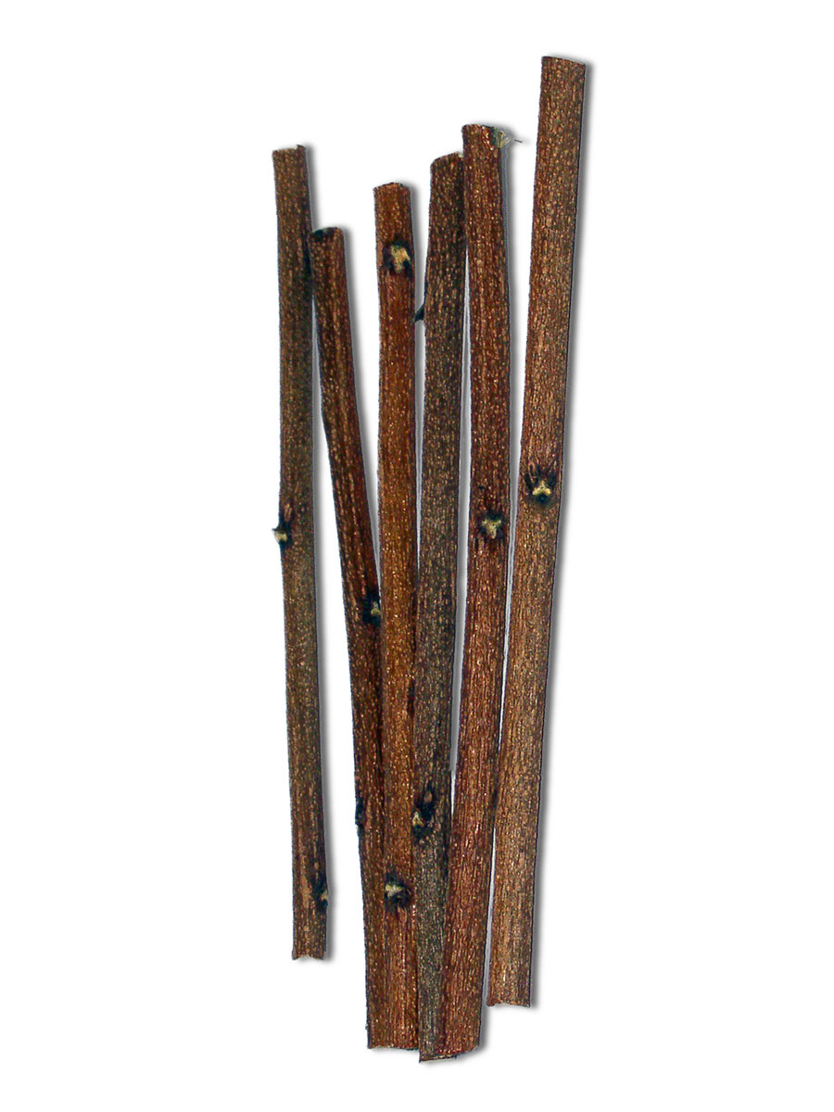
Reproducibility
HEP physicists
An analysis can be re-run on new signal models with little work
Automated system to run an analysis end-to-end
Can track down that pesky question from the competing detector 2 years later
Funding agencies are starting to demand this
Production tools exist for current analysis models
This touches every part of the analysis pipe-line!
Every tool must ask this question if you are going to add it.

Slide 10
Eco Systems
See Axel’s talk!
C++ And ROOT well understood in the community
Full range of tools customized for our use cases
20 years of solid development & debugging
New tools (like RNTuple, RDataFrame, ROOT7 Histograms etc.) are being added.
Best in class storage
Only place we’ll do reconstruction & simulation
Does need support from other labs
Don’t leave as a service – community participation is desired and welcomed!
Research and Industry are pouring their resources
ML frameworks, tools, etc.
Someone else did the GPU work
Almost everything you want to do can be found on stack overflow
Likely known by your students better than you

Slide 11
Eco Systems
C++ And ROOT not well understood by others, and have a significant learning curve
Moving innovation from industry into C++ world is difficult
Storage formats in industry
Designed to be distributed
Rivaling ROOT’s abilities
Industry is not solving the same problems we are
Industry might move onto a new eco-system
Python, by-itself is not fast for actual inner-loop processing
Much of the code is JIT’ed or C/C++

Slide 12
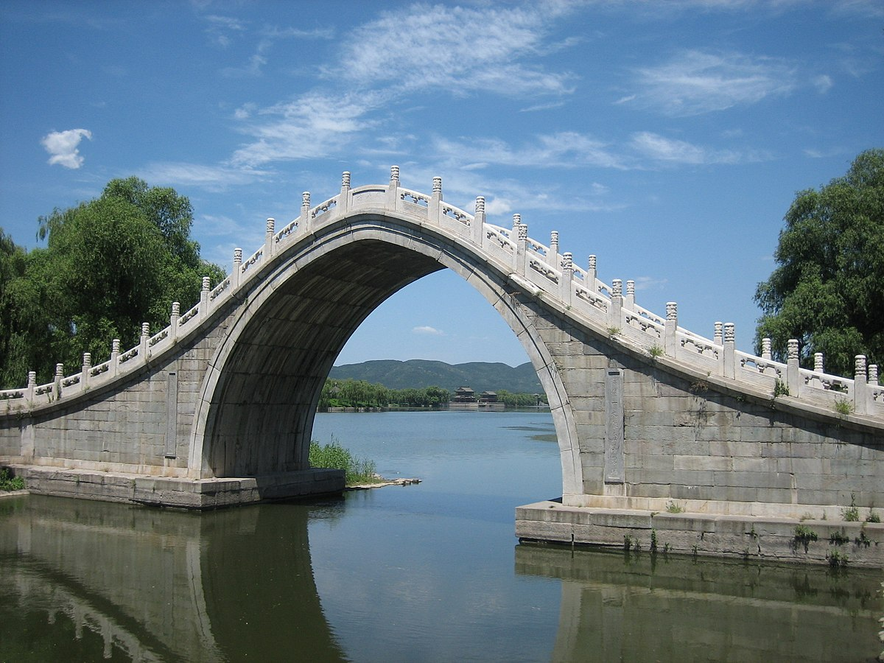
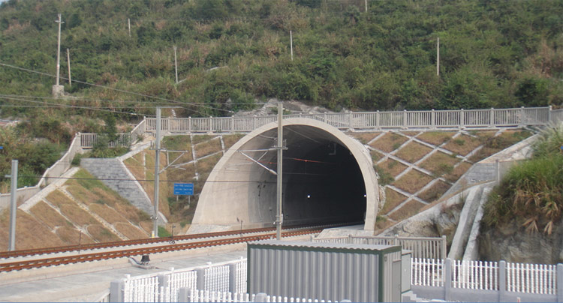
Eco Systems
Community is finding ways to connect the two eco-systems
What can we do to take the best of both worlds?
e.g. Write your ROOT files to be efficiently ready in both eco-systems

Slide 13
Declarative Analysis
As infrastructure gets more complex you get more and more infrastructure mixed with your physics: it is too hard to do physics!
Procedural Analysis:
Loop over events:
Loop over electrons
Loop over electrons
Keep track of pair with mass closest to 91 GeV
Plot mass
Tell the software how to do the job
Fine-tune control, but mixing of control and physics
Declarative Analysis:
In every event:
Find all pairs of electrons
Best pair with mass close to 91
Plot mass
Tell the software what you want to do
Less boiler plate, more physics
Downside: Computer needs to translate into high-speed analysis

Slide 14
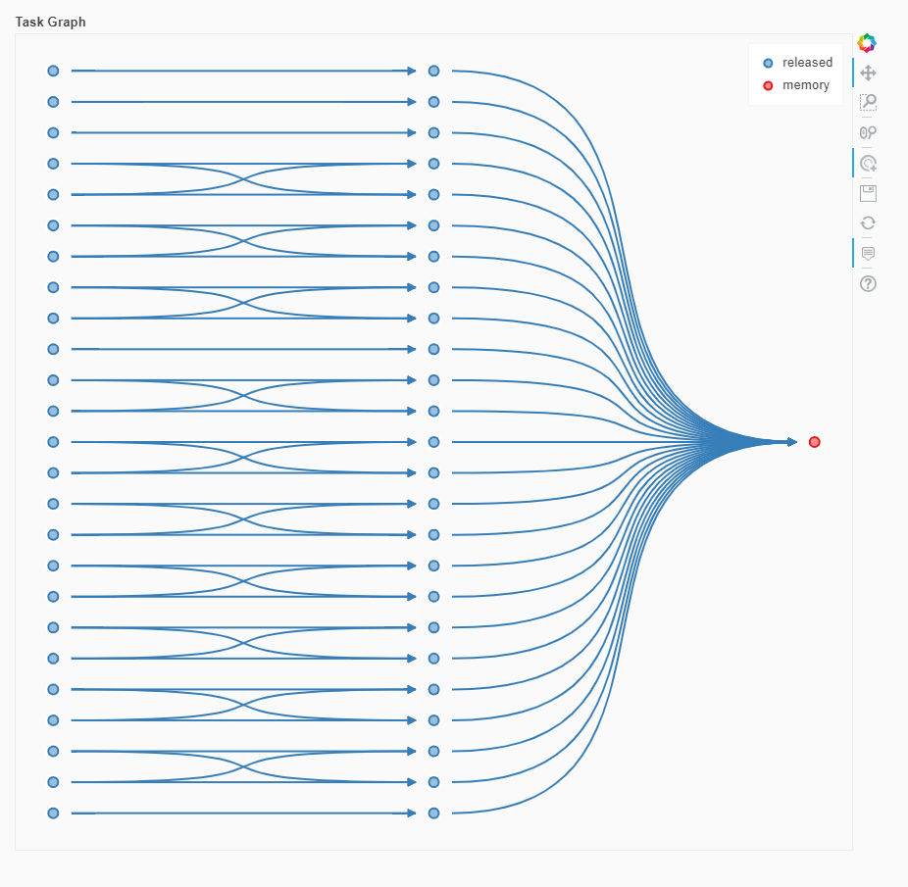
Distributed Analysis
HL-LHC datasets will be too large to spin through in a reasonable amount of time on a single PC
Filling histograms, skimming data for ML training, etc. will become a distributed activity
We have non-interactive solutions
Batch – lsf, slurm, etc
Batch – htcondor
Workflow – BigPanda
Etc.
Building a fault-tolerant distributed system is non-trivial
Industry has created a number of excellent pipe-line processing workflow tools
parsl
dask
ray
Apache tools (kalfka, etc.)
Spark, etc.
Some are well suited to running C++ code and collecting the results
Some can be used to ship data to processors
All are cluster suitable
Wrappers to make them easy for physicist use?
(e.g. coffea)

Slide 15
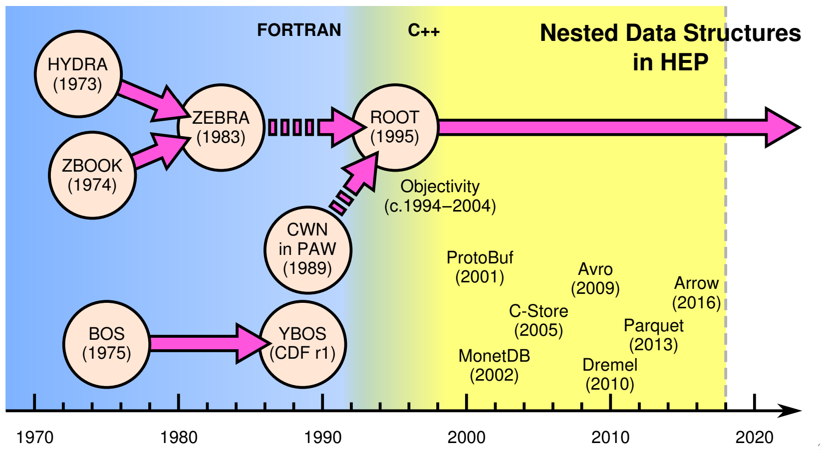
Columnar Analysis
This is not new: HEP had column wise data stores at least 10 years before industry
“missed opportunity”
J. Pivarski, CHEP 2018

Slide 16
Columnar Analysis and Event Analysis
Numpy way of doing things
The physics says process event-by-event
The computer is much more comfortable using vector operations to process many events at once
Electron1.pt + Electron2.pt
Add the $p_{T}$ of the first and second electrons for all 2 billion events
Conceptually works well until you have to ask “how many electrons in an event”

Slide 17
Co-Processors
This is super-hard

Slide 18
Co-Processors
Unless some one else has done the work for you…
Where will they benefit Analysis?
Mostly in AI/ML
Other low-level tools are building it in (like awkward array)

Slide 19
Co-Processors
Where will they benefit Analysis?
Mostly in AI/ML
These are tools! I used TF to write an alignment program for the MATHUSLA test stand

Slide 20
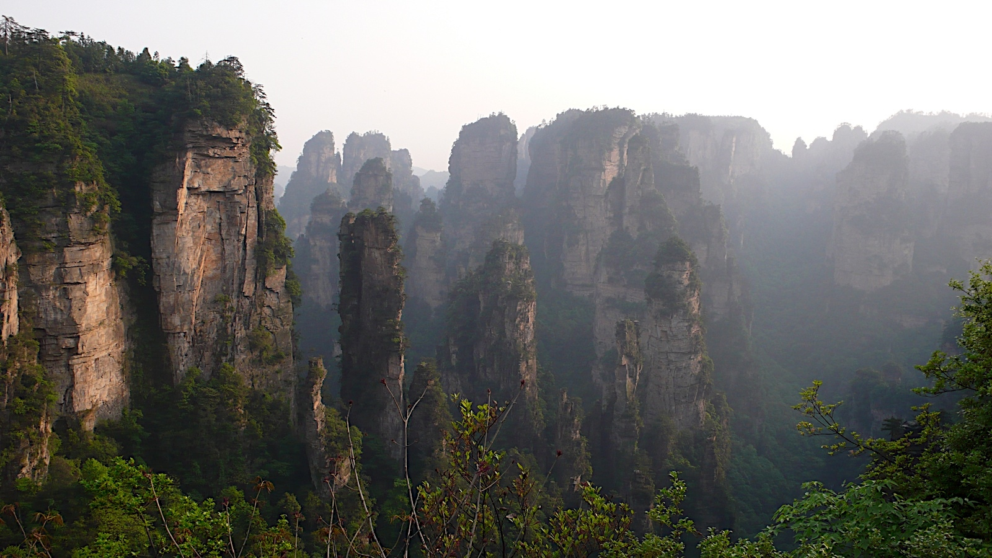
Looking Further Out Over The Edge
Analysis is where innovation likely happens first

Slide 21
Analysis Facilities
Large datasets mean you can no longer run analysis anywhere!
Skim data
Apply corrections
Build histograms
Fit complex statistical models
Train and apply discriminators
Develop core software
Submit “GRID” jobs
Visualize large amounts of data
Access to data
Fitting Service
Cores for Data Processing
Facility
ML Training Service
Jupyter Notebooks
See the recent blueprint meeting

Slide 22
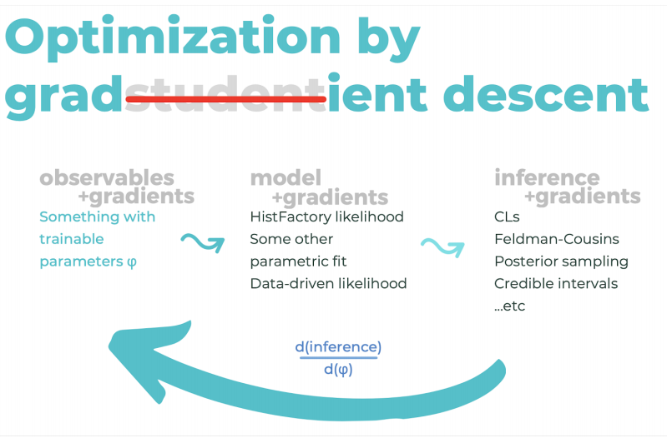
Differentiable Programming
Bring the techniques from ML all the way into the analysis!
K. Cranmer
Need two jets above a set of $p_{T}$ cuts? How to choose those $p_{T}$ cuts?
Use gradient descent to optimize the cuts
Use final likelihood fit to drive the optimization
Requires auto-differentiation across systems!

Slide 23
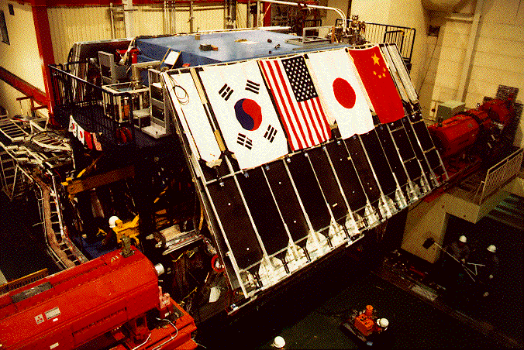
Cautions?
Don’t try to make the analysis framework the same as the reconstruction’s
Do not let 1000 analysis frameworks bloom either…
Many people have good ideas
Getting people to work together to combine frameworks makes things stronger!
Design process so no one is “losing”.

Slide 24
Conclusions
CEPC is a different machine
The pressures on it are very different than on currently running ones
Analysis is one of the fastest moving parts of the HEP eco-system
What I now call speculative will either be mainstream by the time the CEPC is running or will be consigned to the dustbin of history
There is a very active community discussing this
The HEP Software Foundation
In the USA, IRIS-HEP
ROOT workshops
And many more I’m neglecting here
A lot of people work on this: many solutions are cross-experiment!

