Slide 1
Introduction to the TDAQ sessions
David Newbold(UKRI), Chris BEE(Stony Brook/BNL),
Zhen-An LIU(IHEP)*
TDAQ Session CEPC Workshop 2020
SJTU/Shanghai, Oct. 28 2020

Slide 2
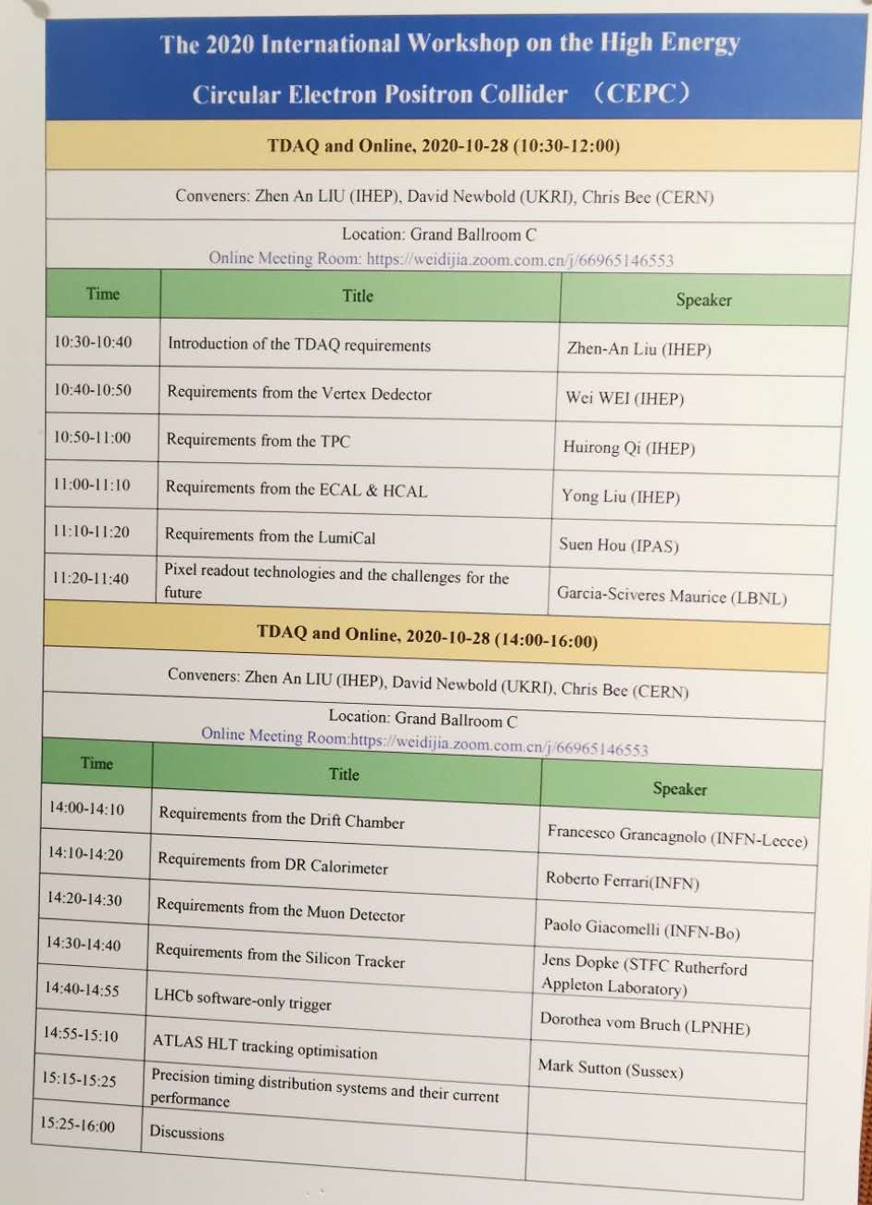
Many Thanks to the contributors
The Conveners are grateful to the presenters
Time difference are taken into account to avoid inconvenience to the presenters, we apologize if still not
Detailed discussion will be in the second session

Slide 3
Purpose: New iteration of understanding of the sub-detectors
8 Talks from all detectors
Data Volume and channel count under different machine running modes
Higgs
W
Z
New assumptions about readout bandwidths and readout implementation and power consumption
Any zero suppression or compression they might carry out at the front end
No
YES, then how

Slide 4
Clearer requirements to TDAQ
8 Talks from all detectors
Needs for control and timing signals in FEE
Clocks, Synch,BC0,L1A,SC,…
Any views/preferences on readout style(triggered or trigger-less readout)
Trigger sequential readout
Continuous sequential readout
Non-sequential readout

Slide 5
Morning/Afternoon for Time Zone
Morning
Requirement from the LumiCal, Suen Hou (IPAS)
Requirement from the Vertex Detector, Wei Wei (IHEP)
Requirement from the TPC, Huirong Qi (IHEP)
Requirement from both ECAL & HCAL, Yong LIU (IHEP)
Afternoon
Requirement to from Drift chamber, Franco Grancagnolo (INFN-Lecce)
Requirement from DR Calorimeter, Roberto Ferrari (INFN)
Requirement from Muon detector, Paolo Giacomelli (INFN-Bo)
Requirement from Silicon Tracker, Jens Dopke (STFC RAL)

Slide 6
Special Technology on readout
Pixel readout technologies and the challenges for the future
By Maurice Garcia-Sciveres (LBNL)

Slide 7
Special Technology on Hardware Trigger-less System
LHCb Software-Only Trigger
By Dorothea vom Bruch(LPNHE)

Slide 8
Special Technology on Software trigger
ATLAS HLT tracking optimization
By Mark Sutton(Sussex)

Slide 9
Special Technology on TCDS
Precision timing distribution systems and their current performance
By Eduardo Brandao De Souza Mendes(CERN)

Slide 10
Discussions on DCDS/TDAQ
Accelerator interface with DCTD
Machine Clock/Synchronization Signals
BC0, revolution,…
TDAQ status feedback
Readout Structure
IHEP Experience and Application in Belle II and CMS
Which one prefer?
Micro-TCA(MTCA) or
Customized ATCA or
xTCA (ATCA-PICMG3.8/MTCA.4) or
Other standard?

Slide 11
Discussions on DCDS/TDAQ(cont.)
Online networking and computing
Hardware/Firmware Technologies
Common hardware(backend readout)
FPGA/GPU/… based processor
Common Firmware
Software DEV platform
Prototypes development
Welcome for R&D
How to collaborate
Demo System development
Components
Key modules R&D
Task sharing
Other more issues？

Slide 12
Next step
After we can gather the updated requirements from all sub-detectors, we will review them for consistency, and to inform what future work is needed on TDAQ.

