Slide 1
Design status of CEPC mechanics
Haijing Wang
The 2020 Workshop of CEPC, Shanghai
Oct. 26-28, 2020

Slide 2
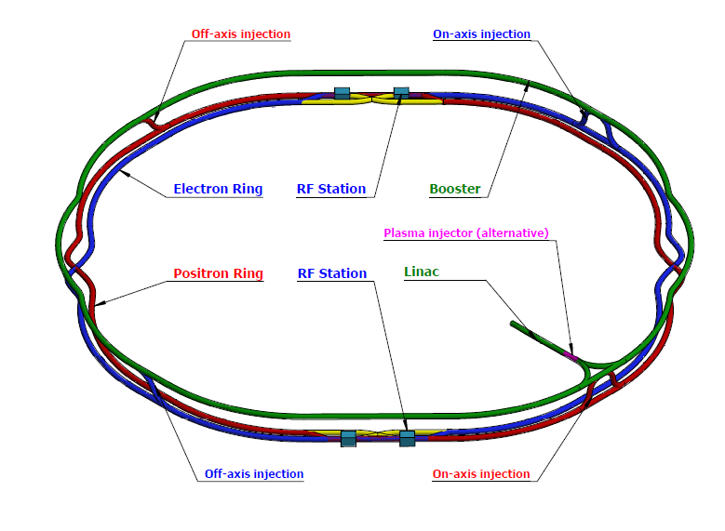
Outline
Overview
Design status for the accelerator
  Magnet supports
  Transportation and installation
Design status for the IR
  MDI layout
  Integration and alignment scheme
  Remote vacuum connector
  SC magnet supports
Movable Collimators
  Structure design and FEA
  Considerations for severe thermal loads
Lists to be done

Slide 3
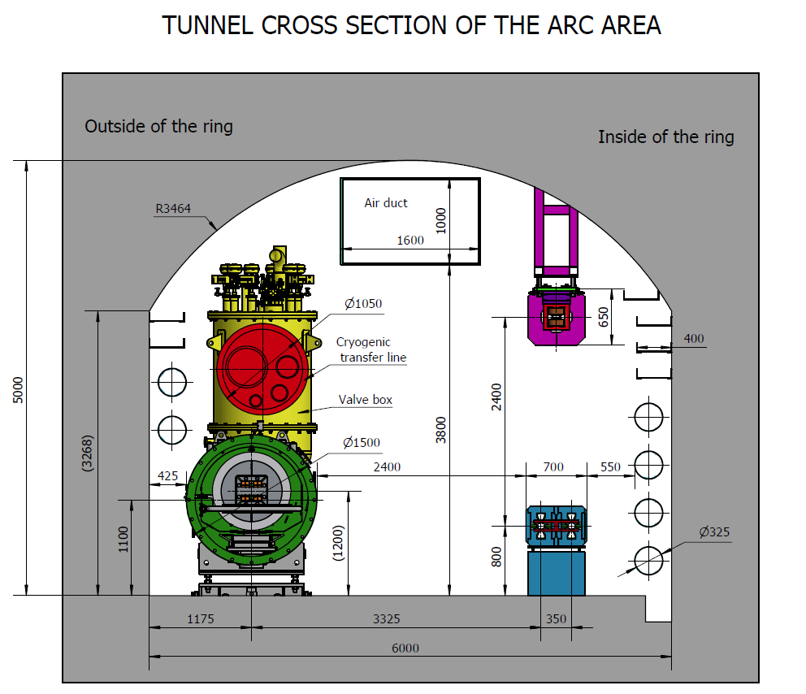
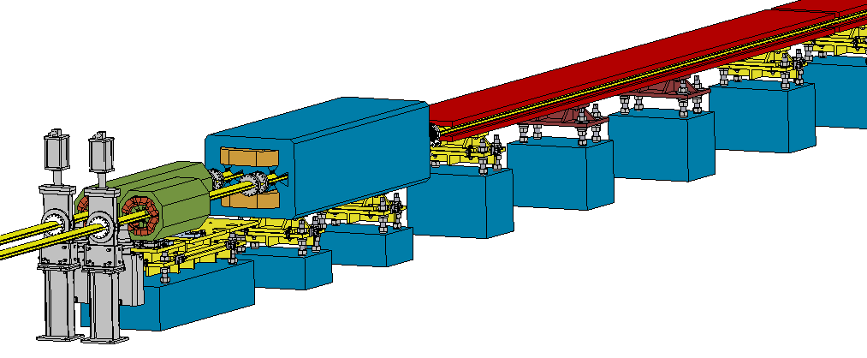
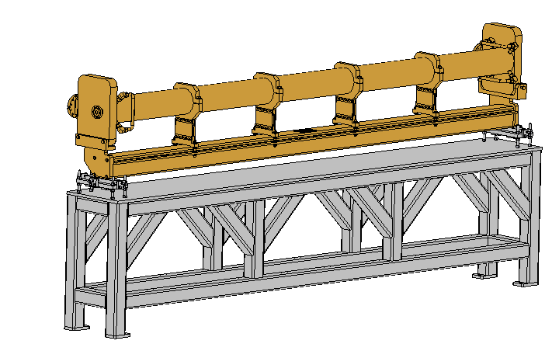
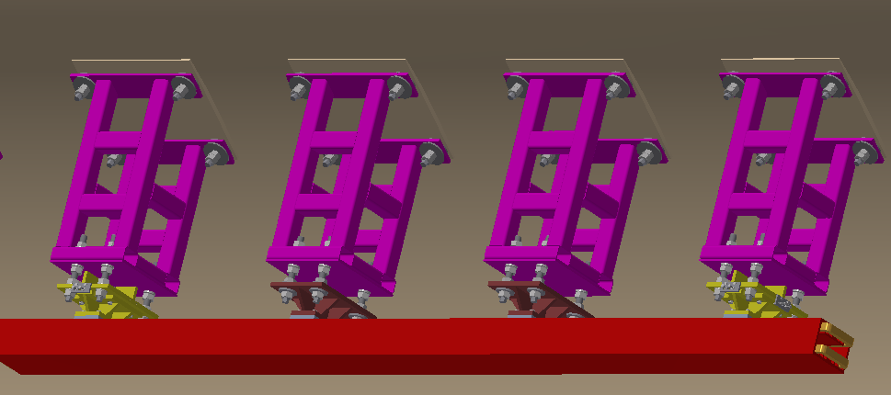
Magnet supports
Over 80% of the length is covered by magnets of about 138 types.
Adjustment Ranges of magnets
X | ≥±20 mm | Δθx | ≥±10 mrad
Y | ≥±30 mm | Δθy | ≥±10 mrad
Z | ≥±20 mm | Δθz | ≥±10 mrad
Booster
Collider

Slide 4
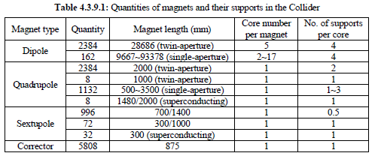
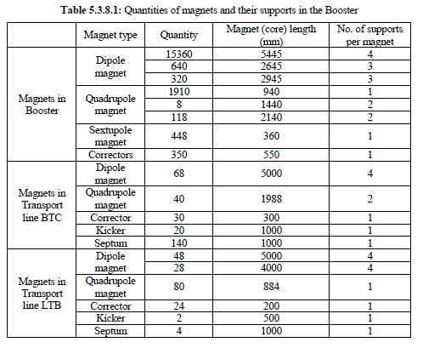
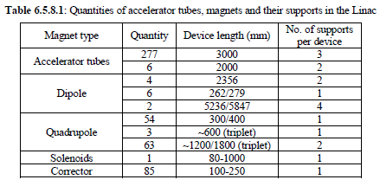
Magnet supports
Plenty of supports to be designed.
We has began the cooperation on design with members of CIPC

Slide 5
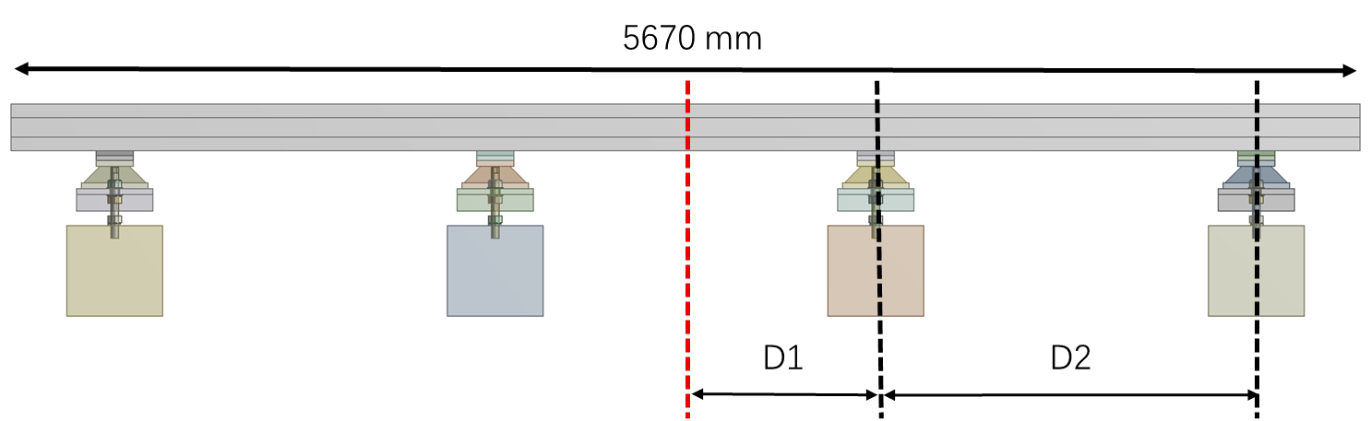
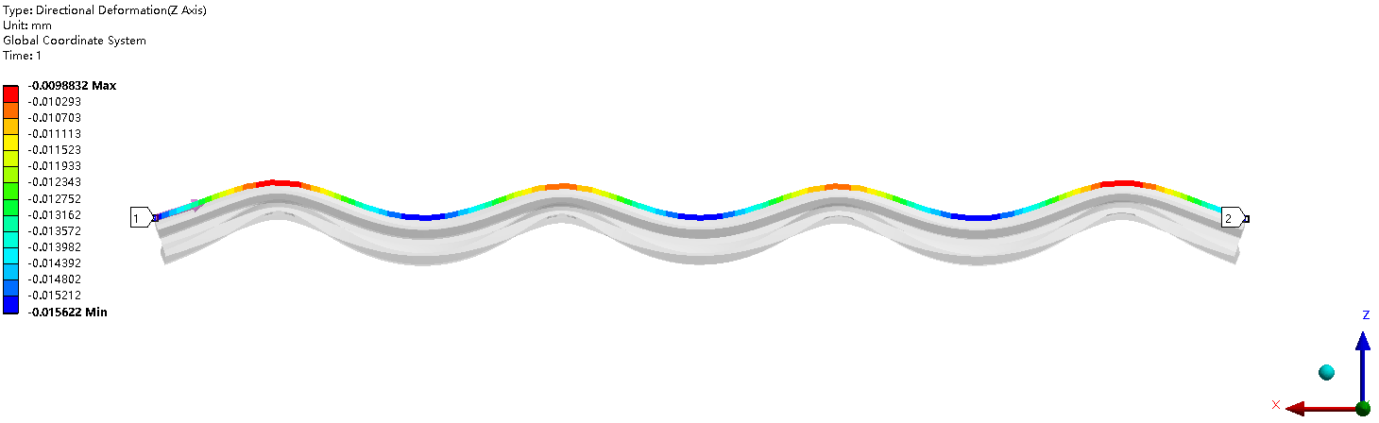
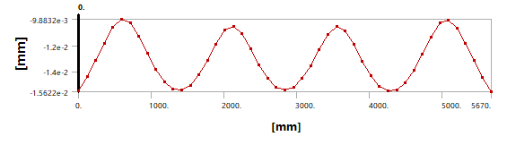
Magnet supports
Optimization for dipole supports
No. of supports | Max. deformation (um)
3 | 19
4 | 7
5 | 5
Other magnet girders will be renewed too.
  Simple & flexible structure.
  Small deformation & good stability
  Low cost
Magnet group people will check if the deformation is workable.
  * Cooperate with Keye co., Ltd

Slide 6
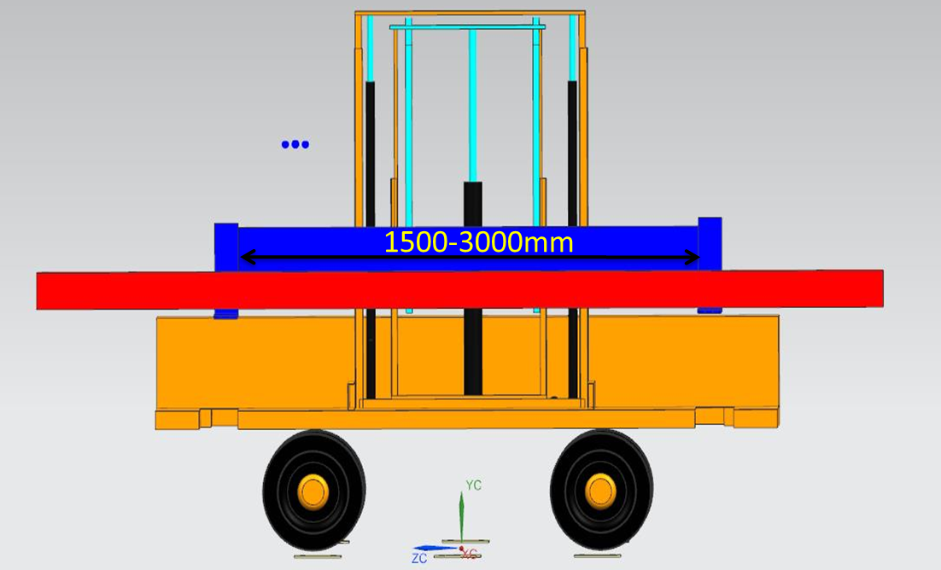
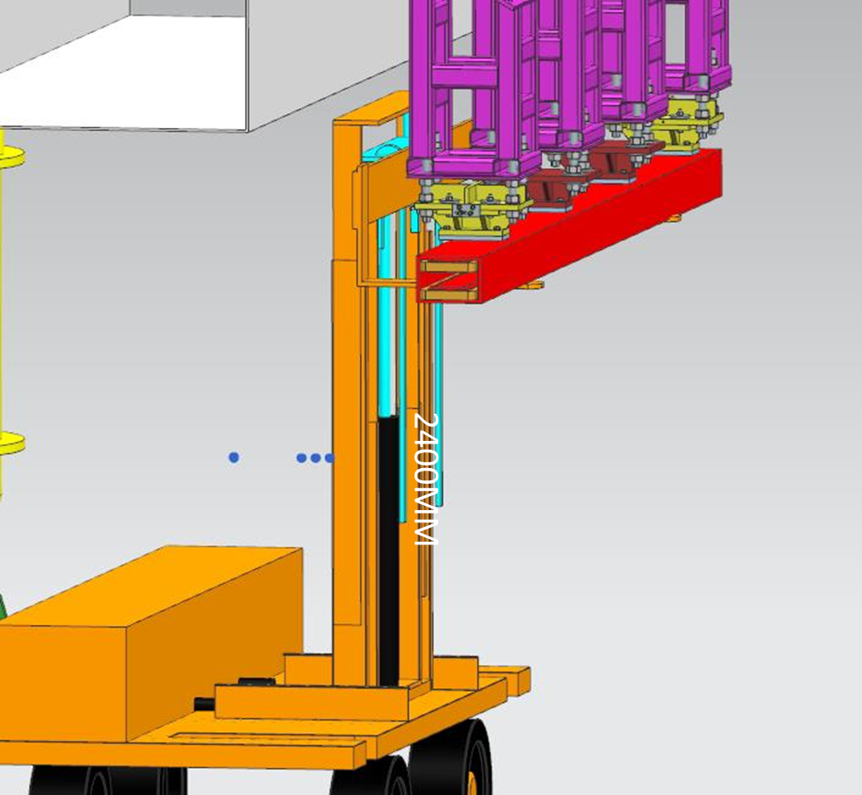
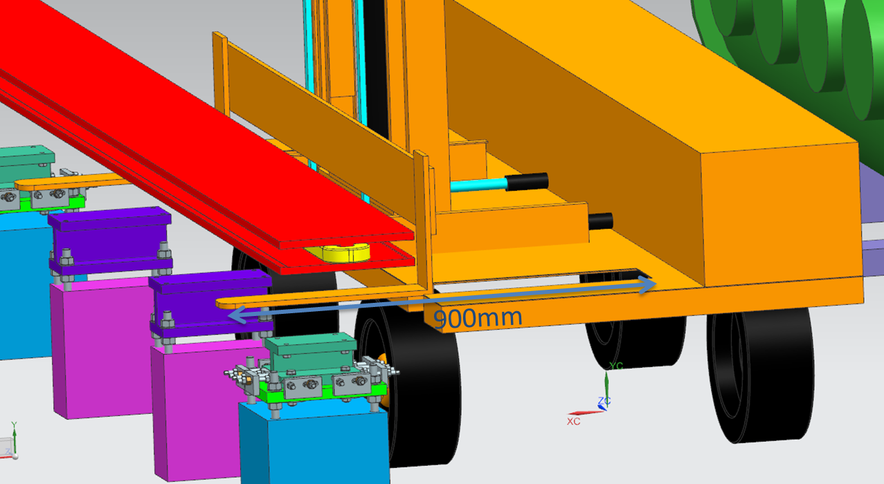
Transportation and installation
Flexible load support for “long” devices and “short” devices
Transportation and coarse location of magnets in Booster
Transportation and coarse location of magnets in Collider
  * Cooperate with Beijing North Vehicle Group Corporation.

Slide 7
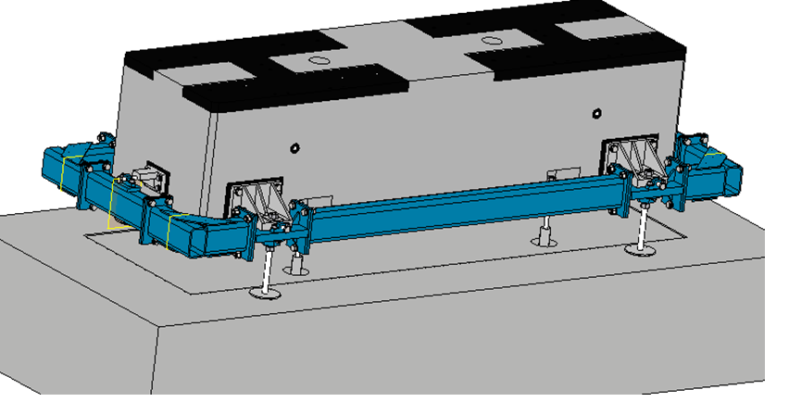
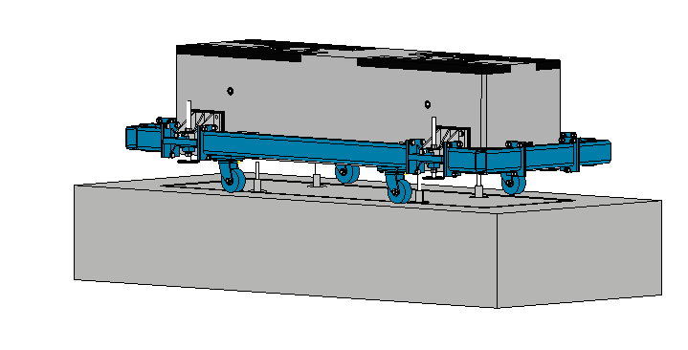
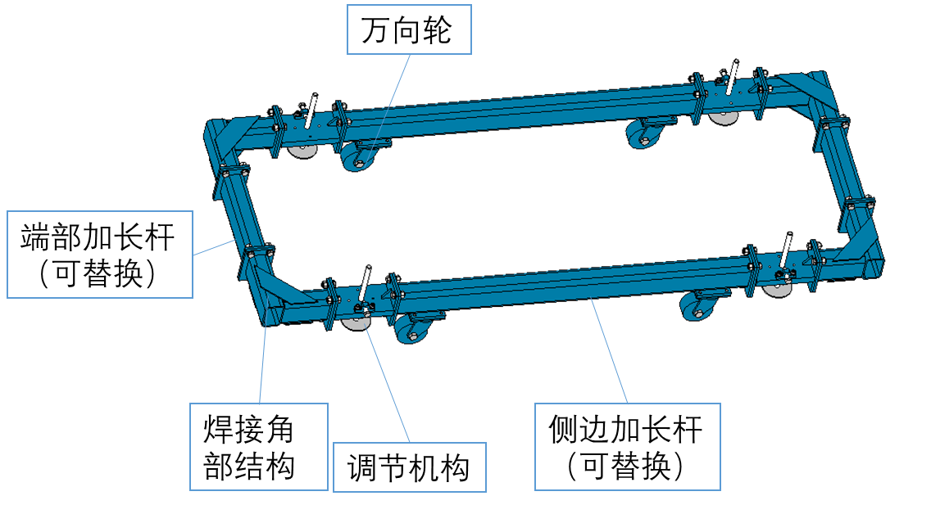
Transportation and installation
Plinth installation and grouting
  Pre-machined plinth.
  Specialized tooling to improve efficiency.

Slide 8
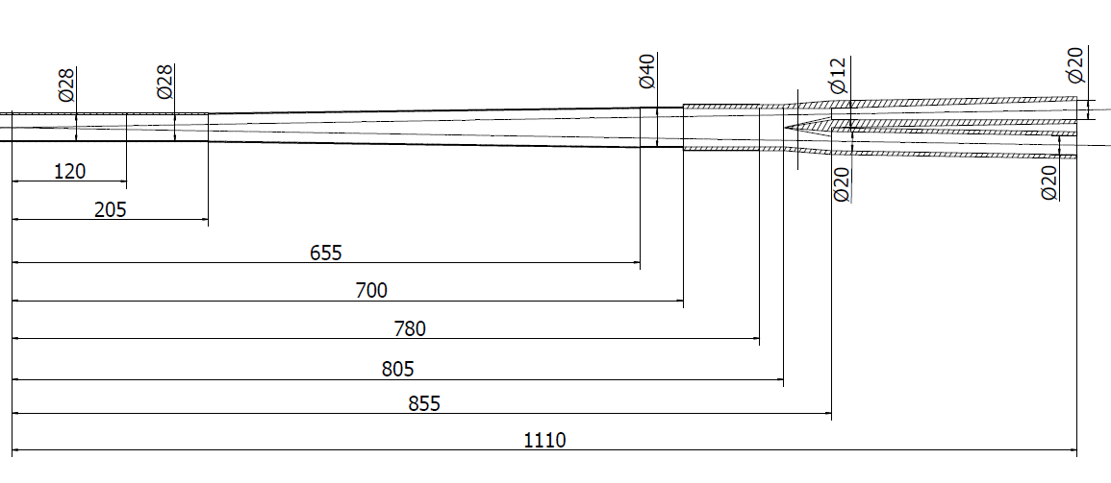
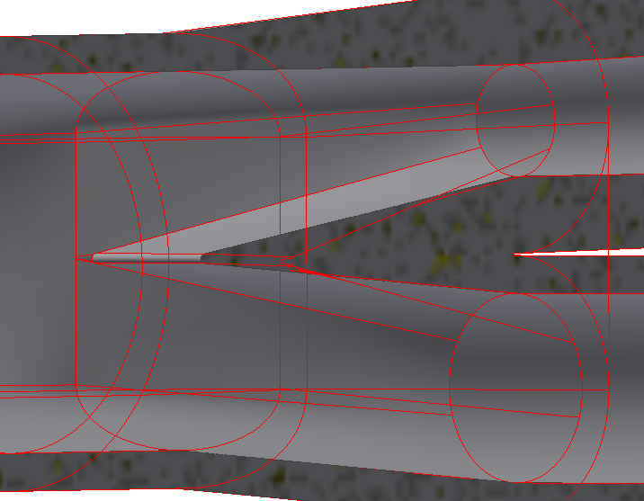
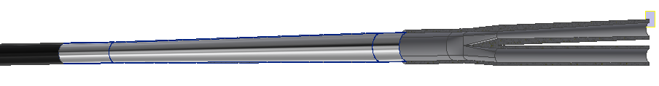
MDI layout
Vacuum layout
  Inner diameter at IP: 28 mm
Semi-symmetry layout to avoid SR
Vacuum connection
Y-shape
chamber
Cryostat chamber
IP chamber
Paraffin cooled
Water cooled
No forced cooling
Water cooled
Be
Al
RF bellows
Cu
IP
IP BPM
Lumical

Slide 9
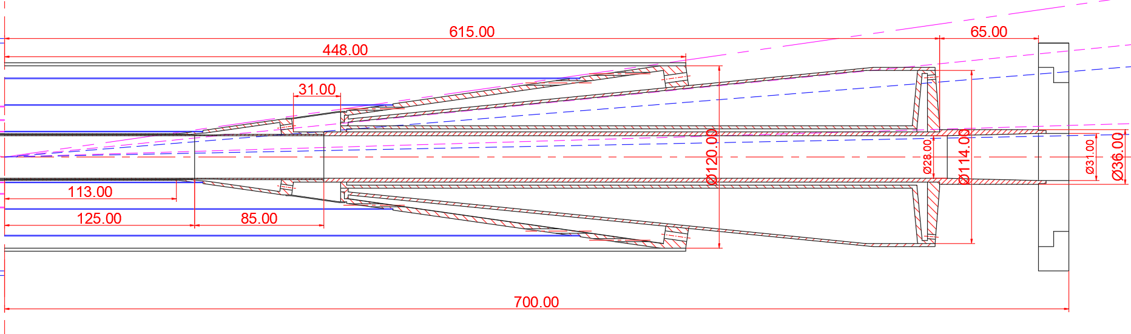
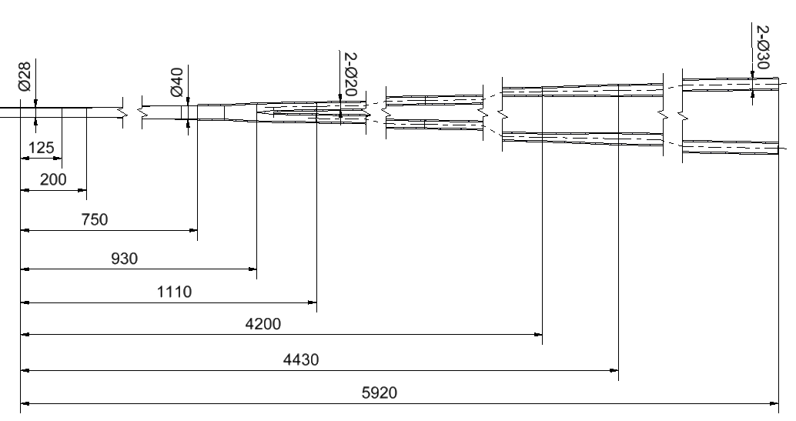
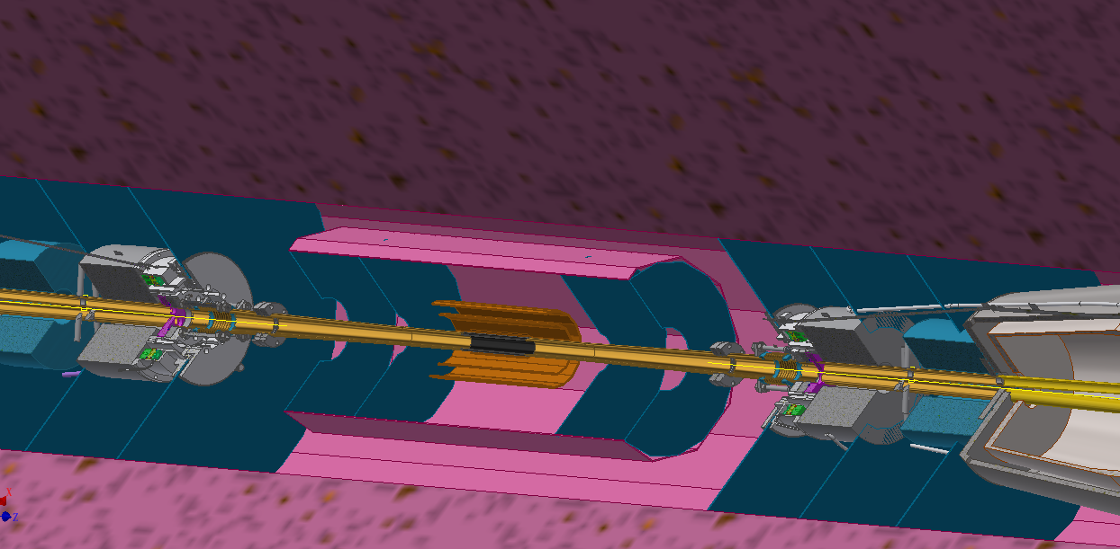
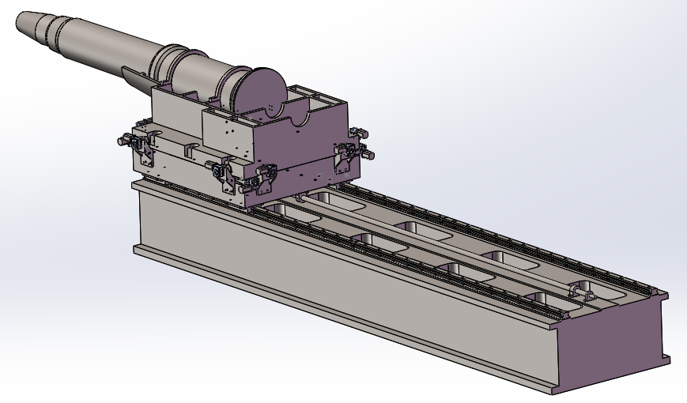
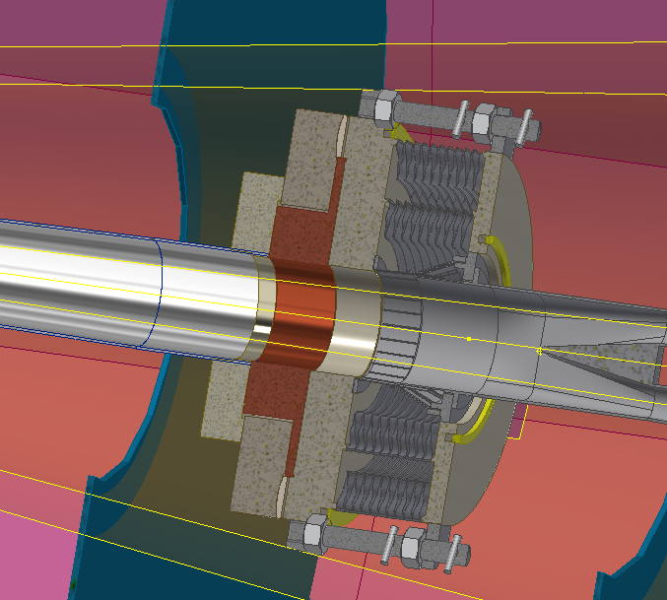
MDI layout
IP chamber by Q. Ji
First vacuum pump @±6.5m
Connection interface of detector and accelerator
SC magnets, cryostat and their support

Slide 10
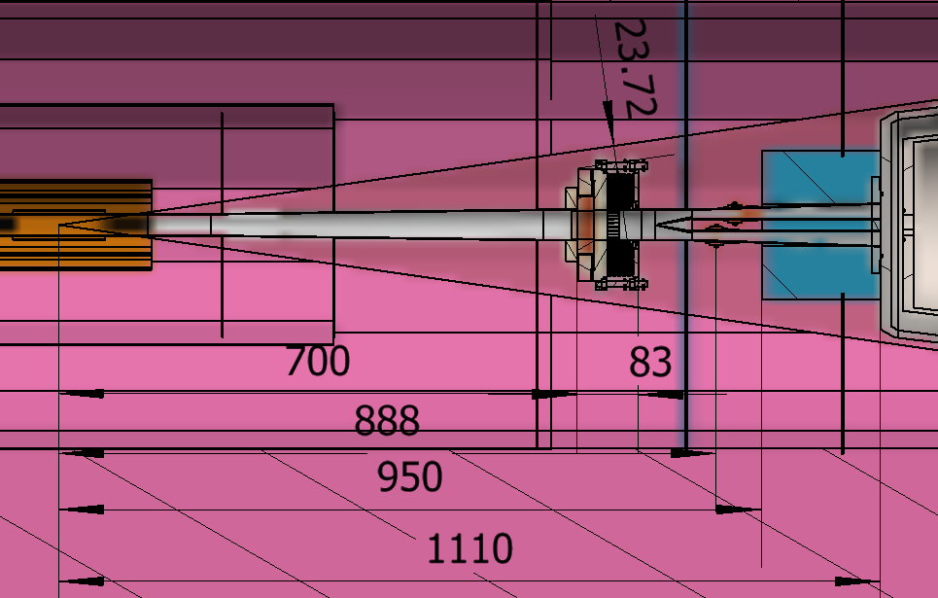
MDI Layout
Difficulties:
    Avoid SR
    Limited longitudinal space: IP chamber, vacuum connector, Y-shape chamber, BPM, Lumical…
    Limited transversal space: all the structure should be within detection angle.
Lumical
BPM
Remote vacuum connector
10

Slide 11
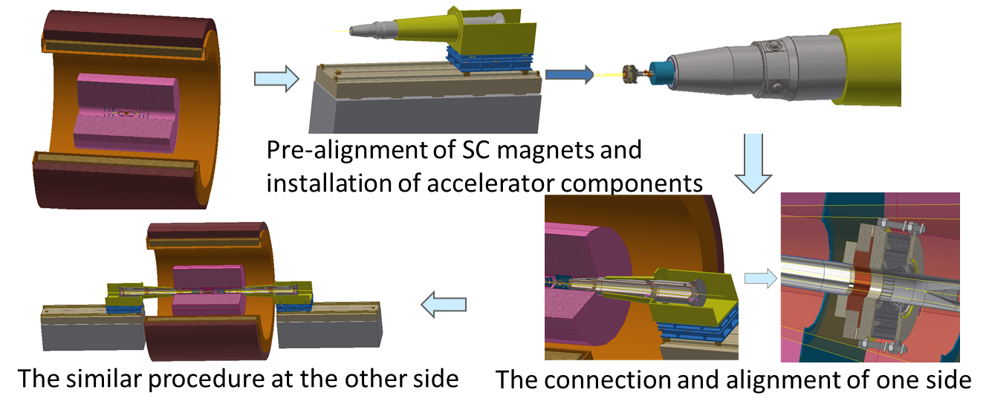
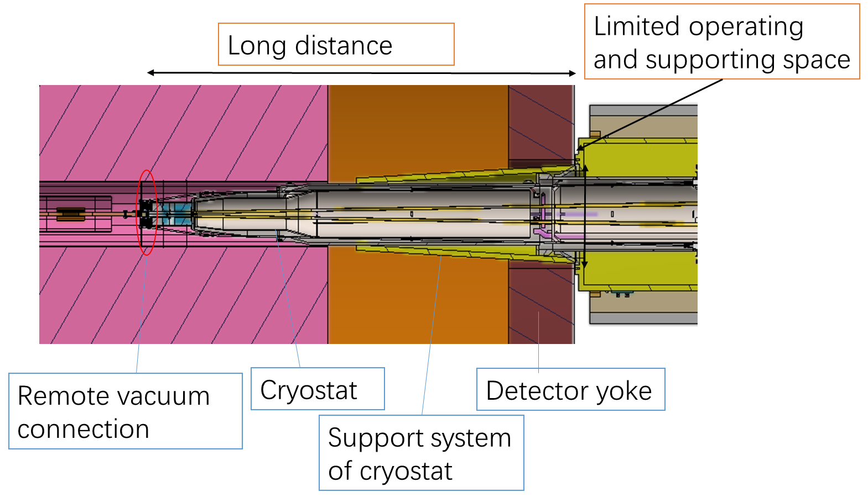
Integration and alignment scheme
 | Distance from yoke boundary to connection location (m)
BEPCII | ~2.3 (has manual operation space)
SuperKEKB | ~3.5 (the longer side)
FCC-ee | ~4.37
CEPC | ~3.8-6.1 *

Slide 12
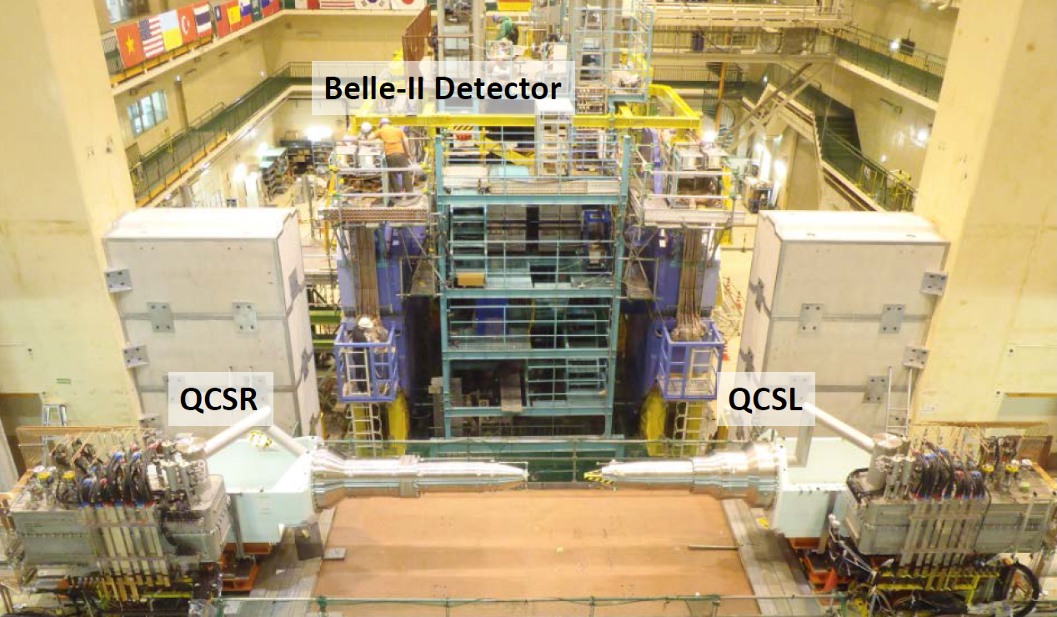
Integration and alignment scheme
Accelerator foundation is fixed. It is good at:
  Beam stability.
  Integration of detector before push-in.
Detector foundation is fixed. It is good at:
  Detector stability
Maybe we can find balanced approach (very long distance with only beam pipes near MDI)
Before and after BESIII push-in
Before Beast(II) push-in
Detector push-pull arrangement of ILC

Slide 13
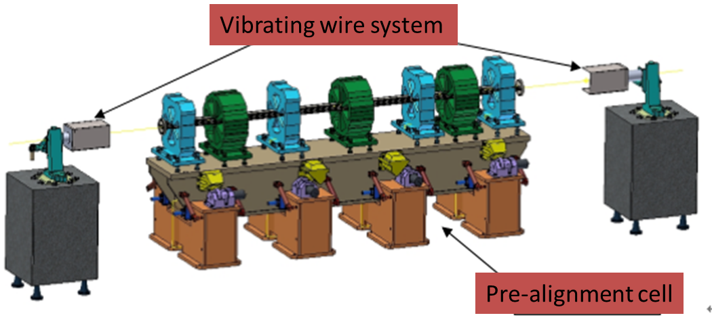
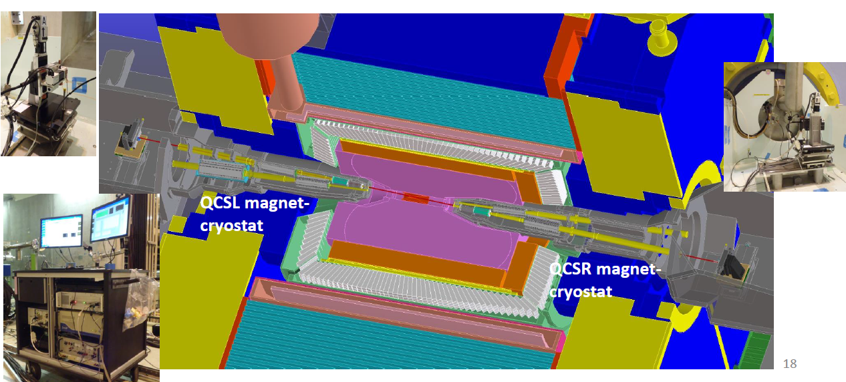
Integration and alignment scheme
Alignment scheme
Alignment scenario:
  Pre-align the SC magnets using vibrating wire system to “certain location” to compensate the effect of loads.
  Align the SC magnets in two cryostats using optical system.
  Measure misalignment using SSW and adjust by corrector magnets meet the alignment requirements.
  Details are under study.
From X. Wang
VWS is a candidate pre-alignment method, accuracy of magnet centers: ≤10 μm
SSW measurement of SuperKEKB
Max. center misalignment is 0.69 mm
“Every alignment errors are able to corrected by the corrector magnets.
N. Ohuchi, IPAC2018

Slide 14
Remote vacuum connector
Difficulties:
    Longitudinal space: Bellows should absorb deformation when baking. →Add Z-direction support, length has been decreased to 83mm.
    Minimize thermal loads: The thermal loads mainly includes SR power and HOM power.→ Avoid SR power by layout design, and decrease HOM power by RF finger.
    Cooling: It is hard to dissipate the heat at RF finger which is thin, low thermal conductivity and far from the coolant.→ FEA
    Transversal space: All the structure should be within detection angle.
    Leak rate requirement: Ultra-high vacuum. Leak rate requirement: ≤2.7e-11Pa.m3/s
Totally 4 mechanisms have been designed, one is focused on now.

Slide 15
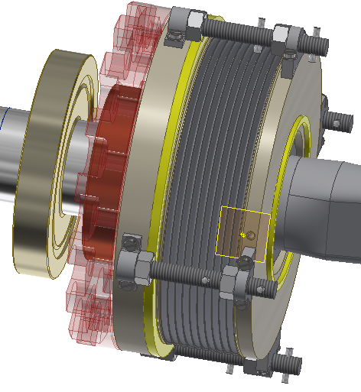
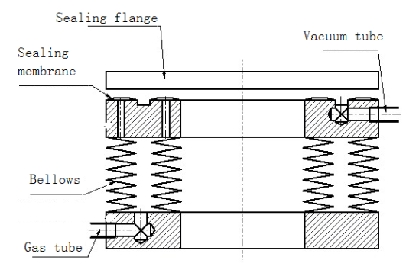
Remote vacuum connector
Improved inflatable seal
Low vacuum
RF finger
Two layers of edge sealing
Dimensions:
Transversal: Max. ϕ174mm
Longitudinal: ~83mm
Replace the sealing membranes by two layers of edge sealing.

Slide 16
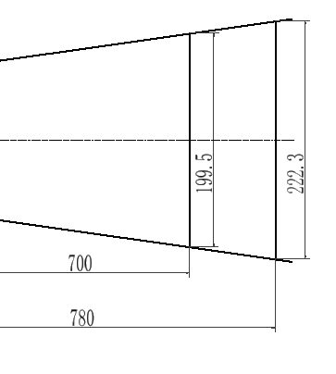
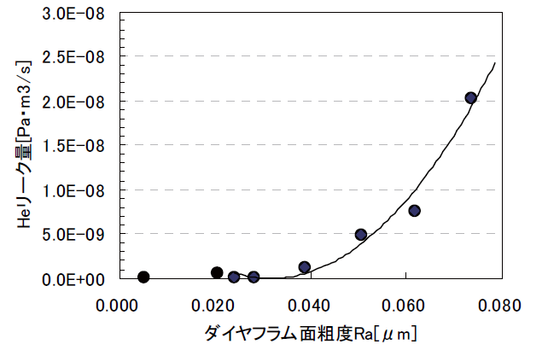
Progress of remote vacuum connector
Sealing methods | Within detection angle | Leak rate estimation | Remarks
RVC | NO |  | Successful used in S-KEKB
Remote chain | Yes |  | Eliminated
Inflatable seal* | Yes |  | Experience from CSNS
Improved inflatable seal | Yes |  | Mainly focused on
* Our experience:
    Single-layer → double layer, leak rate can be improved from 1e-6 Pa.m3/s to 8.5e-10 Pa.m3/s.（From D. Zhu）
    Replace membrane sealing by edge sealing
From J-parc

Slide 17
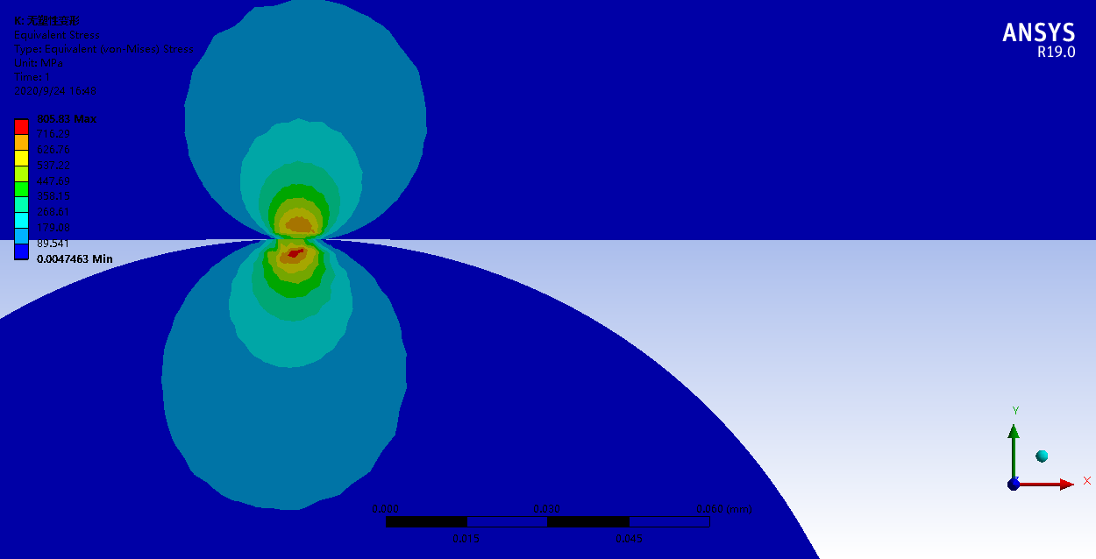
Progress of remote vacuum connector
Leak rate estimation of improved inflatable seal
  Theoretical derivation (Roth’s model)
  Flow conductance: 10⁻¹¹~10⁻¹² m³/s.
  Can fulfill the leak rate requirement when the pressure in low vacuum region is lower then 1 Pa level.
  Roughly estimation.
From X. Tang
Next step
  Consider the effect of flatness
  Match the FEA with simple tests.
  Deduce the leak rate by analogy and FEA.
  Prototype.

Slide 18
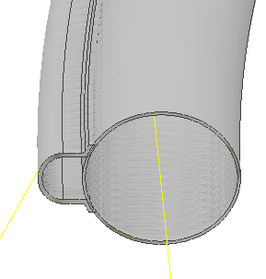
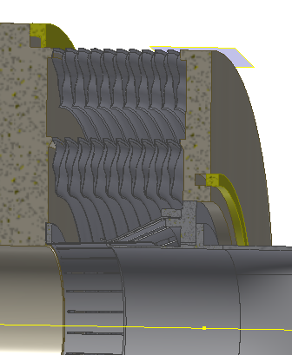
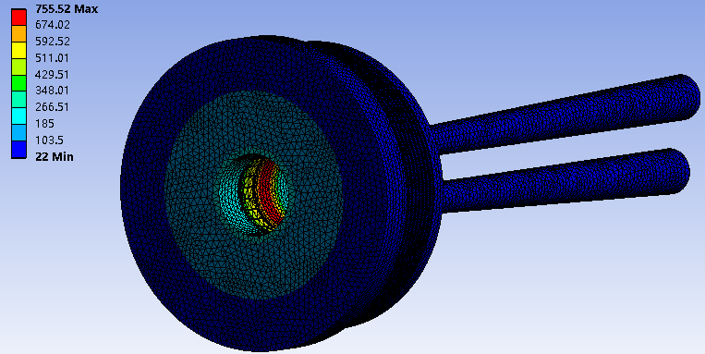
Progress of remote vacuum connector
RF finger is thin, low thermal conductivity and far from the coolant.
Maybe the materials can be replaced?
Coolant
 | CDR H | CDR Z | CDR High Luminosity Z
Power density (W/cm²) | 0.135 | 1.36 | 4.4
Highest temperature (℃) | 44.5 | 248.8 | 755
Structure | Material | Thermal conductivity W/(m·K)
Bellows | 316L | 15
Flange | 316LN
Squeezing finger | Inconel 625 | 9.8
Sliding finger | BeCu | 118

Slide 19
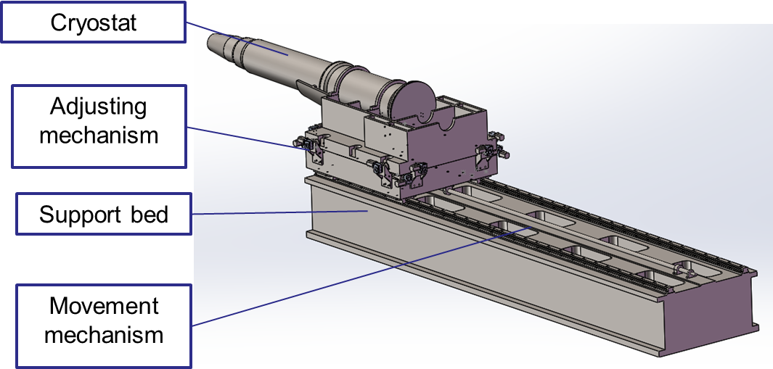
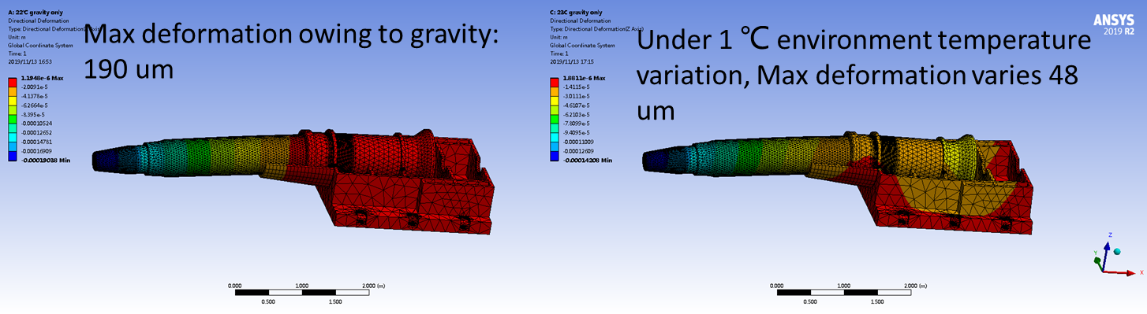
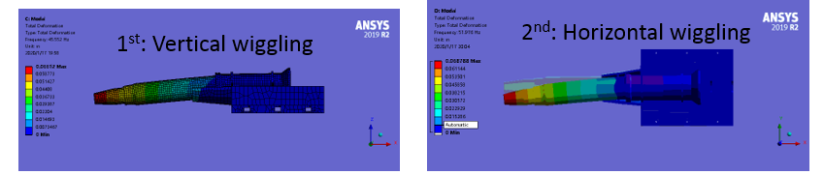
SC magnet supports
Key points
  Stability (static and modal)
  Accuracy
  Easy-operating
  Dimensions
Deformation analyses
Modal analyses

Slide 20
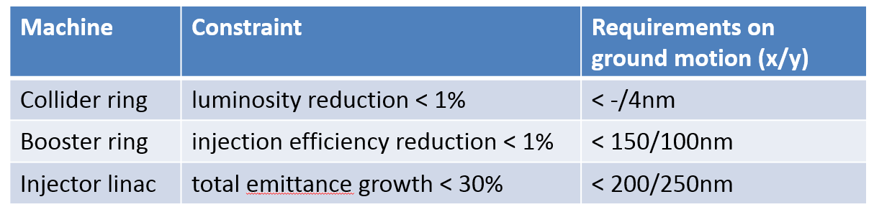
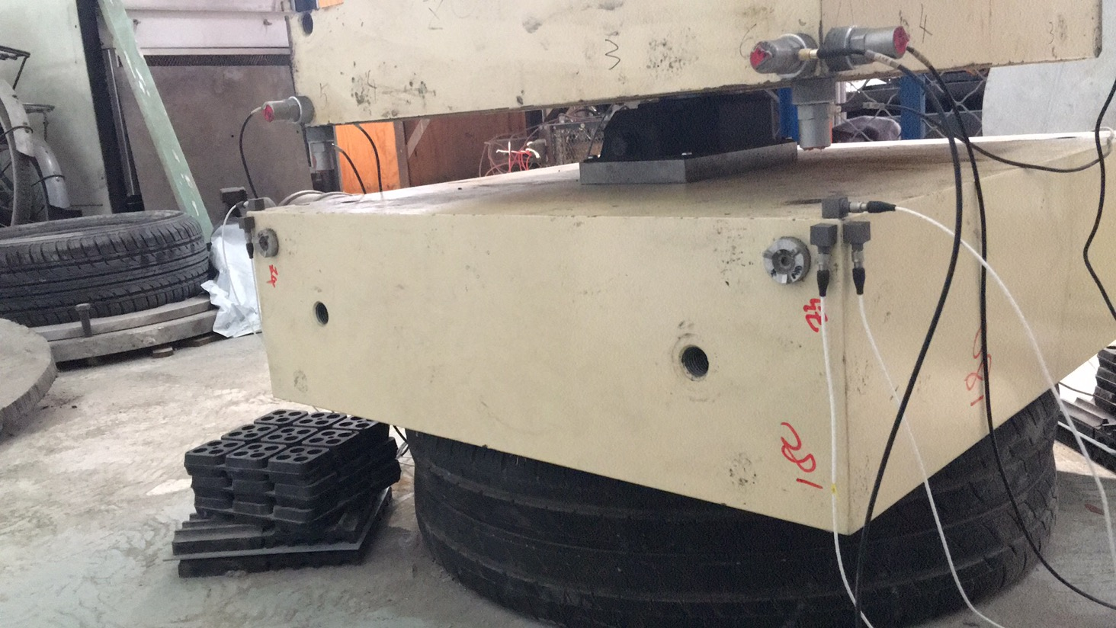
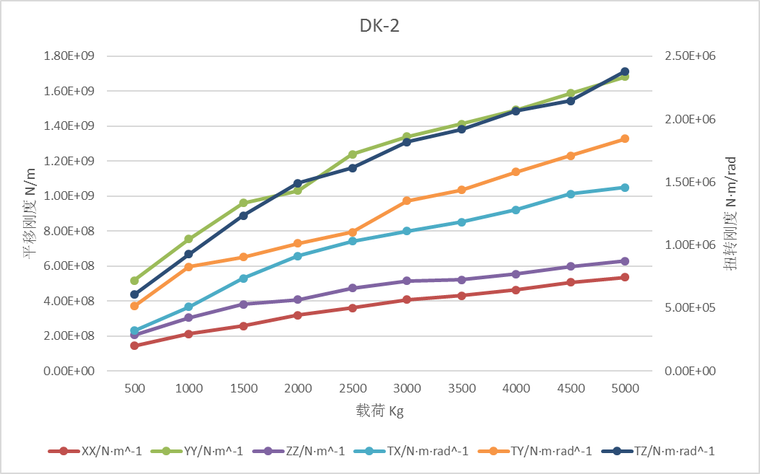
SC magnet supports
From Y. Wang
High stability
Confliction
High stiffness for stability Flexibility for high accuracy.
Studies on support stiffness is on-going.
Motor driven wedges jacks for high stiffness and accuracy.
Auxiliary support, high damping material/structure are also in consideration

Slide 21
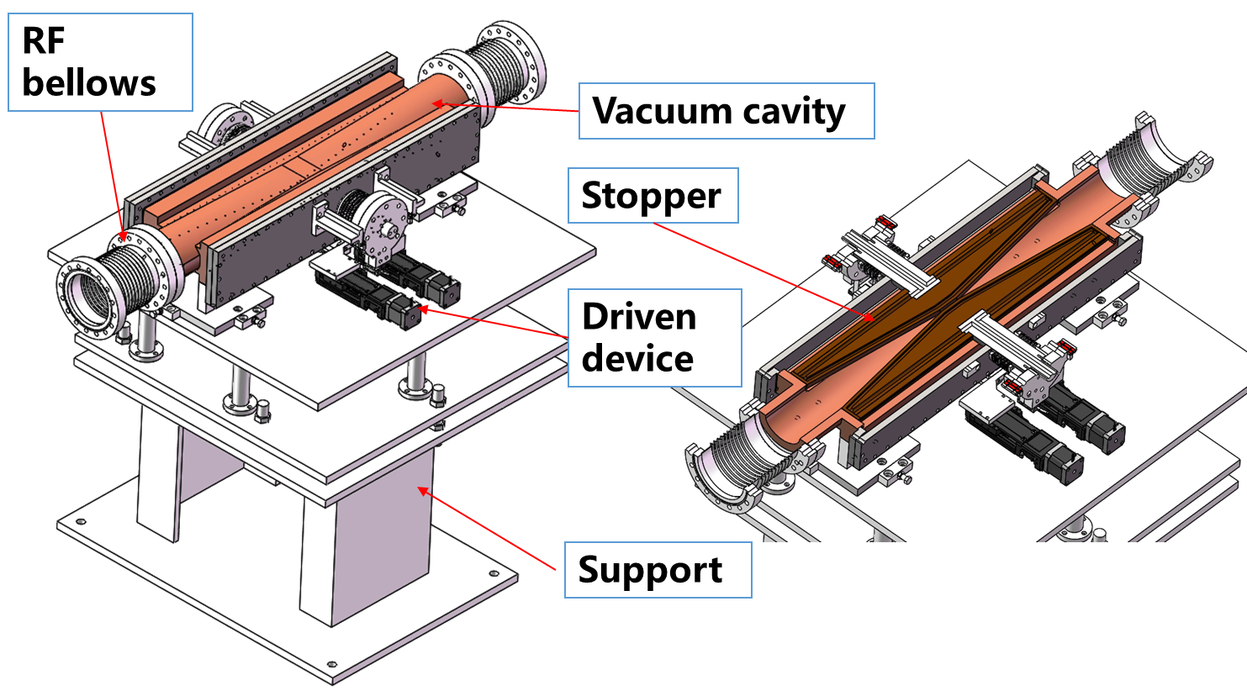
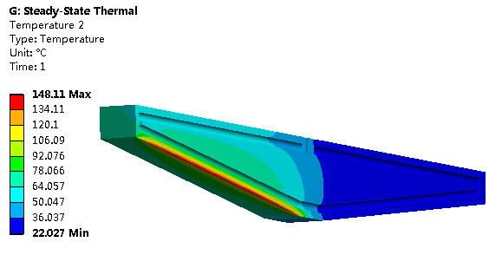
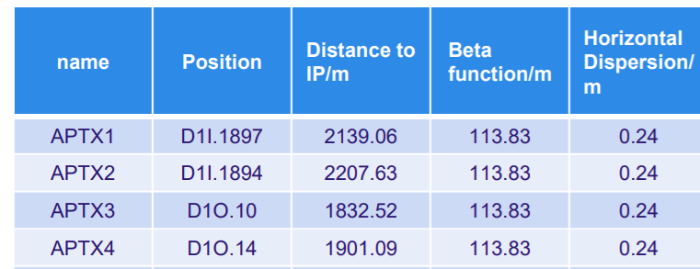
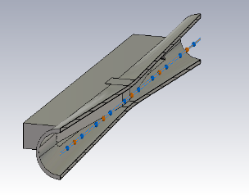
Movable collimators
Located in straight section between two dipoles, the length is 800 mm.
SR power: 7700W @120GeV, 30MW
Highest temperature: 148 ℃
From P. Zhang
Loss-Factor: 0.045V/pC
P_{loss}: 18.8w(Higgs)/76.1w(W)/265.8w(Z)
From Y. Liu

Slide 22
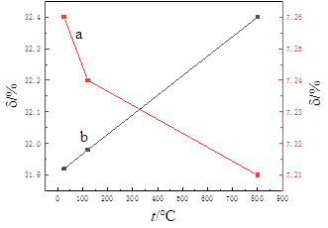





Considerations for severe thermal loads
SR power: GF (Graphene film) –Cu composite
Beam deposition: Aborting system
GF-Cu composite
GF-Cr composite
Disregistry of C-Cu &C-Cr
Y: Highest temperature;
X: Thickness of membrane of high thermal conductivity
From P. Zhang
Carsten Niebuhr, IAS MDI Workshop, Hongkong, 16.-17.01.20

Slide 23
Lists to be done
Detailed design of optimization the magnet supports.
Further estimation the leak rate of the remote vacuum connector.
Detailed design of SC supports.
More detailed integration scheme with detector.
Alignment scheme.
Detailed design of movable collimators and further consideration of severe thermal loads
…

Slide 24
Back ups

Slide 25



Remote vacuum connector
RVC Design
Spline flange
Flange
Pneumatic annular
Limit pin
Spline gear
Support
Screw thread
Spline gear
Bellows
Dimensions:
Transversal: Max. ϕ264mm
Longitudinal: ~223mm
Spline flange
Locking gear
Long tools
flange
  * Cooperate with Shenyang Huiyu vacuum technics co., Ltd.

Slide 26


Remote vacuum connector
Remote chain seal
Bevel gears
Chains
Bi-direction screw
Support
Pneumatic peanut ring
Pneumatic tube
Universal joint
Bellows
Dimensions:
Transversal: Max. ϕ177mm
Longitudinal: ~215mm

Slide 27

Remote vacuum connector
Inflatable seal
  Experience from CSNS: leak rate ~10-7 Pa.m3/s level, four levels higher then CEPC requirement.
Flange
bellows
Flange
Flange
Sealing membrane
Tubes
Guiderods and limits
Dimensions:
Transversal: Max. ϕ174mm
Longitudinal: ~67mm

