Slide 1


R&D on low mass mechanics and highly integrated cooling for future inner tracking devices
F.Bosi, M. Massa
Istituto Nazionale di Fisica Nucleare (INFN) Pisa
The 2020 International Workshop on the High Energy Circular Electron Positron Collider (Oct. 26-28, 2020)

Slide 2
Outline
ABSTRACT
Inner tracking devices at future colliders will need to be compliant with very stringent requirements on position resolution of the sensors. To obtain the needed mechanical stability and the removal of the power dissipated by the read-out electronic, the support structures and cooling add an important contribution to the total material in the active area, in terms of radiation length.
We present the status of the R&D projects for future inner tracking devices developed at INFN Pisa focusing our attention on, both, “classical” lightweight solution and advanced solutions with DRIE processes on silicon wafers. The goals of these studies are to reach high efficiencies on heat transfer minimizing the thermal resistances and growing the ratio surface/volume and to minimize the material budget in active region.
  CoolFPGA
  AIDA 2020
  Belle II VXD Upgrade
  Conclusion
The 2020 International Workshop on the High Energy Circular Electron Positron Collider (Oct. 26-28, 2020)

Slide 3

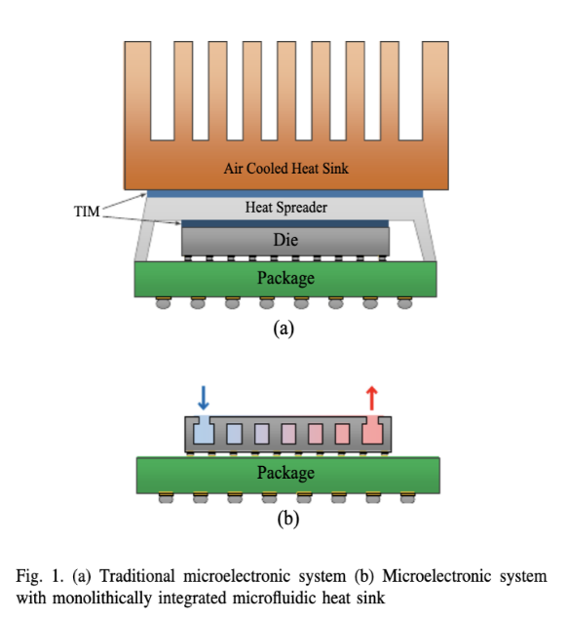
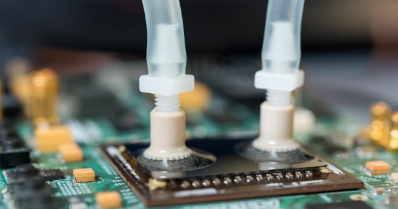
CoolFPGA - Microchannels on the surface of the die
Traditional, air based
Pros compared to traditional heat-sinks:
More efficient way to cool down the device (e.g. high surface/volume ratio, low thermal resistances between the fluid and the circuit dissipating power)
Less obstruction for traditional air-based cooling for other boards components
It overcomes limitations on device density on PCB due to the limited air-based cooling capability of crates
Microchannels on the surface of the die
Cons compared to traditional heat-sinks:
Risks due to manipulation of the bare die
Probably less suitable for large scale systems (in case we need to manipulate O(1k) devices)
Reference:
Sarvey, Zhang, Cheung, Gutala, Rahman, Dasu, Bakir (2017)
Monolithic Integration of a Micropin-Fin Heat Sink in a 28-nm FPGA.
IEEE Transactions on Components, Packaging and Manufacturing Technology. PP. 1-8. 10.1109/TCPMT.2017.2740721
INFN Grant: CoolFPGA (2019-2021) PI: A. Coccaro (INFN-Ge), P. Francavilla (INFN-Pi)
In collaboration with FBK Trento
People involved: M. Boscardin (FBK), F. Bosi (INFN-Pi) M. Massa (INFN-Pi), F. Palla (INFN-Pi), R. Dell’Orso (INFN-Pi)
The 2020 International Workshop on the High Energy Circular Electron Positron Collider (Oct. 26-28, 2020)

Slide 4
EXPERIMENTAL SETUP
FLUID INPUT
FLUID OUTPUT
SILICON 1
Th 625 micron
Metallic Bonding
300/250/200 micron
Th 450 micron
SILICON 2/PYREX
CHIP TO COOL
The 2020 International Workshop on the High Energy Circular Electron Positron Collider (Oct. 26-28, 2020)

Slide 5
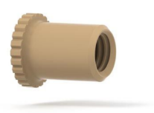
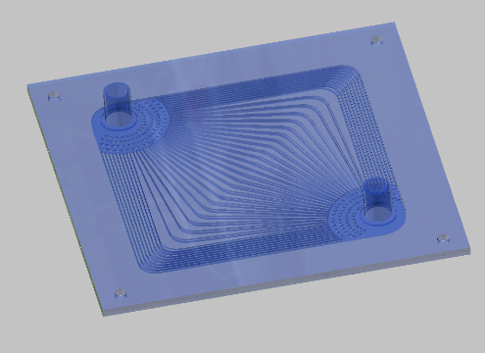
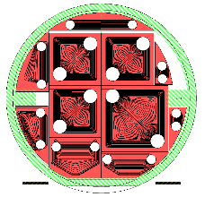
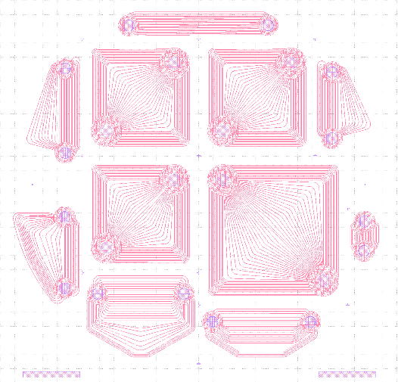
CoolFPGA – Specifications and status
The Plate will be glued on-top of the FPGA chip.
Very safe way to cool the chip.
Plate Thickness: about 1 mm
Microchannel cross section: 0.1 x 0.3 mm²
Plate dimensions: 41 x 41 mm² - 51.2x51.2 mm²
Tube input-output: external diameter 3 mm
Power FPGA: 7 W/cm²
Coolant: water + ethylene glycol
Possibility to use CO2 transition phase cooling
Max coolant Pressure : 12 atm
Coolant Temperature: -5°C
Max temperature FPGA: 50 °C
Commercial peek fluid connection (input/output)
Specific connection peek for fluid (input/output)
E.g.: Biggest structure
Process description:
  Design of the microchannel structures
  Masks Manufacturing for DRIE process
  Metallic bonding to seal the contact surfaces
  Gluing on top surface of the hydraulic connection
Wafer layout with some lateral samples
Production: N.12 wafers
- N.3 sample/wafer of side 41.5mm
- N.1 sample/wafer of side 51.2 mm
- Several test structures
The 2020 International Workshop on the High Energy Circular Electron Positron Collider (Oct. 26-28, 2020)

Slide 6
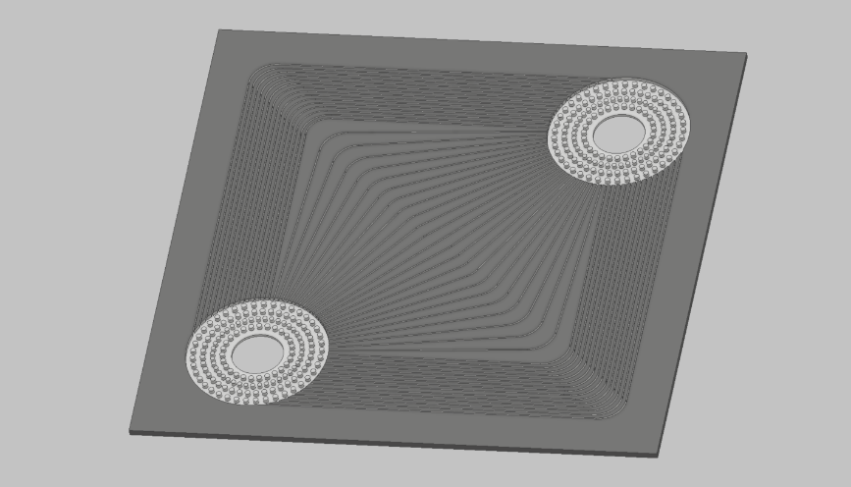
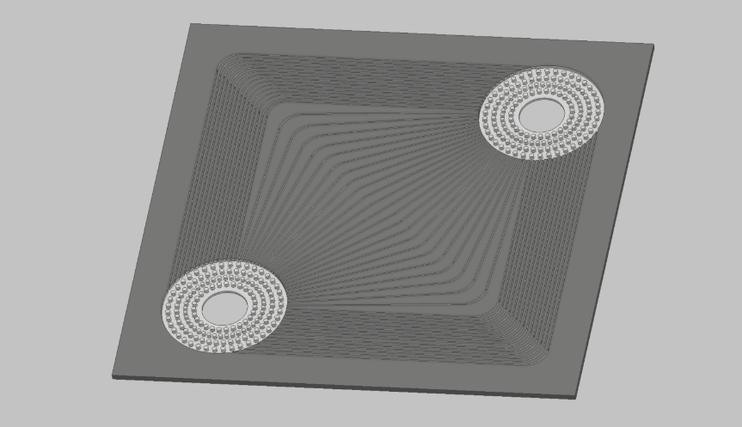
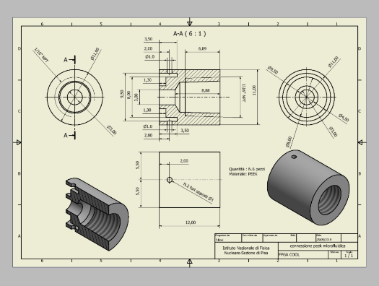
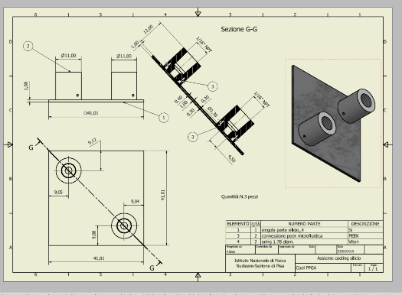
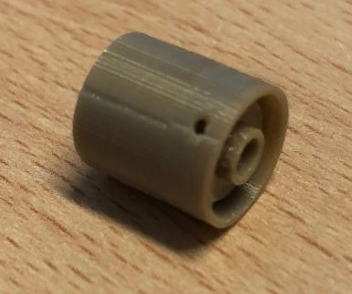
CoolFPGA – Specifications and status
Silicon - DRIE process for
CHIP XILINX KINTEX ULTRASCALA XCKU040
Silicon - DRIE Process for CHIP INTEL STRATIX10 MX
41 mm
51.5 mm
Th 625 micron
Th 625 micron
Specific peek connection
By Roboze Company
General assembly for Silicon of 41 mm
The 2020 International Workshop on the High Energy Circular Electron Positron Collider (Oct. 26-28, 2020)

Slide 7
CoolFPGA – Work Planning
Where are We? Some negative impacts due to Covid-19 but……..
Placed the order to FBK for 12 Wafers
Placed the order for Kapton foil heaters
Placed the order for commercial thermo-hydraulic interface
In our hand the hydraulic interface made by Roboze Industry
Delivery of the silicon with microchannel before the end of the year
Design and construction of the mechanical set to glue the Hydraulic interface on to the chip from now to the end of the year
Starting with the thermo-hydraulic test beginning next year
The 2020 International Workshop on the High Energy Circular Electron Positron Collider (Oct. 26-28, 2020)

Slide 8
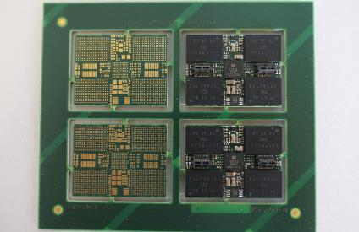
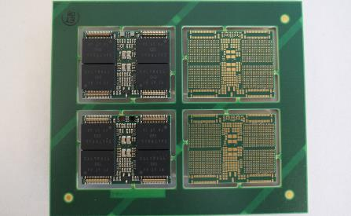
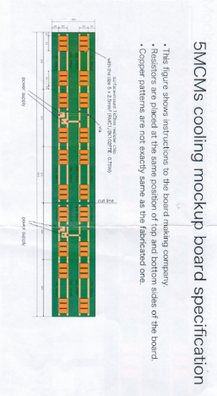
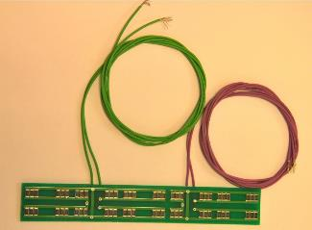
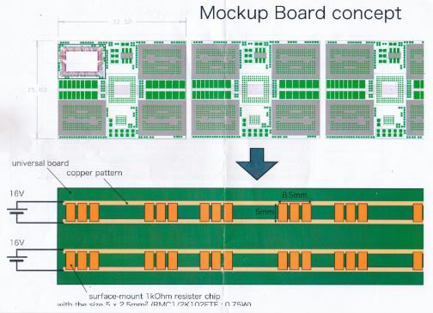
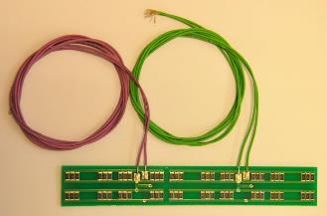
AIDA 2020
Cooling of the multi chip module for a general-purpose readout system for MPGD’s
Contact person: Leif Jönsson, Lund University
MCM Mockup
Top and bottom side
Last version of the panel with MCM Board top and bottom
The MCM Board works in principle but has some unwanted noise that the group is struggling.
When this will be solved ready for production
Thermal specifications
Board mockup
Max 1.0 W/cm²
The 2020 International Workshop on the High Energy Circular Electron Positron Collider (Oct. 26-28, 2020)

Slide 9
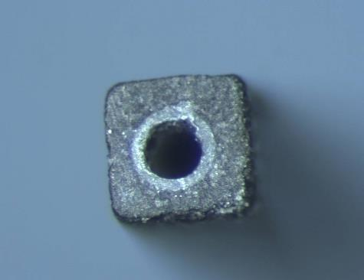
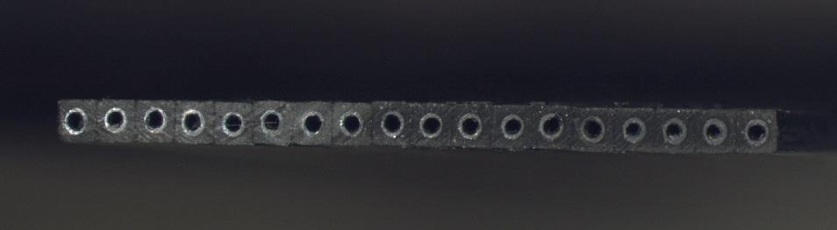
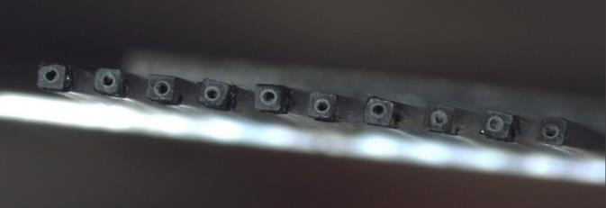
Our first cooling proposal: Microchannel Module Support
Obtained by pultrusion of C.F. TohoTenax HTS 40 , adding and gluing in special masks, side by side, single micro-tube. The inner diameter of the peek micro-tube is 300 μm, the thickness of the square composite profile is 700 μm .
Peek pipe
The single base microchannel unit
A square CF micro-tube with an internal peek tube 50 μm thick used to avoid moisture on carbon fiber
700 μm
700 μm
Dh=300 μm
Full micro-channel module
The total radiation length ^{(*)} of this support is 0.28 %X₀
Carbon Fiber Pultrusion
700 μm
Support Cross Section
Net micro-channel module support
Alternated microtube structure with step of 700 micron
The total radiation length ^{(*)} is 0.15 %X₀
^{(*)}: Material of the support structure: ( C.F. material + peek tube + Water)
The 2020 International Workshop on the High Energy Circular Electron Positron Collider (Oct. 26-28, 2020)
10

Slide 10
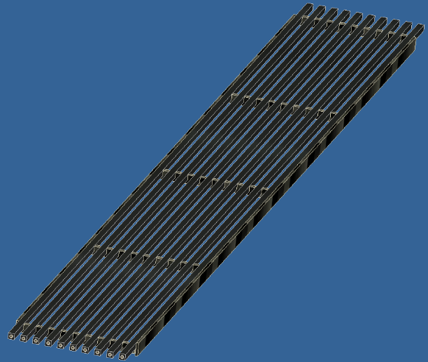
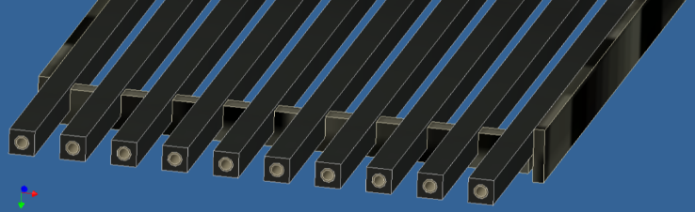
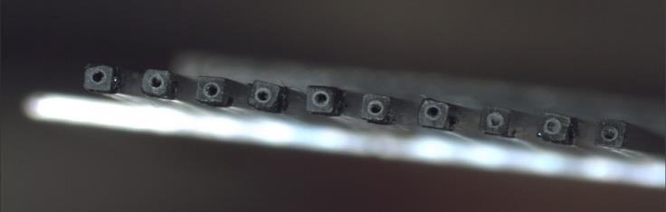
A possible improvement: Module Net Support
Assuming further progress in MAPS sensor design, and looking to actual hybrid pixel, the required Power (analog + digit ), could step down to 1.5-1.0 W/cm².
We choose to design a lighter solution for the support structure .
The Net Module is a micro-channel support with vacancies of tubes with a step of 700 micron .
Lower radiation length with net module support
Net Microchannel Module Support
Carbon fiber stiffer
Material of the support structure: ( CFRP + peek tube + Water + CFRP Stiffeners)
The 2020 International Workshop on the High Energy Circular Electron Positron Collider (Oct. 26-28, 2020)

Slide 11
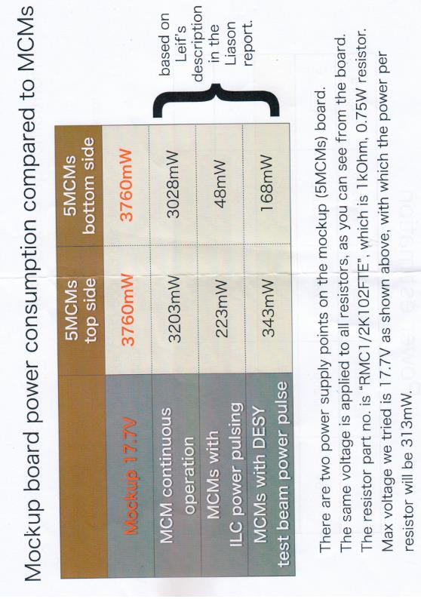
Mockup Board Power Consumption
total 3769
Total 3244
The 2020 International Workshop on the High Energy Circular Electron Positron Collider (Oct. 26-28, 2020)

Slide 12
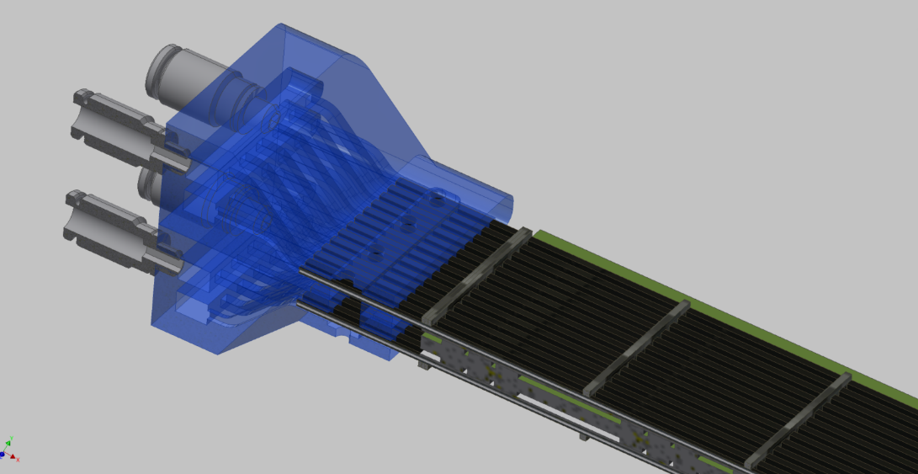
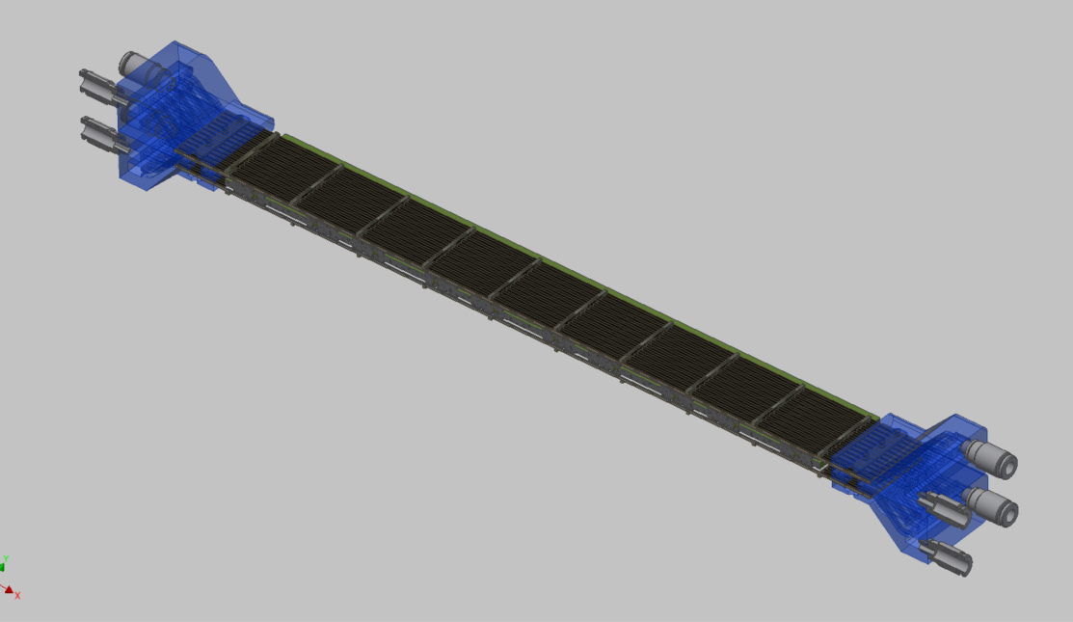
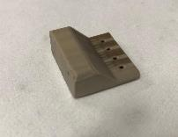
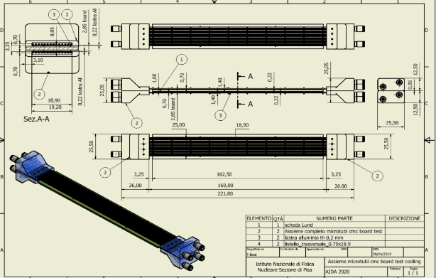
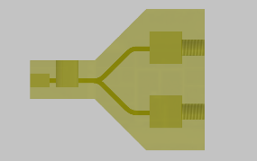
No temperature gradient along the module (Δt<1°C)
Microchannel cooling top/bottom for mockup board
IN
Final experimental setup
OUT
MCM Board
IN
OUT
IN
OUT
Opposite cooling flow by each side
To have same temperature long the module
Inlet/Outlet connector
3D printing technology
Material: Peek
OUT
Opposite cooling flow by each side
IN
The 2020 International Workshop on the High Energy Circular Electron Positron Collider (Oct. 26-28, 2020)

Slide 13
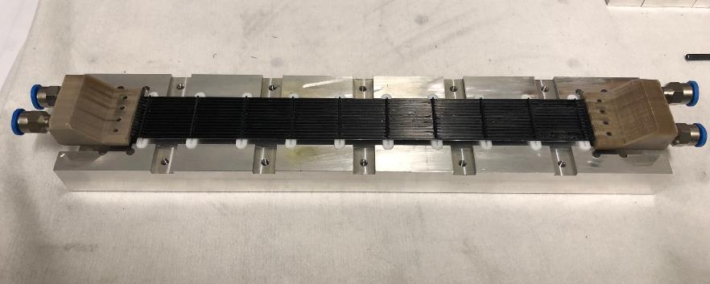
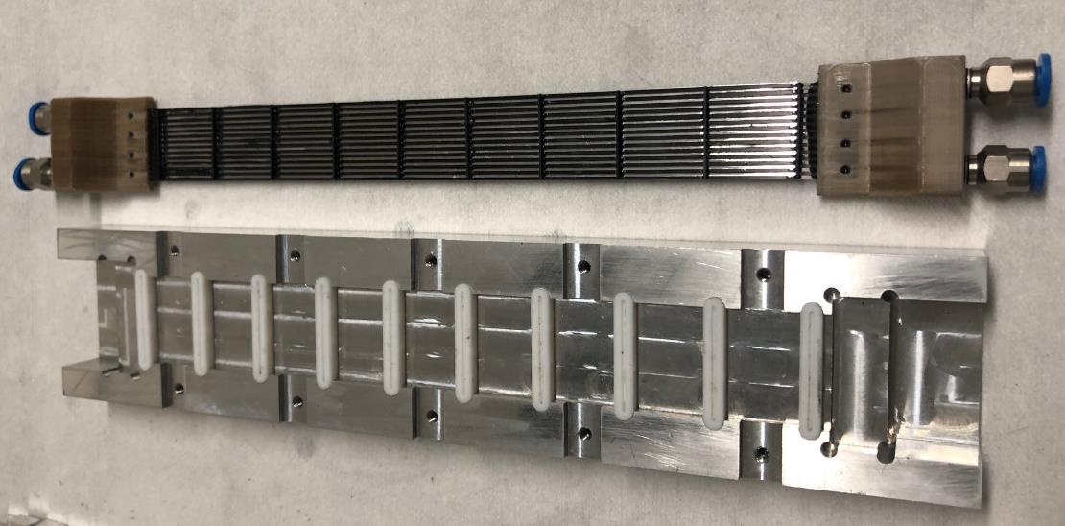
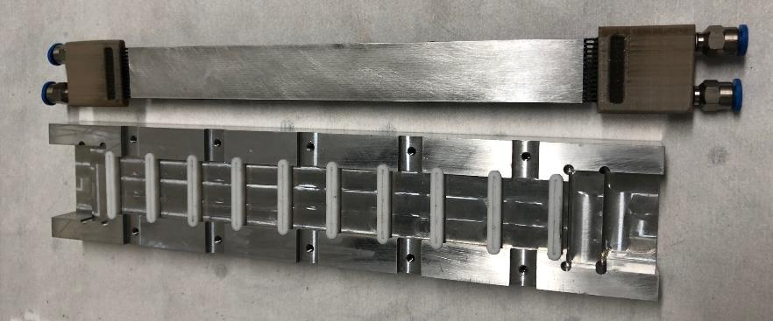
First Module prototype
Top support prototype on the gluing mask
Top prototype
Gluing Mask
Plate in Aluminum for heath diffusion glued on the bottom side of the module support
The 2020 International Workshop on the High Energy Circular Electron Positron Collider (Oct. 26-28, 2020)

Slide 14
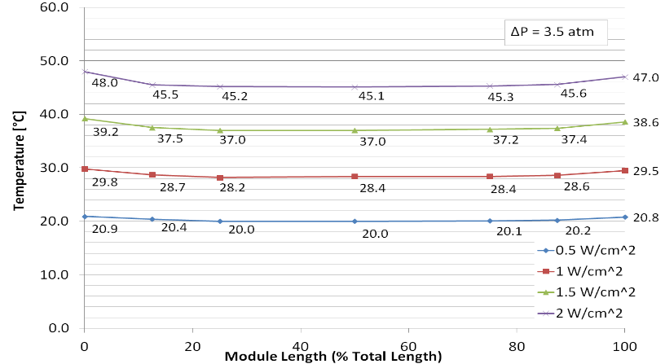
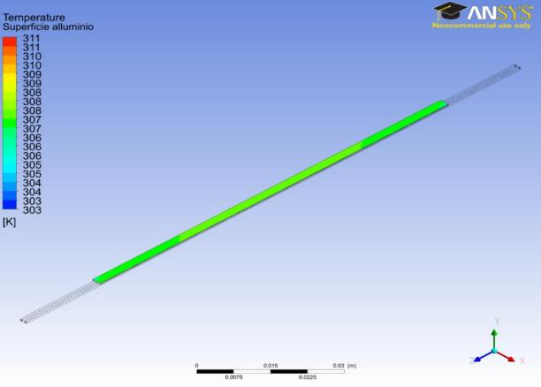
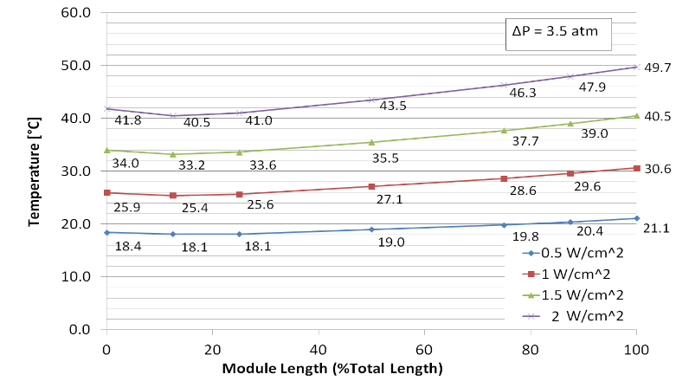
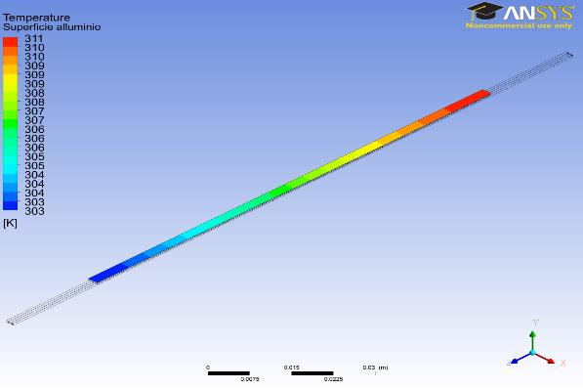
Net Module sample ( L= 120 mm - Dh=300 mm th= 700 mm ) - coolant water-glycol @ 10 °C
ΔT=1 °C
W=2W/cm²
Bidirectional Interface
ΔT=7 °C W=2W/cm²
Monodirectional Interface
The 2020 International Workshop on the High Energy Circular Electron Positron Collider (Oct. 26-28, 2020)

Slide 15
Status of the AIDA Project
First prototype of the microchannel support ready for cooling tests of the MCM board
Second prototype in preparation
TFD lab ready for testing
MCM Mockup Board in our hand
Final setup on the MCM Board will be ready at the end of October 2020
First results of the thermo-hydraulic test on the MCM Mockup Board ready by the end of the year
The 2020 International Workshop on the High Energy Circular Electron Positron Collider (Oct. 26-28, 2020)

Slide 16
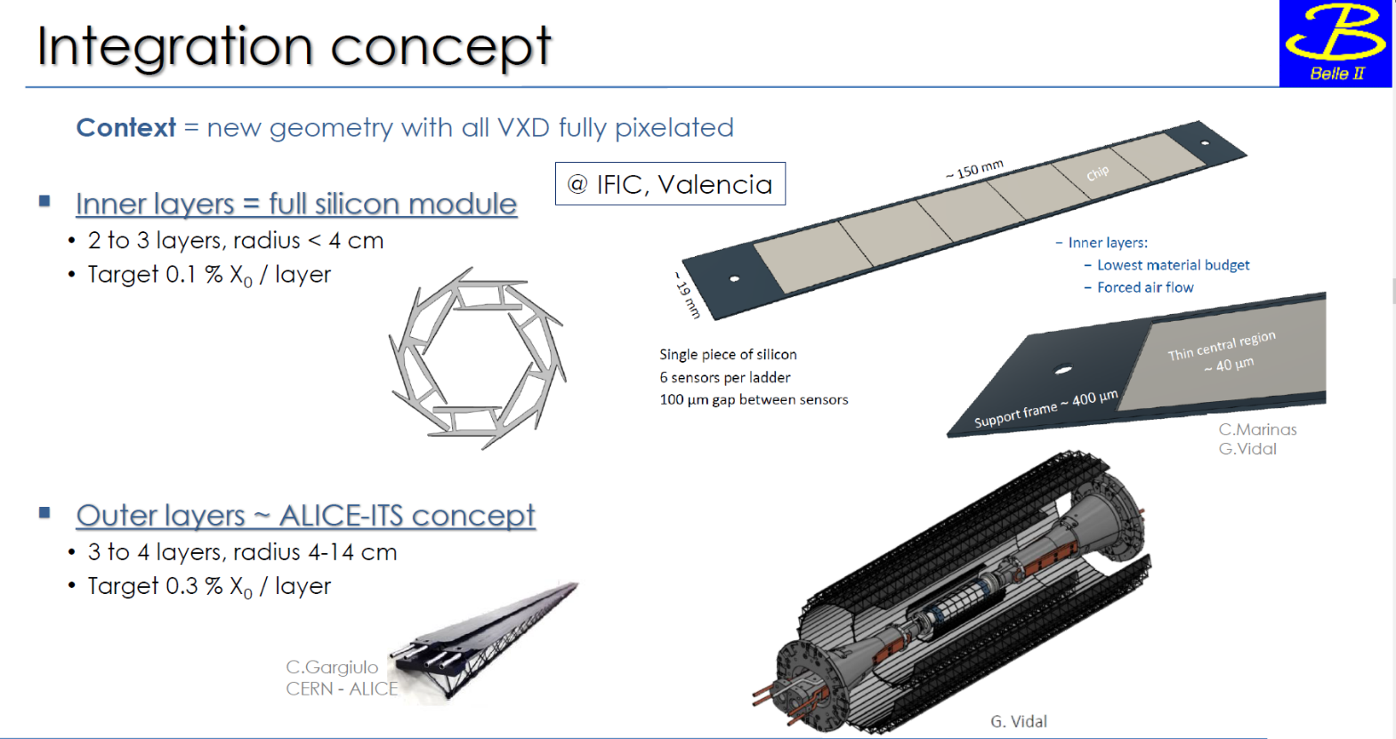
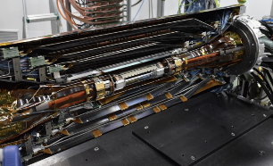
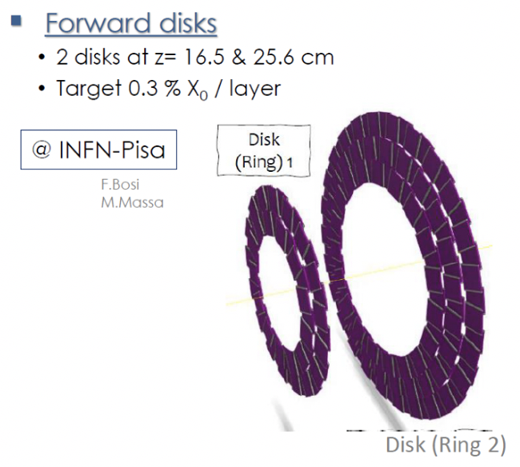
Belle II VXD Upgrade
To reach the design SuperKEKB luminosity an upgrade of the final focusing magnet has been proposed.
The long shutdown in 2026 gives the opportunity to upgrade the VXD, to be more performant
and robust against background.
The Belle II vertex detector (SVD+PXD)
Barrel staves + disks:
Long barrel staves
The 2020 International Workshop on the High Energy Circular Electron Positron Collider (Oct. 26-28, 2020)

Slide 17
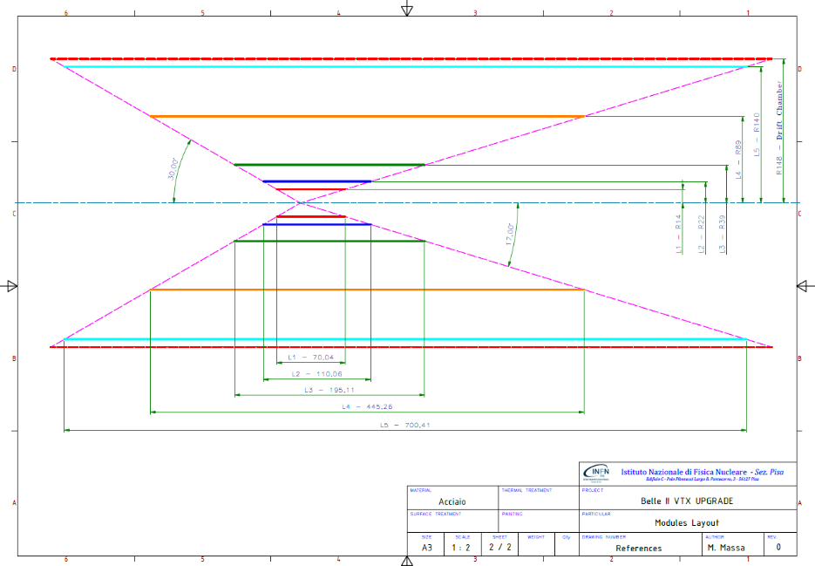
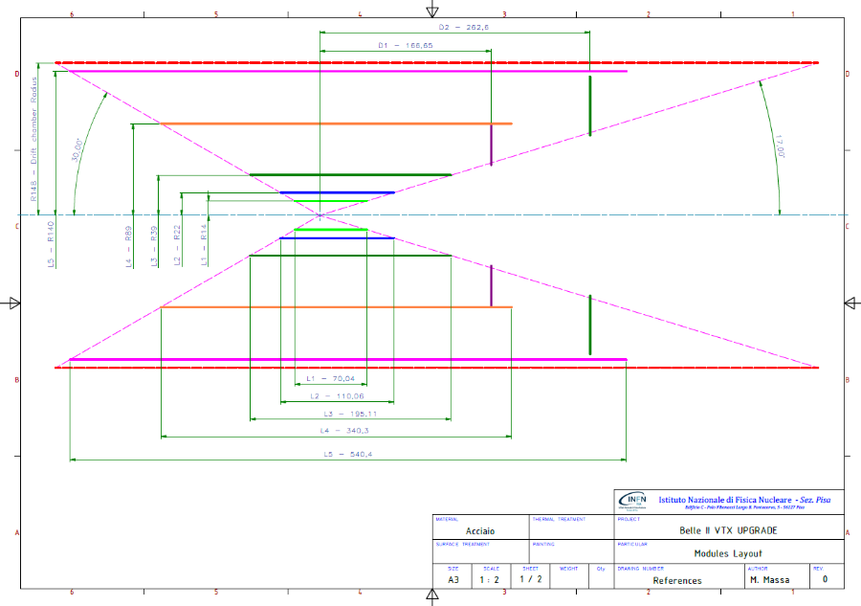
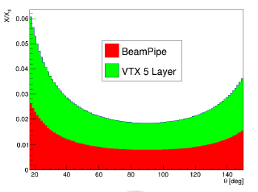
Staves + disks in the forward region.
Belle II VXD Upgrade
Long staves
Simulation in progress to chose the better geometry
The 2020 International Workshop on the High Energy Circular Electron Positron Collider (Oct. 26-28, 2020)

Slide 18
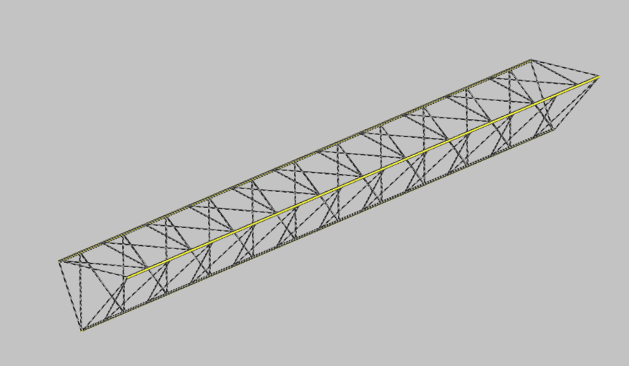
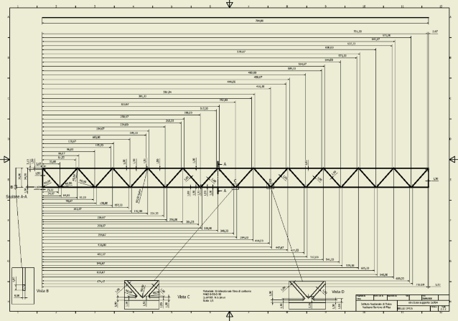
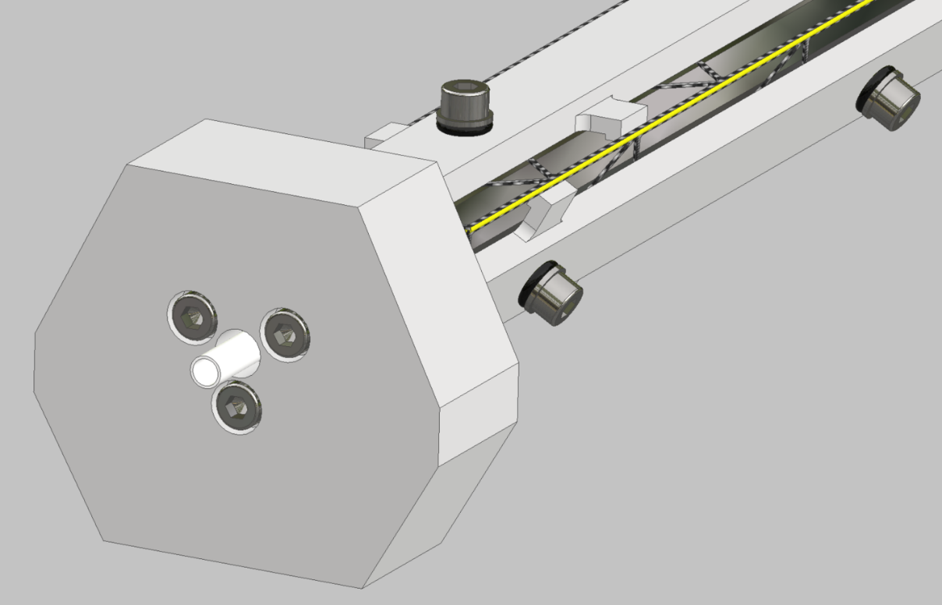
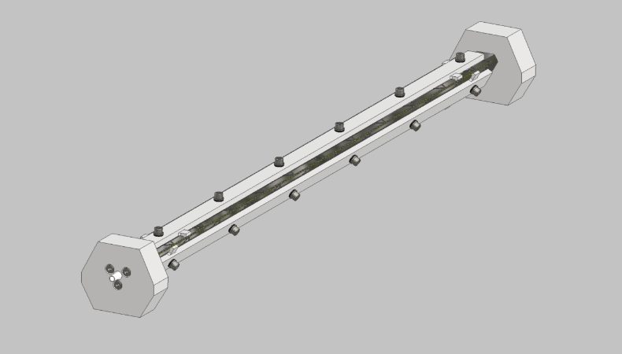
Belle II VXD Upgrade: design of the ladder support structure
Completed 3D reticular carbon fiber structure 1 (or 0.5) mm thick, composed of 3 plates.
Plate carbon fiber 1 (or 0.5) mm thick
Reticular plane structure
36 mm
Water-Jet cutting of laminated plane in carbon fiber.
Cut precision: 50 micron
704 mm
Precision brackets to hold the plate carbon fiber structure while gluing
Plate carbon fiber structure
Mask to perform the 3D carbon fiber structure
Inner cooling circuit to shrink
the internal mask and allow to
extract the 3D carbon fiber structure
Triangular internal mask to join the 3 plates in the 3D carbon fiber structure
The 2020 International Workshop on the High Energy Circular Electron Positron Collider (Oct. 26-28, 2020)

Slide 19
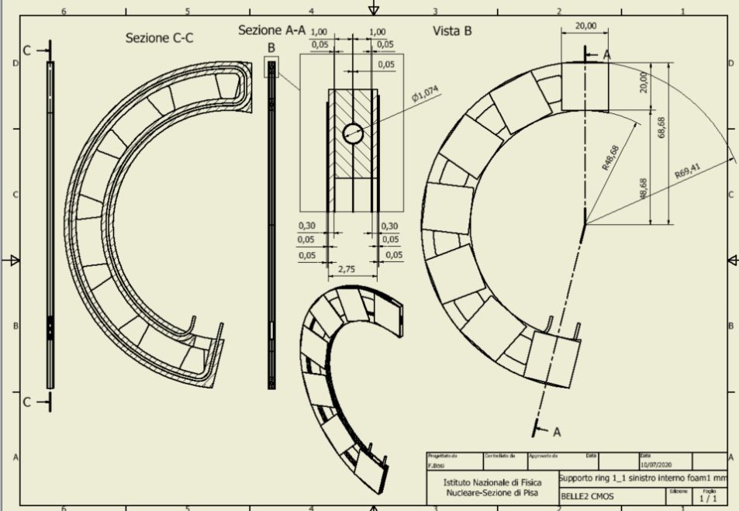
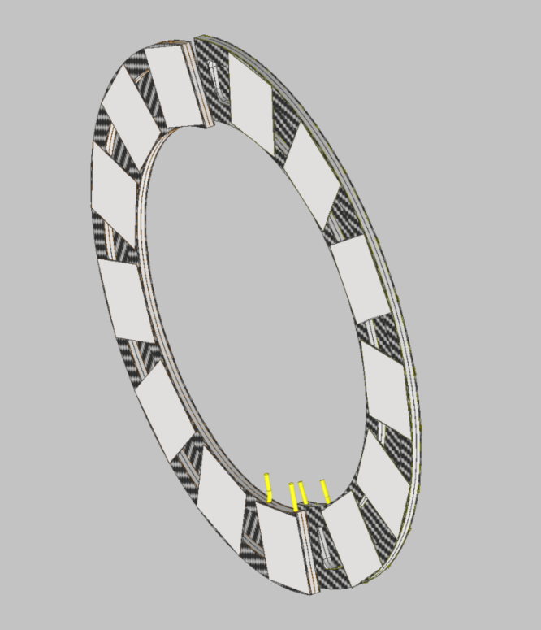
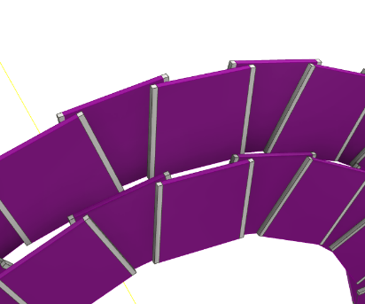
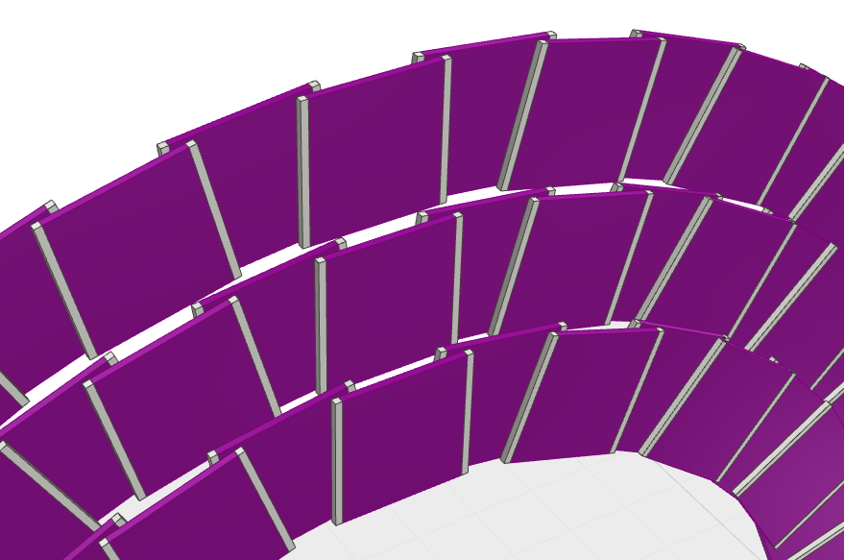
Belle II VXD Upgrade: Design of the support disk structure
Disk 1 Ring 1
Carbon foam Allcomp low density K9 Hi-K
Carbon
Fiber
KDU13
Pixel
silicon sensors
(2cmx2cm) on the 2 faces
Disk 1 (2 rings)
Disk 2 (3 rings)
Detail
of the
sensor
R-Φ
overlaps
Cooling tube PTFE
The 2020 International Workshop on the High Energy Circular Electron Positron Collider (Oct. 26-28, 2020

Slide 20




Belle II VXD Upgrade: ANSYS THERMAL ANALYSIS
Loads:
200 mW/cm² on the chips surface
20 °C (fixed temperature) on the internal walls of the polyamide cooling pipes
Front disk side
Back disk side
Maximum thermal gradient between Chips and water: 4,38 °C
The 2020 International Workshop on the High Energy Circular Electron Positron Collider (Oct. 26-28, 2020)

Slide 21
BELLE2 UPGRADE
Work plan:
Brings up both design of disk and long stave structures
Order the laminated carbon fiber and carbon foam material end test the feasibility of the subtracted water jet technology
At the beginning of the next year construct the first gluing mask prototype
Submit the first support disk prototype to thermal test
Realize the first stave 1 mm and 0.5 mm- thick to test its mechanical properties
The 2020 International Workshop on the High Energy Circular Electron Positron Collider (Oct. 26-28, 2020)

Slide 22
Conclusions
  Several R&D activities started; we need more time to have significant/relevant results
  Design of AIDA 2020, FPGA COOL and BELLE 2 Upgrade to bring up
  Availability for collaborations with other institutes or research groups
The 2020 International Workshop on the High Energy Circular Electron Positron Collider (Oct. 26-28, 2020)

Slide 23
Thanks for your attention
The 2020 International Workshop on the High Energy Circular Electron Positron Collider (Oct. 26-28, 2020)

Slide 24
Backup
The 2020 International Workshop on the High Energy Circular Electron Positron Collider (Oct. 26-28, 2020)

Slide 25
Our R&D Facilities - Clean Rooms
The INFN Pisa clean room area is 550 m², divided in group-specific and common rooms.
We’re now widen the area with others 150 m²
The Clean Room area is ISO8 (class 100000) with some rooms with ISO7 (class 10000) standard.
In every cleanroom workspace area the thermo hygrometric conditions are continuously monitored and are available:
Vacuum
Air pressure facilities (8 atm)
Dry air (dew point -40 °C)
Other facilities/activities:
3D Metrology, with and w/o probe contact, CNC controlled and PCDIMIS metrological sw
Mechanical micro-mounting e.g.: Silicon sensors positioning under CMM for assembling module production
Optical inspection bench
Gluing robot dispensing
Micro-bonding: Manual/semi/automatic deep access bonding machine
Thermal Environment test: Humidity & temperature test chamber for thermal cycles on (large) detector assembly (Volume test 3300x3500x2500 mm3 / Temperature range -70°C - +80 °C)
Temperature measurement by I.R. thermo-camera – Resolution: 0.1 °C – Temperature range: -40/+250 °C – Experimental thermal analysis on prototypes of cooled read-out electronic for semiconductor detector
The 2020 International Workshop on the High Energy Circular Electron Positron Collider (Oct. 26-28, 2020)

Slide 26

Brief History of the Pisa group
Pisa is one of the largest INFN structures, with about 250 physics researchers (from grad student to full professor).
Involved in many experiments, both at accelerators and underground.
Home of Virgo GW interferometer.
For an overview of research at INFN and university:
https://sites.google.com/a/unipi.it/research-in-the-pontecorvo-area/
Technical divisions (about 20 engineers) to support the scientific activities:
Mechanics, Electronics, Computing, Advanced technology
The Advanced technology division (6 technicians + 3 Eng.) provides
engineering and technological support to the experimental activities of the
research groups.
The 2020 International Workshop on the High Energy Circular Electron Positron Collider (Oct. 26-28, 2020)

Slide 27
Clean Rooms
The 2020 International Workshop on the High Energy Circular Electron Positron Collider (Oct. 26-28, 2020)

Slide 28
Thermo-fluid-dynamic-lab
The lab is used for cooling tests and thermal characterization of low mass support structure based on micro-channel technology.
Test bench and chiller for forced convection of liquid monophase
Recently started the activity on micro-cooling in transition phase with CO2 fluid (some issues to resolve with the chiller) but we are waiting the delivery of the MARTA chiller for CMS experiment.
The instrumentation allows to measure/store the values of temperature/pressure/flow in the thermal exchange.
A DAQ HW system with N.24 probe for temperatures, pressure and flow is present.
The monophase chiller is dimensioned for a cooling power up to 0.5 kW primary and secondary cooling circuit
The CO₂ chiller for evaporative cooling has a wide settable range of coolant temperature (-20 °C to +10 °C), the system circuit control can set cooling power in the range 16 W ÷ 400 W and the coolant flow is settable from 0.05 to 1 Kg/min
Next improvement of the lab with MARTA System
for CO₂ cooling
Inlet/outlet pipes
for test section
The 2020 International Workshop on the High Energy Circular Electron Positron Collider (Oct. 26-28, 2020)

Slide 29
Structural Test Lab
The two main activities are:
Mechanical characterization of materials (test up to 50.000 N)
Vibrational analysis
Dynamic Shaker up to 10 Kg Up to 1000 Hz-sinusoidal and random
Example of
Si specimen bending test
(Si_{th} = 50 um)
The 2020 International Workshop on the High Energy Circular Electron Positron Collider (Oct. 26-28, 2020)

Slide 30




Design of a Multi Chip Module for a general-purpose readout system for MPGD:s
• The design of the first version of the 16 layer MCM-board in HDI-technology was completed.
• 25 panels, each with 4 MCM-boards, were ordered in the middle of September 2019. They were
delivered at the end of October 2019.
• An assembly of two boards for testing purpose was completed by the DESY electronics workshop. The first test
in Lund in November-December showed some bugs in the PCB-design. Some bugs were fixed and others not, either
because their function was not critical for the upcoming tests or that it was impossible to fix them.
32.5 mm
25 mm
• For the tests of single MCM-boards a prototype LV-board was designed. The final LV-board will supply
voltages for 5 MCM-boards.
• Improvements: previously we had 7 voltage levels, now this is reduced to two.
• In our tests at DESY, in the beginning of January 2020, we managed to communicate with the SALTRO-chips i.e.
we could read and write data. The noise level was quite low. Pedestal runs were preformed and gave good results.
• However, this first version of the MCM-board also exhibited some problems, the cause of which we have pinned
down by careful debugging.
• The order of a second version of the PCB has been sent out and the expected delivery time is June 2020. We hope
that DESY can find a slot for assembly soon after.
• The problem of finding a FPGA programmer remains.
Contact person: Leif Jönsson, Lund University
The 2020 International Workshop on the High Energy Circular Electron Positron Collider (Oct. 26-28, 2020)

Slide 31



The MCM faces
Samtec connectors
Panasonic connectors
BOTTOM SIDE
TOP SIDE
7 mm
18 mm
Carrier Boards
CPLD
Distance defining the microchannel numbers
The 2020 International Workshop on the High Energy Circular Electron Positron Collider (Oct. 26-28, 2020)

Slide 32

MCM ladder thermal specifications
7mm
18mm
166.5 mm
Max 1.0 W/cm2

Slide 33

MCM ladder thermal specifications
7mm
18mm
166.5 mm
Max 1.0 W/cm2

Slide 34



Bidirectional Hydraulic Interface
3D printing technology
Material: Peek
Opposite cooling flow by one side
To have same temperature long the module
The 2020 International Workshop on the High Energy Circular Electron Positron Collider (Oct. 26-28, 2020)

Slide 35



Bidirectional Hydraulic Interface Prototype
First prototype in peek material
Roboze Italian Company
Precision of the processes 200 micron
Square channel W=1mm for microchannel side of 700 micron
The 2020 International Workshop on the High Energy Circular Electron Positron Collider (Oct. 26-28, 2020)

Slide 36




Multichip real module – Bottom and Top side
MCM Board
Top side
MCM Board
Bottom side
Opposite flux
(Δt<1°C)
Opposite flux
(Δt<1°C)
Bottom side
Micro-cooling structure completed
Top side
Micro-cooling structure completed
The 2020 International Workshop on the High Energy Circular Electron Positron Collider (Oct. 26-28, 2020)

Slide 37

Belle II VXD Upgrade
The 2020 International Workshop on the High Energy Circular Electron Positron Collider (Oct. 26-28, 2020)

Slide 38
Belle II VXD Upgrade
1° Hypotesys
The 2020 International Workshop on the High Energy Circular Electron Positron Collider (Oct. 26-28, 2020)

