Slide 1

CEPC Linac
环形正负电子对撞机
Circular Electron Positron Collider
CEPC Workshop 2020
Oct. 26, 2020
C. Meng, J. Zhang, X. Li, G. Pei, G. Shu, D. Li, J. Gao, Y. Chi
Institute of High Energy Physics, CAS

Slide 2
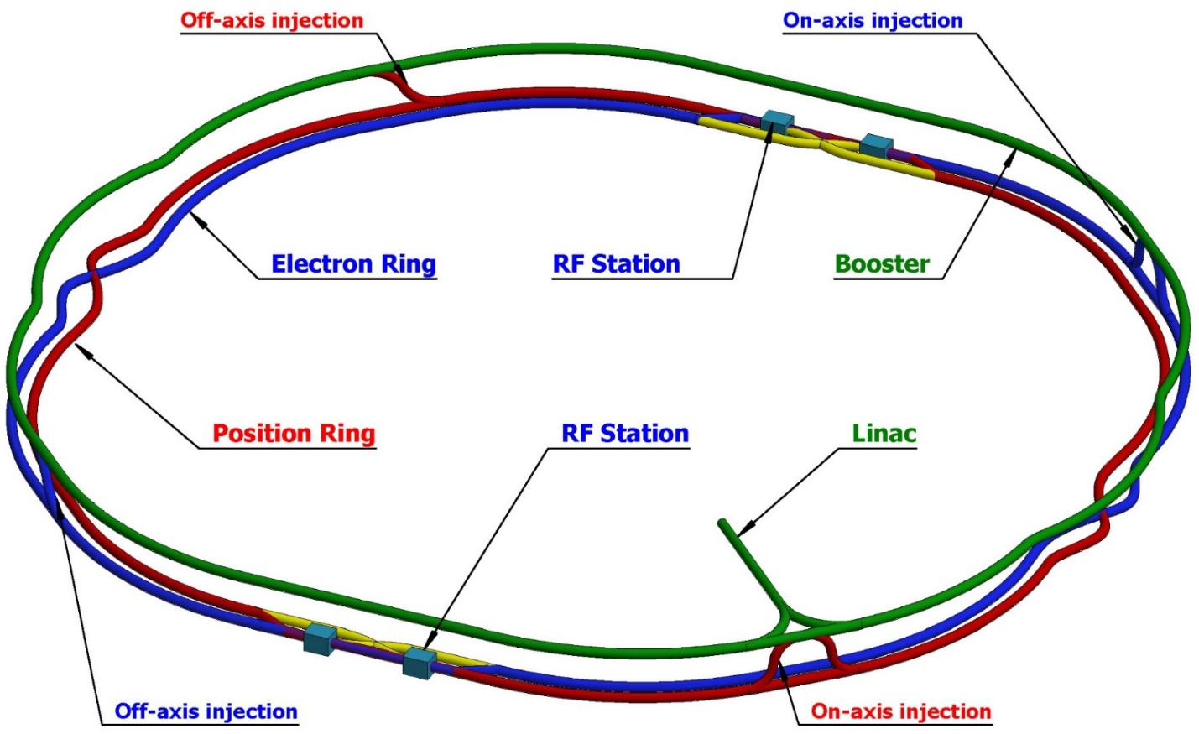
Outline
Introduction
Progress on CEPC Linac design
Summary

Slide 3
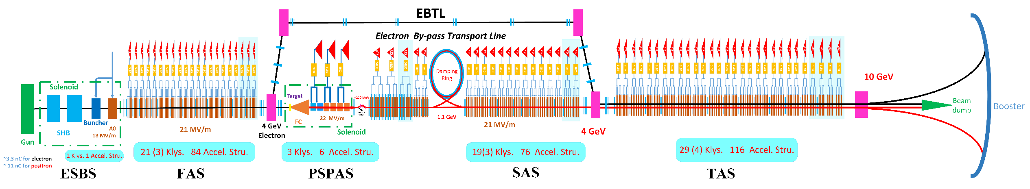
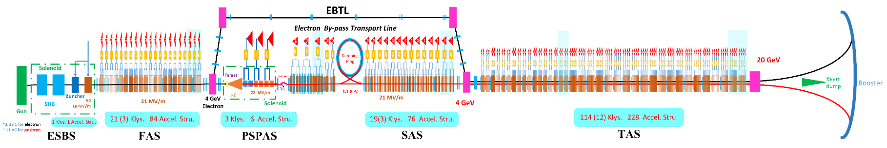
Introduction
CEPC Linac
CEPC layout
  10 GeV Linac
  10-120GeV Booster
  120 GeV Collider
  Transport lines
CEPC Linac
  Baseline scheme
    10 GeV (S-band)
  Alternative scheme
    20 GeV (S+C-band)
  PWFA scheme
    45 GeV
    S-band driven linac
    Plasma acceleration
Alternative design
S-band Accelerating structure
C-band Accelerating structure

Slide 4
Introduction
For the baseline scheme, detailed and solid design is still in progress. However, based on some considerations, more optimized scheme is also being considered.
Here mainly discuss some new changes and considerations to the Linac design, only in the physics design stage.
Parameter | Symbol | Unit | Baseline | Alternative
e⁻ /e⁺ beam energy | E_{e-}/E_{e+} | GeV | 10 | 20
Repetition rate | f_{rep} | Hz | 100 | 100
e⁻ /e⁺ bunch population | Ne-/Ne+ |  | >9.4×10⁹ | >9.4×10⁹
 |  | nC | >1.5 (3) | >1.5 (3)
Energy spread (e⁻ /e⁺ ) | σ_{E} |  | <2×10⁻³ | <2×10⁻³
Emittance (e⁻ /e⁺ ) Req. | ε_{r} | nm | 40 | 40

Slide 5
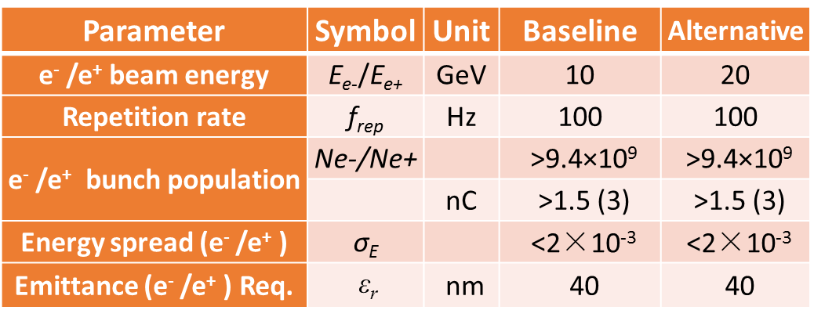
Introduction
Consideration
For the baseline scheme, as the requirements for the performance and capabilities of the CEPC are being pushed forward, the requirements for the Linac also is being updated
  Design for larger parameter range and more potential
  Maybe 10nm-emittance for “High luminosity scheme at Higgs energy” in C. H. Yu’s report
  Maybe two-bunch-per-pulse or 200-Hz-repetition rate for “High luminosity scheme at Z energy” in D. Wang’s report
For the alternative scheme, is it possible that the starting energy of the C-band accelerating structure is lower?
  Yes
  Also, the alternative scheme can be used
  as an updated to the baseline scheme

Slide 6
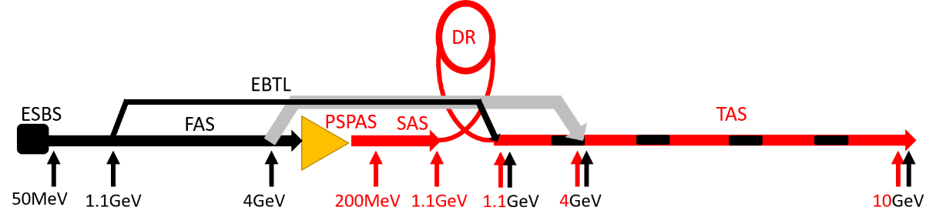
CEPC Linac
Layout update
The energy of electron bypass transport line (EBTL) is from 4GeV to 1.1 GeV
  Reduce the survey design difficulty of the positron source
  Better compatibility between baseline scheme and alternative scheme
    In this case the starting energy of the C-band accelerating structure of the alternative scheme can be 1.1 GeV just after damping ring;
    For the alternative scheme or lower emittance (no smaller than 10 nm) baseline scheme, only the design of the third acceleration section (TAS) need update and other parts can basically fixed.

Slide 7
CEPC Linac
Layout update
The deflection direction of the EBTL is from horizontal to vertical, the distance between EBTL and main linac is from 2 m (H) to 1.2 m (V)
  Easier layout design to avoid the interference with energy analyzing station, transport lines between the Linac and damping ring, waveguide and positron source
  Reduce the tunnel width and maybe no need to increase the height (3.5m)
8 normal accelerating structures are replaced by 10 larger aperture accelerating structure (same type in PSPAS) at the beginning of the second acceleration section (SAS) to reduce the risk of beam loss

Slide 8
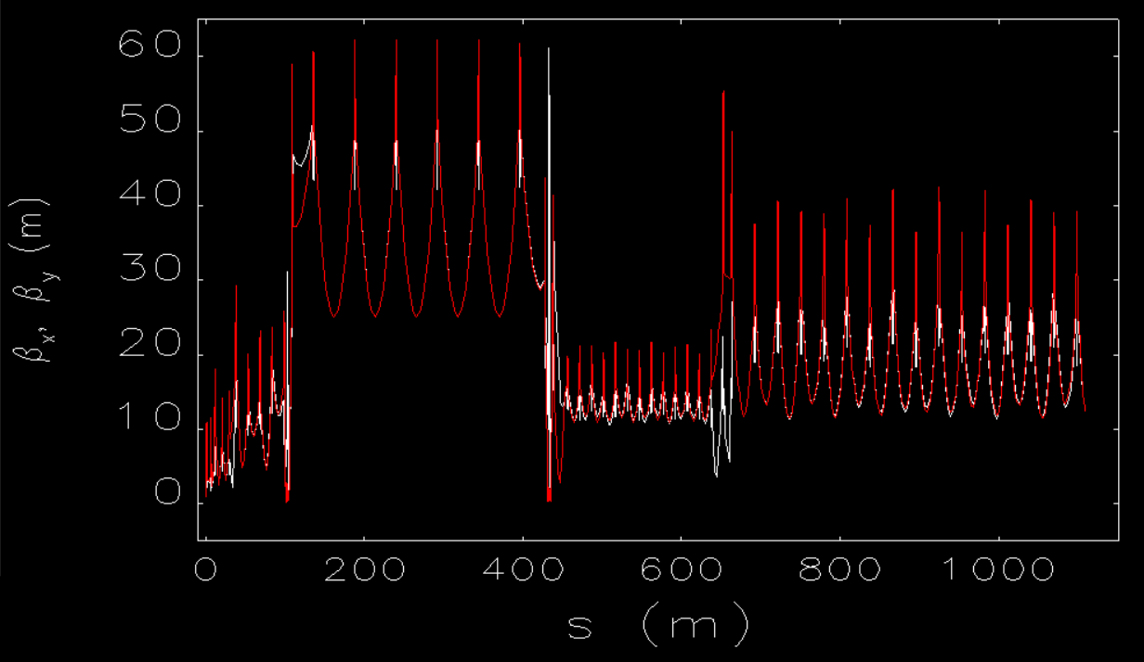
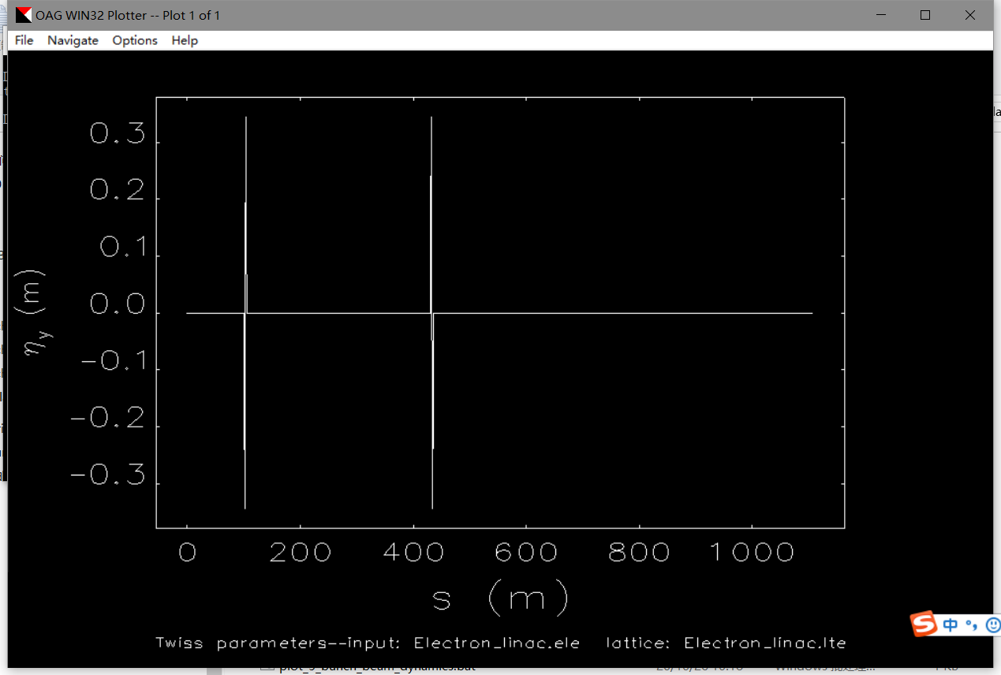
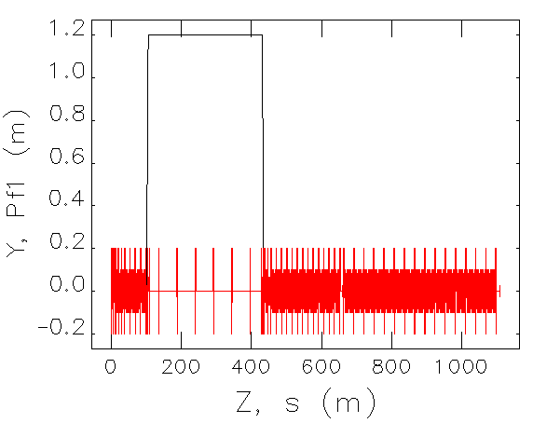
Baseline scheme
Electron beam
Beam dynamics results of the baseline scheme can meet the requirements
The EBTL adopts achromatic design

Slide 9
Baseline scheme
Lower emittance
The emittance of electron beam is 5 nm without errors
  Based on beam distribution of the electron gun in 10A, which is the optimized current, the emittance maybe is larger at a low current
  The electron linac can meet the lower emittance requirement.
The emittance of positron beam is 30 nm without errors
  More damping are needed in the damping ring for positron beam
Parameter | Symbol | Unit | required | Designed
e⁻ /e⁺ beam energy | E_{e-}/E_{e+} | GeV | 10 | 10
Repetition rate | f_{rep} | Hz | 100 | 100
e⁻ /e⁺ bunch population | Ne-/Ne+ |  | 9.4×10⁹ | 1.9×10¹⁰
 |  | nC | 1.5 | 3
Energy spread (e⁻ /e⁺ ) | σ_{E} |  | <2×10⁻³ | <2×10⁻³
Emittance (e⁻ /e⁺ ) Req. | ε_{r} | nm | 40 | 5(e⁻ ) 30(e⁺ )

Slide 10
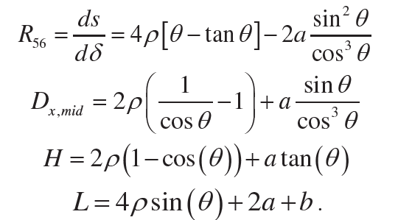
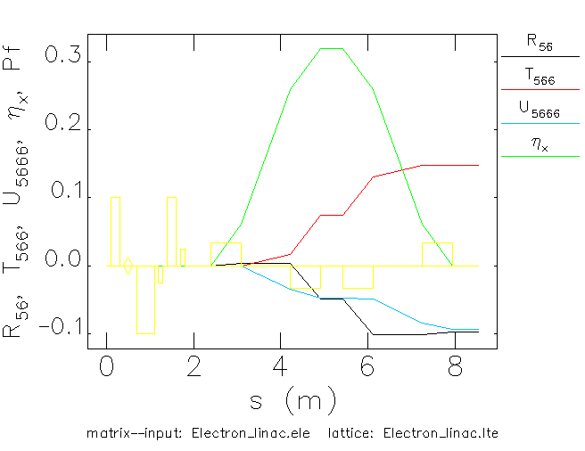
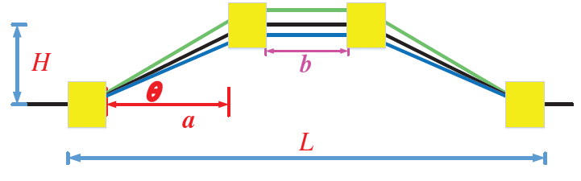
Alternative scheme
Chicane
For C-band accelerating structure, shorter bunch length is needed, so a chicane at the beginning of TAS was introduced.
R56=-0.1m
  Angle: 10 degree
  L=1.13m

Slide 11
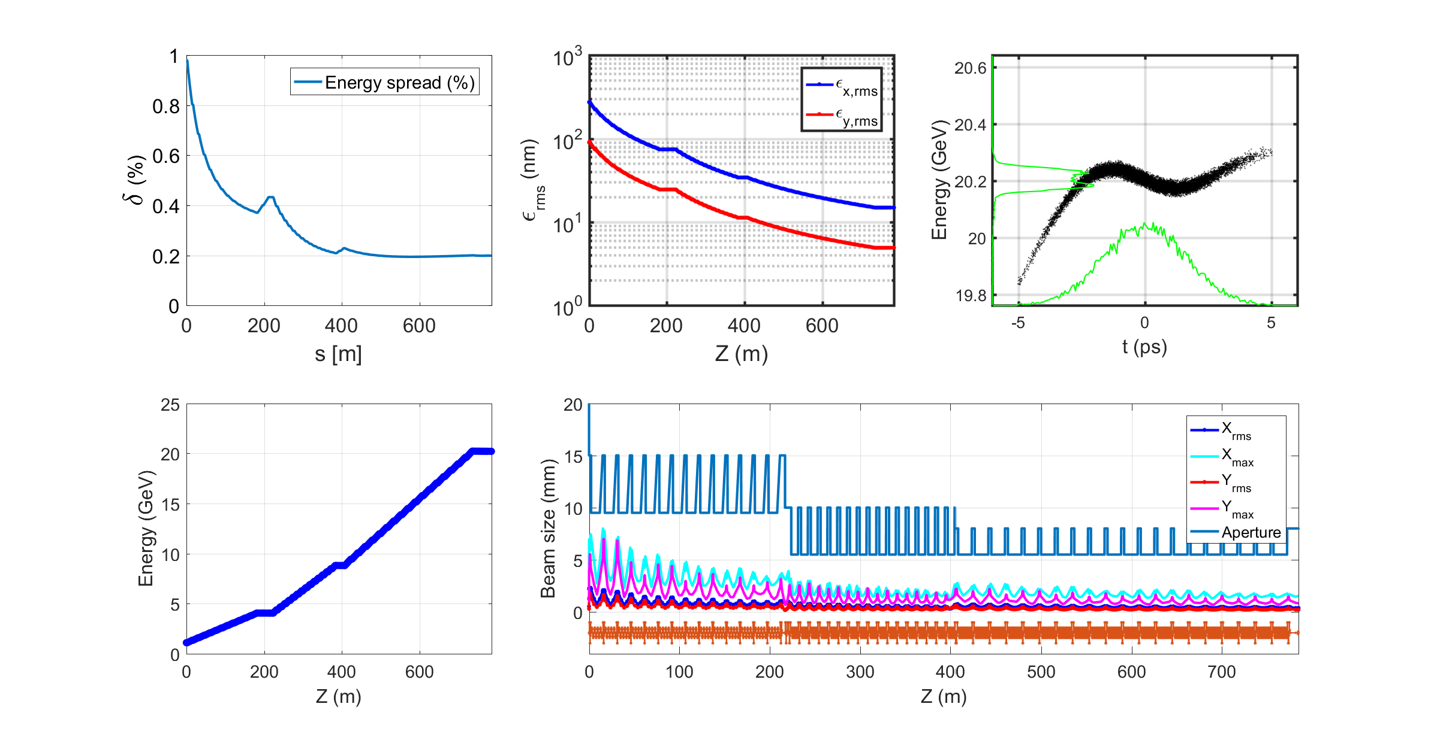
Alternative scheme
Beam dynamics
Energy
  20 GeV
Energy spread
  0.2%
  Rms Bunch length~ 0.5mm
Emittance
  15nm

Slide 12
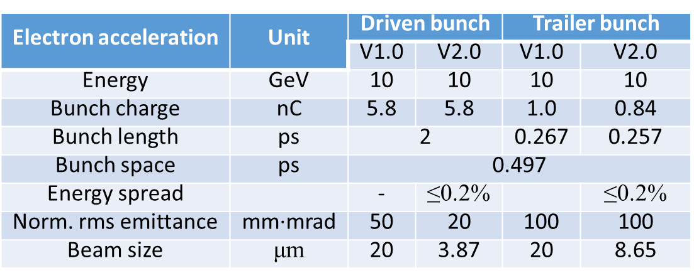
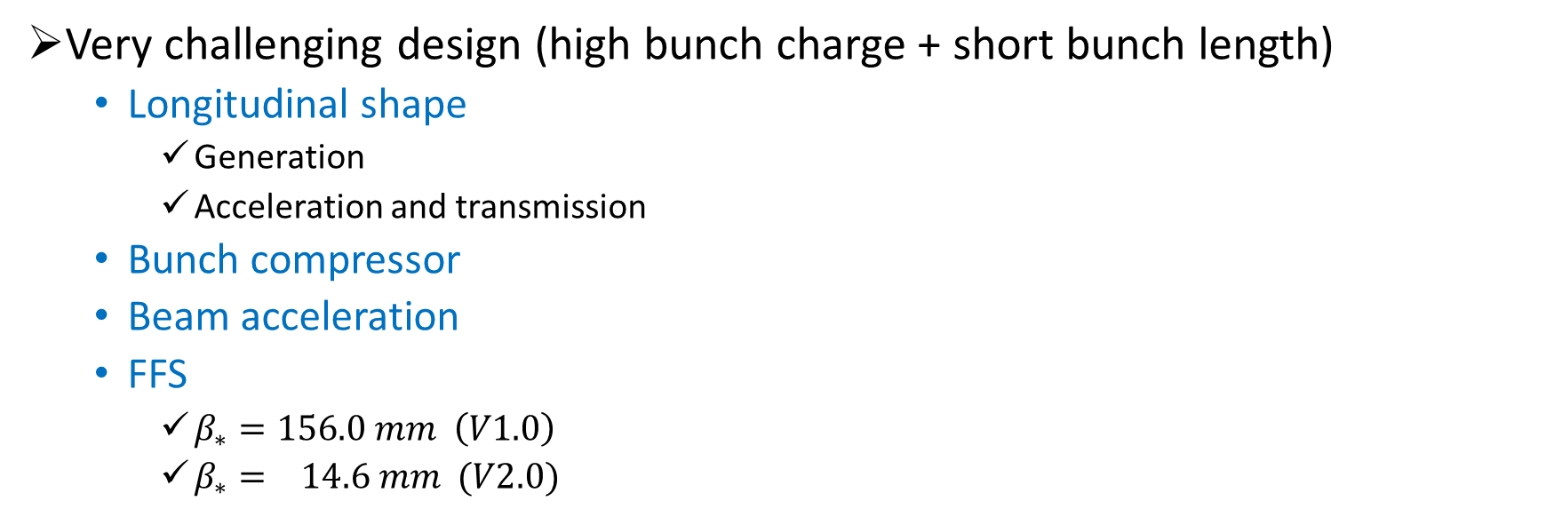
PWFA scheme
Very challenging design (high bunch charge + short bunch length)
  Longitudinal shape
    Generation
    Acceleration and transmission
  Bunch compressor
  Beam acceleration
  FFS
    $β_{∗}=156.0 mm \left(V1.0\right)$
    $β_{∗}= 14.6 mm (V2.0)$

Slide 13
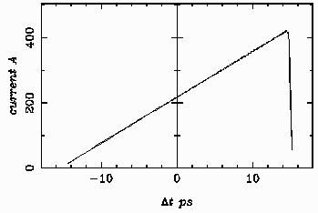
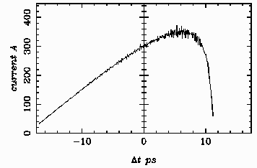
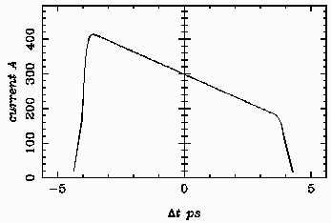
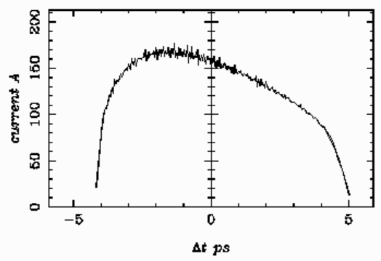
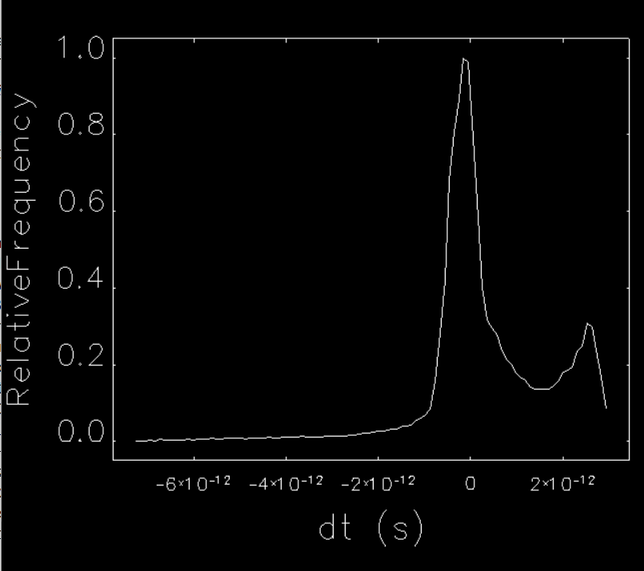
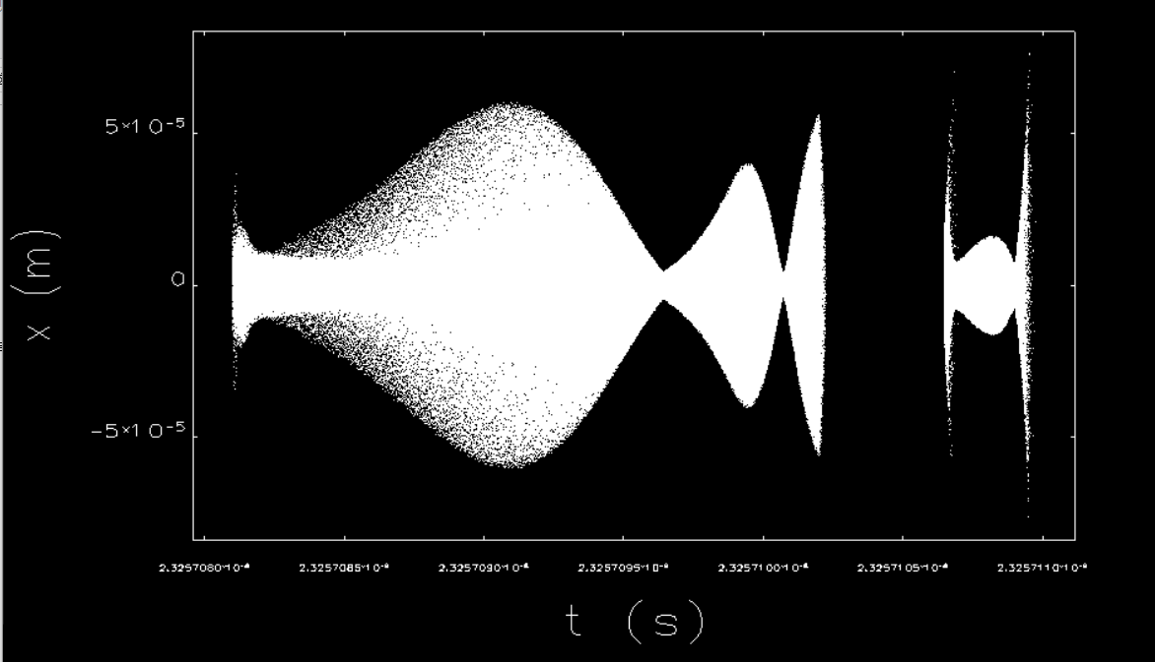
PWFA scheme
Longitudinal shape
RF gun
  Laser shaping
    Space charge: deformation
    Longitudinal and transverse distribution coupling
  Need more effort to optimization
Bunch compressor
  bunch length
  longitudinal shape
    deformation
Longitudinal modulation
  @ transport line
  Under investigation
Laser
Beam
6.5nC
1.2nC

Slide 14
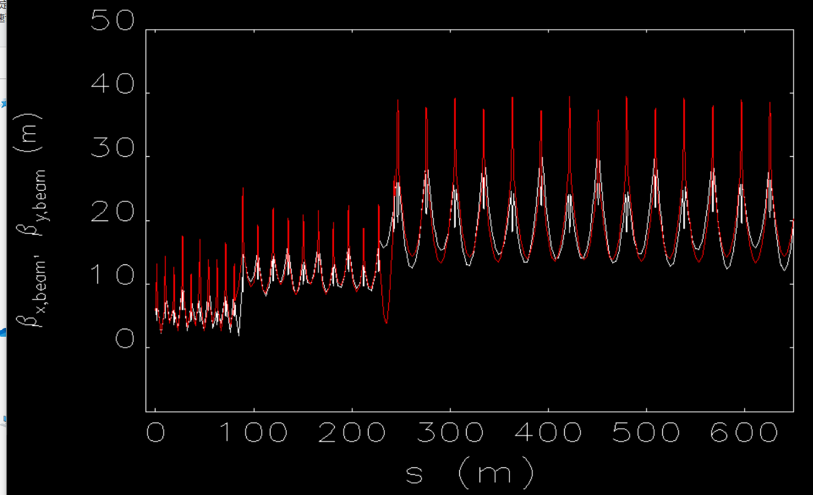
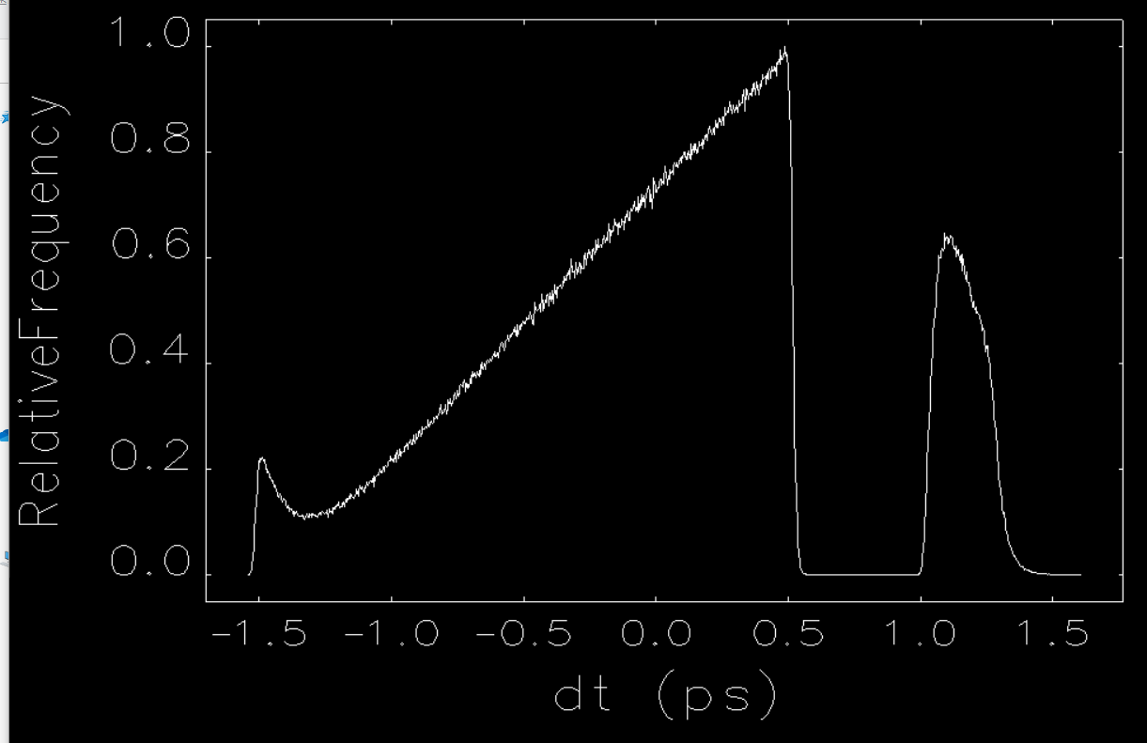
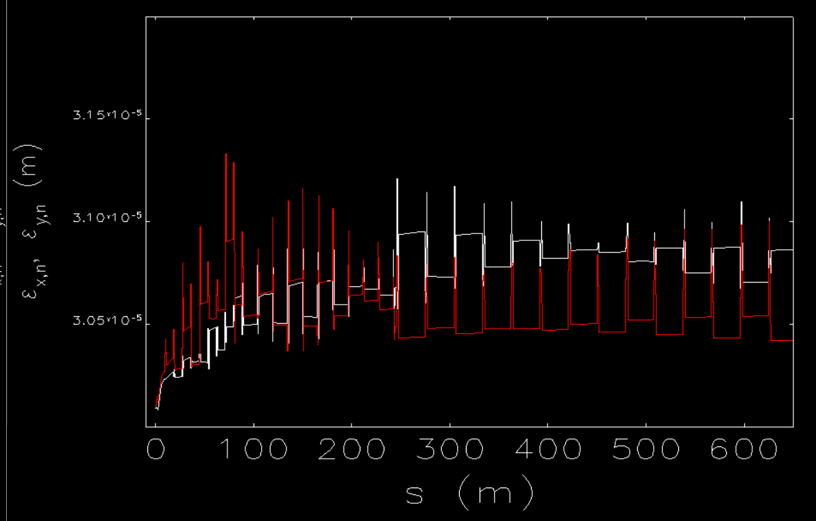
PWFA
Acceleration
Main Linac
  The longitudinal shape could be almost maintained
  The energy spread is too large for the FFS, which is because of the short range wakefield.
  A new chicane at the main linac has been introduced, the design is under optimization
    Long bunch length before the chicane to compensate energy spread
Preliminary design of the driven Linac was proposed, but have not fully meet the beam requirements of plasma acceleration. Further optimization and new method are needed.

Slide 15
Other consideration
Two-bunch acceleration
Bunch space
  Collider ring 650 MHz, booster 1300MHz, Linac 2860 MHz
    Common frequency: f0=130 MHz/n
    Bunch space f_bunch=k*f0
    SHB frequency
      f_shb1=m1*f_bunch
      f_shb2=m2*f_shb1
    f_linac=N*f_shb2
 | frequency |  | Multiple | Period
Common frequency | 13 | MHz | 1 | 76.9231 | ns
Two bunch | 13 | MHz | 1 | 76.9231 | ns
SHB1 | 143 | MHz | 11 | 6.9930 | ns
SHB2 | 572 | MHz | 44 | 1.7483 | ns
LINAC | 2860 | MHz | 220 | 0.3497 | ns
Booster | 1300 | MHz | 100 | 0.7692 | ns
Ring | 650 | MHz | 50 | 1.5385 | ns
  If RF gun is used, the bunch space is more flexible
Energy
  SLED timing for energy compensation
  BPM can distinguish the orbits of the two bunch
    energy measurement and orbit correction
Positron source
  Thermal Stress/shock wave effect
Scheme is possible, however difficulty
  beam commissioning
  LLRF
  BPM

Slide 16
Summary
The design of different schemes of the CEPC Linac is continuous refinement.
Some changes are in consideration for better compatibility and easier physical design.
The baseline scheme and alternative scheme can meet the requirements and have potential for further parameter requirements.
The scheme with beam based plasma wakefield acceleration (PWFA) was proposed. Although the preliminary design was finished, there is still a certain distance from the goal, and more effort and new methods are needed.
Thank you for your attention!

Slide 17
energy spread
Wakefield

Slide 18
Alternative design
COST!
The cost not included
  Source & Damping ring & transport lines @ LINAC
  All LTB hardware device
The cost increase 0.34 Billion CNY (38%), the energy grows up from 10 GeV to 20GeV
@J. R. Zhang
No. | System | Price （Ten thousand）
 |  | S-band (10 GeV) | S&C-band (20 GeV) | Gap
1 | RF system (Ch 6.5.1) | 33338 | 45622 | 12284
2 | RF power source (Ch 6.5.2) | 32190 | 46740 | 14550
3 | Magnets (Ch 6.5.3) | 2183 | 3323 | 1140
4 | Magnet power supplies (Ch 6.5.4) | 2050 | 2328 | 278
5 | Vacuum system (Ch.6.5.5) | 6060 | 10221 | 1847
6 | Instrumentation (Ch 6.5.6) | 6400 | 7335 | 935
7 | Control system (Ch 6.5.7) | 5793 | 6112 | 319
8 | Mechanical systems (Ch 6.5.8) | 1070 | 1327 | 257
 | Total | 89084 | 123008 | 33924

