Slide 1
Work of 650MHz800kW CEPC klystron’s development in GLVAC
Wang Shaozhe

Slide 2
Outline
Work of first CEPC klystron in GLVAC
Facilities establishment
Components manufacture
Final assembly & baking
The following process
Klystron pack & transport
Test result
Work of 650MHz800kW CEPC klystron’s development in GLVAC

Slide 3
Outline
Work of first CEPC klystron in GLVAC
Facilities establishment
Components manufacture
Final assembly & baking
The following process
Klystron pack & transport
Test result
Work of 650MHz800kW CEPC klystron’s development in GLVAC

Slide 4
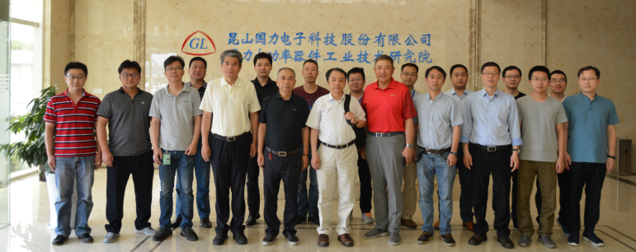
Work of first CEPC klystron in GLVAC
IT IS A JOINT PROJECT
To develop the 650MHz/800kW CW klystron for CEPC and push its efficiency up to 80%, IHEP, IECAS and GLVAC established the collaboration group for the klystron development in 12th 2017, and its group meeting was held every 3 months.
Collaboration group meeting held in GLVAC (6th 2018)
Work of 650MHz800kW CEPC klystron’s development in GLVAC

Slide 5
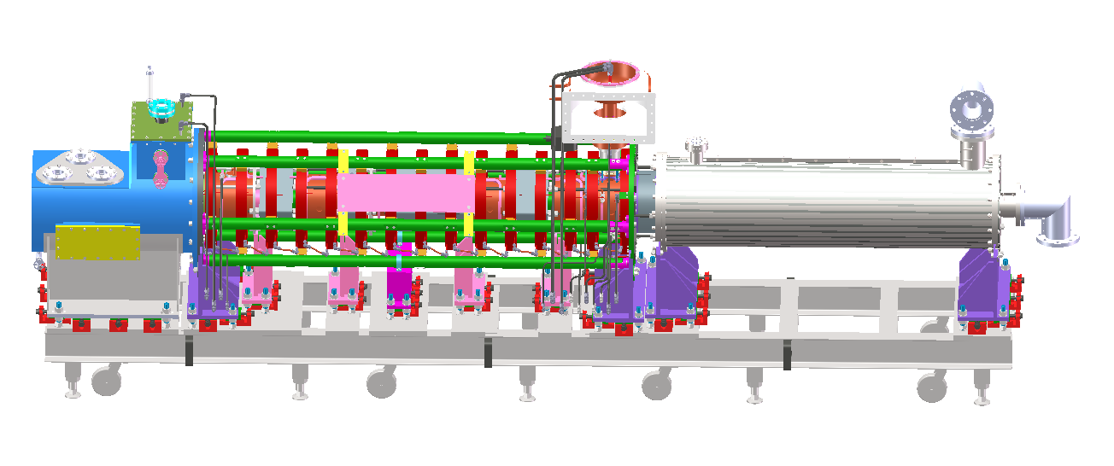
Work of first CEPC klystron in GLVAC
Design
Final assembly (participate)
Baking (participate)
Following process (participate)
Test
E-gun
Cavities
Final assembly (participate)
Baking (participate)
Collector
Coils
Oil cylinder
Operation support
Final assembly & baking
Following process
Klystron pack & transport
Test (participate)
Work of 650MHz800kW CEPC klystron’s development in GLVAC

Slide 6
Outline
Work of first CEPC klystron in GLVAC
Facilities establishment
Components manufacture
Final assembly & baking
The following process
Klystron pack & transport
Test result
Work of 650MHz800kW CEPC klystron’s development in GLVAC

Slide 7
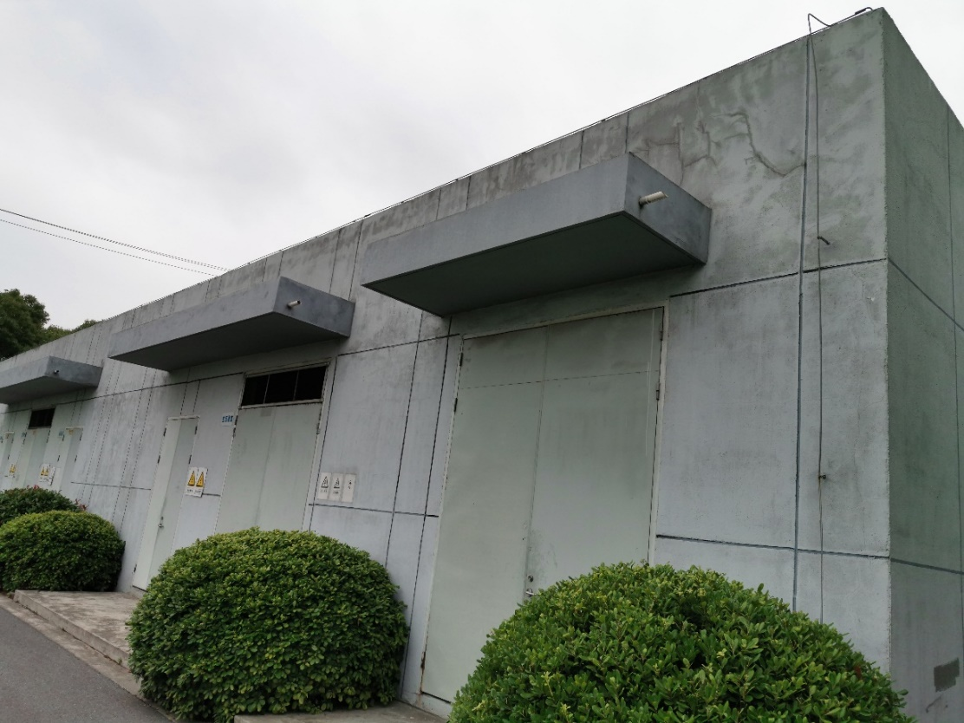
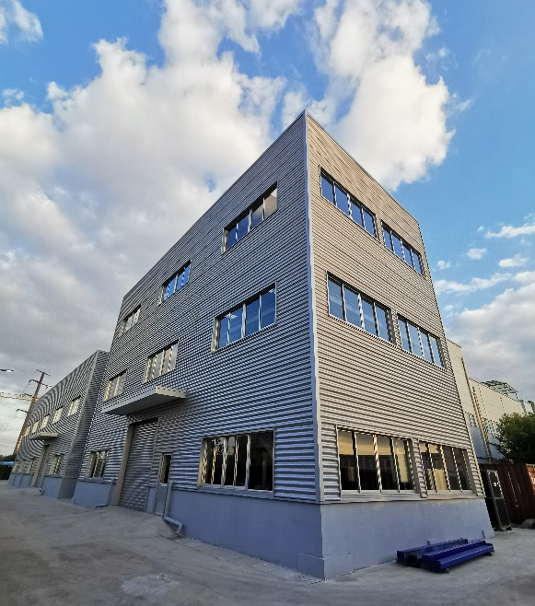
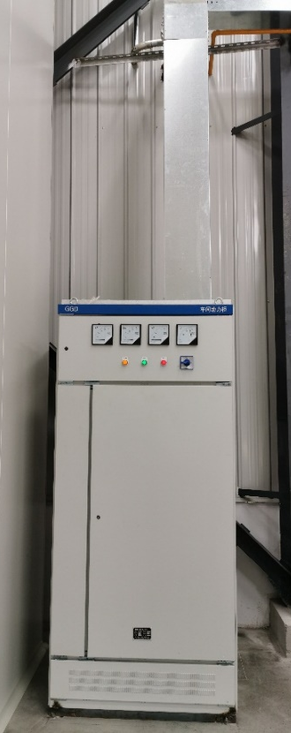
Facilities establishment
The Invest capital of all in GLVAC is more than RMB 20,000,000
Baking-workshop Building
Electricity expansion of 400kW
Work of 650MHz800kW CEPC klystron’s development in GLVAC

Slide 8
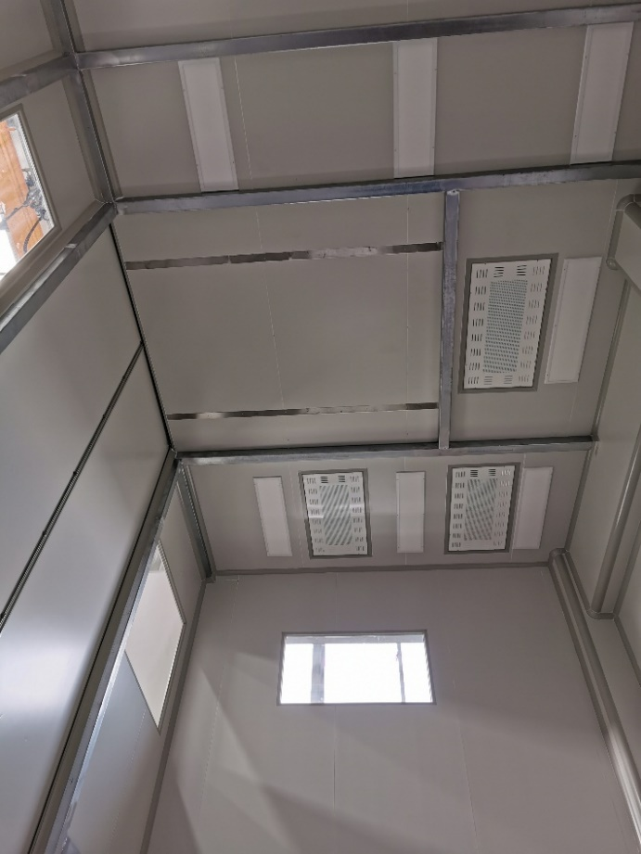
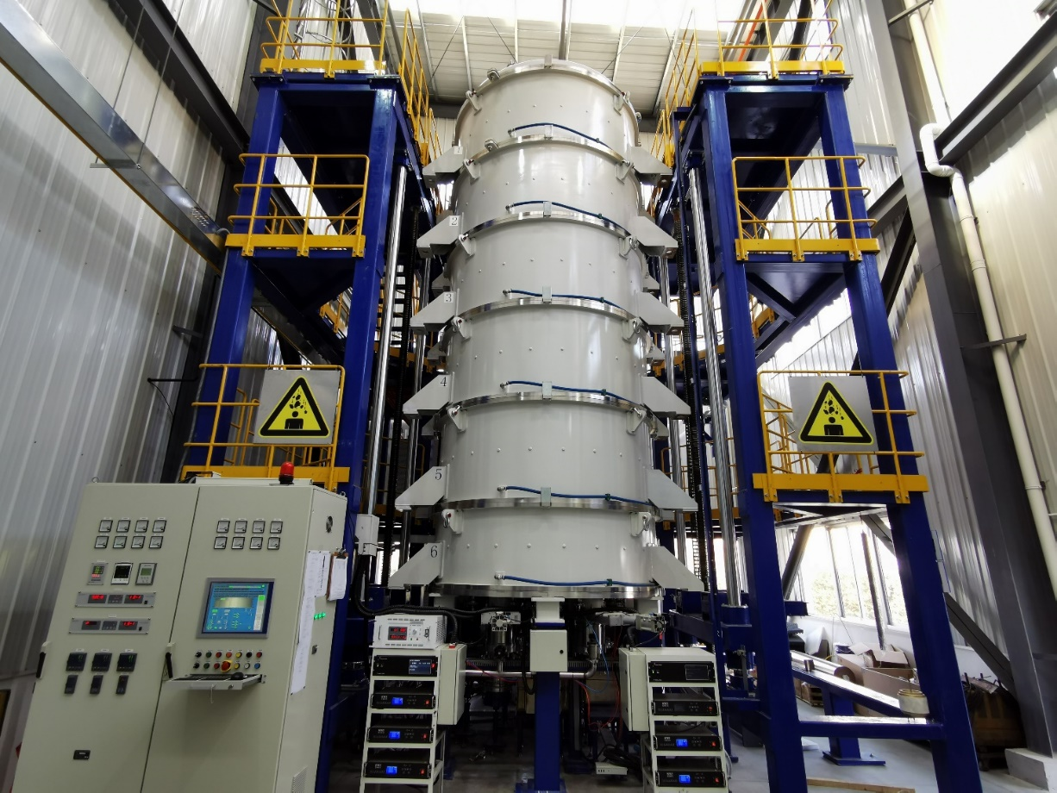
Facilities establishment
7 meters high & CL-100K air
Cleanliness clean room
Largest baking oven in Asia
More than 8 meters high
Work of 650MHz800kW CEPC klystron’s development in GLVAC

Slide 9
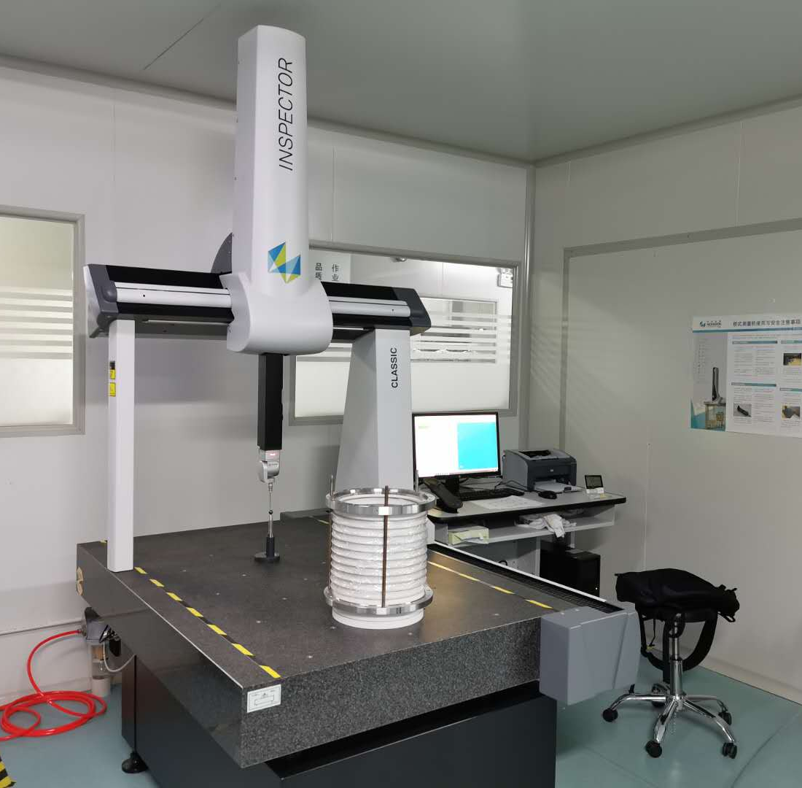
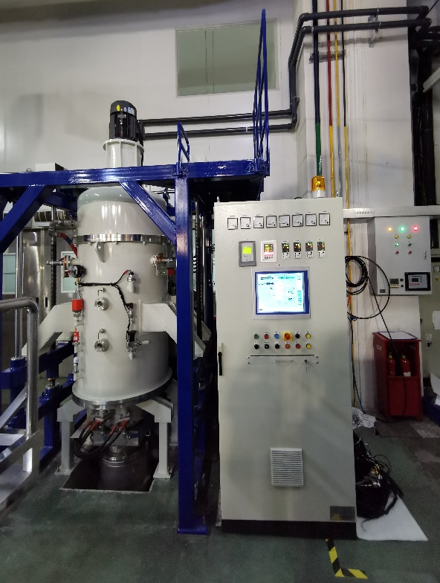
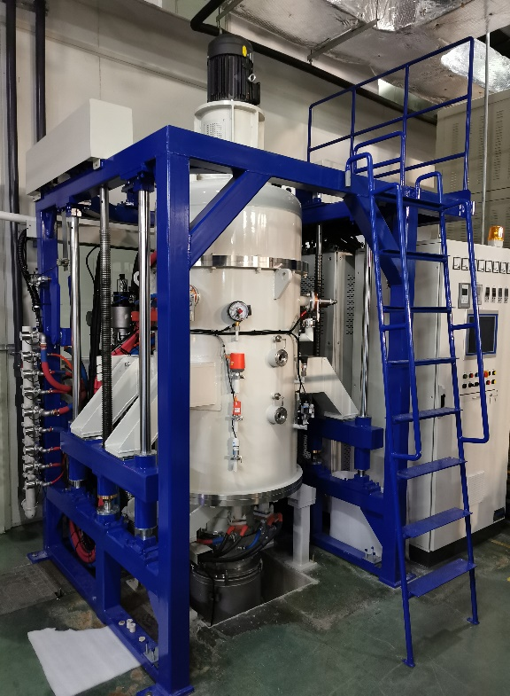
Facilities establishment
Three coordinate measuring system
Special equipment of Vacuum Ovens
Work of 650MHz800kW CEPC klystron’s development in GLVAC

Slide 10
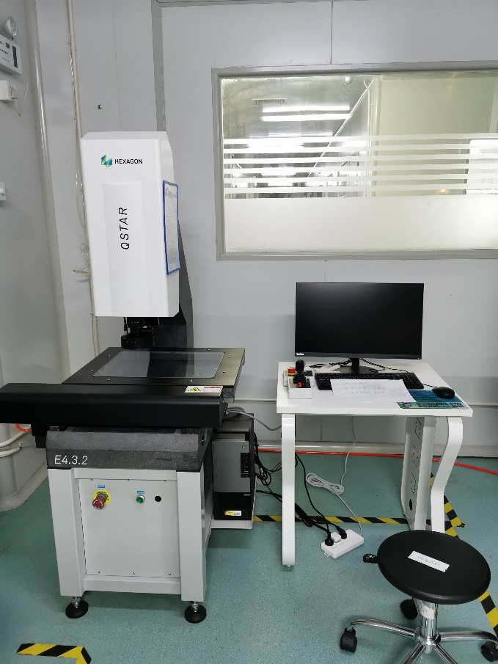
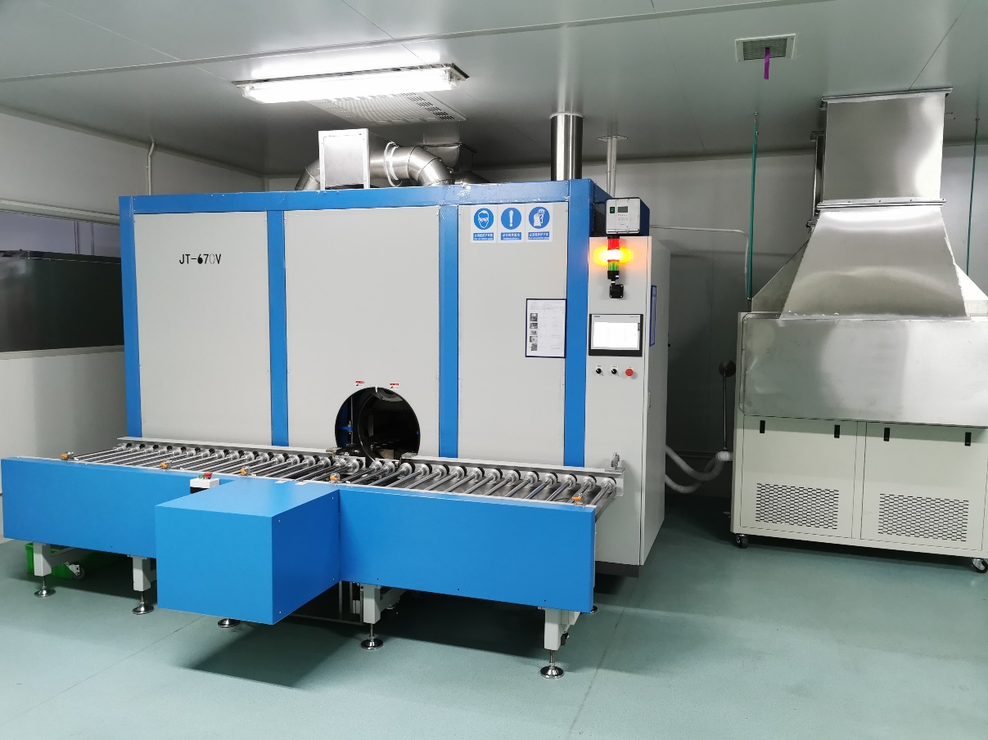
Facilities establishment
YVM
full-automatic Gaseous Phase Cleaning Machine
Work of 650MHz800kW CEPC klystron’s development in GLVAC

Slide 11
Outline
Work of first CEPC klystron in GLVAC
Facilities establishment
Components manufacture
Final assembly & baking
The following process
Klystron pack & transport
Test result
Work of 650MHz800kW CEPC klystron’s development in GLVAC

Slide 12
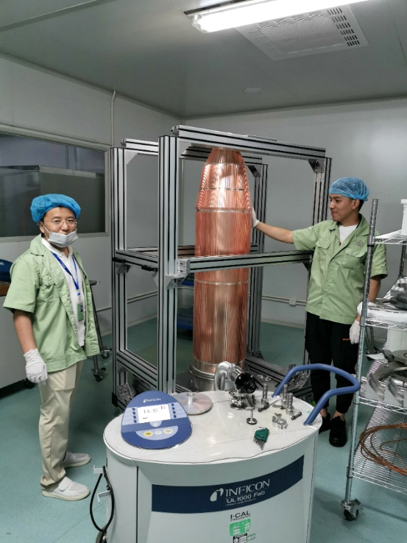
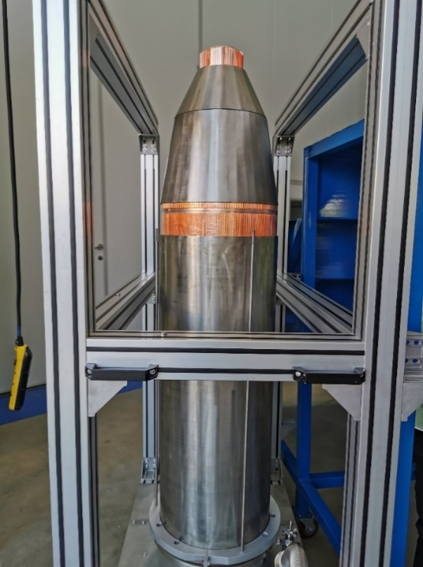
Components manufacture
The 1.8 meters high collector and its water jacket
After brazing its whole perpendicularity is less than 0.2mm
Leak hunting for the copper part in the leak rate less than -10 Pa· m3 /s after brazed
Work of 650MHz800kW CEPC klystron’s development in GLVAC

Slide 13
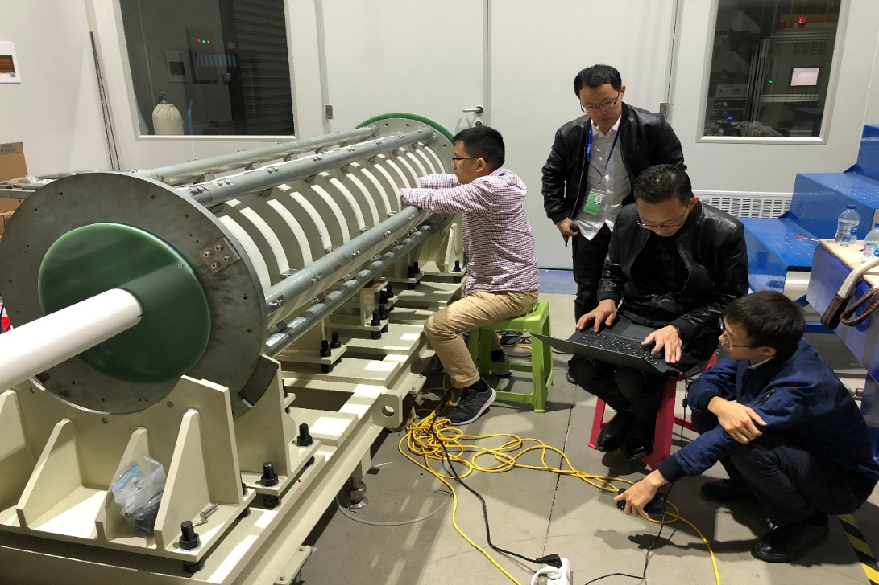
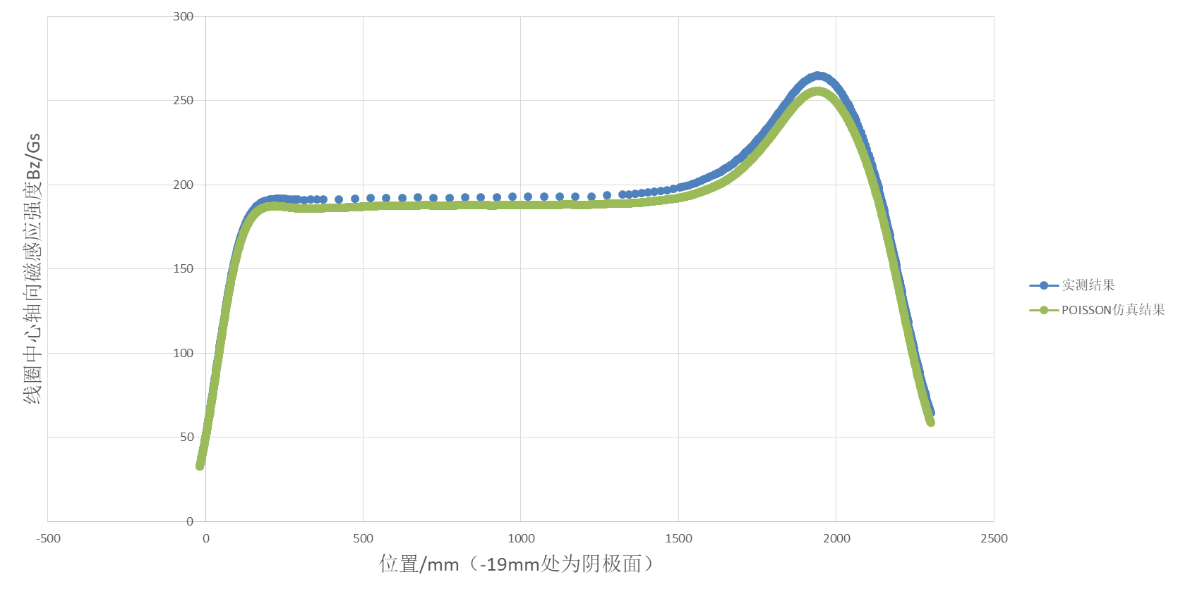
Components manufacture
The 2.2 meters long coils system
Error between magnetic field measurement and simulation is less than 3%
Work of 650MHz800kW CEPC klystron’s development in GLVAC

Slide 14
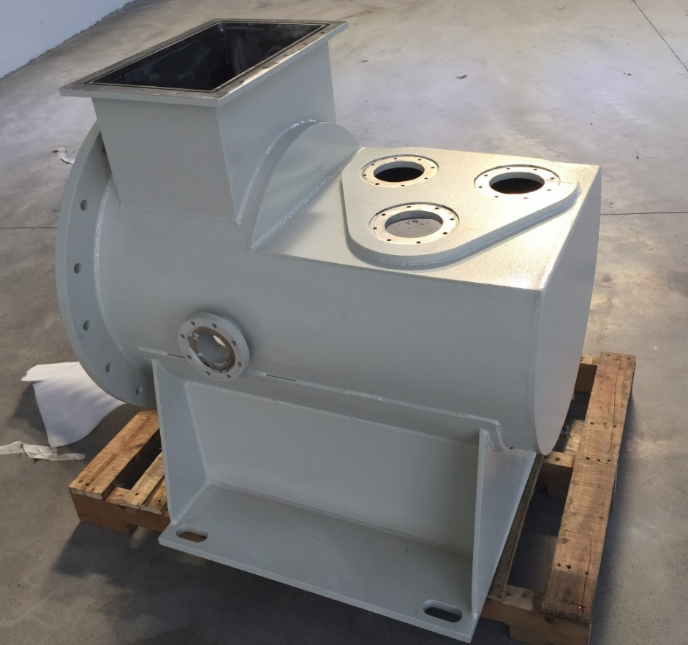
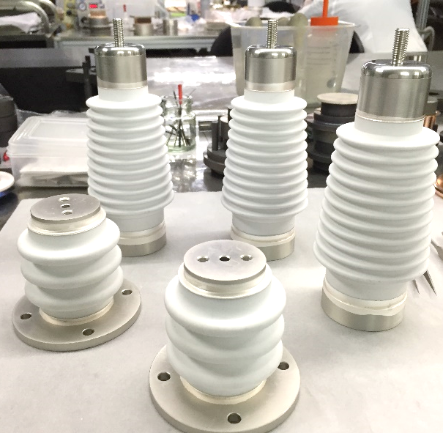
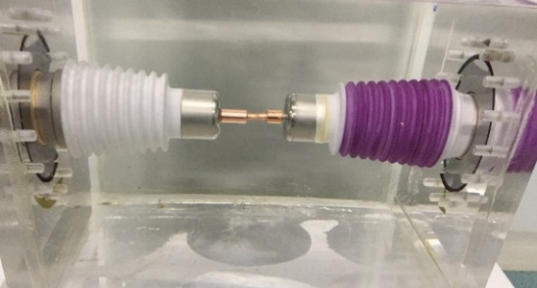
Components manufacture
Shell of oil cylinder
High-pressure components (passed 200kV test)
Work of 650MHz800kW CEPC klystron’s development in GLVAC

Slide 15
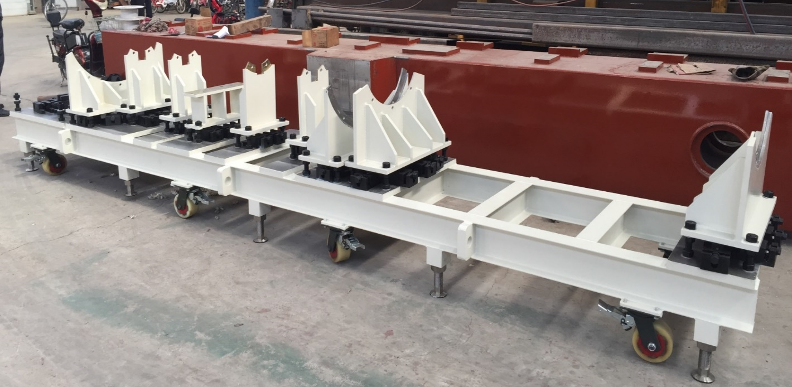
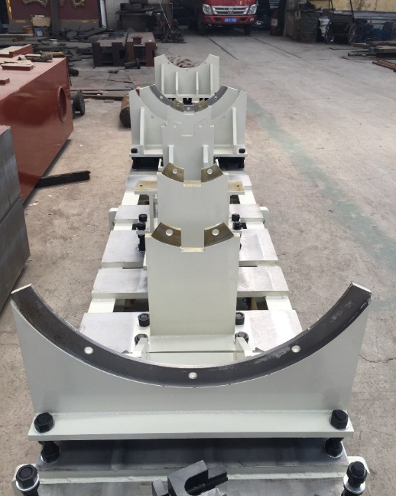
Components manufacture
Operation support
Work of 650MHz800kW CEPC klystron’s development in GLVAC

Slide 16
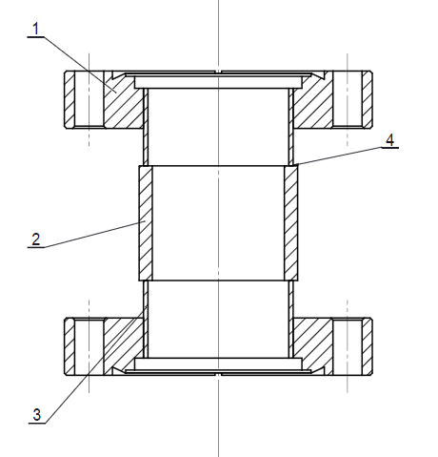
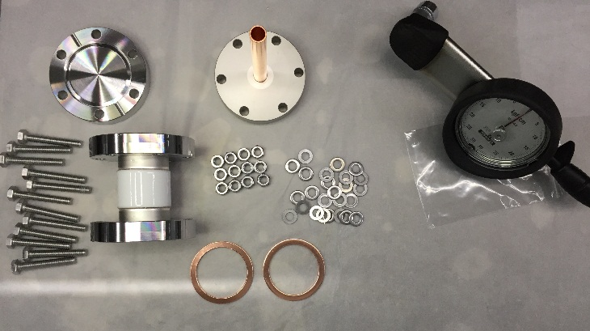
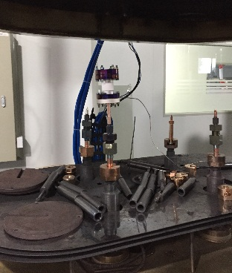
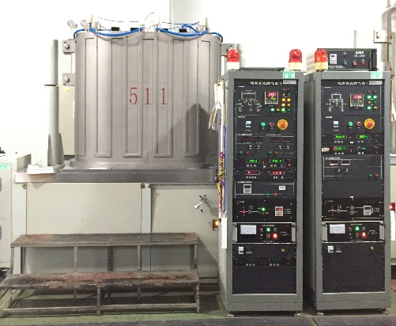
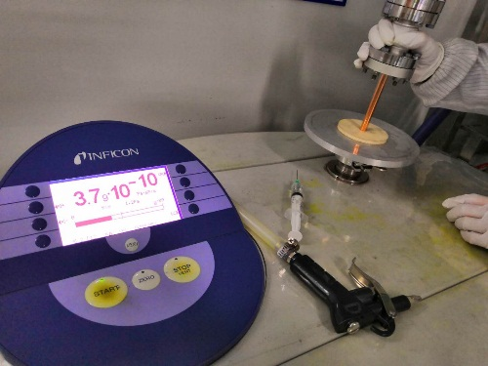
Components manufacture
Insulating part for klystron baking
Drawing
Assembly
leak hunting
Pinch off
Baking test
Work of 650MHz800kW CEPC klystron’s development in GLVAC

Slide 17
Outline
Work of first CEPC klystron in GLVAC
Facilities establishment
Components manufacture
Final assembly & baking
The following process
Klystron pack & transport
Test result
Work of 650MHz800kW CEPC klystron’s development in GLVAC

Slide 18
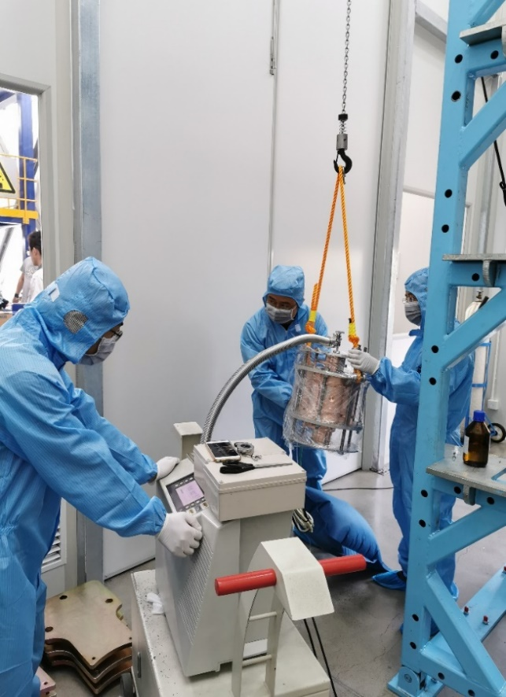
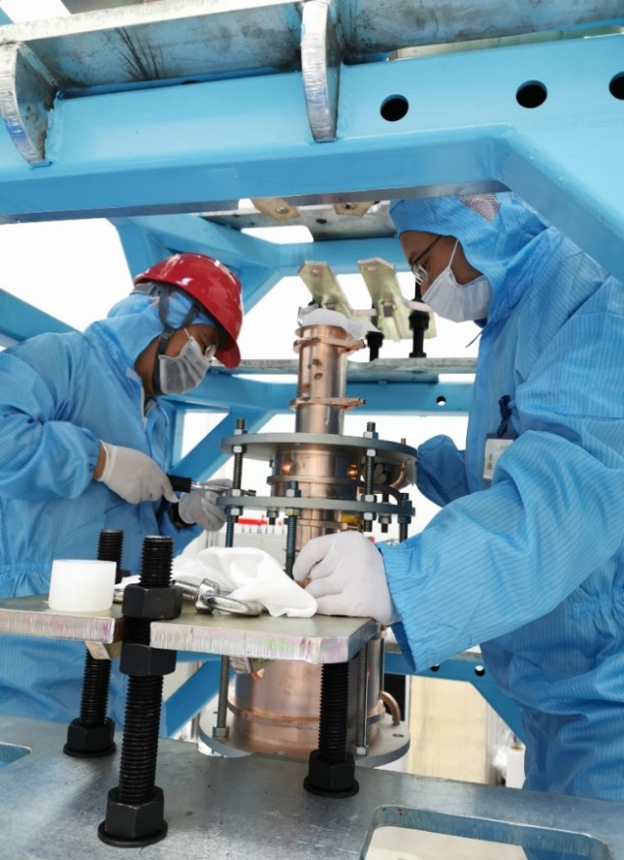
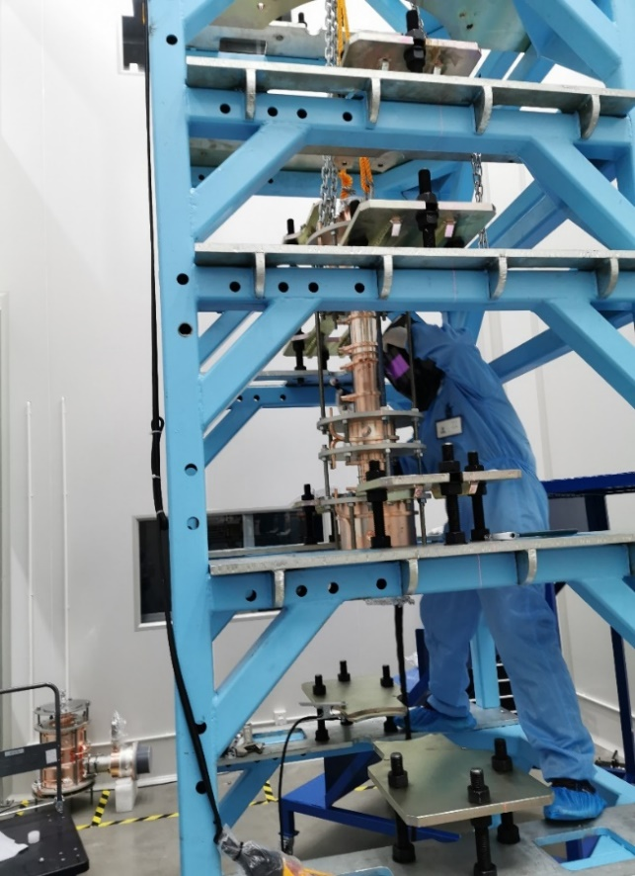
Final assembly & baking
Assembly and leak hunting of the cavities
Work of 650MHz800kW CEPC klystron’s development in GLVAC

Slide 19
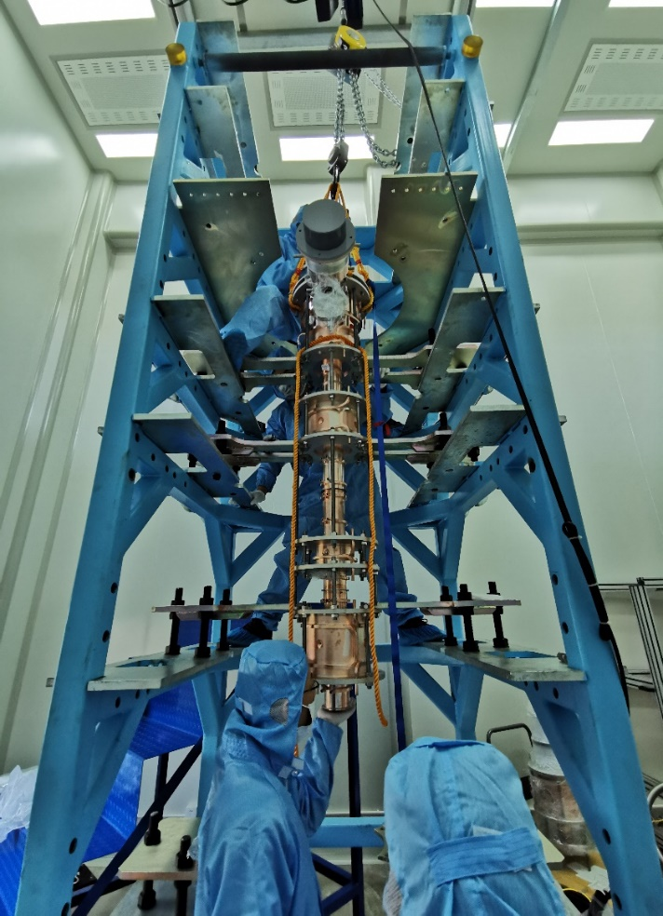
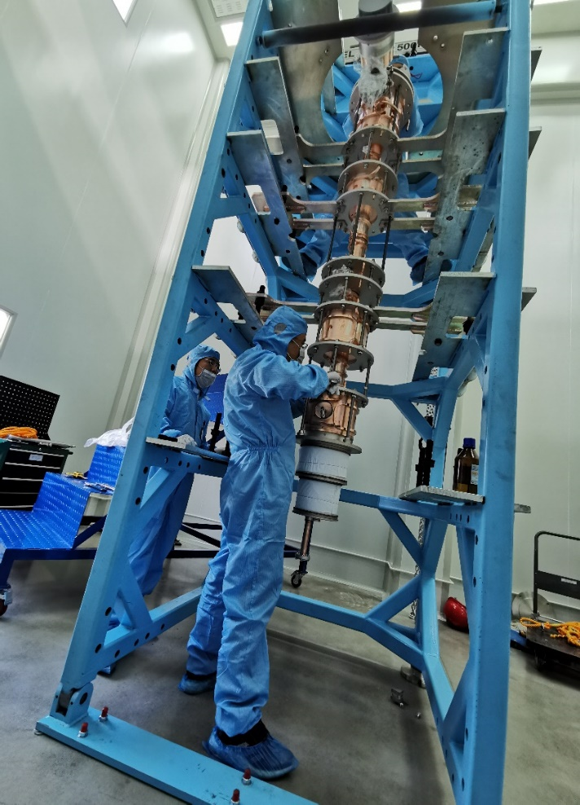
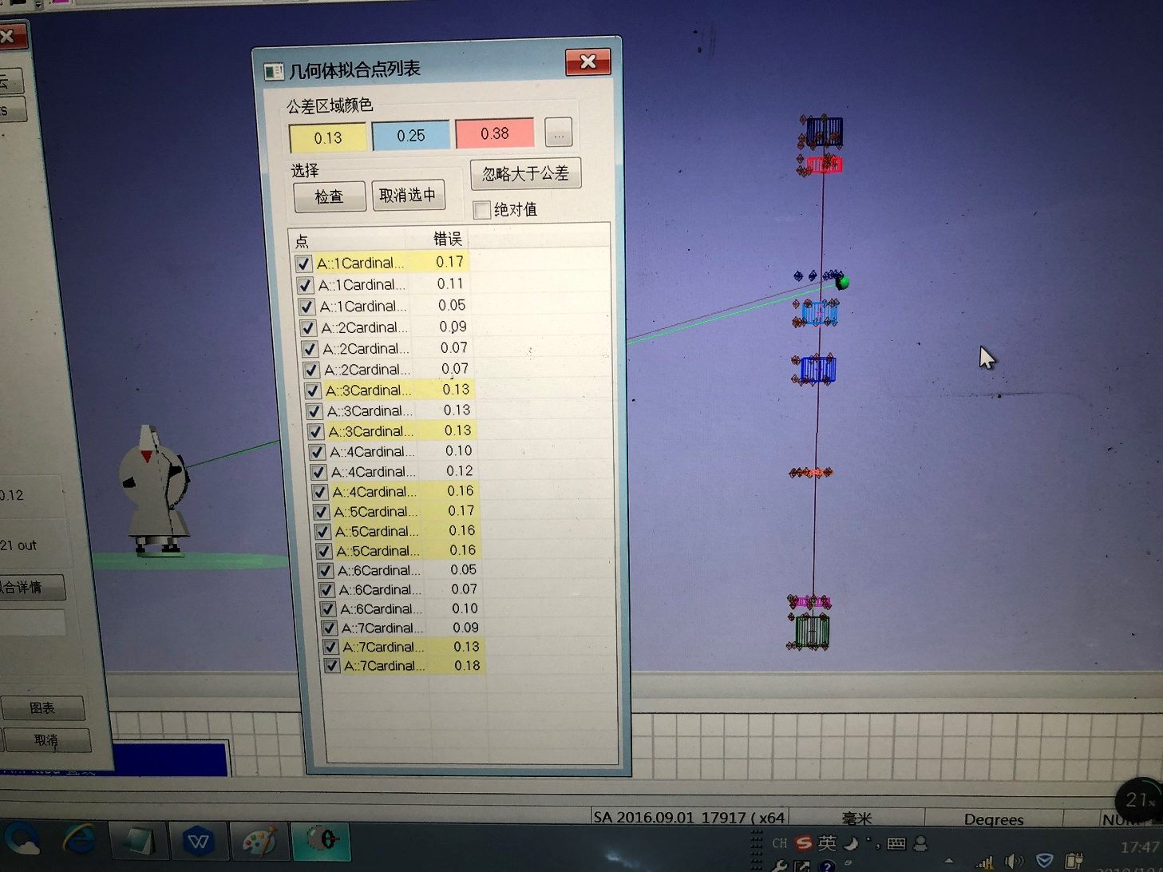
Final assembly & baking
Assembly and leak hunting of e-gun
After adjusting, the concentricity of the cavities is ±0.18mm
Work of 650MHz800kW CEPC klystron’s development in GLVAC

Slide 20
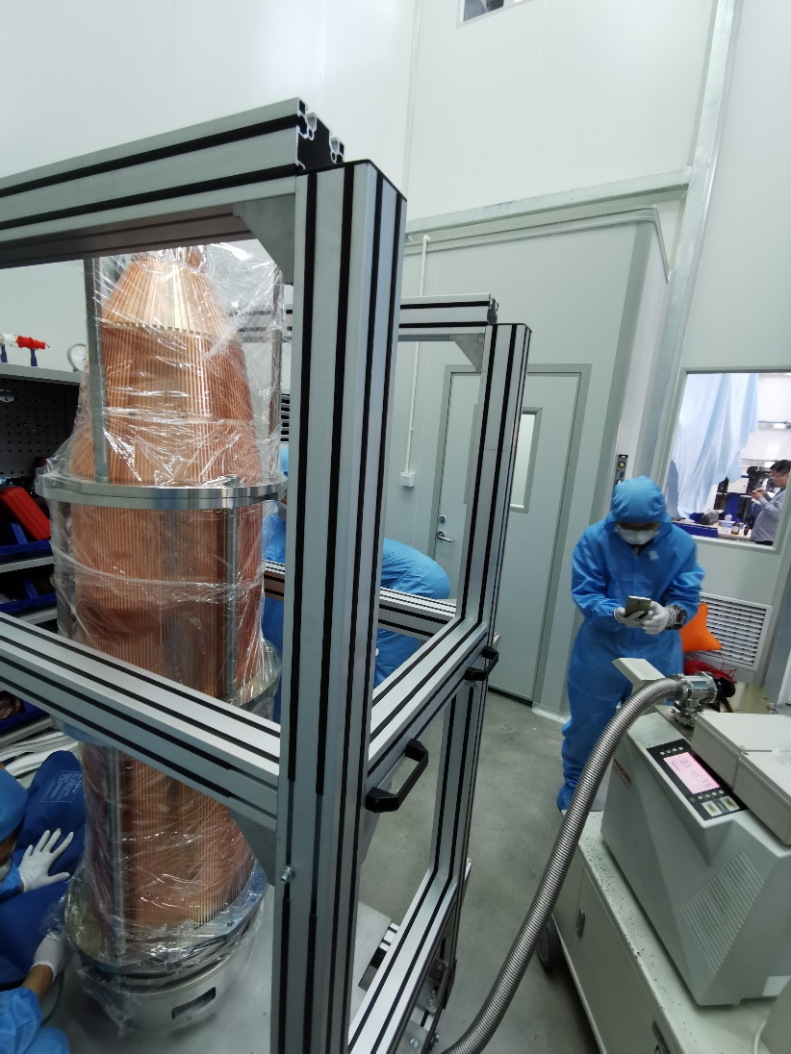
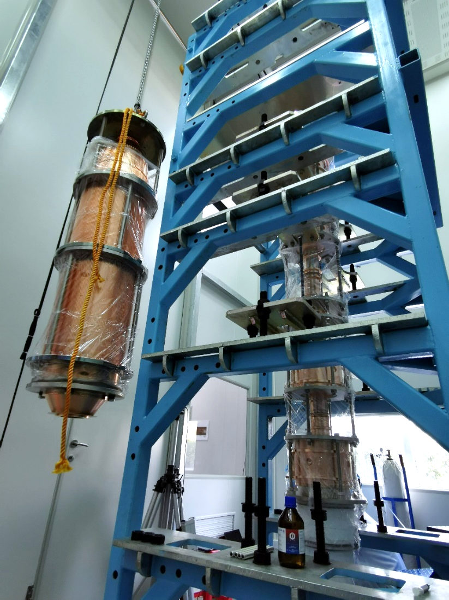
Final assembly & baking
Assembly and leak hunting of collector
Work of 650MHz800kW CEPC klystron’s development in GLVAC

Slide 21
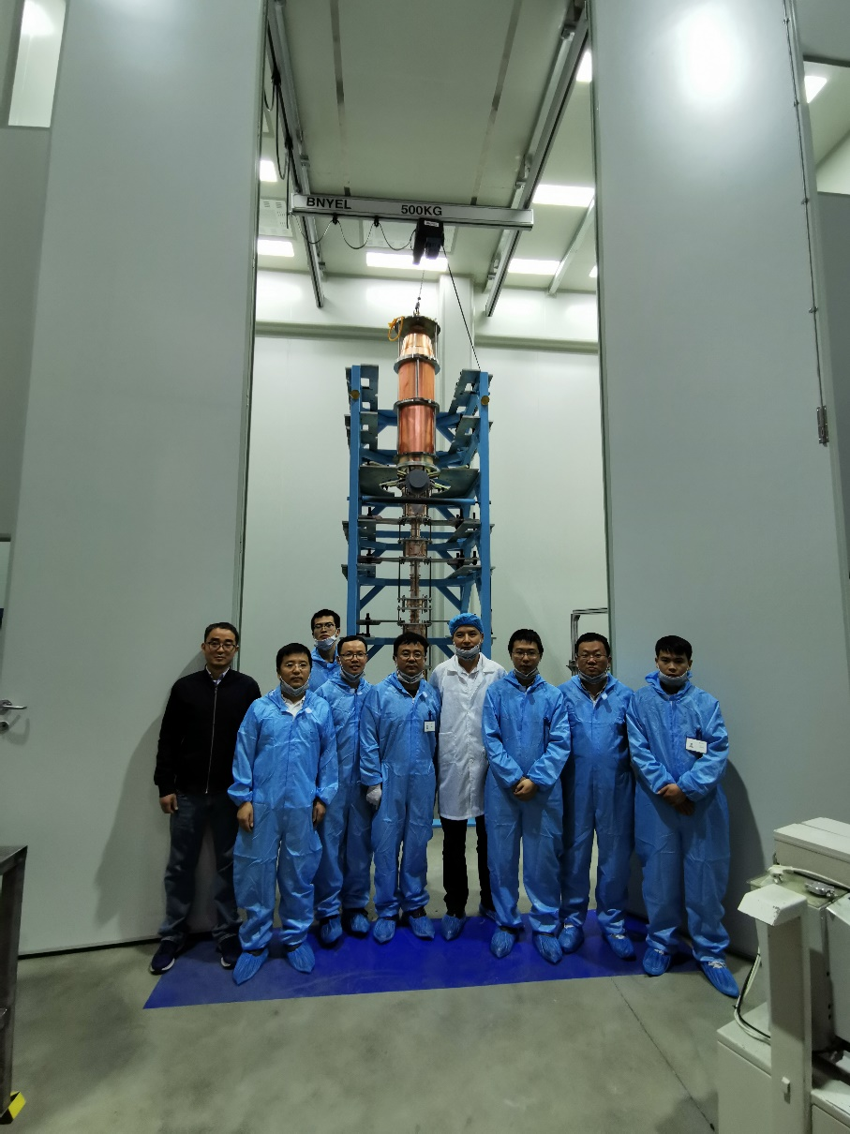
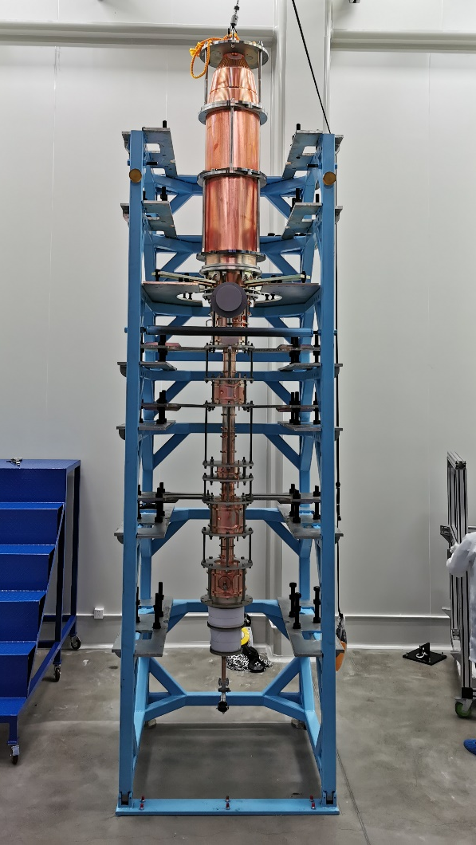
Final assembly & baking
End of final assembly
Work of 650MHz800kW CEPC klystron’s development in GLVAC

Slide 22
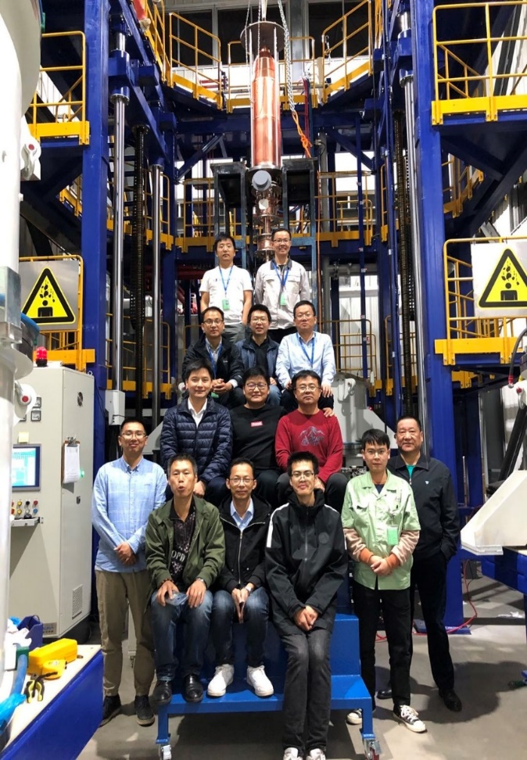
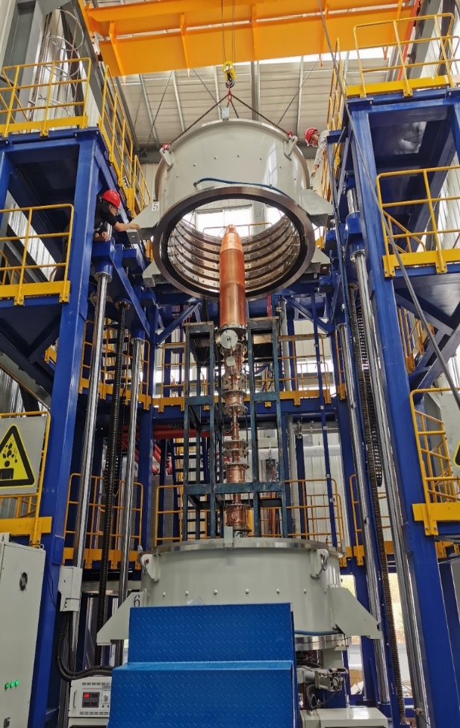
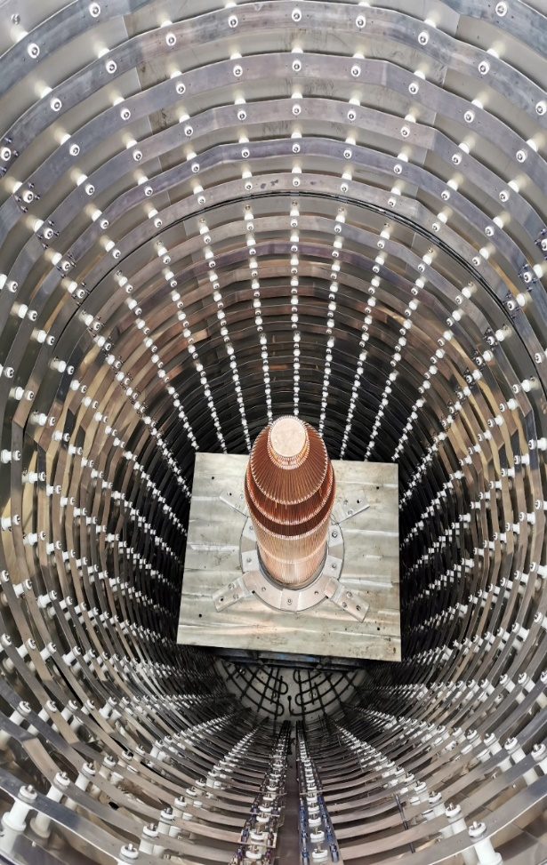
Final assembly & baking
Move the klystron to the baking oven
Work of 650MHz800kW CEPC klystron’s development in GLVAC

Slide 23
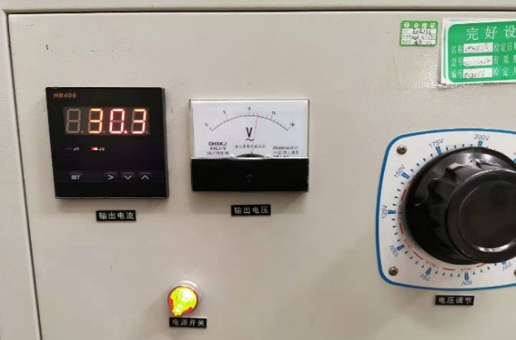
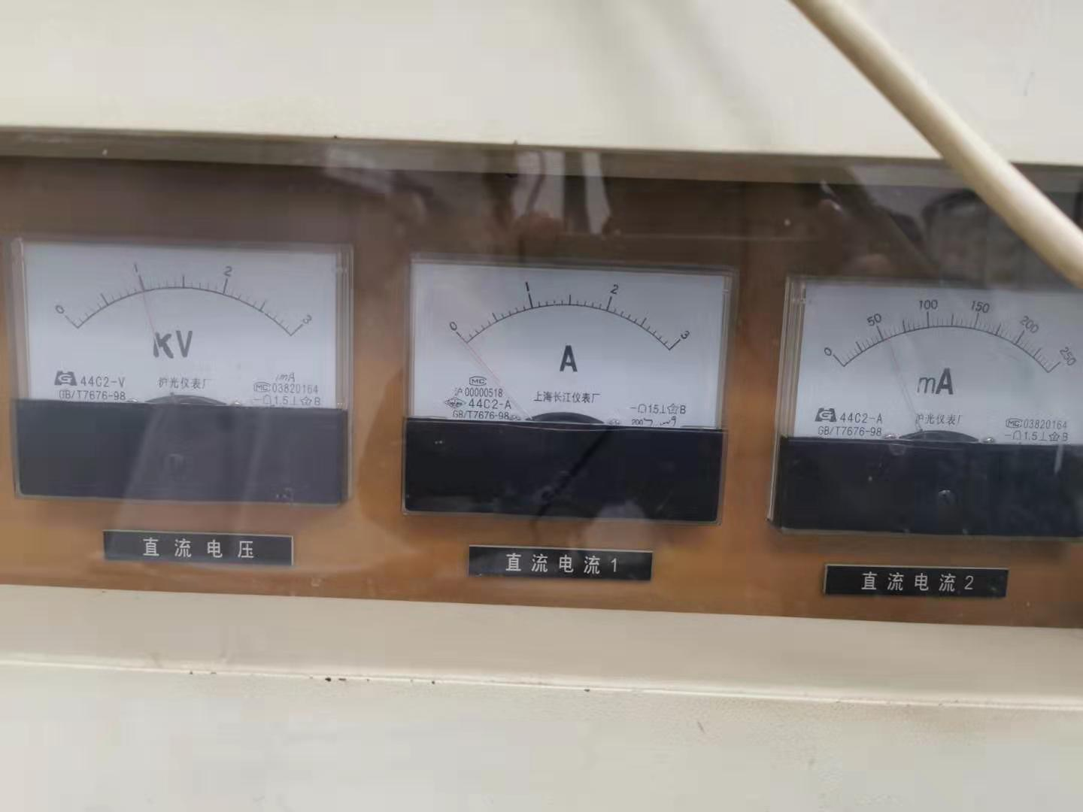
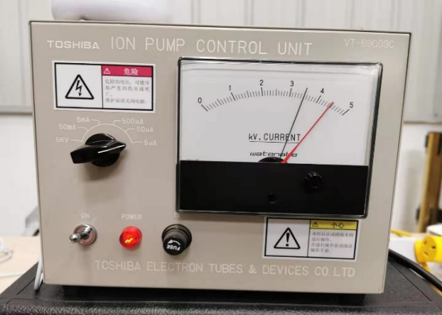
Final assembly & baking
Measurement of electron emission capability
The emission current is 52mA at 1kV which the theoretical value is between 45-55mA
Work of 650MHz800kW CEPC klystron’s development in GLVAC

Slide 24
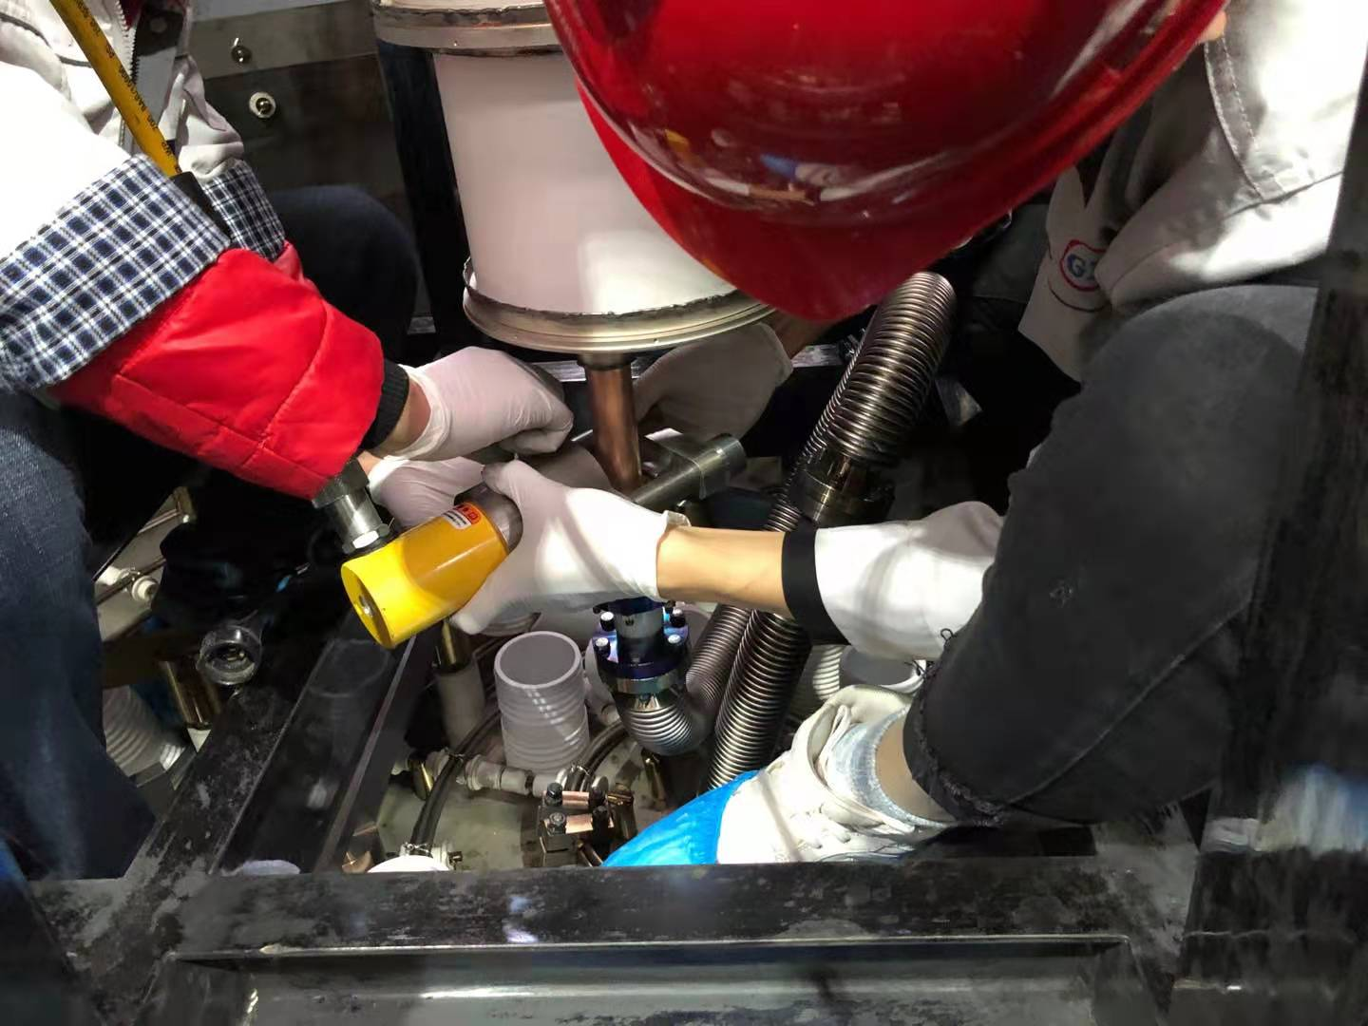
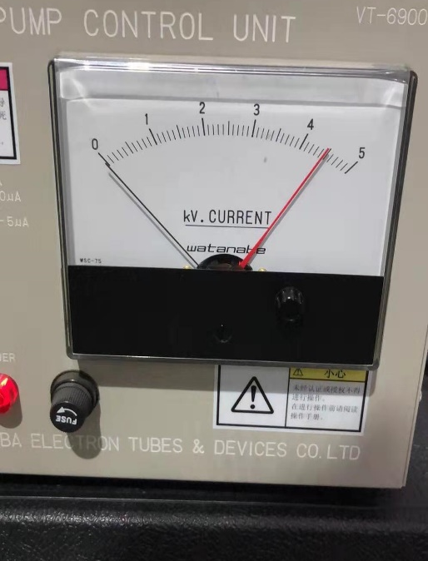
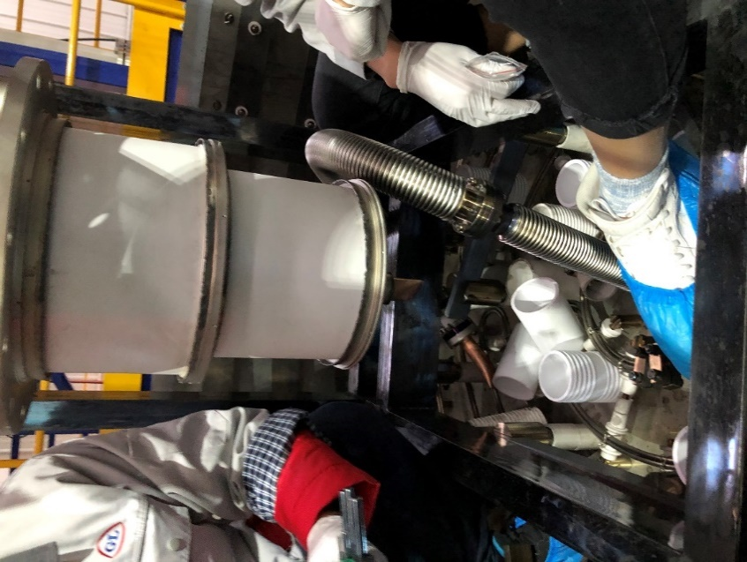
Final assembly & baking
Pinch off
Before pinch off, the vacuum in tube is better than 3.3e-8Pa
After pinch off, the current of titanium pump is almost 0mA
Work of 650MHz800kW CEPC klystron’s development in GLVAC

Slide 25
Outline
Work of first CEPC klystron in GLVAC
Facilities establishment
Components manufacture
Final assembly & baking
The following process
Klystron pack & transport
Test result
Work of 650MHz800kW CEPC klystron’s development in GLVAC

Slide 26
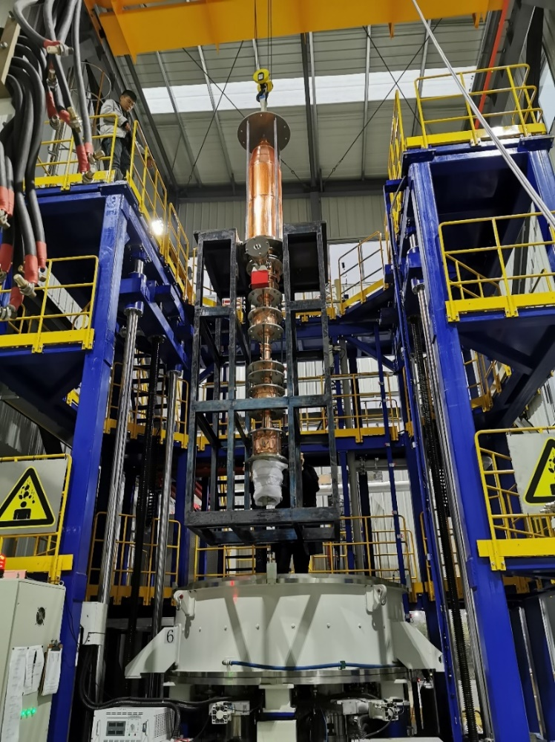
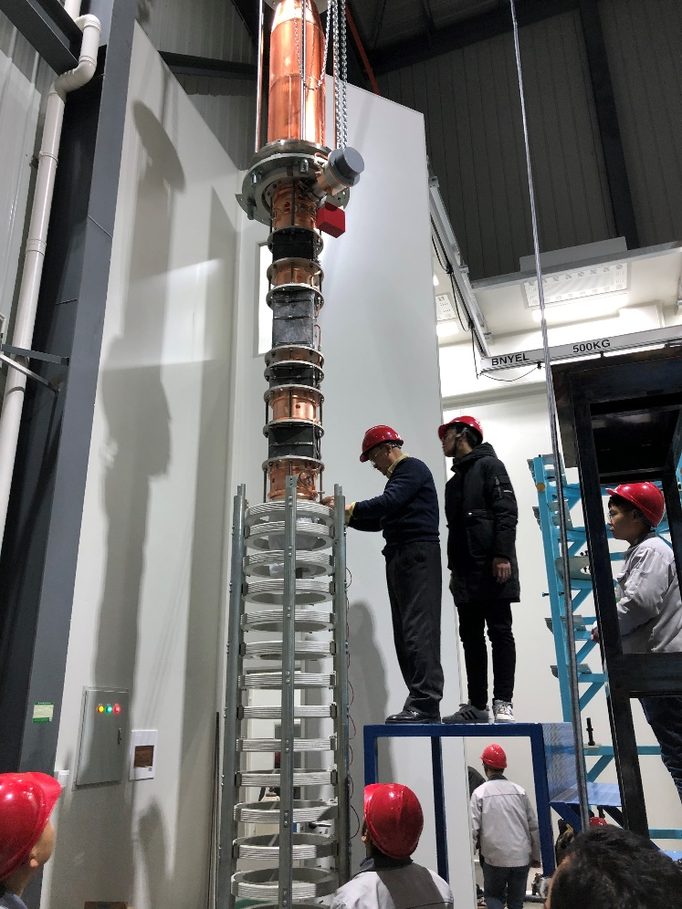
The following process
Taken out of the baking oven
Installation of solenoid system
Work of 650MHz800kW CEPC klystron’s development in GLVAC

Slide 27
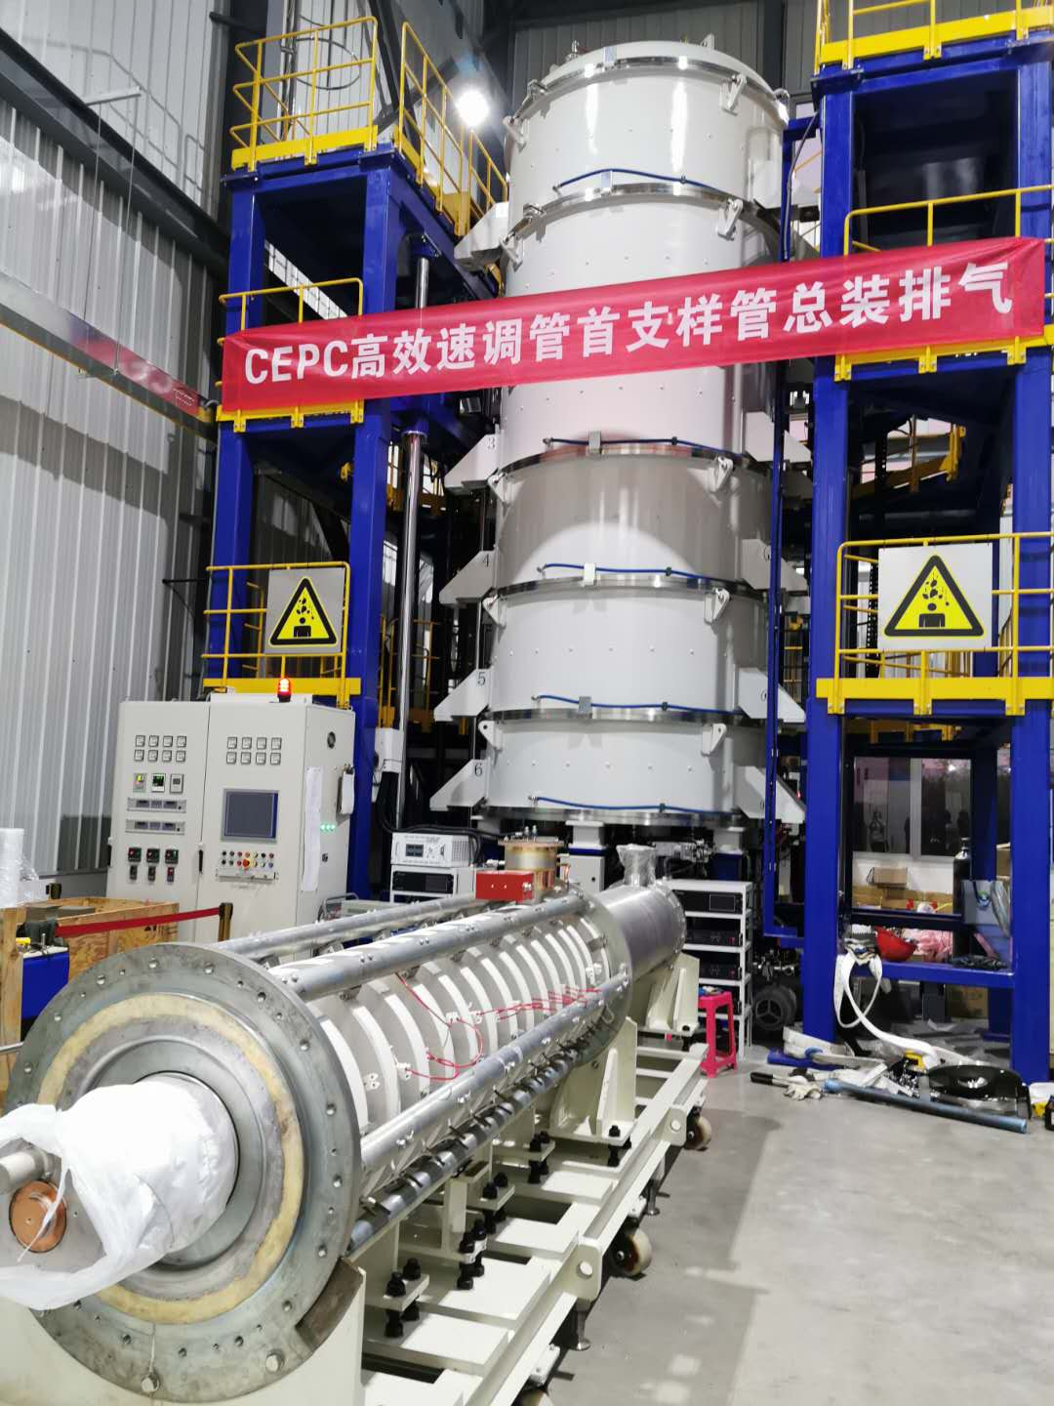
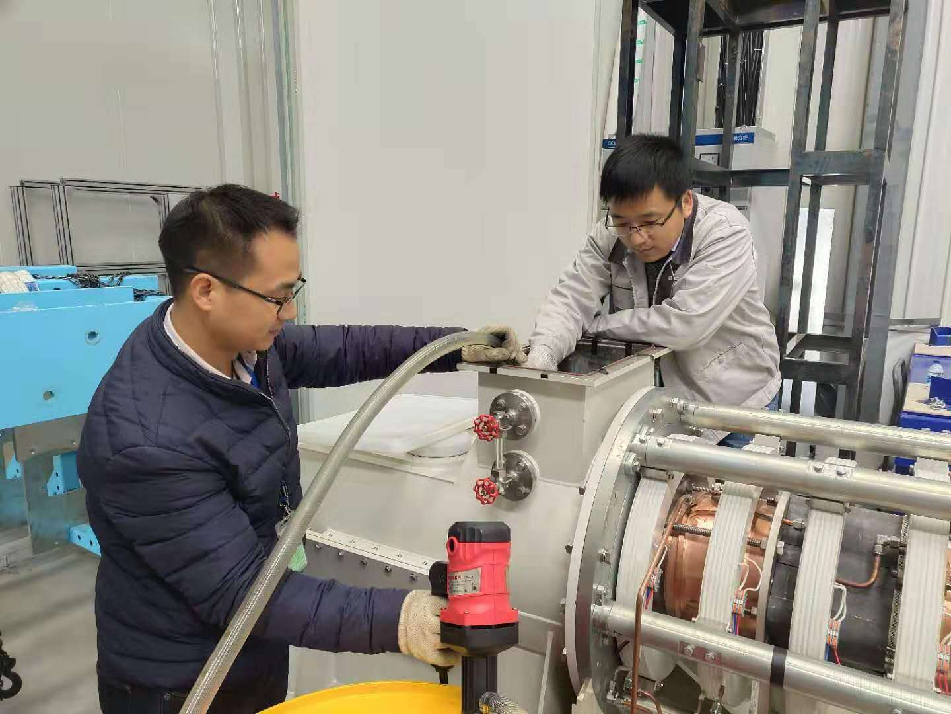
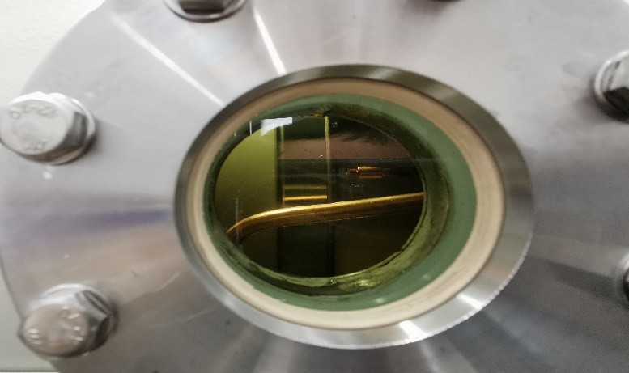
The following process
Put the tube onto the operation support
Installation of oil cylinder and the oil storage test
Work of 650MHz800kW CEPC klystron’s development in GLVAC

Slide 28
The following process
All following process was down
Work of 650MHz800kW CEPC klystron’s development in GLVAC

Slide 29
Outline
Work of first CEPC klystron in GLVAC
Facilities establishment
Components manufacture
Final assembly & baking
The following process
Klystron pack & transport
Test result
Work of 650MHz800kW CEPC klystron’s development in GLVAC

Slide 30
Klystron pack & transport
Klystron packing
Work of 650MHz800kW CEPC klystron’s development in GLVAC

Slide 31
Klystron pack & transport
Transport by air cushion vehicle
Work of 650MHz800kW CEPC klystron’s development in GLVAC

Slide 32
Klystron pack & transport
Open the package
Work of 650MHz800kW CEPC klystron’s development in GLVAC

Slide 33
Klystron pack & transport
Hoisting and move to the test platform
Work of 650MHz800kW CEPC klystron’s development in GLVAC

Slide 34
Klystron pack & transport
Record the vibration situation all the time
Crane operation in GLVAC
Transport situation
Day 1
Transport situation
Day 2
Crane operation in IHEP
Work of 650MHz800kW CEPC klystron’s development in GLVAC

Slide 35
Outline
Work of first CEPC klystron in GLVAC
Facilities establishment
Components manufacture
Final assembly & baking
The following process
Klystron pack & transport
Test result
Work of 650MHz800kW CEPC klystron’s development in GLVAC

Slide 36
Test result
The klystron has been tested in IHEP
Output power: 400kW CW or 800kW 40% duty ratio (limited by the test platform)
Efficiency: 62% (63% design value)
Gain: 43dB
Bandwidth: >1MHz (1dB)
Work of 650MHz800kW CEPC klystron’s development in GLVAC

Slide 37
Next One
12th 2020 - 3rd 2021 Components manufacture
4th 2021 Final assembly
5th 2021 Baking
6th 2021 Transport & Test
Work of 650MHz800kW CEPC klystron’s development in GLVAC

Slide 38
Acknowledgement
Thanks !
Work of 650MHz800kW CEPC klystron’s development in GLVAC

