Slide 1
Physics Performance of the New Concept with Crystal ECAL and Dual Readout HCAL
Chris Tully (Princeton)
(accepted for publication)
https://arxiv.org/abs/2008.00338
The 2020 International Workshop
on High Energy Circular Electron Positron Collider

Slide 2
What is in the paper?
A calorimeter design that has the highest energy resolution for both photons and neutral hadrons
  Implemented a working solution for the problem of crystals destroying hadronic calorimeter resolution
  Solved some practical issues related to the solenoid and cost-performance optimization
Demonstrated the range of tracker parameters and high EM resolution that bring Z→ee up to ~80% the Z→μμ recoil resolution
Introduced π⁰ photon pre-clustering performance benchmarks for EM resolution
Calorimeters have the highest interaction cross-sections and therefore high intrinsic potential for particle ID
  We explore e/pi ( ~ γ/K_{L} ) separation with the ECAL alone
  (Beyond paper) Our gains on π⁰ photon pre-clustering performance using Graph Theory suggest calo-PID could have a bigger role in PFA

Slide 3
Segmented Crystal Option of IDEA
Segmented Crystal ECAL
+ Precision Timing Layer

Slide 4
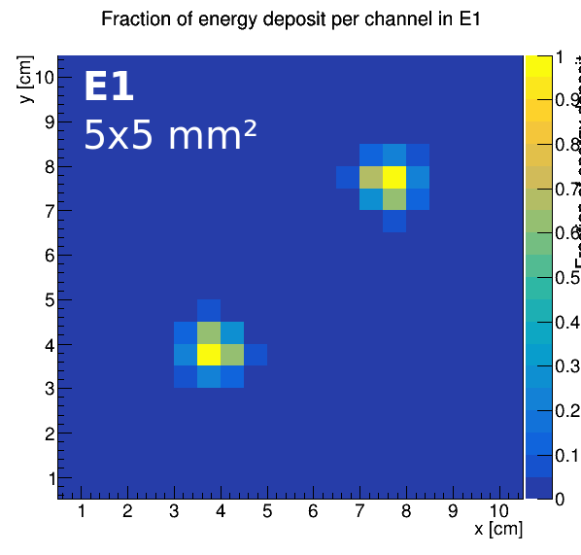
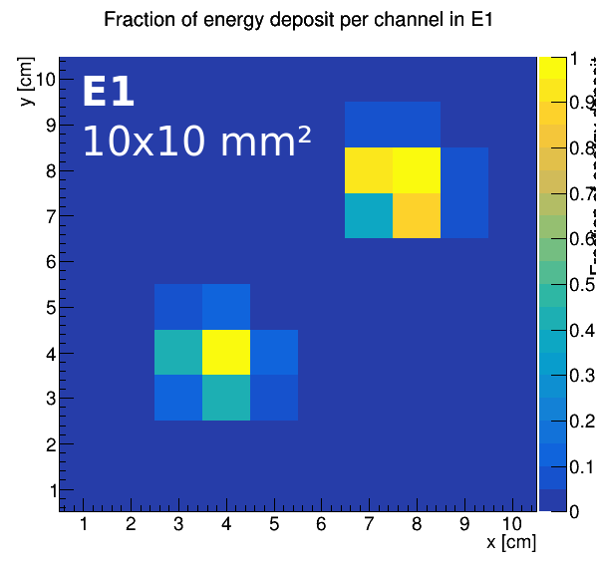
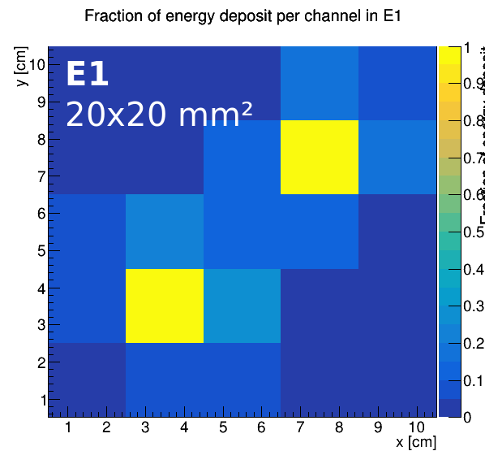
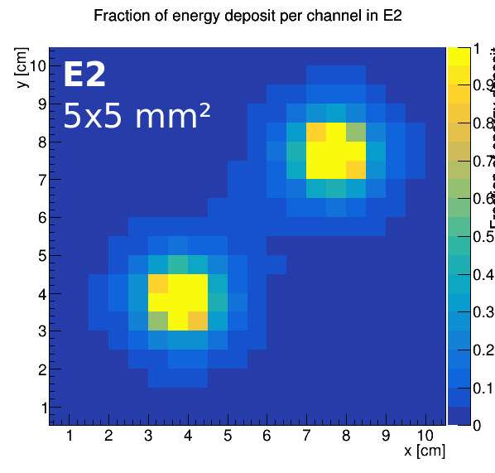
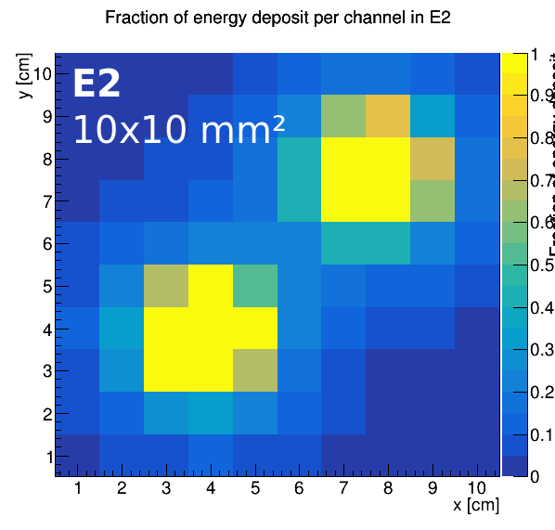
Front/Rear Crystal Transverse Segmentation

Slide 5
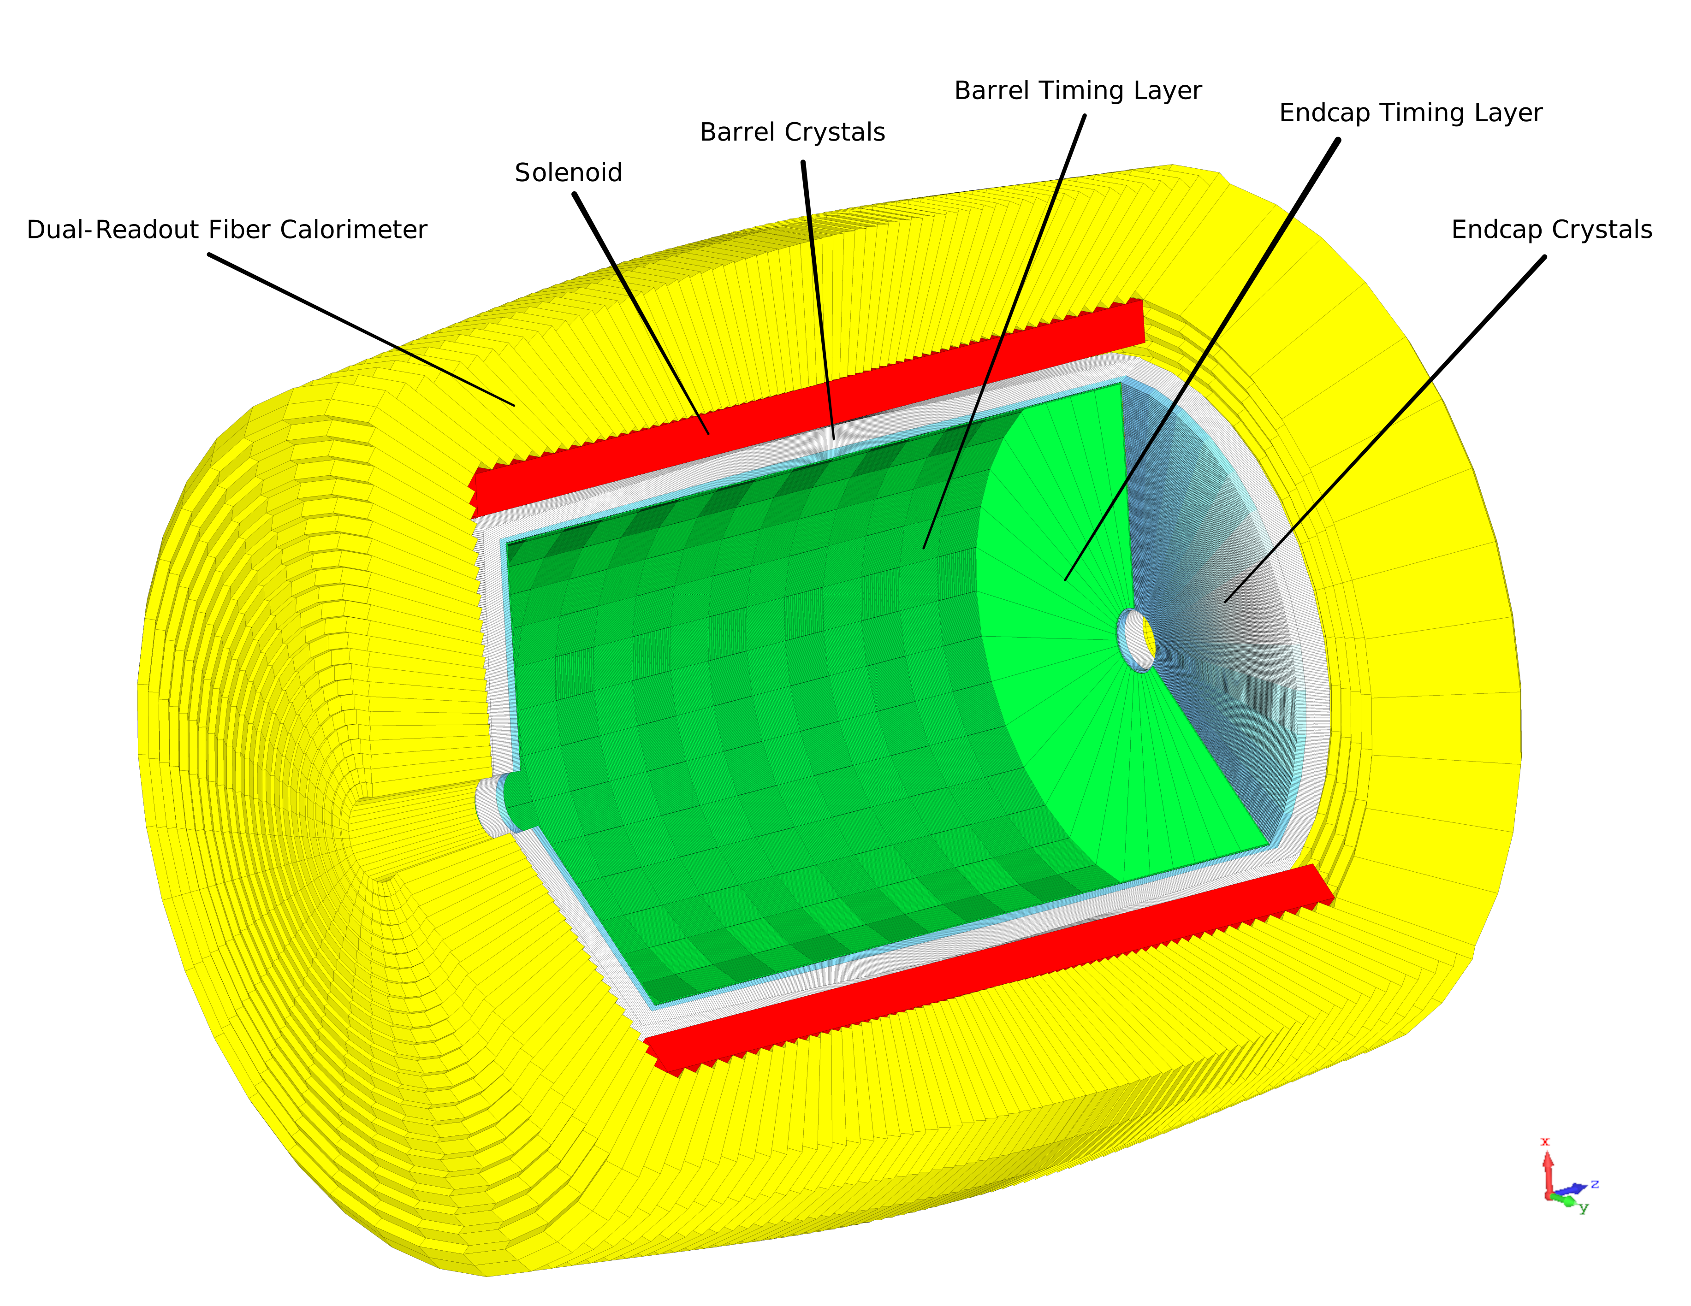
Full Geometry Implementation

Slide 6
Photon and Neutral Hadron Energy Resolutions
IDEA w/ Crystals - electrons
IDEA w/ Crystals - K_{L}
EM: 3%/√E ⨁ 0.5%
HAD: 30%/√E ⨁ 2%

Slide 7
Energy Resolution Target:
<3%/√E Stochastic Term
Requires:
  Shower fluctuations <2%
    Material budget in front of ECAL < 0.3X₀
  Photostatistic fluctuations < 2%
    Signal in photoelectrons >3500 phe/GeV
    Assuming 20% PDE for 10 um cell SiPMs → LY*LCE > 18 ph/MeV
      5 um cells with high PDE in development
    Need to tune SiPM active area accordingly to crystal LY
      PWO: LY=100 ph/MeV → LCE>18% → SiPM area > 64 mm²
        SiPM number of cells: 360k
      BGO: LY=7000 ph/MeV → LCE>0.3% → SiPM area > 1 mm²
        SiPM number of cells: 10k → dynamic range effectively x30-40 larger due to the fast time response of the pixel compared to the BGO decay time

Slide 8
Neutral Hadron Spectra and Jet E Fraction

Slide 9
Z→ee Bremsstrahlung Recovery
Assuming
tracker low-p
(multiple
scattering)
resolution
σ_{p}/p = 0.3%
0.3%

Slide 10
Pre-Clustering of π⁰ Photons

Slide 11
Perfect π⁰–to–π⁰ Photon Jet Correspondence

Slide 12
ECAL-Only Particle Identification
Longitudinal+Transverse: 99% Electron Efficiency @ 99% Pion Rejection
Longitudinal
Transverse

Slide 13
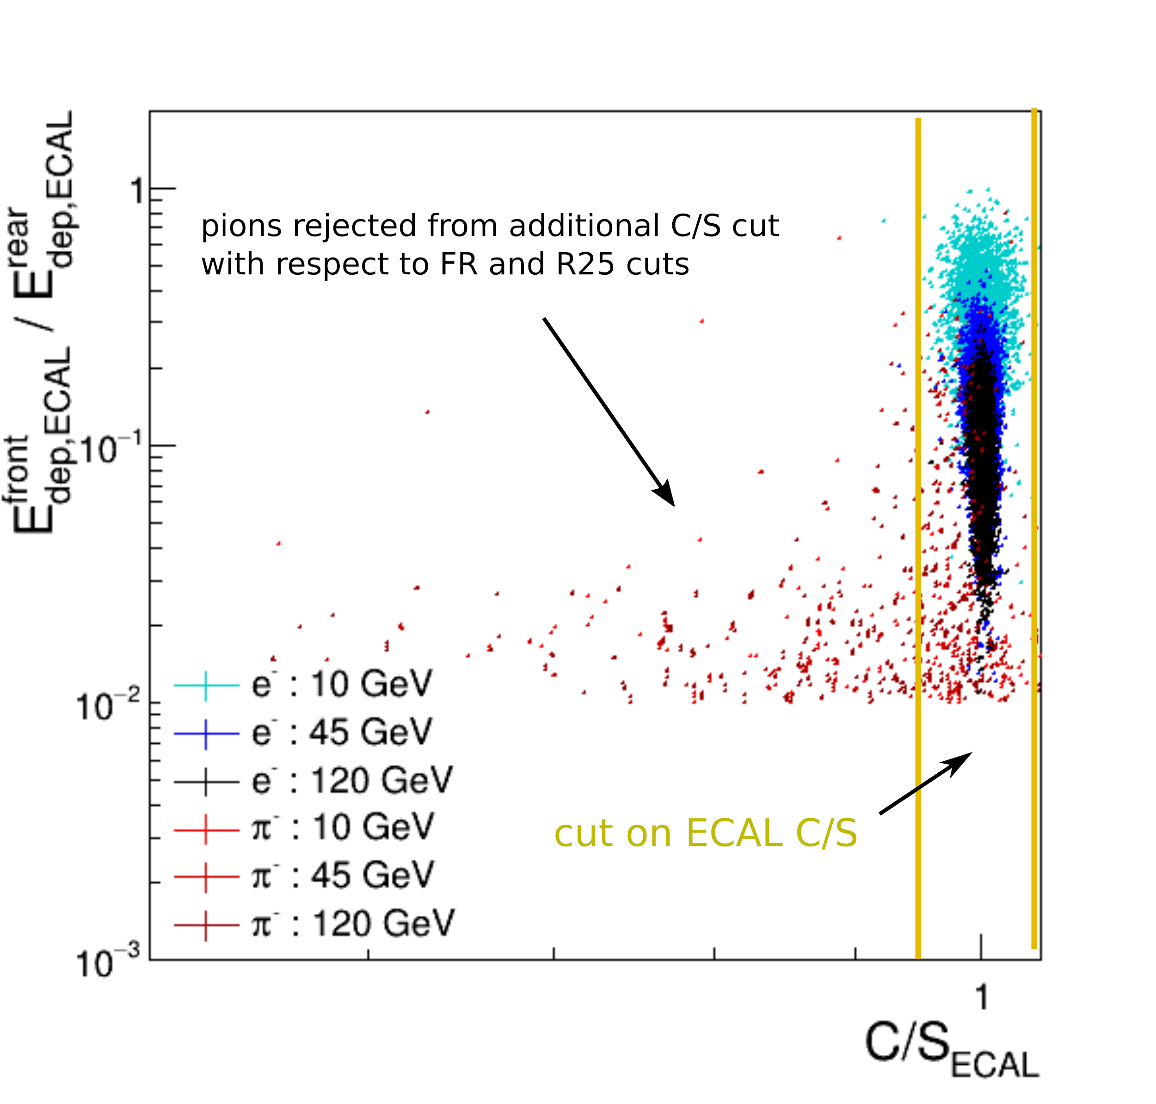
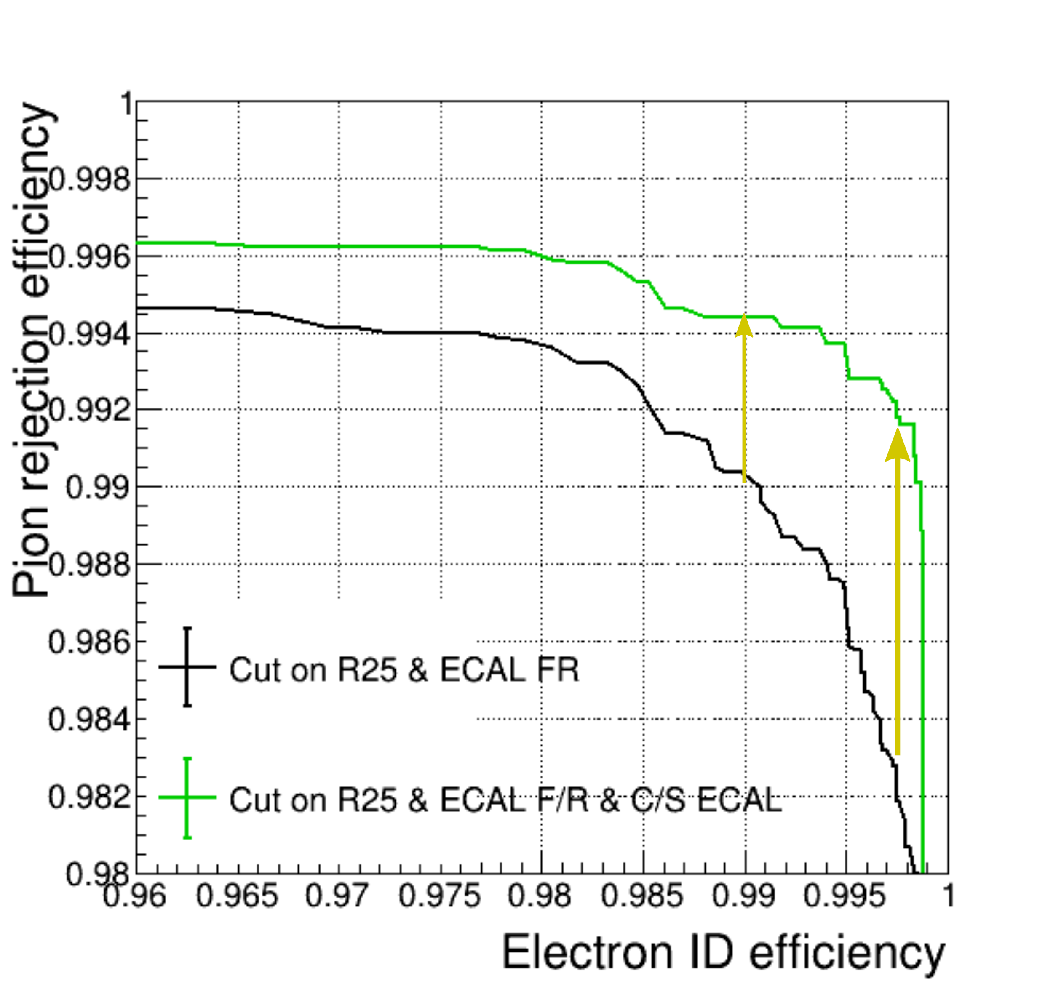
More ECAL-PID Possible
99% Electron Efficiency @ 99.4% Pion Rejection
Submitted to JINST Referee Report
+ PID from Precision Timing Layer

Slide 14
Graph Theory Applied to π⁰ Photon Pre-Clustering
[1] https://dl.acm.org/doi/10.1145/6462.6502
[max_weight_matching] https://networkx.github.io/documentation/stable/reference/algorithms/generated/networkx.algorithms.matching.max_weight_matching.html
M./L. Lucchini

Slide 15
γ
γ
γ
γ
γ
γ
π⁰
π⁰
π⁰
π⁰
γ
γ
M./L. Lucchini

Slide 16
Incorrect pairing
unpaired
M./L. Lucchini

Slide 17
Thinking Ahead
Improvement from Graph Theory on pre-clustering of π⁰ photons was substantial
  Keeps tabs on bad pairings – not enough to have the “best” pairing for a given photon
With an ECAL that can self-select photon or neutral hadron using PID, pairings of EM/HAD clusters and pairings of track/EM/HAD that keep track of bad/inconsistent PID may allow for better PFA outcomes
  Optimizing a high resolution EM/HAD calorimeter for PID-matching could provide a more precise event description, higher identification rates for rare processes and lower overall systematic uncertainties

Slide 18
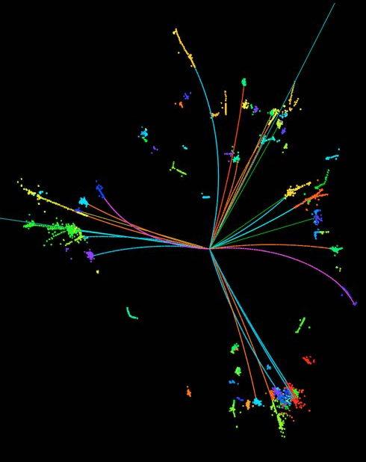
Some Initial Ideas on Graph-PFA
1st Order PFA :
  swaps out hadron showers with tracks
  photons are separated out with ECAL
  electrons/muons separated out by PID
  neutral hadrons are “leftovers”
2nd Order PFA: ?
  PID per cluster creates weight assigned
  to a potential EM/HAD/track match
  created graphs of all possible pairings
  (subject to structure constraints/1st Order PFA),
  assign weights, graphs with unmatched
  tracks/inconsistent PID/isolated cluster
  fragments have low overall weight
  Highest weight graph may improve
  event description and provide a new benchmark for global detector performance
Image from Manqi Ruan

Slide 19
Additional slides

Slide 20
Pair of EM Showers (Single Event)

Slide 21
Pair of EM Showers (Single Event - Log)

Slide 22
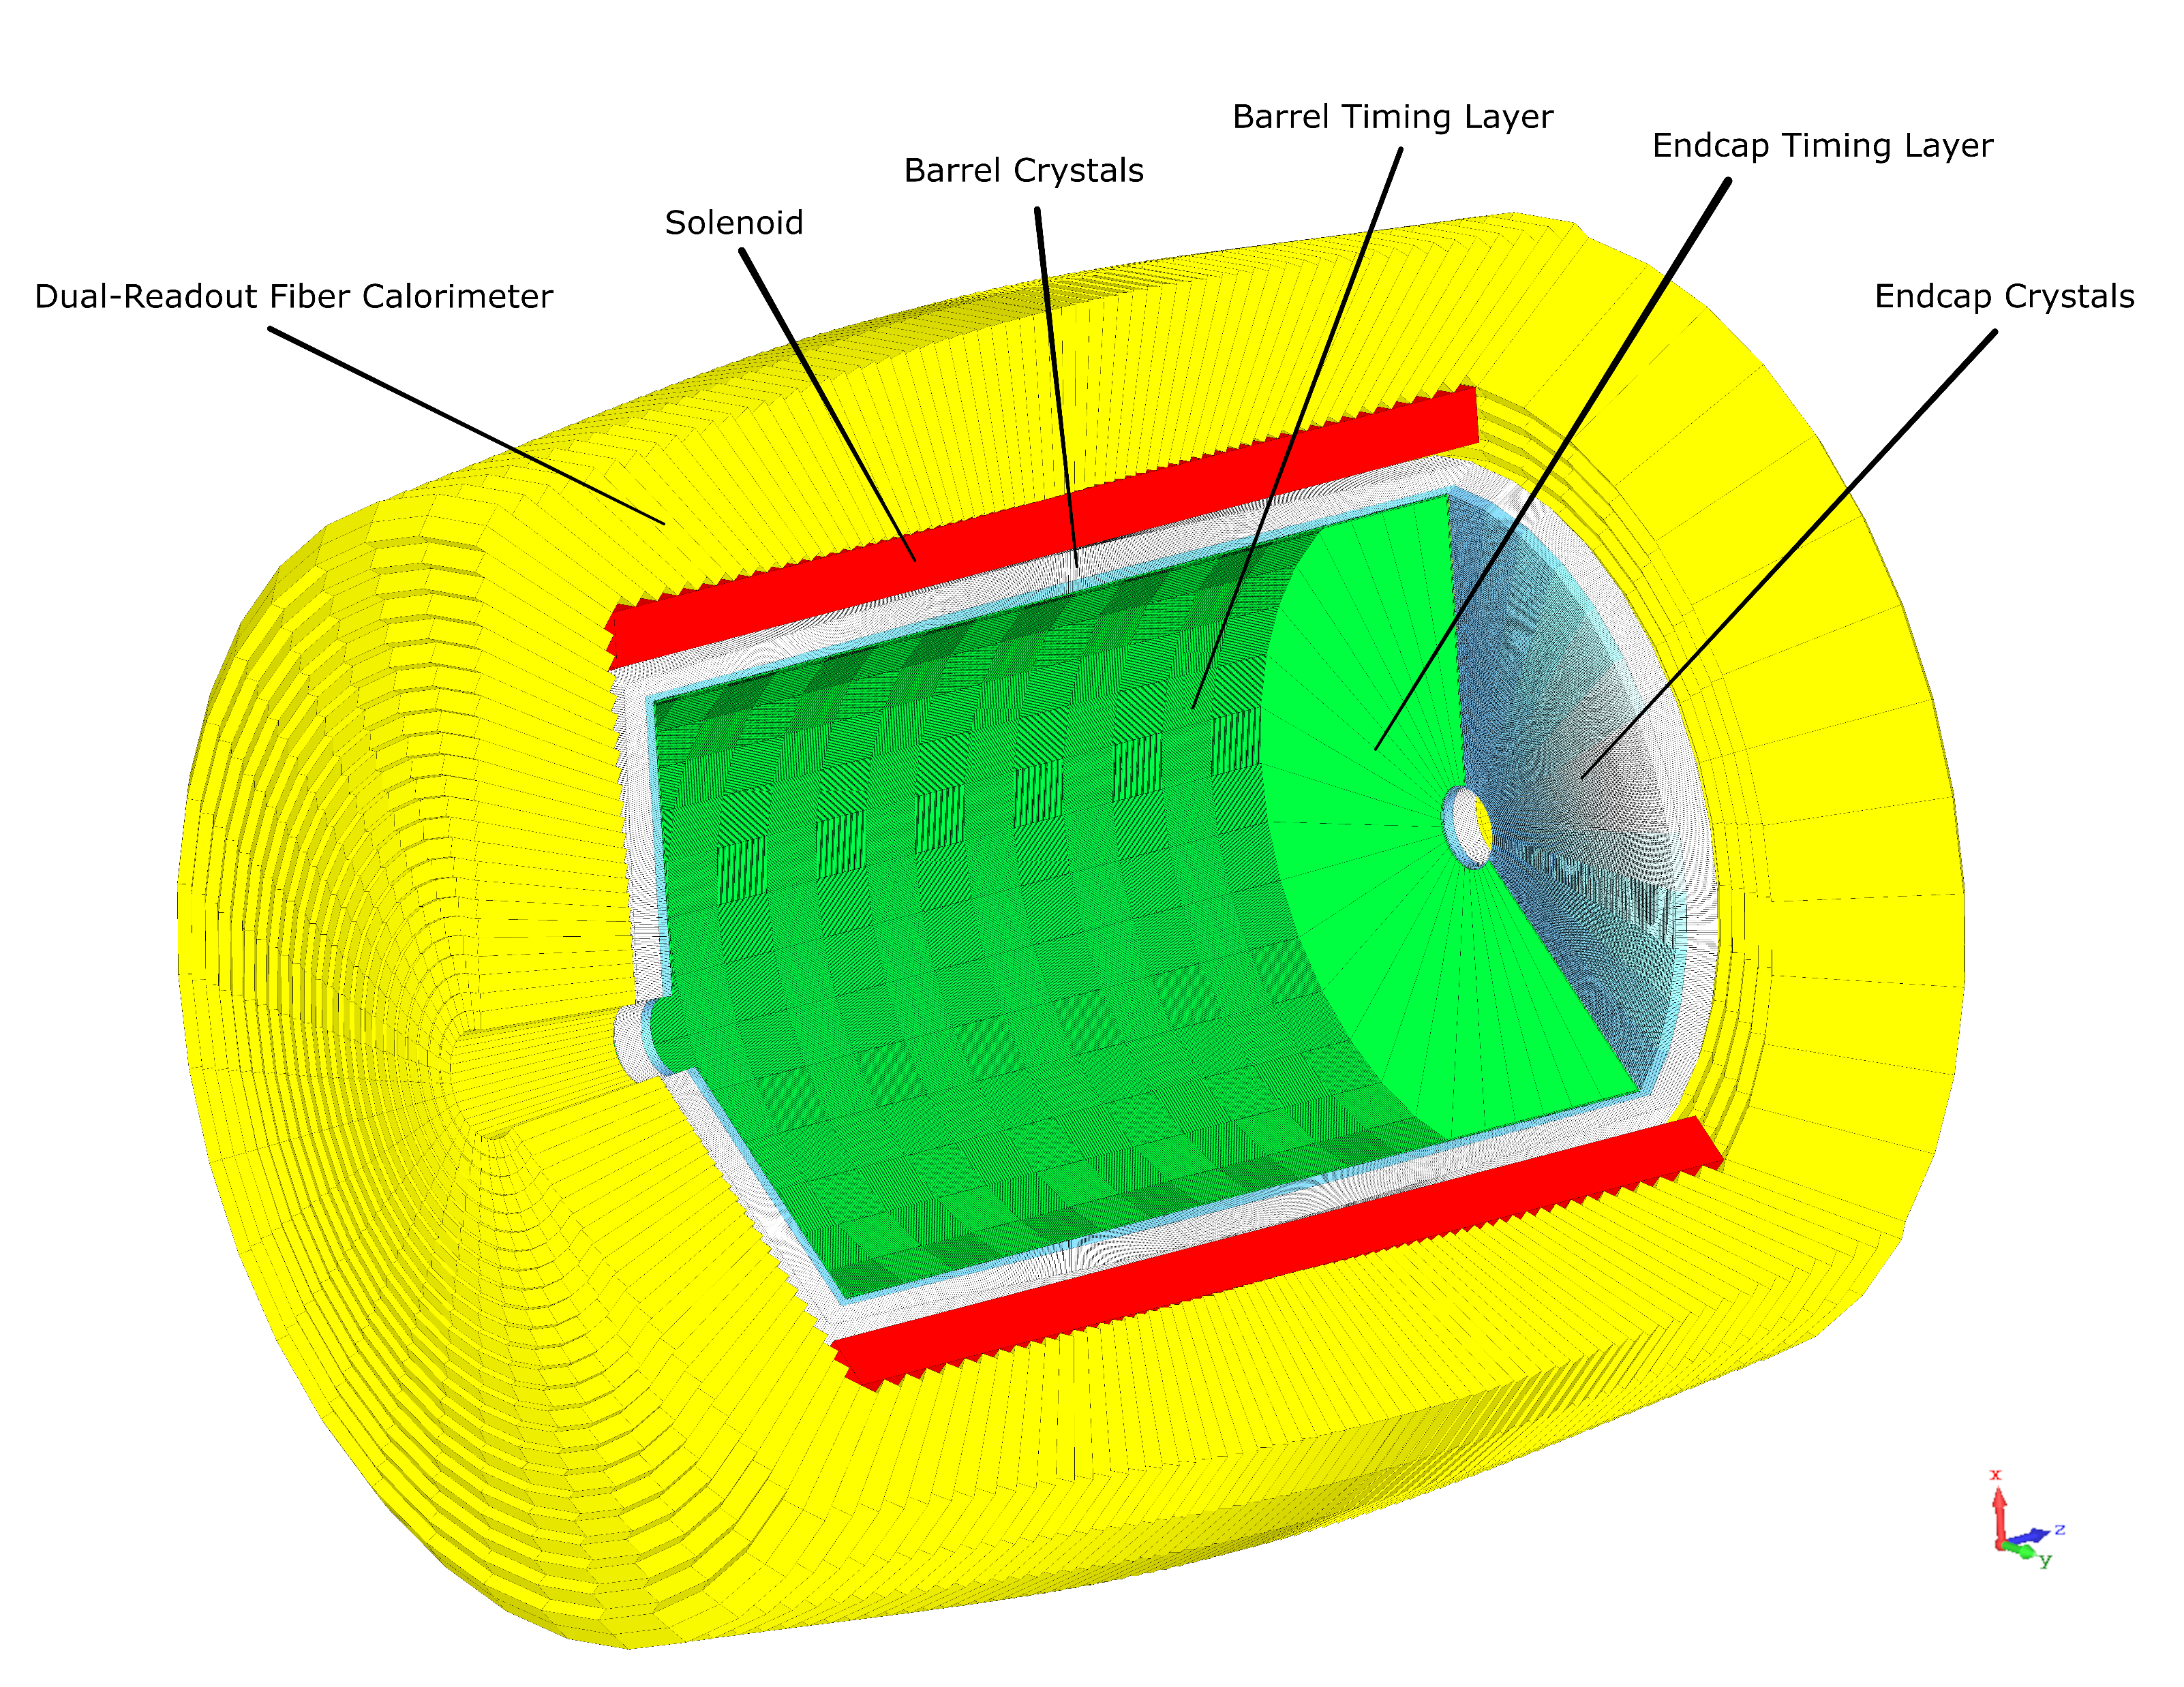
Detector Geometry Guide
Wonyong Chung (wonyongc@princeton.edu)
Any questions, please don’t hesitate to email me!

Slide 23
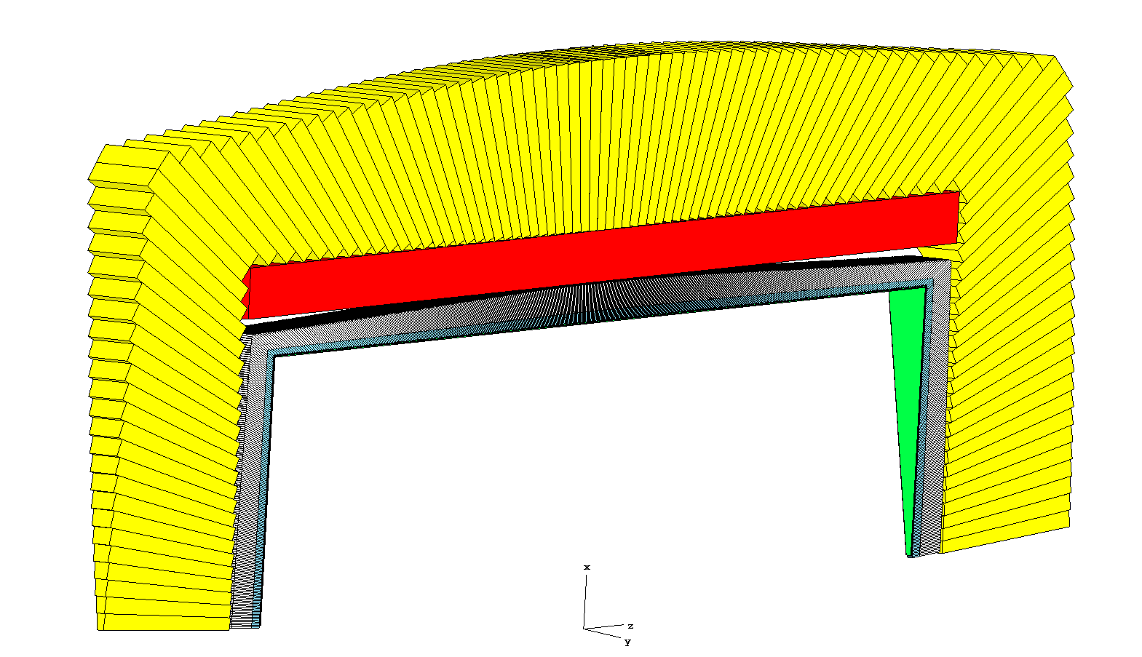

Detector Geometry General Overview
Components:
Solenoid (red)
HCAL (yellow)
ECAL (white/blue)
Timing Layer (green)
One phi slice of each component is made in each ‘MakeComponentName’ function.
The function ExecuteRotationsInPhi then copies each component into the desired number of rotations in phi.
Dimensions of the ECAL are specified first and most others are derived from them.
Some more details in the comments at the top of the script file

Slide 24
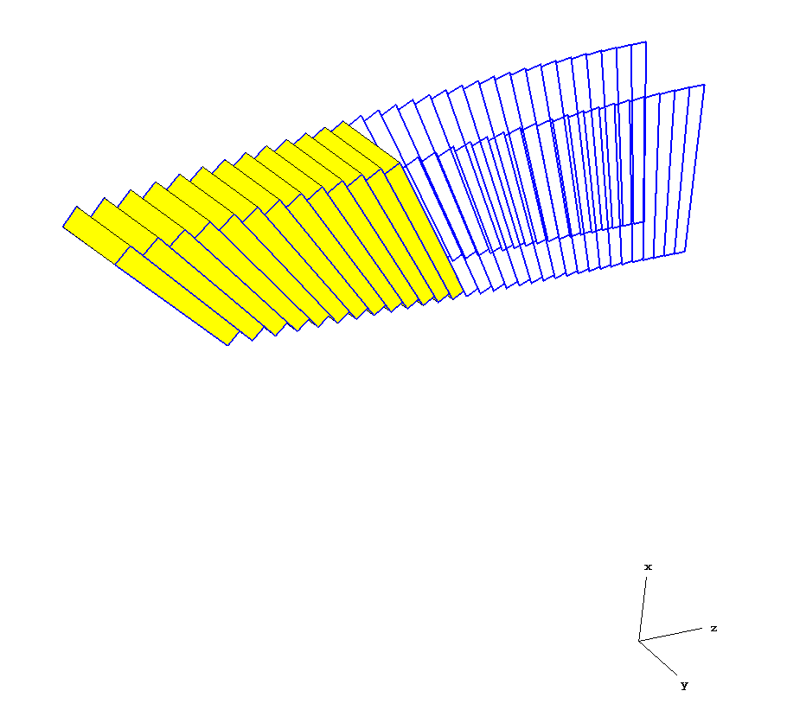
This document specifically details the geometry calculations for the HCAL and ECAL towers.
Outlines of the z-x cross sections of each tower are defined (curves) and one copy of each curve is made at an angle dphi from the original. Solids (towers) are generated by filling in the volume between these two curves in the shortest distance (straight line).
For the ECAL crystals, additional cuts are made in phi for each tower to produce individual crystals.
For the tower curves, z and x coordinates are calculated to make a closed planar polygon in the z-x plane.
The calculations take the provided dimensions and otherwise make two fundamental assumptions:
1. Each tower reads an equal slice of theta from the interaction point. Therefore dtheta is constant for each tower and the dimensions of individual tower faces will differ slightly. The nominal_tower_face dimension is therefore just an estimate.
2. Each tower face makes a 90 degree angle with the line connecting the midpoint of the tower face and the interaction point. Therefore each tower face is the base of an isoceles triangle with the interaction point as the apex.
The variable s is used throughout to denote the sign of the z coordinate.

Slide 25
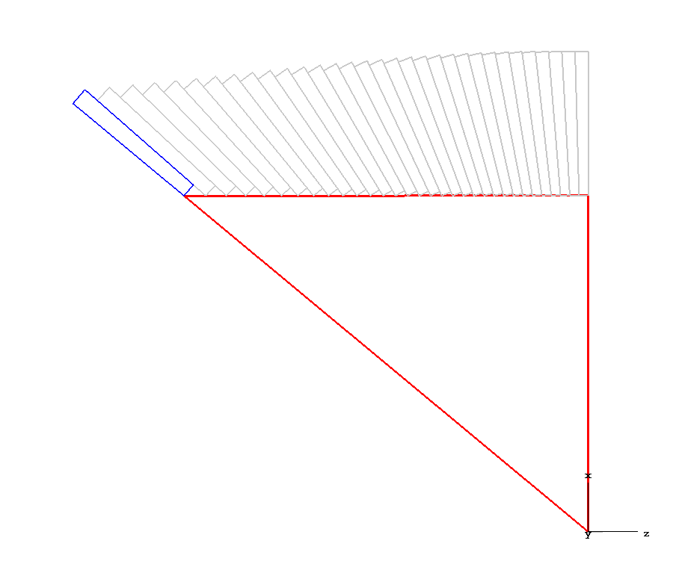
Starting from the outermost tower (farthest in theta).
Theta extends from x axis.
theta = arctan(z_half/r_inner)
n_towers = Floor(z_half/nominal_tower_face)
dtheta = theta/n_towers
We can now calculate coordinates for points 1, 2, 3, 4 of the tower cross-section.
z_half
r_inner
r1

Slide 26
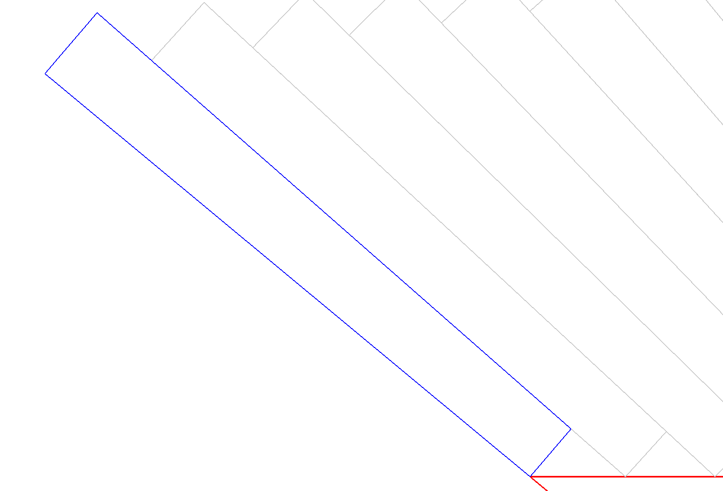
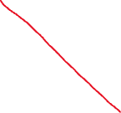
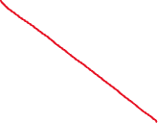
(z3, x3)
r_inner, theta, dtheta (called dth) known
Start with point 1.
s = -1 here because we are in the negative z side
(z4, x4)
z1 = s*r_inner*TanD(theta-dth*(i-1))
x1 = r_inner
z1_next = s*r_inner*TanD(theta-dth*(i))
x1_next = x1
We need to use z1_next to calculate point 2.
(z2, x2)
(z1_next, x1_next)
(z1, x1)

Slide 27
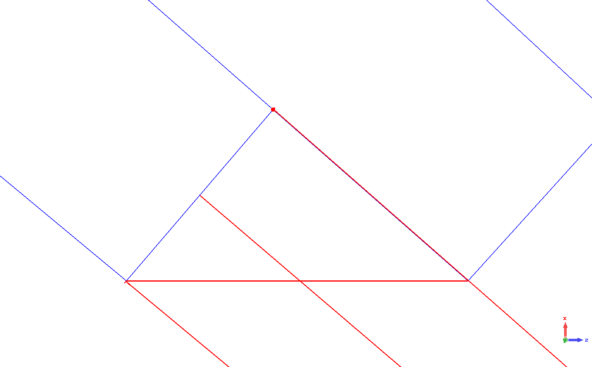
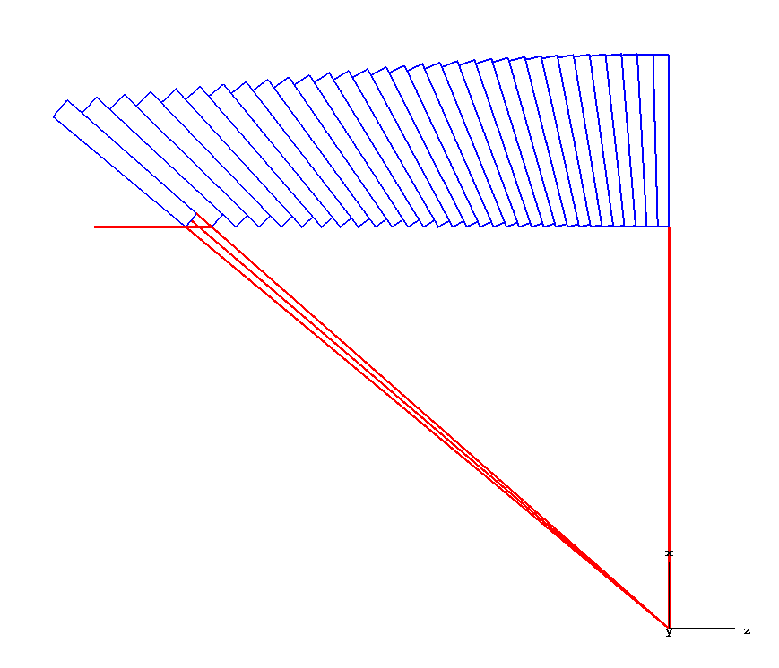
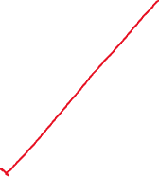
z1, x1, dth known
=> r1 = Sqrt(z1^2+x1^2)
Calculate point 2 using angle alpha and tower face width (tface_width)
Result:
z2 = z1 - s*a*CosD(alpha)
x2 = x1 + a*SinD(alpha)
s = -1 here because we are in the negative z side

Slide 28
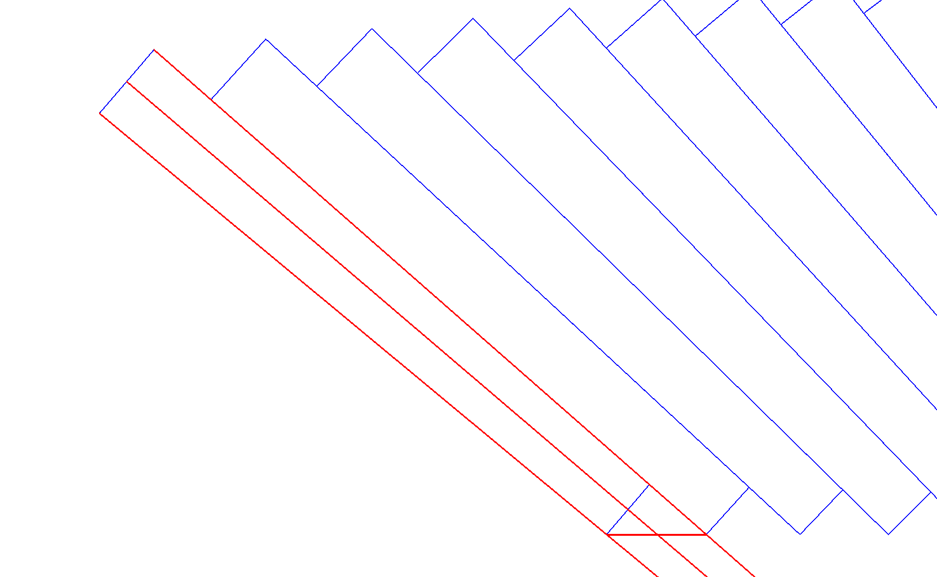
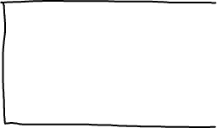
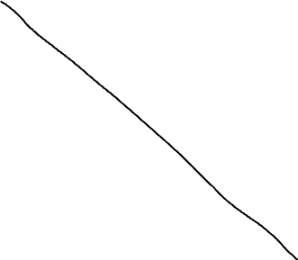

Slide 29
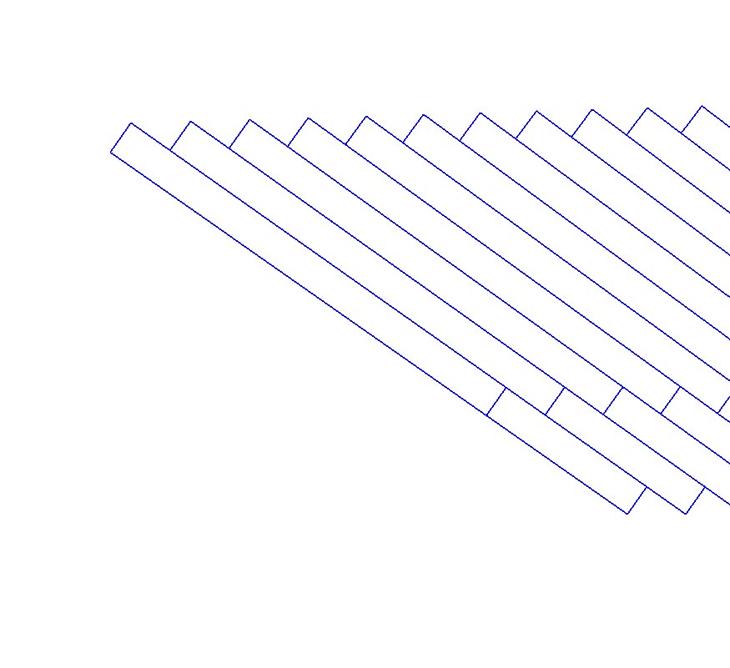


Same logic for segmented ECAL towers (front and rear)
z5 = z2*(r2+t_length_front+t_length_rear)/r2
x5 = x2*(r2+t_length_front+t_length_rear)/r2
z6 = z1*(r1+t_length_front+t_length_rear)/r1
x6 = x1*(r1+t_length_front+t_length_rear)/r1

Slide 30
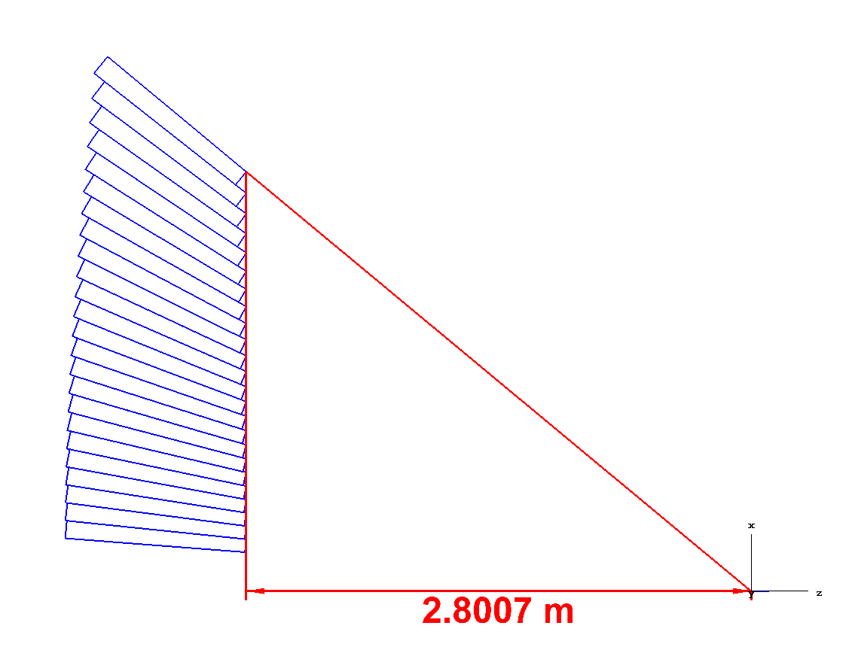
Endcap Towers
Same process follows for endcap towers
Z and X coordinates flipped
Theta extends from z axis, not x axis
Direction of points 1, 2, 3, 4 is reversed
Leaves room for beampipe opening
r1
r_inner
z_half

Slide 31
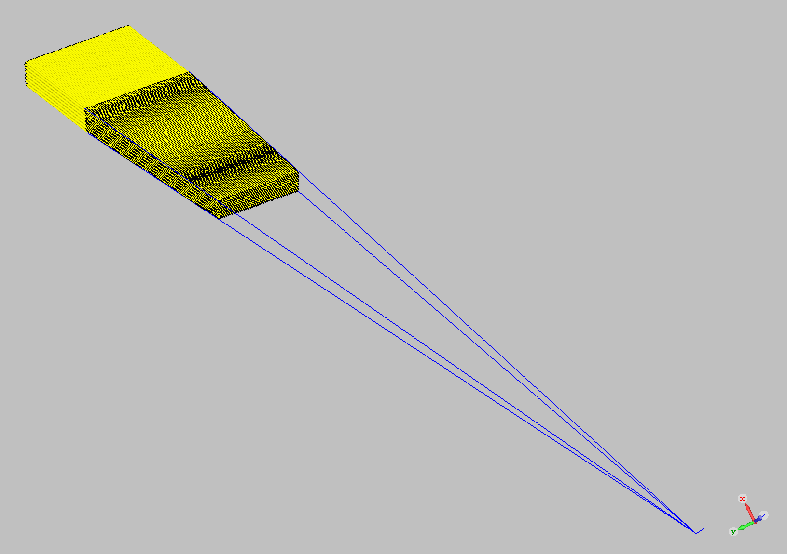

Slide 32
