Slide 1
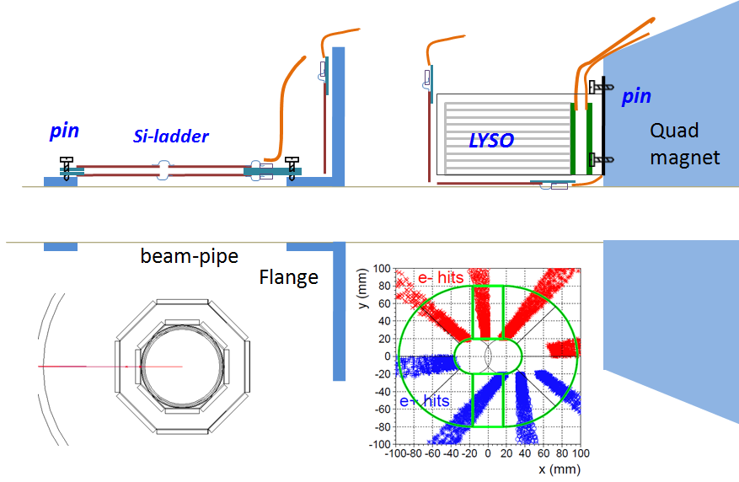
Geometry and Acceptance
for CEPC LumiCal
Suen Hou
Inst. of Physics
Academia Sinica
2020.10.28
https://indico.ihep.ac.cn/event/11444/

Slide 2
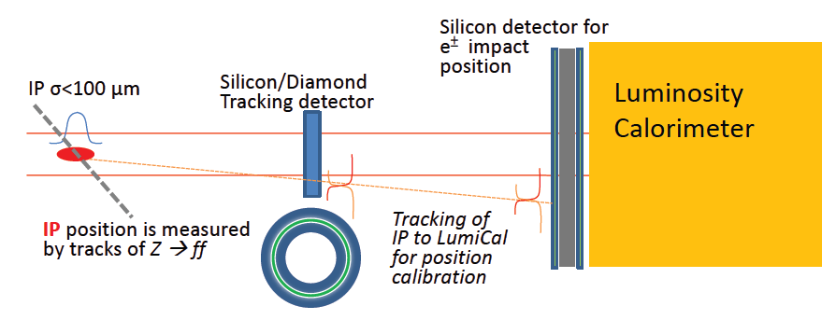
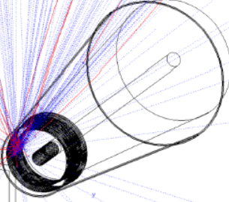
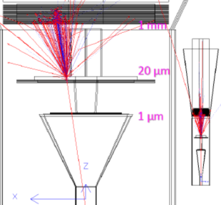
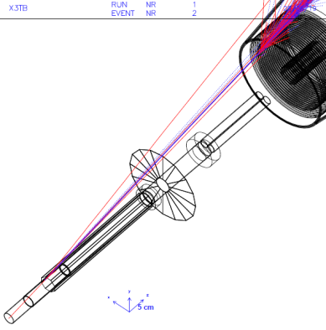
Outline
CDR LumiCal:
a Si-W stack, w.o. beam-pipe reality
post-CDR: beam-pipe geometry & multiple scattering
➔ round beampipe Si-ladder + Crystal Calorimeter
Bhabha cross section @ Z pole :
BHLUMI calculation done
for θ_{min} = 30 mRad ➔ σ(Bhabha) = 75 nb
GEANT study for luminosity precision δL/L ~ 10⁻⁴
multiple scattering passing 1mm Al beampipe
➔ RMS = 50 um @Z=0.5m, θ = 30 mRad
LumiCal Geometry and Mechanics for δL/L ~ 10⁻⁴
Si-ladder: detect electron impact position to δθ ~ 1.5 μRad
→ Si-wafer surrounding beampipe, do Z-position measurement
LYSO Calorimeter:
→ ID beam-electron/photon
CDR version

Slide 3
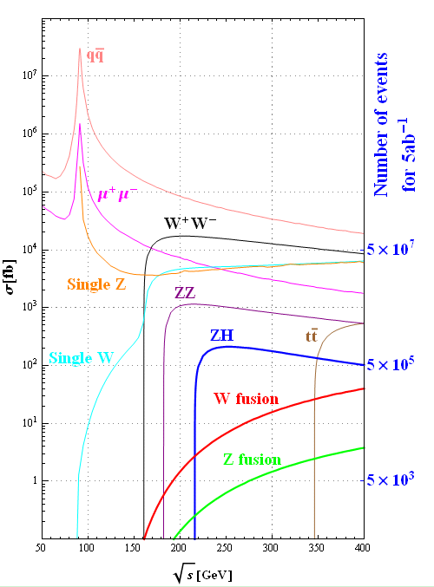
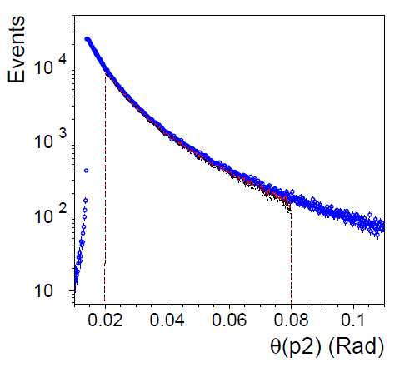
Luminosity criteria
Reference to Z-lineshape
e⁺e⁻ → Z → qq‾
Luminosity of e⁺e⁻ collisions
by QED Bhabha elastics scattering
theoretical precision < 0.1 %
e⁺e⁻ → e⁺e⁻
crosss section
e⁺e⁻ collision
Integrated luminosity
σ = 41 nb
Scattered electron
theta distribution
Detecting
Bhabha event
X,Y
Bhabha detected
In a fiducial region
Z

Slide 4
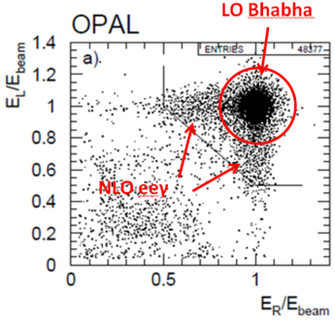
Bhabha detection
e⁺e⁻ → e⁺e⁻ elastics scattering
Event signature
E(e±) = E_{beam}
e⁺ , e⁻ Back-to-Back
NLO e⁺e⁻ → e⁺e⁻ γ
~1% of total events
e⁺ , e⁻ approximately Back-to-Back
one electron E’ < E_{beam}
e/γ ID, spatial resolution
X,Y
Z

Slide 5
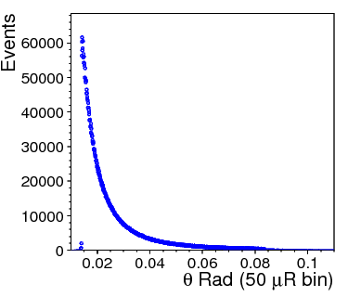
Luminosity precision
Dominant systematic error
δL/L ~ 2 δθ/θ_{min}
For precision of δL/L < 10⁻³
LumiCal @Z= ± 1 m,
ref: θ_{min} = 30 mRad eq. r = 30 mm
→ δθ = 15 μRad eq. dr = 15 μm
Error due to offset on Z
0.1 mm on z → dr = δ Rxθ = 3 μm
Bhabha θ-angle distribution
detector spatial resolution
Fiducial
region
LumiCal design goal:
Spatial res.: narrow binning
“Standard error of the mean” on θ_{min}: σ/√N < 15 μRad
offset on fiducial edge
→ Systematics to
“the mean on θ_{min}“
→ LUMINOSITY error
θ_{min}

Slide 6
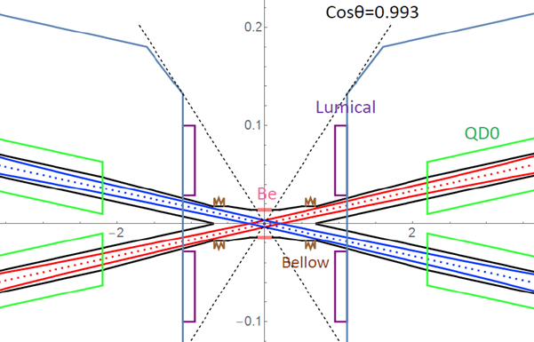
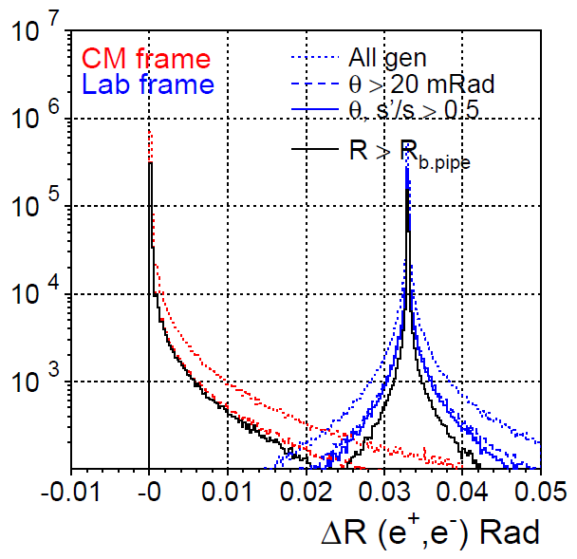
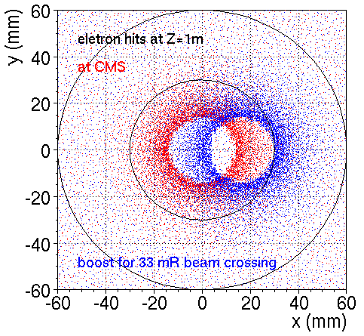
Bhabha boosted by CEPC 33 mRad beam crossing
BHlumi QED calculation
for Bhabha e⁺e⁻ scattering
boosted for the 33 beam crossing
e⁺,e⁻ shift by ~16.5 mRad to
+x direction
Opening angle –pi of the scattered e⁺,e⁻
Electrons shifted
from CMS to LAB
Bhabha electron
x-y distribution
at Z=1m

Slide 7
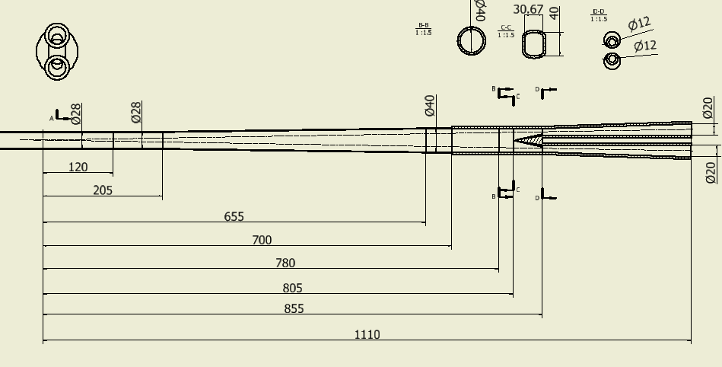
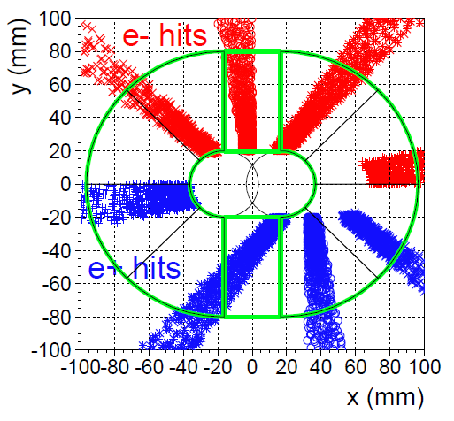
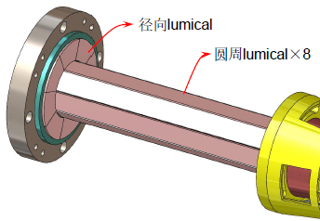
LumiCal acceptance, compare BHlumi with Beampipe design
X-Y hits both e⁺,e⁻ detected
at CEPC Z= ± 1 m
Y. Liu 2020.10.14
r=30mm
BHLUMI estimate boosted electron distribution
for a round beampipe θ_{min} = 30 mRad
CMS |  | LAB detecting
θ range: 10 ~ 80 mRad |  | one electron | both electrons
Nevents | 457232 | 102535 | 29194
Xsec (nb) | 1168.3 | 262 nb | 74.6 nb
*latest beampipe before Flange @Z=655 mm,
acceptance suggested for θ_{min} >38 mRad ➔ LumiCal Acc < 40 nb

Slide 8
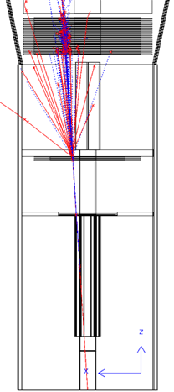
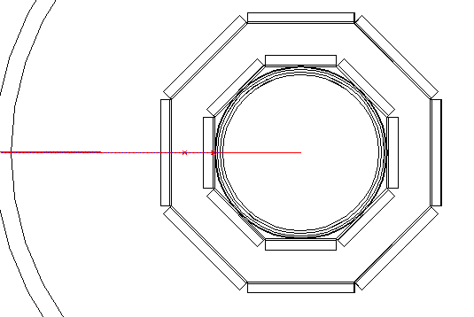
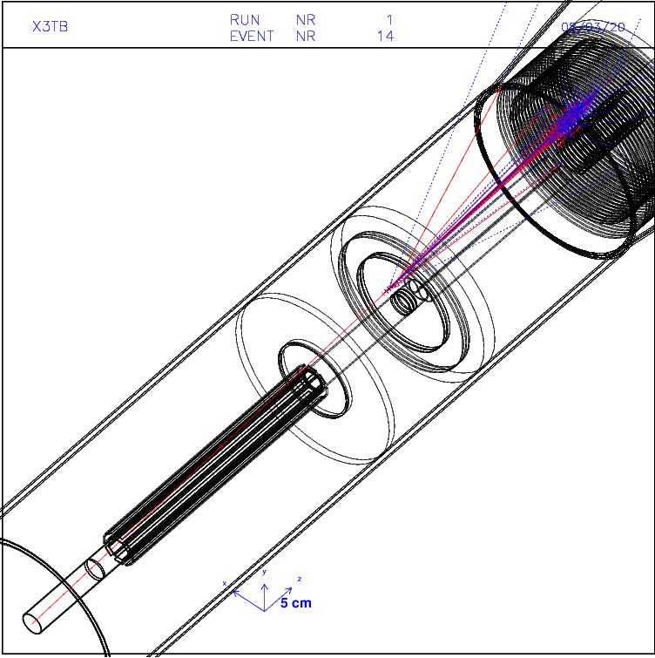
GEANT, multiple scattering off beampipe
Si-ladders surrounding beampipe
minimal smearing by multiple scattering/shower
Electron traversing 1 mm thick Al beampipe
@30 mRad, Z = 0.5 m, dZ traversing beampipe = 33 mm
GEANT
multiple scattering
Passing 1 mm beampipe
Impact position on Si-layer
RMS = 50 μm

Slide 9
GEANT TUBE beam-pipe, Si-ladders
acos(.99) = 141.54 mRad @Z=118 → r= 16.81 (=tanQ*118)
acos(.992)= 126.58 mRad @Z=118 → r= 15.02 mm
Q= 100mRad @Z=118 → r= 11.84 mm @Z=153 → r=15.35 mm
409 TbFe 5mm Fe
Z=0~ 970 mm connecting to
r= 12.34cm ~+.5cm, FE
Acos(.99) = .14154 rad
Acos(.992) = .1266 rad
TbOS 2mm scin
Z=0~ 970 mm r= 12.39cm +.2cm
atan(123.6/970) = .12678 rad
TbIS 2mm scin
Z=0~ 970 mm r= 12.32cm +.2cm
Flng 10mm thick flange
Z=520~530 mm
r= 55~123.2 mm
Acos(.992) =.1266 rad
SiW edge
atan(70/685) =.1018 rad
Al dual tubes
.5mm, .35 mm thick
Fwin window 2 mm
Z=520~522
r= 15.35~55 mm
100 mrad
Flange
BpSn Si octagon rmin =1.5451 cm
Z=16 - 52.0 cm
419 FLSi Si deck
Z=522~524
R = 15.5-55. mm
29.7-105 mrad
FS0i SiW two layers
Deck=3.5mmW+2mmAir
R = 15.5-70. mm
22.3-100.2 mrad @ Z= 696
Z=115 mm
Z=118 mm
15 mm
Z=520 mm
Fend Flange 20mm
Z=696 - 716
r= 15.5~123.2 mm
14 mm
401 InBPipe
InBP Inner Be pipe
Z=0~118 mm,
inner diameter 28 mm 0.5mm thick
InAl Inner Al pipe
Z=118~500 mm,
inner diameter 28 mm 0.5mm thick
Fpip flange pipe 1.5 mm thick
Z= 522-716 mm
at Z=512 r= 14 – 15.5 mm
OuBP outer Be pipe
Z=0~115 mm
inner radius 28/2+1 mm 0.35mm thick
OuAl outer Al pipe
Z=0~115 mm
inner r=28/2+1 mm, 0.35 mm thick

Slide 10
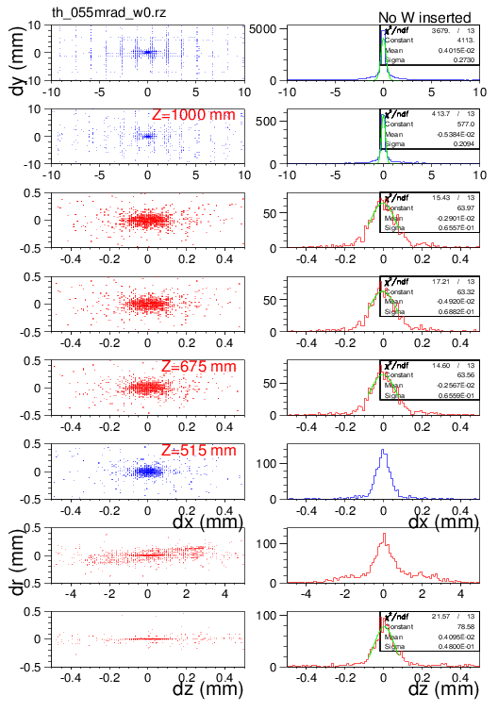
Position(Hits) – Electron shower
Piled up of 50 GeV
electron shower hits
Front 2 Si-layers of Q-pole LumiCal
Pileup of shower ~1 mm resolution
Three Si layers at Z>670 mm
NO Tungsten layers σ= 65 um
1st Si layer behind flange at Z=515 mm
Octagon Si-ladders
surrounding beampipe
1st layer σ= 50 um

Slide 11
Options of LumiCal assembly
2D Si-ladder assembled on CNC table
z-strips for theta position: <200 μm pitch for resolution <25 μm
phi-strips: ~ 1 mm pitch to correct boosted direction
alignment pin to beampipe support➔ precision ~5 μm
CNC survey of Si strip position ~ 3 μm
Bhabha electron resolution:
@fiducial edge, assuming θ_{min} = 30 mRad
δL/L < 10⁻⁴ → δθ = 1.5 μRad
@ Z= 0.5 m, corresponding to dr= 0.75 μm; dz = dr/tan(.03)= 25 μm
Heat dissipation:
8 pairs of z-phi ladders, 30 chips ➔ 100 W /per z-side
(APV25 0.4 W/chip, 28 chips in Z, 128 ch, 0.1 mm pitch z-coverage = 360mm)
use fine-pitch Si-strip
to differentiate Mult.Scatt. distribution (50 μm width)
for event counting over θ_{min}
to 25 μm precison
pin
pin
Si-ladder
Quad-mag
Flange
LYSO
beam-pipe

Slide 12
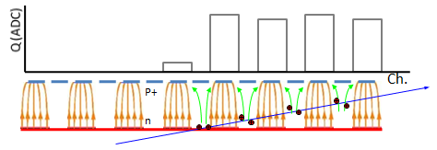
LumiCal Si-wafer option
LumiCal Si wafer volume
GEANT for round beampipe φ = 28 mm
θ = 30 mRad @ z=500 mm
Multi. Scattering at Si wafer: RMS = 50 μm
Assuming Si strip 300 μm thick, pitch = 100 μm,
resolution by the fraction of entrance strip (low z)
fire 100 strips @ 30 mRad
rather extreme for Si strip
resolution by charge sharing
at the edge strips
z=620 mm

Slide 13
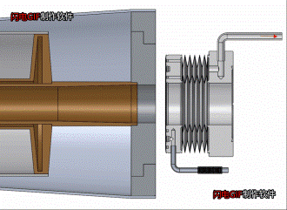
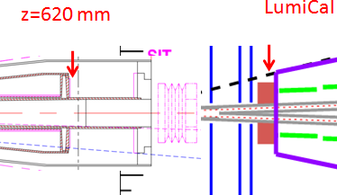
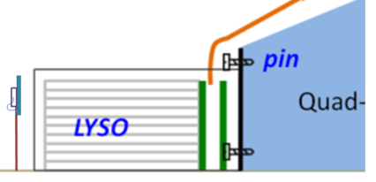
LumiCal Calo options
Upstream to Calo:
beam-pipe, flange, possibly ~5 X₀
shower center ~1 mm precision
Calorimeter option: LYSO + SiPM
to minimize space for electronics
Si-layers in flange/Calo front
as preshower layers for e/γ ID, NLO photon
Calo Assembly:
LYSO in 2x2 cm² bars
~50 kg ring, mounted on Magnet
fabrication may be better than 10 μm
More detailed works needed !!
IP
Si strip disks
In Flange
Octagon
Si-strip in z

Slide 14
Summary
Bhabha detection studied for luminosity δL/L ~ 10⁻⁴
optimizing acceptance for Z(qq) pole cross section
Detecting electron, resolution at θ_{min} edge :
δL/L ~ 10⁻⁴ → σ_{θmin} = 1.5 μRad
Si-ladders surrounding beam-pipe:
electron Z position (@30mRad), σ_{θmin} → σ_{Z} = 25 μm
measuring Bhabha electrons
with impact position smeared by Multiple-Scattering
Calo (LYSO+SiPM) for e/γ identification
further details to be studied !
θ_{min}

