Slide 1
TDAQ and online computing
David Newbold(UKRI), Chris BEE(Stony Brook/BNL),
Zhen-An LIU(IHEP)*
Plenary Session CEPC Workshop 2020
SJTU/Shanghai, Oct. 28 2020

Slide 2
Outlook
Overview on the TDAQ activies
Focus on the talks and discussions in the TDAQ two sessions in this workshop
Some key outcome points and potential action
Summary

Slide 3
Overview on TDAQ activities
Experiments Experience Studies by invited talks(at previous workshops)
Data Acquisition for the PANDA Experiment at FAIR by Wolfgang Kuehn(U.Giessen)
Overview of CMS Trigger by Simon Bologna（U Bristol）
The LHCb Triggerless readout system for LHC Run 3 and beyond by Federico Alessio(CERN)
ATLAS Solution for Phase 2 Storage and Networking by Fabrice Le Goff (CERN)
Data Acquisition for the ATLAS Inner Tracker beyond 2026 by Jens Dopke
DUNE DAQ Plans by Pengfei Ding(FNAL)
LHCb VELO Readout by Karol Hennessy(U. Liverpool)
ATLAS experience with FPGA(TDAQ’s perspective by Weimin Qian(RAL)
Real-time analysis with LHCb by Saur Miroslav(UCAS)

Slide 4
Overview on TDAQ activities(2)
Progress on CEPC TDAQ R&D(prior to now)
Hardware Development at IHEP by Jingzhou Zhao(IHEP)
Readout of JadePix-1, A prototype CMOS Pixel Sensor for CEPC Vertex Detector by Jia Tao(IHEP)
Discussion of CEPC DAQ (EB and networking) by Fei LI(IHEP)
xTCA development/applications on Belle II/CMS Experiment and perspective to CEPC TDAQ by Z.A.LIU (IHEP )

Slide 5
It’s time
Turning from consideration of work outside CEPC to discussion of issues and practical steps specific to CEPC detector
Better understanding the detectors
Start TDAQ R&D activities

Slide 6
New iteration of understanding of the sub-detectors(this workshop)
Update the Data Volume and channel count under different machine running modes
Higgs
W
Z
New assumptions about readout bandwidths and readout implementation and power consumption
Any zero suppression or compression they might carry out at the front end
No
YES, then how

Slide 7
Collect Clearer requirements to TDAQ at this workshop
Needs for control and timing signals in FEE
Clocks, Synch,BC0,L1A,SC,…
Any views/preferences on readout style(triggered or trigger-less readout)
Trigger sequential readout
Continuous sequential readout
Non-sequential readout

Slide 8
Morning/Afternoon for Time Zone
Morning
Requirement from the LumiCal, Suen Hou (IPAS)
Requirement from the Vertex Detector, Wei Wei (IHEP)
Requirement from the TPC, Huirong Qi (IHEP)
Requirement from both ECAL & HCAL, Yong LIU (IHEP)
Afternoon
Requirement to from Drift chamber, Franco Grancagnolo (INFN-Lecce)
Requirement from DR Calorimeter, Roberto Ferrari (INFN)
Requirement from Muon detector, Paolo Giacomelli (INFN-Bo)
Requirement from Silicon Tracker, Jens Dopke (STFC RAL)

Slide 9
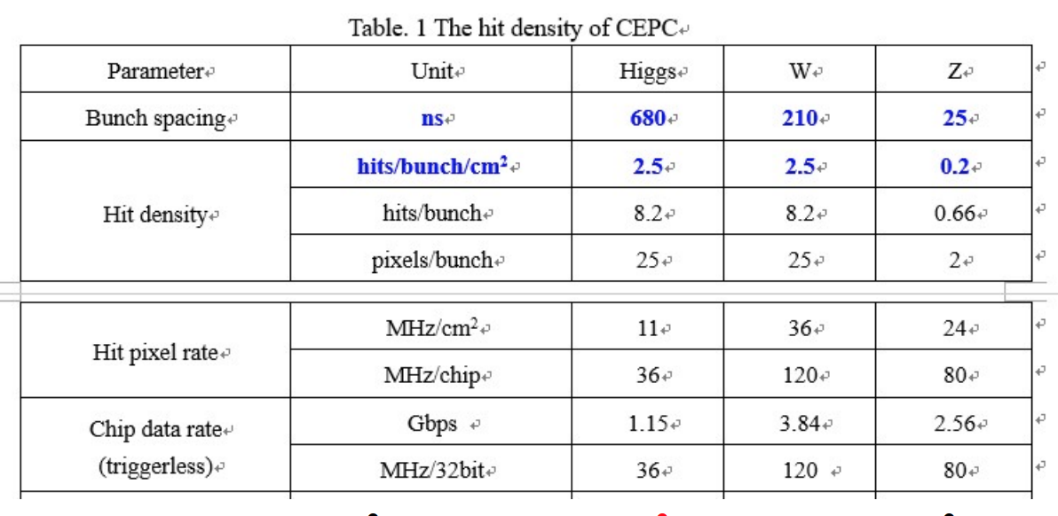
Vertex Detector by WeiWei(IHEP)

Slide 10
Trigger/triggerless readout?

Slide 11
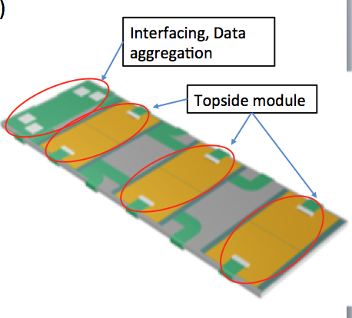
Silicon Tracker by Jens Dopke(STFC/RAL)
Good progress with prototype
BW:10Gb/s/link* 4k links=40Tb/s
Suppression: 1/(5-10), <10Tb/s

Slide 12
Clear Requirement to TDAQ
Both Trigger based mode and triggerless mode
Slow control requirement expected
Local Support Aggregation
Condensing
FE Chip
FE Chip
FE Chip
O(10) Gbps
Local aggregation
On Module Condensing
FE Chip
O(1) Gbps

Slide 13
Drift Chamber by Francesco Grancagnolo (INFN-Lecce)

Slide 14
Maximum total Volume in trigger mode

Slide 15
Total Data Volume after reduction

Slide 16
TPC by Huirong Qi
Total Channel:840k,6.5K chips

Slide 17
TPC by Huirong Qi
Total data volume:13.8GB/s
Trigger option unclear yet

Slide 18
ECAL by Yong Liu(IHEP)

Slide 19
HCAL by Yong Liu(IHEP)

Slide 20
ECAL/HCAL by Yong Liu(IHEP)
Requirements to TDAQ still unclear

Slide 21
DR Calo by Roberto Ferrari(INFN)
?

Slide 22
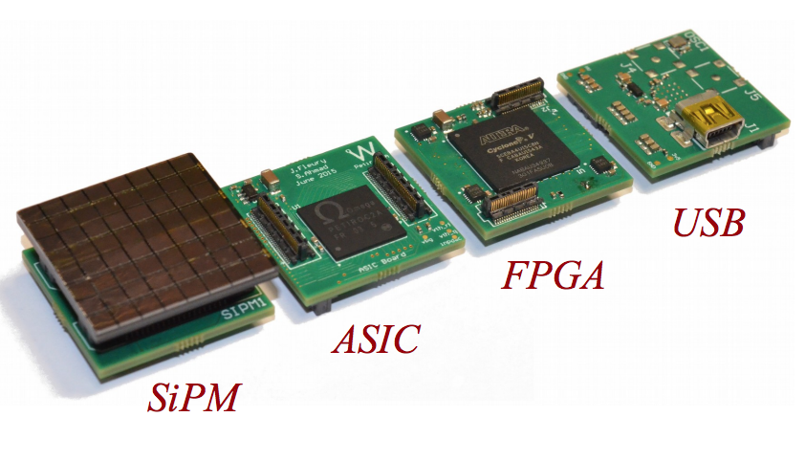
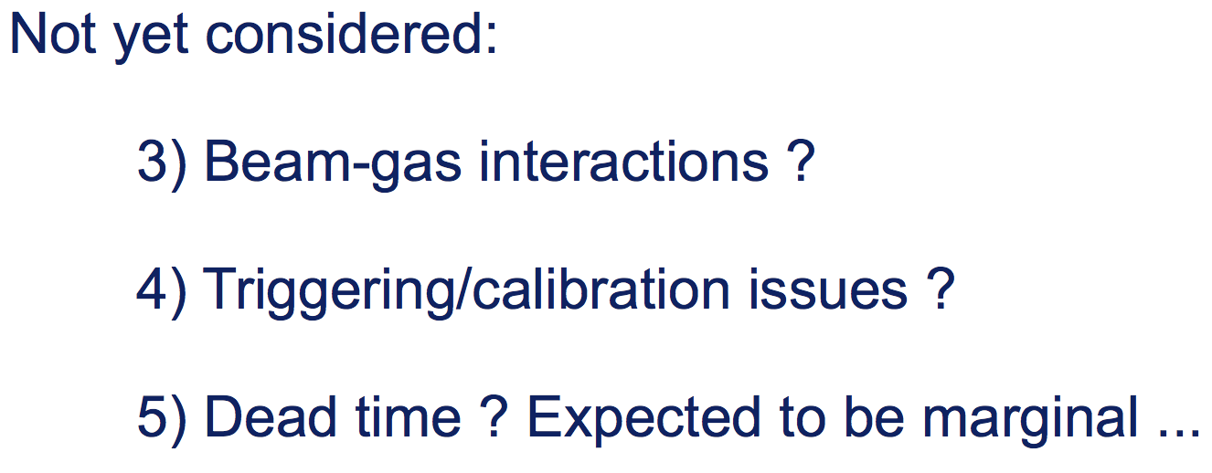
DR Calo by Roberto Ferrari(INFN)
Requirement to TDAQ to be considered

Slide 23
LumiCal by Suen Hou(IPAS)

Slide 24
LumiCal by Suen Hou(IPAS)

Slide 25
Summary of the Requirement
.

Slide 26
Further action
We gather the updated requirements from all sub-detectors as in last page, we will review them carefully for consistency, and to inform what future work is needed on TDAQ.
Some quick comments on each of the detector system see backup slides

Slide 27
Invited Special Technology on readout
Pixel readout technologies and the challenges for the future
By Maurice Garcia-Sciveres (LBNL)

Slide 28
Invited Special Technology on Software trigger
ATLAS HLT tracking optimisation

Slide 29
Good example of Offline selection to online HLT

Slide 30
Good example for Resource estimation

Slide 31
Invited Special Technology on TCDS
Precision timing distribution systems and their current performance
By Eduardo Mendes(CERN)

Slide 32
How a precise timing distribution could be realized

Slide 33
Versatile Link for low-jitter

Slide 34
Implementing the Versatile link in the experiment

Slide 35
Higher Phase-determinism IP

Slide 36
Timing compensation and monitoring

Slide 37
Discussions on Stradegy of DCDS/TDAQ Rearch & Design
Accelerator interface with DCTD
Machine Clock/Synchronization Signals
BC0, revolution,…
TDAQ status feedback
Readout Structure
IHEP Experience and Application in Belle II and CMS
Which platform one prefer?
Micro-TCA(MTCA) or
Customized ATCA or
xTCA (ATCA-PICMG3.8/MTCA.4) or
Other standard?

Slide 38
Discussions on DCDS/TDAQ(cont.)
Online networking and computing
Hardware/Firmware Technologies
Common hardware(backend readout)
FPGA/GPU/… based processor
Common Firmware
Software DEV platform
Prototypes development
Welcome for R&D
How to collaborate
Demo System development
Components
Key modules R&D
Task sharing
Other more issues？

Slide 39
Highlight/key points
We learn that constraints from Vertex detector are probably the most significant
Other detectors are less constrained, but the data rates may still be very large, and present a significant data concentration problem
Common philosophy/ideas/standards are now needed for control and readout of on-detector electronics, to prevent from any divergence
Agreeing these common standards will make early R&D and prototyping possible and optimally for everyone. (more refers to backup slides)

Slide 40
Potential next actions
Start to consider timing and control strategy
Must avoid divergence of thinking in different groups / detectors
Start to consider online software strategy
Produce first estimate of required resources (mostly human)

Slide 41
Summary
Very productive sessions
Updates on the requirements to TDAQ
Better understanding
More Detailed Key Technologies presented
Fruitful discussion with common understanding
Potential next work/actions are proposed

Slide 42
backups

Slide 43
Summary and thinking of Lumical
Event rate 2.6kHz @ 10e34
80k channels @8b -> 210MB/s
(Lumi goes up to 10e36???)
ZS factor 1%
-> 21MB/s
Could trigger from strip detector
L1 -> 100kHz?
L2 -> 10kHz?
HLT -> 1kHz?
Stand alone -> but data rates not huge
(Separate DAQ stream?)

Slide 44
Summary and thinking of Vertex
Peak hit occupancy: 120MHz / chip in W mode
Dominated by inner layer (outer layer 10x smaller)
Event-driven readout - what does this mean?
Can handle both triggered and trigger less readout
Triggered -> 160Mb/s/chip; max 3us latency
Triggerless -> 4Gb/s/chip
5000 chips total
Preference: no output to trigger, receives trigger
(But the latency?)
Say 1000 @ 4Gbps for inner layer -> 4Tb/s (!!!)
Speaker estimates ~8Tb/s
-> No pixels in trigger
-> Trigger required
Triggered data rate is low
-> Read out on L1, but latency is a serious challenge
Room for compromise on buffer depth?

Slide 45
Summary and thinking of TPC
Raw data rate 13.8GB/s -> small
Readout time 100us?
Does not seem compatible with inclusion in the trigger

Slide 46
Summary and thinking of Calo
Order 10GB/s for both options ECAL
0.3 - 1GB/s for HCAL
Triggerless fully possible…
But what about readout link count?
What about latency?
Main problem will be data concentration
(-> more latency!)

Slide 47
Summary and thinking of Calo
IDEA
200kHz event rate assumption (FCCee)
56k channels, 400ns drift time
2Gs/s per channel at 12b
Post-ZS raw data rate 1TB/s (TRIGGERED)
60GB/s after clustering - could improve with timing information
Can be self-triggering (note the 400ns)

Slide 48
Summary and thinking of DR Calo
300kW!
40GB/s at 100kHz triggered
“Very conservative”
More reasonable, 1.3GB/s (trivial)
Untriggered? What is trigger output?
1TB/s noise hits!
No discussion of trigger outputs so far
(What is the raw-raw rate? Looks like 400 * 1.3GB/s = 500GB/s? This is quite large)

Slide 49
Summary and thinking of Muon
2.5MB/s for 100kHz triggered -> very small
(1.5M ch)
Preshower 300MB.s
(7.5M ch)
Untriggered readout probably possible, yet to be investigated

Slide 50
Summary and thinking of Silicon
50m^2 silicon, 150k sensors
Can run triggerless or triggered
SLOW CONTROLS?
Material vs redundancy
4k data links * 10Gb/s = 40Tb/s
Buffer size for triggered is 80 hits / chip
- Seems fine at Z pole
2Tb/s raw

Slide 51
Potential next actions:
Understand what data is available from calo / muons
Define basic trigger selections, investigate selectivity, trigger rates, etc.
Understand whether fast tracking information is useful / necessary
‘Lightweight L1’
Look at whether implementation in 3us is feasible
Tabulate data rates from detector for LL1, start to look at consequences
Data rates from detector
Necessary modularity and concentration of readout
Power and cost of electronics on and off detector
Order of magnitude estimates only
Tabulate data volumes and rates to storage
Do we need a further pass of data selection, or
Assume a ‘keep everything’ strategy after LL1?
Perhaps a first pass of further RoI selection / zero suppression?
What level of monitoring / prompt reconstruction is needed?
Start to consider timing and control strategy
Must avoid divergence of thinking in different groups / detectors
Start to consider online software strategy
Produce first estimate of required resources (mostly human)

Slide 52
TDAQ Coverage
Detector Readout
Hardware Trigger
Software/High Level Trigger
Event Building and Storage with Online Control
Fast Control/TCDS/machine interface
Slow Control/future trend

Slide 53
Strategy
Investigate other experiments
Trigger based System/Triggerless System
Trigger based readout/triggerless readout
If Trigger less
Continuous Sequential readout/non-sequential readout
International Exchange/collaboration
Further understanding with the Bandwidth of Detector Systems
Determine the requirements from Detector Readout
Trigger/triggerless readout
If triggerless: Continous sequential/non-sequential readout
TCDS
Time Stamp (BCN/BX, L1, …) for both trigger/triggerless
Hardware readout Structure(VME/xTCA/PXI,…)
Networking and Online

Slide 54
More Key points to think
Early decisions on trigger and readout mode are important
They fundamentally affect design of detector
Some kind of fast trigger is needed for vertex (at least)
Is this guaranteed by design constraints?
3us implies hardware, is this a fixed parameter?
Only first thinking about trigger signals from calo / muons
- Seems feasible to do trigger less readout of both
- Implications need some study
Do we need tracks in the trigger system?
Drift chambers seem possible to read out triggerless
Not clear whether tracking is doable or whether it is necessary
Is it possible to make vertex detector RoI choices based on call / muons alone?
We have a DATA CONCENTRATION problem in some sub detectors
Potentially inefficient use of data links without significant aggregation
What about slow controls? Timing?
Can we aim for a ‘fully integrated / redundant’ control system?
Can we aim for a common readout protocol?
For some systems (vertex, silicon), timing and control needs vary according to run mode

