Slide 1

Physics Motivation and Overview
Which Way beyond the SM?
“...the direct method may be used...but indirect methods will be needed in order to secure victory.”
“...there are not more than two methods of attack – the direct and the indirect; ...Who can exhaust the possibilities of their combination?”
Sun Tzu, The Art of War
John Ellis

Slide 2
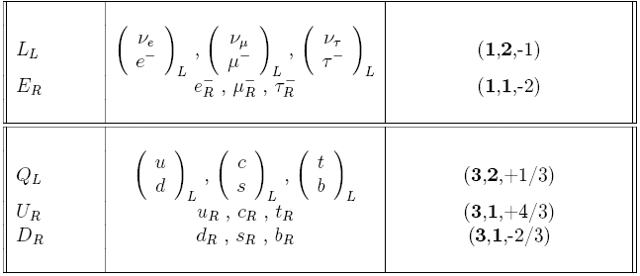
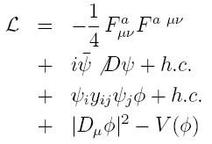
Summary of the Standard Model
What are we?
Particles and SU(3) × SU(2) × U(1) quantum numbers:
Lagrangian: gauge interactions
matter fermions
Yukawa interactions
Higgs potential
Tested below 0.1%
before LHC
Testing now
in progress

Slide 3
LHC Measurements
Agree with the
Standard Model
Higgs
production

Slide 4
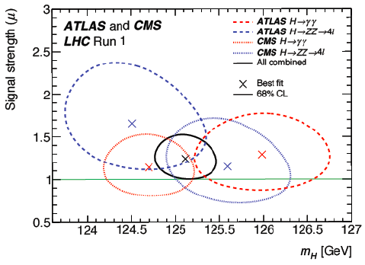
Higgs Mass Measurements
ATLAS + CMS ZZ* and γγ final states
Run 1:
ATLAS Run 2: 124.97 ± 0.24 GeV
CMS Run 2: 125.35 ± 0.15 GeV
Crucial for
stability of
electroweak
vacuum
0.1% accuracy!

Slide 5
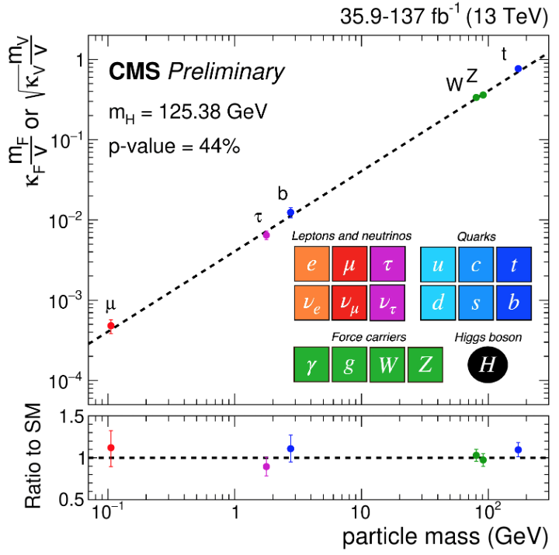
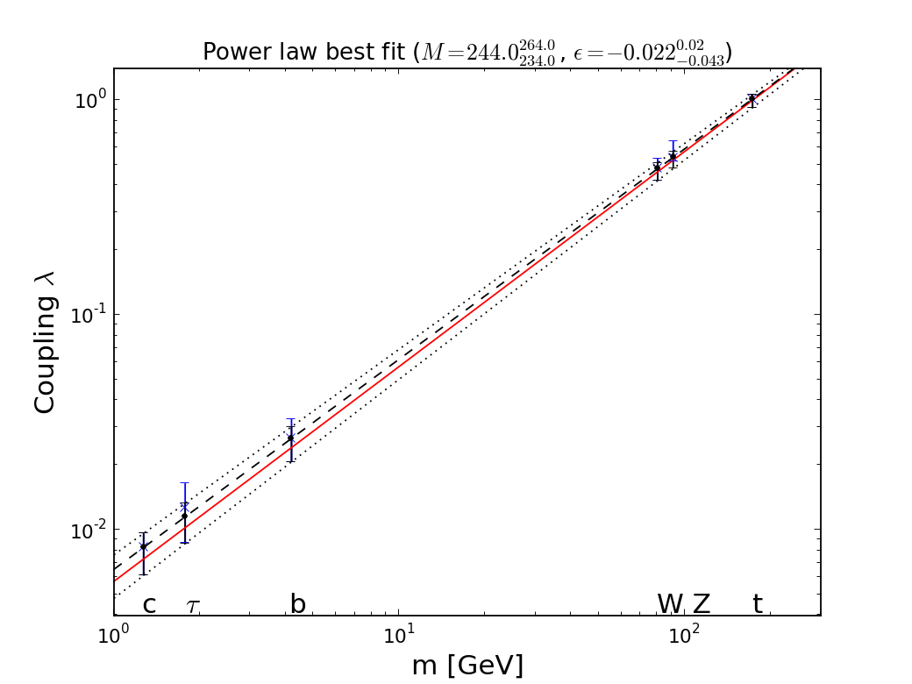

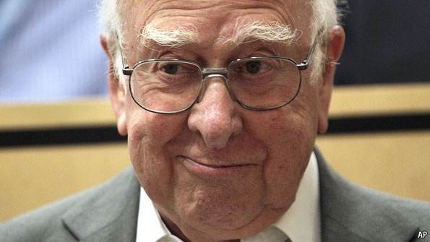

It Walks and Quacks like a Higgs
Do couplings scale ~ mass? With scale = v?
Red line = SM, dashed line = best fit
Global
fit
JE & Tevong You
Blue dashed line = Standard Model

Slide 6
Everything about Higgs is Puzzling
+ …
Pattern of Yukawa couplings y:
  Flavour problem
Magnitude of mass term μ:
  Naturalness/hierarchy problem
Magnitude of quartic coupling λ:
  Stability of electroweak vacuum
Cosmological constant term V₀:
  Dark energy
Higher-dimensional interactions?

Slide 7
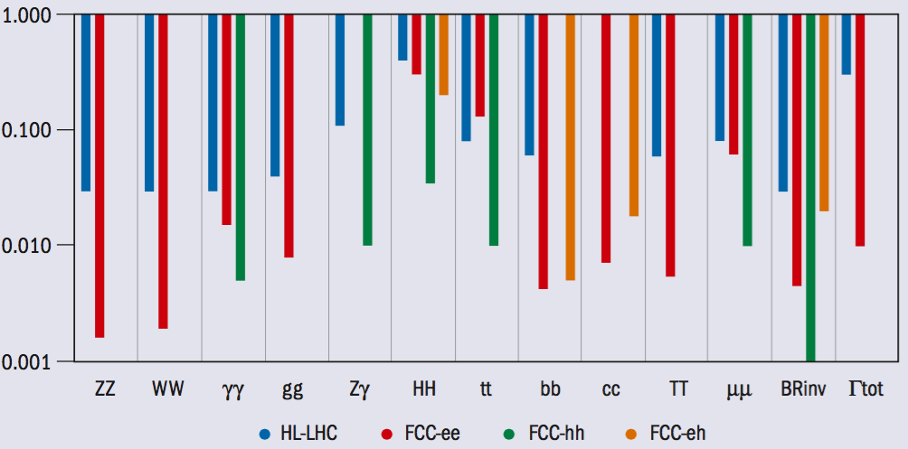
Possible Future Higgs Measurements
FCC CDR
Need to reduce theoretical uncertainties to match experimental errors
  Needed for BSM interpretation
High precision at FCC-ee/CEPC
Big statistics at FCC-hh/SppC

Slide 8
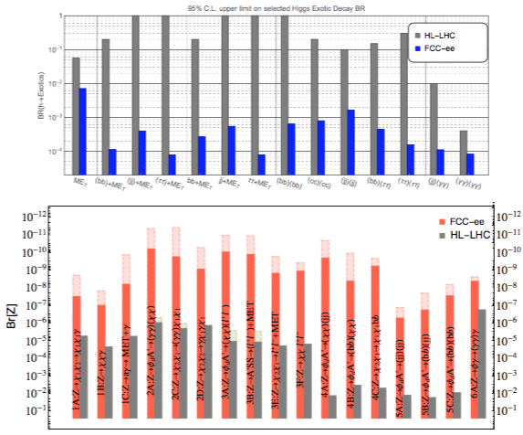
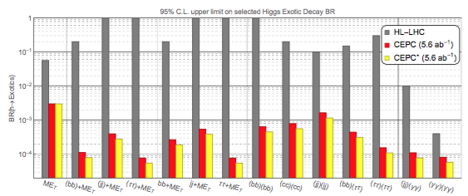
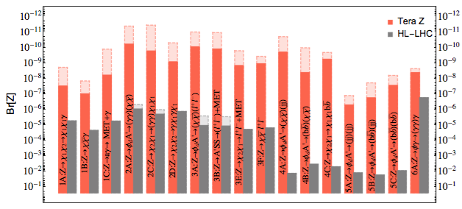
Constraints on Exotic H and Z Decays
FCC + CEPC CDRs

Slide 9
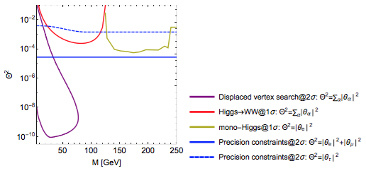
CEPC Constraints on Sterile Neutrinos
CEPC CDR
Explore seesaw models
of neutrino masses

Slide 10
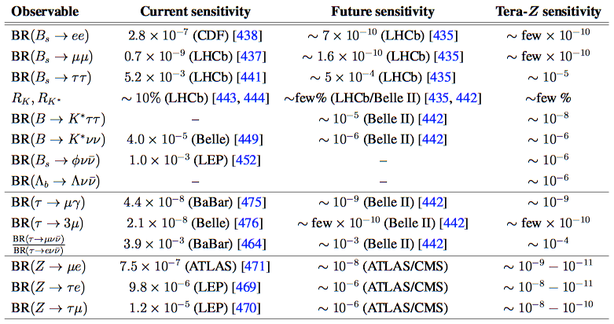
Tera-Z Flavour Physics
CEPC CDR

Slide 11
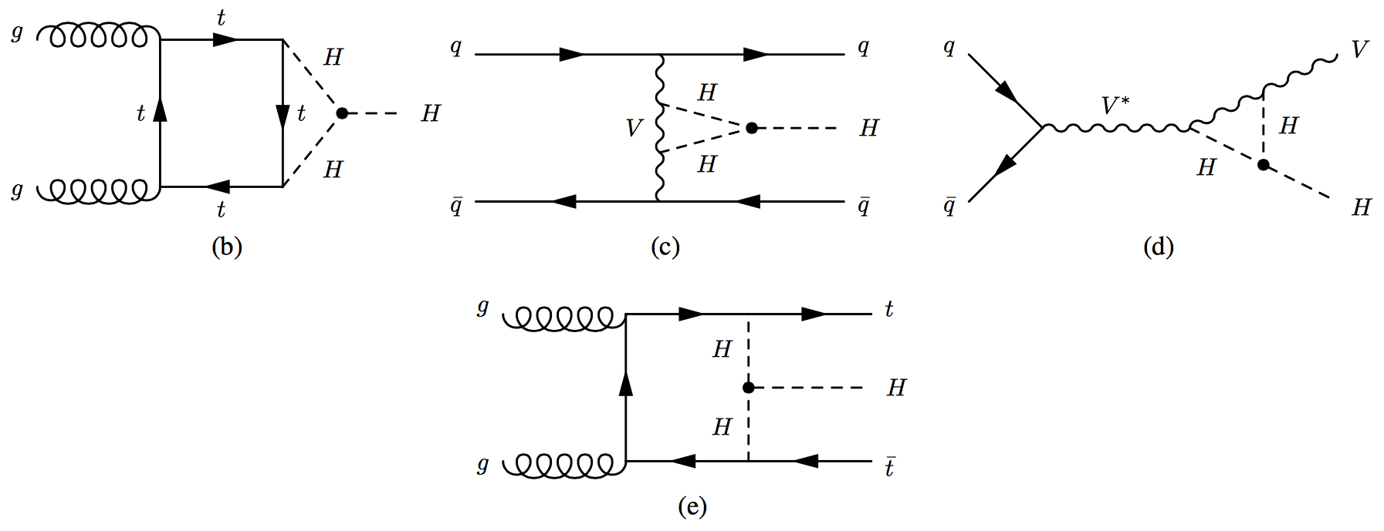
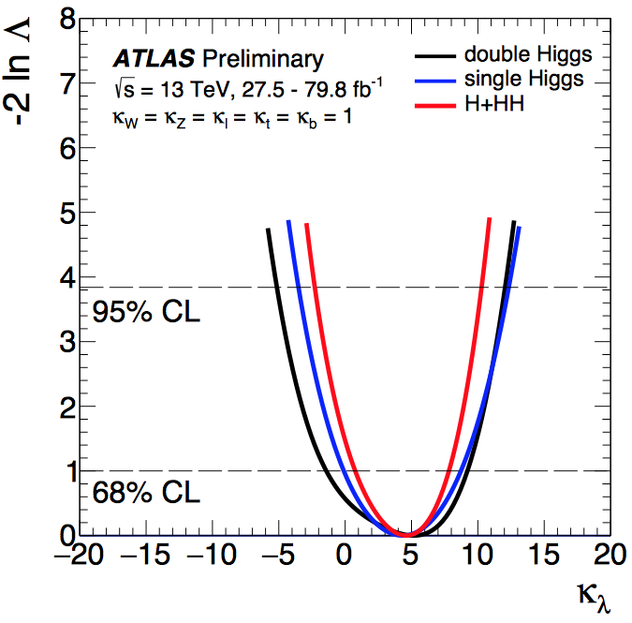
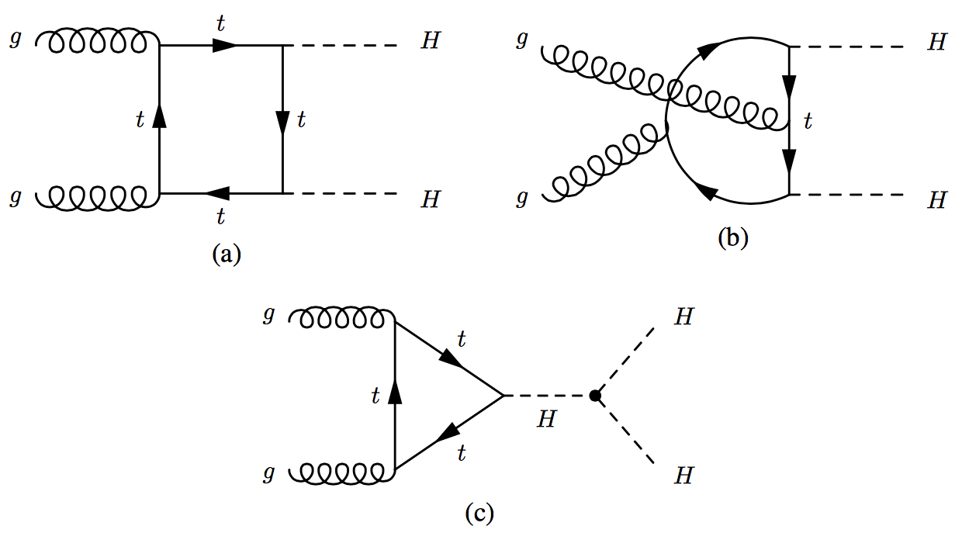
Sensitivity to HHH Coupling
Similar sensitivities
from single and
double Higgs production – but still a long way to go!

Slide 12
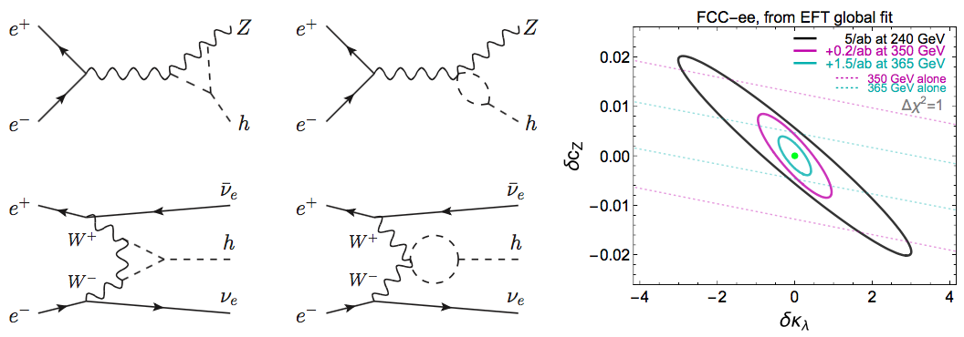
Sensitivity to HHH Coupling
FCC CDR
Sensitivity through radiative corrections
Combining all FCC-ee centre-of-mass energies: precision in κ_{λ} of ±40%
Improved to ±35% in combination with HL-LHC
Further improved to ±25% when c_{Z} fixed to SM value.

Slide 13
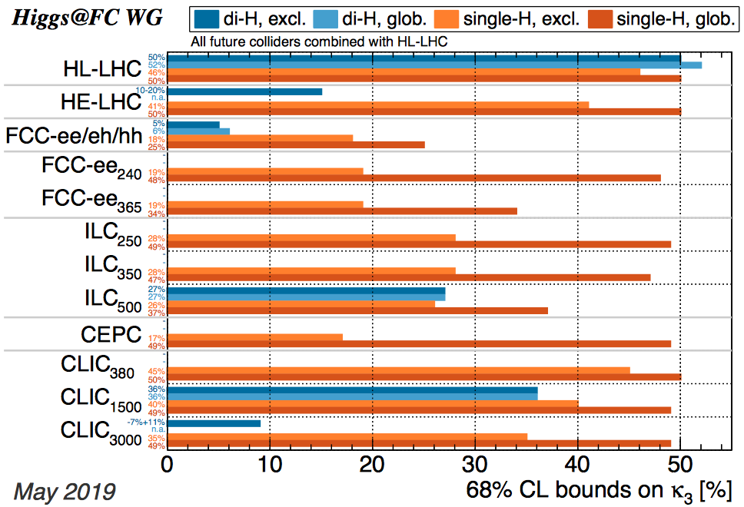
Triple-Higgs Coupling Analyses
De Blas et al, arXiv:1905.03764

Slide 14

Effective Field Theories (EFTs) a long and glorious History
One way to look for BSM physics
1930’s: “Standard Model” of QED had d=4
Fermi’s four-fermion theory of weak force
Dimension-6 operators: S, P, V, A, T?
  Due to exchanges of massive particles?
Experiment ➔ V-A
  ➔ massive vector bosons ➔ gauge theory
Yukawa’s meson theory of strong N-N force
  Due to exchanges of mesons? ➔ pions
Chiral dynamics of pions: (∂π∂π)ππ clue ➔ QCD

Slide 15

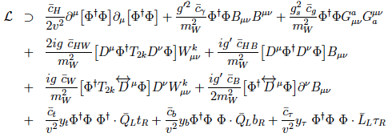
Standard Model Effective Field Theory
Higher-dimensional operators as relics of higher-energy physics, e.g., dimension 6:
Operators constrained by SU(2) × U(1) symmetry:
Constrain with precision EW, Higgs data, TGCs ...

Slide 16
Global SMEFT Fit
to Higgs, Diboson and Electroweak Data
Global fit to dimension-6 operators using precision electroweak data, W⁺W⁻ at LEP, Higgs and diboson data from LHC Runs 1 and 2
Improvements in the constraints from Run 2
Constraints on BSM models
  Some contribute to operators at tree level
  Stops that contribute at loop level
JE, Murphy, Sanz & You, arXiv:1803.03252

Slide 17
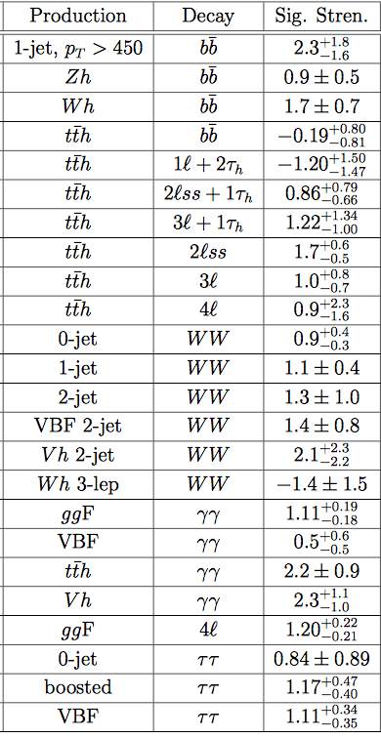
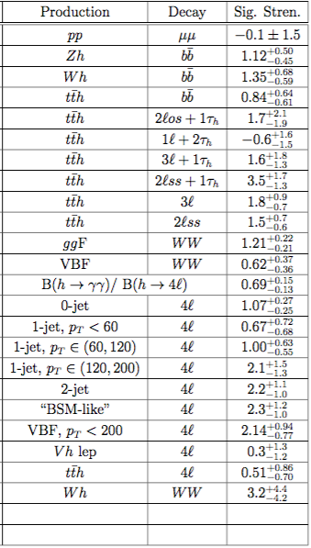
Run 2 Higgs
Measurements used in
SMEFT Fit
CMS
ATLAS
Include all
available
kinematical
information
+ W⁺W⁻
measurement
at high p_{T}
Probe 12 SMEFT directions
JE, Murphy, Sanz & You, arXiv:1803.03252

Slide 18
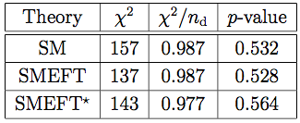
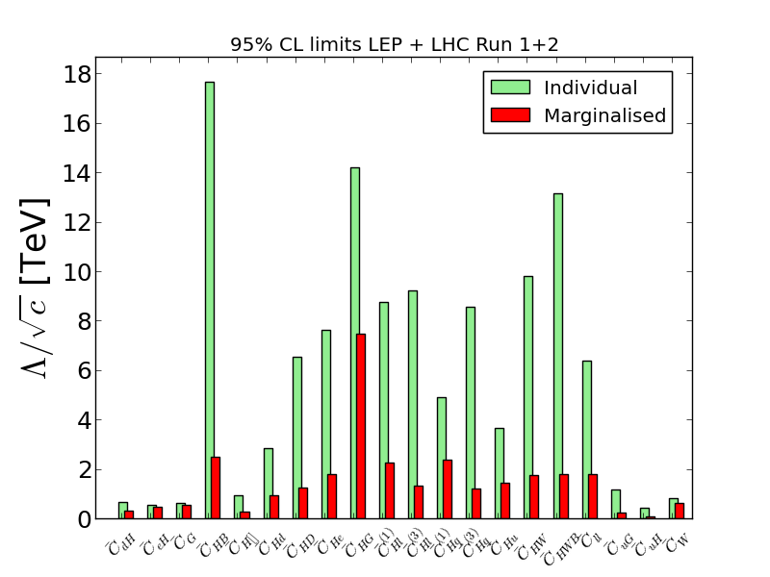
Summary
20
Warsaw basis
13
JE, Murphy, Sanz & You, arXiv:1803.03252

Slide 19
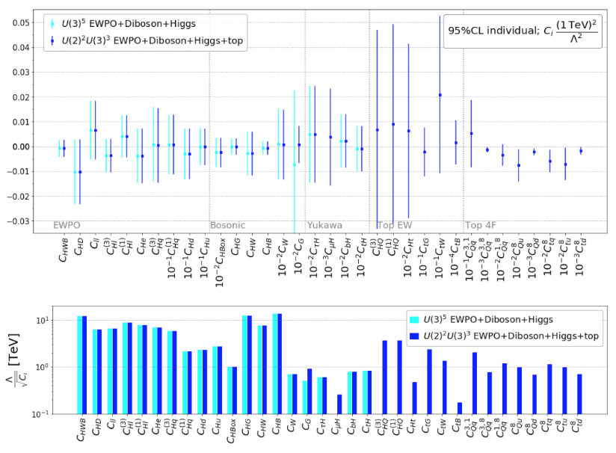
Updated Fit including Top Data
Over 200 EW, H, diboson, top LHC Runs 1 + 2 measurements, allow top flavour non-universality
No significant indications
of non-zero operators
Constraints on
individual operators
JE, Madigan, Mimasu, Sanz & You, to appear

Slide 20
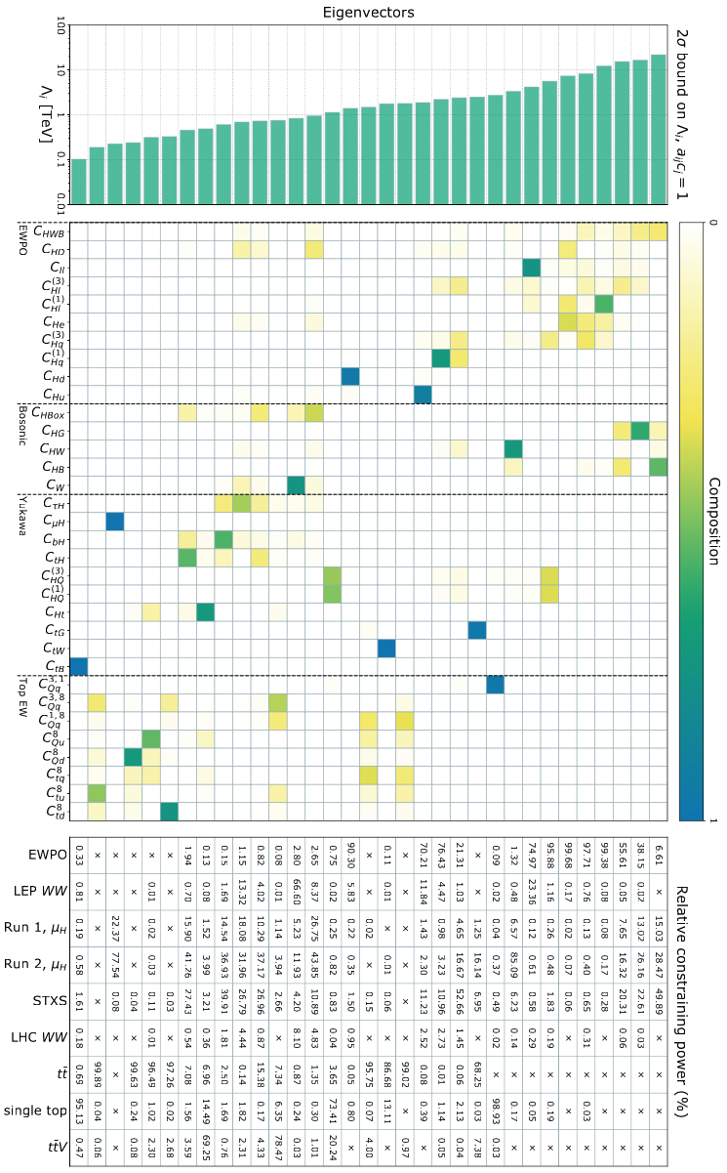
Principal Component Analysis
EW, H, diboson, top from LHC Runs 1 + 2 data
Relative importance (%)
More constrained operator combinations ➔
JE, Madigan, Mimasu, Sanz & You, to appear

Slide 21
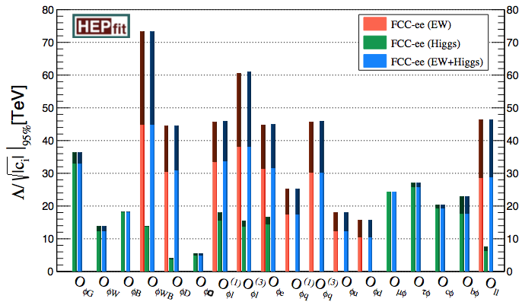
Future EFT Constraints from Higgs and Electroweak Measurements
FCC CDR
Dark colours include
theoretical errors

Slide 22
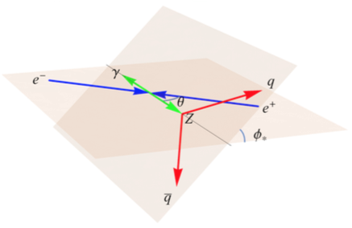


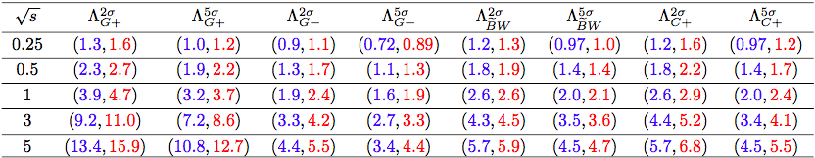
Beyond Dimension 6
Neutral triple gauge couplings
have no dimension-4, -6 contributions
Appear first at dimension-8:
Probe in e⁺e⁻ ➔ Zγ, using hadronic Z decays:
Unpolarized beams: Λ>> E_{CM}
JE, He & Xiao, arXiv:2008.04298
(JE, Ge, He & Xiao, arXiv:1902.06632)

Slide 23
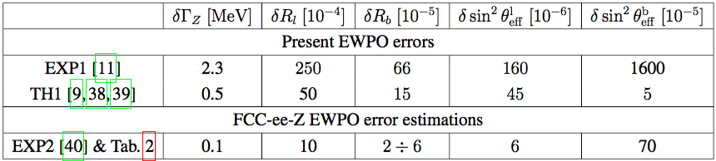
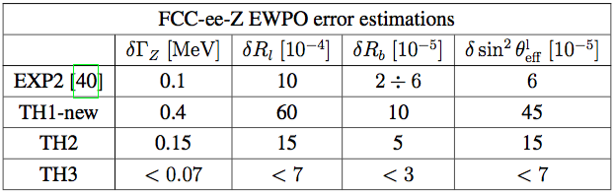
Precision Electroweak Measurements
Present and future EWPO errors
Blondel et al, arXiv:1809.01830
Comparison of future EWPO errors with TH estimates

Slide 24
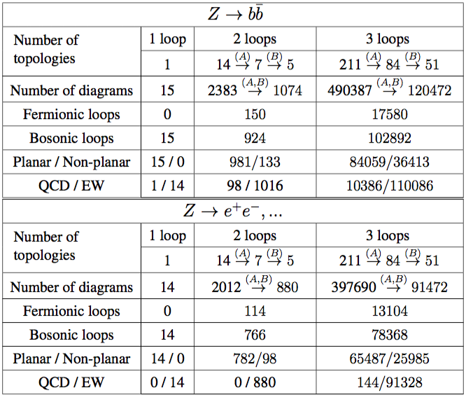
Numbers of Diagrams to be Calculated
Blondel et al, arXiv:1809.01830
A lot of work
for theorists,
but feasible!

Slide 25

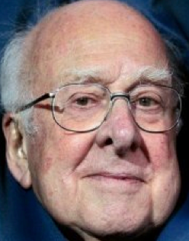

« Empty » space is unstable
Dark matter
Flavour & origin of matter
Masses/mixing of neutrinos
Hierarchy problem
Inflation
Quantum gravity
…
Where are we going?
^{The} Standard Model
Notes:
25

Slide 26
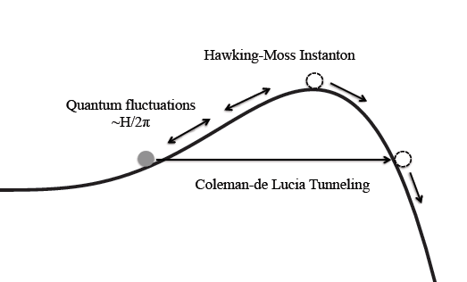

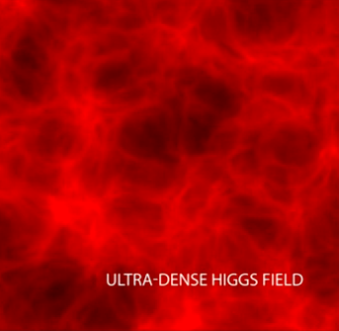
Will the Universe Collapse?
Should it have Collapsed already?
Fluctuate over barrier
in the early Universe?
Not if
infinite wall:
Supersymmetry?
Fluctuate over barrier?
We are here
Fluctuate over barrier?
Tunnel through barrier
in current Universe?
Tunnel through
barrier now?
Quantum fluctuations
The Big Crunch

Slide 27


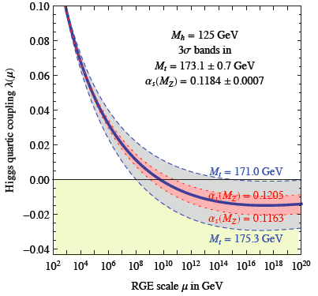
Theoretical Constraints on Higgs Mass
Buttazzo, Degrassi, Giardino, Giudice, Sala, Salvio & Strumia, arXiv:1307.3536
Large M_{h} → large self-coupling → blow up at low-energy scale Λ due to
renormalization
Small: renormalization
due to t quark drives
quartic coupling < 0
at some scale Λ
→ vacuum unstable
Vacuum could be stabilized by Supersymmetry
Instability @
10^{11.1±0.8} GeV

Slide 28
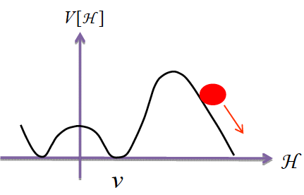
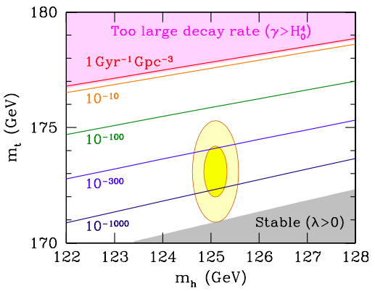
Vacuum Instability in the Standard Model
Andreassen, Frost & Schwartz, arXiv:1707.08124
Sensitive to α_{s} as well as m_{t} and M_{H}
Instability scale:
m_{t} = 172.76±0.30 GeV ➔ log₁₀(Λ/GeV) = 11.1±0.8
Buttazzo, Degrassi, Giardino, Giudice, Sala, Salvio & Strumia, arXiv:1307.3536

Slide 29
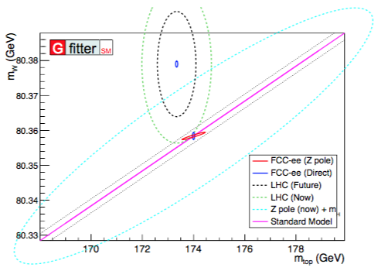
FCC-ee: Measurements of m_{t} & m_{W}
FCC CDR

Slide 30
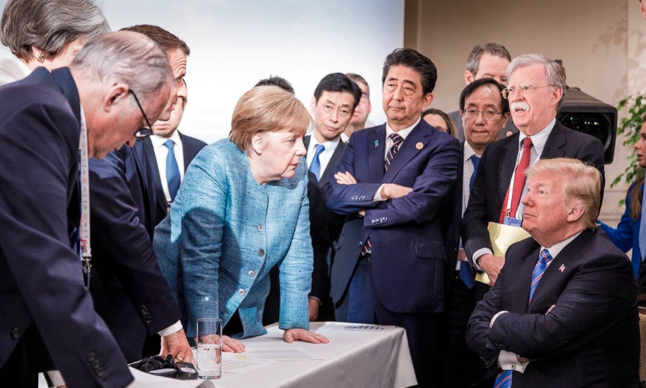
You must be joking!
We still believe in supersymmetry

Slide 31
What lies beyond the Standard Model?
Supersymmetry
New motivations
From LHC Run 1
Stabilize electroweak vacuum
Successful prediction for Higgs mass
  Should be < 130 GeV in simple models
Successful predictions for couplings
  Should be within few % of SM values
Naturalness, GUTs, string, …, dark matter

Slide 32
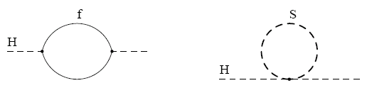



Loop Corrections to Higgs Mass²
Consider generic fermion and boson loops:
Each is quadratically divergent: ∫^{Λ}d⁴k/k²
Leading divergence cancelled if
Supersymmetry!
2
x 2

Slide 33
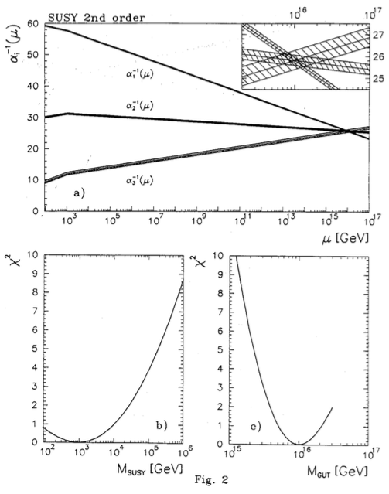
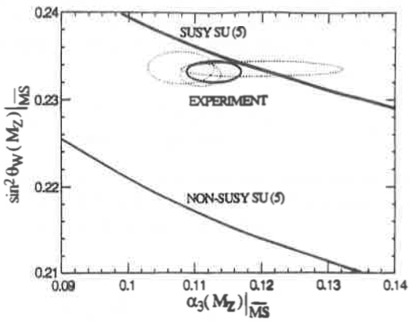
Circumstantial Evidence for Supersymmetric Grand Unification
1991
Amaldi, de Boer & Furstenau
CEPC/FCC-ee will test
GUTs much more precisely
JE, Kelley & Nanopoulos

Slide 34
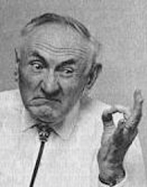
The Dark Matter Hypothesis
Proposed by Fritz Zwicky, based on observations of the Coma galaxy cluster
The galaxies move too quickly
The observations require a
stronger gravitational field
than provided by the visible matter
Dark matter?

Slide 35
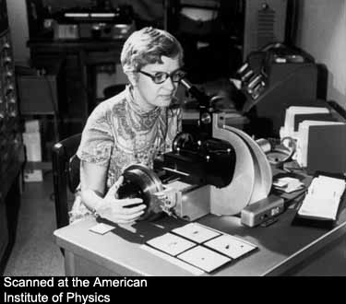
The Rotation Curves of Galaxies
Measured by Vera Rubin et al.
The stars also orbit ‘too quickly’
Her observations also required a
stronger gravitational field
than provided by the visible matter
Further strong evidence for dark matter
Also:
  Structure formation, CMB, …

Slide 36
WIMP Candidates
Could have right density if weigh 100 to 1000 GeV (accessible to LHC experiments?)
Present in many extensions of Standard Model
Particularly in attempts to understand strength of weak interactions, mass of Higgs boson
Examples:
  Extra dimensions of space
  Supersymmetry

Slide 37
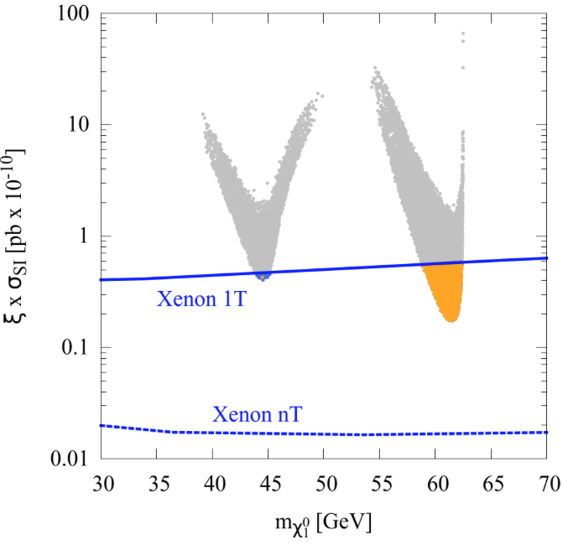
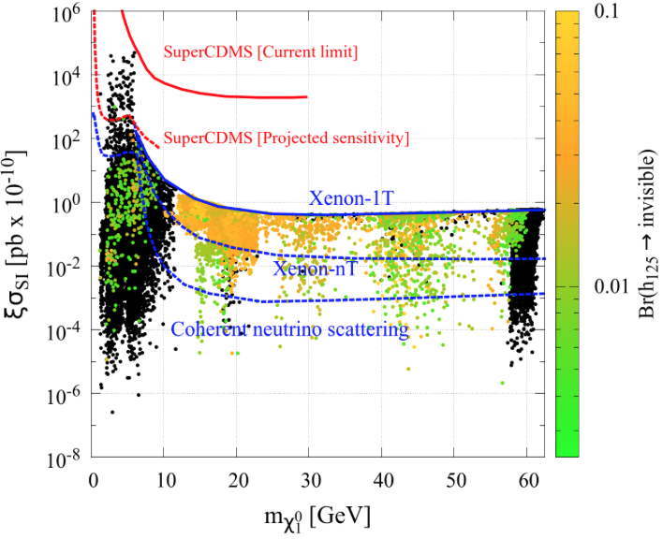
How Light can LSP be? < m_{h}/2!
Barman, Belanger & Godbole, arXiv:2010.11674
Relic density = ξ < 1 ✕ cosmological DM density
Consistent with LHC and DM scattering limits
,
Detectable in upcoming DM scattering experiments?
Detectable rate for invisible H decays?
Phenomenological MSSM
Non-minimal SUSY model

Slide 38
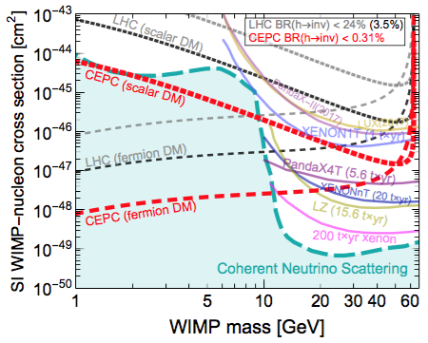
Constraints from Invisible H Decays
CEPC CDR

Slide 39
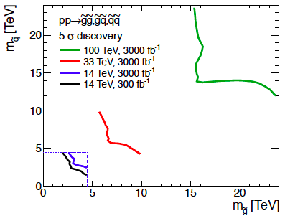
Heavy Squarks and Gluinos?
But sparticles could be much heavier
FCC CDR
Discover 12 TeV squark,
16 TeV gluino @ 5σ
at FCC-hh, SppC

Slide 40

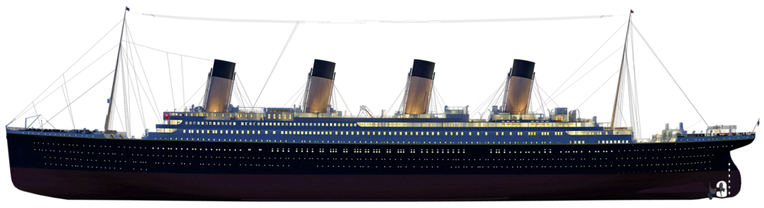
Summary
Visible matter
Standard Model
Dark Matter &
Dark Energy
https://www.youtube.com/watch?v=Ts6vS-qYuY4

