Slide 1
CgemLineFit
Hongpeng Wang
Liangliang Wang
2020-3-5

Slide 2
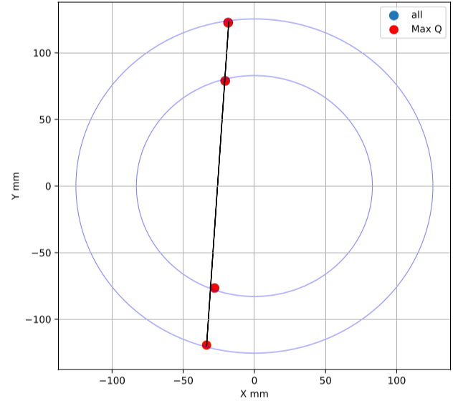
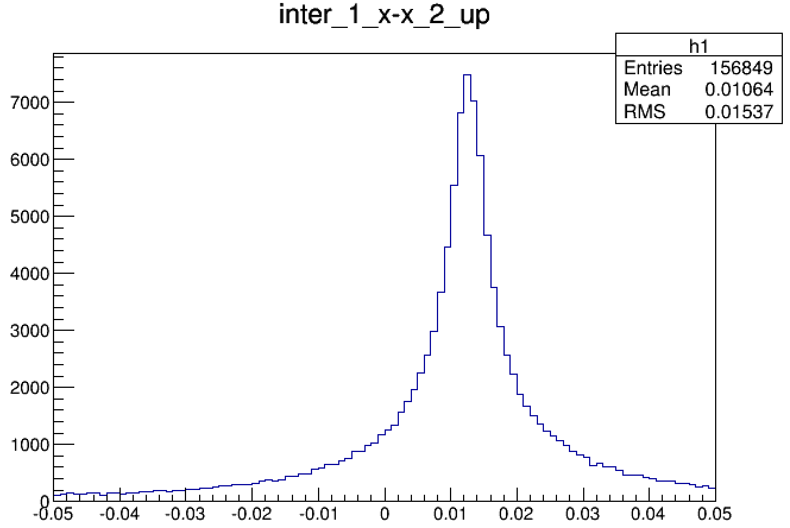
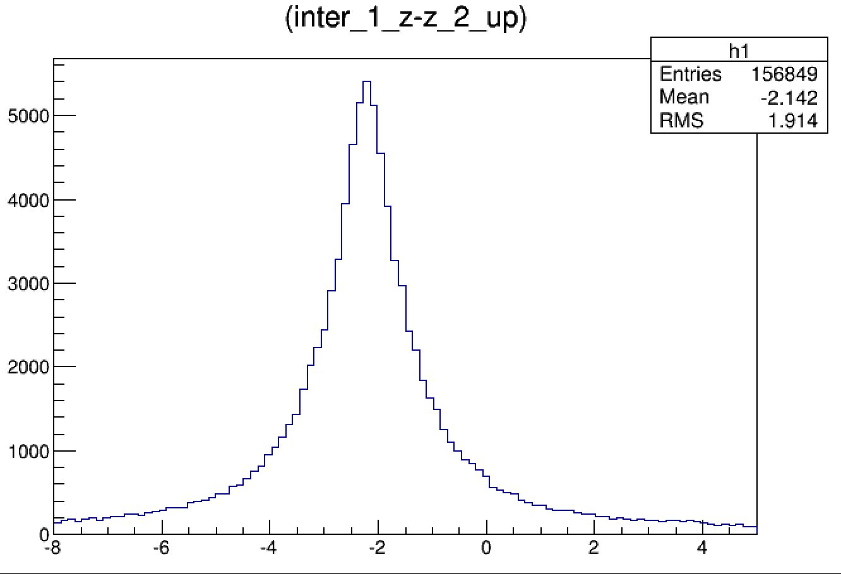
Rough Alignment
Link the inner 2 clusters , and calculate the residual in outer layer.
Set the offset of central value as the alignment parameter.
Run17 data only.
$σ phi$ : rad(upper,middle)
$σ Z$ : mm (upper,middle)

Slide 3
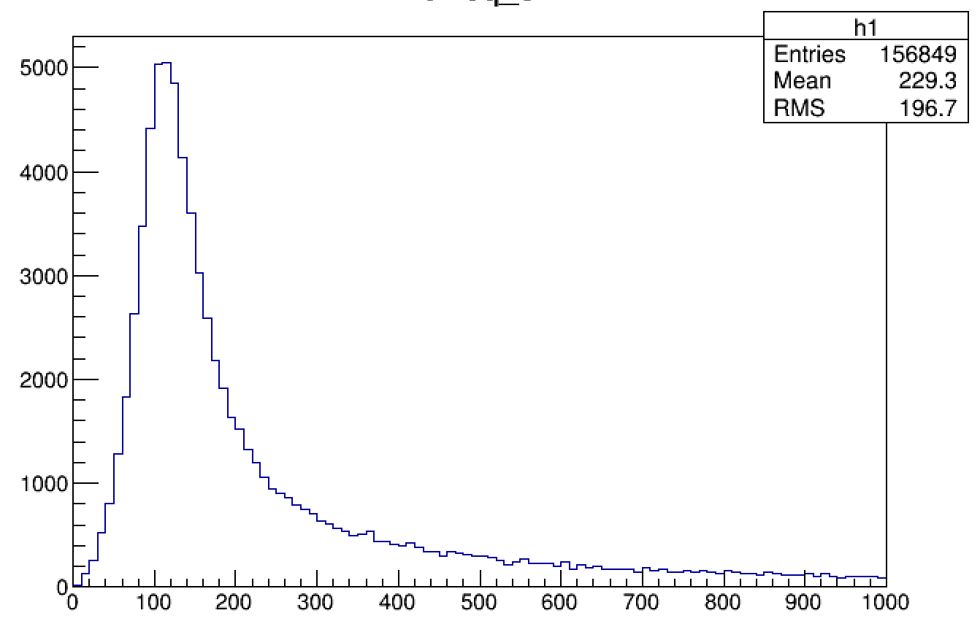
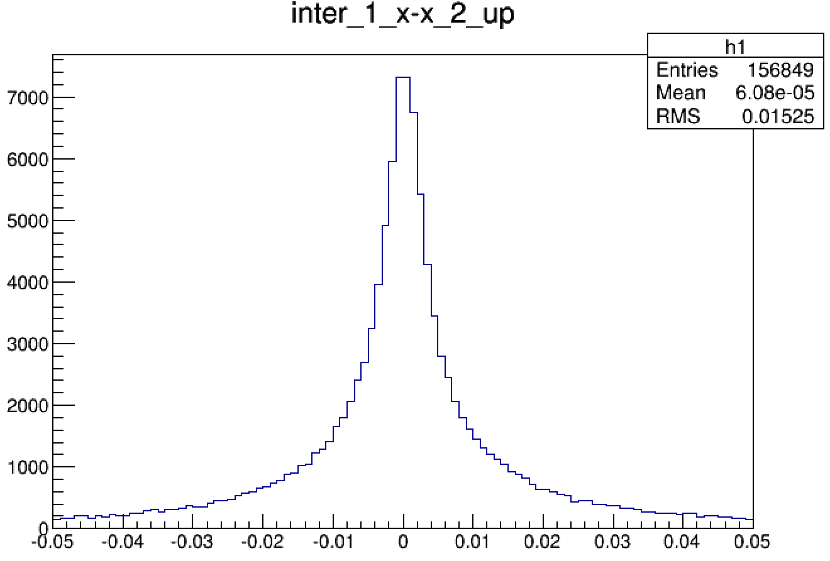
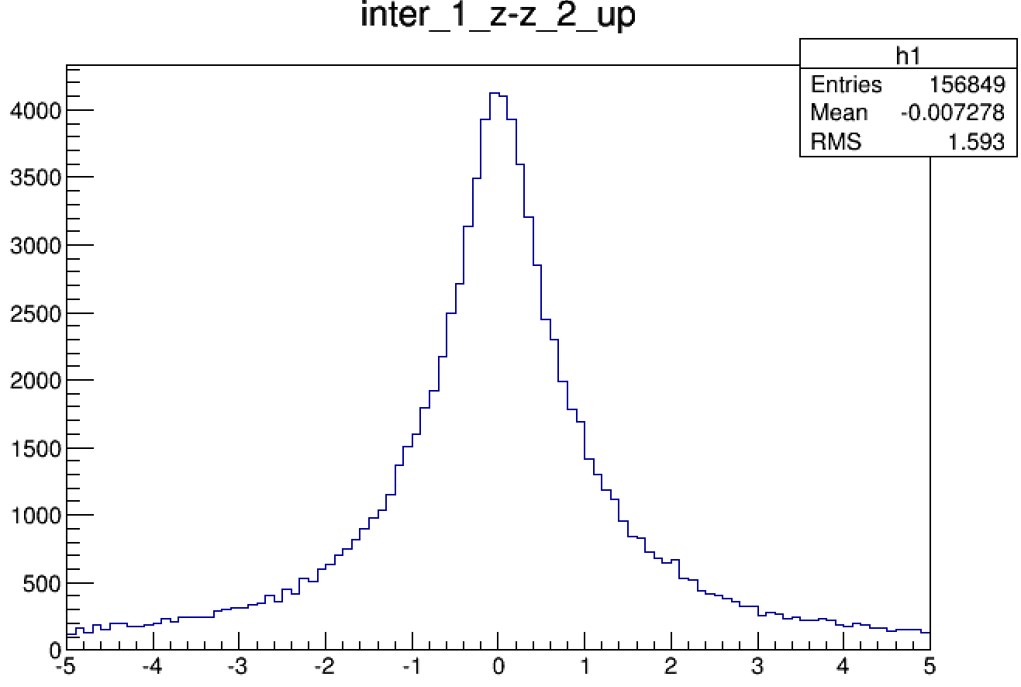
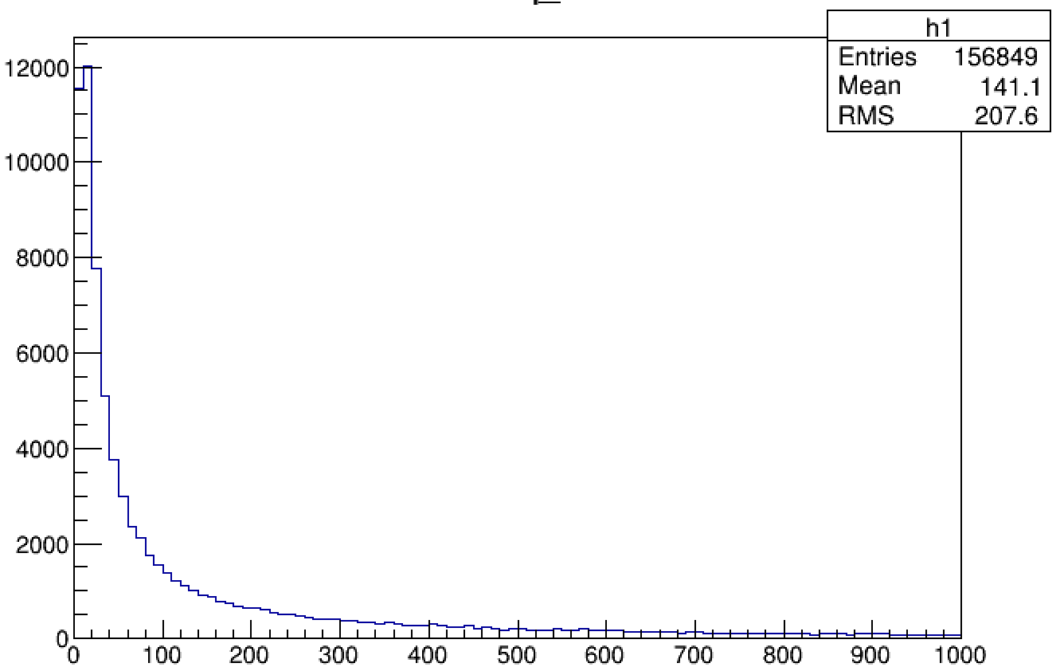
Alignment
No alignment parameters input
Fitting with rough alignment parameter
$σ phi$ : rad(upper,middle)
$σ Z$ : mm (upper,middle)
$$χ^{2}( 4 clusters)$$

Slide 4
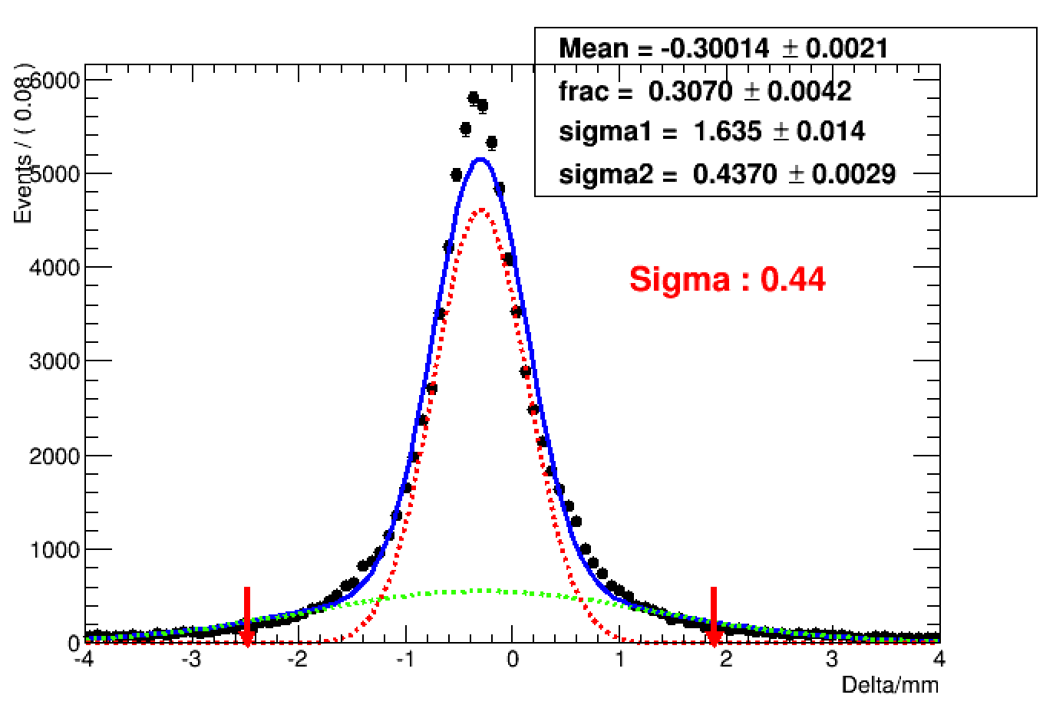
Study the efficiency and resolution
Run 17 data.
Ask at least 3 clusters besides the study sheet.
Find the best 3 clusters combination with smallest$χ^{2}$($χ^{2}$<2000).
In study sheet , reserve only one cluster , which is closest to the position forecasted by other 3 clusters.
Fit to the residual of x/v by double gaussian function, set the function with smaller sigma as signal ,and central value $±5σ$as the signal window.
$σx$ in upper sheet ,middle layer

Slide 5
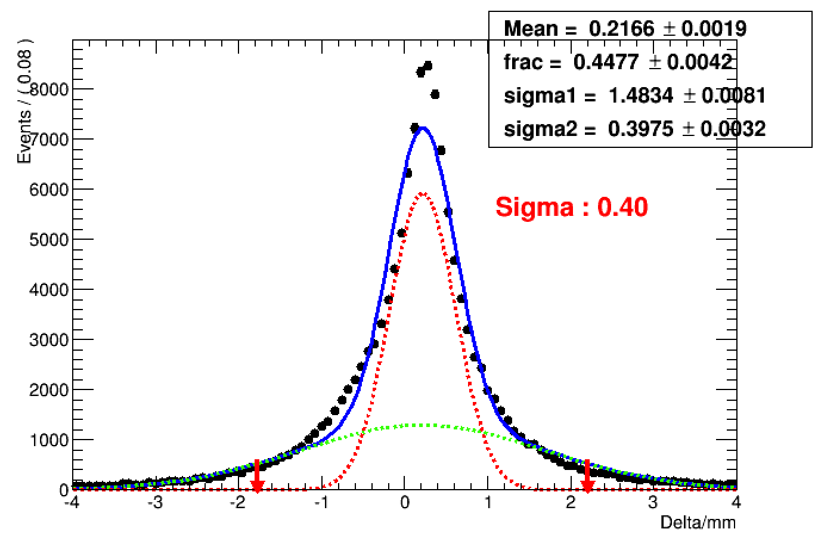
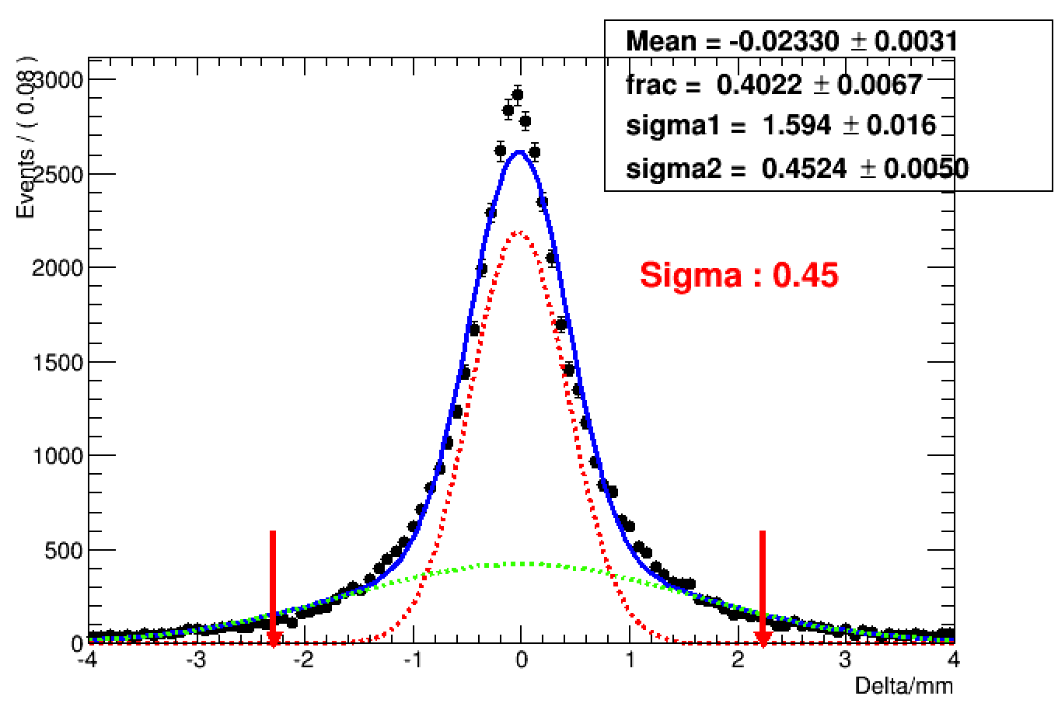
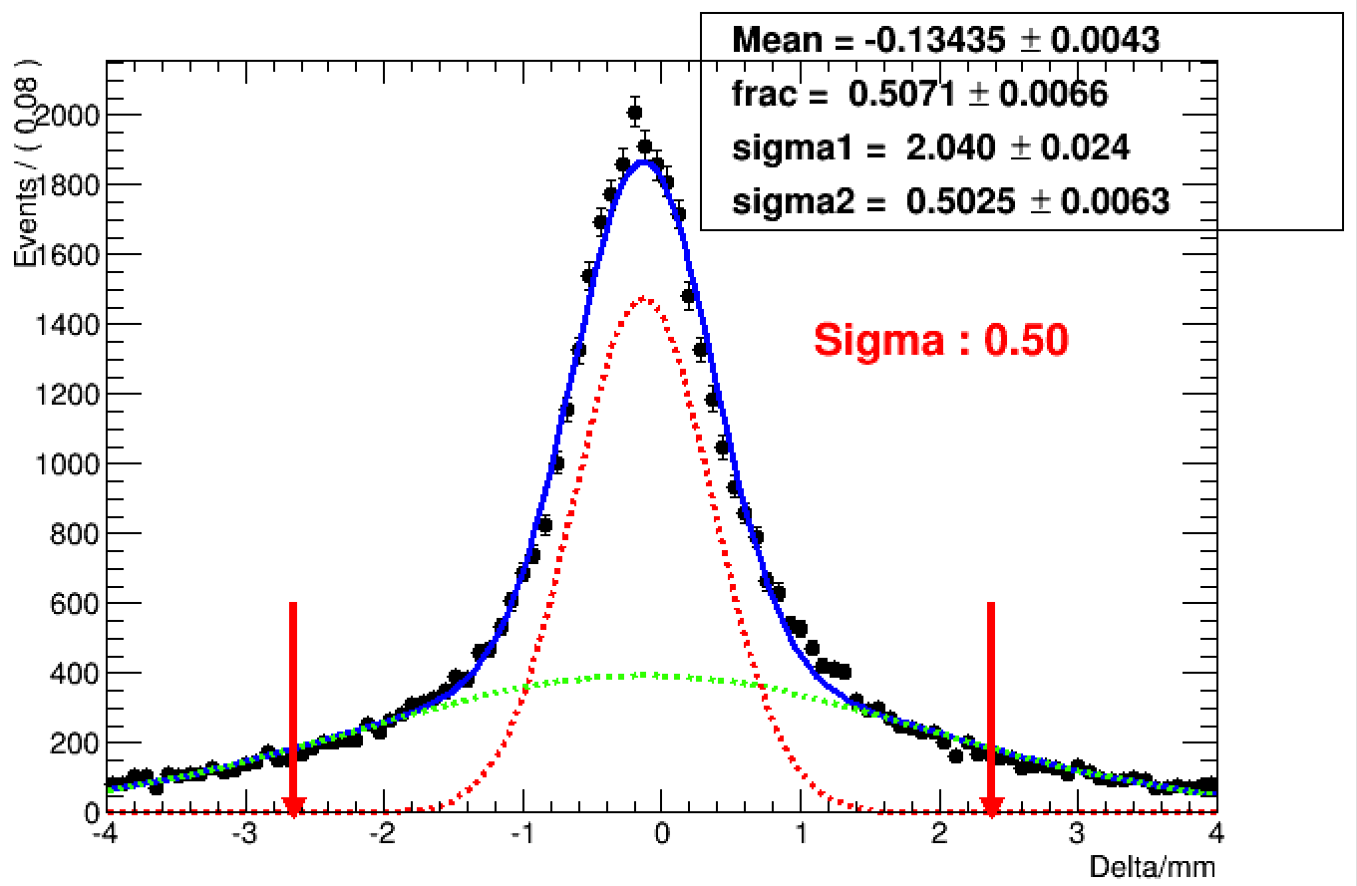
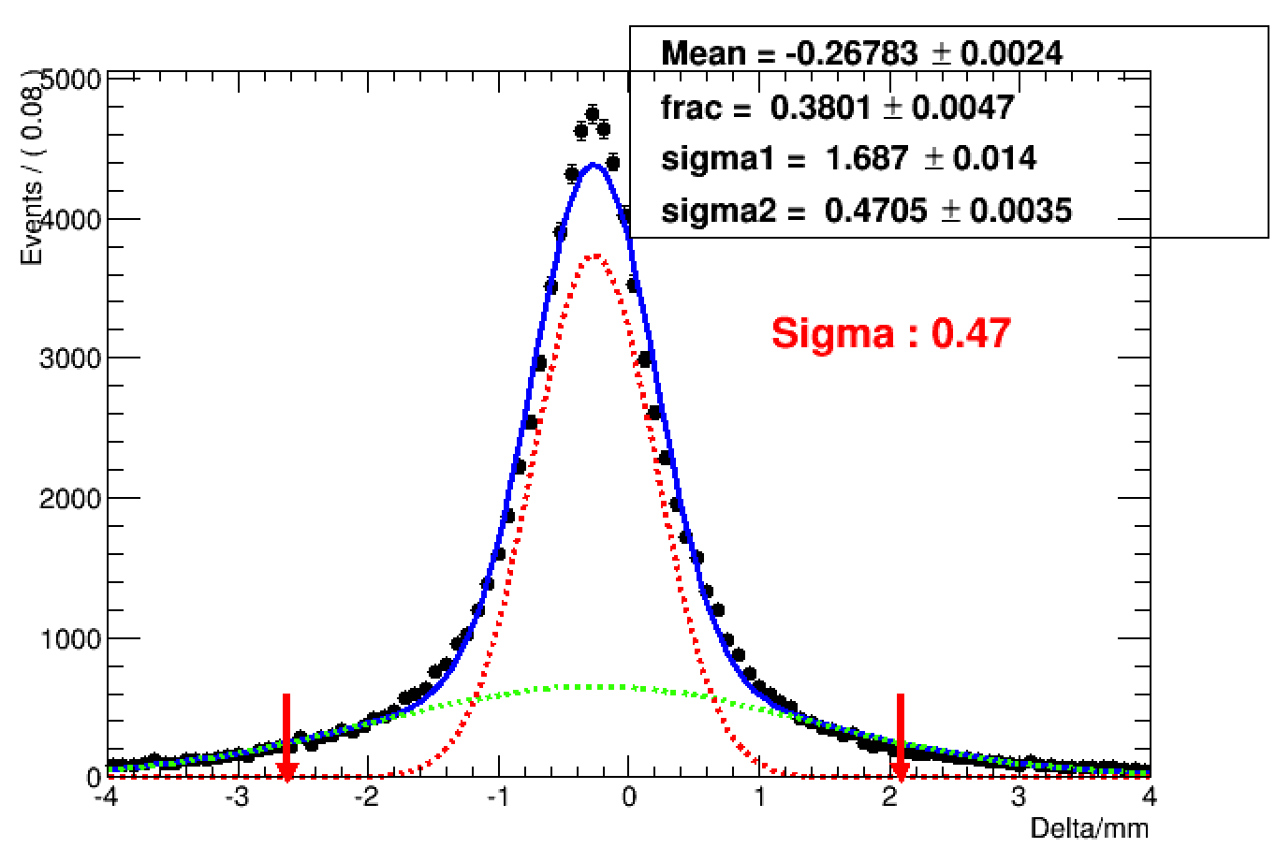
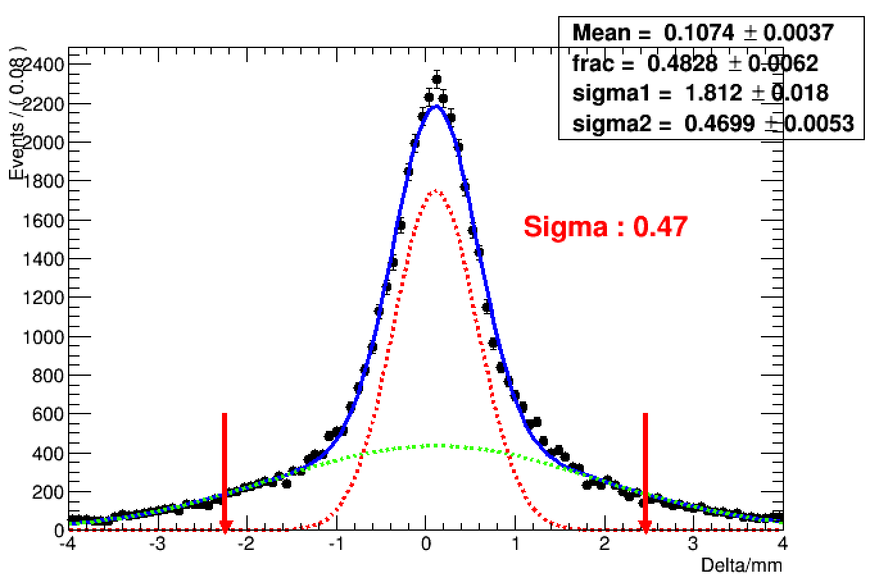
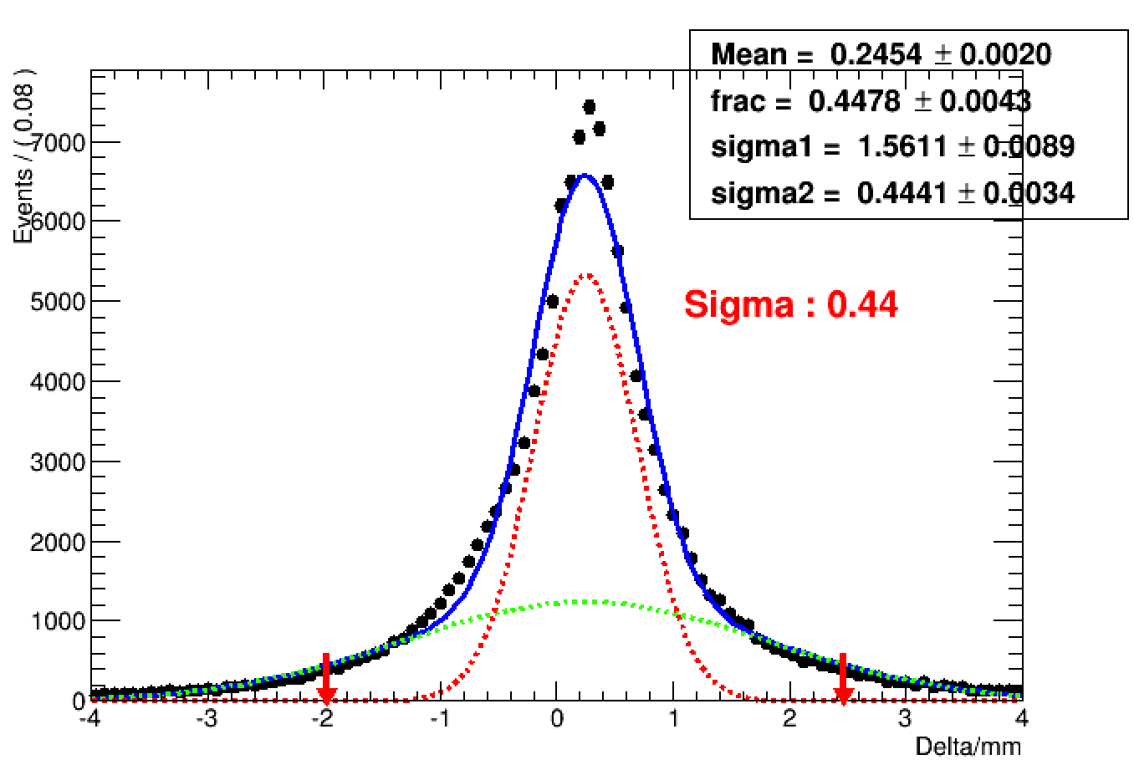
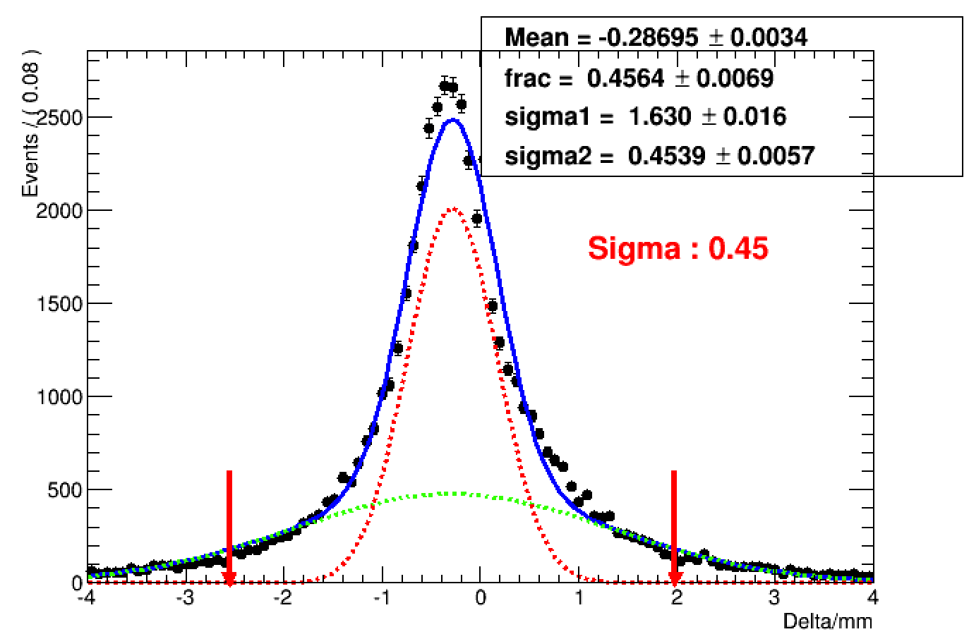
Residual distribution
up, middle bottom, middle up, inner bottom, inner
$σ$X :mm
$σ$V:
mm
Eff.=0.752
Eff.=0.841
Eff.=0.845
Eff.=0.843
Eff.=0.817
Eff.=0.801
Eff.=0.854
Eff.=0.847

Slide 6
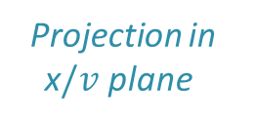
Incident angle in x/v plane
Project the cosmic line to the x/v plane, which is perpendicular to drift plane and parallel to the $\vec{x} /\vec{v}$ direction.
Study relation between the resolution and the incident angle in x/v plane.
x$/v$ Plane
Angle in x$/v$ Plane
$$\vec{x} /\vec{v}$$
Drift Plane
Projection in x$/v$ plane

Slide 7
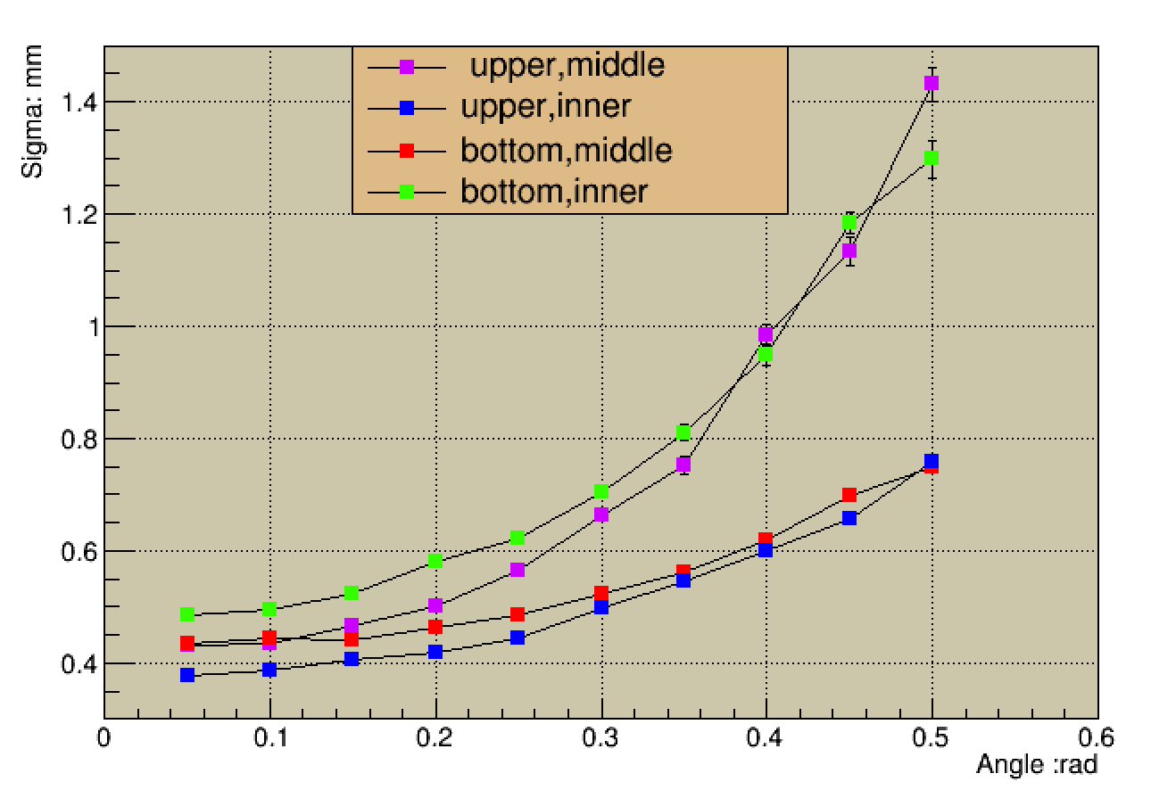
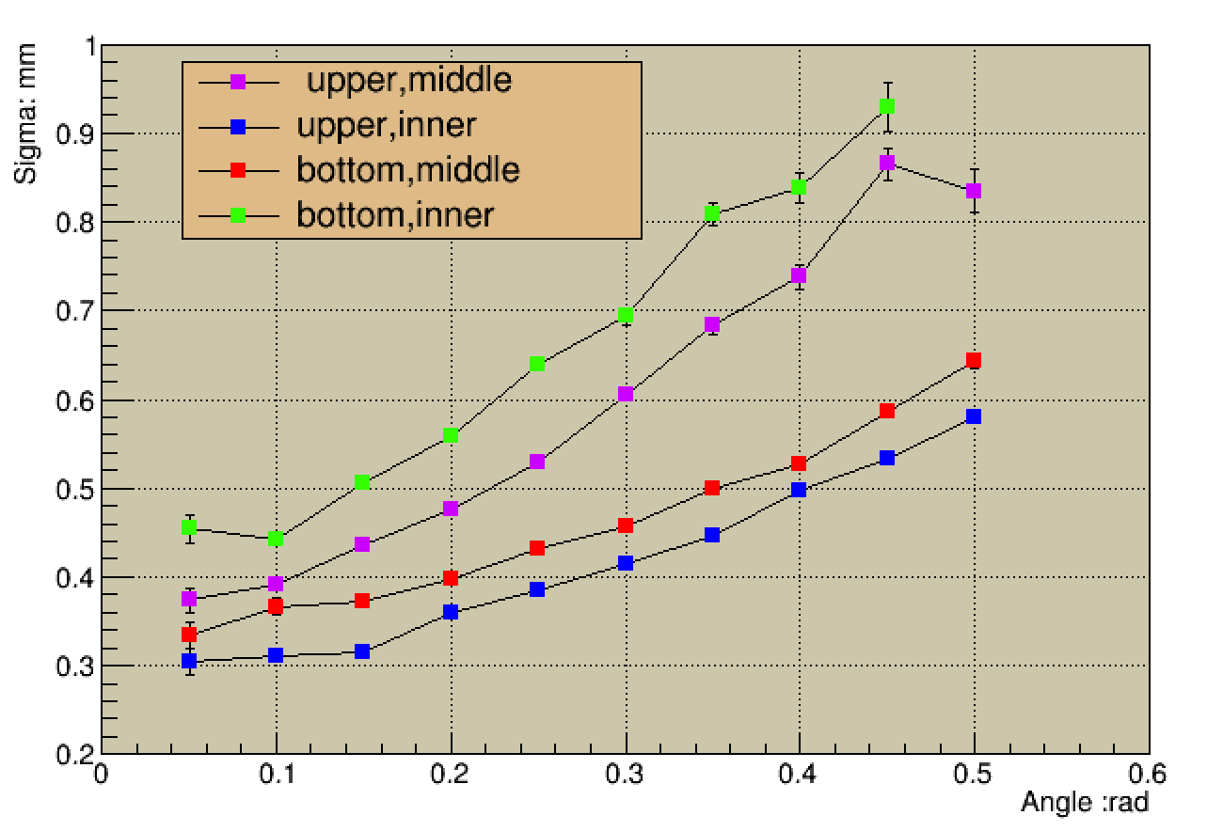
Residual distribution vs x/v Angle (center charge)
$σ$X vs x angle $σ$V vs v angle

Slide 8
Thanks!

