Slide 1
Test of new fit method
H. Wang, A. Guo, L. Wu, L. Wang, R. Mitchell

Slide 2
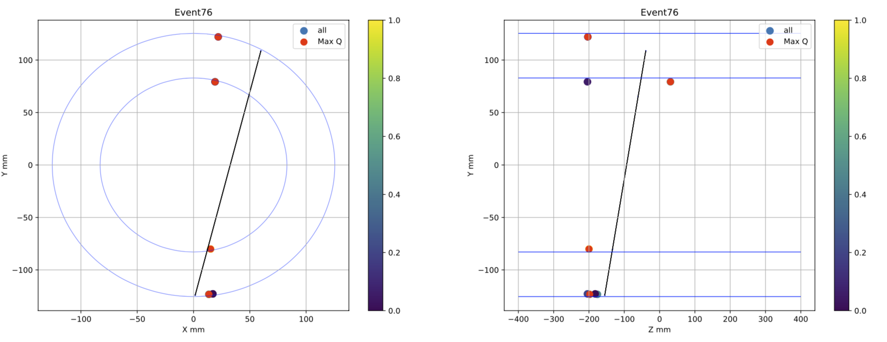
Problem of MaxQ method

Slide 3
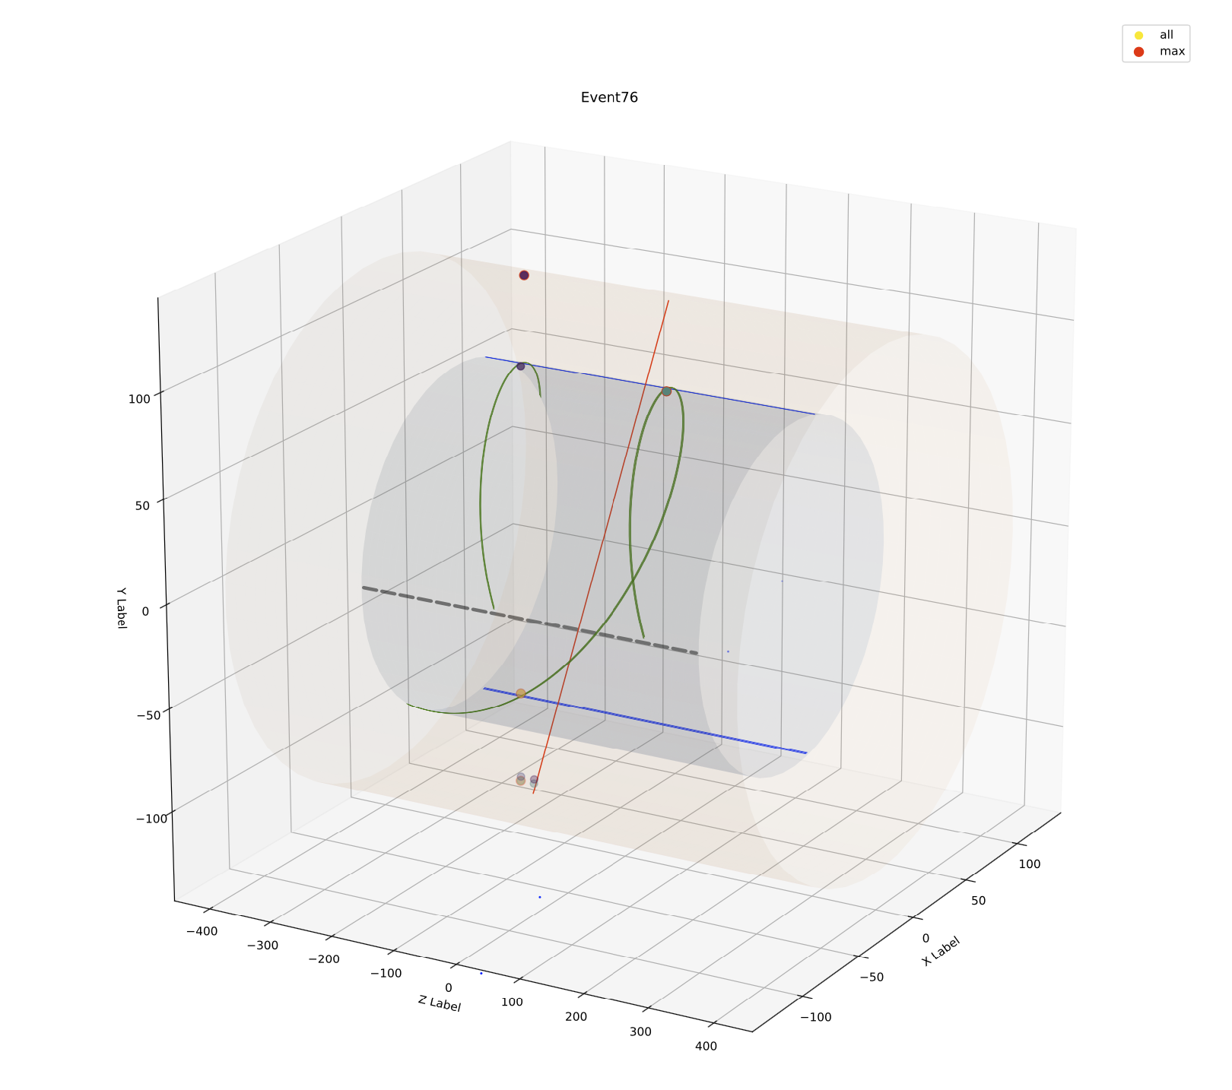
Problem of MaxQ method
Low Q
High Q

Slide 4
Loop All Method
By Hongpeng, Liangliang
Loop all x-clusters clusters combinations，and do a line fit in X-Y plane to find the combination with smallest FCN:
$χ_{x}^{2}={\left(\frac{φ−φ^{′}}{\frac{σ}{R_{n}}}\right)}^{2}$.
Find the matching v-clusters, do a 3-D line fit and get the right combination with FCN:
$χ_{xv}^{2}={\left(\frac{φ−φ^{′}}{\frac{σ}{R_{n}}}\right)}^{2}$ + ${\left(\frac{V−V′}{σ}\right)}^{2}.$
Set $χ_{phi }^{2}$<2000.
combination number of phi <50, combination number of V number <50.

Slide 5
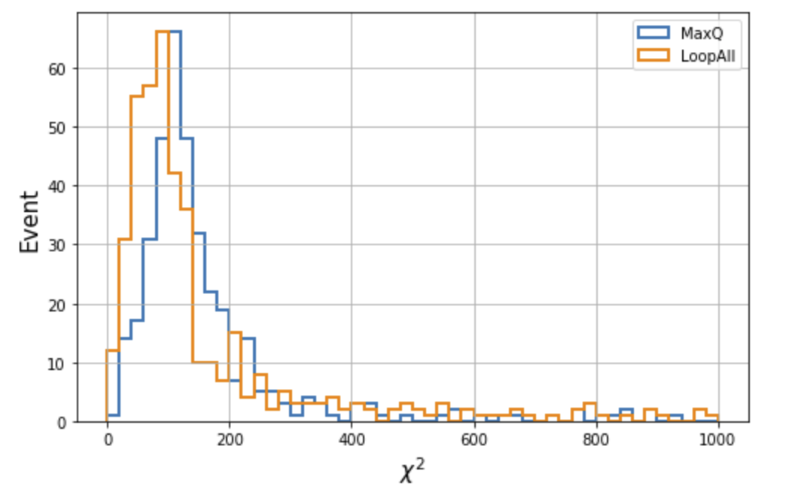
Comparison of $χ^{2}$ distribution
Without Alignment

Slide 6
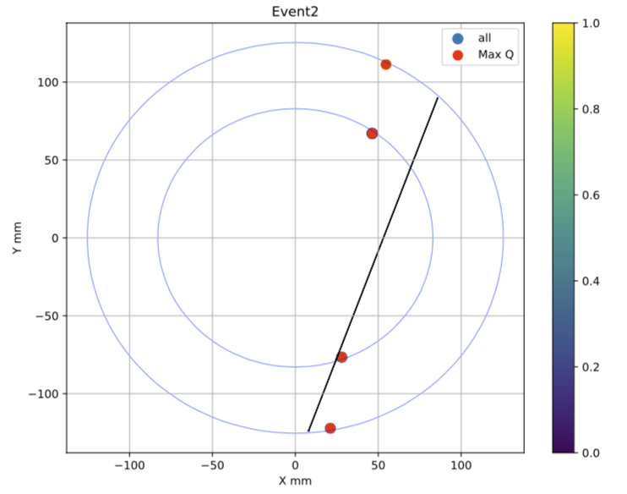
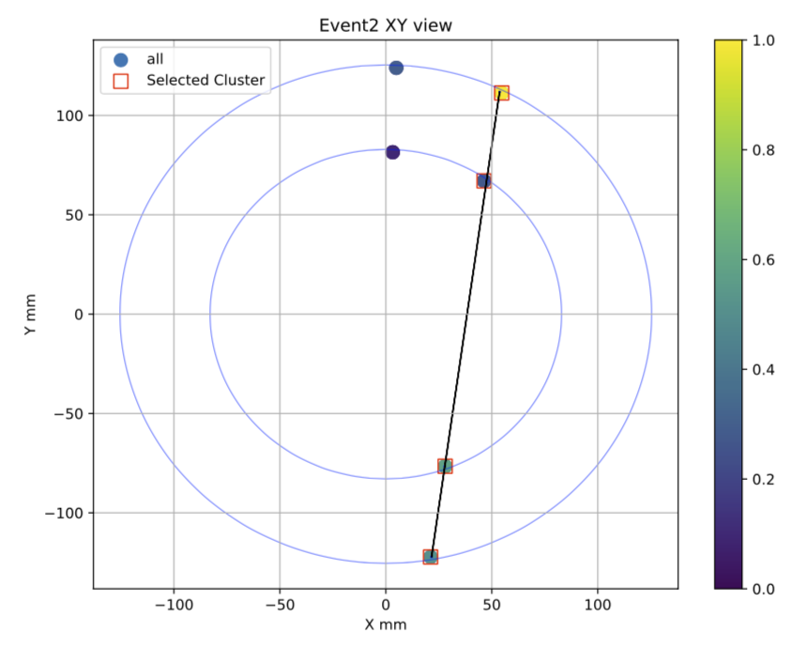
Comparison of event display
Due to different Q requirement
MaxQ
Loop_All

Slide 7
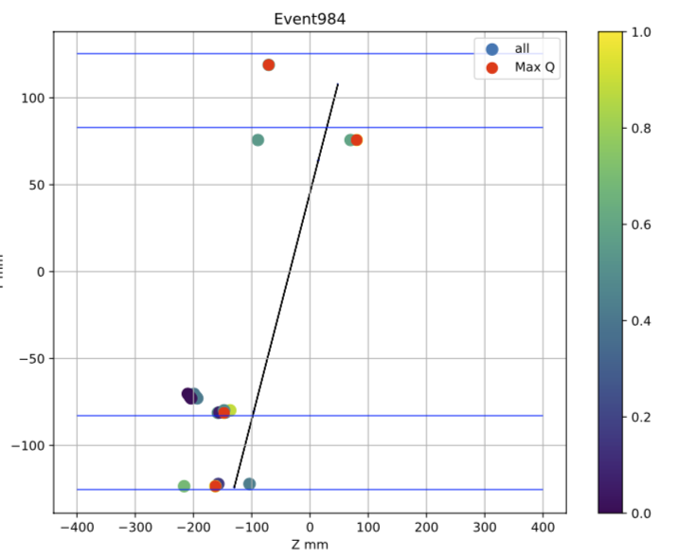
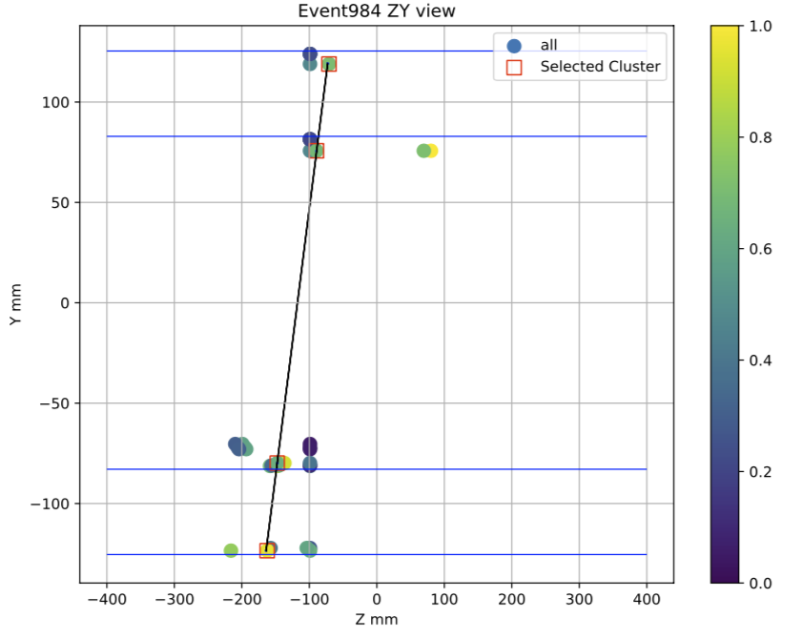
Comparison of event display
MaxQ
Loop_All

Slide 8
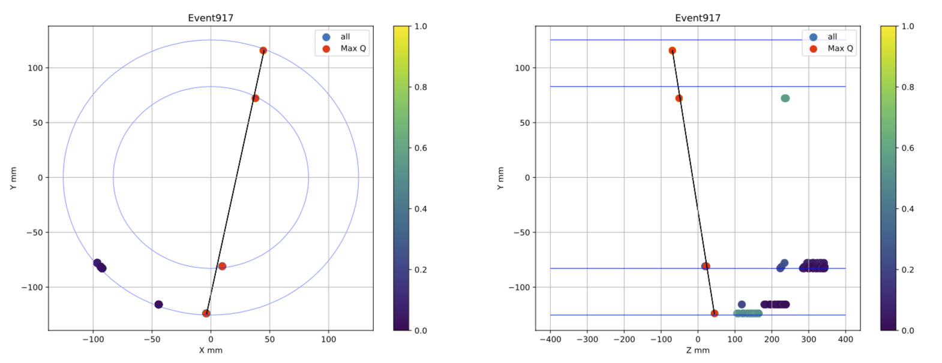
Event usage rate
MaxQ
For some events, MaxQ method works well but Loop_All method will discard them because of the large number of combination
The event usage rate estimated by 1000 event roughly:
MaxQ: ~75%
Loop_All: ~38%

Slide 9
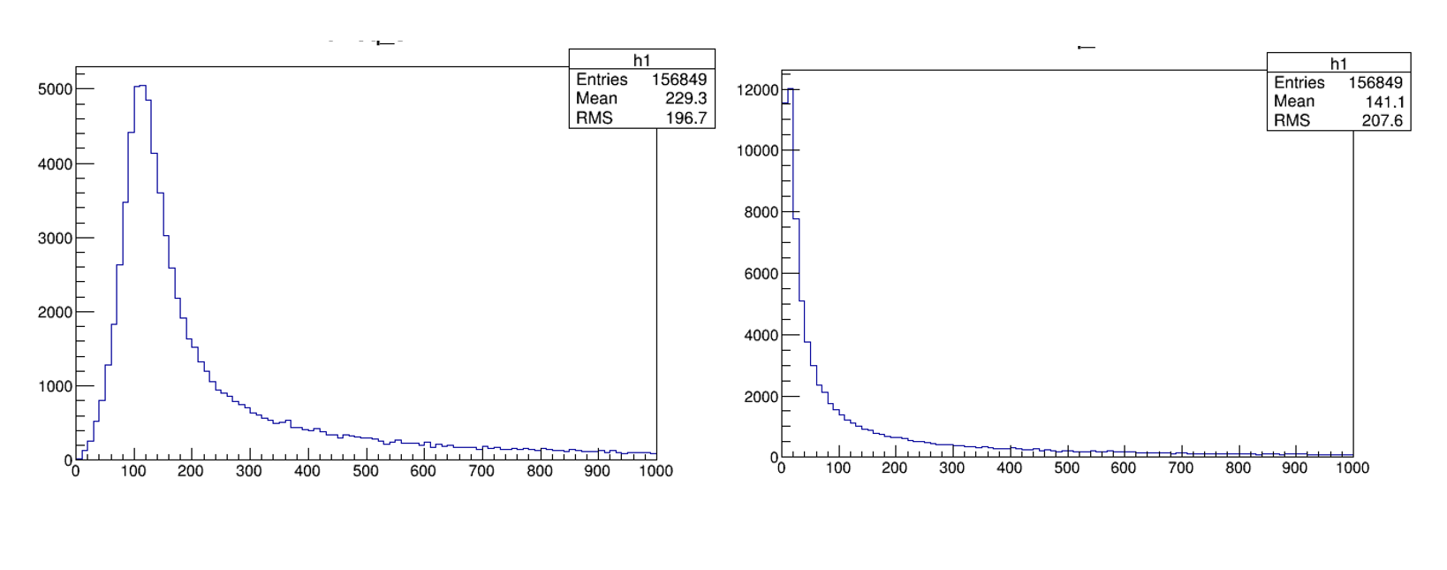
Preliminary results of alignment
By Hongpeng
$χ^{2}$ distribution before and after alignment
Based on run17
Thanks!

