Slide 1
Migration of Calorimeter digitisation
Wu Linghui, Zou Jiaheng
2020-3-2

Slide 2
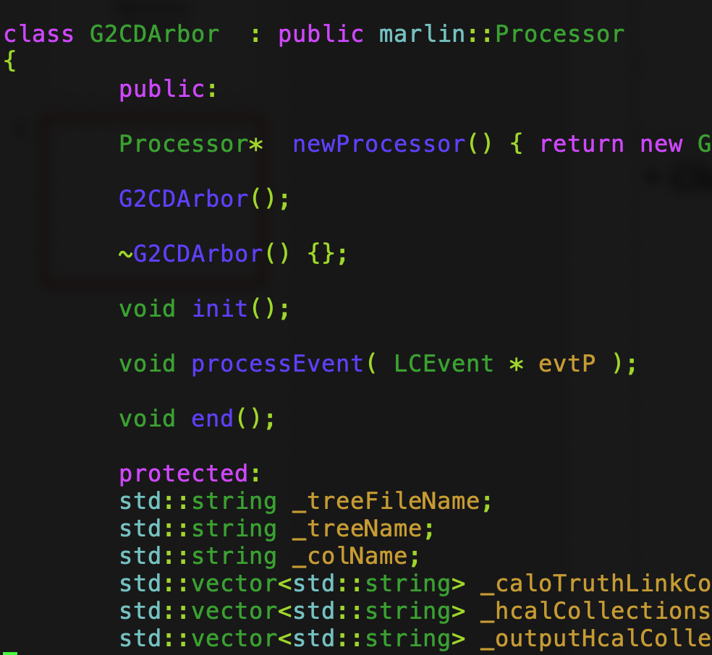
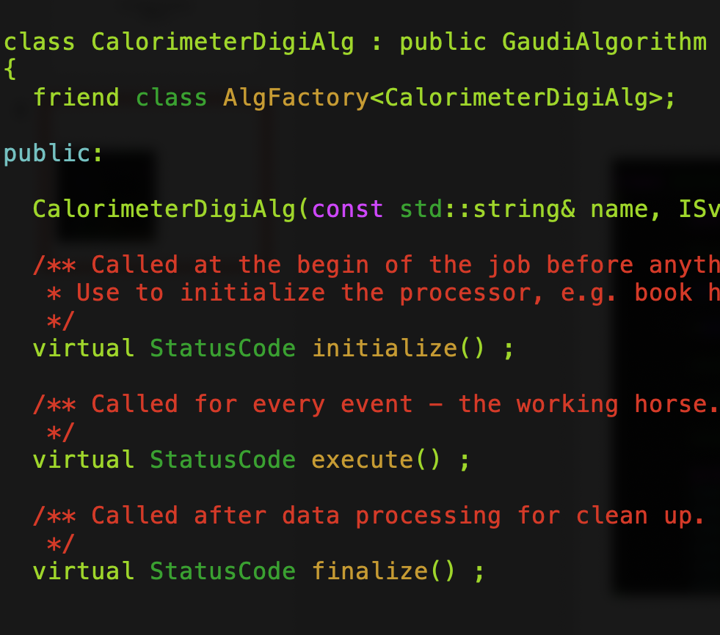
G2CDArbor
in Marlin
CalorimeterDigiAlg
in CEPCSW
/afs/ihep.ac.cn/users/m/manqi/ArborV3Deve/ArborMag
CEPCSW/Reconstruction/Digitisers

Slide 3
Input and output collections
Input
Output
ecalCollections
EcalBarrelSiliconCollection
EcalEndcapSiliconCollection
EcalEndcapRingCollection
EcalPreShowerCollections
EcalBarrelSiliconPreShowerCollection
EcalEndcapRingPreShowerCollection
EcalEndcapSiliconPreShowerCollection
hcalCollections
HcalBarrelRegCollection
HcalEndcapsCollection
HcalEndcapRingsCollection
outputEcalCollections
ECALBarrel
ECALEndcap
ECALOther
outputHcalCollections
HCALBarrel
HCALEndcap
HCALOther
caloTruthLinkCollection

Slide 4
G2CDArbor.cc
std::vector<std::string> ecalCollections;
ecalCollections.push_back(std::string("EcalBarrelSiliconCollection"));
ecalCollections.push_back(std::string("EcalEndcapSiliconCollection"));
ecalCollections.push_back(std::string("EcalEndcapRingCollection"));
registerInputCollections( LCIO::SIMCALORIMETERHIT,
"ECALCollections" ,
"Input ECAL Hits Collection Names" ,
_ecalCollections ,
ecalCollections);
CalorimeterDigiAlg.cpp
declareProperty("EcalBarrelSiliconCollection", _ecalBarrelSiliconHitCol, "Input ECAL Barrel Silicon Hits Collection");
declareProperty("EcalEndcapSiliconCollection", _ecalEndcapSiliconHitCol, "Input ECAL Endcap Silicon Hits Collection");
declareProperty("EcalEndcapRingCollection", _ecalEndcapRingHitCol, "Input ECAL Endcap Ring Hits Collection");
_ecalCollections.push_back(_ecalBarrelSiliconHitCol);
_ecalCollections.push_back(_ecalEndcapSiliconHitCol);
_ecalCollections.push_back(_ecalEndcapRingHitCol);

Slide 5
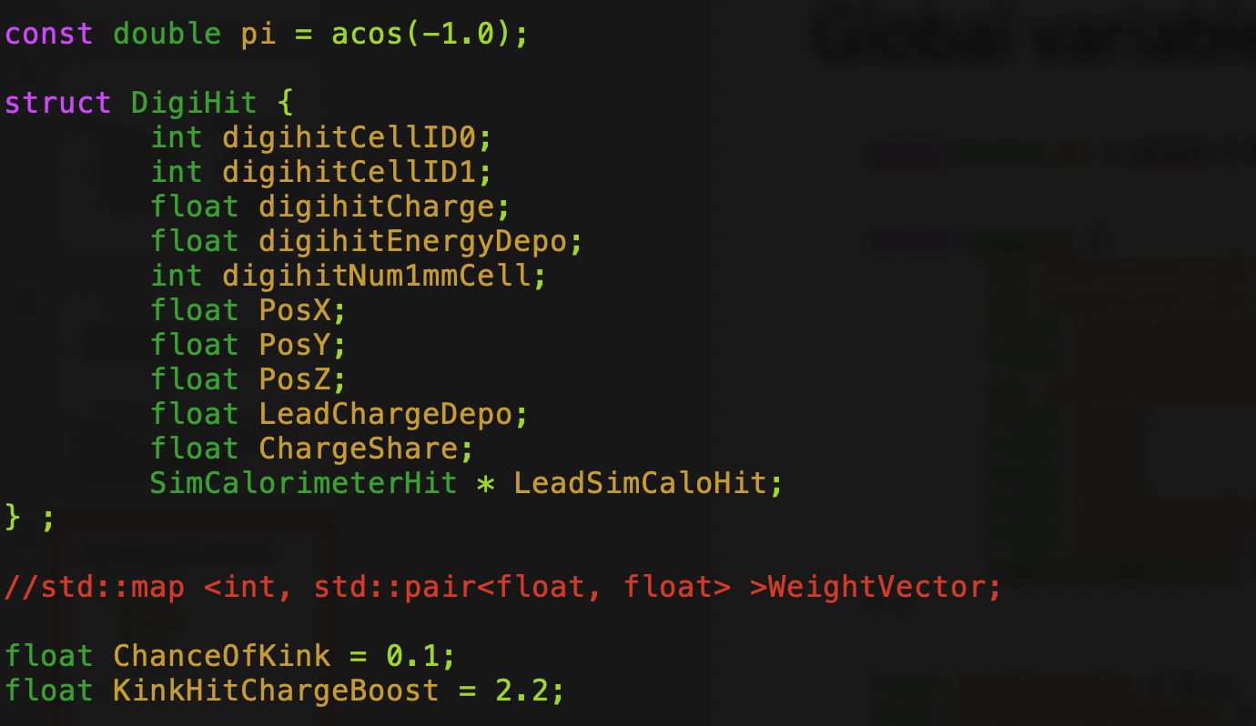
Global variables in G2CDArbor

Slide 6
Next step
Complete the code and software debugging
Comparison of the output before and after migration
A jobOption and input data are needed

