Slide 1
CEPC optics correction with magnet’s errors and influence to DA
Yuanyuan Wei, Bin Wang, Yiwei Wang, Chenghui Yu, Yuan Zhang
The Institute of High Energy Physics, Beijing
CEPC Day March 27 2020, IHEP

Slide 2
Outline
The magnet’s error effect
The correction scheme
The correction results
50μm IR quadupole misalignment
100μm IR quadupole misalignment
Algorithm upgrade
Summary
To do list

Slide 3
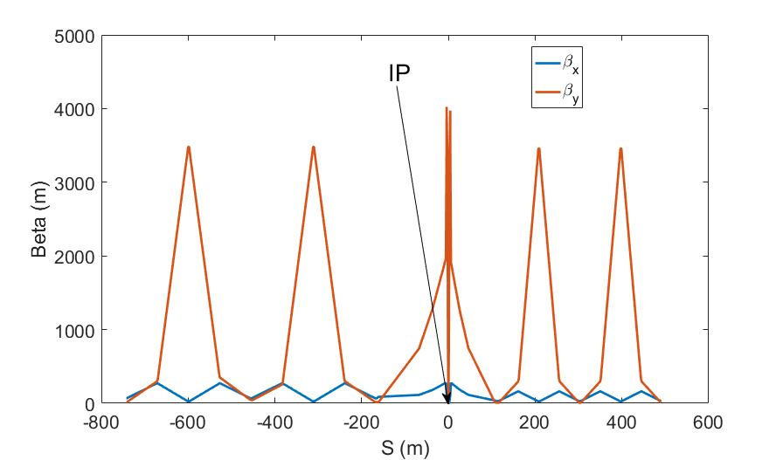
Lattice
E=120GeV
$ν_{x}$=363.11
$ν_{y}$=365.22
$β_{x }^{∗}$= 0.36m
${ β}_{y }^{∗}$= 0.0015m
$β_{x,max}$=599m
$β_{y,max}$=4023m
$ε_{x}$ = 1.21nm

Slide 4
Magnet’s error effect
Component | Δx (μm) | Δy (μm) | Δθ_{z} (μrad)
Arc quadrupole | 100 | 100 | 100
IR Quadrupole | 100 | 100 | 100
Sextupole | 100 | 100 | 100
Component | Field error
Dipole | 0.01%
Arc Quadrupole | 0.02%
Horizontal misalignments in quadrupoles
ΔD_{x} and Δx
Vertical misalignments in quadrupoles
ΔD_{y} and Δy
Horizontal misalignments in sextupoles
beta beat and tune shift
Vertical misalignments in sextupoles
ΔD_{y} and coupling
Bending field errors
ΔD_{x} and Δx
Quadrupole field errors
beta beat and tune shift

Slide 5
Correction scheme
COD correction with sextupoles off
Turn on the sextupoles and perform COD correction again.
Dispersion correction (DFS)
Beta beating correction (LOCO)
Coupling and vertical dispersion correction (Local coupling parameter correction）.

Slide 6
COD correction
BPMs placed at quadrupoles (~1500, 4 per betatron wave)
Horizontal correctors placed beside focusing quadrupoles（~1500）
Vertical correctors placed beside defocusing quadrupoles（~1500）
Orbit correction is applied using orbit response matrix and SVD method.

Slide 7
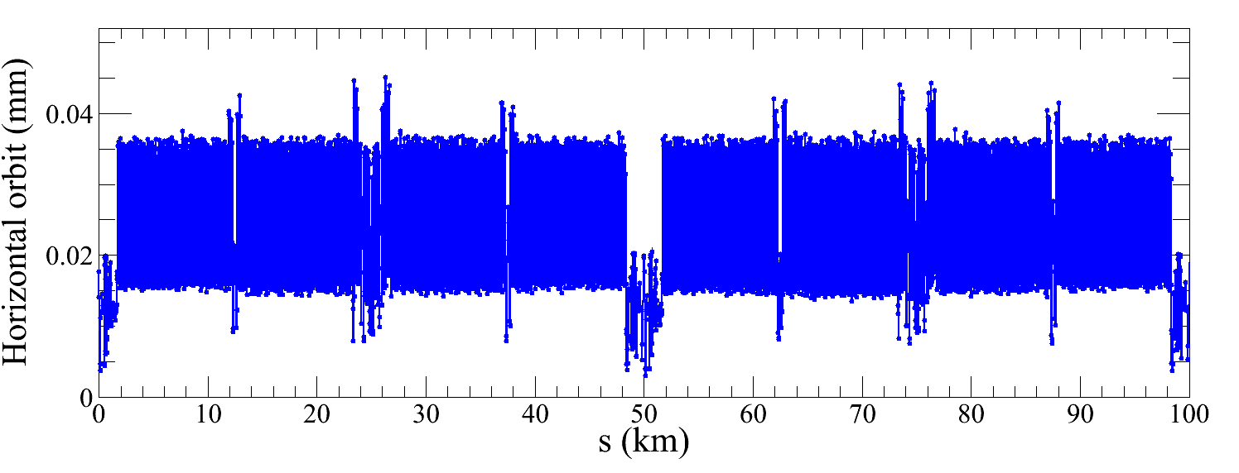
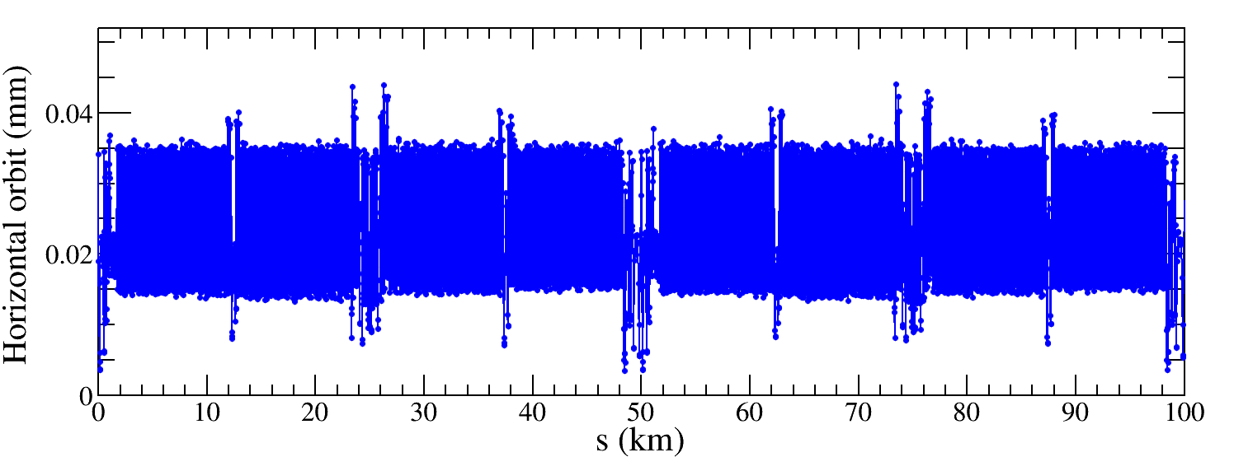
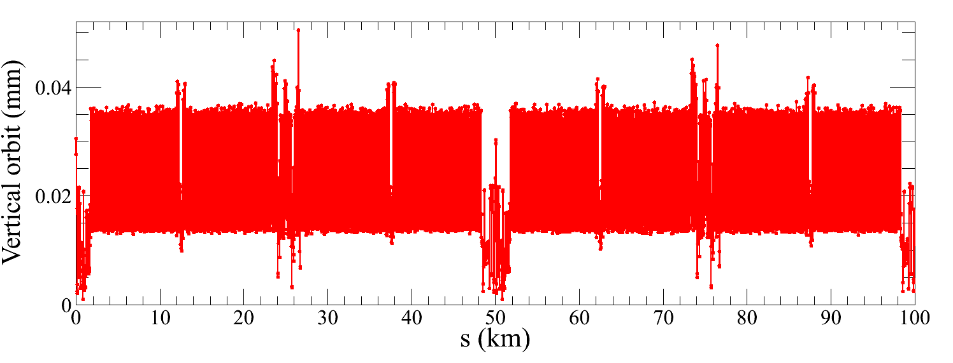
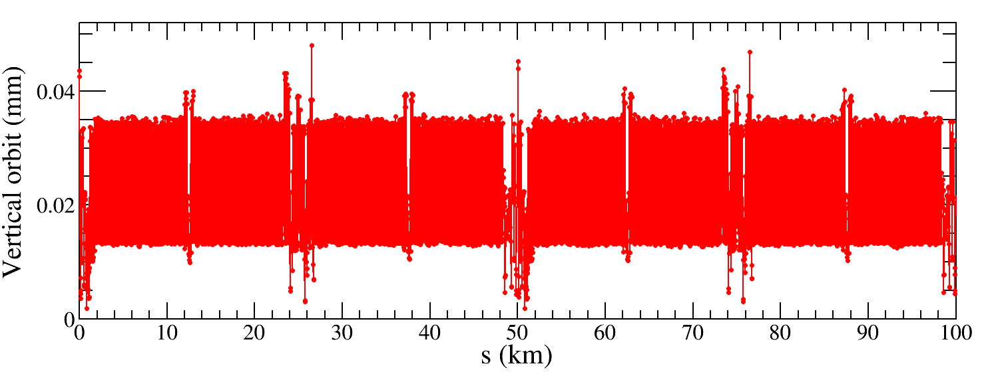
COD correction
IR=50μm 981 seeds
IR=100μm 955 seeds
$${RMS}_{COD}<0.05 mm$$

Slide 8
Dispersion correction
Dispersion free steering principle (DFS): orbit manipulation by knob correctors.
$$\vec{d}=\left(\begin{aligned}\left(1−α\right)\vec{u} \\ α\vec{D}u\end{aligned}\right)$$
M$=\left(\begin{aligned}\left(1−α\right)A \\ αB\end{aligned}\right)$
$$\vec{d}+M\vec{θ}=0$$
$\vec{u}: O$rbit vector
$\vec{D}u :Dispersion$ vector
$$\vec{θ}: Corrector strengths vector$$
$α$: Weight factor
A: Orbit response matrix
B: Dispersion response matrix

Slide 9
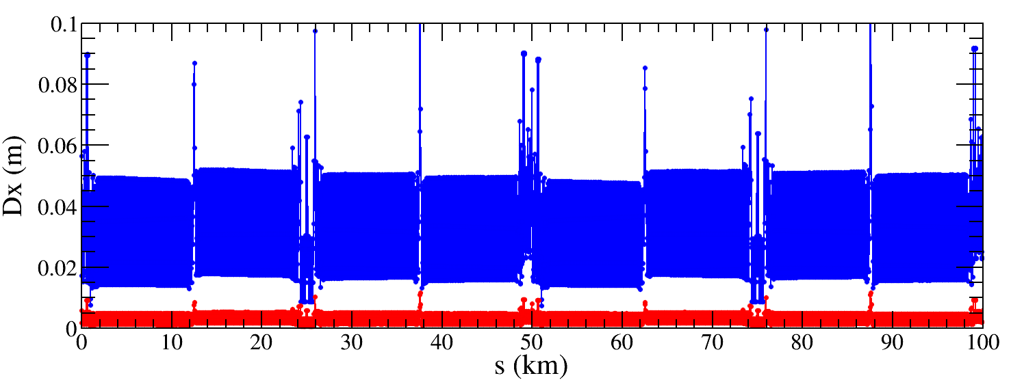
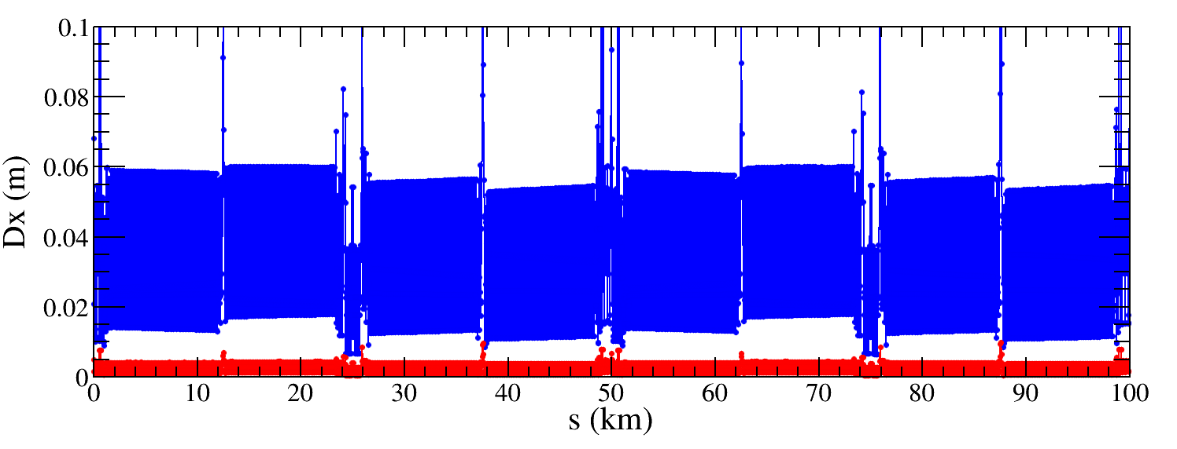
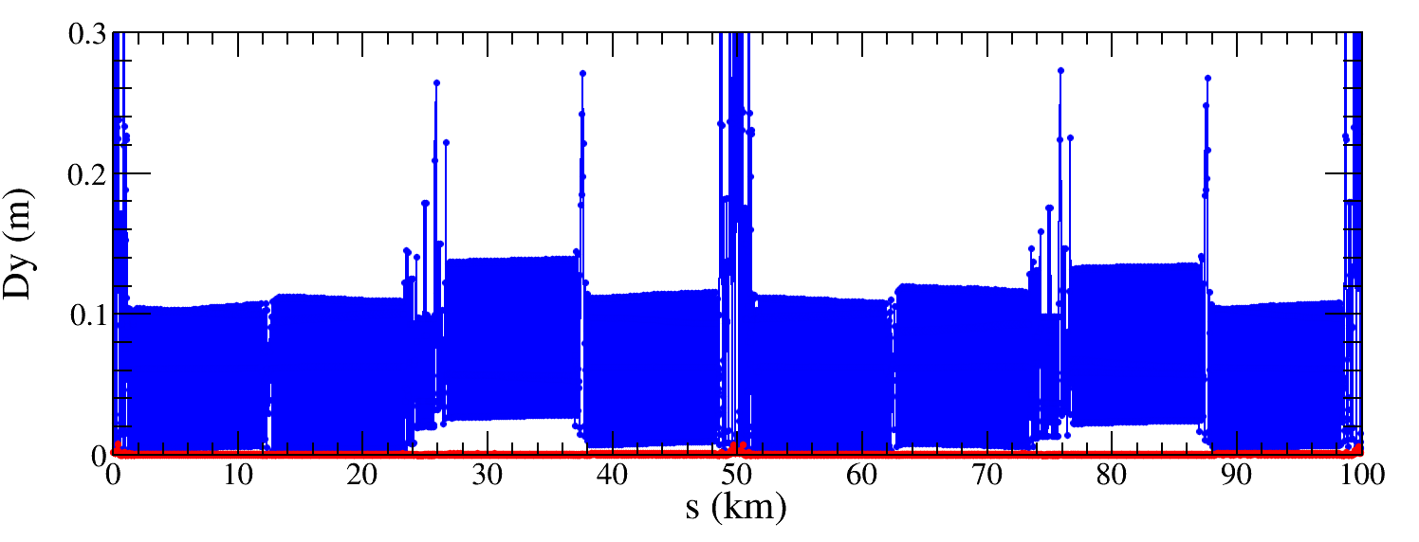
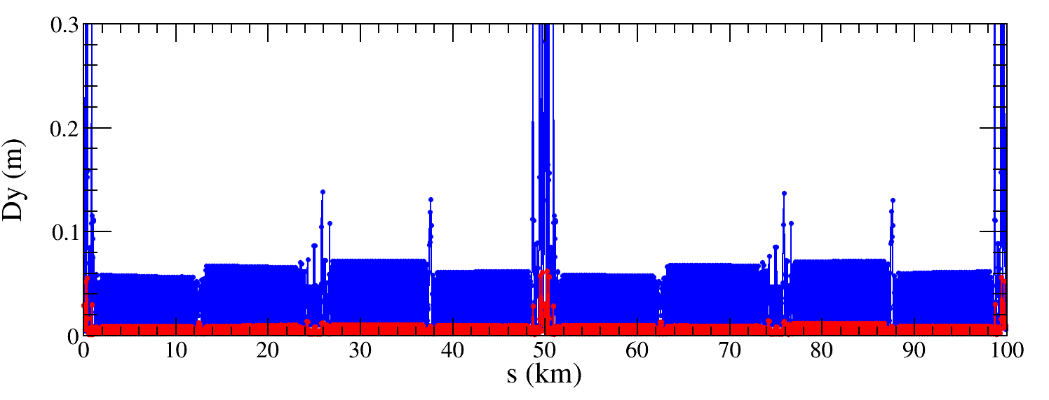
Dispersion correction
IR=50μm 943 seeds
IR=100μm 736 seeds
${∆D}_{x,rms}$ decreased from 29mm to 4.3mm
Factor 7 improvement
${∆D}_{x,rms}$ decreased from 31mm to 2.2mm
Factor 14 improvement
${∆D}_{y,rms}$ decreased from 102mm to 2.3mm
Factor 44 improvement
${∆D}_{y,rms}$ decreased from 42.7mm to 5.9mm
Factor 7 improvement

Slide 10
Beta-beating correction
Correct the beta functions with sextupoles on.
Based on AT LOCO: model based correction
Establish lattice model M_{mod}, multi-parameter fit to the orbit response matrix M_{meas} to obtain calibrated model:
Parameters fitted: K, KS …
Use calibrated model to perform correction and apply to machine.
Application to correct beta-beating, dispersion and coupled response matrix.

Slide 11
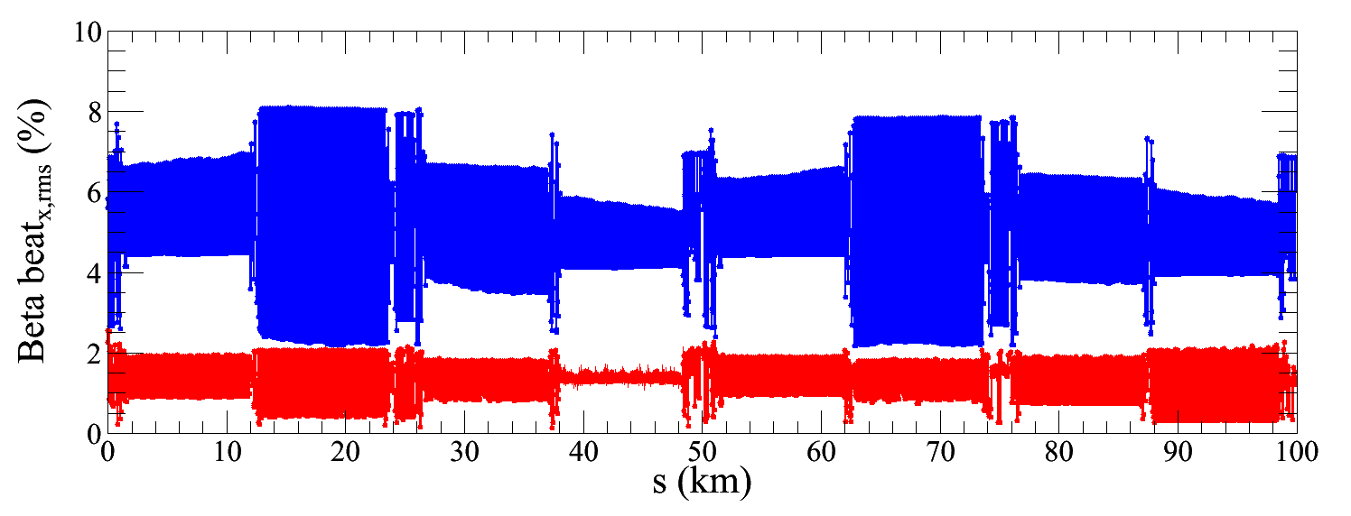
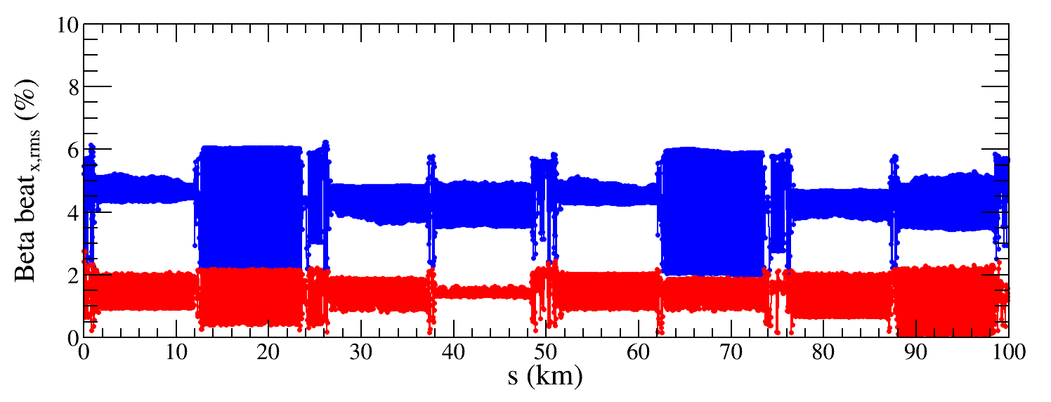
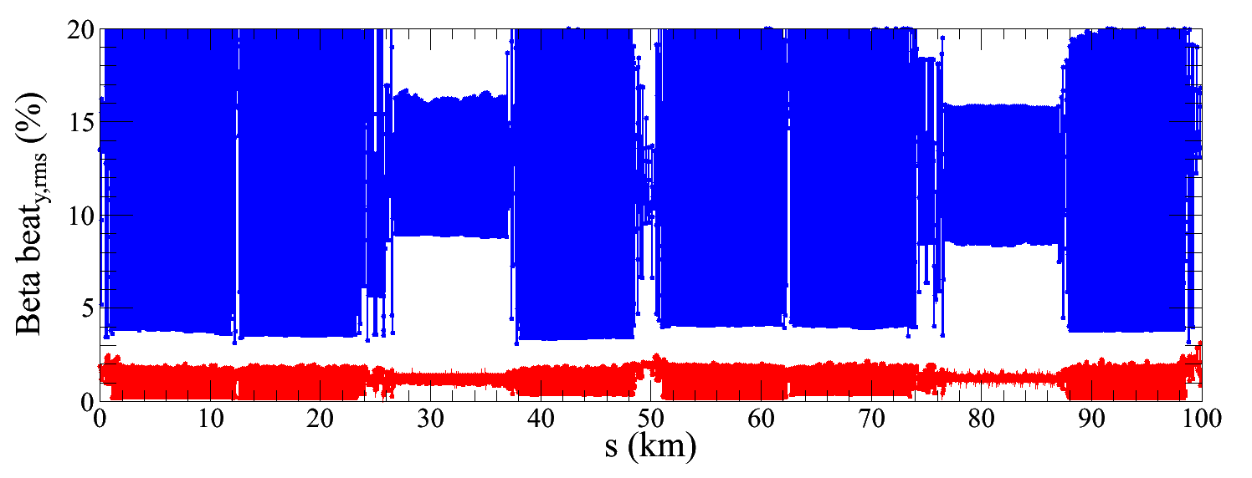
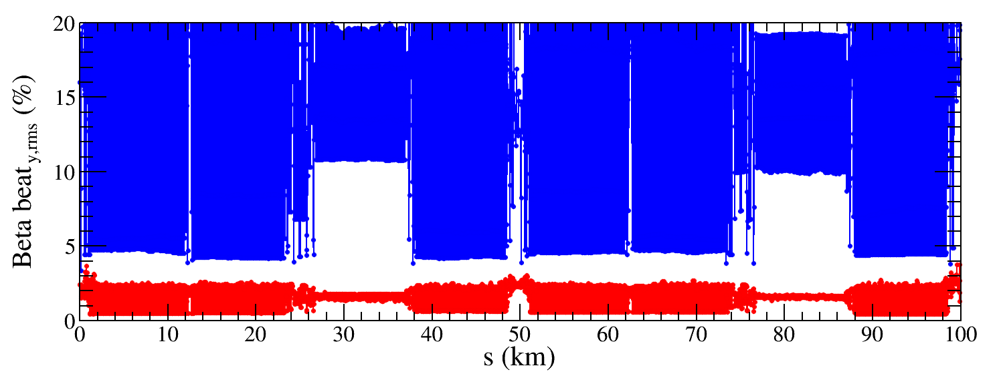
Beta-beating correction
1/5 quadrupoles,1/2 IR quadrupoles (~600 out of 3000 quadrupoles) strengths are changed to restore beta functions along the ring.
IR=50μm 496 seeds
IR=100μm 99 seeds
${∆β/β}_{x,rms}$ decreased from 5.1% to 1.3%
${∆β/β}_{x,rms}$ decreased from 4.3% to 1.4%
${∆β/β}_{y,rms}$ decreased from 11.8% to 1.1%
${∆β/β}_{y,rms}$ decreased from 14.3% to 1.5%

Slide 12
Correction results
Component | Δx (μm) | Δy (μm) | Δθ_{z} (μrad)
Arc quadrupole | 100 | 100 | 100
IR Quadrupole | 50 | 50 | 50
Sextupole | 100 | 100 | 100
Component | Δx (μm) | Δy (μm) | Δθ_{z} (μrad)
Arc quadrupole | 100 | 100 | 100
IR Quadrupole | 100 | 100 | 100
Sextupole | 100 | 100 | 100
Observable | Before correction | After correction
Hori. disp. | 29.0 mm | 4.3 mm
Vert. disp. | 102.1 mm | 2.3 mm
Hori. Beta-beating | 5.1% | 1.3%
Vert. Beta-beating | 11.8% | 1.1%
Observable | Before correction | After correction
Hori. disp. | 30.9 mm | 2.2 mm
Vert. disp. | 42.7 mm | 5.9 mm
Hori. Beta-beating | 4.3% | 1.4%
Vert. Beta-beating | 14.3% | 1.5%

Slide 13
Coupling correction
Neglecting beam-beam effects
Local coupling parameter matching was developed for BEPCII.
Both coupling and vertical dispersion are controlled.
Using the trim coils of the sextupoles (~1000), which providing skew-quadrupole field, to perform emittance tuning for CEPC.
The vertical orbit distortion due to a horizontal deflection at a BPM is:
$\frac{∆y_{cod}}{∆x_{cod}}={\overline{c}}_{b,22}k_{1}+{\overline{c}}_{b,12}k_{2}$+${\overline{c}}_{c,11}k_{3}$+${\overline{c}}_{c,12}k_{4}$
$k_{1}$, $k_{2}{,k}_{3},k_{4}$ ：only related to the decoupled linear optics
${\overline{c}}_{b,22}{,\overline{c}}_{b,12},{\overline{c}}_{c,11},{\overline{c}}_{c,12}$: local coupling parameters
${\overline{c}}_{b,12}=M_{c}\vec{ks}$
$M_{c}$: ${\overline{c}}_{b,12}$ response matrix
$\vec{ks}$ : skew-quadrupole vector

Slide 14
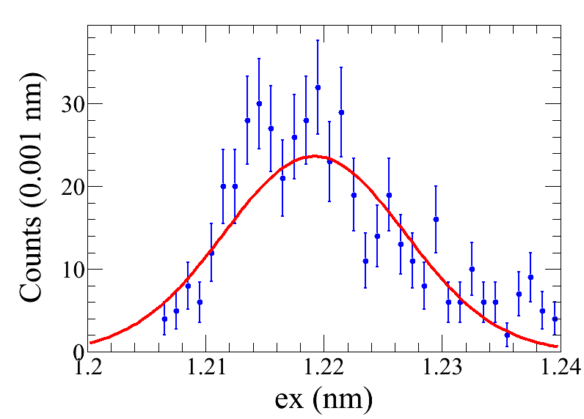
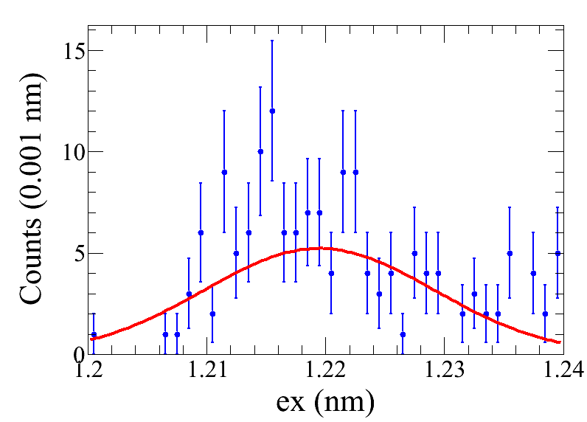
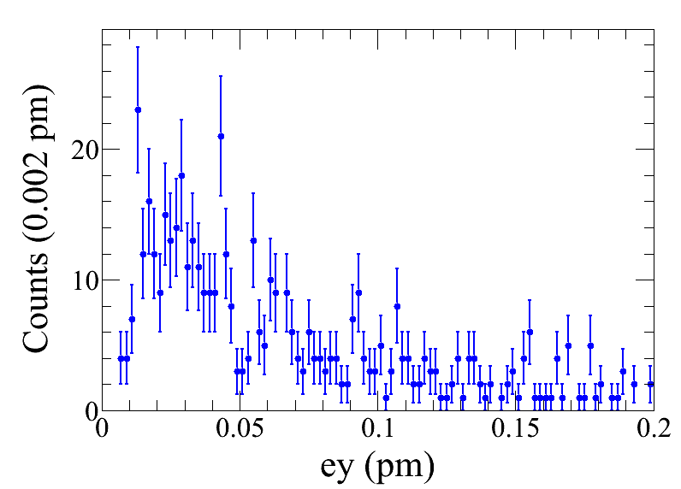
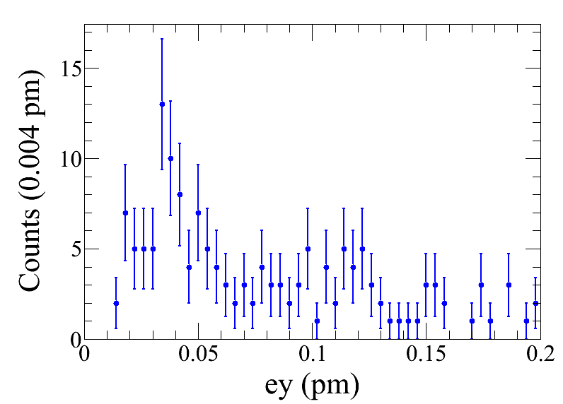
IR=50μm 491 seeds
IR=100μm 154 seeds
ex = 1.217$±$0.005 nm
ey = 0.043 $±$0.002 pm
ey/ex = (0.0035 $±$0.0002)%
ex = 1.219$±$0.010 nm
ey = 0.078 $±$0.002 pm
ey/ex = (0.0064 $±$0.0002)%

Slide 15
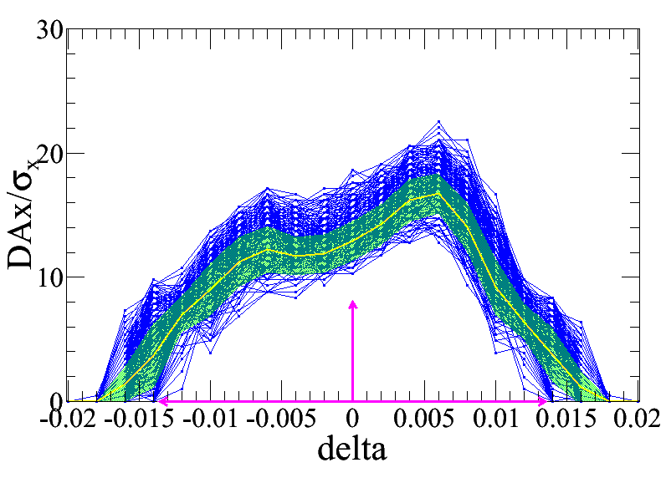
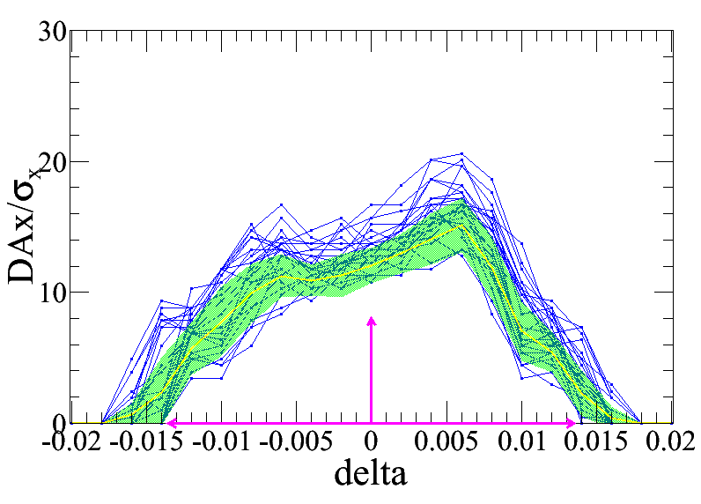
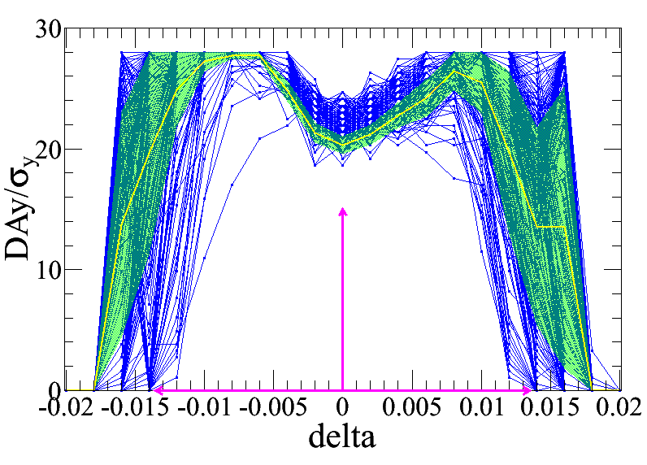
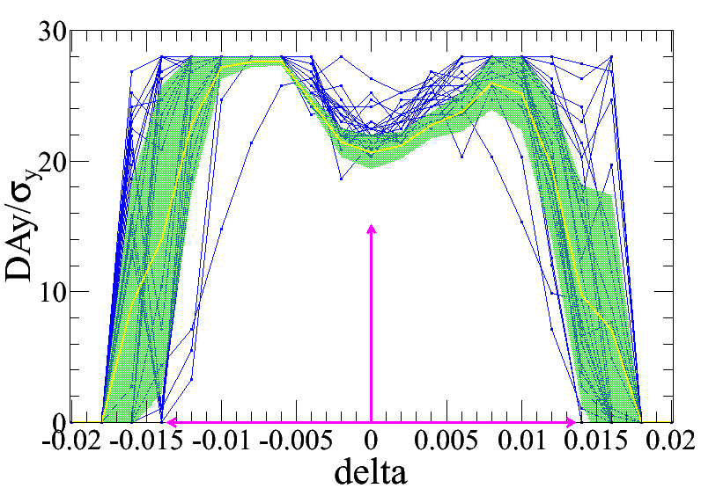
DA and MA
IR=50μm 226 seeds satisfy
DA_x > 10 && DA_y > 15 && min_del > 0.0135
IR=100μm 25 seeds satisfy
DA_x > 10 && DA_y > 15 && min_del > 0.0135
Tracking by Wang bin

Slide 16
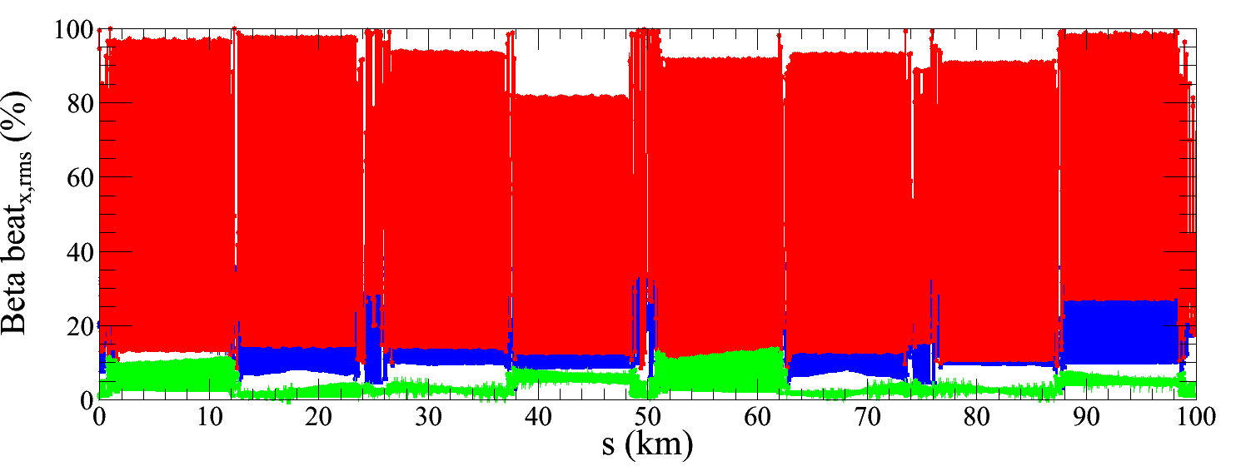
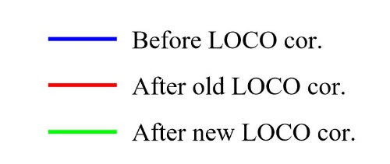
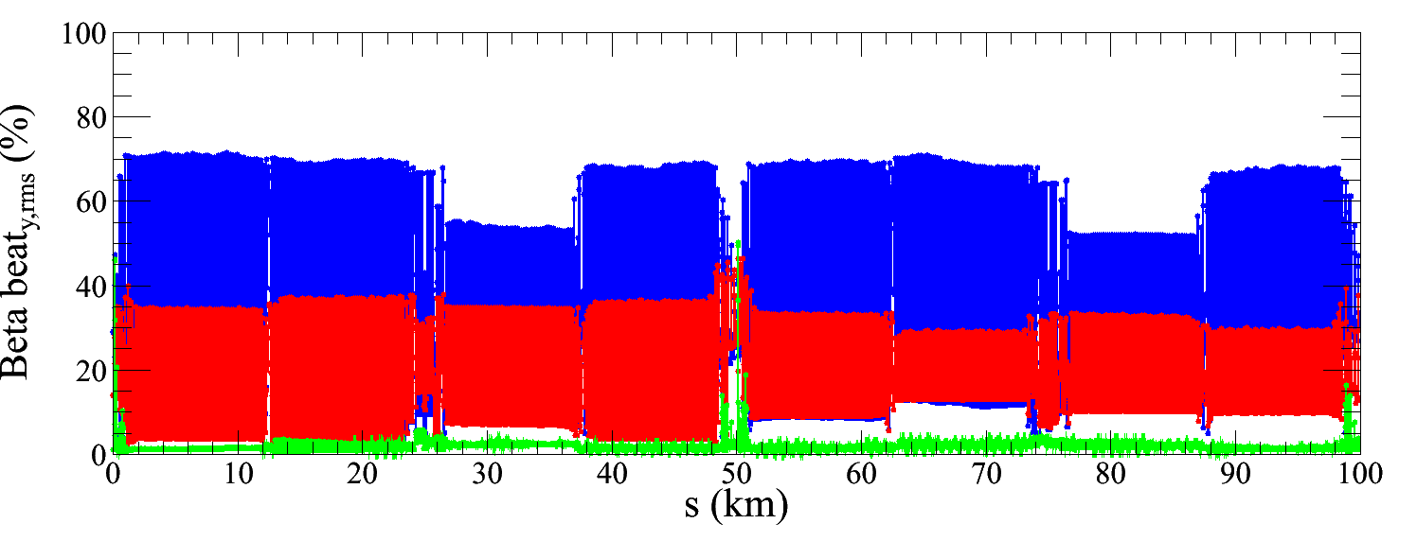
Algorithm upgrade
More variables fitted in LOCO to improve the beta beating correction.
Fit dispersion at the same time with beta beating correction.
Constraint the strength of skew component in coupling correction.
Iterate the dispersion, beta beating and coupling correction.
IR=100μm
20 seeds test with upgraded algorithm

Slide 17
Summary
The optics correction is very challenging for the relaxed tolerance of the imperfections.
Passing rate can be increased with upgraded algorithm.
More finer correction of optics is necessary for satisfying the DA and MA requirements.

Slide 18
To do list
.
Optimize the correction strategy to achieve finer tuning of optics with more iteration and more variables included in fitting.
Introduce extra knobs to compensate the optics at IP.
Introduce more types of imperfections.
Study off-momentum correction.

Slide 19
Thanks for your attention

