Slide 1
CEPC instability studies for high luminosity H and Z
Na Wang, Yudong Liu, Yuan Zhang
CEPC day, March 27, 2020, IHEP

Slide 2
Main beam parameters
Parameter [unit] | Higgs-CDR | Higgs-High Lum | Z-CDR | Z-39MW
Beam energy [GeV] | 120 |  | 45.5
L_{max}/IP (10³⁴cm⁻²s⁻¹) | 2.9 | 5.2 | 32.1 | 101.6
β_{IP} x/y (m) | 0.36/0.0015 | 0.33/0.001 | 0.2/0.001
Emittance (H/V) [nm] | 1.21/0.0031 | 0.89/0.0018 | 0.18/0.0016
Beam current [mA] | 17.4 | 17.8 | 461.0 | 1081.4
Bunch number | 242 | 218 | 12000 | 15000
Bunch Population [10¹⁰] | 15 | 17 | 8 | 15.0
Momentum compaction | 1.11×10⁻⁵ | 0.91×10⁻⁵ ↓ | 1.11×10⁻⁵
Natural bunch length σ_{z} (mm) | 2.7 | 2.2 ↓ | 2.4
Natural energy spread | 1.0×10⁻³ |  | 3.8×10⁻⁴
Betatron tune ν_{x}/ν_{y} | 363.10/365.22 | 391.11/393.22 ↑ | 363.10/365.22 | 391.11/393.22↑
Synchrotron tune | 0.065 | 0.066 | 0.028
Radiation damping [ms] | 46/46/23 | 47.6/47.6/23.8 | 843/843/436 | 849/849/424

Slide 3
Rough estimations
Estimations with analytical formulae give rough requirements on broadband and narrowband impedances.
Parameter [unit] | Higgs-CDR | Higgs-High Lum | Z-CDR | Z-39MW
Beam current [mA] | 17.4 | 17.8 | 461.0 | 1081.4
Bunch number | 242 | 218 | 12000 | 15000
Bunch Population [10¹⁰] | 15 | 17 | 8 | 15.0
Threshold on broadband |Z_{L}/n|_{eff} [mΩ] | 8.8 | 7.7 | 0.9 | 0.5
Threshold on broadband k_{y} [kV/pC/m] | 65.6 | 63.2 | 20.1 | 11.5
Threshold on narrowband | 3.5 | 3.4 | 1.1×10⁻³ | 5.0×10⁻⁴
Threshold of narrowband Zy | 2.3 | 2.3 | 1.8×10⁻³ | 8.2×10⁻⁴
No showstopper for Higgs!

Slide 4
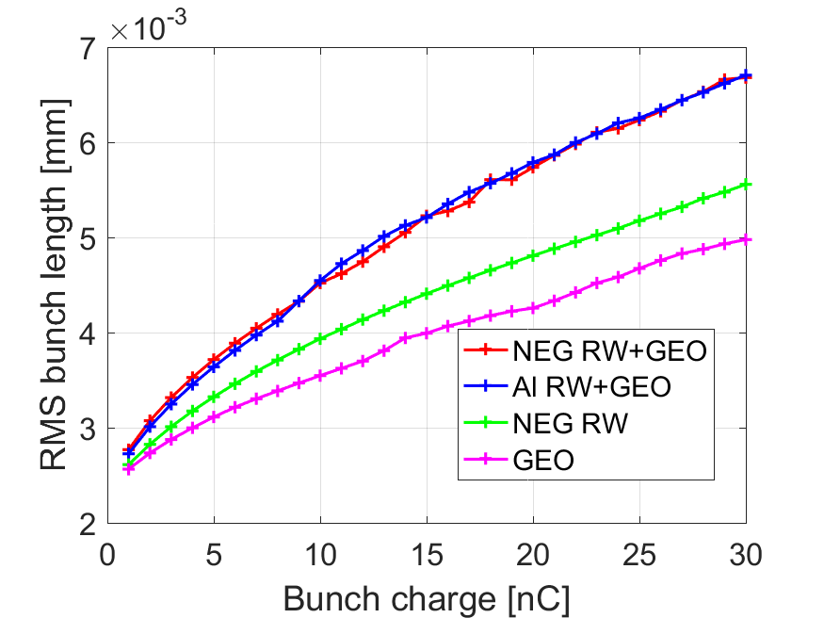
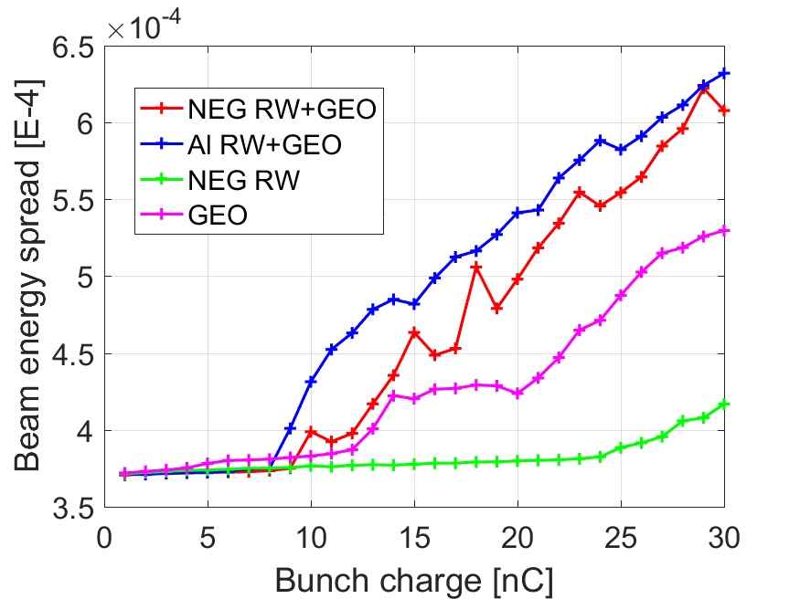
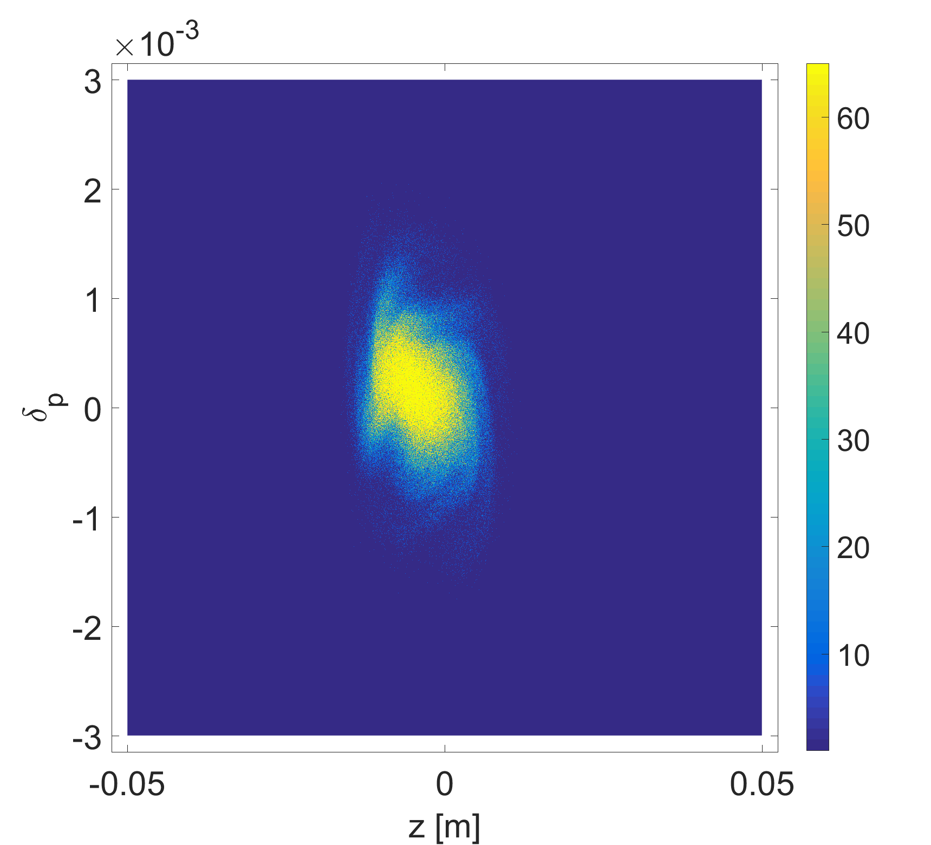
Instability for Z (1)
Microwave instability and bunch lengthening
Rarely induce beam losses, but may reduce the luminosity due to the deformed beam distribution and increasing of the beam energy spread.
Parameter | Z-CDR | Z-39MW
σ_{l0} [mm] | 2.4
σ_{l} with ZL [mm] (σ_{l}/σ_{l0}-1) | 5.1 (113%) | 6.2 (150%)
σ_{e}/σ_{e0}-1 | 15% | 50%
CDR
39MW
CDR
39MW
10nC

Slide 5
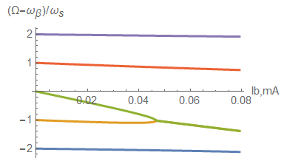
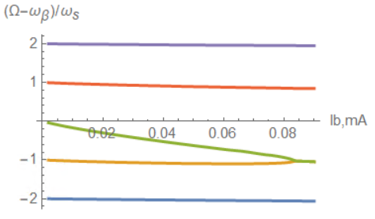
Instability for Z (2)
Transverse mode coupling instability
Fast instability, normally with beam losses.
Considering bunch lengthening due to the impedance or beamstrahlung, the current threshold increases
CDR
39MW
CDR
39MW
Without bunch lengthening
With bunch lengthening

Slide 6
Instability for Z (3)
Transverse resistive wall instability
The coupled bunch instability can be driven by the resonance at zero frequency of the transverse resistive wall impedance.
Growth time of the most dangerous mode vs. damping factors
=> High-Lumi Z needs more efficient feedback damping!
 | Z-CDR | Z-39MW
Instability growth time [ms] | 4.3 (~12 turns) | 1.8 (~5 turns)
Radiation damping [ms] | 843
Bunch by bunch feedback [ms] | 1.7(~5 turns)

Slide 7
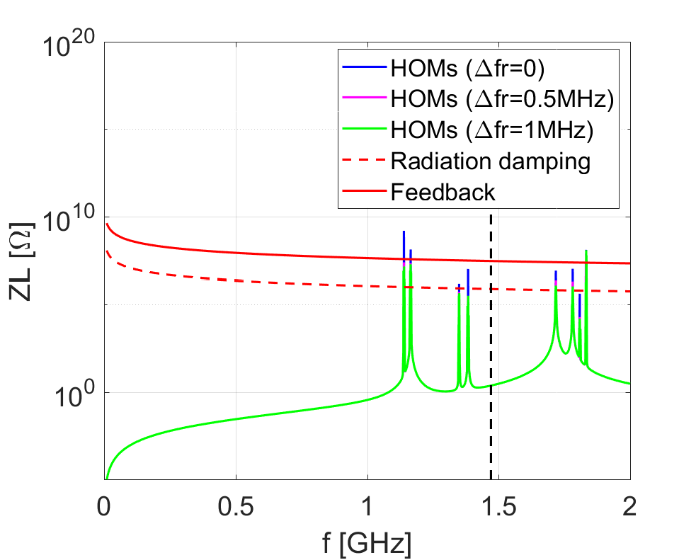
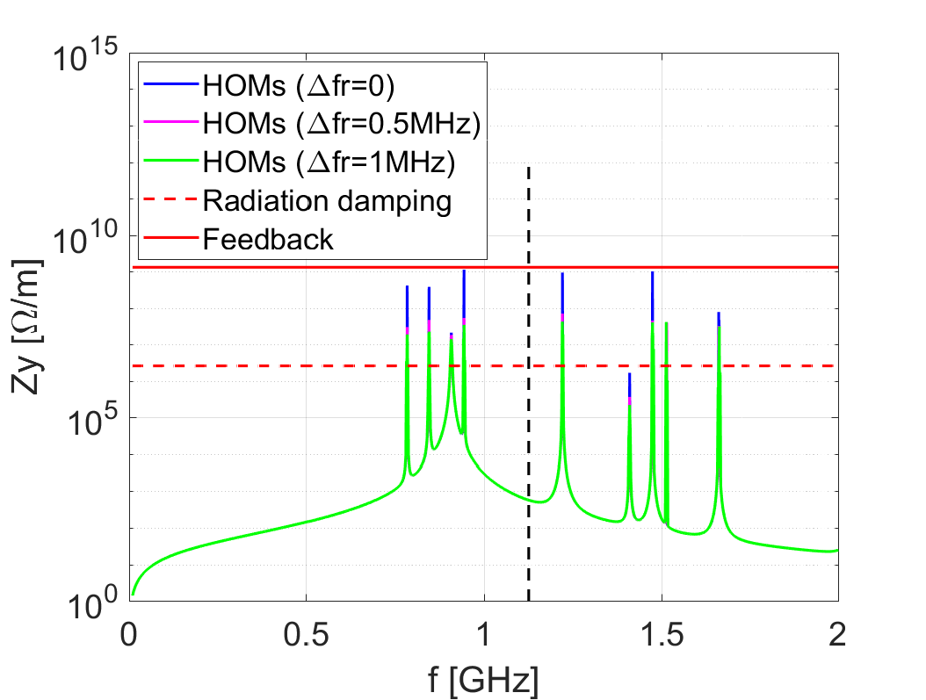
Instability for Z (4)
CBI due to RF HOMs
With 120 2-cell SC RF cavities and a HOM frequency spread larger than 0.5MHz, all the HOMs are below the threshold of feedback damping.
For High-Lumi with 1-cell cavities, the amplitude of the HOMs will be roughly reduced by a factor of ~2 (Discussion with JiYuan Zhai), the threshold will decrease by a factor of ~2 → No significant changes

Slide 8
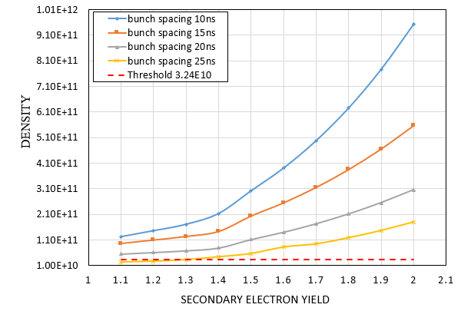
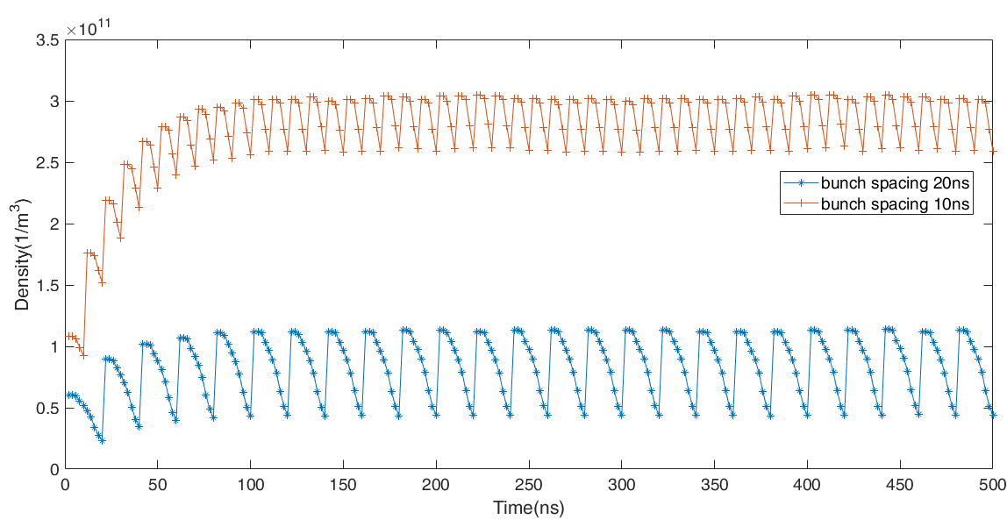
Instability for Z (5)
YuDong Liu
Electron Cloud
With bunch spacing of 20ns, the electron cloud density is above the instability threshold even the SEY is suppressed to 1.1 by NEG coating!
Possible mitigations:
1) Antechamber, 2) Photon absorber, 3) Solenoid, 4) Cleaning electrode

Slide 9
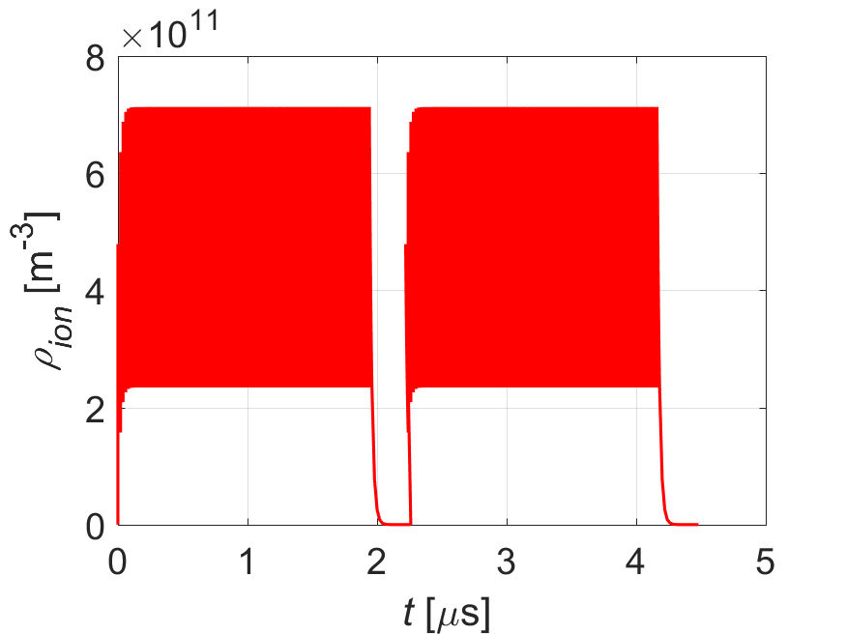
Instability for Z (6)
Beam ion instability
Induce emittance blow-up and a positive tune shift along the bunch train.
Filling pattern: CDR {Ntrain=150, Bunch spacing=25ns, Gap=270ns}
High-Lumi {Ntrain=150, Bunch spacing=20ns, Gap=280ns}
Faster growth rate for High-Lumi Z ⇒ Effectiveness of feedback on fighting ion instability need to be checked
Parameters | Z-CDR | Z-39MW
L_{sep}ω_{ion}/c₀ | 0.6 | 0.6
ρ_{ion,ave}[m⁻³] | 2.7E11 | 4.0E11
τ_{e} [ms] | 0.2 | 0.1
τ_{H} [ms] | 7.2 | 5.4
Δν_{y} | 0.009 | 0.008
Build-up of the ions along the bunch train

Slide 10
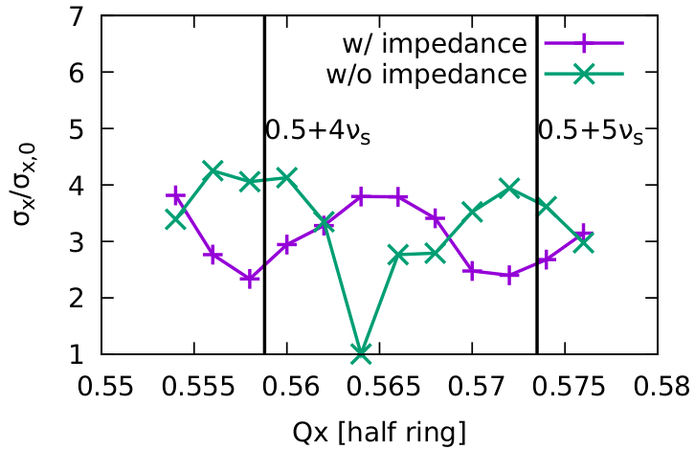
Instability for Z (7)
Yuan Zhang
Cross talk with beam-beam observed for CDR parameter
Less stable region obtained with impedance included in the beam-beam simulation.
The effect can get more severe for High-Lumi Z!
Only one working point is stable without impedance.
The beam-beam interaction gets more unstable with longitudinal impedance due to the X-Z coupling.
Possible mitigations:
Beam parameter optimization
Impedance reduction

Slide 11
Summary
No showstopper for High-Lumi Higgs
Instability gets stronger for High-Lumi Z, main showstoppers are
The design current is far above the threshold of MWI, in addition to the coupling with beam-beam, the beam will get more unstable in horizontal ⇒ further optimizations on beam parameters and impedances are required (overall consideration on beam-beam, MWI, TMCI, …).
Electron cloud instability needs further modifications on the vacuum designs.
Transverse resistive wall instability needs more efficient feedback damping.

Slide 12
Backup slides

Slide 13
CEPC-CDR vs FCC-ee: Higgs
From Dou Wang
 | CEPC-CDR | FCC-ee | Luminosity contribution | Limit for CEPC
Number of IPs | 2 | 2
Energy (GeV) | 120 | 120
Circumference (km) | 100 | 100
SR loss/turn (GeV) | 1.73 | 1.72
Half crossing angle (mrad) | 16.5 | 15
Piwinski angle | 3.48 | 5.8 | A: 1/1.67 | Limited by E
N_{e}/bunch (10¹⁰) | 15 | 18 | B: 1.44 | Beam-beam effect
Bunch number | 242 | 328 | C: 1.35 | SR power
Beam current (mA) | 17.4 | 29
SR power /beam (MW) | 30 | 50 (30)
Bending radius (km) | 10.7 | 10.76
Momentum compaction (10⁻⁵) | 1.11 | 0.73
β_{IP} x/y (m) | 0.36/0.0015 | 0.3/0.001 | D: 1.34 | DA, error tollerance
Emittance x/y (nm) | 1.21/0.0024 | 0.63/0.0013 | E: 1.88 | Cell length, magnet number
Transverse σ_{IP} (um) | 20.9/0.06 | 13.7/0.036
ξ_{x}/ξ_{y}/IP | 0.018/0.109 | 0.016/0.118
V_{RF} (GV) | 2.17 | 2.0
f _{RF} (MHz) (harmonic) | 650 | 400
Nature bunch length σ_{z} (mm) | 2.72 | 3.15
Bunch length σ_{z} (mm) | 4.4 | 5.3
HOM power/cavity (kw) | 0.46 (2cell) | ?
Energy spread (%) | 0.134 | 0.165
Energy acceptance (DA) (%) | 1.35 | 1.7
Energy acceptance by RF (%) | 2.06 | 2.3
Beamstruhlung lifetime /quantum lifetime (min) | 80/80 | 18
Lifetime (min) | 26 | 12 |  | Limited by injection system
L_{max}/IP (10³⁴cm⁻²s⁻¹) | 2.93 | 8.5 (5.1) | 2.9 (1.74)
How to increase Luminosity: B, D, E

Slide 14
CEPC high lum. Higgs parameter after CDR
From Dou Wang
 | Higgs | W | Z（3T） | Z（2T）
Number of IPs | 2
Beam energy (GeV) | 120 | 80 | 45.5
Circumference (km) | 100
Synchrotron radiation loss/turn (GeV) | 1.68 | 0.33 | 0.035
Crossing angle at IP (mrad) | 16.5×2
Piwinski angle | 3.78 | 8.5 | 27.7
Number of particles/bunch N_{e} (10¹⁰) | 17.0 | 12.0 | 8.0
Bunch number (bunch spacing) | 218 (0.76μs) | 1568 (0.20μs) | 12000 (25ns+10%gap)
Beam current (mA) | 17.8 | 90.4 | 461.0
Synchrotron radiation power /beam (MW) | 30 | 30 | 16.5
Bending radius (km) | 10.7
Momentum compact (10⁻⁵) | 0.91
β function at IP β_{x}* / β_{y}* (m) | 0.33/0.001 | 0.33/0.001 | 0.2/0.001
Emittance ε_{x}/ε_{y} (nm) | 0.89/0.0018 | 0.395/0.0012 | 0.13/0.003 | 0.13/0.00115
Beam size at IP σ_{x} /σ_{y} (μm) | 17.1/0.042 | 11.4/0.035 | 5.1/0.054 | 5.1/0.034
Beam-beam parameters ξ_{x}/ξ_{y} | 0.024/0.113 | 0.012/0.1 | 0.004/0.053 | 0.004/0.085
RF voltage V_{RF} (GV) | 2.4 | 0.43 | 0.082
RF frequency f _{RF} (MHz) (harmonic) | 650 (216816)
Natural bunch length σ_{z} (mm) | 2.2 | 2.98 | 2.42
Bunch length σ_{z} (mm) | 3.93 | 5.9 | 8.5
HOM power/cavity (2 cell) (kw) | 0.58 | 0.77 | 1.94
Energy spread (%) | 0.19 | 0.098 | 0.080
Energy acceptance requirement (%) | 1.7 | 0.90 | 0.49
Energy acceptance by RF (%) | 3.0 | 1.27 | 1.55
Photon number due to beamstrahlung | 0.104 | 0.050 | 0.023
Beamstruhlung lifetime /quantum lifetime* (min) | 30/50 | >400
Lifetime (hour) | 0.22 | 1.2 | 3.2 | 2.0
F (hour glass) | 0.85 | 0.92 | 0.98
Luminosity/IP L (10³⁴cm⁻²s⁻¹) | 5.2 | 14.5 | 23.6 | 37.7
*include beam-beam simulation and real lattice

Slide 15
CEPC high lum. Z parameter after CDR
From Dou Wang
 | CEPC-CDR | CEPC-30MW | CEPC-39MW | FCC-ee
Number of IPs | 2 | 2 | 2 | 2
Energy (GeV) | 45.5 | 45.5 | 45.5 | 45.6
Circumference (km) | 100 | 100 | 100 | 100
SR loss/turn (GeV) | 0.036 | 0.036 | 0.036 | 0.036
Half crossing angle (mrad) | 16.5 | 16.5 | 16.5 | 15
Piwinski angle | 23.8 | 27.9 | 33.0 | 28.5
N_{e}/bunch (10¹⁰) | 8.0 | 12.0 | 15.0 | 17
Bunch number | 12000 | 14564 (20.6ns+10%gap) | 15000 | 16640
Beam current (mA) | 461 | 839.9 | 1081.4 | 1390
SR power /beam (MW) | 16.5 | 30 | 38.6 | 50
Bending radius (km) | 10.7 | 10.7 | 10.7 | 10.76
Momentum compaction (10⁻⁵) | 1.11 | 1.11 | 1.11 | 1.48
β_{IP} x/y (m) | 0.2/0.001 | 0.2/0.001 | 0.2/0.001 | 0.15/0.0008
Emittance x/y (nm) | 0.18/0.0016 | 0.18/0.0016 | 0.18/0.0016 | 0.27/0.001
Transverse σ_{IP} (um) | 6.0/0.04 | 6.0/0.04 | 6.0/0.04 | 6.4/0.028
ξ_{x}/ξ_{y}/IP | 0.004/0.079 | 0.004/0.093 | 0.004/0.098 | 0.004/0.133
V_{RF} (GV) | 0.1 | 0.10 | 0.10 | 0.1
f _{RF} (MHz) (harmonic) | 650 | 650 | 650 | 400
Nature bunch length σ_{z} (mm) | 2.42 | 2.42 | 2.42 | 3.5
Bunch length σ_{z} (mm) | 8.5 | 10.0 | 11.8 | 12.1
HOM power/cavity (kw) | 1.94 (2cell) | 2.29 (1cell) | 3.15 (1cell) | ?
Energy spread (%) | 0.08 | 0.1 | 0.115 | 0.132
Energy acceptance (DA) (%) | 1.5 | 0.6 | 0.7 | 1.3
Energy acceptance by RF (%) | 1.7 | 1.7 | 1.7 | 1.9
Lifetime by rad. Bhabha scattering (hour) | 2.9 |  |  | 1.13
Lifetime (hour) | 2.5 | 2.0 | 1.8 | 1.0
L_{max}/IP (10³⁴cm⁻²s⁻¹) | 32.1 | 74.5 | 101.6 | 230
Single cell cavities for Z are essential to control the HOM power.

Slide 16
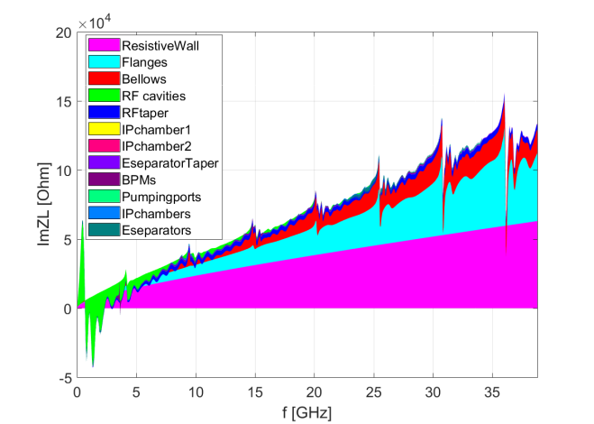
CEPC Impedance budget (@σ_{z}=3mm)
Components | Number | Z||/n, mΩ | k_{loss}, V/pC | ky, kV/pC/m
Resistive wall | - | 6.2 | 363.7 | 11.3
RF cavities | 240 | -1.0 | 225.2 | 0.3
Flanges | 20000 | 2.8 | 19.8 | 2.8
BPMs | 1450 | 0.12 | 13.1 | 0.3
Bellows | 12000 | 2.2 | 65.8 | 2.9
Pumping ports | 5000 | 0.02 | 0.4 | 0.6
IP chambers | 2 | 0.02 | 6.7 | 1.3
Electro-separators | 22 | 0.2 | 41.2 | 0.2
Taper transitions | 164 | 0.8 | 50.9 | 0.5
Total |  | 11.4 | 786.8 | 20.2
The broadband impedances are dominated by the RW, flanges and bellows.
The loss factor is mainly contributed by the resistive wall and the RF cavities.
More components, such as the collimators, absorbers and kickers, should be included.

Slide 17
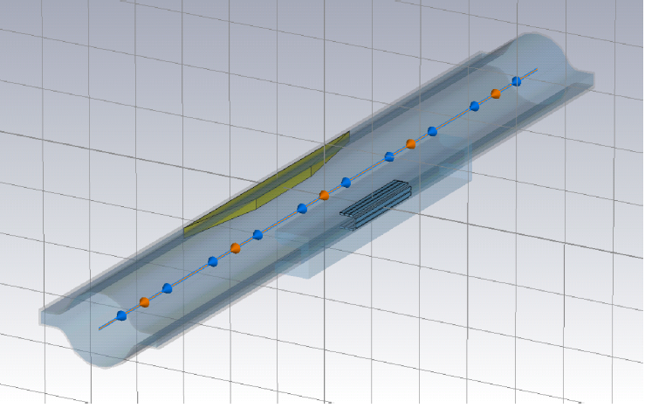
Vacuum chamber in FCC (FCC-cdr_volume_2)
Beam pipe in FCC-ee is a circular vacuum chamber of 35 mm radius with a rectangular antechamber on each side.
The SR absorbers will be installed inside the chamber winglets every 4~6 meters (num~10000).
SR absorbers
pumping slots
antechamber

Slide 18
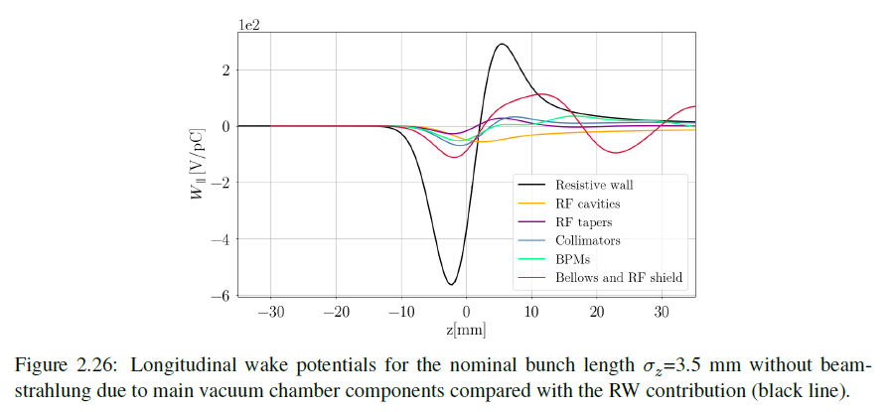
Growth time of the RW ~7 turns

