Slide 1
CEPC SC magnets with different diameters
Yingshun Zhu*, Xiangchen Yang, Ran Liang, Chuang Shen, Miaofu Xu
Institute of High Energy Physics, Chinese Academy of Sciences
March 27, 2020
CEPC working day

Slide 2
Outline
Overview of CEPC SC magnets
SC quadrupole design with CDR diameter
SC quadrupole design with new diameter
FCC-ee SC quadrupole status
Summary

Slide 3
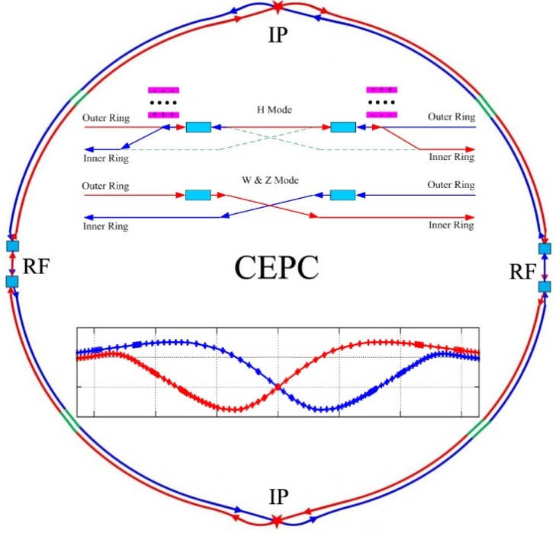
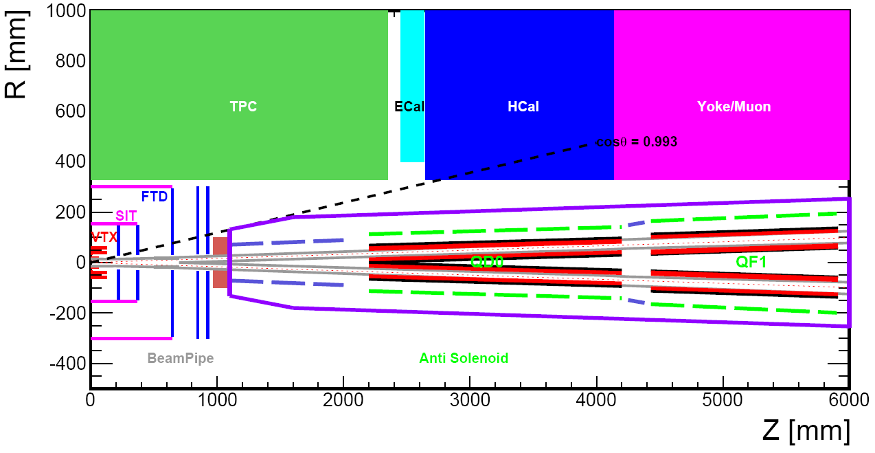
Overview of CEPC SC magnets
CEPC is a Circular Electron Positron Collider with a circumference about 100 km, beam energy up to 120 GeV proposed by IHEP.
Most magnets needed for CEPC Accelerator are conventional magnets.
To greatly squeeze the beam for high luminosity, compact high gradient final focus quadrupole magnets are required on both sides of the IP points in CEPC collider ring.
CEPC MDI layout
Sketch of CEPC Collider ring

Slide 4
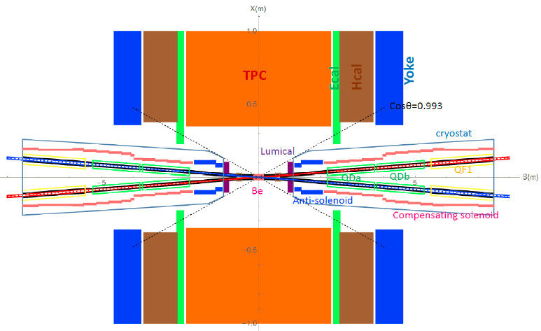
CEPC SC Magnets including: superconducting QD0,QF1, anti-solenoid on each side of the IP point. QD0, QF1, and anti-solenoid coils are in the same cryostat.
In addition, there are 32 superconducting sextupole magnets in IR.
Schematic layout of QD0, QF1, and anti-solenoid

Slide 5
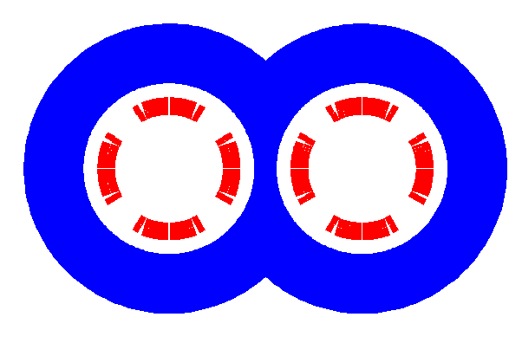
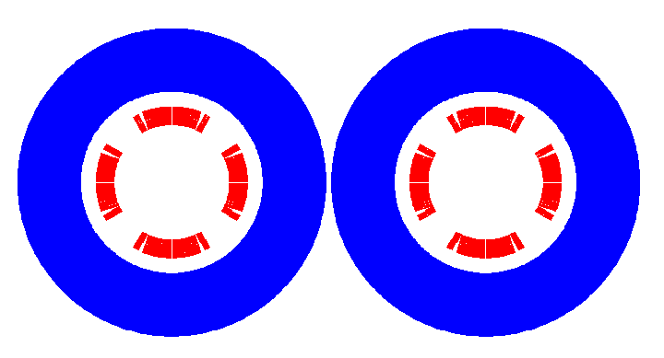
SC quadrupole design with CDR diameter
QD0 CDR: 136T/m, inner diameter 40mm, length 2m.
Overall design
Minimal distance between two aperture beam lines: 72.6 mm.
Not enough space to place two single apertures side by side, so a compact design is adopted.
cos2θ quadrupole coil using NbTi Rutherford: highest magnetic efficiency and cooling capacity, good stability, elimination of field crosstalk.
Iron yoke can enhance the field gradient, reduce the coil excitation current.
Iron core in the middle part is shared by the two apertures.

Slide 6
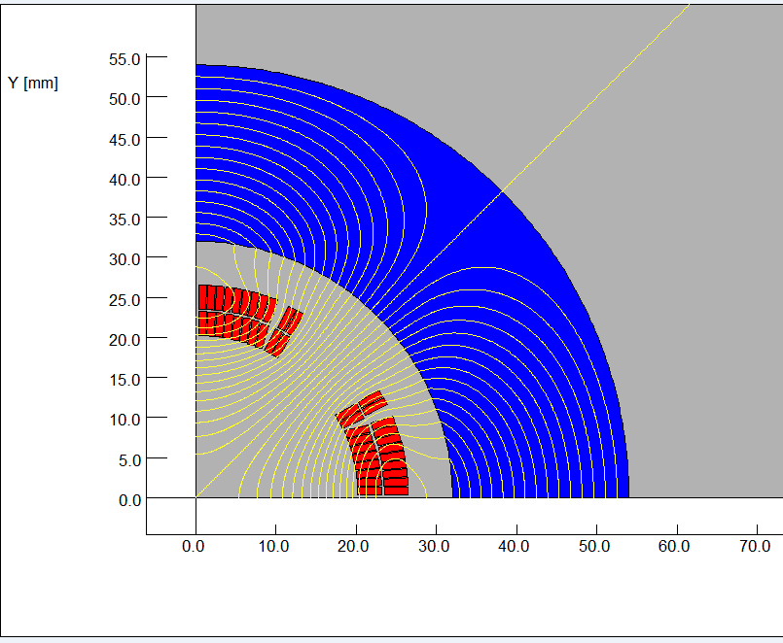
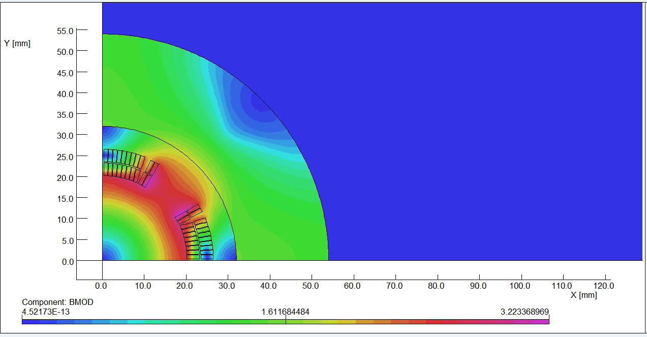
The design of QD0 is based on two layers cos2θ quadrupole coil using NbTi Rutherford cable with iron yoke.
The QD0 single aperture coil cross section is optimized with four coil blocks in two layers separated by wedges, and there are 21 turns in each pole.
2D magnetic field calculation is performed using OPERA.
Actual insulation thickness and coil fabrication process are taken into account.
2D flux lines (1/4 cross section)
Magnetic flux density distribution

Slide 7
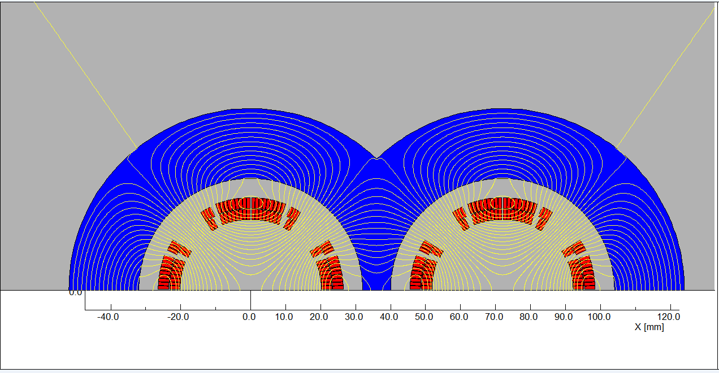
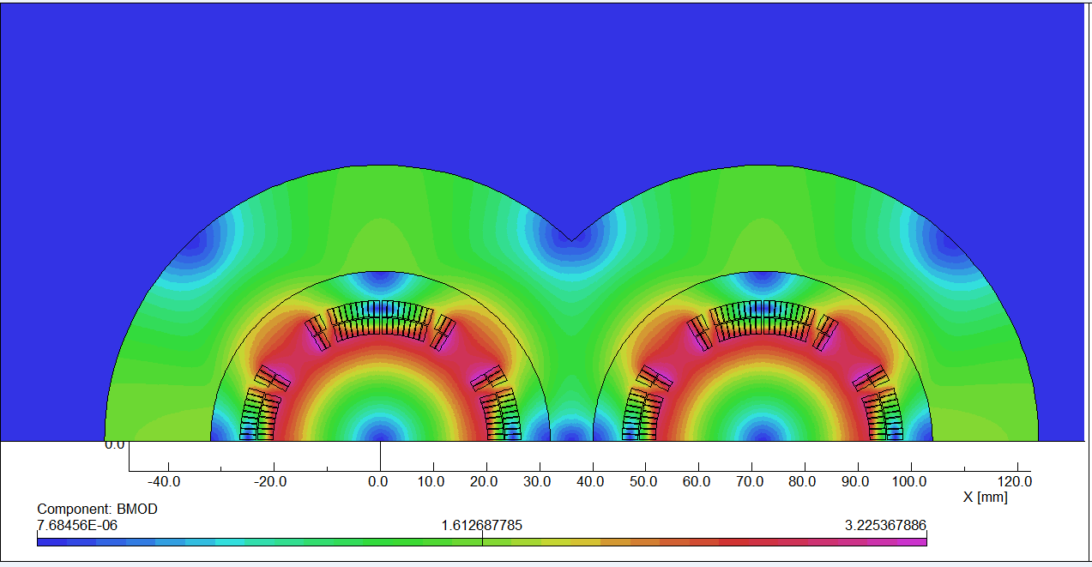
2D field cross talk of QD0 two apertures near the IP side.
2D Flux lines
Bmod distribution

Slide 8
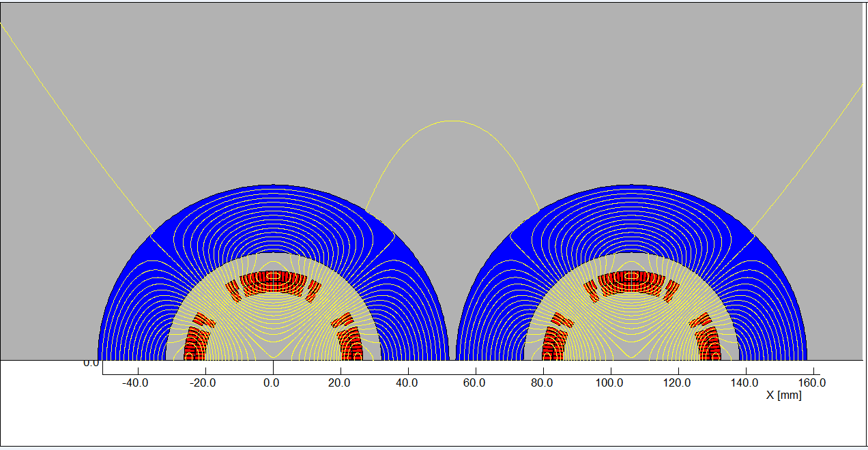
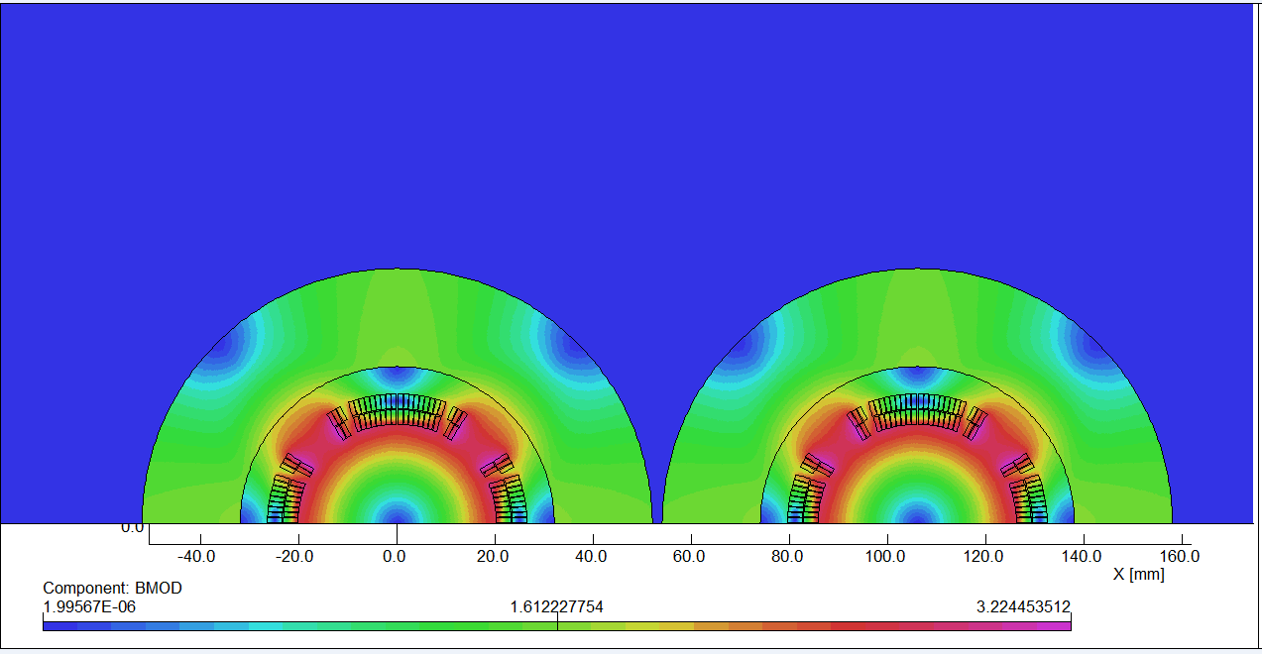
2D field cross talk of QD0 when the distance between two aperture is larger.
2D Flux lines
Bmod distribution

Slide 9
In 2D case where the distance between the two aperture is the smallest and the field crosstalk is the most serious, iron yoke can well shield the leakage field of each aperture, and the field harmonics as a result of field crosstalk between the two apertures is smaller than 0.5×10⁻⁴.
In other cases where the distance between the two apertures becomes larger, the field harmonics as a result of field crosstalk will be smaller.
Using the iron yoke, the field harmonics as a result of the field crosstalk is not a problem.
No additional cancel coil for the field crosstalk compensation is needed.
In addition, compared with the iron-free design of QD0, the excitation current can be reduced.

Slide 10
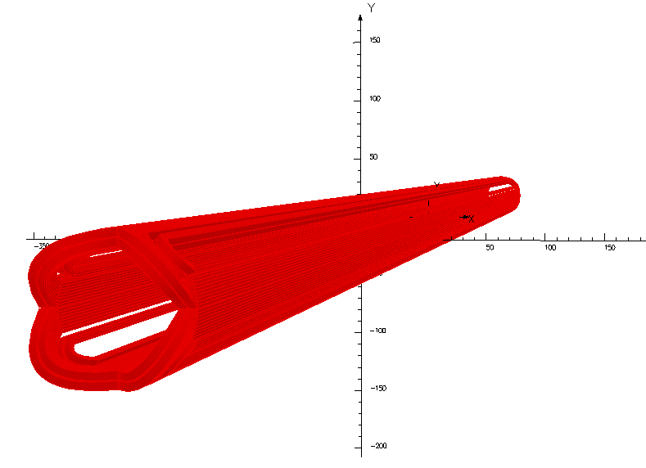
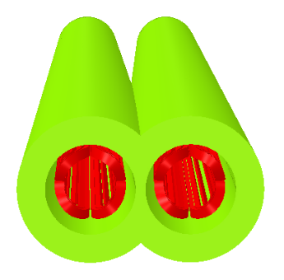
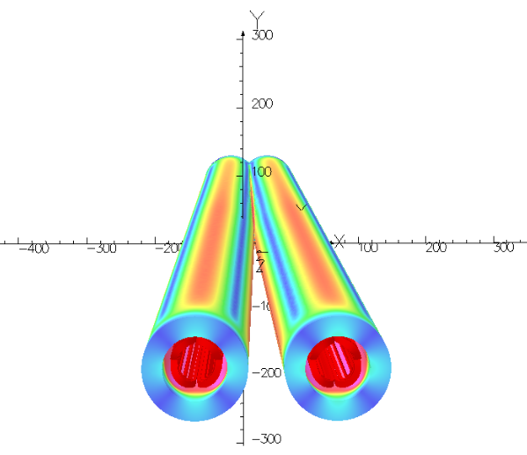
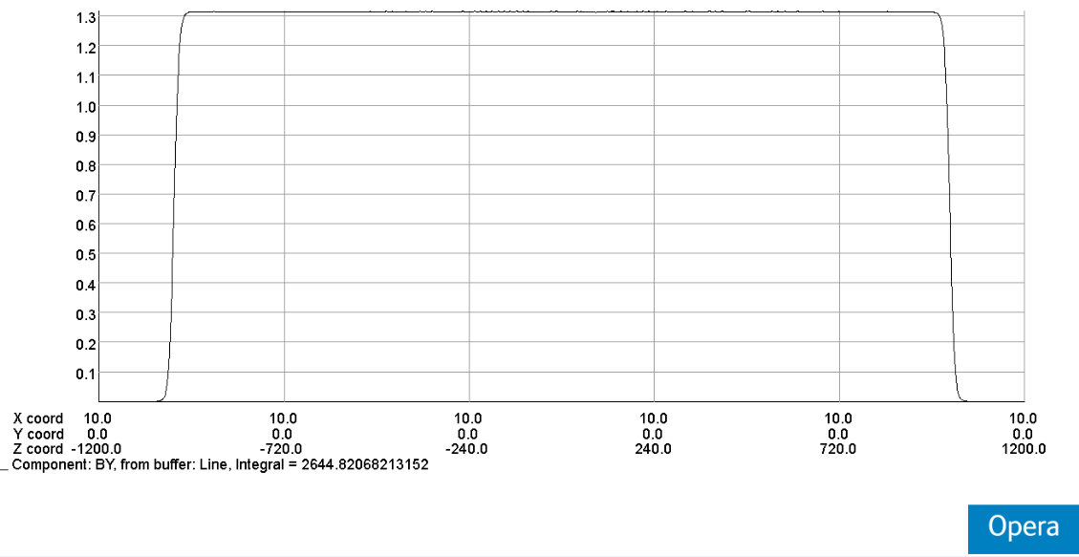
QD0: Double aperture quadrupole magnet using cos2θ coil with iron yoke, with crossing angle between two apertures.
Novel design, the first such magnet in the world.

Slide 11
Design parameters of QD0:
Table 1: Design parameters of QD0 (with iron core)
Magnet name | QD0
Field gradient (T/m) | 136
Magnetic length (m) | 2.0
Coil turns per pole | 21
Excitation current (A） | 2080
Coil layers | 2
Conductor | Rutherford Cable, width 3 mm, mid thickness 0.93 mm, keystone angle 1.9 deg, Cu:Sc=1.3, 12 strands
Stored energy (KJ) (Double aperture) | 21.5
Inductance (H） | 0.010
Peak field in coil (T) | 3.3
Coil inner diameter (mm) | 40
Coil outer diameter (mm) | 53
X direction Lorentz force/octant (kN) | 112
Y direction Lorentz force/octant (kN) | -108
The current of QD0 at W and Z model will decrease.

Slide 12
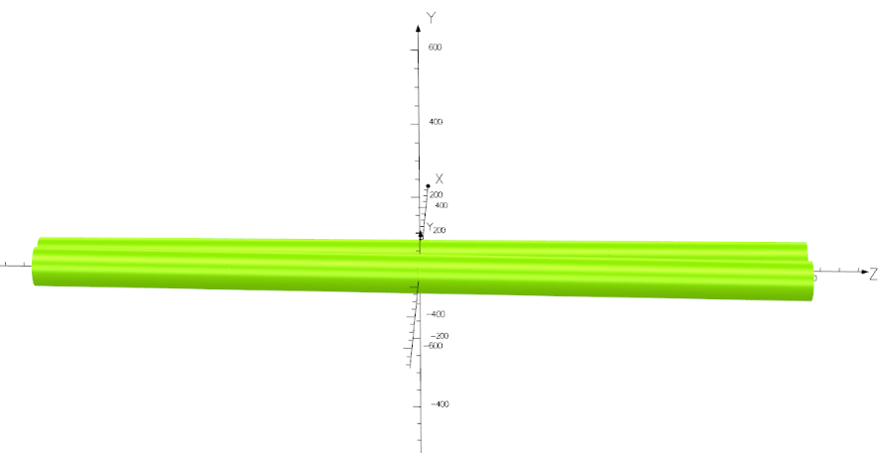
Design of QD0 short model magnet
Novel design of QD0:
Collared cos2θ quadrupole magnet with shared iron yoke and crossing angle between two aperture centerlines.
So far, there is no cos2θ superconducting quadrupole magnet developed in China.
In the R&D of CEPC interaction region superconducting magnets, the first step is to develop a short QD0 model magnet with 0.5m length (near IP side).

Slide 13
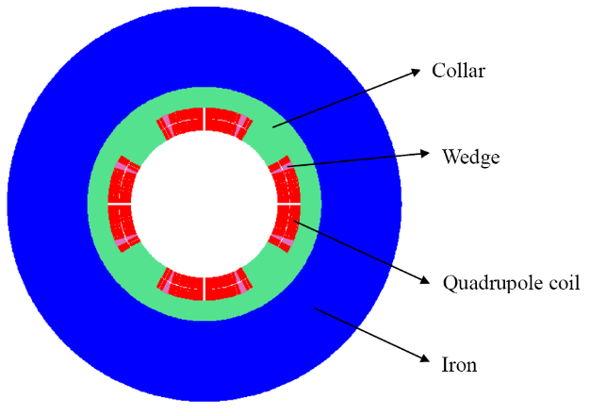
The aim of QD0 short model magnet:
Verify magnet design;
Exploring magnet manufacturing technology;
Master cryogenic testing Technology;
Master the excitation and quench performance of magnet;
Lay the foundation for the development of long QD0 prototype.

Slide 14
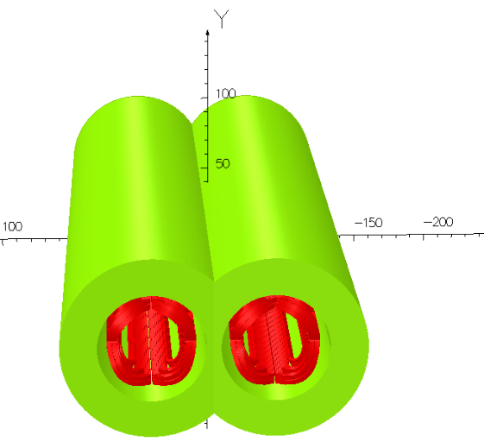
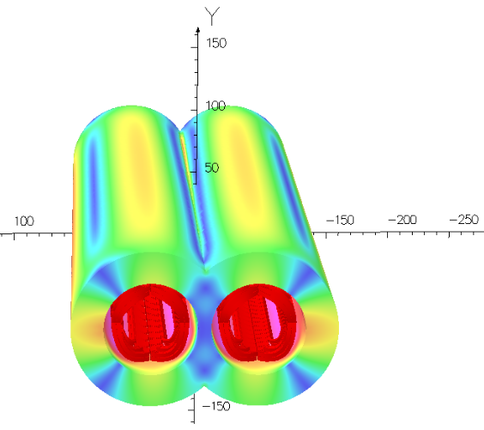
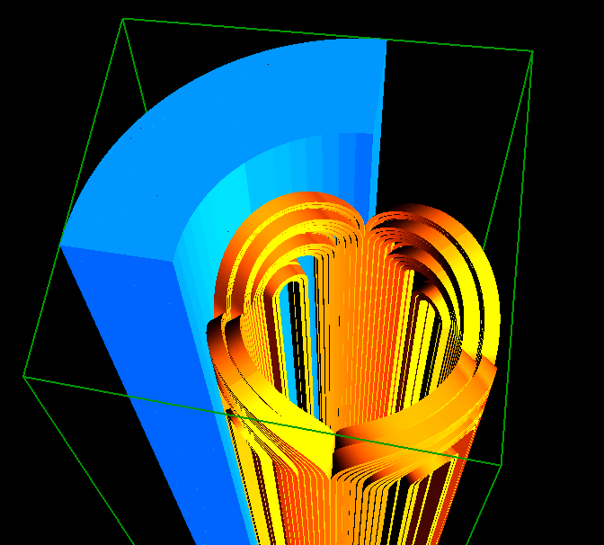
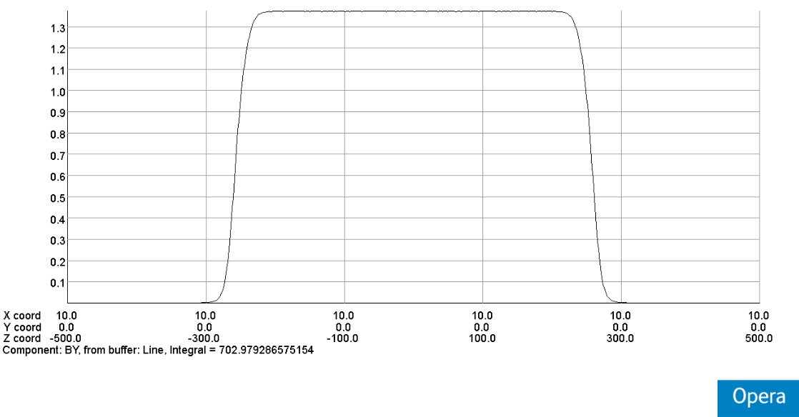
3D field simulation of two apertures 0.5m QD0.

Slide 15
3D field simulation result shows that, local field harmonic as a result of field cross talk is smaller than 0.5 unit (1×10⁻⁴).
Each integrated multipole field as a result of field crosstalk between the two apertures is smaller than 0.3 unit.
The dipole field is smaller than 10 Gs at each longitudinal position.
Table 2: 3D integrated field harmonics（unit, 1×10⁻⁴）
n | B_{n}/B₂@R=9.8 mm
2 | 10000.0
3 | -0.28
4 | 0.017
5 | -0.01
6 | 0.06
7 | -0.02
8 | 0.022
9 | 0.012
10 | -1.78
11 | -0.02
12 | 0.015

Slide 16
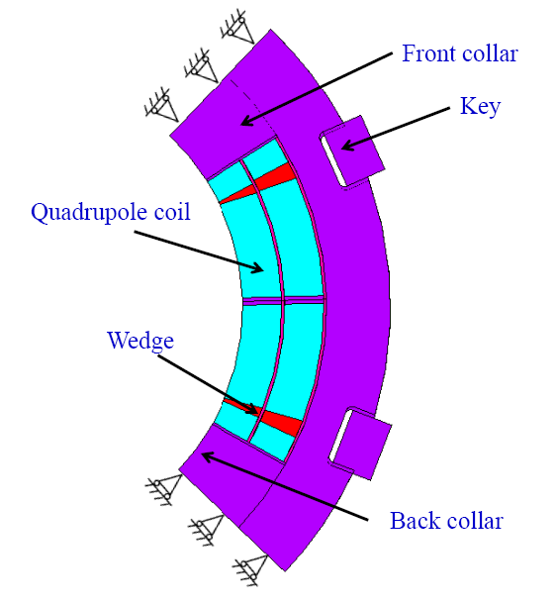
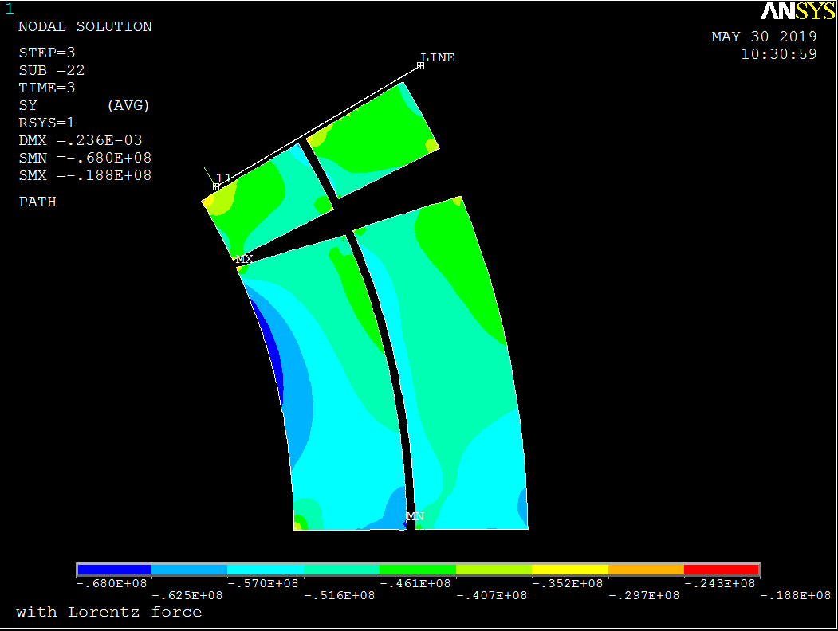
Stress analysis of QD0 short model magnet:
A total of 8 keys are used in the whole cross section.
The FEM analysis result shows that, the stress in each component during each operation step is safe.
Collar material with high strength is required.
Model
Stress in coil after excitation

Slide 17
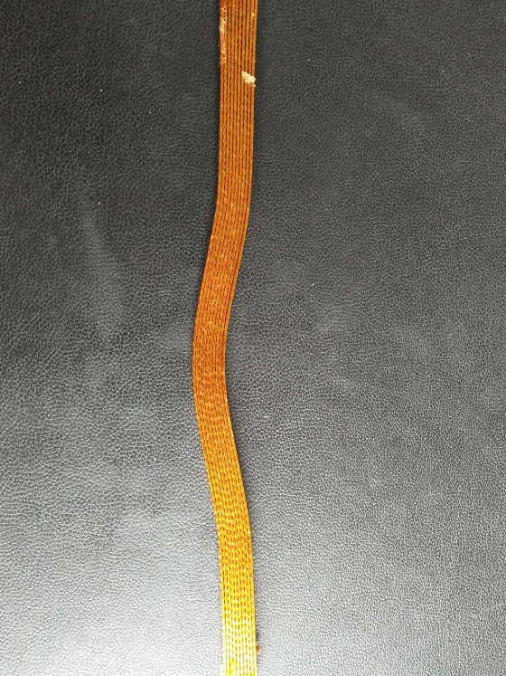
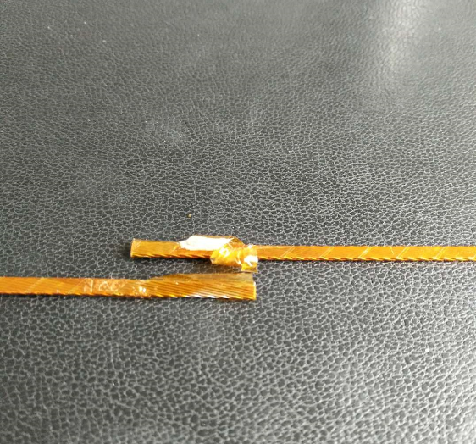
In 2018 Ordered: NbTi/Cu Strand and keystoned Rutherford Cable
Strand:
NbTi/Cu, 0.5mm in diameter,
Cu/Sc=1.3, Filament diameter < 8μm,
@4.2K, Ic≥340A@3T，Ic≥280A@4T，Ic≥230A@5T.
Rutherford Cable:
Width: 3mm, mid thickness: 0.93 mm, keystone angle: 1.9 deg, No of stands: 12.
Cu Rutherford cable sample

Slide 18
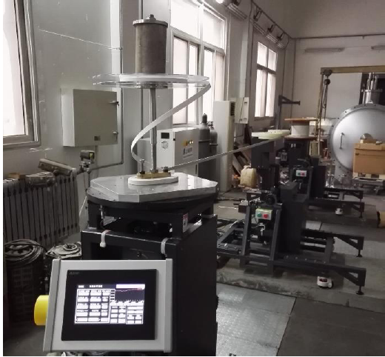
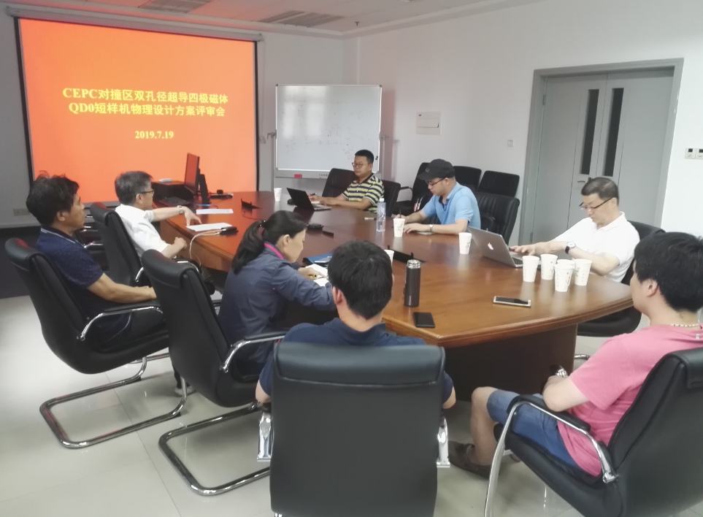
Cost inquiry for 0.5m QD0 short model magnet completed.
The basic hardwares necessary for short model magnet were investigated.
The physical design of QD0 short model magnet passed the experts review in July 2019.
评审意见：QD0是CEPC核心设备之一，设计方案是国际上首次提出，建议尽快开始短样机研制。
IHEP winding machine
Review meeting

Slide 19
SC quadrupole design with new diameter
The requirement of the Final Focus quadrupoles is recently updated.
Design considerations
The field gradient of quadrupoles is reduced compared to that in CDR; the development of QDa is the most challenging.
Design of quadrupoles and anti-solenoid is similar to that in CDR.
Space for the corrector coil is enough inside the bore of quadrupole.
Iron yoke is used to eliminate the field crosstalk from the two apertures.
Table 3: Updated Requirements of final focus quadrupole magnets for Higgs
Magnet | Central field gradient (T/m) | Magnetic length (m) | Width of GFR (mm) | Minimal distance between two aperture beam lines (mm)
QDa | 77.5 | 1.5 | 19.2 | 72.61
QDb | 77.5 | 1.5 | 22.0 | 124.75
QF1 | 63.4 | 2.0 | 30.9 | 181.85

Slide 20
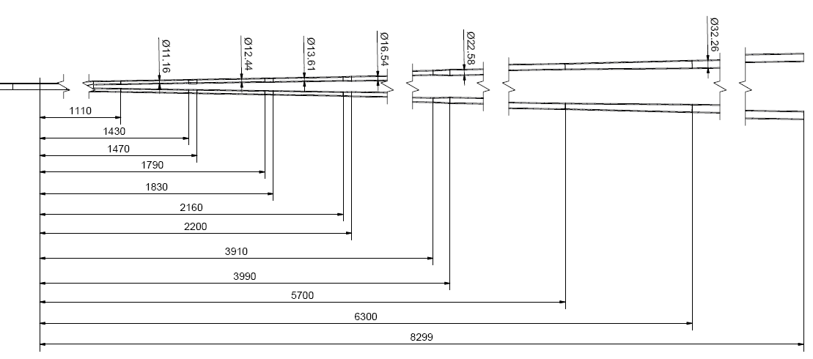
New Beam pipe

Slide 21
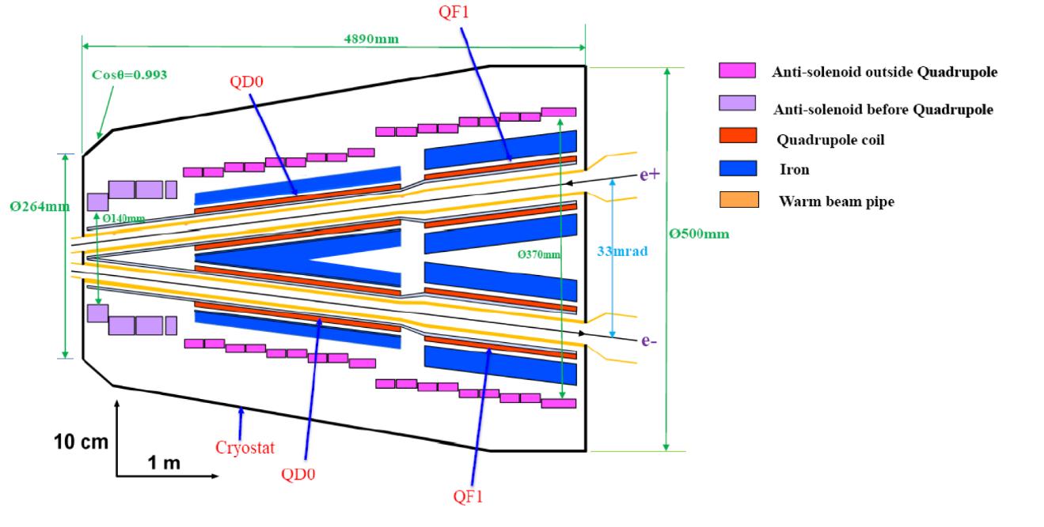
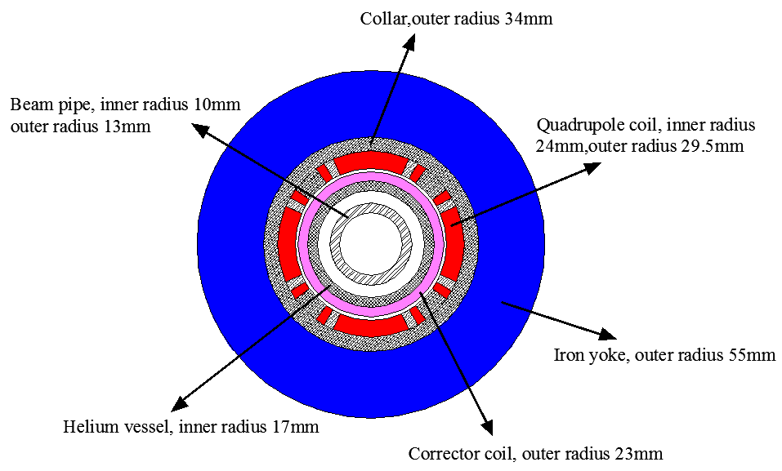
Anti-solenoid diameter meet the requirement of the new beam pipe
Qda single aperture layout

Slide 22
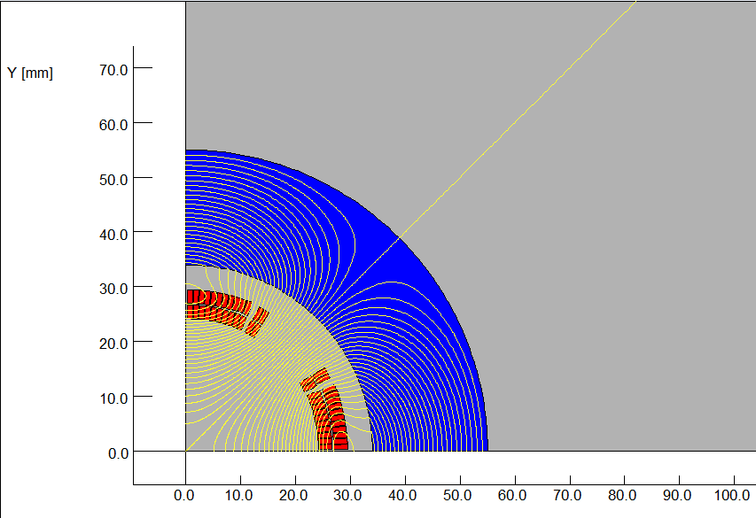
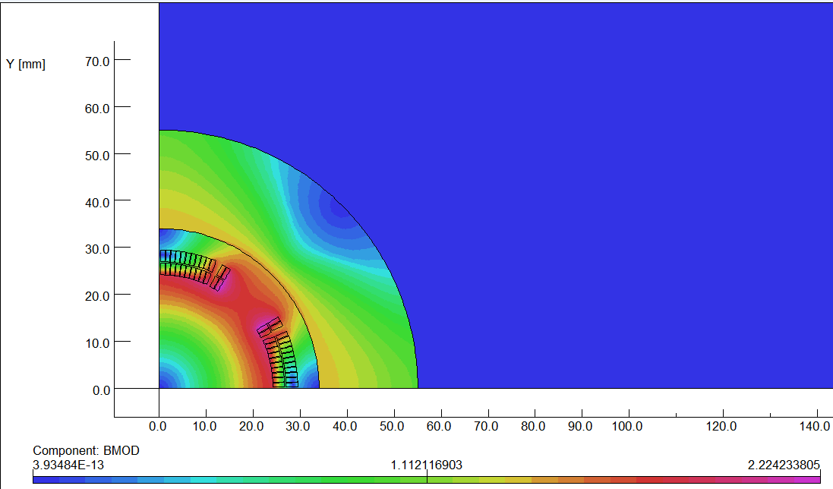
Design progress of Qda (inner diameter 48mm)
The design of QDa is based on two layers cos2θ quadrupole coil using Rutherford cable with iron yoke.
The QDa single aperture cross section is optimized with four coil blocks in two layers separated by wedges, and there are 25 turns in each pole.
The excitation current of QDa is 1240A, and each multipole field in single aperture is smaller than 1×10⁻⁴.
2D flux lines (1/4 cross section)
Magnetic flux density distribution

Slide 23
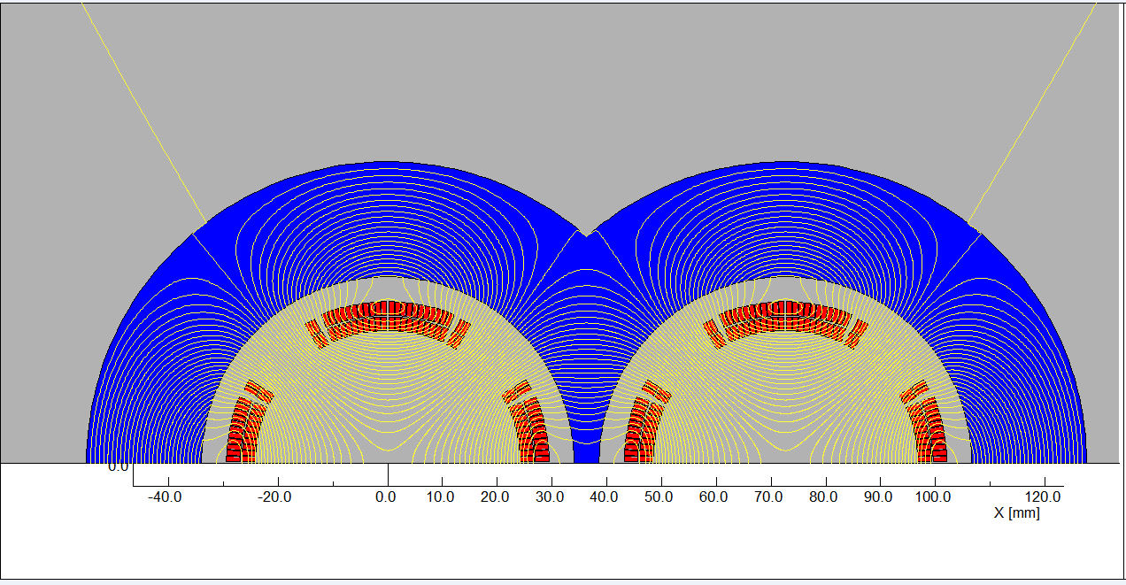
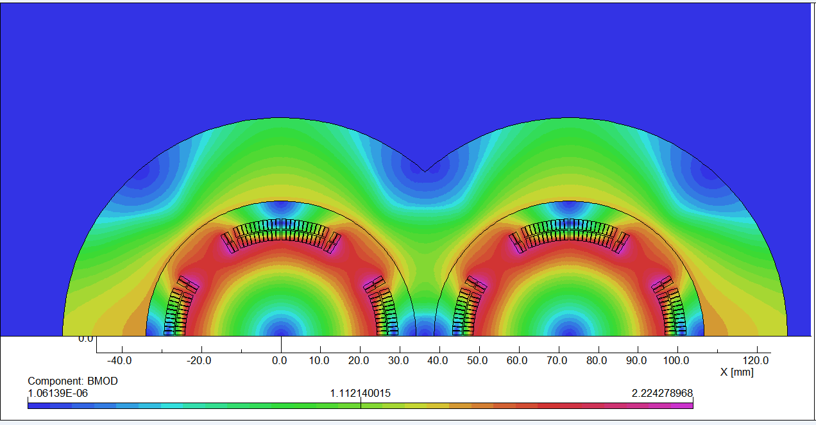
Field cross talk of the two apertures:
2D field cross talk of QDa two apertures near the IP side, where the distance between two aperture centerlines is minimum.
Iron yoke can well shield the leakage field of each aperture. The field harmonics as a result of field crosstalk is smaller than 0.5×10⁻⁴.
The dipole field in each single aperture as a result of field crosstalk is smaller than 5 Gs.
2D Flux lines
Bmod distribution

Slide 24
Design parameters and single aperture cross section of QDa:
Table 4: Design parameters of QDa for Higgs
Magnet name | QDa
Field gradient (T/m) | 77.5
Magnetic length (m) | 1.5
Coil turns per pole | 25
Excitation current (A） | 1240
Coil layers | 2
Conductor | Rutherford Cable, width 2.5 mm, mid thickness 0.93 mm, keystone angle 1.9 deg
Stored energy (KJ) (Double aperture) | 8.0
Inductance (H） | 0.010
Peak field in coil (T) | 2.4
Coil inner diameter (mm) | 48
Coil outer diameter (mm) | 59
X direction Lorentz force/octant (kN) | 39
Y direction Lorentz force/octant (kN) | -34
To minimize the quench caused by beam loss, a thin layer of liquid helium will be introduced inside superconducting corrector coils.

Slide 25
Feasibility of HTS superconducting magnet technology is being considered for CEPC IR superconducting magnets.
Advantage: Large critical current, heat load resistant,
High operating temperature.
Disadvantage: Expensive, conductor and coil manufacture not mature,
Large diameter of superconductor filament.
HTS Bi-2212 option for CEPC SC quadrupole
Bi-2212: High current carrying capacity, isotropic properties, relatively mature production technology
Similar cross section as NbTi option;
Wind and react; or React and wind;

Slide 26
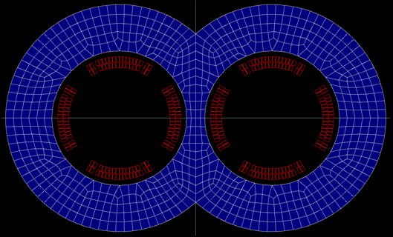
Bi-2212 option of QDa
Two layers cos2θ quadrupole coil using Rutherford cable with iron yoke.
Inner diameter 48mm, Bi-2212 strand diameter 0.8 mm.
Rutherford Cable: Width 2.4mm, No of stands: 6.
17turns each pole.
The excitation current of QDa is 1700A, and each multipole field in each aperture is smaller than 2×10⁻⁴.
2D calculation model

Slide 27
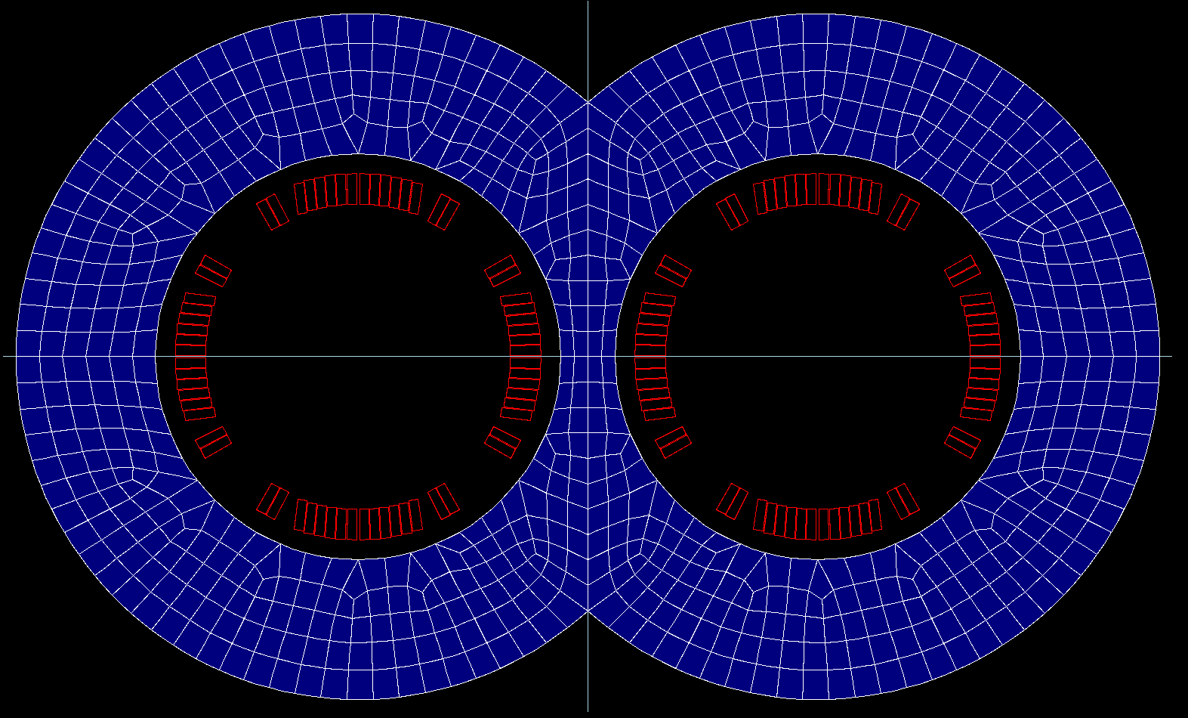
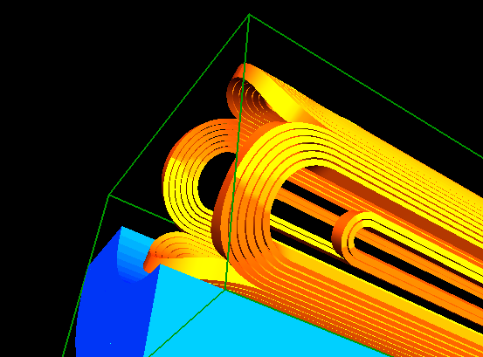
Alternative Bi-2212 option of QDa
One layer cos2θ quadrupole coil using Rutherford cable with iron yoke.
Inner diameter 48mm, Bi-2212 strand diameter 0.8 mm.
Rutherford Cable: Width 4mm, No of stands: 10.
8 turns each pole.
The excitation current of QDa is 3600A, and each multipole field in each aperture is smaller than 2×10⁻⁴.
As a first step, some test on Bi-2212 conductor is planned.
2D calculation model
3D calculation model

Slide 28
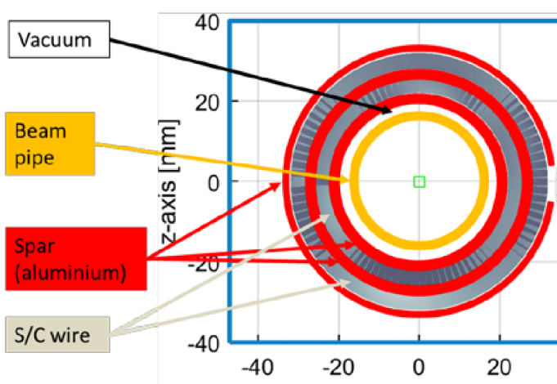
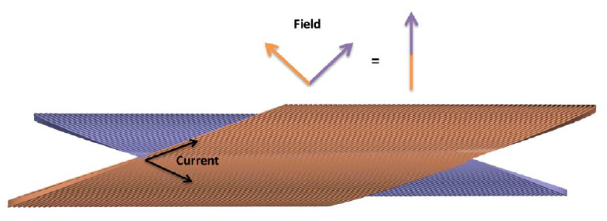
FCC-ee SC quadrupole status
FCC-ee（周长100km）， 对撞区双孔径最终聚焦超导四极磁体。
概念设计：
QC1L1，长1.2m，最高磁场梯度100T/m，磁体内孔径40mm。
采用无铁芯、CCT (Canted Cosine Theta)四极线圈方案。
前提假设：“Iron cannot provide the elimination of cross-talk”（无空间）
两孔径之间磁场干涉的校正，包含在四极线圈几何形状设计中。

Slide 29
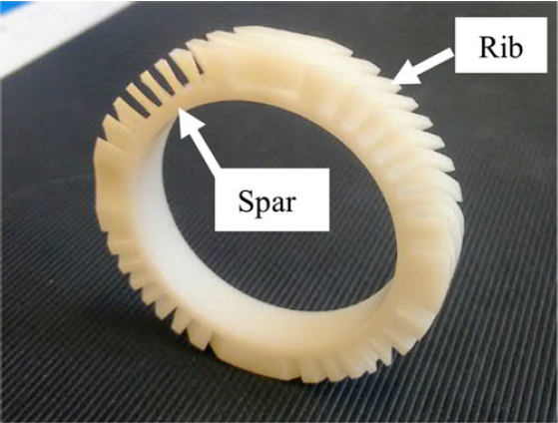
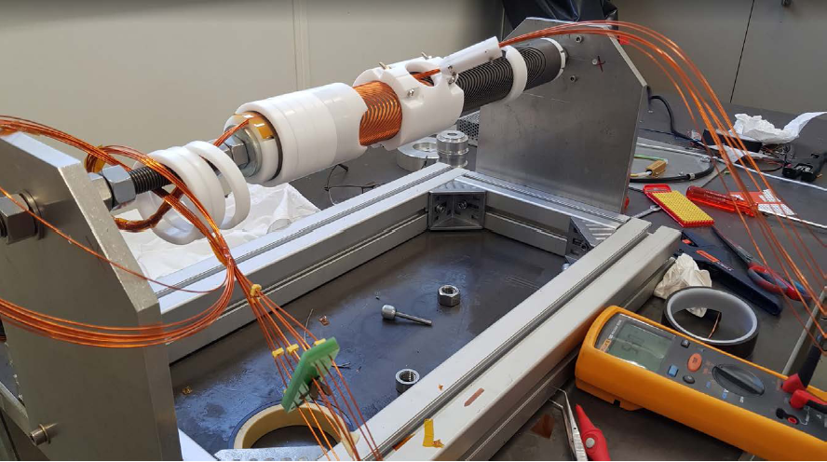
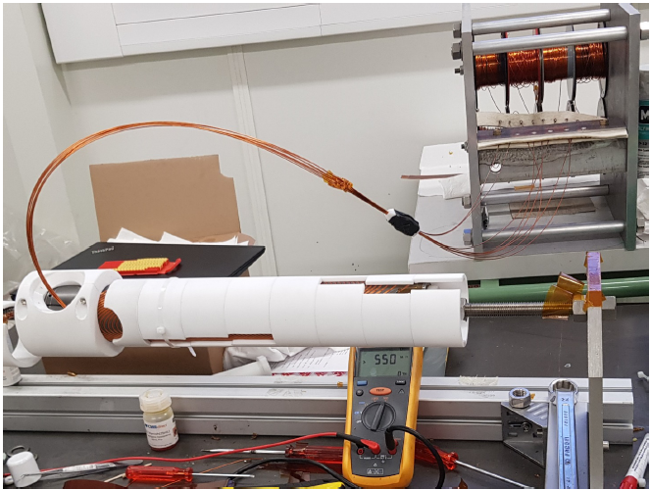
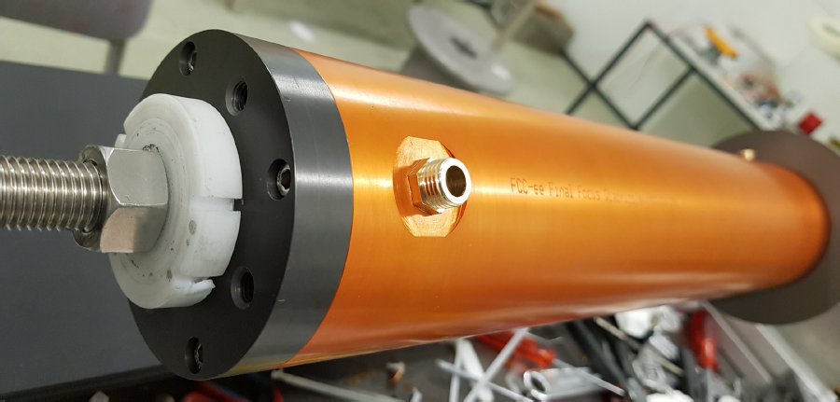
FCC-ee CCT 四极磁体样机已加工完成（单孔径）。

Slide 30
Summary
Superconducting quadrupole magnets are key devices for CEPC.
Novel design of QD0 is adopted. Despite limited space, magnetic field cross talk effect between two apertures is negligible using iron yoke.
Compared with the iron-free design of QD0, the excitation current with iron yoke can be reduced about 20%.
Physical design of 0.5m QD0 short model magnet has been finished, and all the design requirements have been met. Its fabrication is planned to be started (depending on fund).
With the reduced field gradient in the updated design, both the NbTi option and HTS option for CEPC superconducting magnets will be considered.

Slide 31
Thanks for your attention!
CEPC Working day

