Slide 1
CEPC collider ring requirements on ground motion (preliminary)
Yiwei Wang, Bin Wang
3 March 2020, IHEP

Slide 2
Luminosity reduction due to low frequency ground motion (preliminary)
3 times of transverse damping time 46.5ms*3 => 7Hz
Consider ground motion with frequency < 7Hz
Closed orbit jitter but emttance growth will be damped
mainly due to quadrupole jitter
Mainly concern in collider ring is luminosity reduction. The jitter shifts the beams centroids and thus the colliding beams do not fully overlap at the IP. The relative luminosity reduction with small jitter is*
$$\frac{∆L}{L}≅e^{−\frac{{(∆y/σ_{y})}^{2} }{4}}−1≅−\frac{{(∆y/σ_{y})}^{2} }{4}$$
Magnification factor at IP $AF$=${∆y_{IP}}/{y_{jit}}$
* Tor O. Raubenheimer , PhD thesis

Slide 3
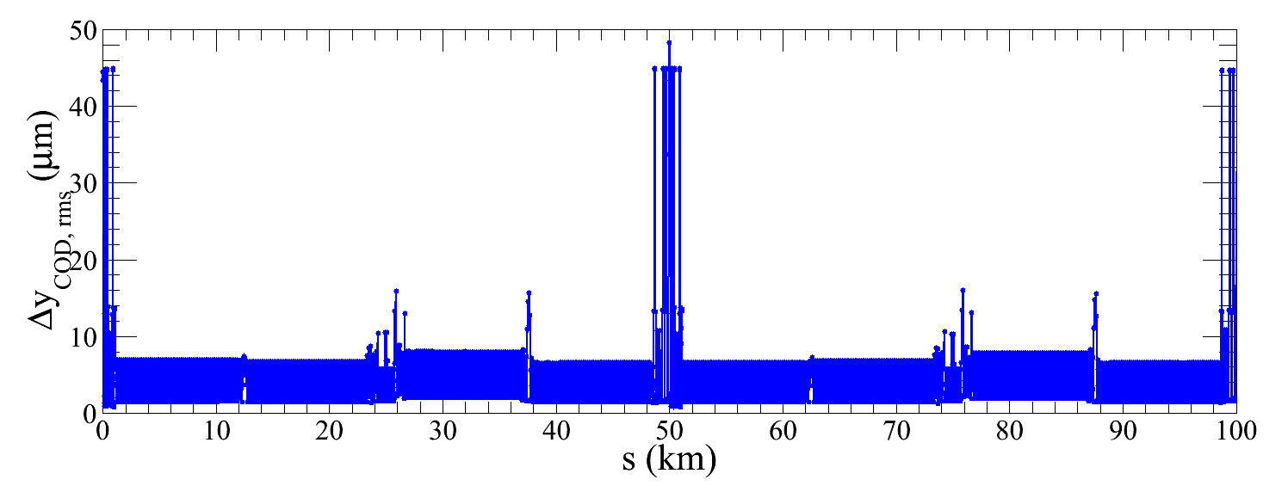
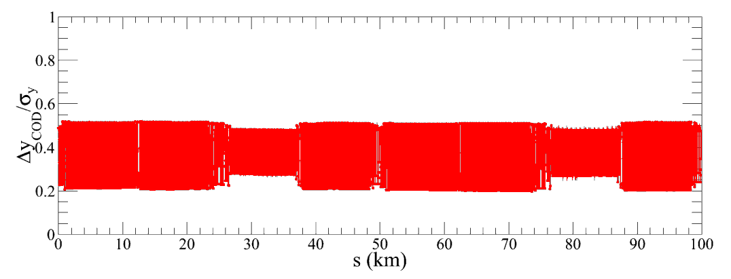
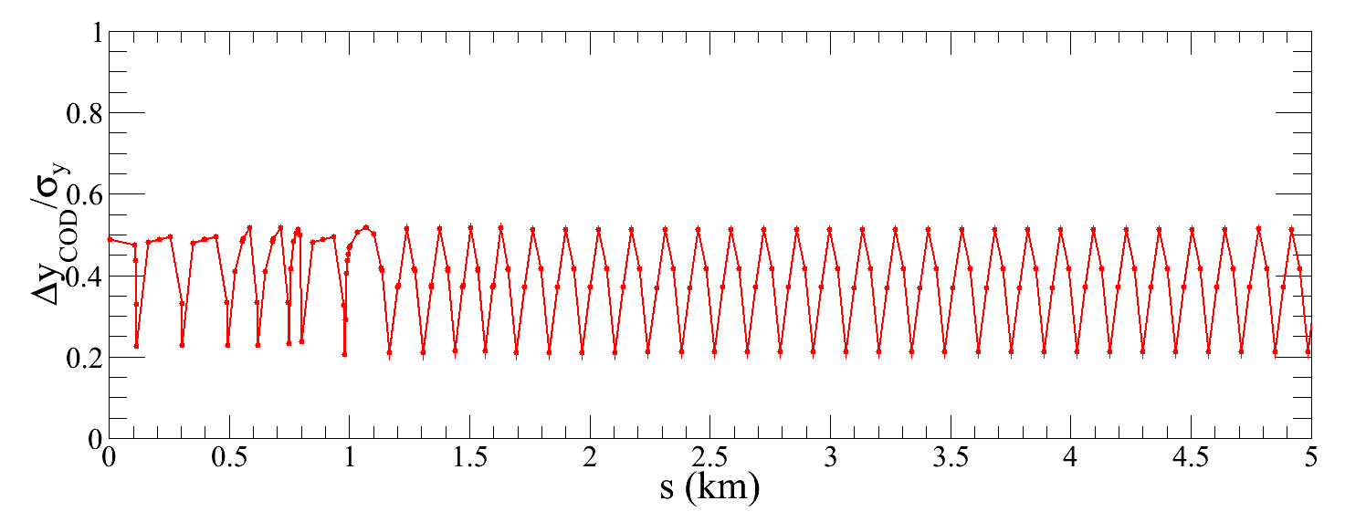
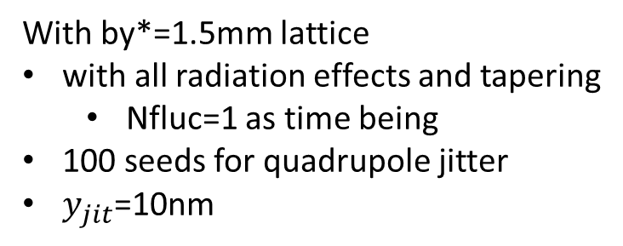
Simulation with quadrupole jitter
by Bin Wang
Quadrupole jitter $y_{jit}$=10nm and f<7Hz
$σ_{y}$=60nm, ${({∆y_{IP}}/{σ_{y}})}_{rms}$=0.5, $AF$=3, ${∆L}/L$=6%
More detailed simulation: beam-beam, machine geometry, wave velocity, spectrum, emittance
With by*=1.5mm lattice
with all radiation effects and tapering
Nfluc=1 as time being
100 seeds for quadrupole jitter
$y_{jit}$=10nm

Slide 4
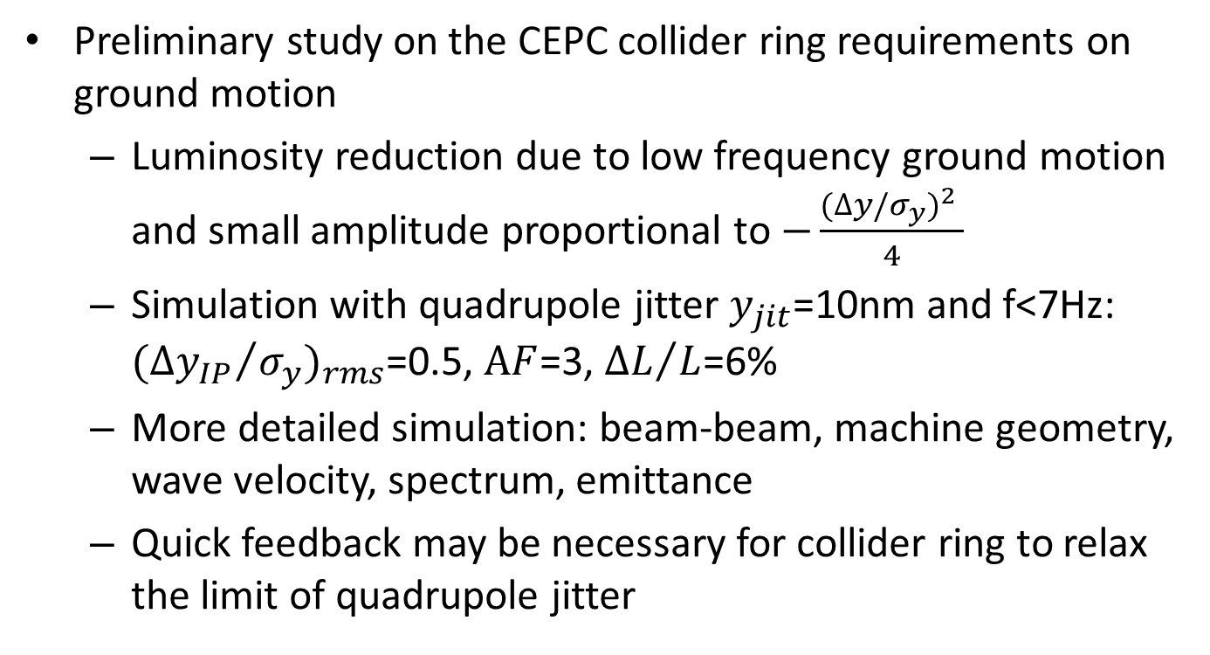
Summary
Preliminary study on the CEPC collider ring requirements on ground motion
Luminosity reduction due to low frequency ground motion and small amplitude proportional to $−\frac{{(∆y/σ_{y})}^{2} }{4}$
Simulation with quadrupole jitter $y_{jit}$=10nm and f<7Hz: ${({∆y_{IP}}/{σ_{y}})}_{rms}$=0.5, $AF$=3, ${∆L}/L$=6%
More detailed simulation: beam-beam, machine geometry, wave velocity, spectrum, emittance
Quick feedback may be necessary for collider ring to relax the limit of quadrupole jitter

