Slide 1
光源地基振动研究报告
闫芳
加速器中心，IHEP，北京
2020-03-03

Slide 2
主要内容
1
光源振动指标的确定
2
光源振动指标的分解
3
减隔振思路
4
5
6

Slide 3
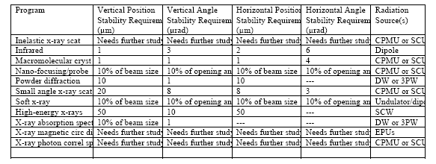
1. 光源振动指标的确定
国际上大部分实验用户要求束流中心轨道的抖动小于束流RMS尺寸以及偏角的10%
NSLS_II | keeping the motion induced beam size increment within 10% of the beam size
ESRF | 20% emittance growth, 10% e-beam size and 10% divergence
MAX-IV | Tolerance on electron beam fluctuations 10% of the RMS beam size
TPS | dσ/σ~=5%
APS | 5% of design particle beam dimensions

Slide 4
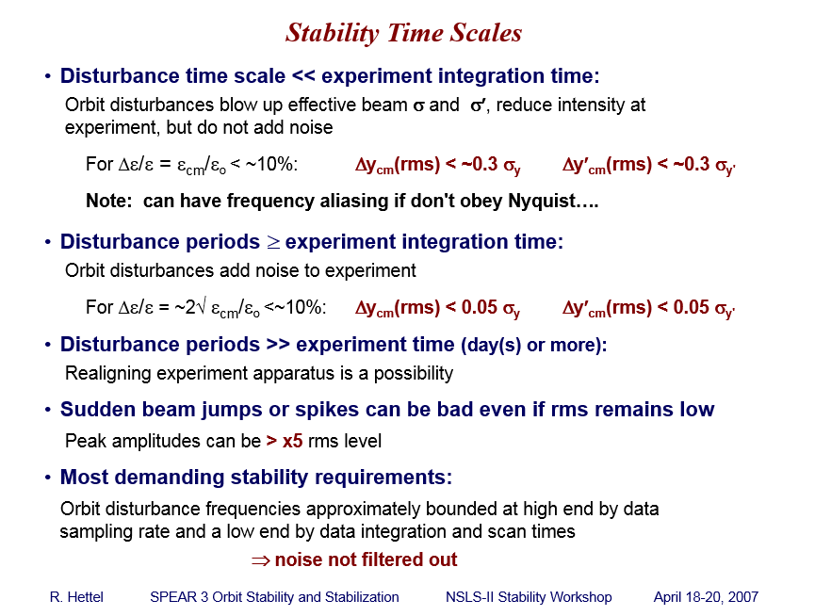
1. 光源振动指标的确定

Slide 5
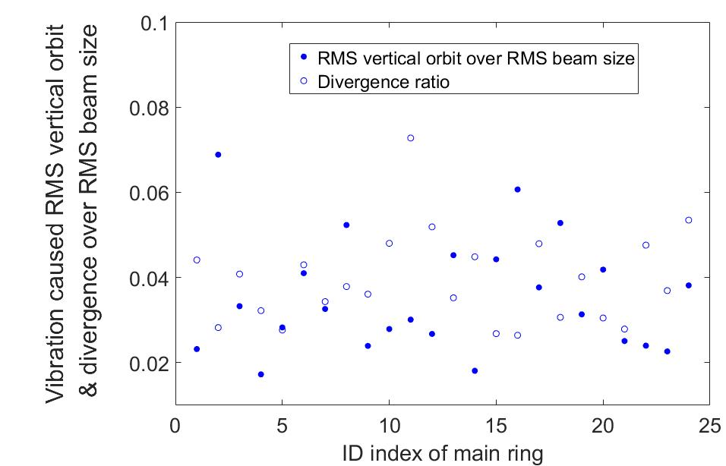

1. 光源振动指标的确定
The tolerance on the floor motion required to keep beam fluctuation smaller than 10% of the RMS beam size and 10% of the beam divergence in the meanwhile with FOFB;
We aim at an effective bandwidth of FOFB from DC up to 1kHz:
  The 1 kHz upper frequency limit of FOFB specification takes into account of the future innovation in fast X-ray detection with higher bandwidth.
Vibrations with RMS displacement integration of 25nm over 1Hz~100Hz were introduced in the HEPS lattice :
Without FOFB
With FOFB
By Y. Y. Wei
Displacement PSD is scaled $by1/{ f^{3}}$，vibration distribution on each element are random, BPM accuracy is not considered.

Slide 6
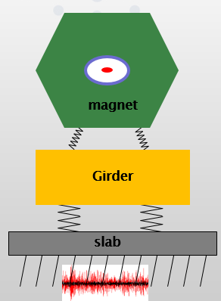
1. 光源振动指标的确定
地基振动传导到加速器的磁铁等元件上会导致束流中心轨道的波动，进而引起束流等效发射度的增长和亮度的下降；
根据国内外储存环光源实验用户对束流轨道稳定性的要求, 要求地面振动及其他各种动态误差引起电子束流中心位置和角偏差的波动 小于束流均方根尺寸和角散度的10%，要求：
地面振动 (包括地脉动、周边环境中各种设备和人类活动包括
轨道交通、行人等引起的振动)在1-100Hz频率范围内的RMS
位移积分值小于25nm，并进行如下参数分解：
要求周边其他振动源引起的振动传导
至主环地面上的影响均小于1nm；
要求主环的基础以及地基对地面振动的放大倍数为1；
要求支架及基座 (包括磁铁) 对地面振动的放大倍数为1 。
Courtesy from
L. Zhang (SLAC)

Slide 7
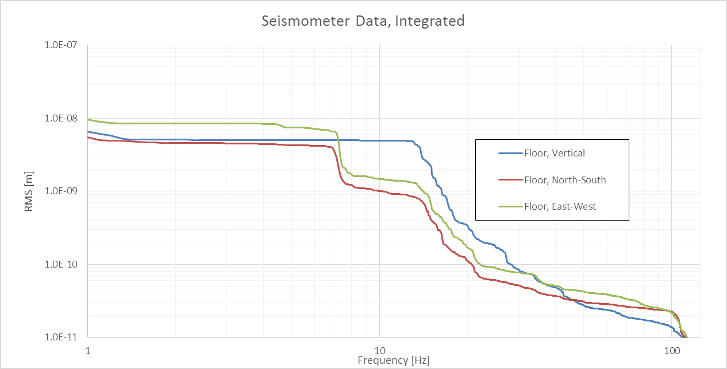
Floor Vibrations, SAM House, Closest to E22
2. 光源振动指标的分解
a) 要求支架及基座 (包括磁铁) 对地面振动的放大倍数为1
振动的传播有两个途径：
通过地面-支架-磁铁-束流
通过真空管道-磁铁-束流
地板上主要振动频率
MAX-IV
18Hz
MAX-IV

Slide 8
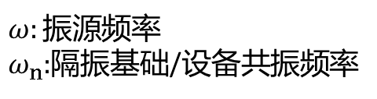
2. 光源振动指标参数分解
a) 要求支架及基座 (包括磁铁) 对地面振动的放大倍数为1
$ω:振源$频率
$ω_{n}:$隔振基础/设备共振频率
磁铁支架
1.When the frequency ratio is more than , the transfer rate is less than 1, the isolator have effects；
2.When the frequency ratio is more than 3, the transfer rate is close to constant. The large frequency rate makes a soft supply.
3.When the frequency ratio is close to 1, the system is in the resonance frequency. In this situation, increasing more damping will decrease vibration.

Slide 9
2. 光源振动指标参数分解
a) 要求支架及基座 (包括磁铁) 对地面振动的放大倍数为1
Overview on magnet-girder assembly
ESRF EBS 4 vertical motorized jacks, stiffer hori. Manual adj. 42 1.0~1.1

Slide 10
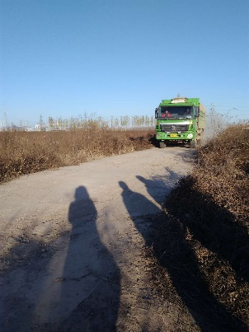
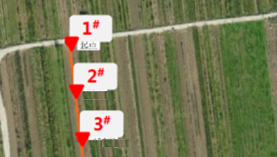
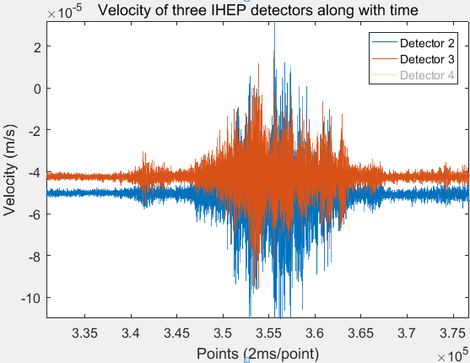
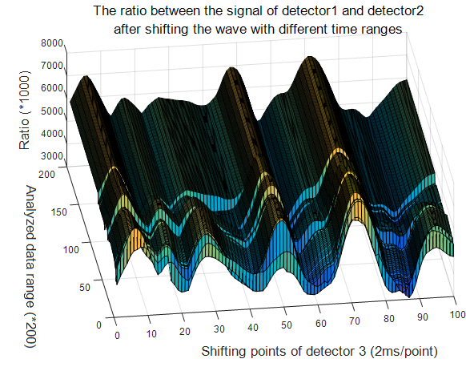
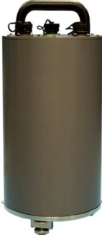
Status
Refresh：Wave velocity
Valley position | Time diff. of two detector (ms) | Corr. To f (Hz)
13 points | 26 | 38.5
22 points | 44 | 22.7
40 points | 80 | 12.5
56 points | 112 | 8.9
64 points | 128 | 7.8
82 points | 164 | 6.1
88 points | 176 | 5.7
30m
Guralp:
60s-100Hz
Sampling rate: 500Hz, the wave velocity in vertical direction is 30 m/(56*(2 ms))=268 m/s
Notes:
To establish the simulation model, wave velocity of the ground motion was measured on HEPS site using truck as the vibration source on this road. Sensors are placed in this direction. This is the measurement data of velocity spectrum. Shifting the data measured by the detector behind, the best overlap gives smallest ratio of the data of two sensors besides the major vibration frequencies while truck is passing by as shown In this psd spectrum. The wave velocity is obtained accordingly which is 268m/s on HEPS site.

Slide 11
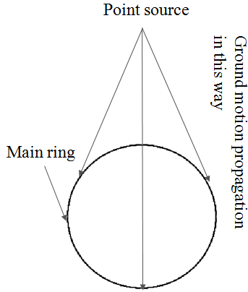
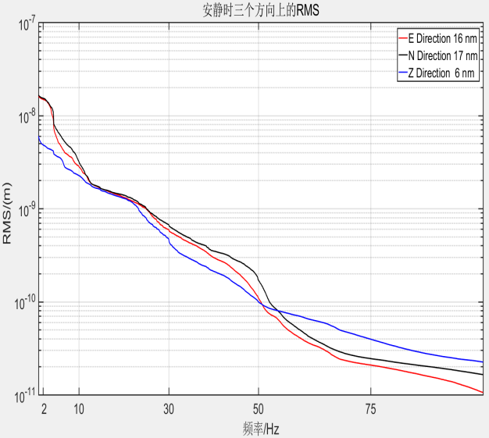
Status
Refresh: Ground motion specifications
The actual measured data of RMS displacement on HEPS ground is introduced into the
simulation model with vibration wave velocity of 268 m/s.
The max. beam orbit with different frequency are calculated in x/y directions.
The lattice sensitive frequency range is obtained (<54Hz) and the Eigen frequency of the
girder assembling is set to be bigger than 54Hz accordingly.

Slide 12
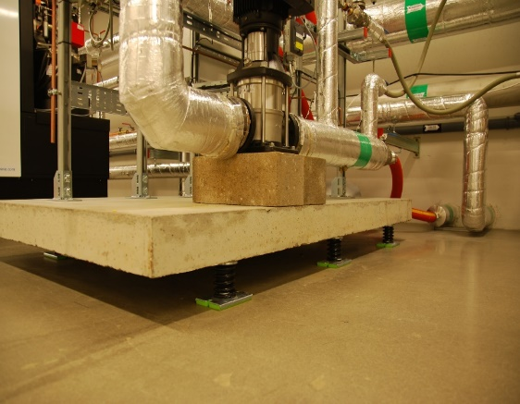
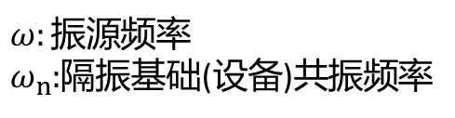
2. 光源振动指标的分解
b) 要求周边其他振动源引起的振动传导至主环地面上的影响均小于1nm
$ω:振源$频率
$ω_{n}:$隔振基础(设备)共振频率
不同阻尼比曲线
动力设备
The policy during the construction and buildup phase was that no source should have a contribution higher than 1nm RMS. Given the achieved vibration level, a new and tougher criterion is used, as stated above. For the tram line, where it is difficult and expensive to reach <<1nm contributions, the 1nm goal was used.

Slide 13
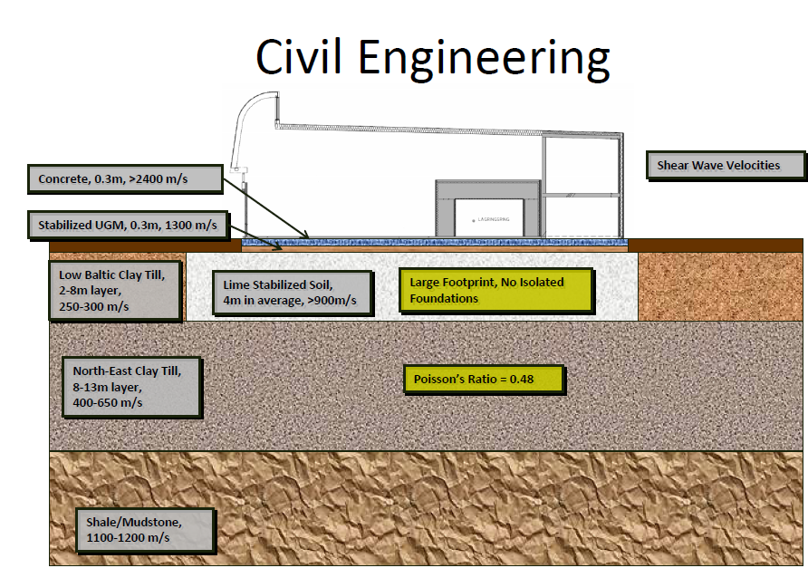
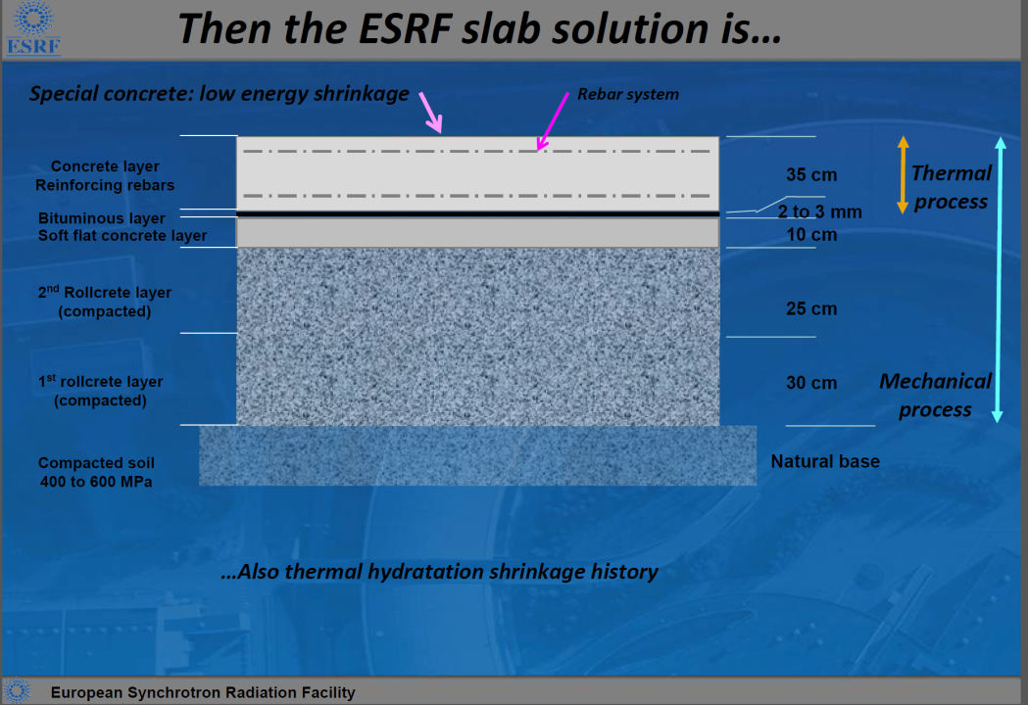
2. 光源振动指标的分解
c) 地基及板下基础对振动的放大倍数不大于1的指标要求
MEDSI2012
Slab design in some Light Sources (from Lin Zhang)
  With piles: thickness of the slab < 1m
  Without piles: thickness of the slab ~ 1m on good mechanical quality of soil (density > 1800 kg/m3, Elastic modulus > 400 MPa)

Slide 14
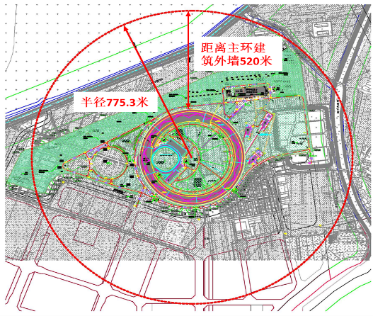
3. 减隔振思路
振动源
根据振动来源分：凡知道来源的振动均做减隔振处理
地脉动
交通载荷
等外部振源
内部振源
隔振
远离
减振
控规：使振源远离关键设备，使振动通过经过长距离衰减达到限制要求
振源与减振弹簧的频率相差3-5倍达到减振的目的
与周边土的剪切波速差距2-3倍，使周边振动反射
怀柔规划新建城铁与项目安全距离
Courtesy of Max-IV

Slide 15
3. 减隔振思路
振动源
根据振动频率分
远小于0.1Hz
<0.1Hz
0.1-3Hz
4-30Hz
30-100Hz
100-1000Hz
昼夜温差别引起的形变：慢反馈
交通载荷、人文噪声
隧道内设备、动力设备等
真空管道
地脉动
温度大幅度变化引起的形变：
重新准直、RF FB
已知振源能/未能有效减振的、未知振源等
均通过快慢结合的快轨道反馈 （FOFB）解决

Slide 16
谢谢大家！

