Slide 1
Ground vibration tolerance for CEPC booster
Dou Wang, Daheng Ji
2020.03.03

Slide 2
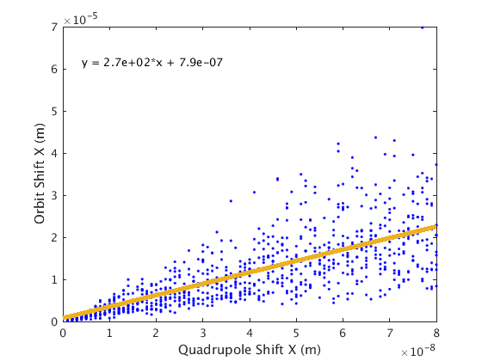
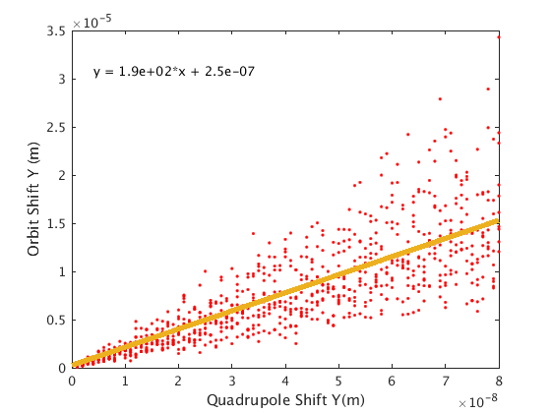
Orbit sensitivity with quadrupole displacement
Amplification factor： ~300(H)/200(V)

Slide 3
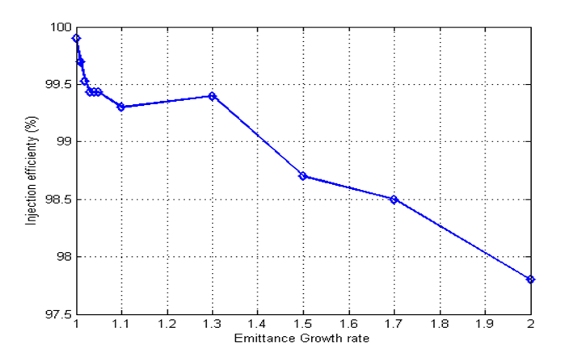
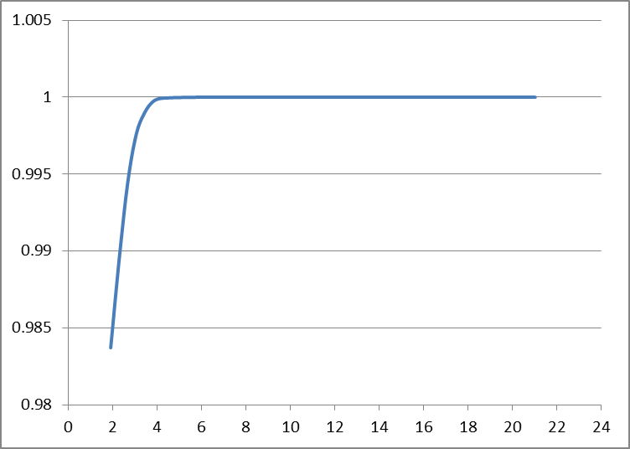
Tolerance for orbit jitter
10 GeV
120GeV
Orbit < 3mm
Orbit < 30um

Slide 4
Tolerance for ground vibration
Vibrations with RMS displacement integration of 150nm
RMS displacement < 10nm higher than 1Hz

