Slide 1
CEPC alignment precision Wang xiaolong 2020.3.3

Slide 2
Outline
CEPC alignment precision requirement
Alignment control network
Component fiducialization
Component pre-alignment
Tunnel installation alignment
Alignment environment requirement

Slide 3
Component alignment precision requirement
Provide by physics group
Component | Transversal/mm | Vertical/mm | Longitudinal/mm | Pitch /mrad | Yaw /mrad | Roll /mrad
Arc Dipole | 0.1 | 0.1 | 0.1 | 0.1 | 0.1 | 0.1
Arc Quadrupole | 0.1 | 0.1 | 0.1 | 0.1 | 0.1 | 0.1
Arc Sextupole | 0.1 | 0.1 | 0.1 | 0.1 | 0.1 | 0.1
IR Quadrupole | 0.05 | 0.05 | 0.05 | 0.05 | 0.05 | 0.05
IR SCQ | 0.05 | 0.05 | 0.05 | 0.05 | 0.05 | 0.05
IR Sextupole | 0.05 | 0.05 | 0.05 | 0.05 | 0.05 | 0.05
RF、injection、Linac alignment requirement reference to the arc region components
Error sources
Alignment control network error
Component fiducialization pre-alignment error
Field measurement error
Installation adjustment error

Slide 4
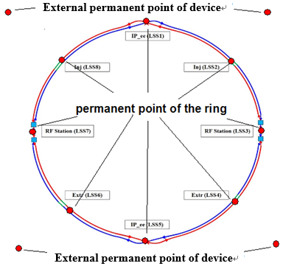
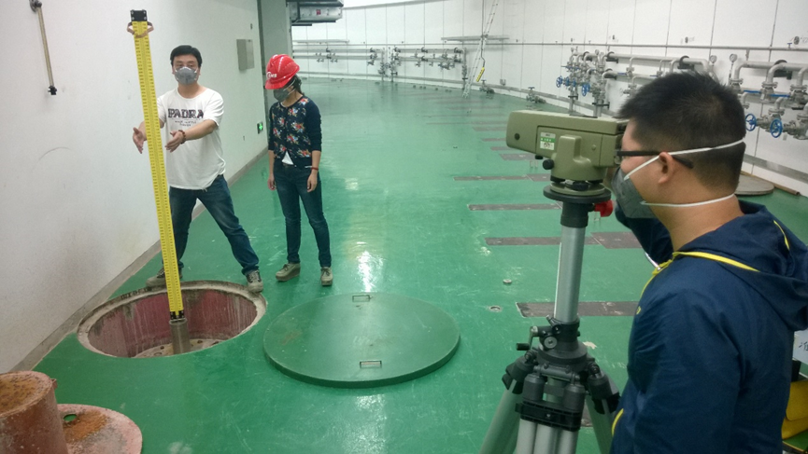
Alignment control network
Control network：provide an unified location reference frame for CEPC alignment and control the error accumulation of survey and alignment；
3 levels control network
Surface control network
Backbone control network
Tunnel control network
Surface control network
CEPC global absolute position & shape control, high precision constraint datum for tunnel control network.
Composed of 14 permanent points
10 internal points are in CEPC tunnel, a part of the tunnel control network.

Slide 5
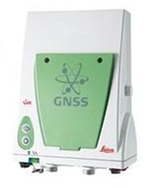
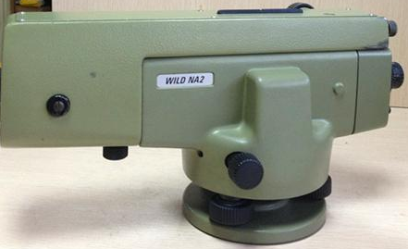
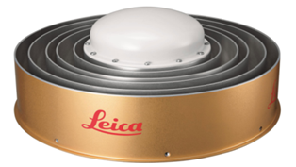
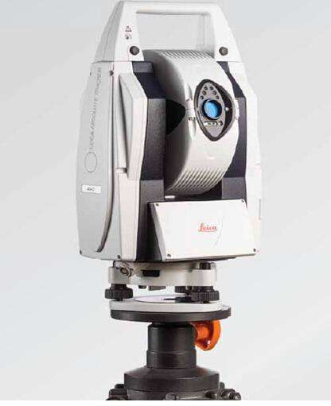
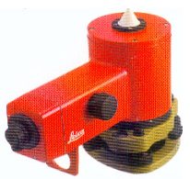
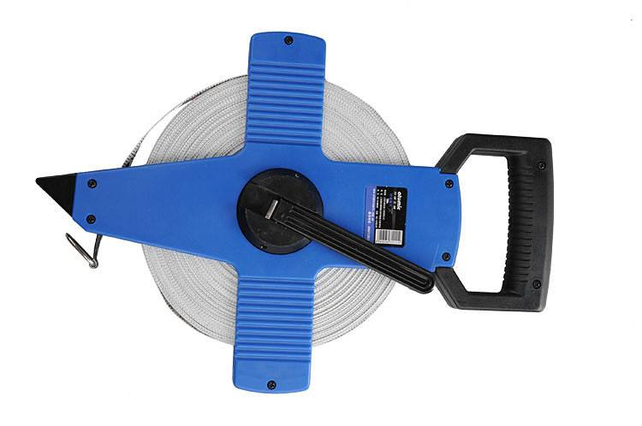
Instruments
水平：3mm+0.5ppm
垂直：6mm+0.5ppm
每公里往返精度：±0.2mm
LEICA GS10
AR20
+ LGO
LEICA NA2 + EpsNas
LEICA Wild NL
Tape
1:200000
LEICA AT403
点位测量精度：±15 µm + 6 µm/m

Slide 6
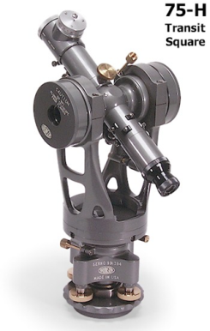
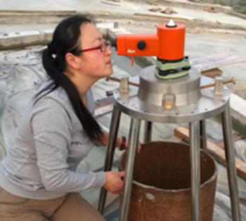
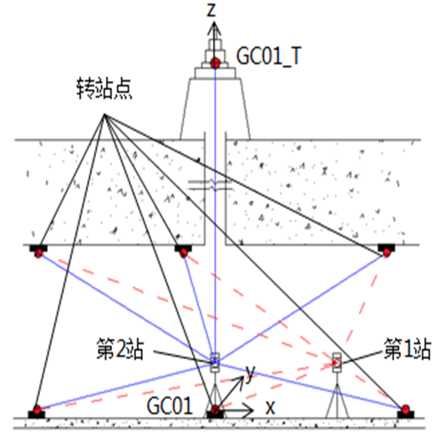
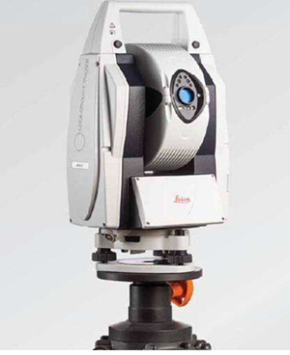
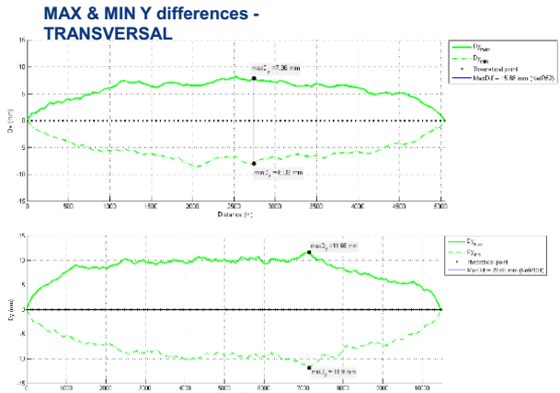
Surface control network measurement
Plumbing point
Instrument height measurement
GNSS measurement
Level measurement
Best-fit,GNSS to level,establish CEPC coordinate system。
Control point accuracy：10mm；
Check measurement：
Total station,auxiliary control network,check the base lines
Tunnel control network accuracy is related to the distance between the adjacent permanent points.CERN simulation result shows 8mm for 5km and 12mm for 10km.

Slide 7
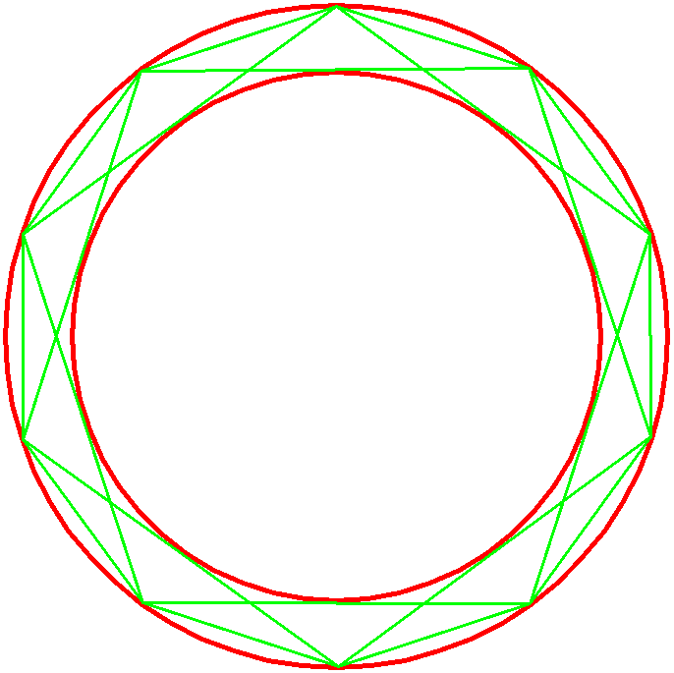
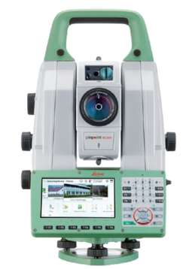
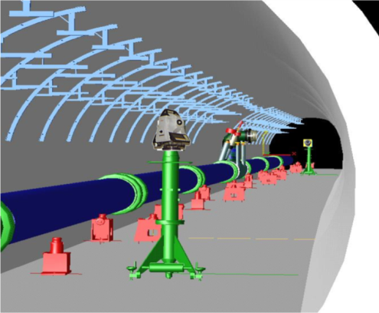
Backbone control network
Strengthen the tunnel control network，reduce error accumulation.
Straight line triangulation network，short line 300m，long line 600m.
徕卡TS60
测量范围:1.5m~>3500m
点位测量精度：0.6mm+ 1ppm
测角精度：0.5’’
Simulation
Use surface control network as known point to constrain backbone control network adjust.
Simulation condition: angle 1 sec.distance 1mm+1ppm，station 42
The biggest error between adjacent permanent points is 8mm.

Slide 8
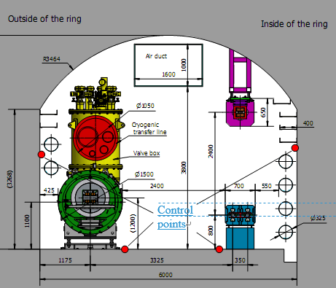
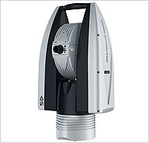
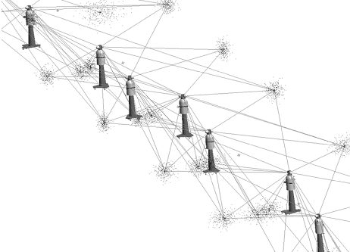
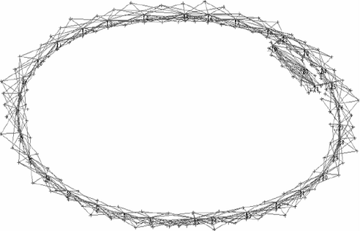
Tunnel control network
Provide position reference for component installation & alignment
tunnel control network along CEPC tunnel will be evenly distributed with an interval of 6 meters .
4 control points each section.
Instruments：laser tracker &level
Tunnel control network measurement
Laser tracker measurement
徕卡AT960
powerlock：自动锁定靶球
数据采集速率：1000点/秒
AIFM:绝对测距
角度精度：15 µm + 6 µm/m
距离精度：0.5µm/m
动态锁定：10µm

Slide 9
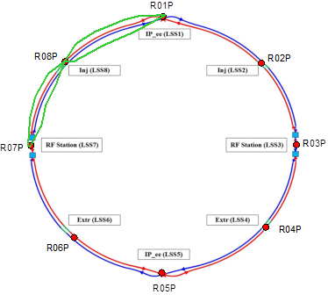
Tunnel control network
Level measurement
Level route：adopt subsection round trip measurement , 4 quadrants , each quadrant measure one closed route. Linac and BT is one route。
Front and back sight distance is both 18m。
Secondary leveling specification
水准路线长度 | 109550 X2米=219公里
测量效率 | 2公里/1组/天
4组共需 | 28天
测段往返差 | 每千米偶然中误差
mm | 1mm

Slide 10
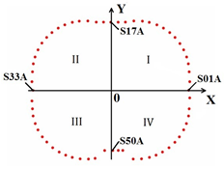
Tunnel control network
Tunnel control network precision
BEPCII SR 237.53m ，control point precision is better than 0.08mm.(2006,2008,2010,2012)
CSNS RCS 240m，RMS precision is 0.07mm.
CEPC RMS precision is 0.07mm.
BEPCII

Slide 11
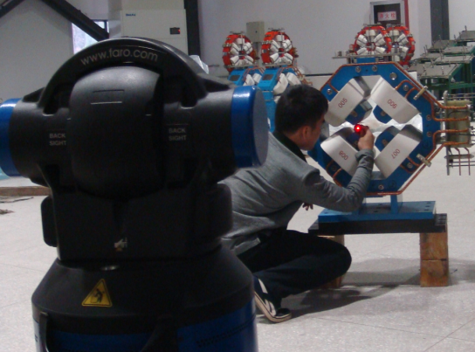
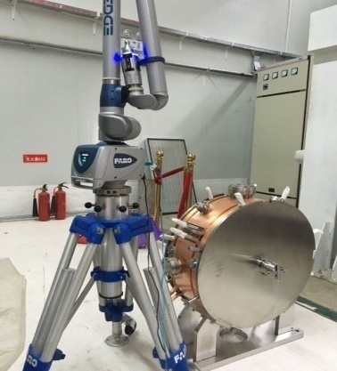
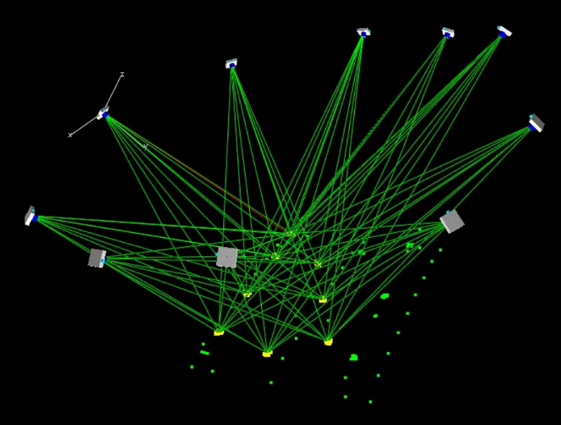
Component fiducialization
Component fiducialization is to draw the beam center to its fiducials, then the fiducials coordinates can be transferred to CEPC global coordinate system and used for component tunnel alignment
Geometric measurement：laser tracker、 Articulated arm 、CMM、photogrammetry
Magnetic field measurement：rotate coil、vibrating wire
Non-contact measurement：level, transit square
Attitude measurement： electronic gradienter
Camera
测量臂
范围：0~4m
精度：±0.023~ ±0.1mm
摄影测量

Slide 12
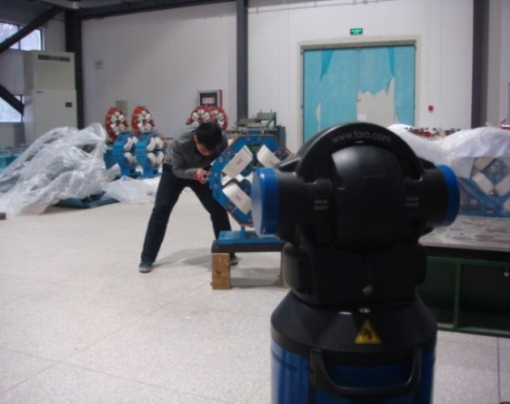
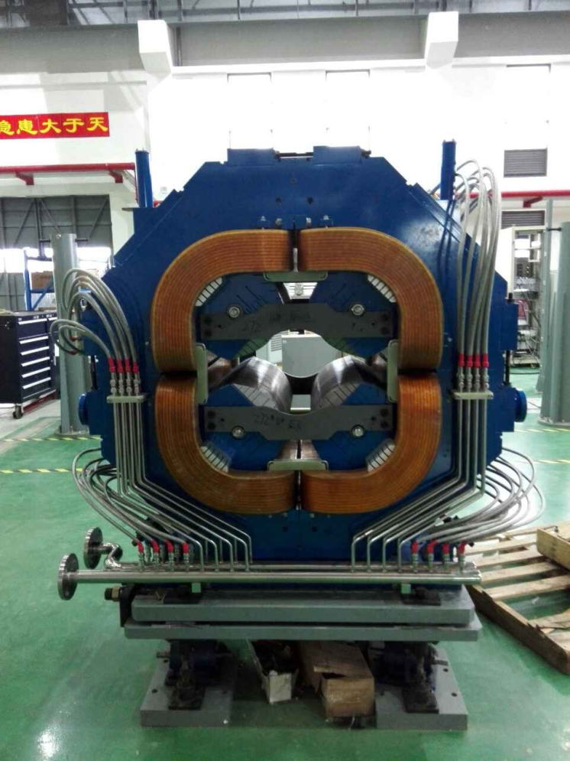
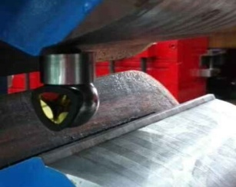
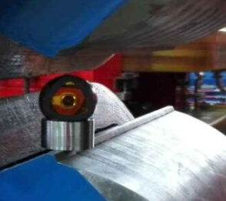
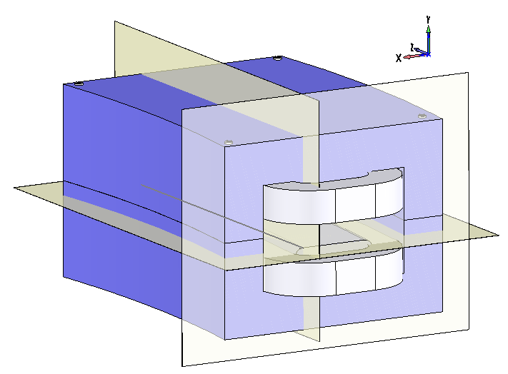
Component fiducialization
Mechanical center extraction fiducialization accuracy is limited to component fabrication accuracy and consistency accuracy of mechanical center and magnetic center.
Y
X
Transversal /mm | Vertical /mm | Longitudinal /mm
0.05 | 0.05 | 0.08-0.15
Dipole Magnet
Fiducialization Datum Planes

Slide 13
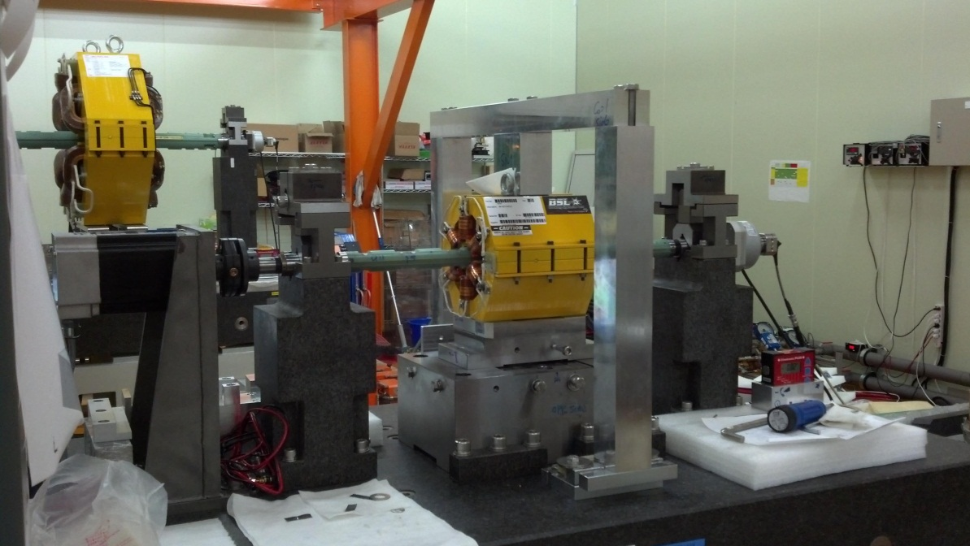
Component fiducialization
Magnetic center extraction fiducialization accuracy is limited to component fabrication accuracy and rotate center measurement accuracy.
Rotate coil：micron level precision
Cooperate with CMM
Transversal /mm | Vertical /mm | Longitudinal /mm
0.014 | 0.014 | 0.05

Slide 14
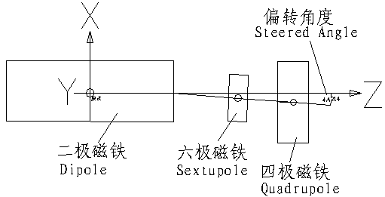
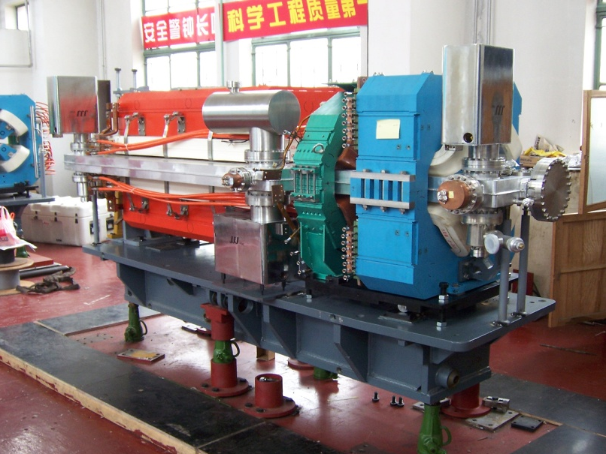
Pre-alignment
Components on the same girder are aligned in advance.
The girder can be aligned as one unit in tunnel。
Can get higher alignment accuracy of the components on one girder.
Can save tunnel installation time.
XX=-(LMB+Z) sin(θB/2)+X cos(θB/2) + XBE
YY=Y
ZZ=(LMB+Z) cos(θB/2)+X sin(θB/2) + ZBE

Slide 15
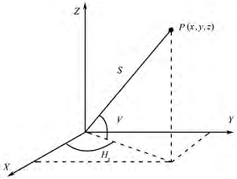
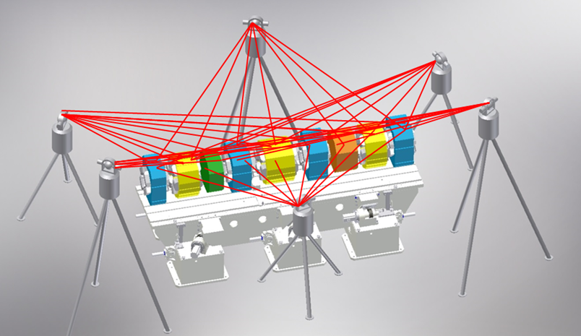
Pre-alignment—Laser tracker
激光跟踪仪
Pre-alignment cell
It is desirable to make geodesic sites on all magnets at the same height.

Slide 16
Pre-alignment
Laser tracker pre-alignment accuracy | Items related to accuracy | Error estimation /mm
0.082mm | Component fiducialization | 0.05
 | Offset of adjustment and fix | 0.05
 | Measurement of laser tracker | 0.035
 | Deviation caused by component re-assembly | 0.010
 | Deviation caused by transportation | 0.02

Slide 17
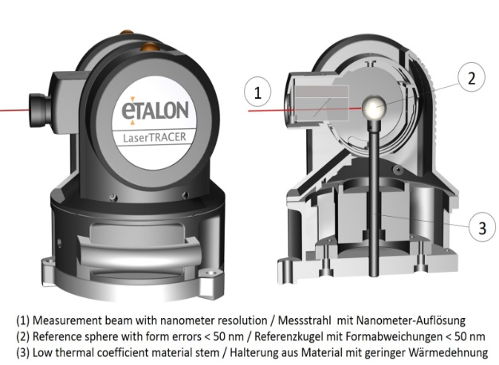
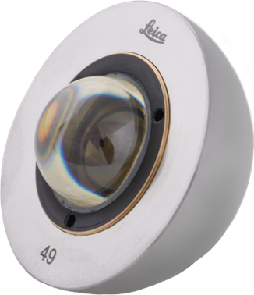
Pre-alignment—Laser tracer
预期实现7μm点位测量精度
精度：0.2μm+0.3μm/m
多路激光测距，交汇测量点空间三维坐标
三个7m*7m 工位, 高度4.3m

Slide 18
Pre-alignment
Laser tracer pre-alignment accuracy | Items related to accuracy | Error estimation /mm
0.075mm | Component fiducialization | 0.05
 | Offset of adjustment and fix | 0.05
 | Measurement of laser tracer | 0.007
 | Deviation caused by component re-assembly | 0.010
 | Deviation caused by transportation | 0.02

Slide 19
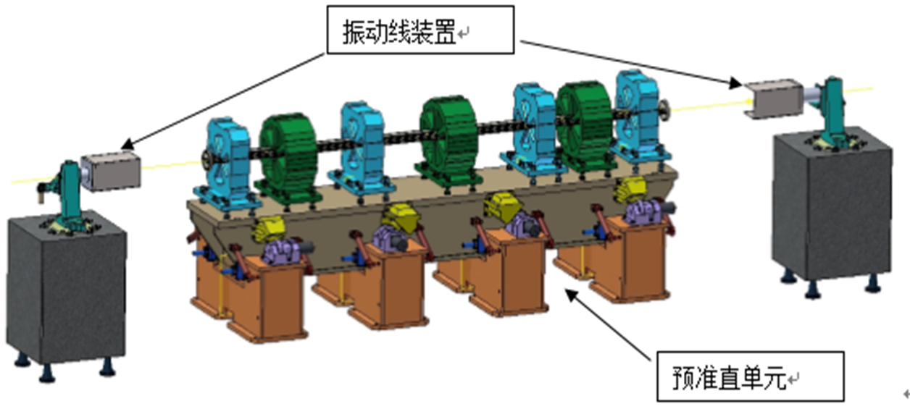
pre-alignment-Vibrating wire
Measure each component magnetic center
Adjust every component to the center line
measure the position relation of wire and fiducials with WPS and laser tracker
The error of scanning the magnetic center is better than 10 microns
The error of measuring the wire position is 6 microns
Vibrating wire system
Pre-alignment cell

Slide 20
pre-alignment accuracy
Vibrating wire system | Items related to accuracy | Error estimation /mm
0.066mm | Vibrating wire measurement | 0.010
 | Offset of adjustment and fix | 0.05
 | WPS measurement | 0.006
 | Measurement of fiducials | 0.035
 | Deviation caused by component re-assembly | 0.01
 | Deviation caused by transportation | 0.02
The error of components

Slide 21
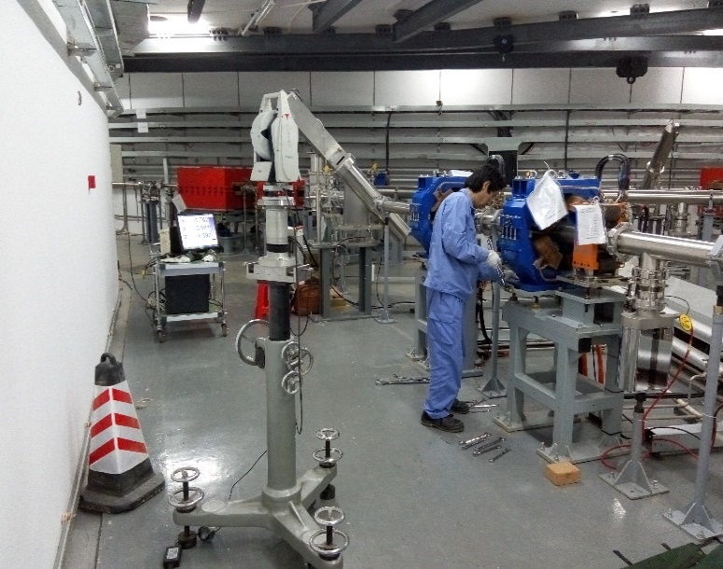
Tunnel installation alignment
Use tunnel control network and laser trackers to perform tunnel components alignment.
Measure the tunnel control network and through best-fit to determine the laser tracker position in CEPC global coordinate system.
Using laser tracker measure the component fiducial points to obtain the component position.
Adjust the component to the required tolerance.
Fiducialization /mm | Control network /mm | Measurement /mm | Adjustment & fix /mm | Totall /mm
0.05-0.15 | 0.07 | 0.05 | 0.05 | 0.11—0.18

Slide 22
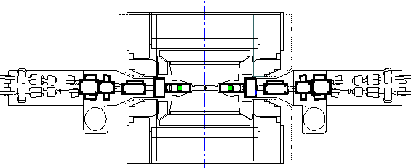
MDI alignment
Laser tracker and control network rough alignment
Laser-based alignment system
set laser-based alignment system beside the detector
Use laser tracker and control network align the laser-based alignment system parallel with the beam
Use laser-based alignment system as a reference align components to the designed position.
Laser-based alignment system precision:30m offset 0.02mm
激光准直系统
跟踪仪

Slide 23
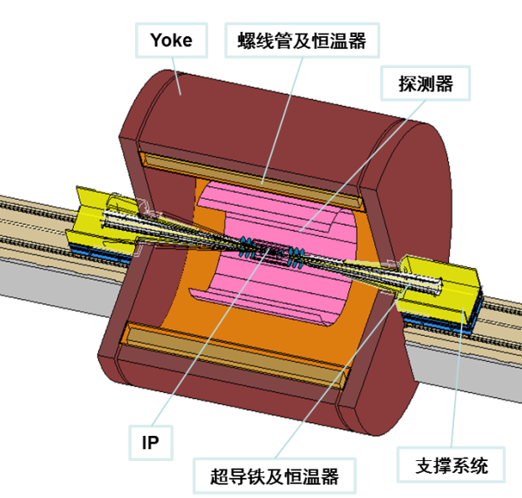
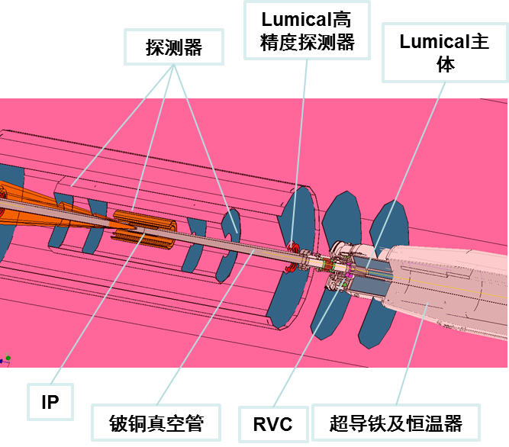
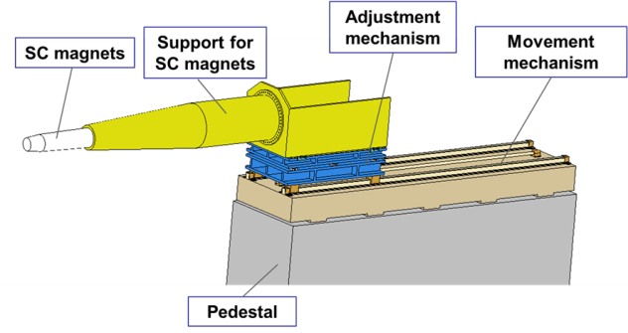
MDI alignment
SM and Cryomodule will be inserted into detector, fiducials exposed outside are too few to effectively control the component .
Need to research an inner measurement system to monitor SM and detector position relation.

Slide 24
Alignment environment requirement
Fiducialization & pr-alignment
隔振：独立隔振地基，（1）在频域1Hz~100Hz内，振动速度要求低到12μm/s以下。（2）振动频率在1~100Hz的水平和垂直振动，在1秒内的均方根振幅均小于25nm。
温度：波动度±0.1℃，全场均匀度1℃，调节范围18℃~26℃，且在调节范围下均需满足波动度和均匀度要求；
湿度：湿度调节范围30%-60% (%RH) ，湿度波动度±5% (%RH) 。
风速：距地面1.2m工作面风速≤0.3m/s；
噪音：室内噪音≤60dB；
GB51076-2015电子工业防微振工程技术规范
中国计量科学研究院精密测量实验室的建设标准
HEPS
NSLS-II

Slide 25
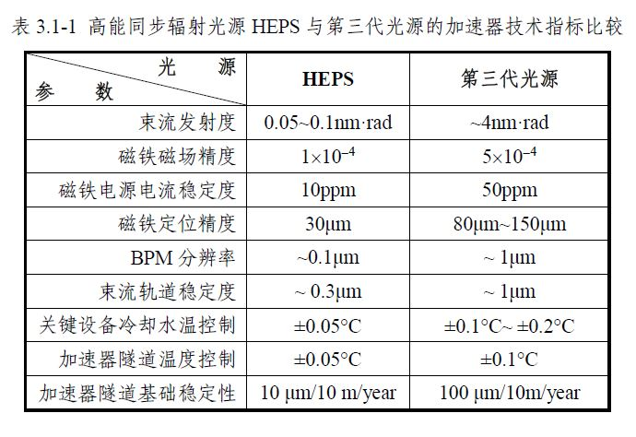
Alignment environment requirement
Tunnel alignment
直线、环隧道地面平整度：任意2米范围内，高差不超过1毫米。
地面不均匀沉降：要求小于10微米/10米/年。
隧道温度波动度要求小于±0.1℃
风速：工作区域风速≤0.3m/s；

Slide 26
Thank You !

