Slide 1
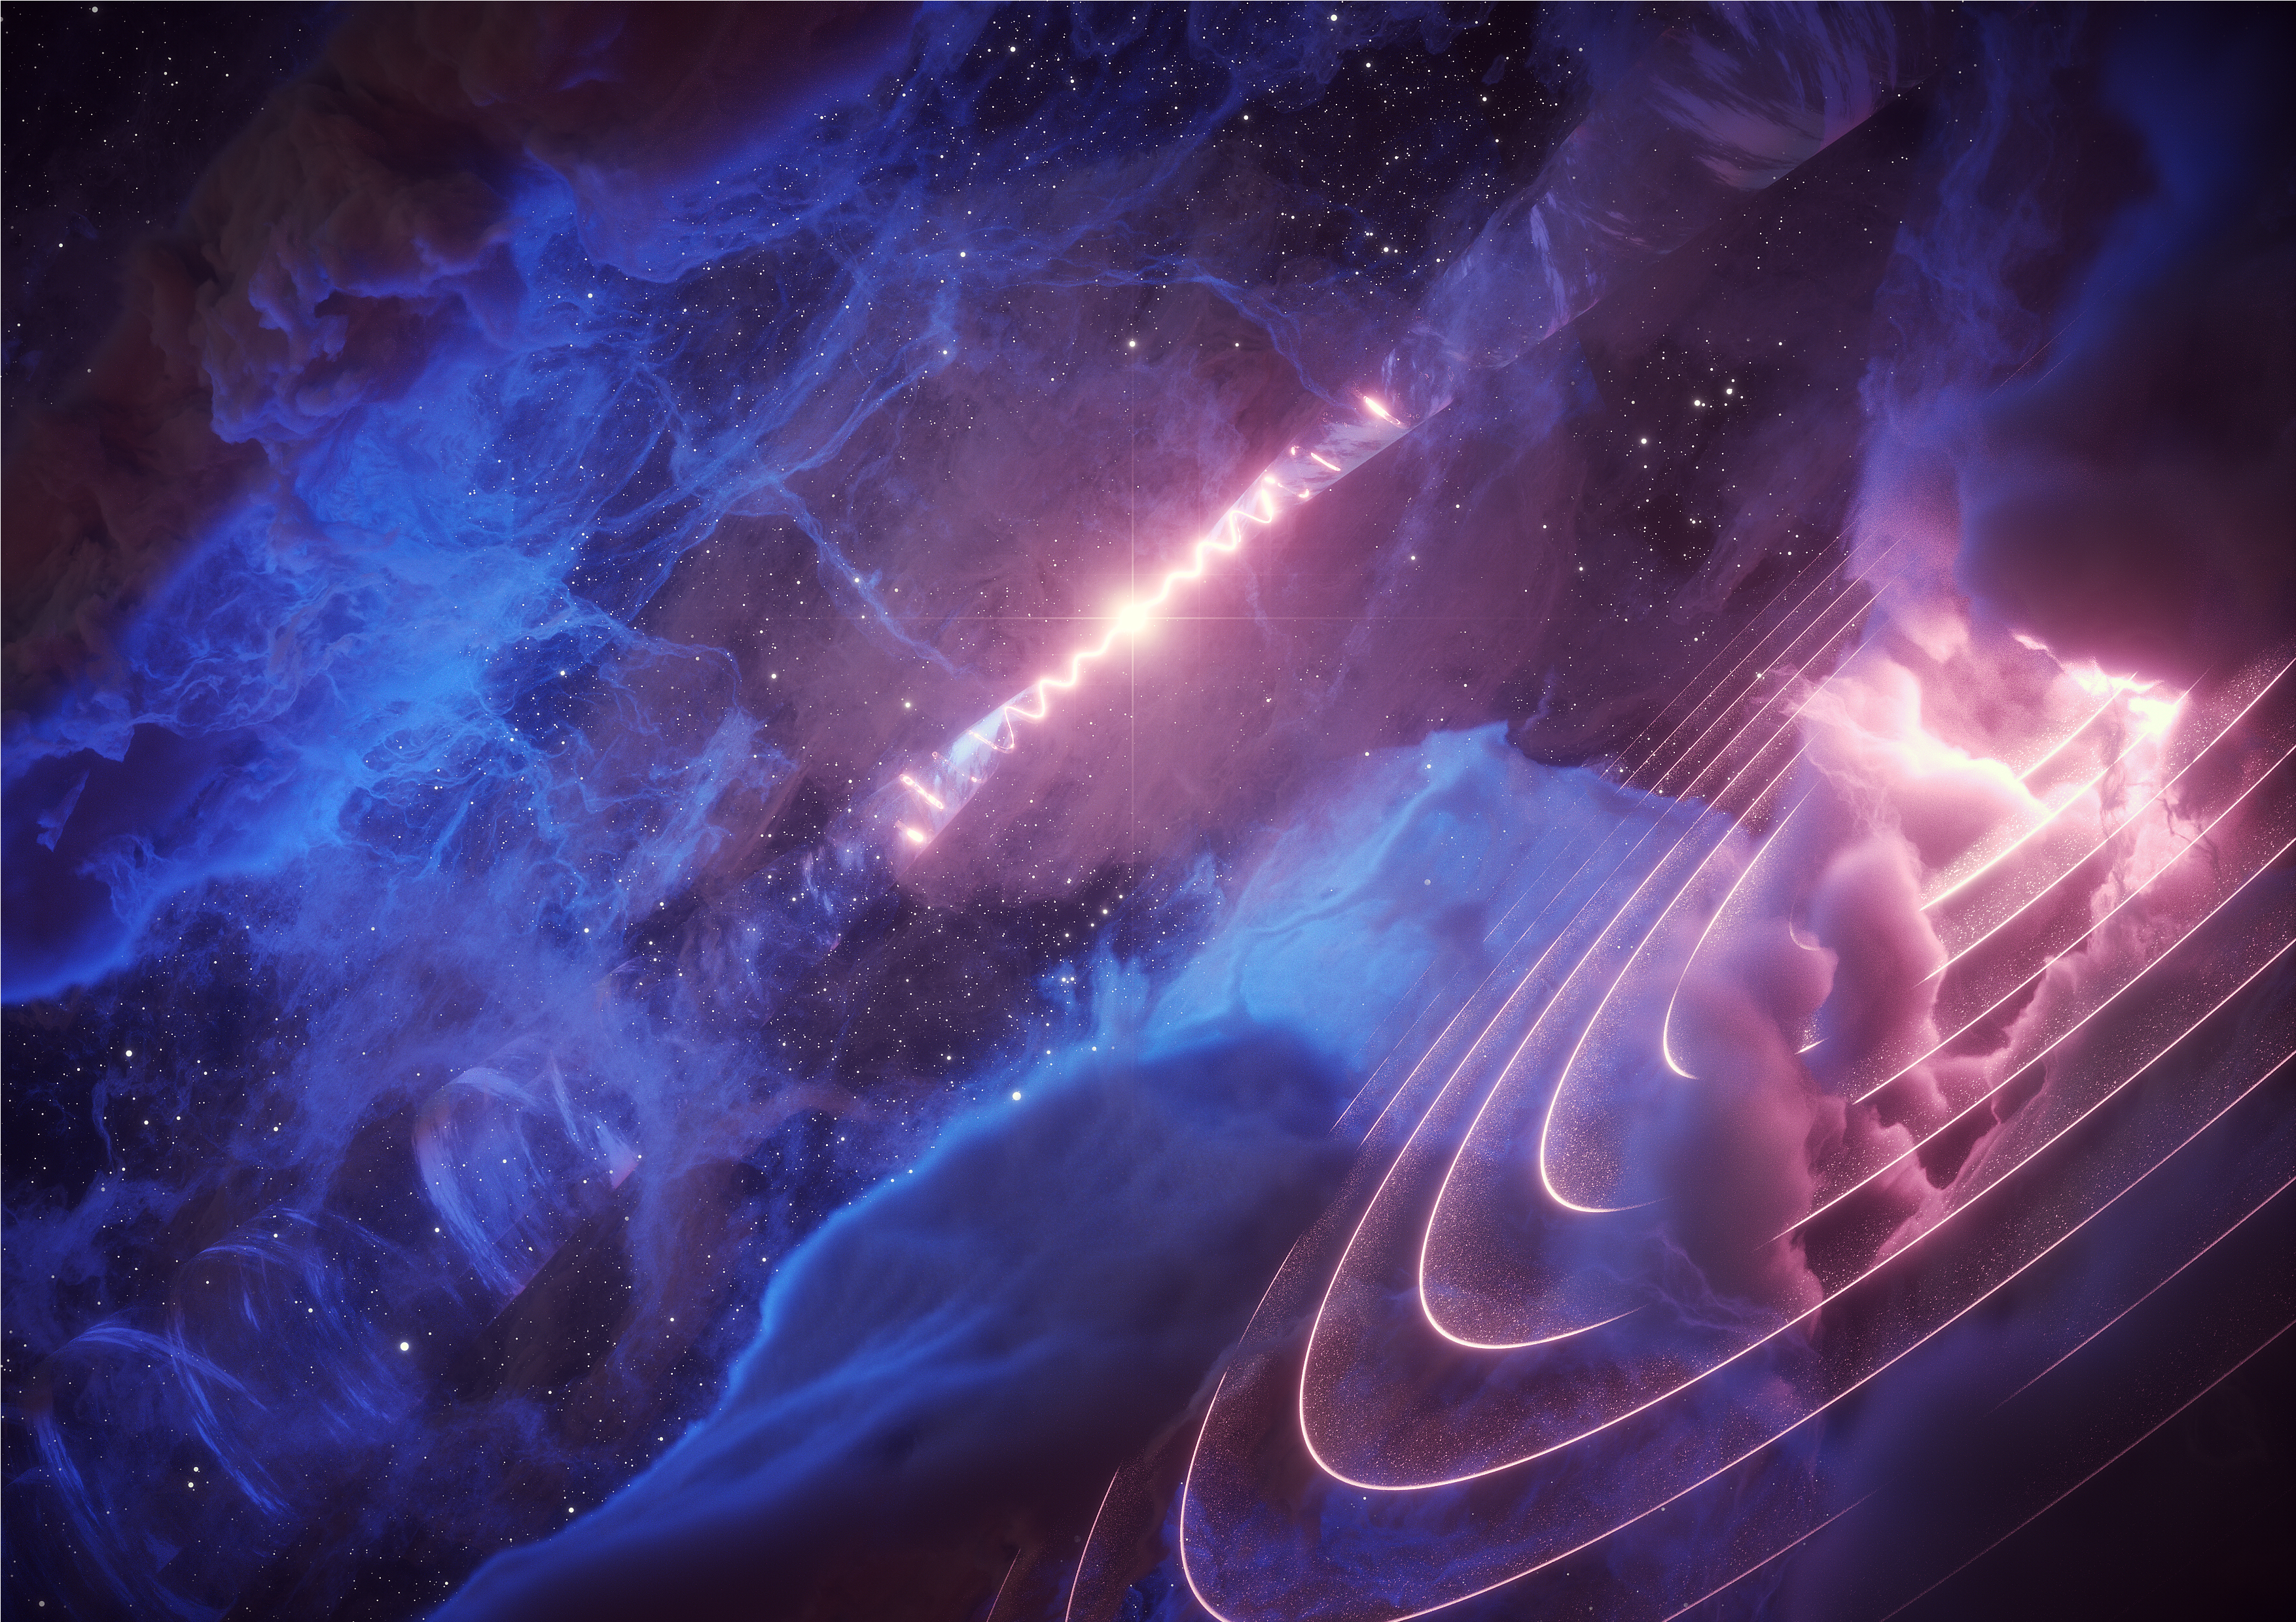
LHAASO observation of the microquasar SS 433 region
李剑
中国科学技术大学
In collaboration with
陈松战、杨睿智、柳若愚 et al.
Illustration credit: DESY/Science Communication Lab

Slide 2

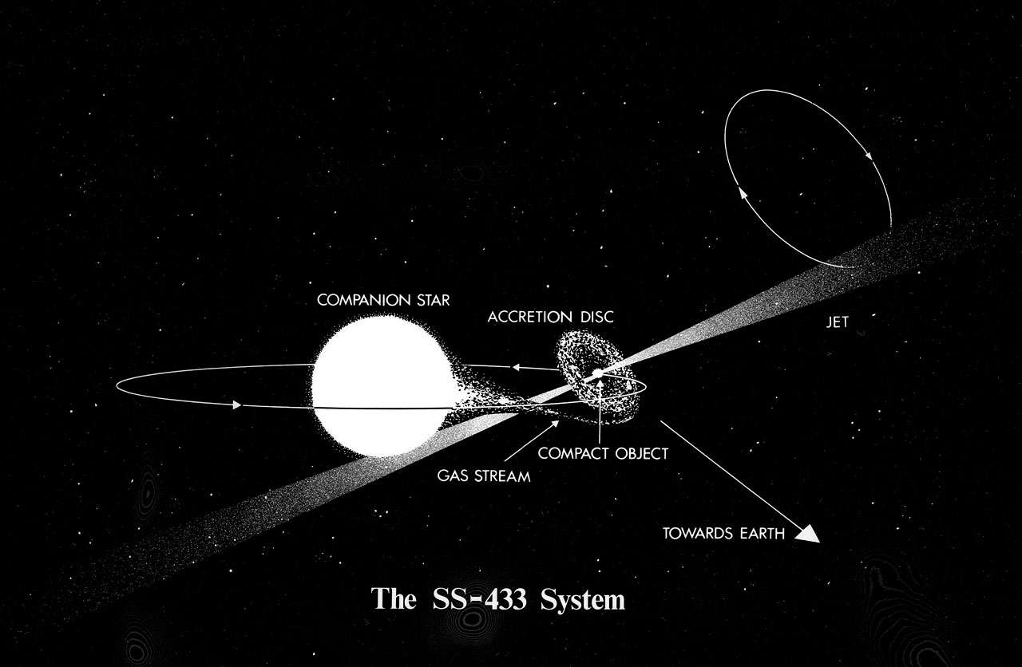
SS 433: A very powerful Galactic microquasar
SS 433 is a unique galactic accreting microquasar with mildly relativistic (v =0.26c), precessing jets located at a distance of 4.6 kpc
It is composed by a compact object (10-20 M_{sun} black hole) and a 30 M_{sun} A7Ib supergiant star.
The system exhibits photometric and spectral periodicities related to precession (~162.5 days) and orbital (13.082 days) period
2

Slide 3
SS 433: X-ray and TeV emission from jet termination lobe
. Dubner et al. 1998.
HAWC ~20 TeV
ROSAT 0.9-2 keV
Abeysekara et al. 2018, Nature
3

Slide 4
SS 433 in multi-TeV photons (detected by HAWC)
Fermi/LAT
LHAASO
Abeysekara et al. 2018, nature
4

Slide 5
SS 433 in GeV: the first reliable map of the source
White contour is Effelsberg 11cm radio continuum (2695 MHz) while cyan contour is X-ray ROSAT observation in 0.9-2 keV.
Two regions of TS excesses are apparent in the map.
The west excess location is consistent with the one found in X-rays. Not the east one.
E | W
Li et al. 2020, NatAs, 4. 1177
TS map (0.1-300 GeV, off peak phase of PSR J1907+0602)
5

Slide 6
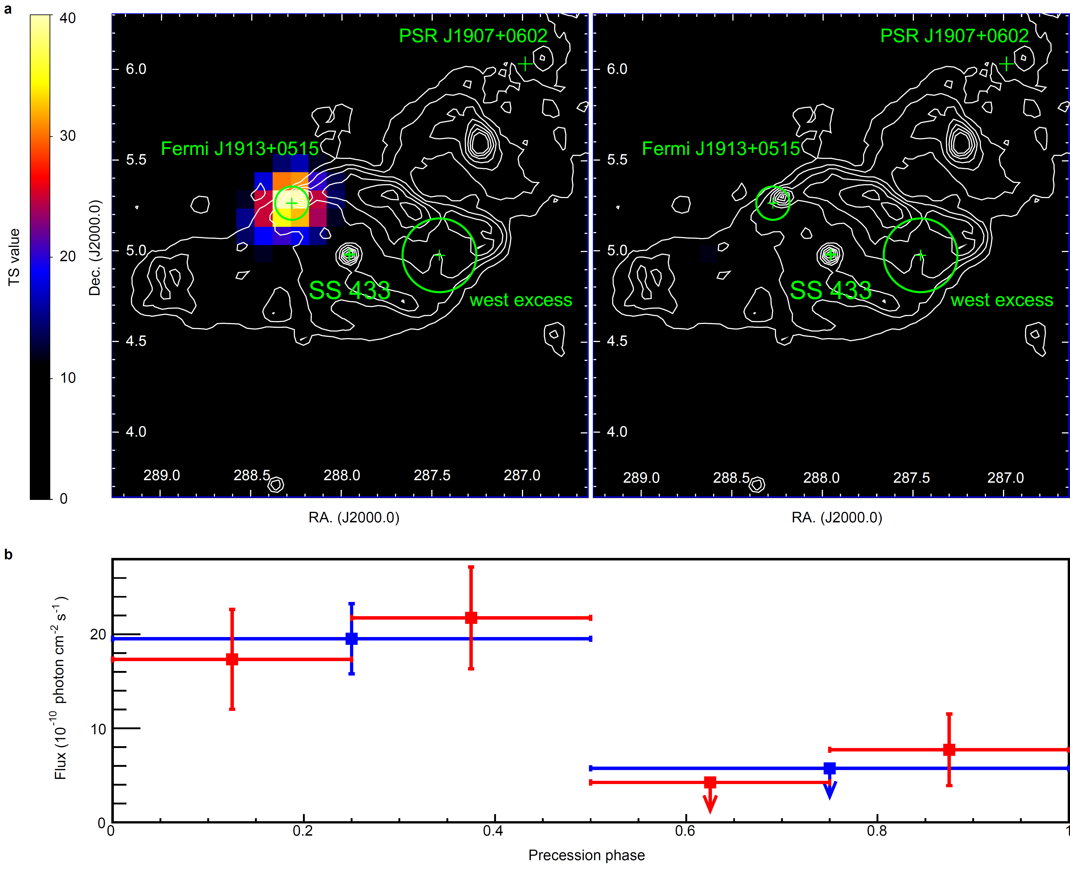
The periodicity hint is confirmed by likelihood analysis
Precession phase 0.0-0.5
TS=39 (5.9σ)
Precession phase 0.5-1.0
TS= 3 (1σ)
Flux change at 4.2 σ level
Li et al. 2020, NatAs, 4. 1177
6

Slide 7
Dark area, only notable thing at the location of the excess is a cloud
Su et al. (2018) reported atomic HI clouds associated with SS 433.
One such cloud (R~15 pc size, <n>~22 cm⁻³, M~25000 Solar Masses) positionally coincides with the GeV excess.
Arecibo HI emission integrated in the interval 65-82 km s⁻¹.
7

Slide 8
SS 433 in GeV: molecular clouds in the center of gamma-ray excess
IRAM 30m telescope ¹²CO (1-0) and ¹²CO (2-1) map in 70-73 km/s
(the distance is consistent with SS 433, 11 arcsec, ~0.25pc)
8

Slide 9
SS 433 in GeV: molecular clouds in the center of gamma-ray excess
Large Millimeter Telescope (LMT, 50m) 2 hours observations have been approved with grade A (6.5 arcsec, ~0.14pc).
(But to prove our model, we may need ALMA with a resolution of 1arcsec or less)
Chandra 50ks observation has been approved in this cycle.
9

Slide 10
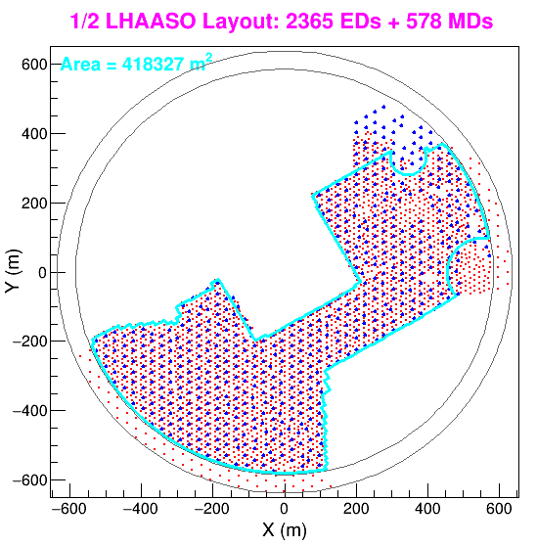
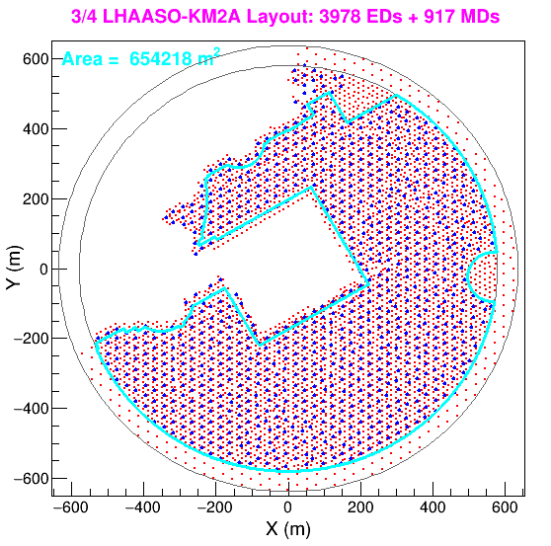
Data for Map
SS 433 with LHAASO/KM2A
From 2019-12-27 to 2021-07-20
2019-12-27→2020-11-30
2020-12-01 → 2021-07-19
10

Slide 11
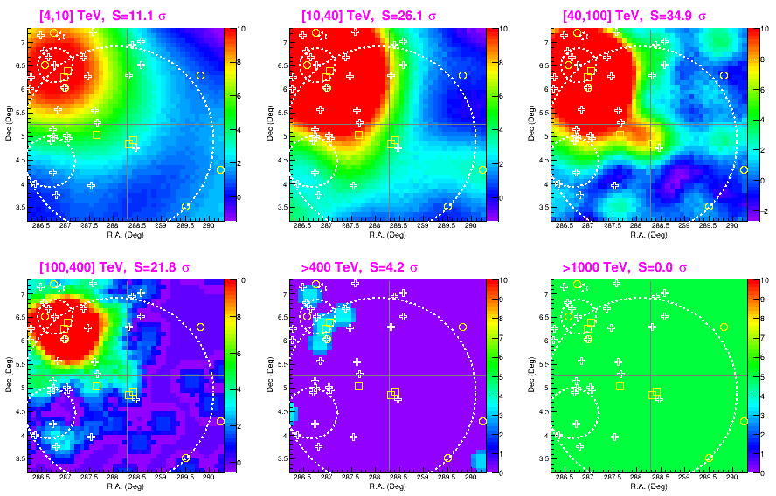
SS 433 with LHAASO/KM2A
SS 433 region in different energy range.
The center is the position of Fermi J1913+0515.

Slide 12
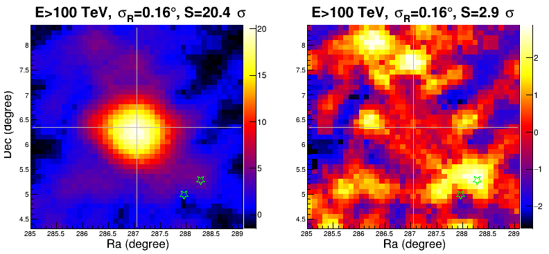
SS 433 with LHAASO/KM2A
E>100 TeV, MGRO J1908+06 modelled (right) and not (left)
Stars are the e1 and w1 of SS 433 (HAWC detection)

Slide 13
SS 433 with LHAASO/KM2A
Fermi/LAT TS map in 0.1- 300GeV (top) and KM2A significance map in 40-100 TeV (bottom)
MGRO J1908+06 has already been modelled in LHAASO data

Slide 14
SS 433 with LHAASO/KM2A
KM2A significance map in 40-100 TeV (top) and HI map (bottom)

Slide 15
SS 433 with LHAASO/KM2A
To test the periodicity, we extracted photons above 40 TeV within 0.5 degree of Fermi J1913+0515.

Slide 16
SS 433 with LHAASO/KM2A
No significant modulation could be detected yet.
LAT result for comparison

Slide 17
SS 433 with LHAASO/KM2A
Next step
Waiting for more data, of course.
Source localization and position uncertainty.
Point source vs extended source?
What is the nature of the source? Multi-wavelength identification

Slide 18
Updates on TeV pulsar search (Jian Li & Xian Hou):
Pipeline decided with Tempo2
Pulsation from Crab still around 2 sigma (WCDA 1, 2019-09---2020-10)
3. Detailed simulation is under production to estimate how much data we need to detect the significant pulsation from Crab.
4. Building ephemerides of other bright gamma-ray pulsars for searches.

Slide 19

Thank you!
jianli@ustc.edu.cn
19

Slide 20
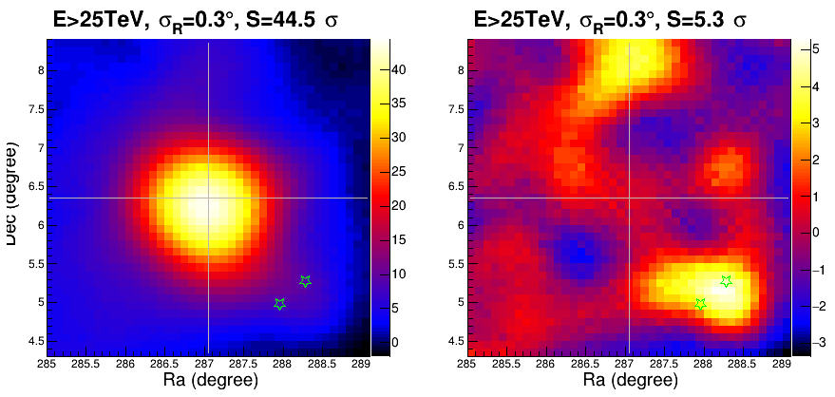
SS 433 with LHAASO/KM2A
E>25 TeV, MGRO J1908+06 modelled (right) and not (left)
Stars are the e1 and w1 of SS 433 (HAWC detection)

Slide 21
Back up slides

Slide 22
LHAASO observation of SS 433 region above 100 TeV
Because of the strong contamination from nearby MGRO J1908+06, we could not clearly distinguish SS 433 and MGRO J1908+06 below 100 TeV.
LHAASO/KM2A significance map of SS 433 region above 100 TeV
The gamma-ray excess is above 4.2 sigma
22

Slide 23
LHAASO observation of SS 433 region above 100 TeV
Compare to HI atomic cloud
23

Slide 24
LHAASO observation of SS 433 region above 100 TeV
Because of the strong contamination from nearby MGRO J1908+06, we could not clearly distinguish SS 433 and MGRO J1908+06 below 100 TeV.
LHAASO/KM2A significance map of SS 433 region above 100 TeV
The gamma-ray excess is above 4.2 sigma
24

Slide 25
LHAASO observation of SS 433 region above 100 TeV
We also test if there is periodic flux variation related to the jet precession of 162.25 days (0.5 degree of KM2A data).
a hint of peaking at precession phase 0.0-0.25, but the significance is too low (~1 sigma)
More observation time is needed.
> 40 TeV
> 100 TeV
25

Slide 26
Next step
Explore the gamma-ray excess associated with Fermi J1913+0515
Flux upper limits of SS 433 jet lobs with MGRO J1908+06 modelled
26

Slide 27
Next step
Flux upper limits of SS 433 jet lobs with MGRO J1908+06 modelled
Fermi/LAT
LHAASO
27

Slide 28
Next step
Explore the gamma-ray excess associated with Fermi J1913+0515
Flux upper limits of SS 433 jet lobs with MGRO J1908+06 modelled
MORE DATA !
28

Slide 29
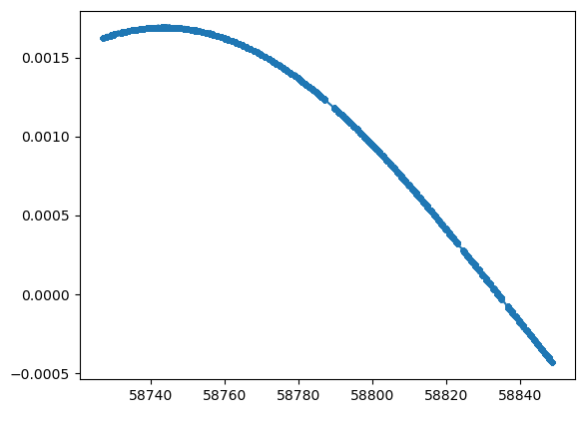
LHAASO 搜寻TeV脉冲星进展 （李剑 侯贤）
已经建立全部软件流程
（1）LHAASO光子的太阳系质心修正
我们测试了两种方案，python和tempo2。经过比较，我们发现Python程序的太阳系质心修正与tempo2相比，存在一个周期性系统偏差，量级在3个milisecond。应该是Python程序里缺少了某个修正项。
Tempo2 和python 结果的差值 （s）
MJD （days）

Slide 30
LHAASO 搜寻TeV脉冲星进展 （李剑 侯贤）
已经建立全部软件流程
（2）脉冲星星历的获取（射电/Fermi）
（3）LHAASO光子的脉冲折叠
（4）脉冲显著性估计
我们用LHAASO/WCDA和KM2A对Crab的观测进行了测试，程序运行流畅
在0.1 度范围内，2-4TeV能量范围内，我们探测到一些脉冲迹象，但是显著性太低，只有不到2 sigma，主要原因还是观测时间太短，背景太高
下一步：
（1）测试其他脉冲星 （2）测试更多数据 （3）脉冲星能谱的叠加分析

Slide 31
number 1 detector array, data from 2019 Sept to 2020 Sept

Slide 33
Surprising signal
Fermi J1913+0515
We produced weighted light curves above 1 GeV with a bin of 1 days and searched using Lomb Scargle periodogram.
A relevant hint for a period signal at 160.88+/-2.66 days is detected from the east side excess (J1913) with a single frequency significance of 3.5σ, which is consistent with the jet precession period of 162.25 days.
Neither the west excess nor other sources in the vicinity show the same periodicity.
West excess
PSR J907+0602
33

Slide 34
Questions
Detecting a periodicity from the source is actually something expected and predicted, since the precession period itself is long-known.
But why the location of the source does not match SS 443 or the jets?
What is the origin of the periodicity detected?
34

Slide 35
If at the center… we could have understood it…
A periodicity was indeed predicted (Reynoso et al. 2008), as caused by gamma-gamma absorption between GeV and X-ray photons.
However, all of this supposed to happen at the very base of the jet, at very high ambient densities so that photon interactions can proceed
This is very far from the position of our detected signal.
35

Slide 36
SS 433 in GeV: is the cloud illuminated by the jets?
If so.. Perhaps a periodic particle injection leads to a periodic emission.
However, the motion of SS 433 jet is helical and coherence of the radio jet only appears to be sustained in the arcsecond.
Radio image of SS 433 in 4.85 GHz (Blundell et al. 2004)
Monceaux-Baroux et al. 2015
Simulations also show that the jet loses the helical morphology after ~4 precession cycles, because of interaction with the surrounding medium
36

Slide 37
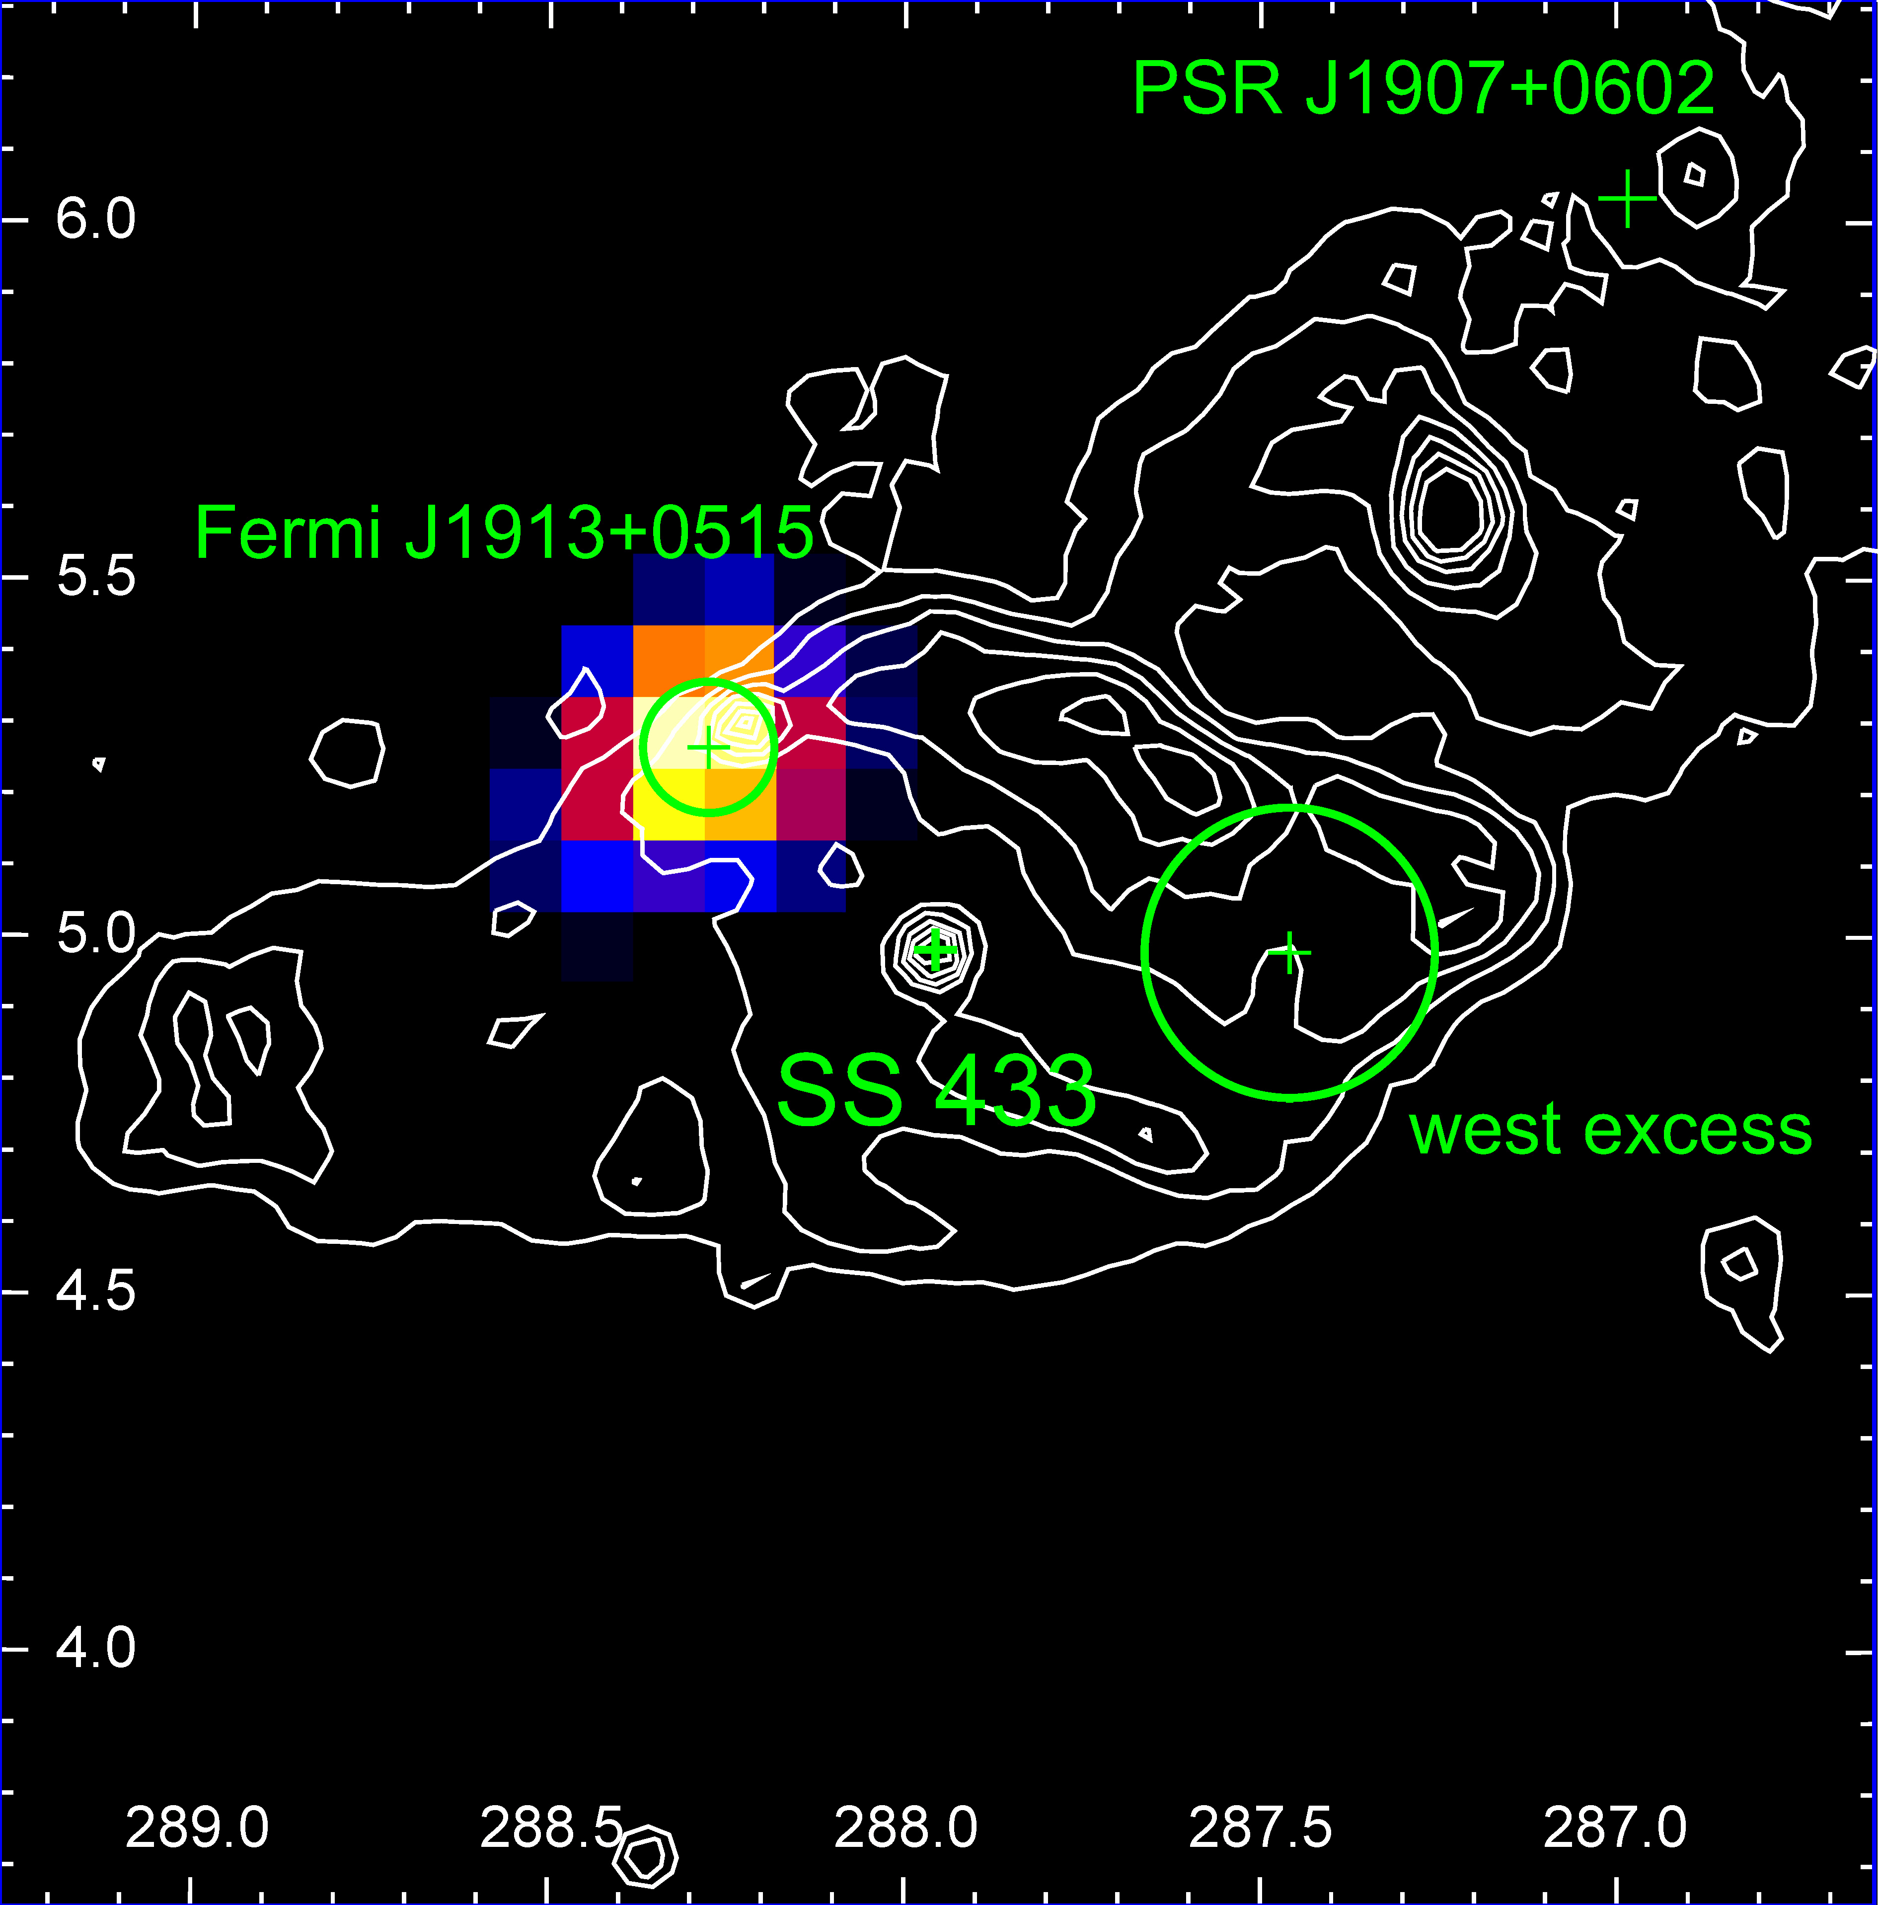
The position of the timing excess is off the center and the jets’ path
…and the cloud is not in jet direction and precession path.
37

Slide 38
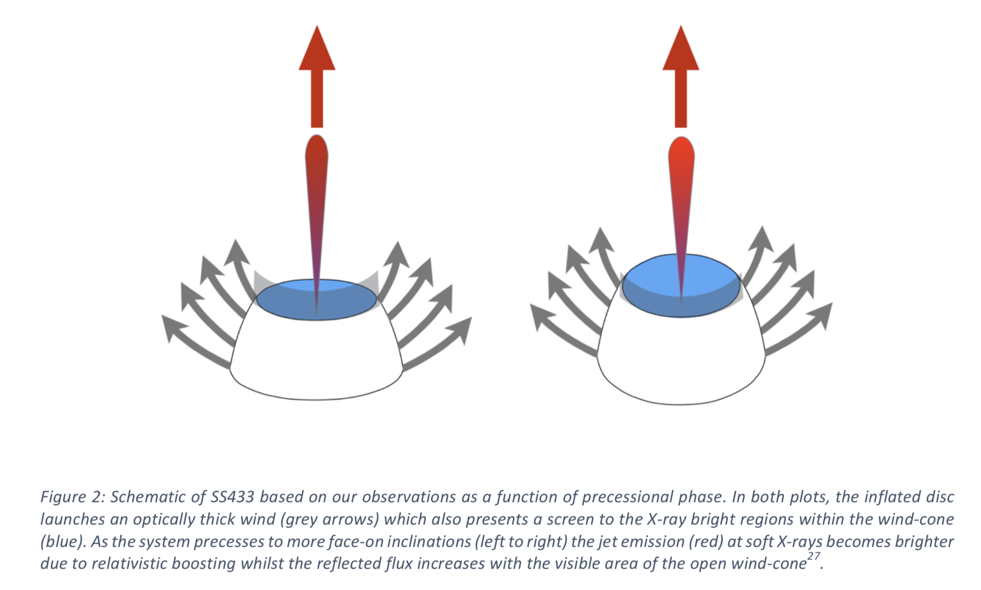
Another source of high energy particles: relativistic outflow
The line-of-sight outflow velocity is 0.14-0.29c.
Precession of the outflow in solidarity with the jet and the accretion disk, having a favorable geometry.
jet
Relativistic
outflow
Partially screened central object
Middleton et al. 2018
38
Notes:
This is consistent with
the fact that SS 433 is not so bright in X-rays despite the large accretion rate of up to 1E-4 solar mass per year
The outflows detected in the X-ray spectra of ultraluminous X-ray sources (ULXs), also known to harbour super-critical accretion flows.

Slide 39
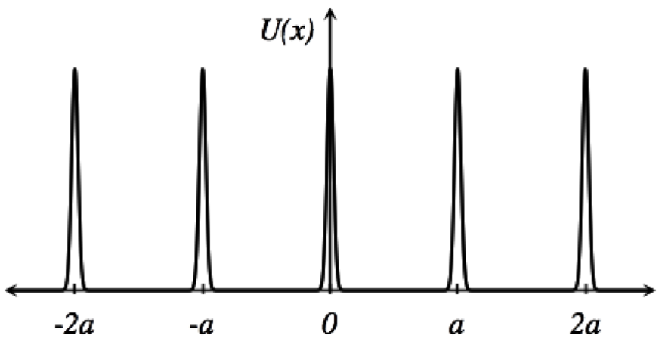
SS 433 in GeV
We considered a periodic impulsive injection from the central source (or the termination shock) and found that isotropic diffusion would not produce a periodic gamma-ray signal at the cloud.
39

Slide 40
SS 433 in GeV: cloud heart-beating via anisotropic diffusion?
The anisotropic diffusion (if the cloud and the source are magnetically connected) could ease the energetics, and allow that most of the CR content in the outflow is channeled into the HI cloud region.
Once there, particles must interact in clumps (or the cloud cusp) with n >> n_{average} in order to increase the gamma-ray yield and allow for a periodicity maintenance
40

