Slide 1
Simulation of Horizontal Air Shower Detection with LHAASO
Qinyuan Zhang
zhangqy@stu.pku.edu.cn
Department of Astronomy, Peking University
2021.10
Notes:
(LHAASO上水平大气簇射探测的模拟)

Slide 2
Outline
Introduction
Proton horizontal shower simulation
neutrino horizontal shower simulation
Angular resolution for horizontal air shower
Summary
Notes:
背景介绍，质子shower模拟，电子中微子shower模拟，模拟质子事件得到的角分辨率，总结

Slide 3
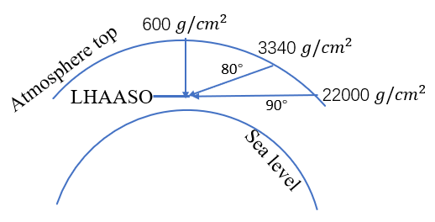
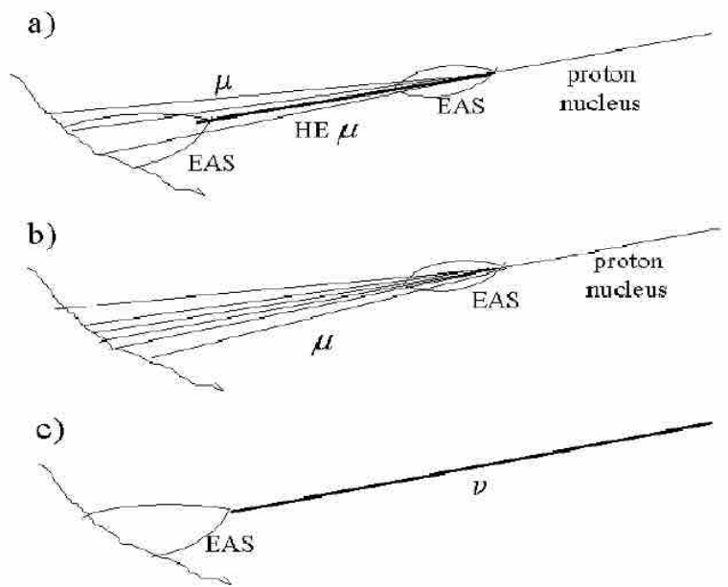
Introduction
Horizontal Air Shower(HAS): Cosmic ray detection rate will decrease sharply as zenith angle increase
Neutrino: Neutrino can penetrate the thick atmosphere because of its small cross section
Saving computing resources
Notes:
HAS研究背景，水平大气簇射，由于在较大天顶角，随角度增大，大气厚度迅速增加，电磁成分被吸收。但中微子而言，由于其反应截面很小，可以穿过很厚的大气，同时更厚的大气也提供了。大天顶角的水平簇射触发阵列能力弱，如果完全随机模拟，会耗费很多时间和资源，研究FIH 和 efficiency来节约计算资源。

Slide 4
Method
Half array
CORSIKA
G4
Reconstruction
Data selection, analysis
CORSIKA Option for horizontal event:
1.To simulate shower with zenith angle > 70°, CURVED is needed
2.For neutrino as primary particle, NUPRIM is needed
(CURVED+NUPRIM)
First interaction height is fixed at some values to study the trigger efficiency
Notes:
CORSIKA v76400 G4KM2A4.10
为模拟70°以上事件，打开CURVED选项，如果模拟中微子还要打开NUPRIM
G4使用G4KM2A4.10
在模拟时固定第一反应高度到不同的值来看不同FIH上的出发效率，找出一个对触发起主要贡献的区间

Slide 5
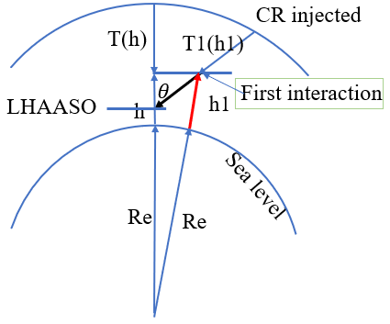
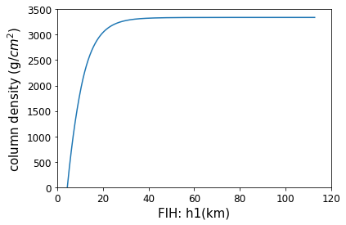
Coordinate system in CORSIKA
Upper panel shows the coordinate system.
First interaction height (FIH): h1 (km)
Zenith angle: $θ$ (degree)
Vertical depth: T(h) ($g/{cm}^{2}$)
Slant depth: T1(h1) ($g/{cm}^{2}$)
atmosphere structure at 80°
h1 is used as first interaction height in the study of trigger efficiency.
Notes:
当打开CURVED选项后，FIH如图
80度上大气结构，很快超过600

Slide 6
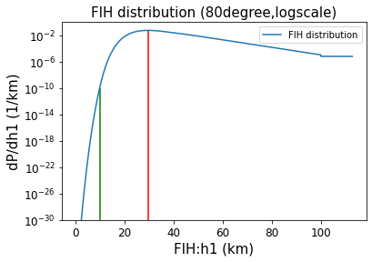
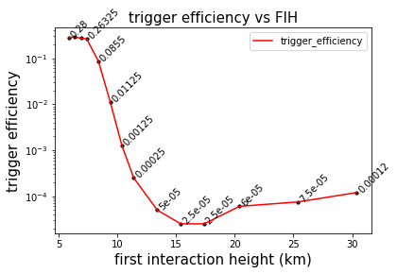
First interaction height and trigger efficiency
29.5km
Left panel shows the FIH distribution for proton(1PeV) at 80°(zenith angle)
Right panel is the trigger efficiency for proton(1-10PeV) at 80°(zenith angle) at different FIH.(Radius in G4 600m)
Trigger efficiency=n_tr/N_tot

Slide 7
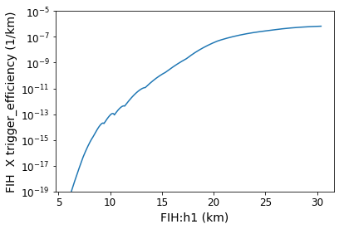
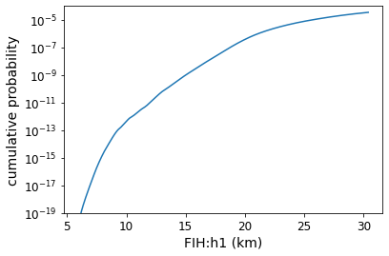
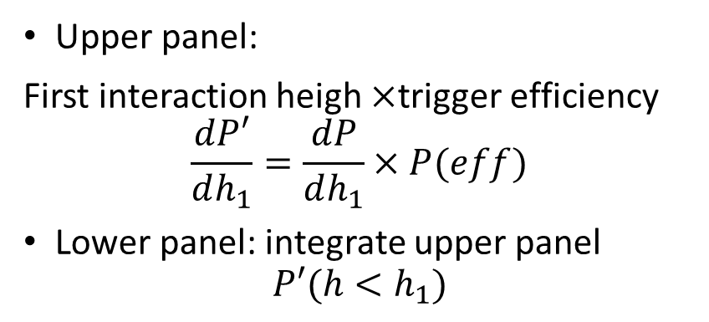

Proton events FIH
$$\frac{dP′}{dh_{1}}$$
Upper panel:
First interaction heigh $×$trigger efficiency
$$\frac{dP′}{dh_{1}}=\frac{dP}{dh_{1}}×P(eff)$$
Lower panel: integrate upper panel
$$P′(h<h_{1})$$
$$P′(h<h_{1})$$
integrate
$$\sim {10}^{−5}$$
The proton events which can be detected by LHAASO are dominated by events with first interaction height ~30 km
increase
One cannot find an "effective height" to fix the FIH of cosmic rays and simplify the simulation for HAS

Slide 8
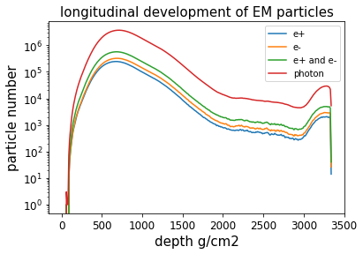
“Bump” in the longitudinal development
EM “bump”
Increase
Trigger efficiency decrease sharply when first interaction height < 15km, but don’t change a lot when first interaction height >15km
Events with a EM “bump” play a role
muon bremsstrahlung, pair production
Notes:
EM components

Slide 9
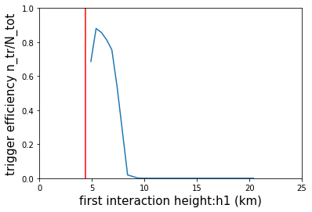
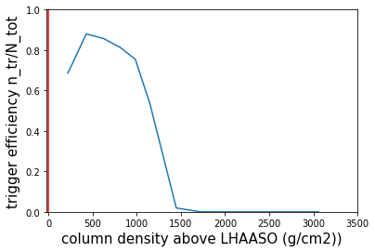
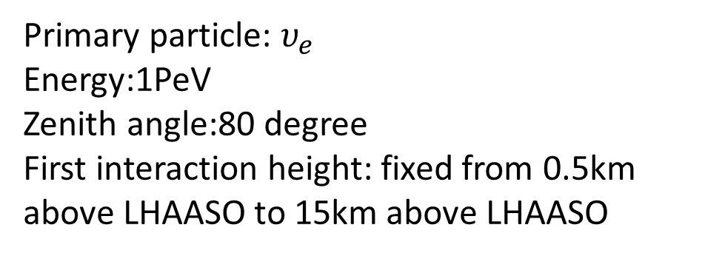
Effective height for neutrinos
Primary particle: $υ_{e}$
Energy:1PeV
Zenith angle:80 degree
First interaction height: fixed from 0.5km above LHAASO to 15km above LHAASO
LHAASO
Trigger efficiency is the ratio: n_tr/N_tot
effective height(50% max trigger efficiency) $h_{eff}≈8km$(3.6km above lhaaso)
Events with first interaction height < $h_{eff}$ dominate

Slide 10
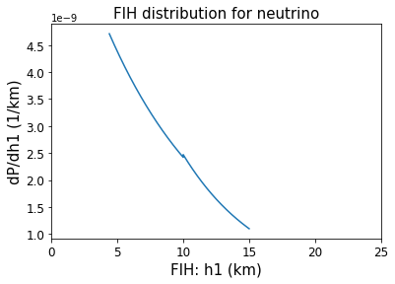
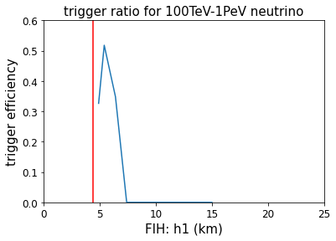
Neutrino first interaction height
decrease
Cross section for interaction of neutrino and air
For E = 100 TeV $σ\sim 250$ pb
zenith angle = 80°
For neutrino interact with air in h1=4.5~7km, the probability is $1×{10}^{−8}$
To detect a 100TeV neutrino from a transient (such as SN)
probability $1×{10}^{−8}$
10kpc away
Total energy of neutrinos need to be ${10}^{47}$erg
LHAASO

Slide 11
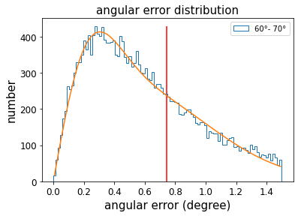
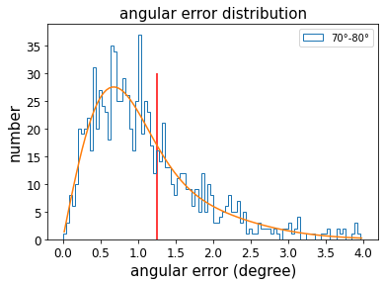
Angular resolution for large zenith angle
Fit:$ρ\left(err\right)=\frac{A_{1}err}{σ_{1}^{2}}\exp\left(−\frac{{err}^{2}}{2σ_{1}^{2}}\right)+\frac{A_{2}err}{σ_{2}^{2}}exp⁡(−\frac{{err}^{2}}{2σ_{2}^{2}})$
Proton
1PeV~10PeV
68%
68%
Angular resolution: 0.74 degree
Angular resolution: 1.25 degree

Slide 12
Summary
Proton triggered events: FIH is large
Proton trigger events (1PeV~10PeV, zenith angle~80°) are dominated by events with large first interaction height(~25km above LHAASO).
”Bump” improve the trigger efficiency of proton shower.
Neutrino triggered events: FIH is small
Neutrino trigger events (100TeV~1PeV, 80°) dominated by events with small first interaction height(<7km). The neutrino trigger probability is small.
The angular resolution for 60°~70° events(1~10PeV) is 0.74°, for 70°~80° is 1.25°
Thanks!

Slide 13
Backup

Slide 14
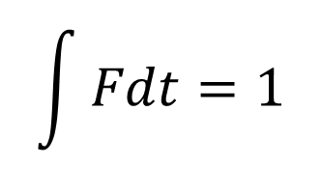
Estimation of transient energy
~100TeV neutrino number we can detect
$$\int{Fdt}=\frac{E}{4πd^{2}}∙\frac{1}{100TeV}∙Acosθ∙{10}^{−8}$$
$$Acosθ=0.2{km}^{2}$$
$$\int{Fdt}=1$$
$$\frac{E}{d^{2}}=100 erg/{cm}^{2}$$
To get
If we set
$$d=10kpc=3×{10}^{22}cm$$
Then the energy is ${10}^{47} erg$

Slide 15
Angular resolution for horizontal events
$$\hat{AB}=arccos⁡[\sin\left(θ_{A}\right)\sin\left(θ_{B}\right)\cos\left(φ_{A}−φ_{B}\right)+\cos\left(θ_{A}\right)\cos\left(θ_{B}\right)]$$
The angular error : $\hat{AB}$
If AO is true incidence direction, And BO is reconstruction incidence direction
$$φ_{A}$$
$$φ_{B}$$
B
A
$$θ_{A}$$
$$θ_{B}$$
The distribution of angular error are used for angular resolution.
O

