Slide 1
Preliminary Analysis of Diffuse Emission from PeV to Sub-PeV
Yu,Y.H, Xi,S.Q., Chen,S.Z.
Collaborator:Wang X,Y,;Liang,Y;F,Li,C;Wu,S,et al.

Slide 2
OUTLINE
1. INTRODUCTION
2. DATA and MOTHOD
3. DISTRIBUTION and SPECTRUM
4. UNCERTAINTY
5. SUMMARY

Slide 3
1. INTRODUCTION

Slide 4
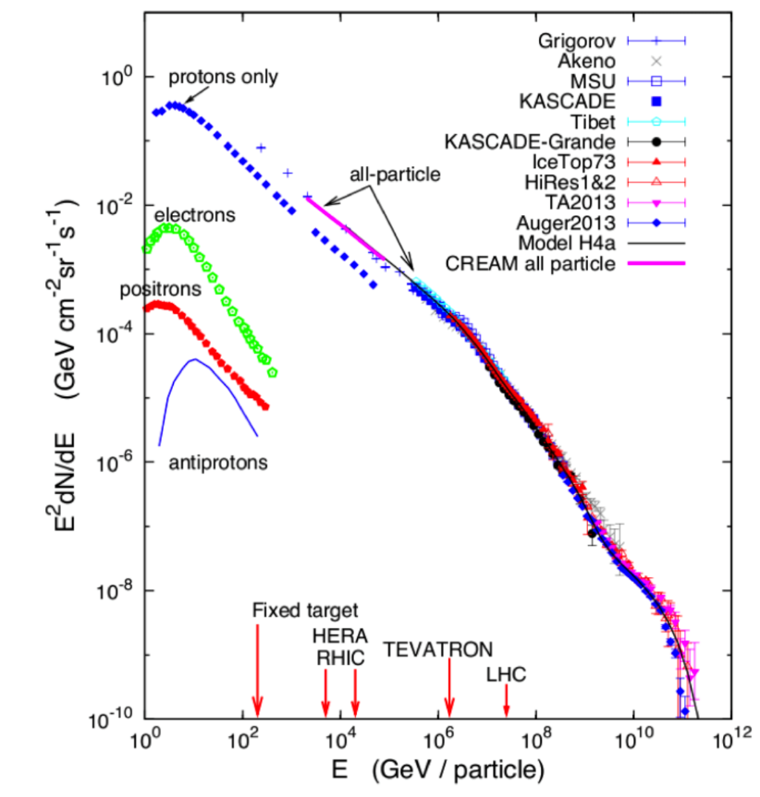
1. “Knee” CR Problem?
Accelerator:
1.What ? (YSC or SNR or PWN or Extro-Galactic Source…)
Propagating:
Knee
2. How？(Normal Diffusion? Slow Diffusion？ …)
Local CR Measurement

Slide 5
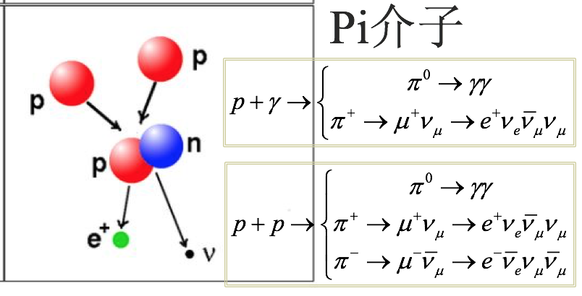
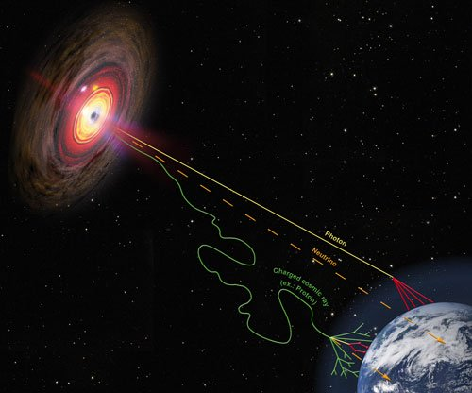
1. >100 TeV Gamma probe
Accelerator
Points or Extended Source:
Probe of accelerator;
Propagating
Diffuse Emission:
Probe of propagating,
accelerator distribution,
ISM…

Slide 6
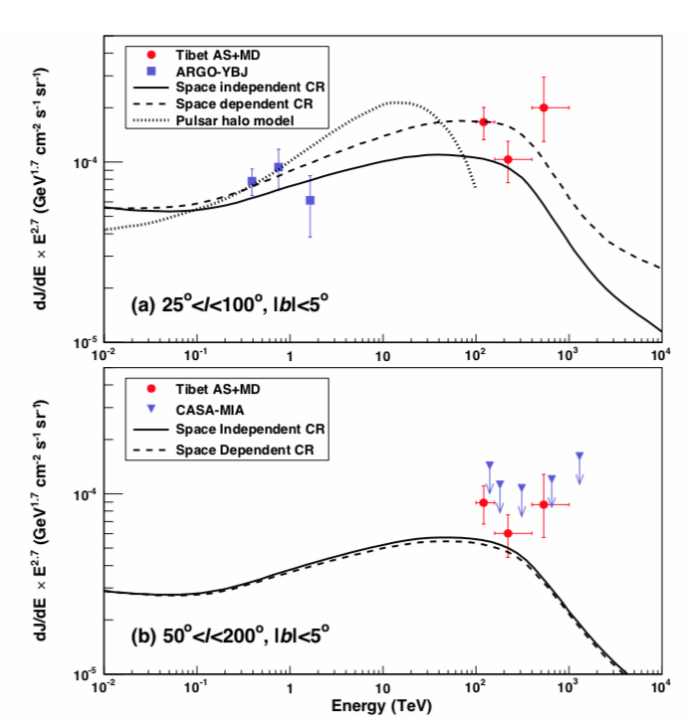
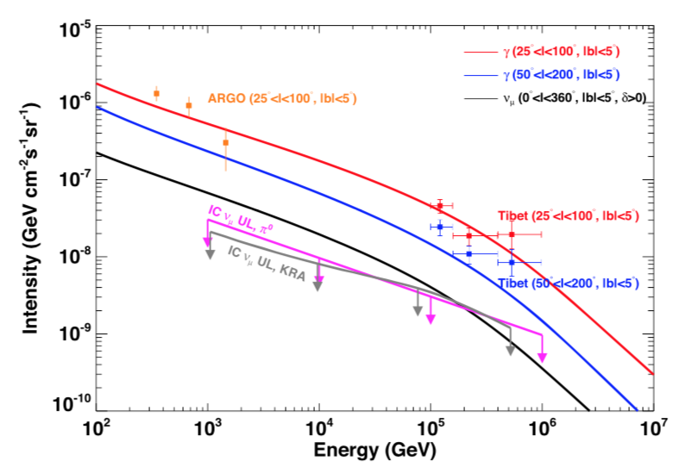
1: Asgamma >100 TeV DGE Measure?
Neutrino observation require contribution of Extra-source!
Asgamma collaboration (2021)
Ruo-Yu Liu&Xiang-Yu Wang (2021)

Slide 7
2. DATA and METHOD

Slide 8
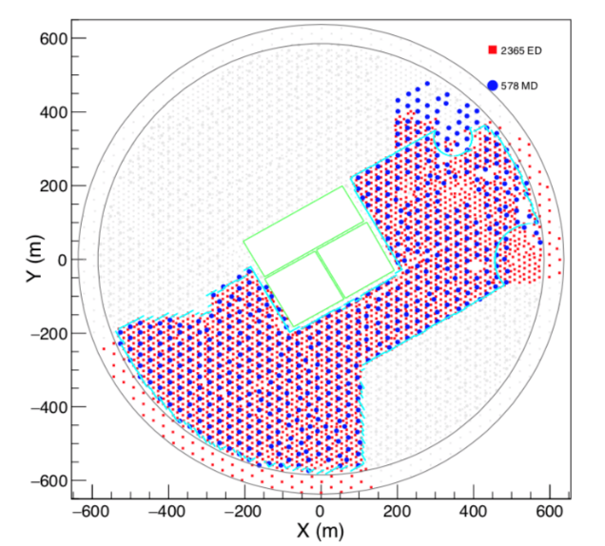
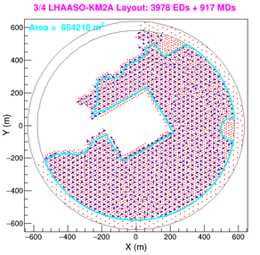
2.Data Selection
Time：2019.12.27-2020.11.30
Time：2020.12.01-2021.07.19
Cut parameter：
$$R=log⁡(\frac{N_{μ}+0.0001}{N_{e}})$$
70% cut. -5.46，-5.49，-2.31，-2.36，-2.43，-2.50，-2.55，-2.58，-2.60，-2.61，-2.63，-2.61
Zen<40°

Slide 9
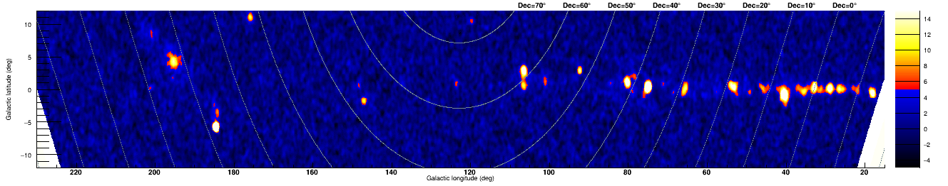
2. Search and Mask the Source
Geminga(~5 deg)
Cygnus Cocoon(~5 deg)
Circle size is mask region (size are between ~0.8-1.5 deg).

Slide 10
3. SPECIAL and SPECTRAL DISTRIBUTION

Slide 11
3. >100 TeV Counts Map after masking Source
From top to bottom: smooth with 0.5,1.5, 2.5 degree gaussian kernal.

Slide 12
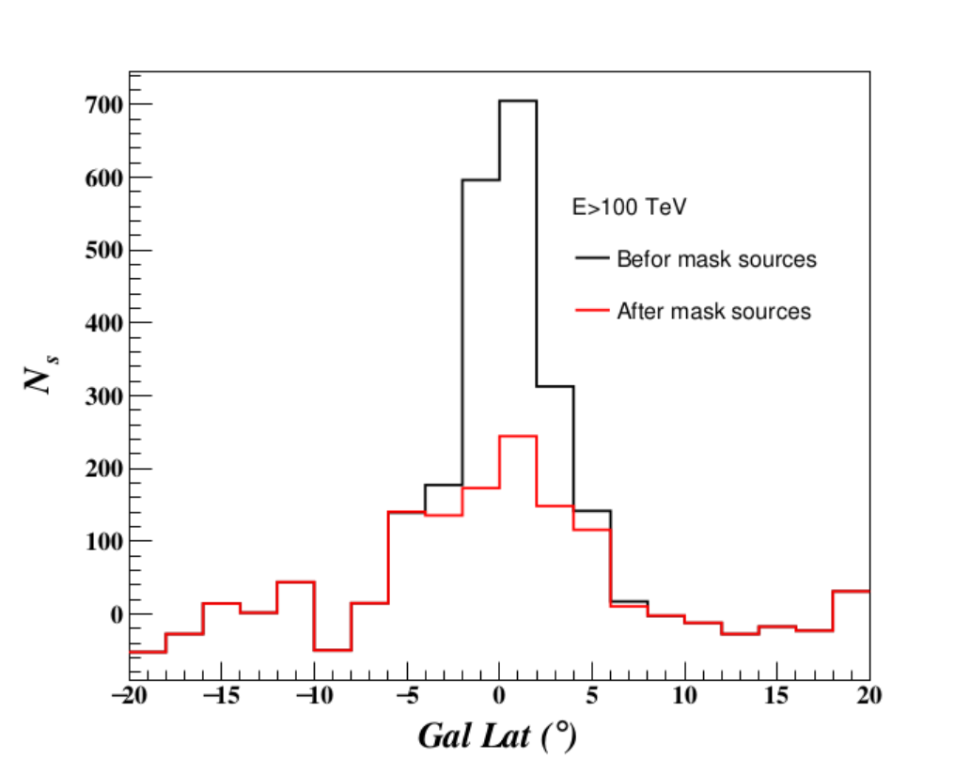
3.Events Distribution with b
Obvious Excess in |b|<5 region;
~45 % Source flux in |b|<5 region;

Slide 13
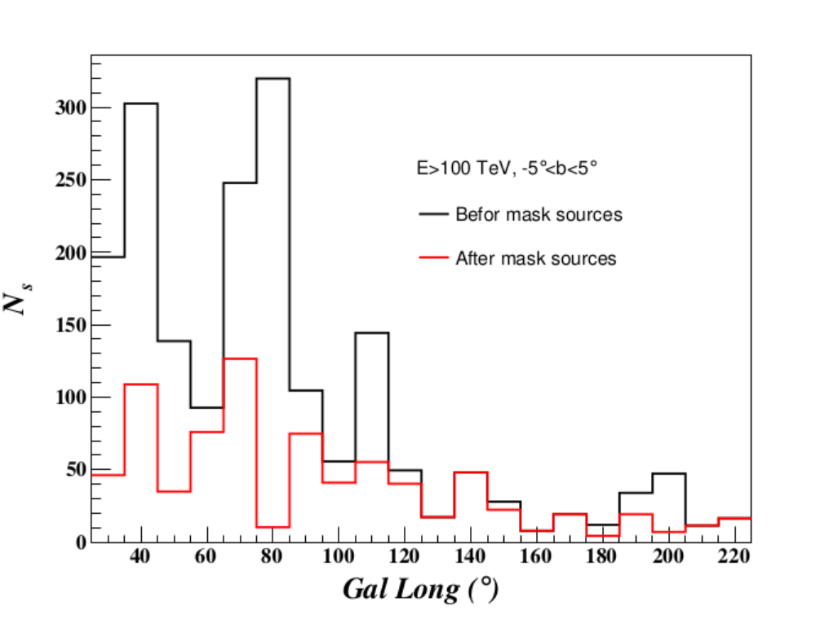
3.Events Distribution with l
25<l<55 region: more sources and thus more regions are removed , the DGE is for region 2<|b|<5;
65<l<85 region: complex Cygnus Cocoon;
l ~ 110 region: G106.8 region contribution looks like to be removed well;

Slide 14
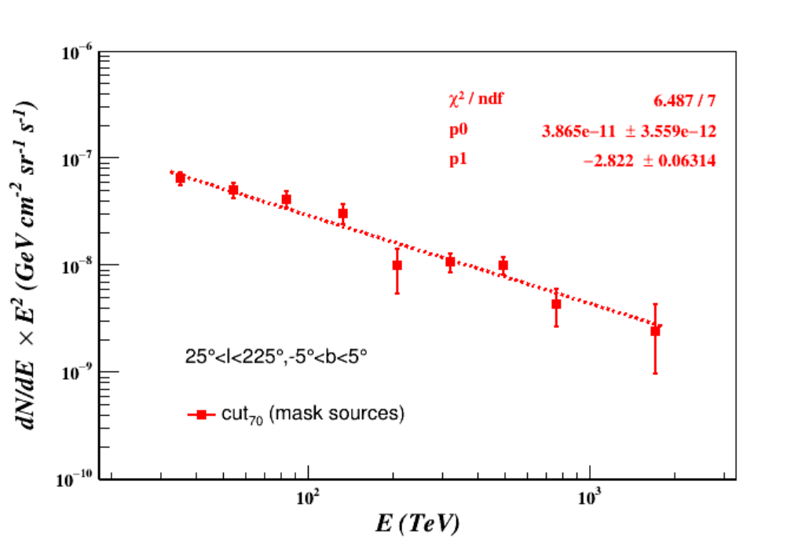
3. SED For Region (25<l<220, |b|<5)
The spectral index: ～2.83;
Break or No break?
1. WCDA measurement for clearing low energy spectral index;
2. More sub-PeV to PeV data collection;
3. Check to the 200-400 TeV SED point carefully;

Slide 15
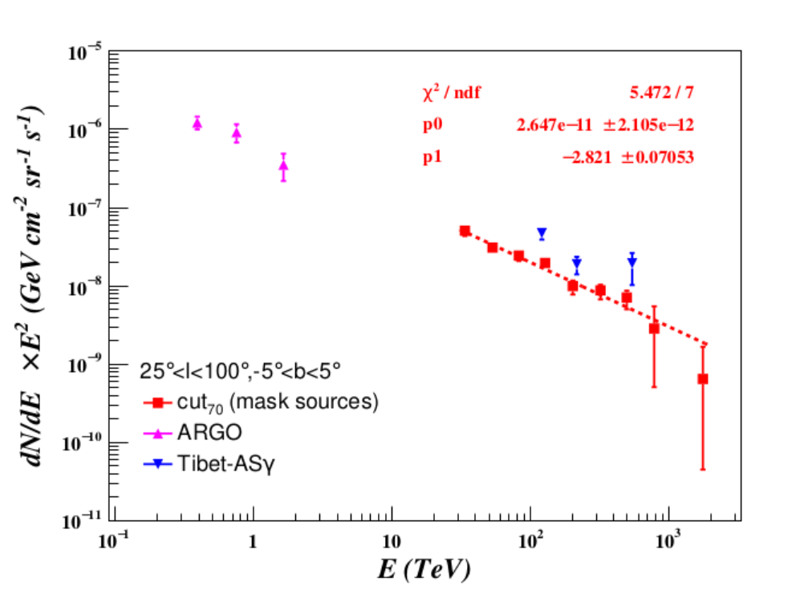
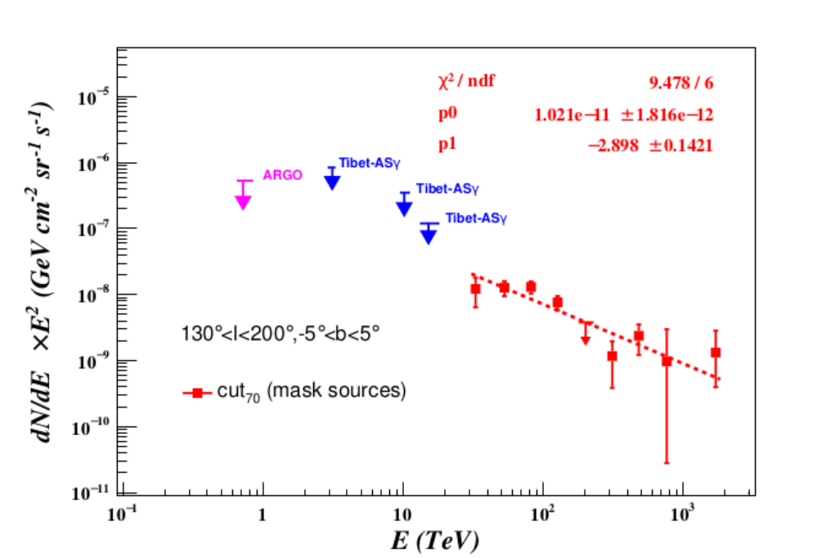
3. SED for inner region and outer region
Obvious difference from ASgamma measurement.
Statistical fluctuation or new component？
inner Galactic region
outer Galactic region

Slide 16
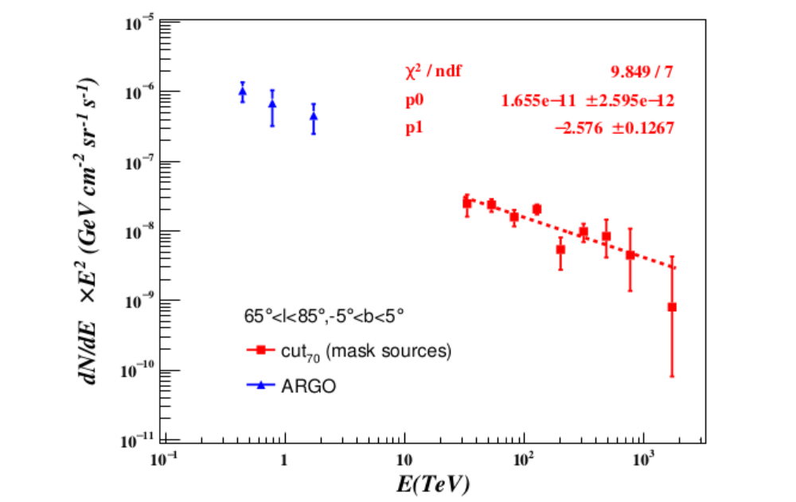
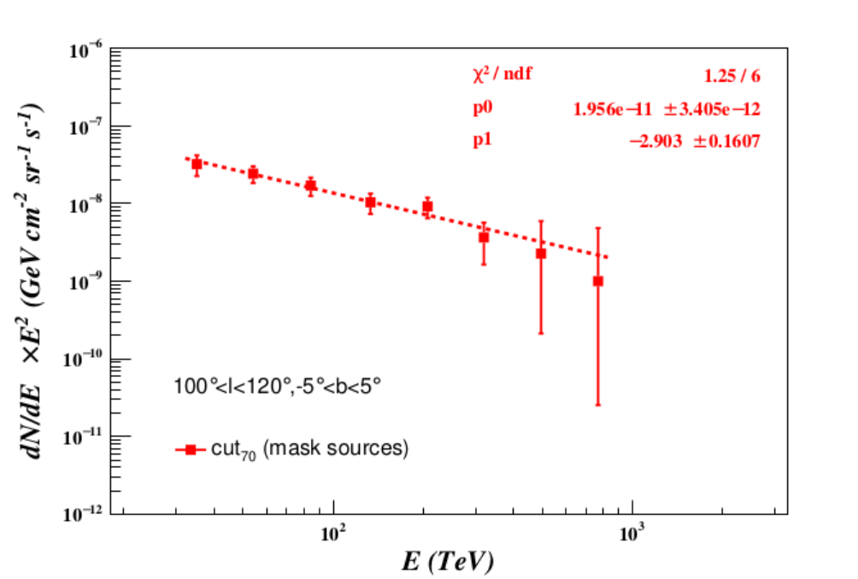
3. SED Cygnus Cocoon Region and G106.8 Region
Maybe harder around Cygnus Cocoon region comparing with other region!

Slide 17
3. Comparing to 0.8 TeV DGE.
0.8 TeV DGE
The spatial distribution are similar to the 0.8 TeV DGE measured by Fermi-LAT.
Counts map removed the >25 TeV sources
The region of |b|<1 deg are almost removed!!!
the spatial template should be used for the DEG emission measure.
Underestimate

Slide 18
4. UNCERTAINTY ESTIMATION

Slide 19
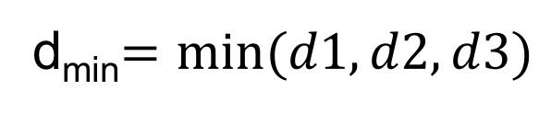
Minimal Angular Distance (d_{min}) for each photon separated with all sources
d1
d3
d_{min}$=min⁡(d1, d2,d3)$
d2
The larger the less possible association with the source!
Source
Photon

Slide 20
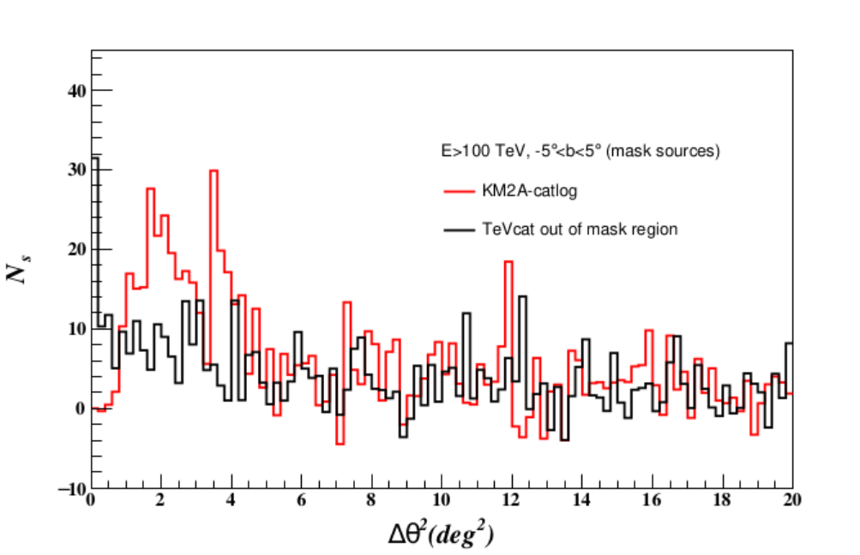
PSF and/or unresolved source uncertainty
Uncertainty estimation:
The unresolved source can impact our results with < 10%.

Slide 21
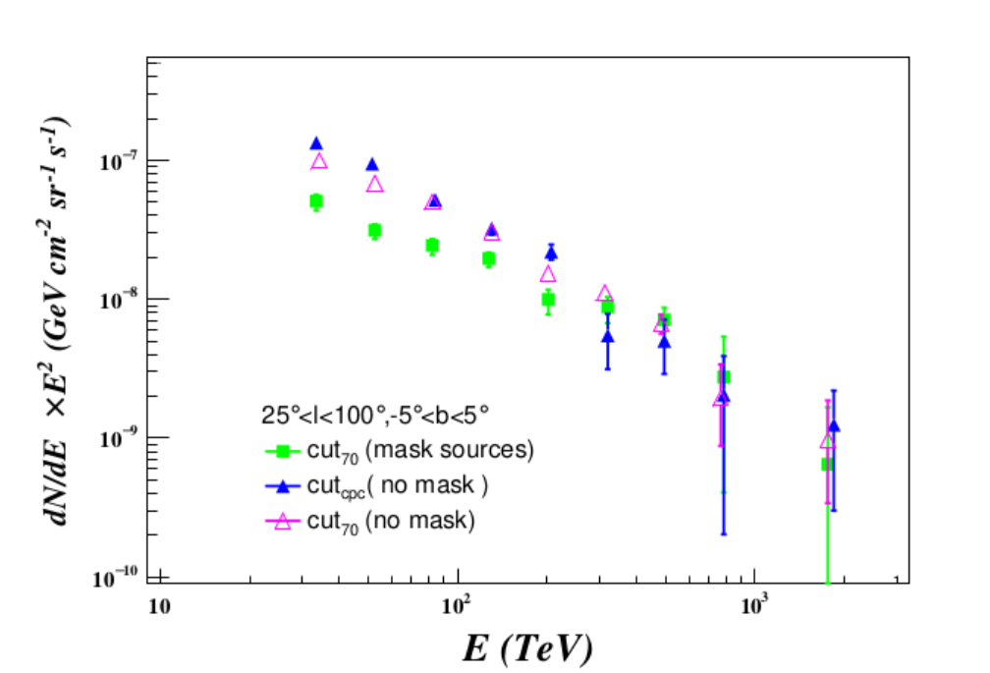
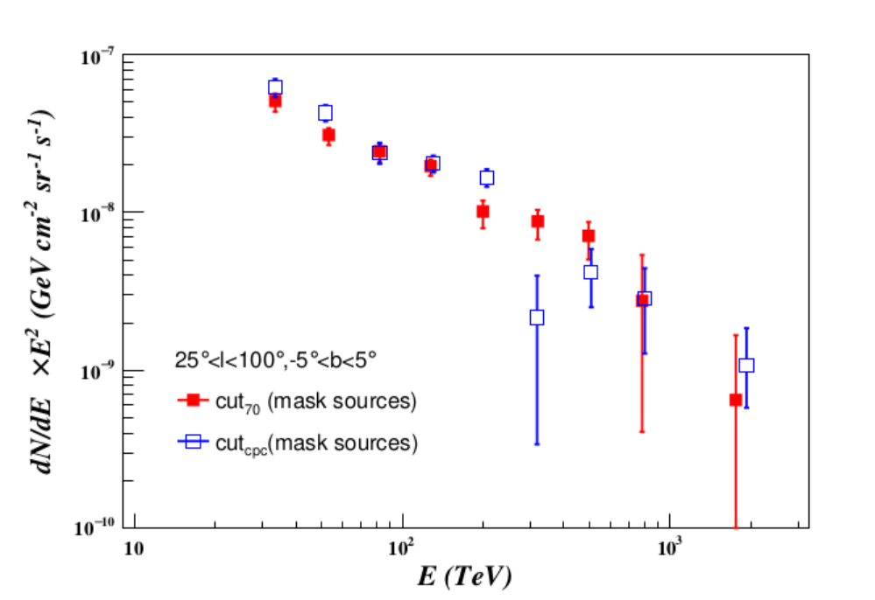
Cut condition impact
~ 20% variation for SED measurement

Slide 22
Summary
1. We do the analysis of diffuse Emission form sub-PeV to PeV preliminarily;
2. >100 TeV SED of DGE are lower than that reported by ASgamma.
3. No obvious SED break are found now. Concluding weather or not the break need to more data and WCDA measurement.
4. The Spectral Index of Cygnus cocoon seems to be harder than other region.
5. The spatial distribution of >100 TeV counts map are roughly similar to the 0.8 TeV DGE measured by Fermi-LAT. An measure considering the spatial distribution will be done next step.

Slide 23
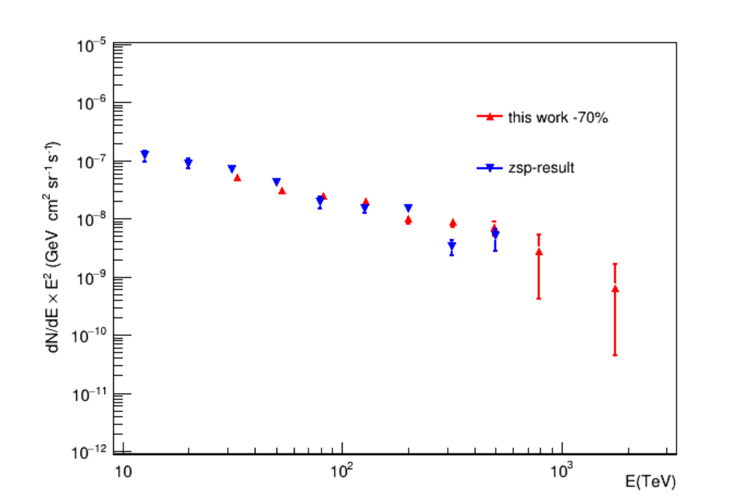
Similar to the results of zsp’s
25<l<100 inner Galactic region

Slide 24
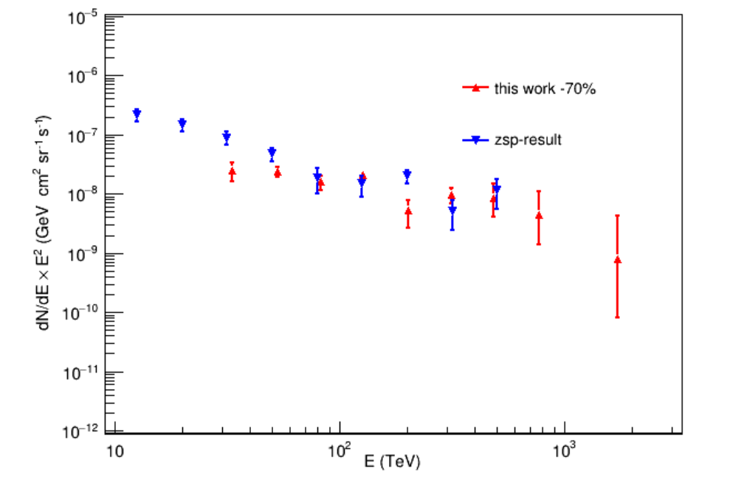
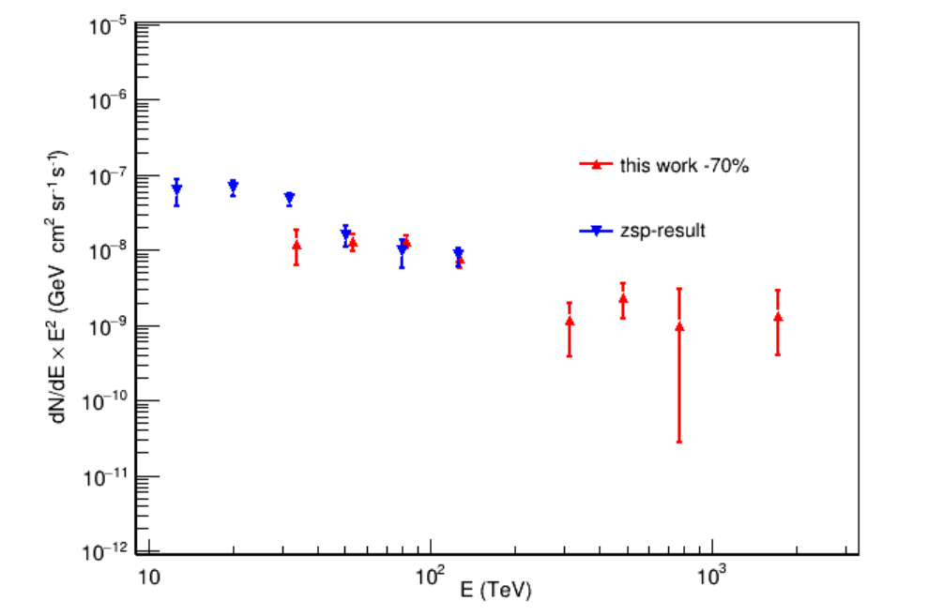
Comparing to the zsp’s results (Larger difference at low energy range)
65<L<85 Cocoon region
130<l<200 region

