Slide 1
Progress of Measurement of Cosmic Ray Spectrum of Proton by LHAASO Experiment
Zhiyong You, Shoushan Zhang, Linlin Ma, Liqiao Yin, Yudong Wang
IHEP
14 Oct. 2021 Shanghai, China

Slide 2
Outline
Cosmic Ray Spectrum and LHAASO Experiment
Combined Observation of Multiple Telescopes and Energy Reconstruction
Parameters Sensitive to the Mass Compositions
Summary and Next Work

Slide 3
Cosmic Ray Spectrum and LHAASO Experiment

Slide 4
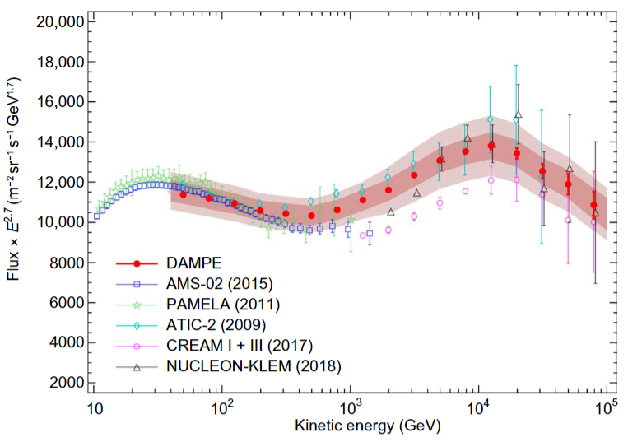
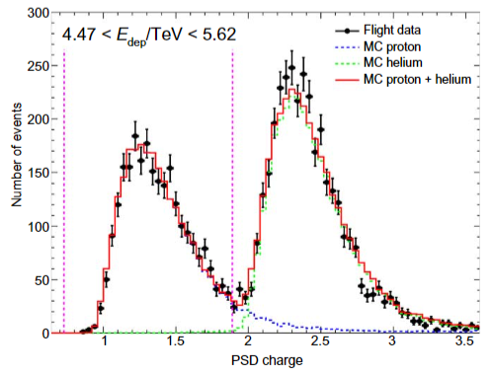
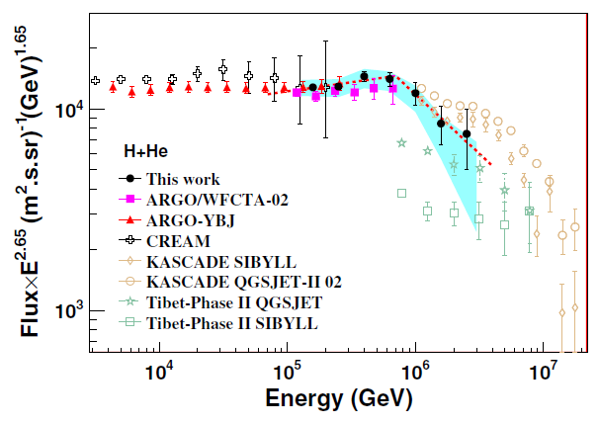
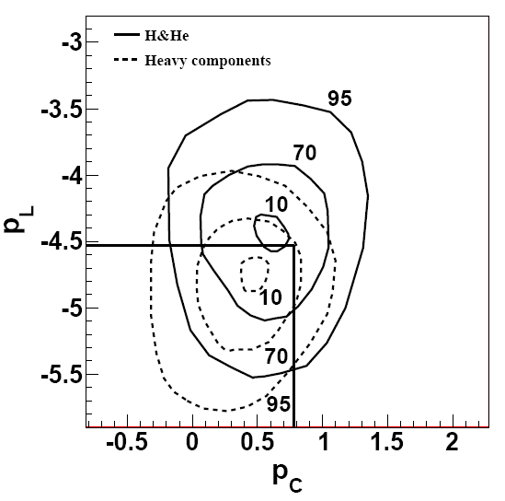
Cosmic Ray Spectrum
Key structure: Knee$\sim {10}^{15}eV$
Main Point:
Energy
Composition
Statistics
DAMPE
Indirect
Direct
Aperture
Particle ID
ARGO + WFCTA prototype

Slide 5
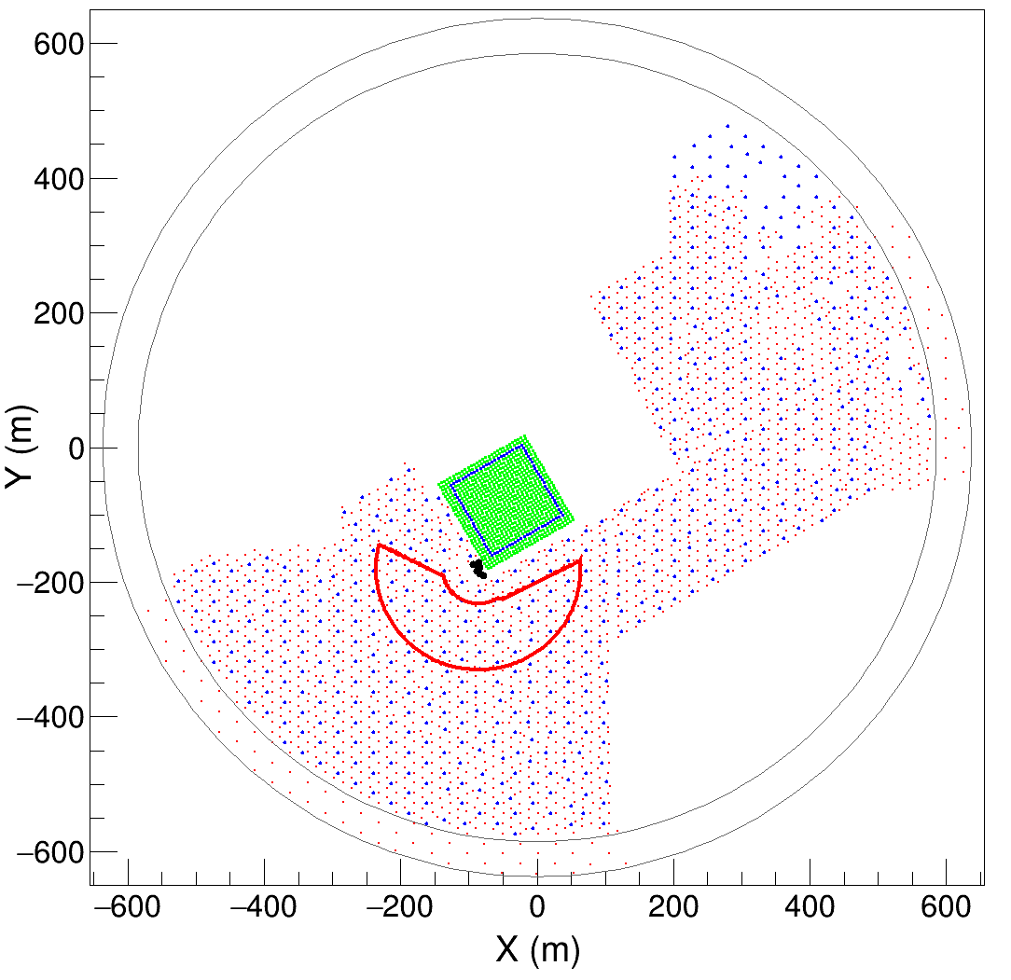
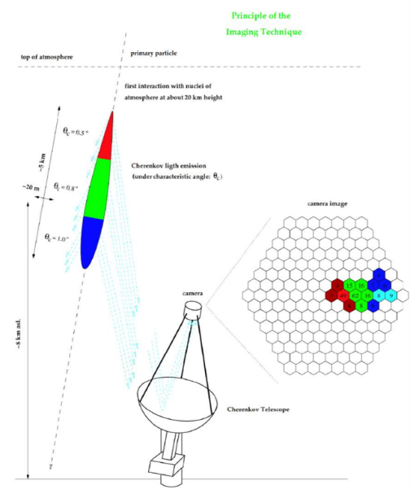
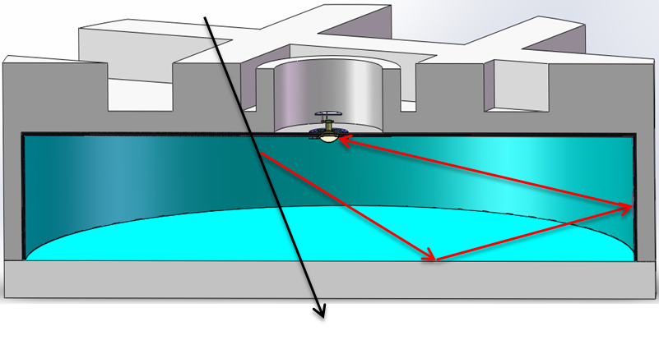
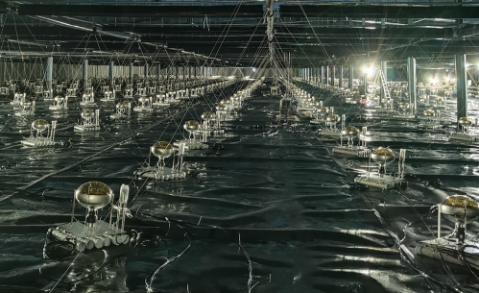
LHAASO Experiment
MD
2.5m
WFCTA
WCDA
1.2m
C photon
μ
KM2A
Geometry Reconstruction:
Core resolution:
<3m above 100TeV (WCDA)
Angular resolution:
<${0.3}^{∘}$ above 100TeV (WCDA)
Select events in WCDA:
WCDA:
Reconstruction shower core located in WCDA
The brightest cell in WCDA > 4000 $N_{pe}$
$N_{pe}|_{0−10m}>0.3×N_{pe}|_{0−30m}$
WFCTA:
More than 10 tubes are saved after image clean
Period:
2020.11 ~ 2021.03
Observation time and Events:
750 hours, 0.7 million events

Slide 6
Combined Observation of Multiple Telescopes and Energy Reconstruction

Slide 7
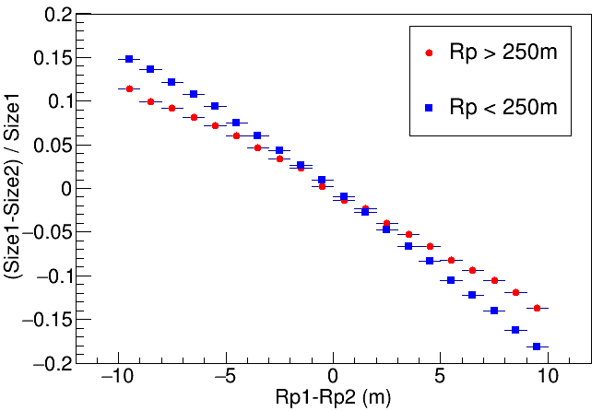
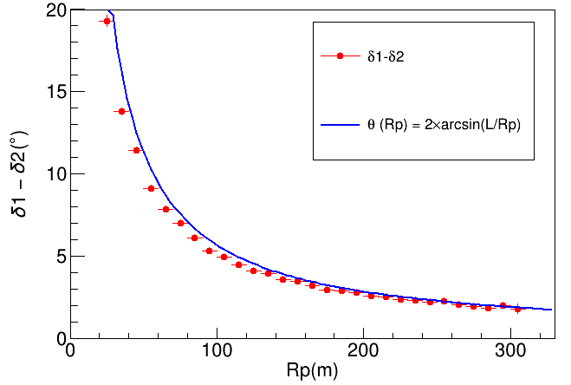
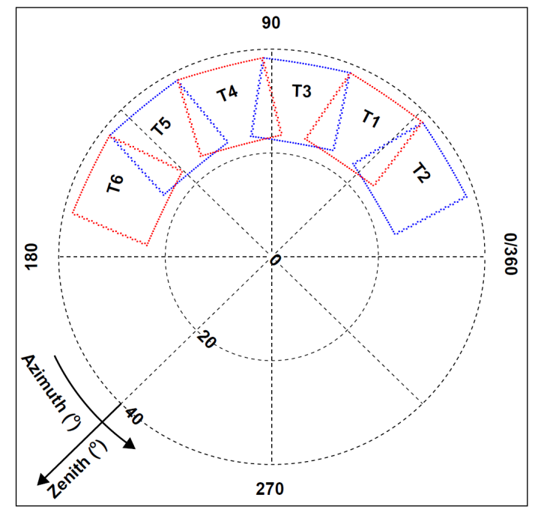
Cherenkov Image Reconstruction by Multiple Telescopes
$$|ΔRp|<1m$$
The difference between the events observed by two telescopes
Telescope address
Overlap field-of-view
Cherenkov photons detected by telescopes
Image axis in two telescopes

Slide 8
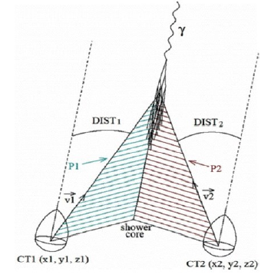
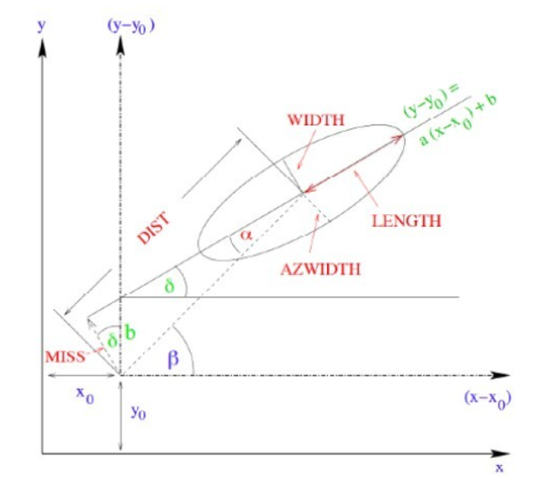
Cherenkov Image Reconstruction by Multiple Telescopes
$$|ΔRp|<1m$$
The difference between the events observed by two telescopes
Telescope address
Overlap field-of-view
Cherenkov photons detected by telescopes
Image axis in two telescopes

Slide 9
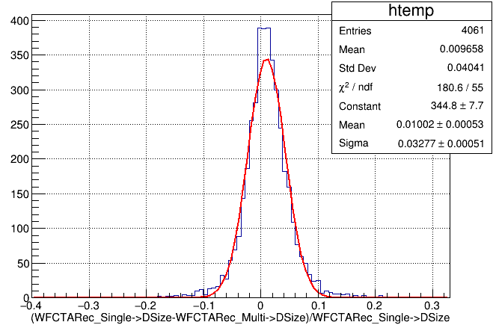
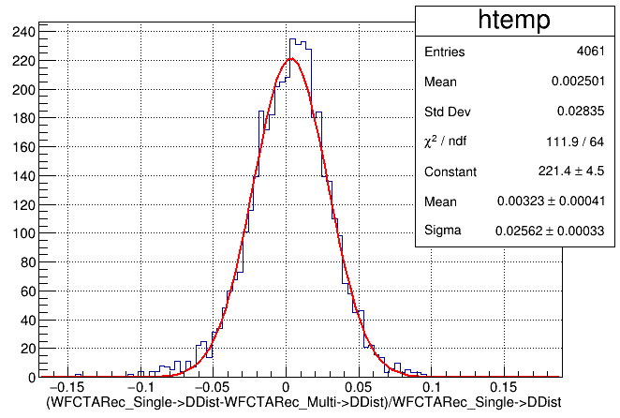
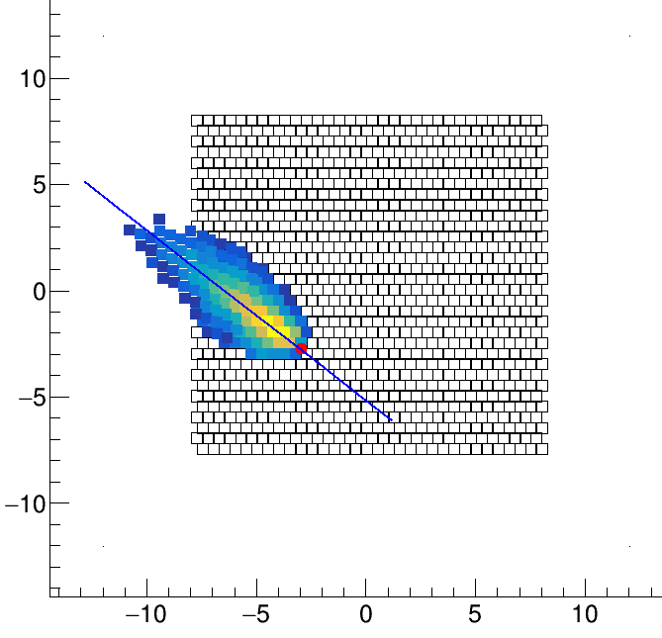
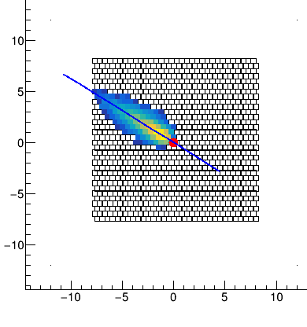
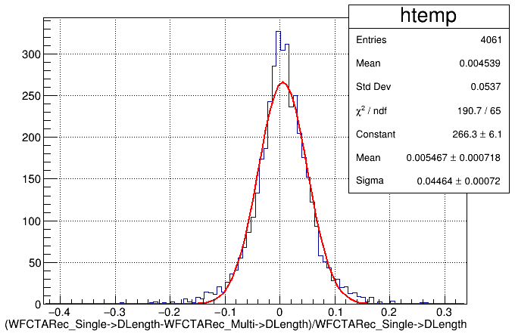
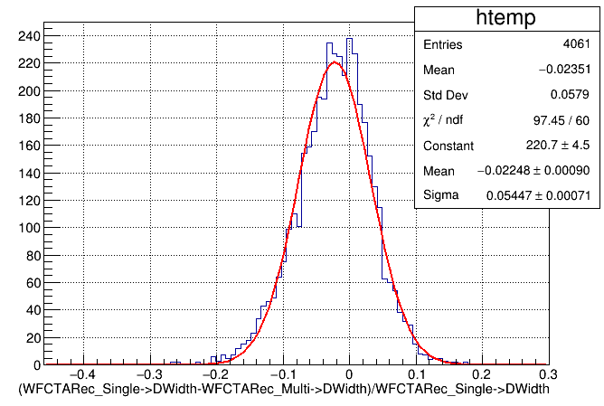
Comparison of the Reconstruction Result of Combined Image with the Real Image
Size
Dist
Event selection:
select events of field of view overlap
Npix>10
|MeanY|<5
|MeanX|>5
Length
Width
Parameters agree in 5%

Slide 10
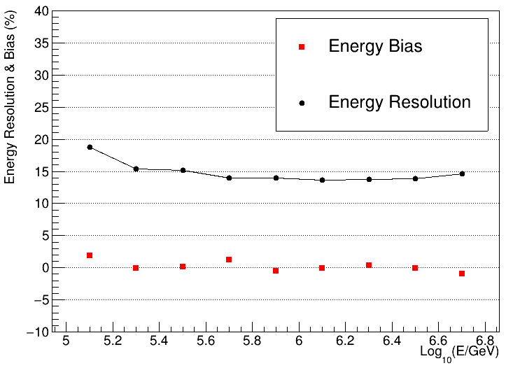
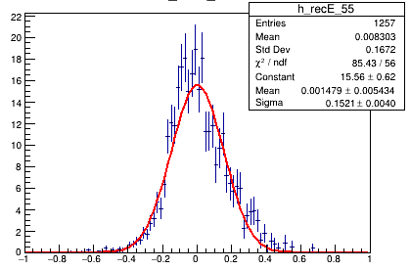
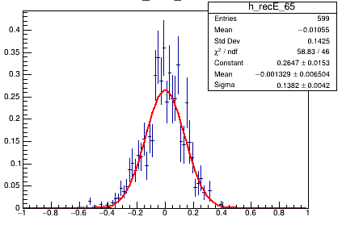
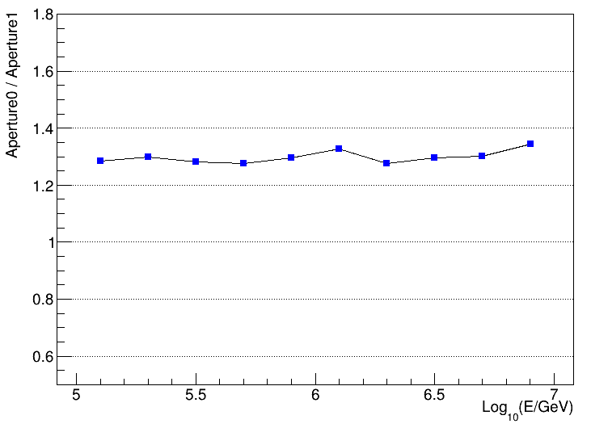
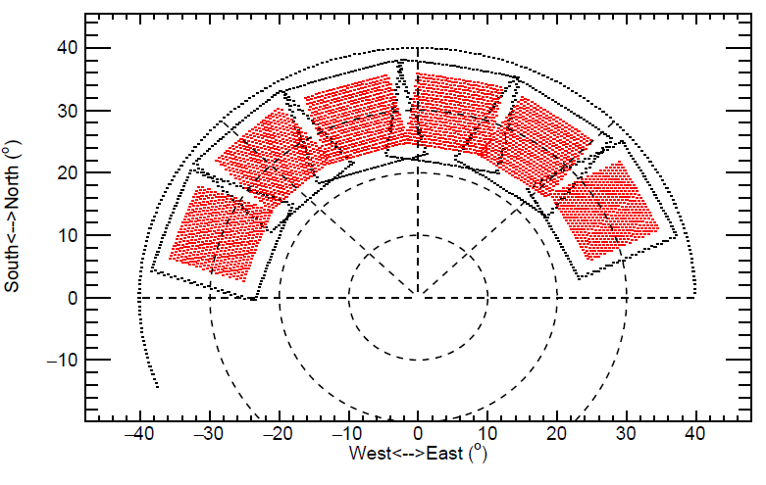
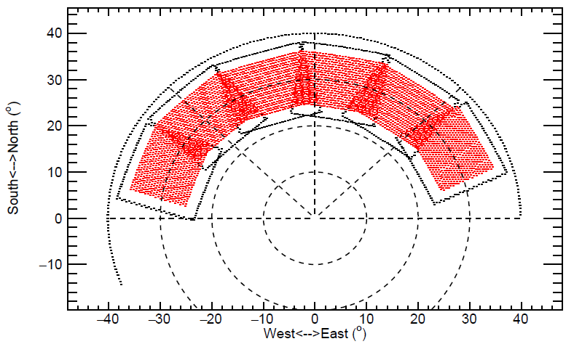
Energy Reconstruction
300TeV
3PeV
Systematic bias: <3%
Resolution: <15% above 300TeV
Gaussian distribution
Aperture: 30% more than single telescope
FoV of Single Telescope
FoV of Multiple Telescopes

Slide 11
Parameters Sensitive to the Mass Compositions

Slide 12
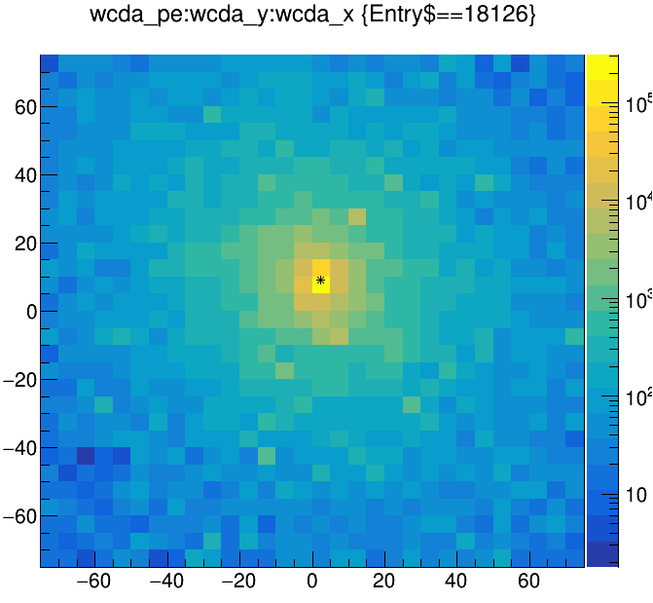
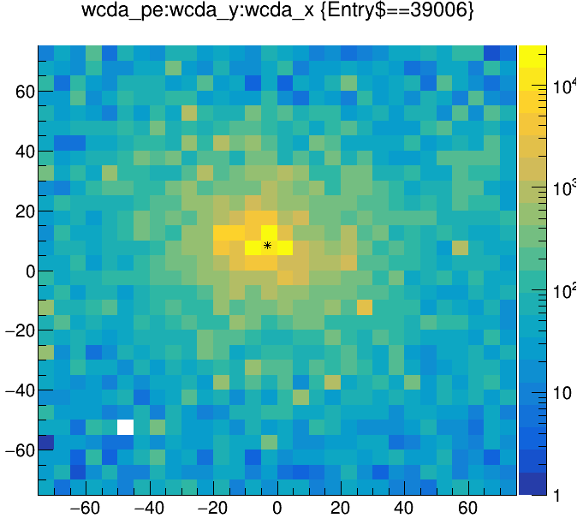
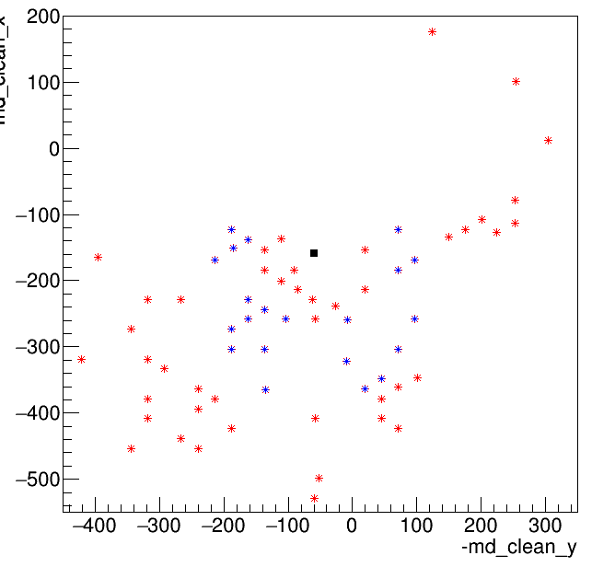
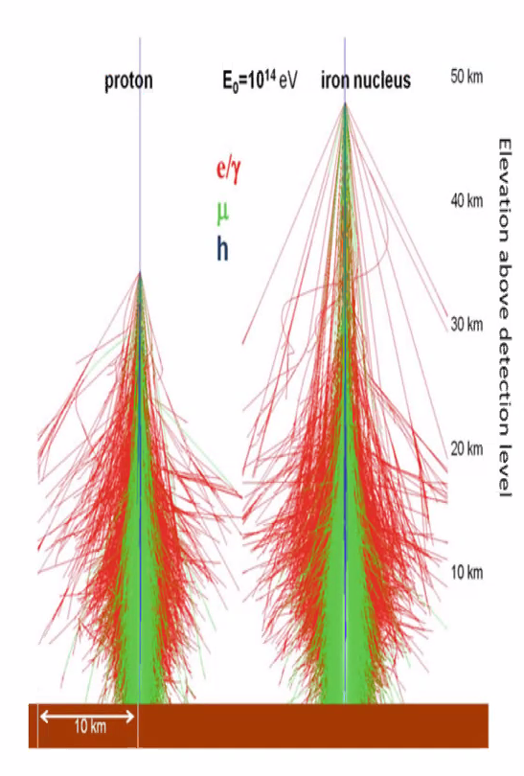
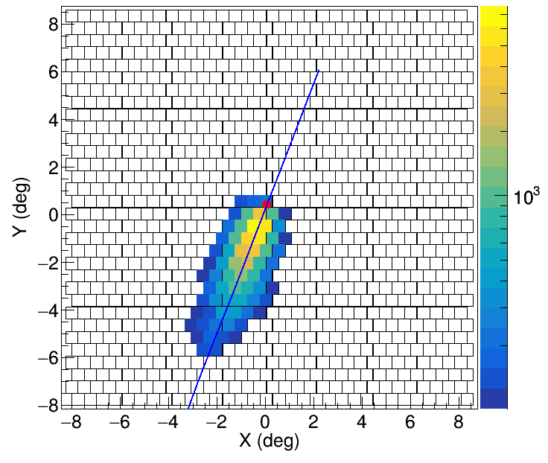
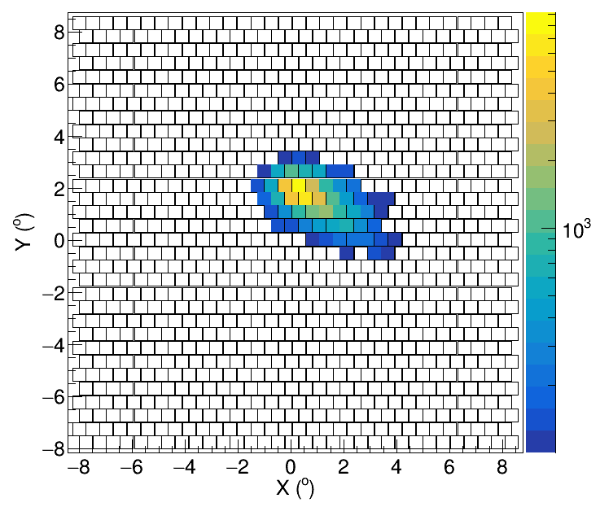
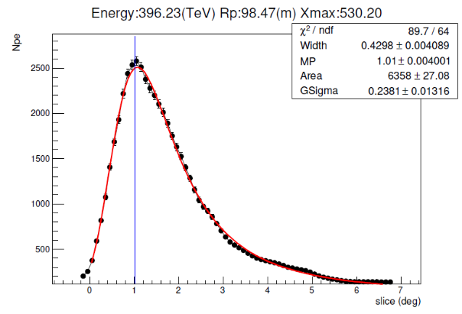
Component Sensitive Parameters
Shower core
Proton
Iron
Muon number in KM2A
Proton
Iron

Slide 13
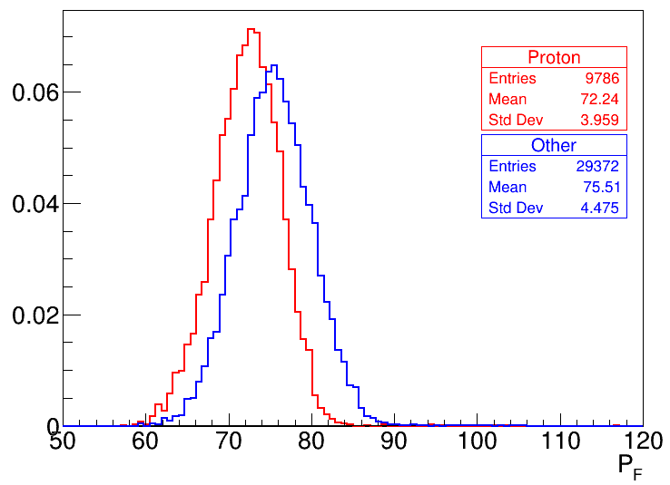
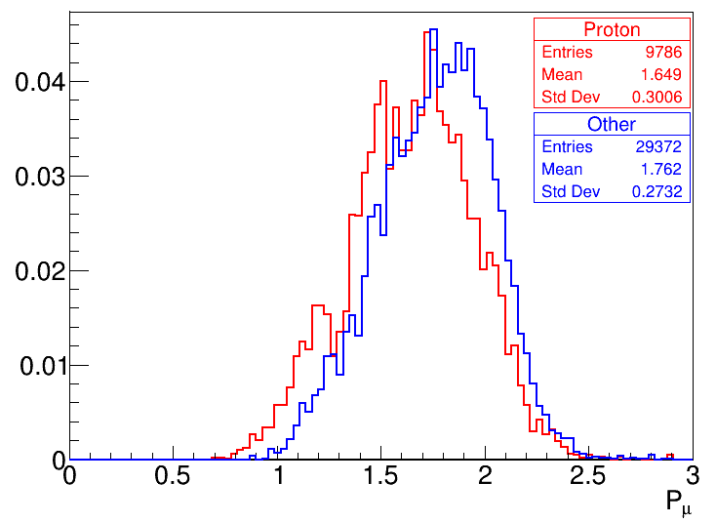
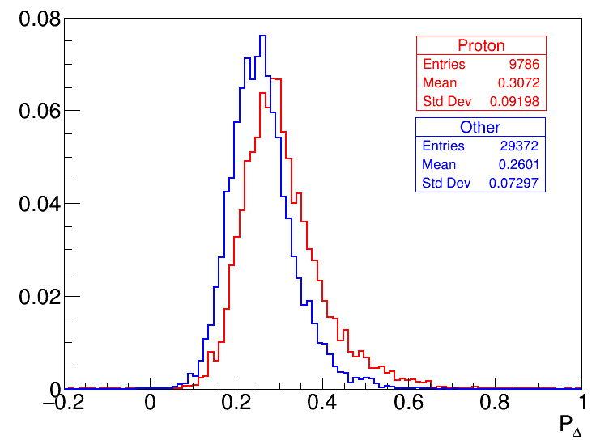
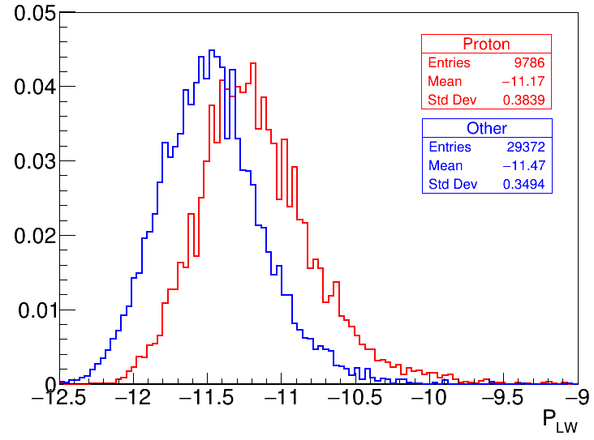
Proton Selection
WCDA : $P_{F}$ (extension rate)
KM2A : $P_{μ}$ (muon)
WFCTA: $P_{Δ}$ (Fit Width)
WFCTA: $P_{C}$ (Length/Width)
$$P_{F}= <ER>{\left.​\right|}_{Size0}$$
$$P_{μ}=\log_{10}{N_{μ}}{\left.​\right|}_{Size0}$$
$$P_{Δ}=Δ{\left.​\right|}_{Rp,Size0}$$
$$P_{C}=L/W{\left.​\right|}_{Rp,Size0}$$
Red: Proton
Blue: Helium + CNO + MgAlSi + Iron (Gassier Model)

Slide 14
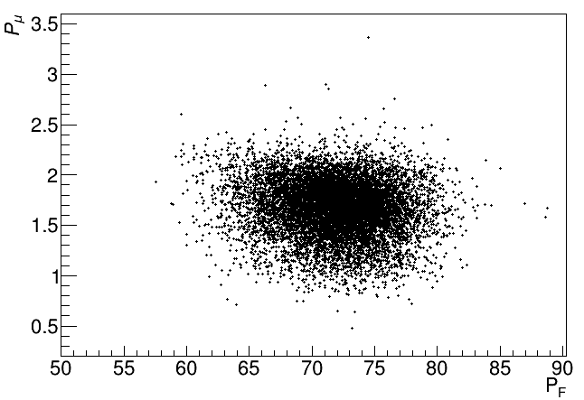
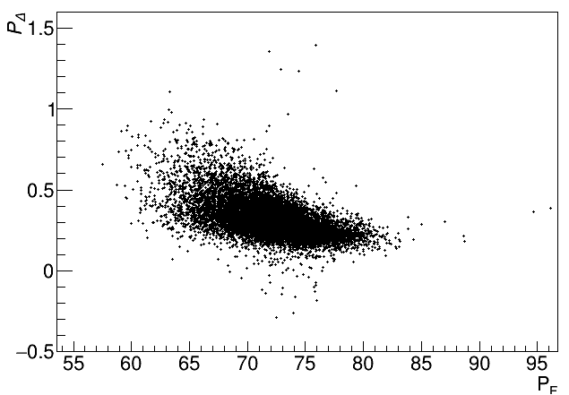
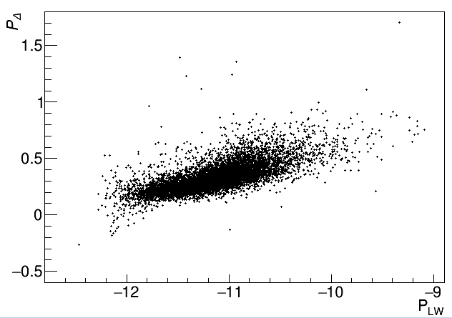
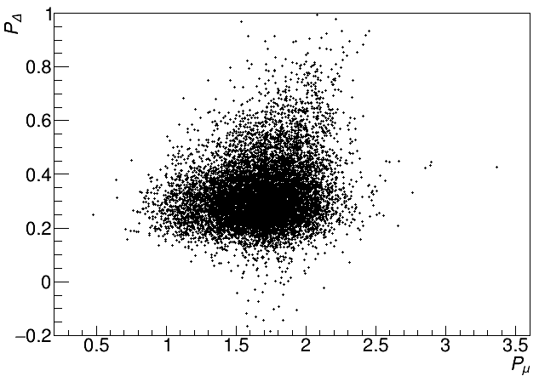
The Correlation between Parameters
$P_{Δ}$, $P_{LW}$ is related to the longitudinal development of EAS, and there are strong correlations between these variables

Slide 15
Summary and Next Work
For events fall on WCDA, the observation time and events: 750 hours, 0.7 million events.
The combined reconstruction of multiple telescopes is completed and can significantly improve the effective area of WFCTA: ~30%
With the core resolution better than 3m and angular resolution better than ${0.3}^{∘}$ above 100 TeV, Energy resolution of WFCTA less than 15% above 300TeV
Next work: Parameters sensitive to the composition will be used in combination to select proton components and more simulation events based on EPOS+FLUKA is being created.

Slide 17
Back up

Slide 18
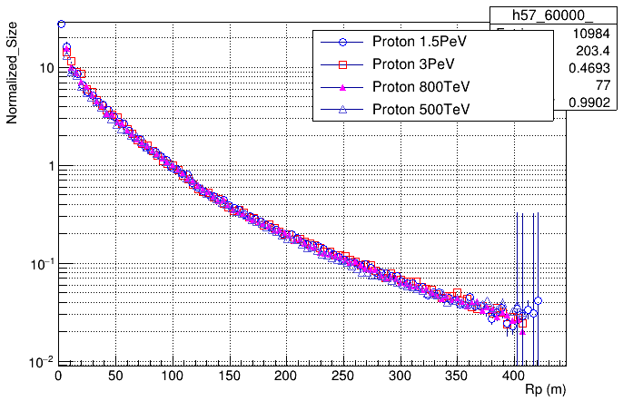
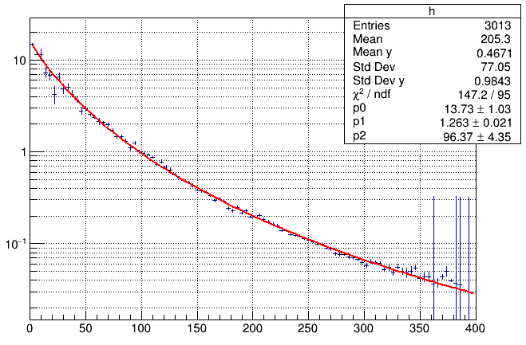
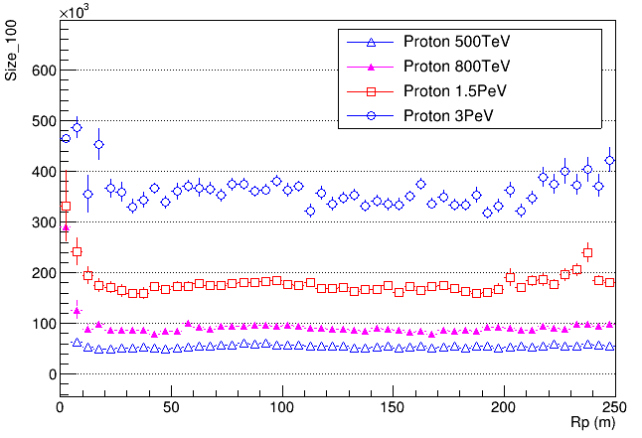
Size vs. Rp at different energy bin
The relationship of Size and Rp is same in different energy bins, a common NKG-like formula is used to fit this relatonship.
$$η=C_{0}{\left(\frac{Rp}{r_{m}}\right)}^{s−1.3}×{\left(1+\frac{Rp}{r_{m}}\right)}^{s−5}$$

Slide 19
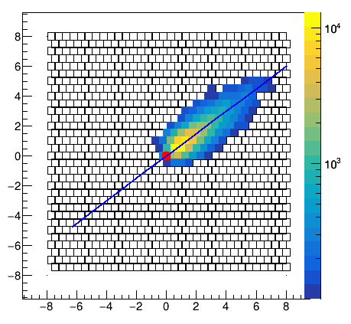
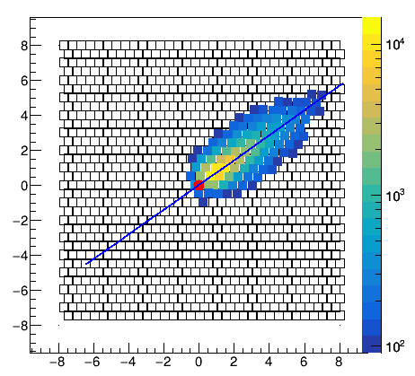
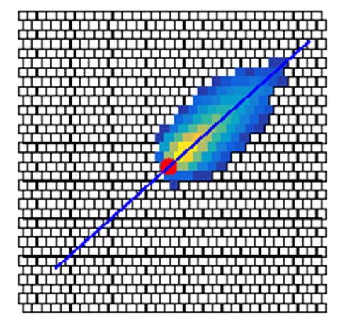
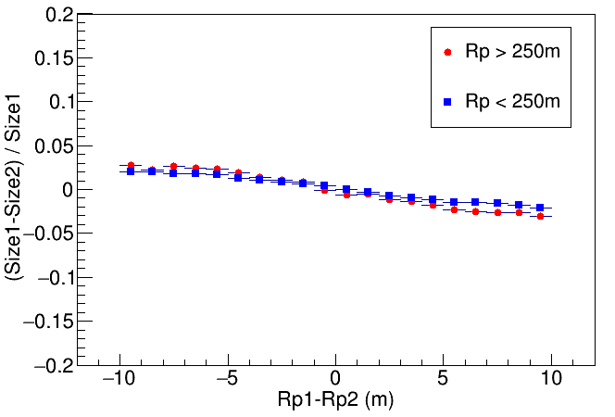
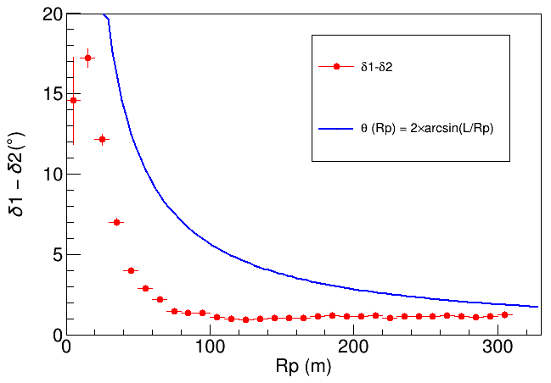
Change pointing from one telescope to another
Tel1
Tel3
Tel3 to Tel1
 | Tel1 | Tel3 | Tel3 to Tel1
Size | 103843 | 116216 | 103971
SDP angle | 36.90 | 41.97 | 35.30
$$|ΔRp|<1m$$

Slide 20
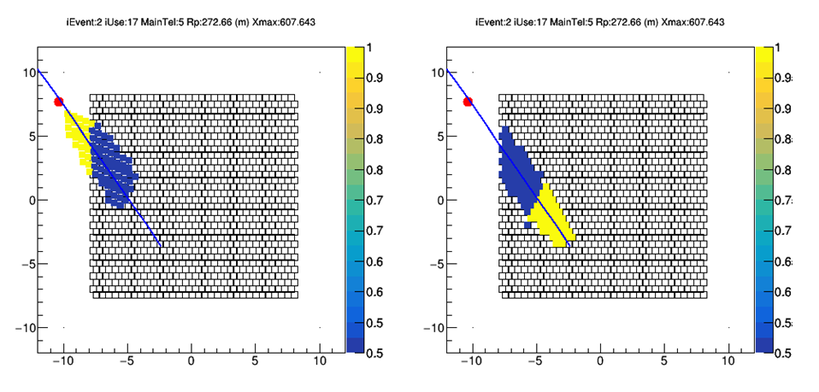
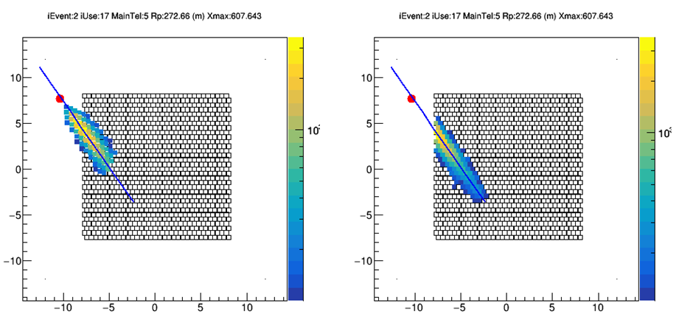
The processing of field-of-view overlaps
Weight
Weight
The weight of the field of view overlap is Npe/2, the weight of the other parts is Npe
Npe
Npe

Slide 21
Comparison of the results of two simulations of virtual telescopes
Event selection: Npix>10 && NedgeSiPMs==0
DSize
DSize
For the same event, the results of the two simulations will differ due to random sampling in the simulation, the difference is about 3%
The difference between the combined reconstruction results and the complete observational reconstruction results of a single telescope is less than 5%
移到上一页去，这一页只讲模拟中随机抽样引起的差别

Slide 22
Proton Selection
WCDA : $P_{F}$ (extension rate)
KM2A : $P_{μ}$ (muon)
WFCTA: $P_{Δ}$ (Fit Width)
WFCTA: $P_{C}$ (Length/Width)
$$P_{F}= <ER>{\left.​\right|}_{Size0}$$
$$P_{μ}=\log_{10}{N_{μ}}{\left.​\right|}_{Size0}$$
$$P_{Δ}=Δ{\left.​\right|}_{Rp,Size0}$$
$$P_{C}=L/W{\left.​\right|}_{Rp,Size0}$$
0~400米环带muon

Slide 23
Component Sensitive Parameters
$$P_{Δ}=\left(Δ−0.002×R_{p}\right)+0.0288×{\left(\log_{10}Size0\right)}^{2}−0.184×(\log_{10}Size0)$$
$$P_{Dist}=\left(Dist+7.57e−05×R_{p}^{2}−0.0063∗R_{p}\right)−754883×(\log_{10}Size0)$$
$$\log_{10}Size0=\log_{10}{Size}+0.00914×R_{p}$$

Slide 24
Energy Reconstruction
$$\log_{10}{E=p1×Rp+p0}$$
$$RecE=RecE(Size,Rp)$$

Slide 25
能量重建（多台望远镜|MeanX|>5）
训练事例：Npix>10&&abs(DMeanX)<5&&abs(DMeanY)<5
重建事例：Npix>10&&abs(DMeanY)<5&&abs(DMeanX)>5 (Tel: 1,3,4,5) Npix>10&&abs(DMeanY)<5&&DMeanX>5 (Tel: 2) Npix>10&&abs(DMeanY)<5&&DMeanX<-5 (Tel: 6)

Slide 26
能量重建（多台望远镜|MeanX|<5）
训练事例：Npix>10&&abs(DMeanX)<5&&abs(DMeanY)<5
重建事例：Npix>10&&abs(DMeanY)<5&&abs(DMeanX)<5
程序：/eos/user/y/youzhiyong/MC-Match/LHAASOREC_Multi/Sim_Stage2/FirstRec/LHAASO_2020_V2/WFCTAMC-v5.1.3.1/QGSJET_FLUKA/rec-v2/software

Slide 27
补充：单台重建与virtual望远镜重建的对比
core_in_km2a && Npix>10 && |MeanY|<5 && VirtualRecEdgeSiPMS==0
|MeanX|<5
|MeanX|>5
DSize
DSize
|MeanX|>5
|MeanX|<5
DLength
DLength

