Slide 1


Measurement of diffuse gamma ray at galactic plane by LHAASO-KM2A
The second LHAASO collaboration meeting in 2021 & LHAASO Project status meeting
Rui Zhang¹、Shi-ping Zhao¹ ³
Yi Zhang¹ ²、Qiang Yuan¹ 、Xiao-yuan Huang¹
2021-10-14
1.Purple Mountain Observatory
2.Institute of High Energy Physics
3.Shandong University
1

Slide 2
OUTLINE
1. INTRO: Diffuse Galactic γ-ray Emission (DGE)
2. INTRO: LHAASO-KM2A Observation
3. Experimental data Selection
4.Monte Carlo simulations
5. Diffuse emission analysis
2

Slide 3
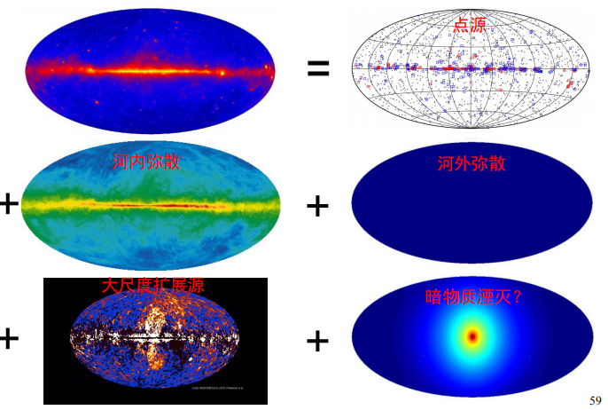
Gamma-ray Sky Map
1. INTRO: Diffuse Galactic γ-ray Emission (DGE)
3
Notes:
我们看到的伽马天图由点源，河内弥散，河外弥散，大尺度扩展源，暗物质湮灭产物共同组成。

Slide 4
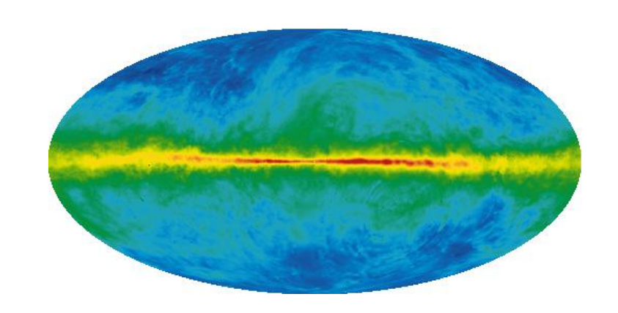
Sources of DGE from the Galactic plane
1. INTRO: Diffuse Galactic γ-ray Emission (DGE)
bremsstrahlung
Inverse Compton scattering
To study the propagation mechanism of cosmic rays;
To study the material composition of Galactic plane;
To search for dark matter annihilation signals;
...
4
Notes:
我要研究的河内弥散主要由三部分来源，包括宇宙线核子与星际物质作用产生的中性π介子衰变而来的γ，电子与星际物质作用的韧致辐射光子，与星际辐射场作用的逆康普顿散射光子。

Slide 5
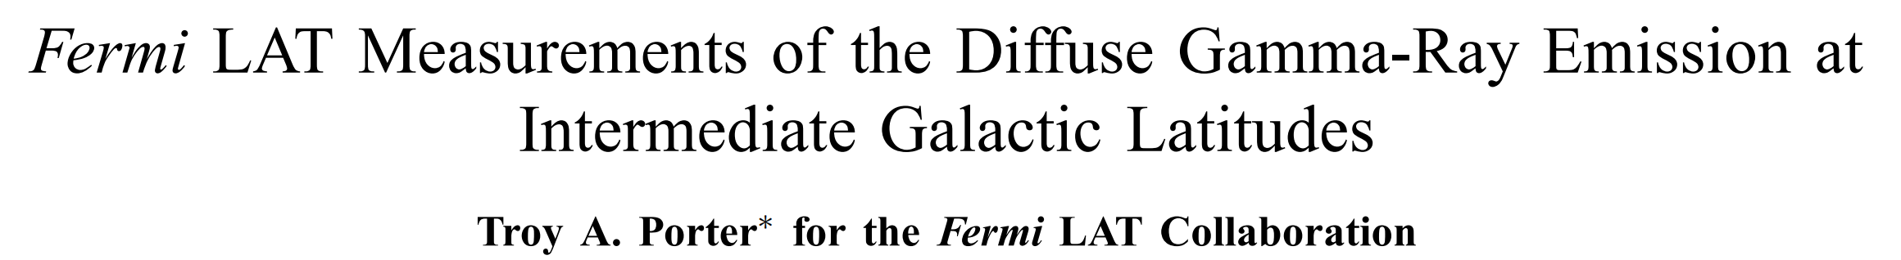
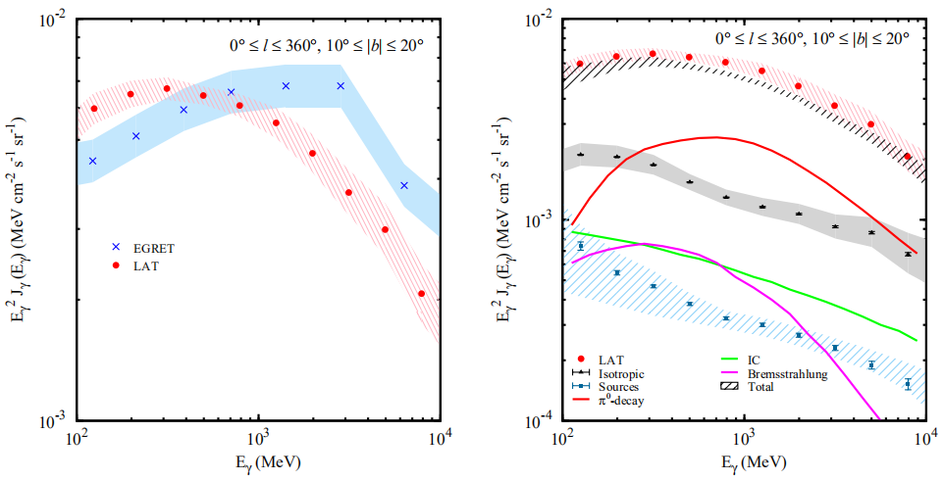
Satellite Observation of DGE
1. INTRO: Diffuse Galactic γ-ray Emission (DGE)
SAS-2 and COS B：first time
COMPTEL and EGRET：“GeV excess”
Fermi-LAT：high resolution
To explain "GeV excess":
Harder cosmic ray injection spectrum;
Contributions of unobserved point sources such as SNR;
Scenes outside the Standard Model: dark matter particles annihilation;
Energy spectrum of Fermi-LAT is well reproduced by the DGE model
5
Notes:
弥散伽马的观测开始于SAS-2和COS B：发现了在100MeV-几GeV之间银道面弥散辐射与星际介质密度之间存在比较强的关联，由此第一次证实了弥散γ辐射的存在。
COMPTEL和EGRET：将观测能区拓宽至30MeV-50GeV；
EGRET的观测结果和根据模型做出的预期相比在GeV能段呈现出了超出现象。（全天各个方向的超出）
就是图中蓝色区域。此结果引发了许多新的理论猜想如较硬的宇宙线注入谱，或者为观测到的点源如超新星遗迹（SNR）的贡献或暗物质粒子湮灭的贡献等等。超出未被2008年发射的Fermi-LAT证实。就是图中红线区域，Fermi-LAT的能谱结果可以很好用模型结果解释。

Slide 6
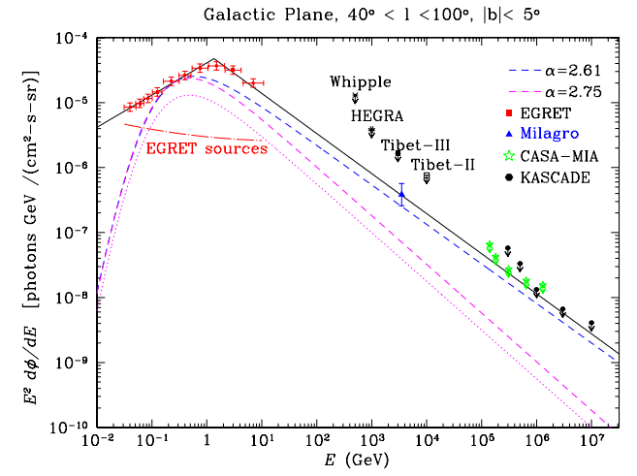
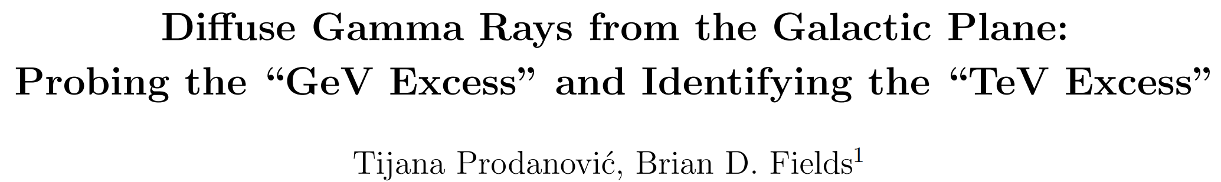
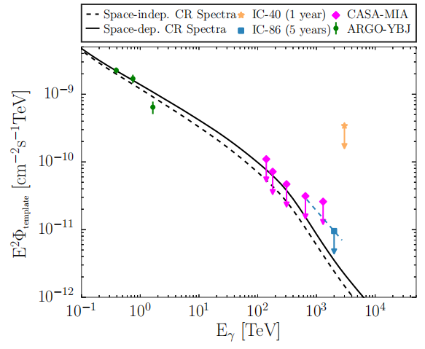
Ground Observation of DGE
1. INTRO: Diffuse Galactic γ-ray Emission (DGE)
Imaging Atmospheric Cherenkov Telescopes:
Whipple and HEGRA
H.E.S.S.
Air Shower Array:
ASγ，KASCADE，CASA-MIA
Milagro:“TeV excess”
ARGO-YBJ
ICECUBE
LHAASO-KM2A
忽略IC贡献,最大π0衰变能谱
HEGRA(99% C.L., 38° < l < 43°, |b| < 2°);
Whipple (99.9% C.L., 38.5° < l < 41.5°, |b| <2°) ;
Tibet ASγ (99%C.L., 20° < l < 55°, |b| < 2°);
CASA-MIA(90%C.L.,50° < l < 200°, |b| < 5°);
KASCADE(90%C.L.,0° < ra < 360°, 14°<dec < 84°);
6
Notes:
在能量较高的情况下，由于其通量较低，只有具有较大有效面积的地面探测器才能有效地研究漫射伽马射线。这时候就需要大气切伦科夫望远镜和地面大气簇射阵列。许多实验都给出了上限，其中比较瞩目的是milagro的结果。假定逆康普顿散射在TeV能段可忽略，Milagro的观测比预期高几倍，存在“TeV 超出”。
从图上可以看到，Egret的结果和milagro的结果可以用能谱指数2.61这条线经验拟合上。 表明milagro的“TeV超出”，可能与EGRET观察到的“GeV超出”有关。当然他们都已经超出了模型假设。AGRO-YBJ实验在亚TeV段没有看到milagro的超出现象，且结果和Fermi的模型预测结果一致。
这些就是简单的情况介绍了，对于弥散伽马辐射，我们的lhaaso-km2a可以很好地丰富现在的探测结果。

Slide 7
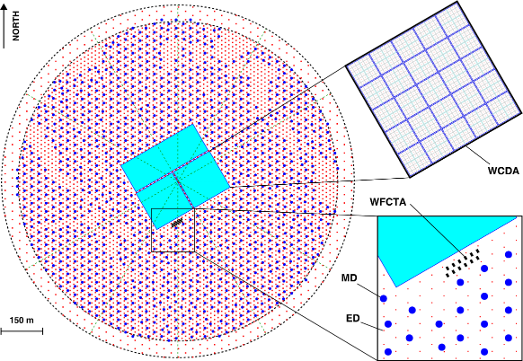
A Large area EAS array covering 1.3 km²
2.INTRO: LHAASO-KM2A Observation
5195 EDs
  1 m² each
  15 m spacing
1171 MDs
  36 m² each
  30 m spacing
3120 WCDs
  25 m² each
18 WFCTs
LHAASO:
composition：KM2A、WCDA、WFCTA
scientific targets： exploration of the origin of high-energy cosmic rays, scanning search for gamma sources, new physical phenomena, etc
-KM2A：
Large field of view, High duty cycle
Best range：>20TeV
Search for new gamma sources
Study on DGE
7
Notes:
LHAASO主要由三个部分组成，平方公里阵列km2a，水池WCDA，切伦科夫望远镜阵列WFCTA。其中我们的km2a由5千多个ED电磁探测器和1千多个MD缪子探测器组成，具有大视场、全天候的优点，最佳观测能段>20TeV，可用来寻找新的gamma源，测量其能谱，研究银河系弥散辐射等等。

Slide 8


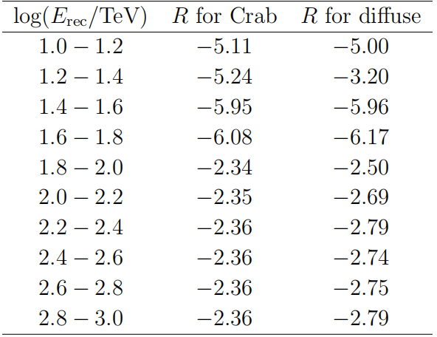
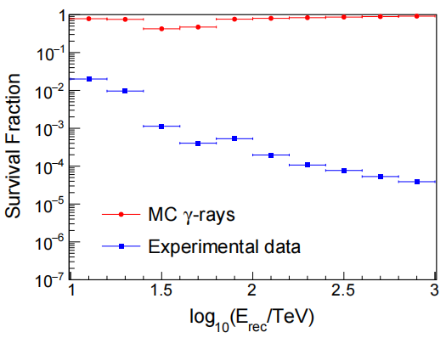
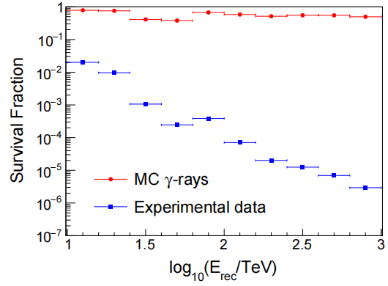
Gamma/Proton Rejection parameter(2)
3. Experimental data Selection
Maximize
Crab analysis
diffuse analysis
Survival Fraction
Low E : very CLOSE
>100 TeV :
crab analysis ~90%（more γ events）
diffuse analysis 50~60% (better Q)
8

Slide 9
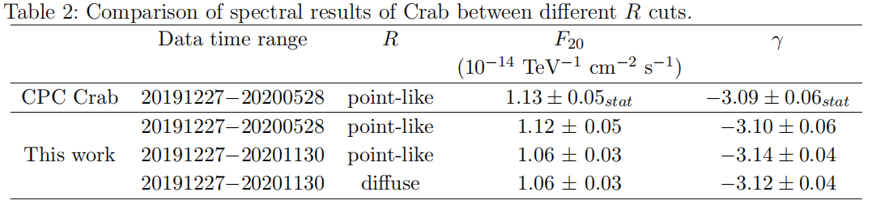
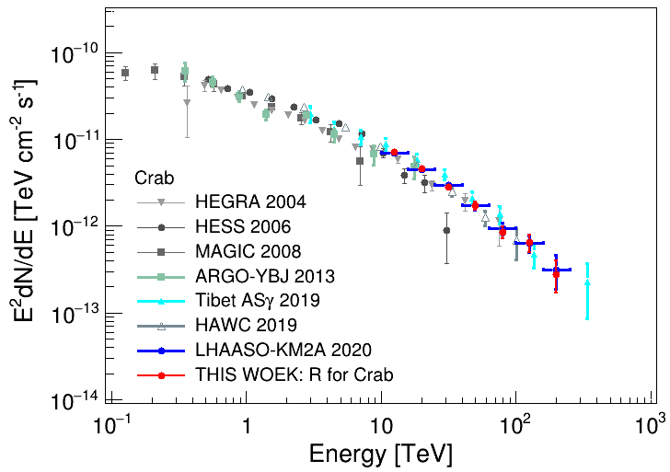
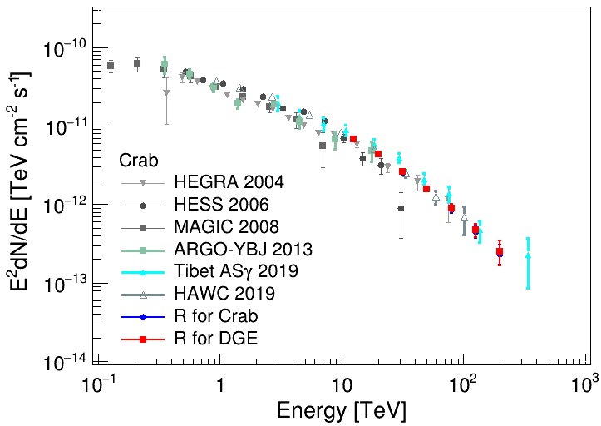
Gamma/Proton Rejection parameter(3)
5. Diffuse emission analysis
Verify:
Rejection parameter.
Background estimation method(after).
9

Slide 10
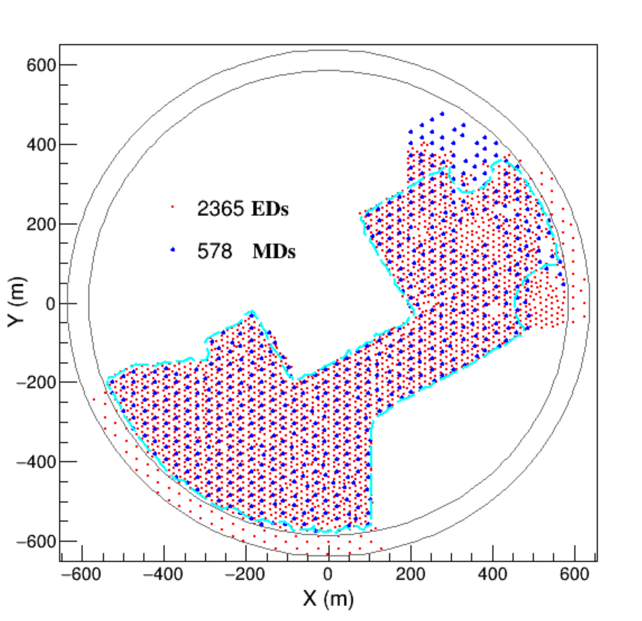
Event Selection
3. Experimental data Selection
Number of EDs and Number of particles > 10.
Reconstructed zenith angle < 50°.
Number of particles within 40 m from the shower core is larger than that within 40-100m.
the shower age is with 0.6 to 2.4.
Gamma/Proton Rejection parameter for DGE;
EXP data: 1/2 Array, 20191227-20201130
10

Slide 11
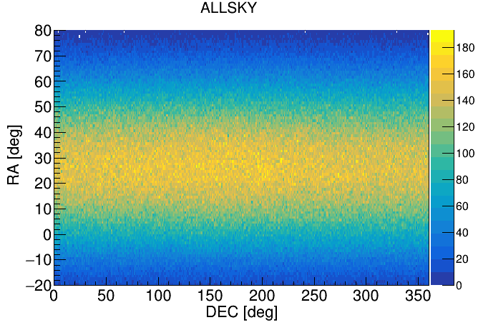
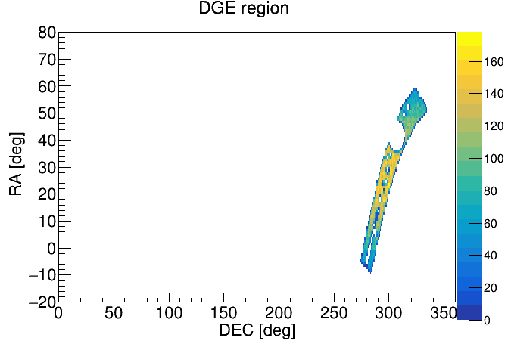
DGE simulation
4.Monte Carlo simulations
Gamma events: CORSIKA (version7.6400) & Geant4 (v4.10.00)
E: 1 TeV - 10 PeV， powerlaw ~ E^{−2.0}，zenith ~ 0° to 70°
Events Time Distribution: Simulation ~ Experiment
11

Slide 12
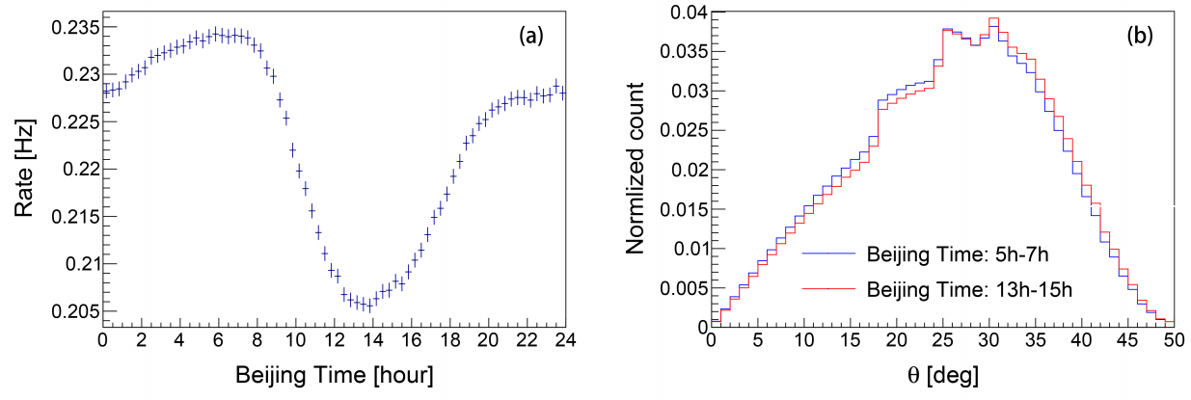
BKG: “Direct Integral”（DI）method(1)
5. Diffuse emission analysis
Efficiency: BKG events at same direction (zen, azi) & different arrival time (mjd or lst)
Efficiency change over time
→Solution: 10hr-window with a moving step of 1hr
12

Slide 13
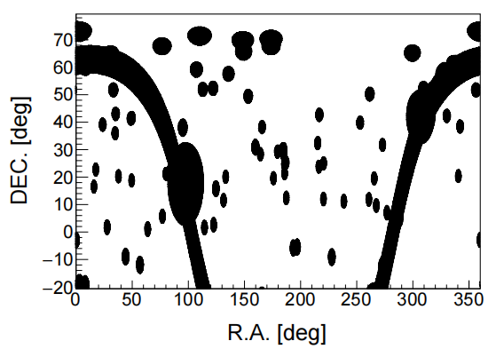

BKG: “Direct Integral”（DI）method(2)
5. Diffuse emission analysis
Efficiency: BKG events at same direction (zen, azi) & different arrival time (mjd or lst)
Efficiency change over time
“MASK”: TeVcat source + Galactic Plane ( |b| < 5°)
check of Crab (P9)
13

Slide 14
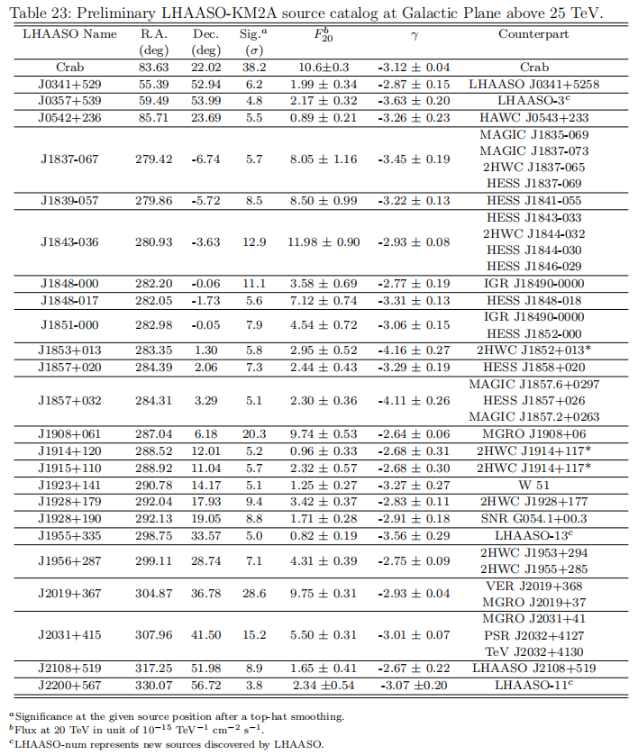
LHAASO sourcelist
(LHAASOcat)
5. Diffuse emission analysis
rec_E > 25 TeV
Significance > 5 σ
-5°<gb < 5°
1/2 Array
14

Slide 15

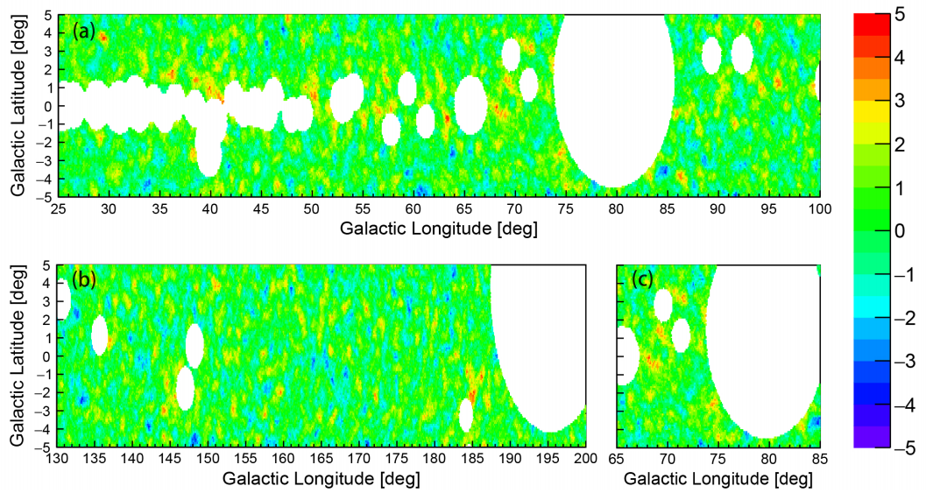
Subtraction of resolved sources
5. Diffuse emission analysis
3 region:
Inner, Outer, Cygnus
MASK:
LHAASOcat +TeVcat - counterpart,
E>25TeV
INNER
SIG=11.1σ
OUTER
CYGNUS
SIG=7.0σ
SIG=6.3σ
15

Slide 16
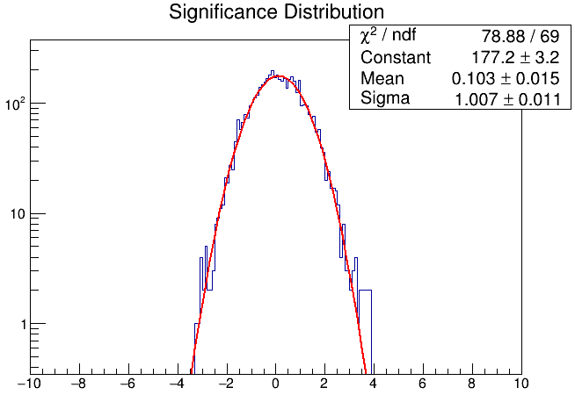
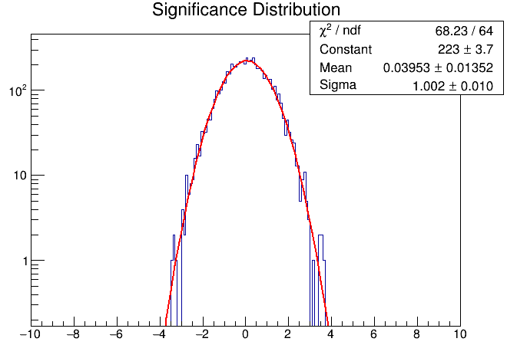
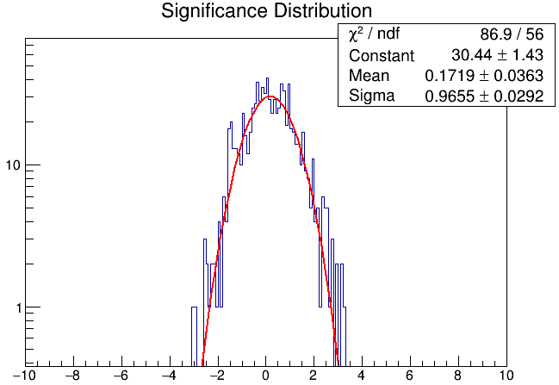
Subtraction of resolved sources
5. Diffuse emission analysis
Significance 1D
Independent GRID = 0.4° × 0.4°
INNER
3 region:
Inner, Outer, Cygnus
MASK:
LHAASOcat +TeVcat - counterpart,
E>25TeV
INNER
OUTER
SIG=11.1σ
OUTER
CYGNUS
CYGNUS
SIG=7.0σ
SIG=6.3σ
16

Slide 17
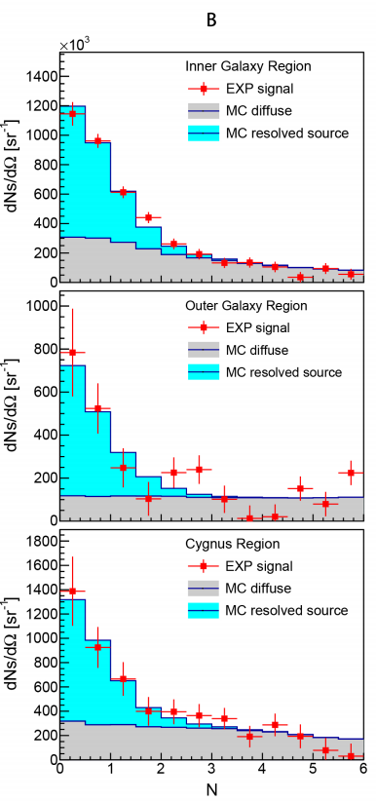

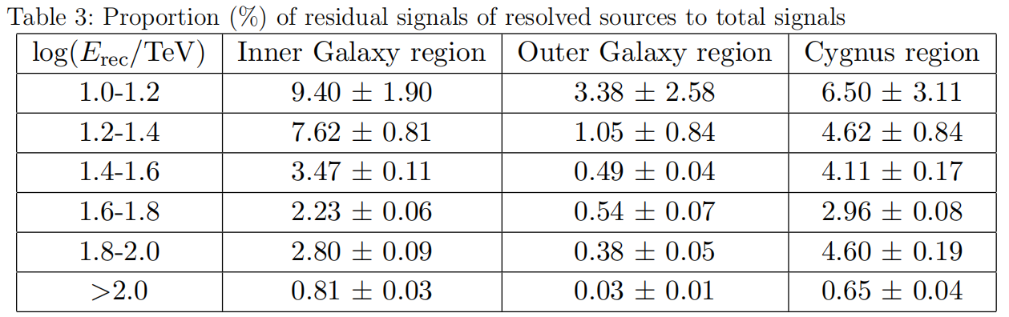
Point source contamination
5. Diffuse emission analysis
INNER
, N=2, psf=psf_{1.0-1.2}
OUTER
CYGNUS
resolved source ：LHAASOcat +TeVcat - counterpart
17

Slide 18


Spectrum Fitting
5. Diffuse emission analysis
Forward-Folding：powerlaw ~
Maximizing
, E₀=50TeV
where,
N^{obs} is the observed counts,
N^{bkg} is the background counts by BKG-DI,
N^{sig} is the predicted counts from Forward-folding.
18

Slide 19
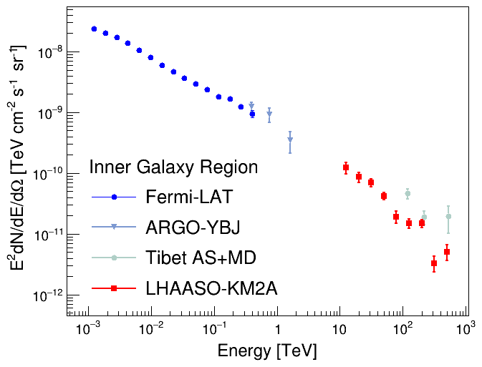
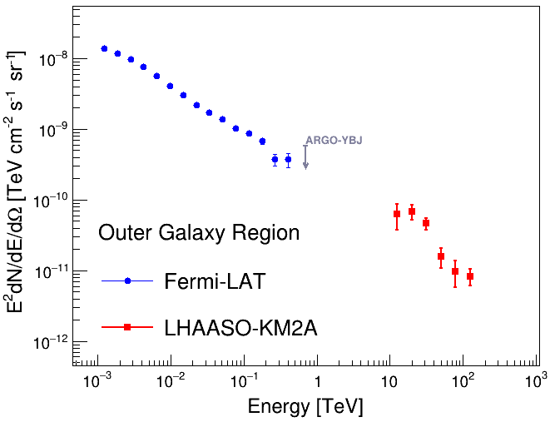
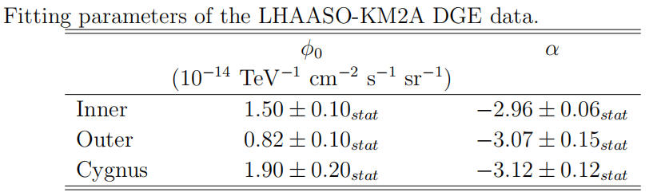
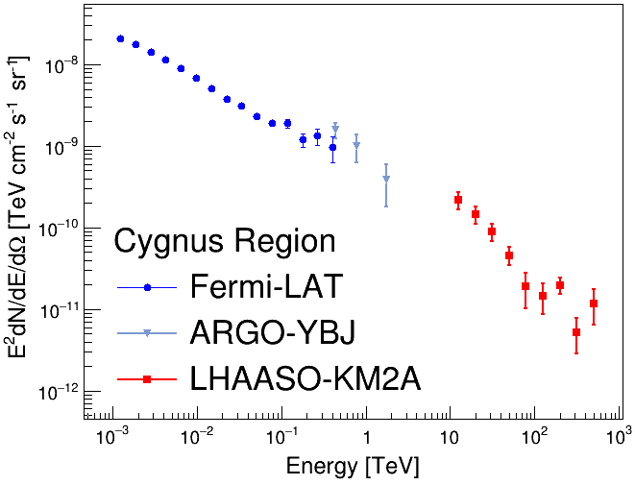
Spectrum Fitting
5. Diffuse emission analysis
INNER
Forward-Folding：powerlaw ~
Maximizing
, E₀=50TeV
OUTER
where,
N^{obs} is the observed counts,
N^{bkg} is the background counts by BKG-DI,
N^{sig} is the predicted counts from Forward-folding.
CYGNUS
19

Slide 20
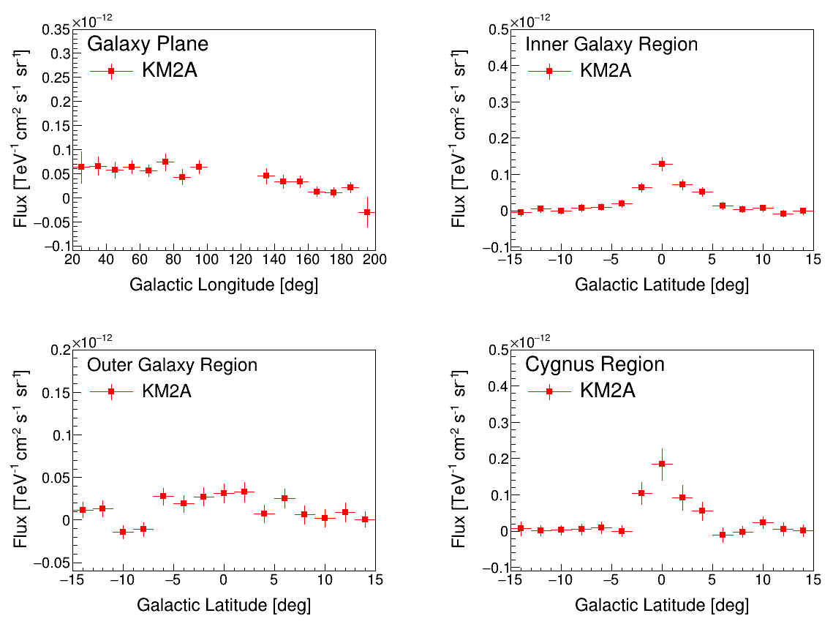
GL,GB distribution
5. Diffuse emission analysis
INNER
@31.6TeV
INNER
OUTER
OUTER
CYGNUS
CYGNUS
20

Slide 21
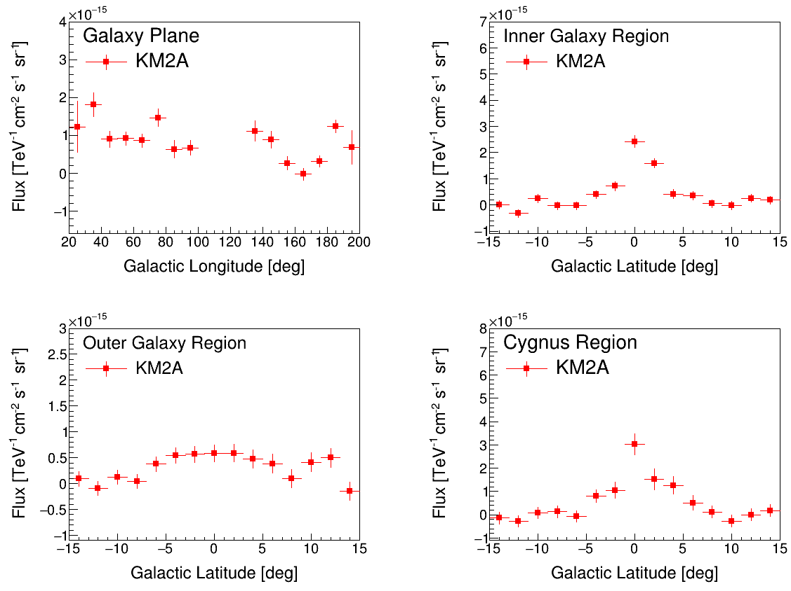
GL,GB distribution
5. Diffuse emission analysis
INNER
@126TeV
INNER
OUTER
OUTER
CYGNUS
CYGNUS
21

Slide 22
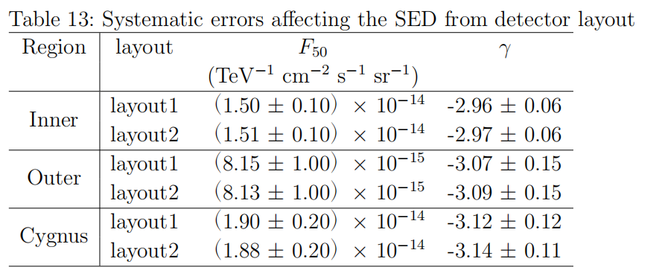
Systematic Uncertainties(1)
5. Diffuse emission analysis
Layout：
The number of operating units varied with time；
2 different layouts in the detector simulation；
Flux: <1%;
Index: ~0.02
22

Slide 23
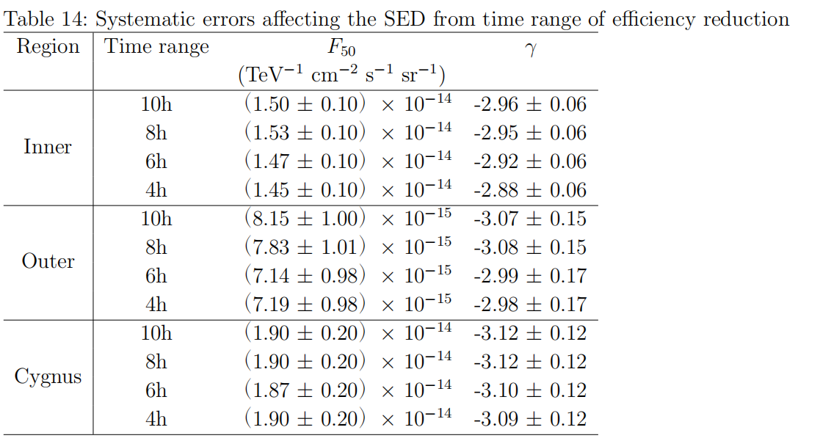
Systematic Uncertainties(2)
5. Diffuse emission analysis
Layout;
BKG-DI: Efficiency estimated by time ranges
Short: Instantaneous Efficiency, but less statistics with “MASK”;
Long: unstable Efficiency, but more statistics
Adopted: 10hr-window with a moving step of 1hr
Flux: ~2%;
Index: ~0.04
Flux: ~12%;
Index: ~0.08
Flux: <2%;
Index: ~0.02
23

Slide 24
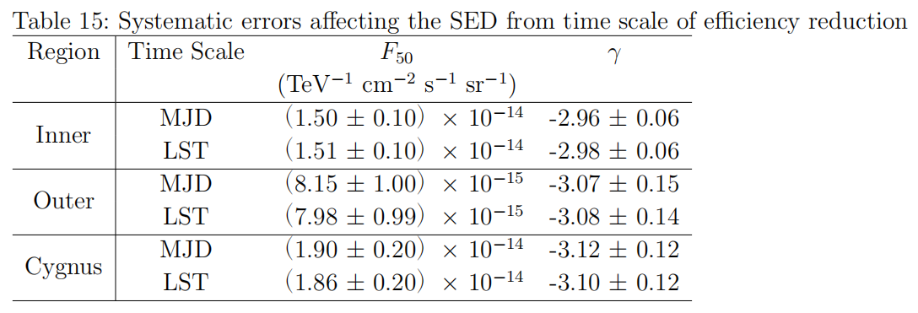
Systematic Uncertainties(3)
5. Diffuse emission analysis
layout;
BKG-DI:
Efficiency estimated by time ranges
Efficiency based on LST or MJD
Flux: ~2%;
Index: ~0.02
24

Slide 25
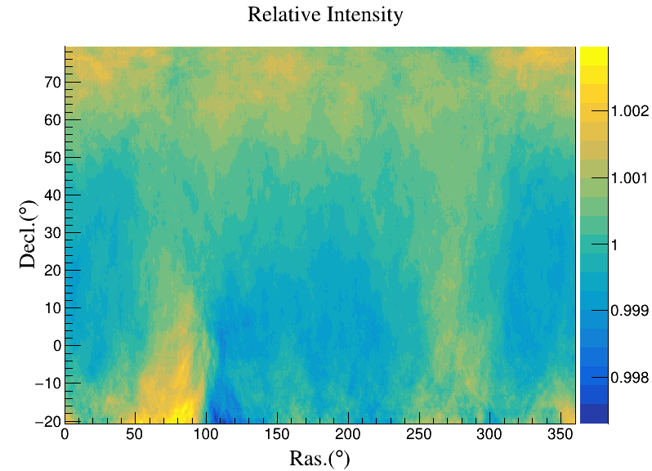
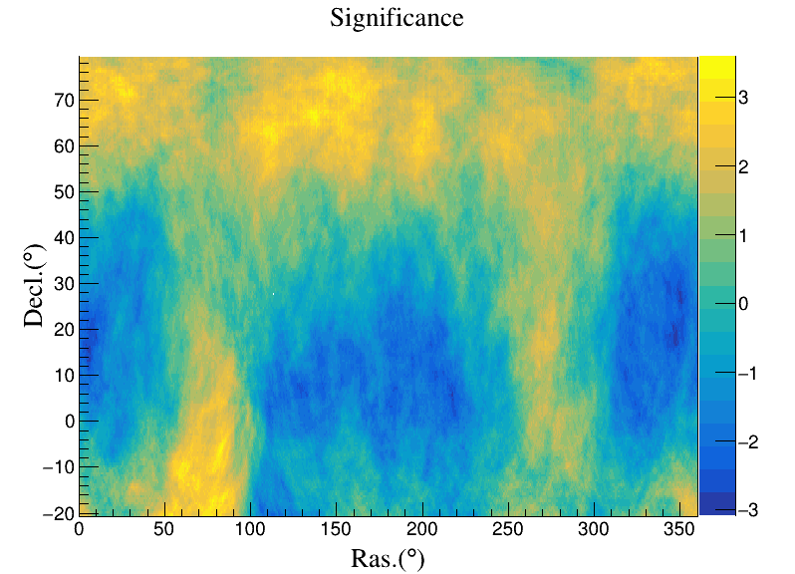
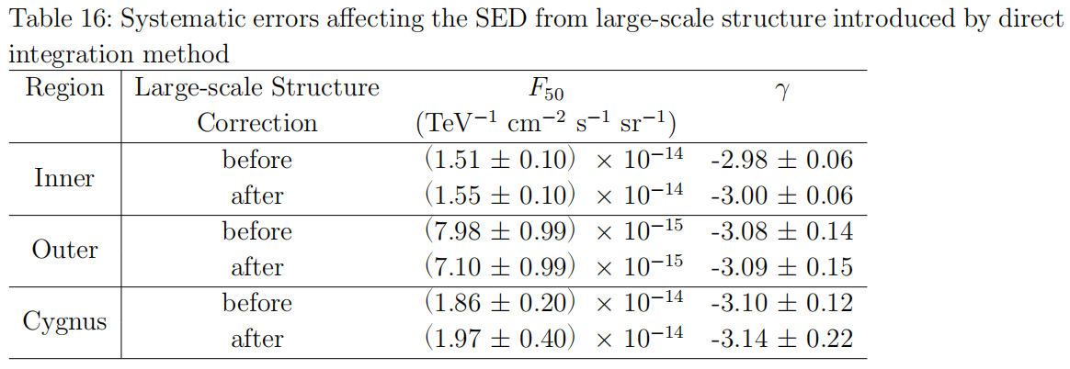
Systematic Uncertainties(4)
5. Diffuse emission analysis
logE: 1.0-1.2
SW: 30°
layout;
BKG-DI:
Efficiency estimated by time ranges
Efficiency based on LST or MJD
pseudo Large-Scale structure caused by DI
Long time ranges: unstable Efficiency
→ pseudo Large-Scale structure (+ CR anisotropy)
logE: 1.0-1.2
SW: 30°
Flux: ~3%;
Index: ~0.02
Flux: ~11%;
Index: ~0.01
Flux: <6%;
Index: ~0.04
25

Slide 26
Systematic Uncertainties(5)
5. Diffuse emission analysis
layout;
BKG-DI:
Efficiency estimated by time ranges
Efficiency based on LST or MJD
pseudo Large-Scale structure caused by DI
atmospheric models
CPC Crab:
Flux < 7%;
Index ~ 0.02;
26

Slide 27
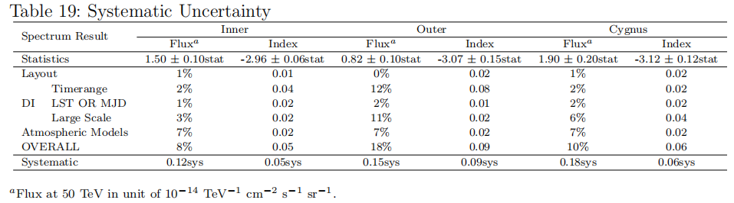
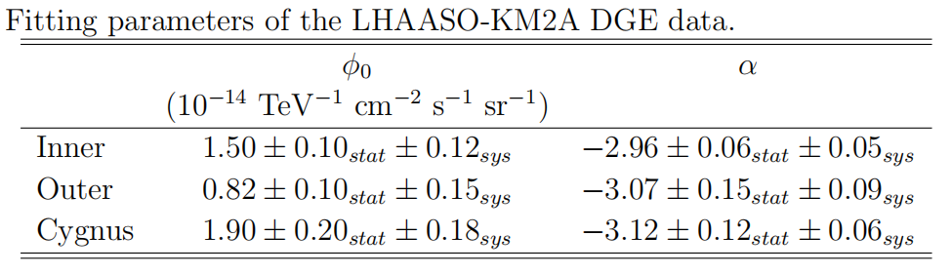
Systematic Uncertainties
INNER
OUTER
CYGNUS
22

Slide 28
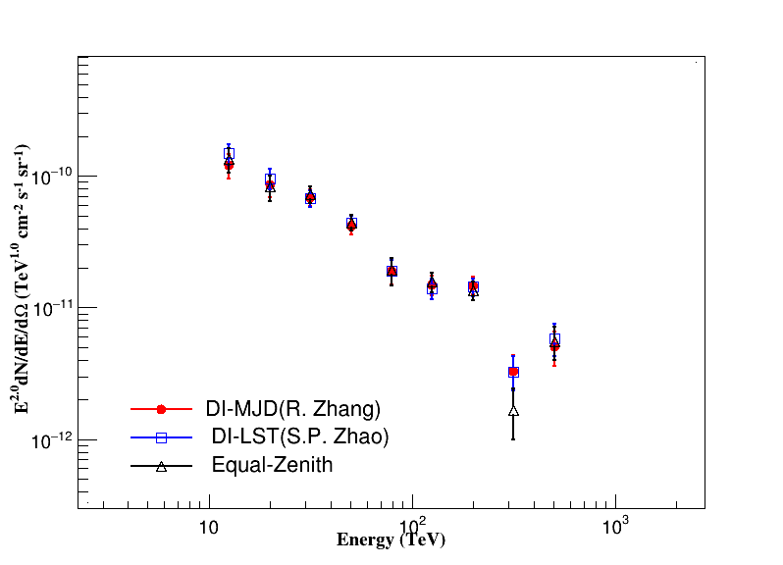
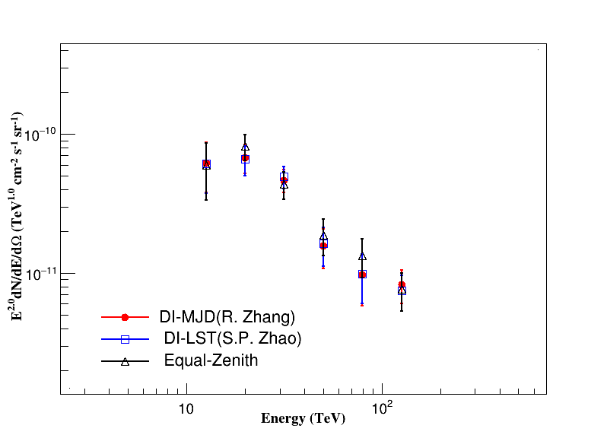
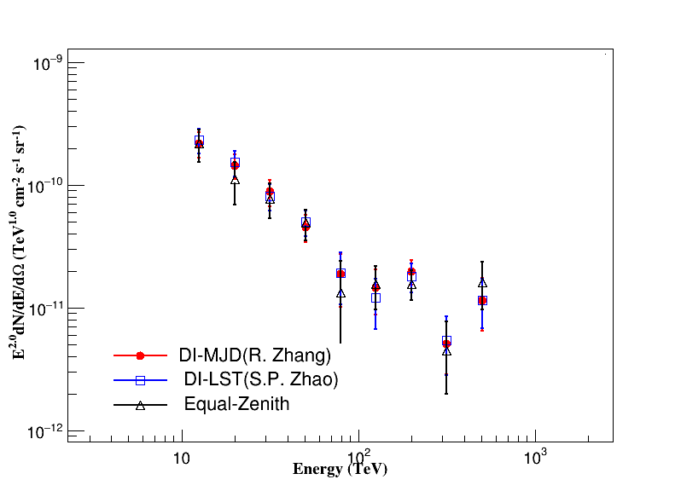
Cross Check
INNER
OUTER
CYGNUS
Comparation: (Rui Zhang、Shi-ping Zhao)
Differences:
BKG-DI Efficiency based on LST(Shi-ping Zhao) or MJD(Rui Zhang)
BKG-Equal Zenith angle method by Shi-ping Zhao
Common parts: Analysis Methods and Procedure
Simulation, SED fitting...
Analyze independently
23

Slide 29
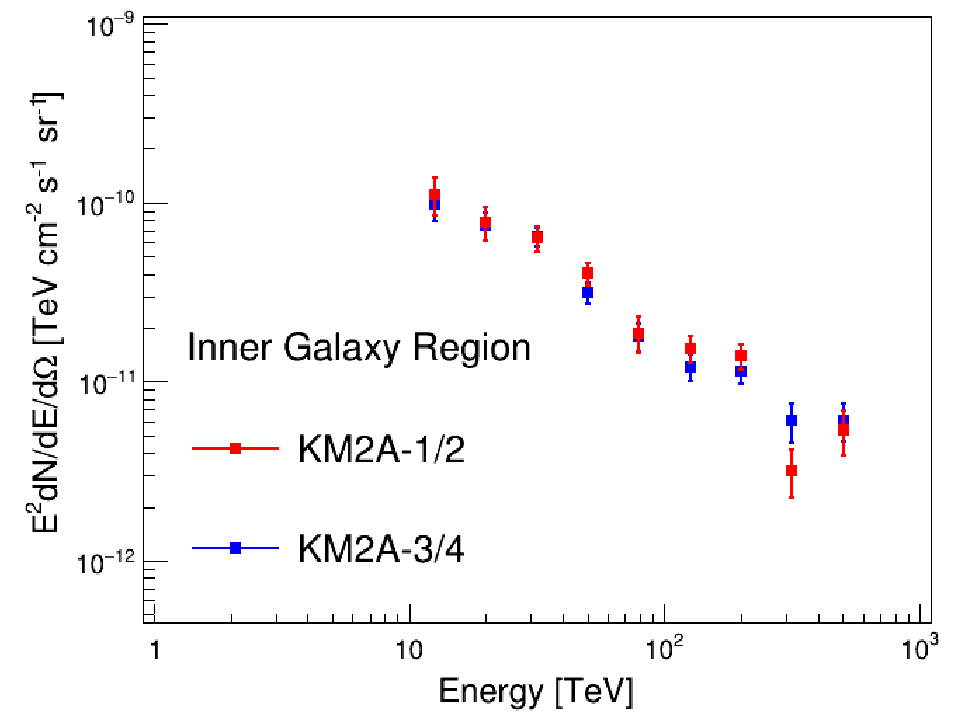
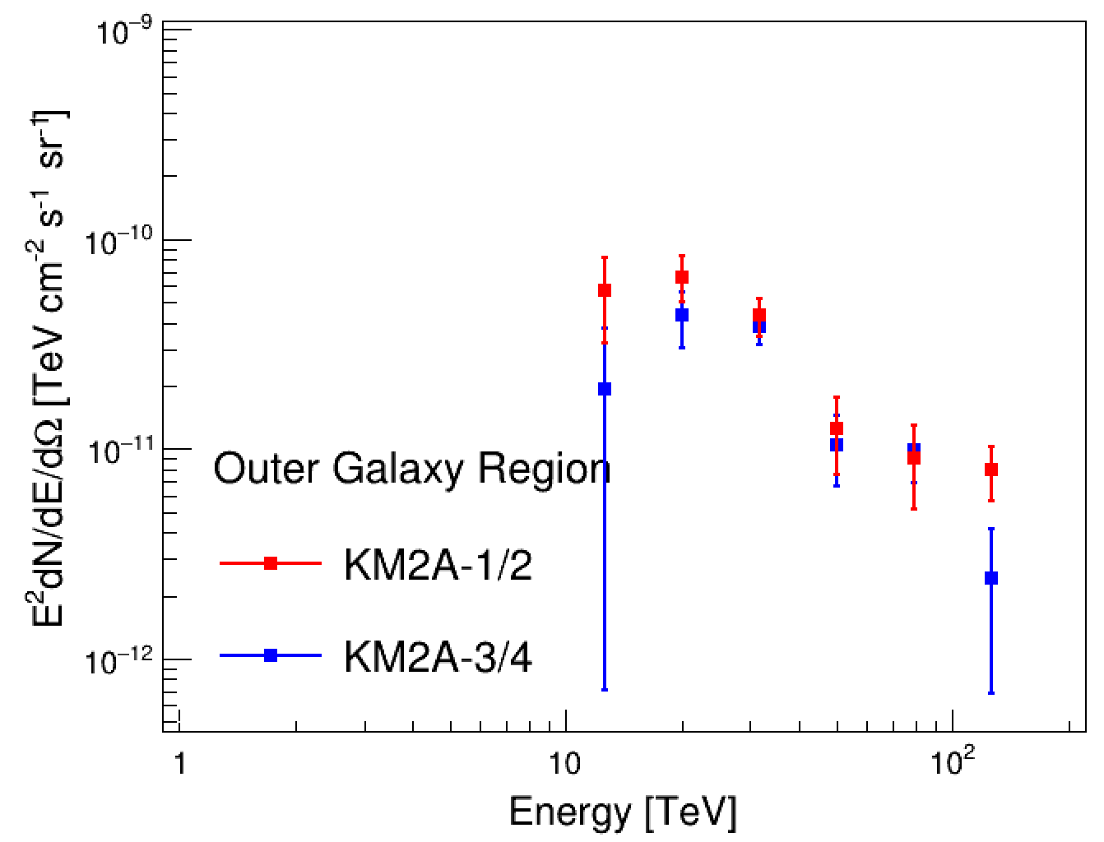
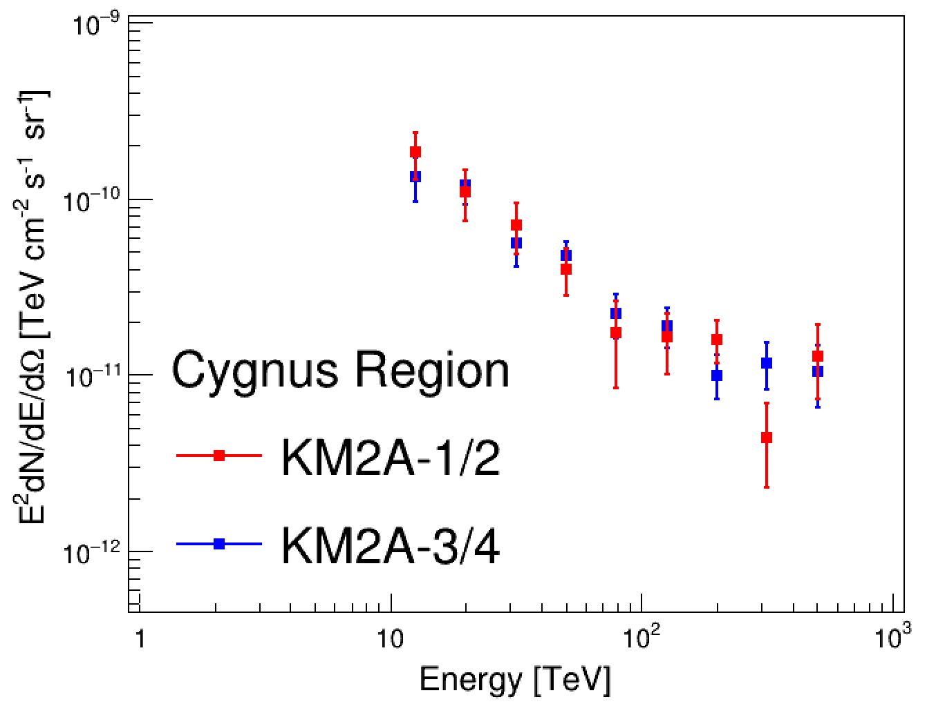
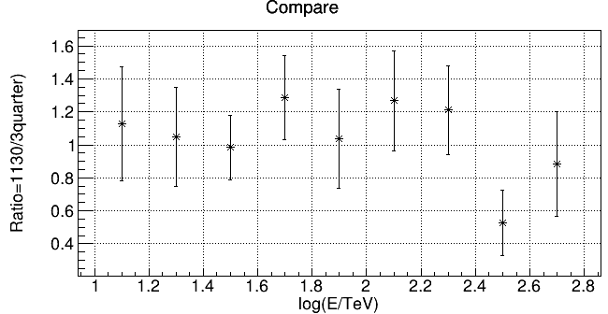
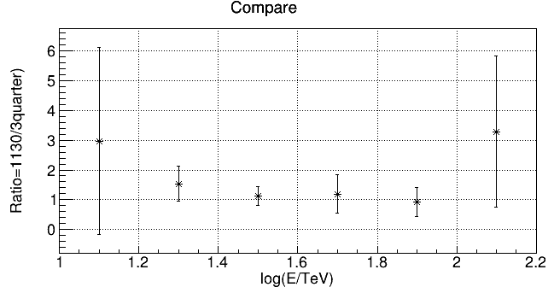
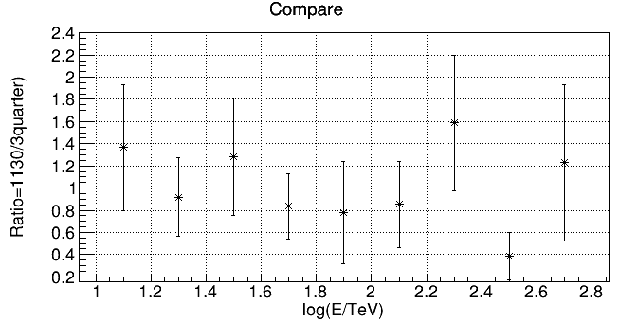
Check with 3/4 Array
Add on LHAASO sources seen by 3/4 Array
new mask sources
ra dec ext name
301.38 30.78 0.21 3quarter_new1
301.66 33.83 0.56 3quarter_new2(2HWC J2006+341)
289.53 15.97 0 3quarter_new3
85.64 23.21 1.13 J16-1(3quarter_renew)
INNER
OUTER
CYGNUS
24

Slide 30
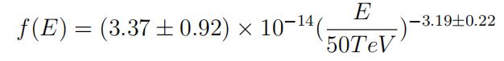


Check with ASγ
5. Diffuse emission analysis
MASK: TeVcat. R=0.5°
new：LHAASO J2108+5157, no counterpart.
25

Slide 31
Conclusion
INNER
Diffuse gamma emission in three regions of Galactic plane is measured with high significance with KM2A-1/2 data
The analysis procedure includes:
OUTER
Optimization of γ/p discrimination
Subtraction of known pointlike and extended sources (detected by LHAASO and other VHE instruments)
Background estimate with direct integration method and equal-zenith angle method
Studies of a series of systematic uncertainties
CYGNUS
26

Slide 32


Conclusion
INNER
Compared with the prediction of cosmic ray interactions, significant excesses from 10 GeV to 50 TeV have been revealed
Possible excesses above 100 TeV in the inner Galaxy and Cygnus regions exist --- more data are needed
Excesses concentrate in the low-latitude region, probably due to unresolved sources

Slide 33



Explanation from existing EXPdata
INNER
OUTER
CYGNUS
Simplest Suggestion:
Density of cosmic ray is uniform
Result:
Cosmic ray composition is insufficient to support spectral results.

Slide 34

6.Modeling of diffuse γ rays
General picture of Galactic cosmic rays
© I. V. Moskalenko
Acceleration at source
Diffusion and Interaction
Helio-sphere propagation
Detection at the Earth
Diffuse γ rays are expected a priori to be produced during the propagation

Slide 35

6.Modeling of diffuse γ rays
Propagation modeling
Diffusion
Convection
Reacceleration
Energy loss
Fragmentation
Decay
GALPROP: Strong & Moskalenko (1998) DRAGON: Evoli et al. (2008) http://galprop.stanford.edu/ https://github.com/cosmicrays/DRAGON

Slide 36


6.Modeling of diffuse γ rays
Cosmic ray fitting
Yuan et al. (2020, JCAP)
Propagation parameters

Slide 37


6.Modeling of diffuse γ rays
Cosmic ray fitting
Model 1: KASCADE knees of p and He
Model 2: ARGO knees of p and He
Model 3: spatially-dependent propagation (SDP)

Slide 38


6.Modeling of diffuse γ rays
Cosmic ray fitting
Spatially dependent propagation (SDP) model is well motivated by HAWC pulsar halo observations
An SDP + local source model can account for simultaneously the spectra and anisotropies
Liu et al. (2019, JCAP)

Slide 39

6.Modeling of diffuse γ rays
Cosmic ray fitting
Spline interpolation method to define the source injection spectrum

Slide 40


6.Modeling of diffuse γ rays
Cosmic ray fitting

Slide 41


6.Modeling of diffuse γ rays
Diffuse γ: data-model comparison

Slide 42


6.Modeling of diffuse γ rays
Diffuse γ: data-model comparison
@31.6TeV
@126TeV

Slide 43

6.Modeling of diffuse γ rays
Diffuse γ: possible interpretation
Cygnus region seems to be under-predicted
Pulsar halo by R. Y. Liu

Slide 44

6.Modeling of diffuse γ rays
Diffuse γ: possible interpretation
Fresh interaction around sources by P. P. Zhang, Y. Q. Guo

